Slide 1
TalkEx Business
Complete User Manual
Enterprise CPaaS Dashboard — Send, Automate & Manage Business Messaging
Owner: SatyaJeet Kr. Singh Organization: CoreAxis Ventures Email: support@talkex.net Phone: +91 9113107586 Website: web.talkex.net | talkex.net
SatyaJeet Kr. Singh • CoreAxis Ventures | support@talkex.net | +91 9113107586 | web.talkex.net | talkex.net
1

Slide 2
Table of Contents
TalkEx Business
All Modules & Features
SatyaJeet Kr. Singh • CoreAxis Ventures | support@talkex.net | +91 9113107586 | web.talkex.net | talkex.net
2

Slide 3
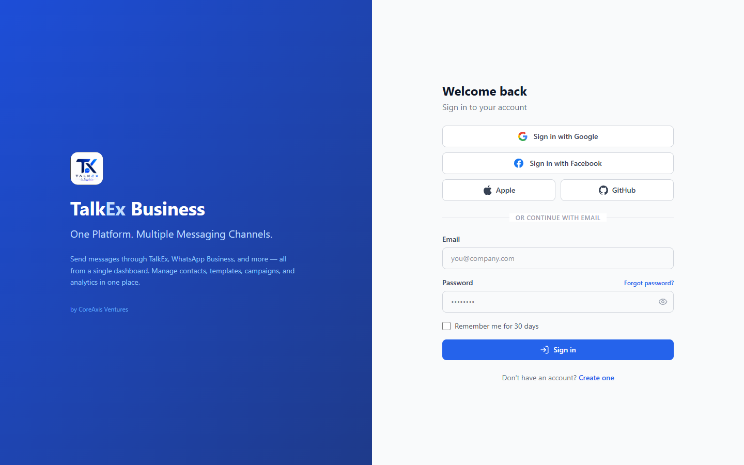
Login
TalkEx Business
Sign in to your TalkEx Business account
Step-by-Step Guide
SatyaJeet Kr. Singh • CoreAxis Ventures | support@talkex.net | +91 9113107586 | web.talkex.net | talkex.net
3

Slide 4
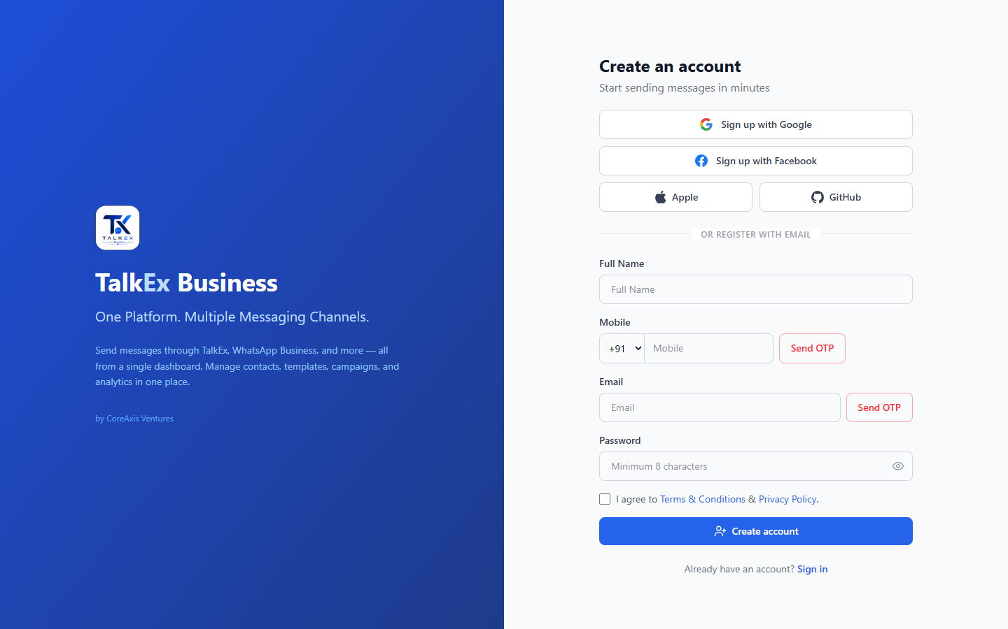
Register
TalkEx Business
Create a new TalkEx Business account
Step-by-Step Guide
SatyaJeet Kr. Singh • CoreAxis Ventures | support@talkex.net | +91 9113107586 | web.talkex.net | talkex.net
4

Slide 5
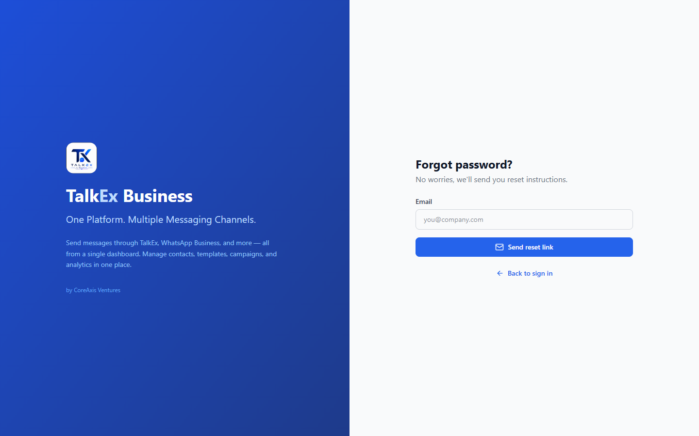
Forgot Password
TalkEx Business
Reset your account password via email
Step-by-Step Guide
SatyaJeet Kr. Singh • CoreAxis Ventures | support@talkex.net | +91 9113107586 | web.talkex.net | talkex.net
5

Slide 6
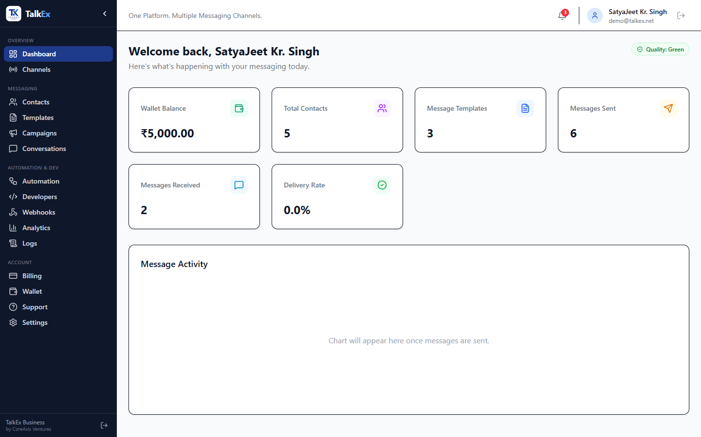
Dashboard
TalkEx Business
Your business messaging command center
Step-by-Step Guide
SatyaJeet Kr. Singh • CoreAxis Ventures | support@talkex.net | +91 9113107586 | web.talkex.net | talkex.net
6

Slide 7
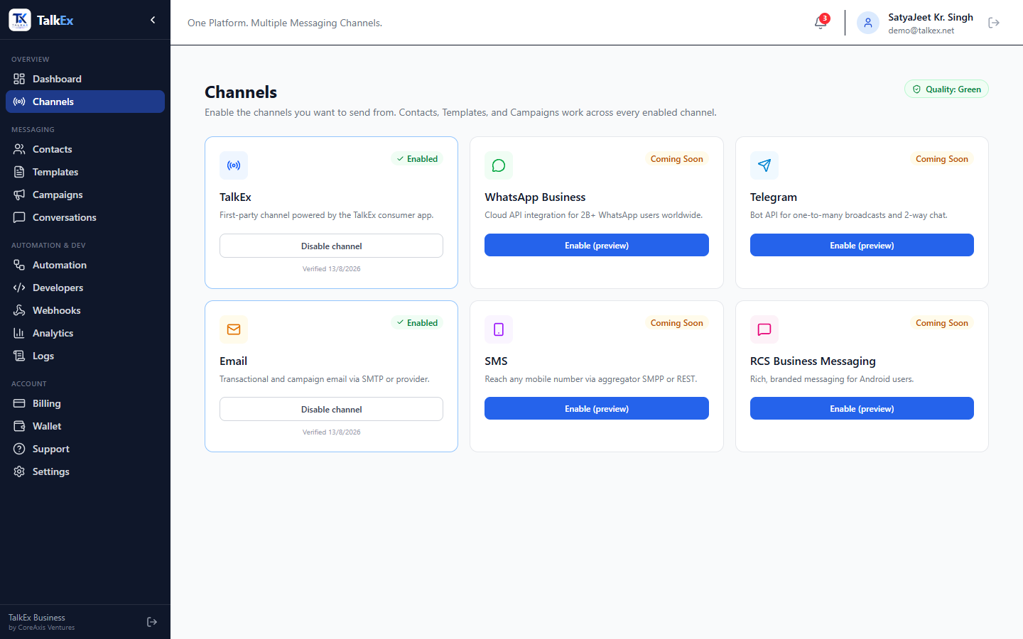
Channels
TalkEx Business
Enable and configure messaging channels
Step-by-Step Guide
SatyaJeet Kr. Singh • CoreAxis Ventures | support@talkex.net | +91 9113107586 | web.talkex.net | talkex.net
7

Slide 8
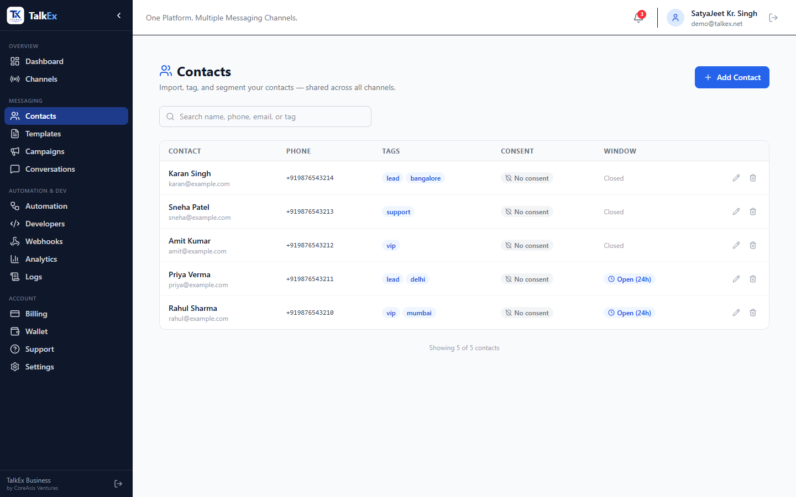
Contacts
TalkEx Business
Manage your contact database
Step-by-Step Guide
SatyaJeet Kr. Singh • CoreAxis Ventures | support@talkex.net | +91 9113107586 | web.talkex.net | talkex.net
8

Slide 9
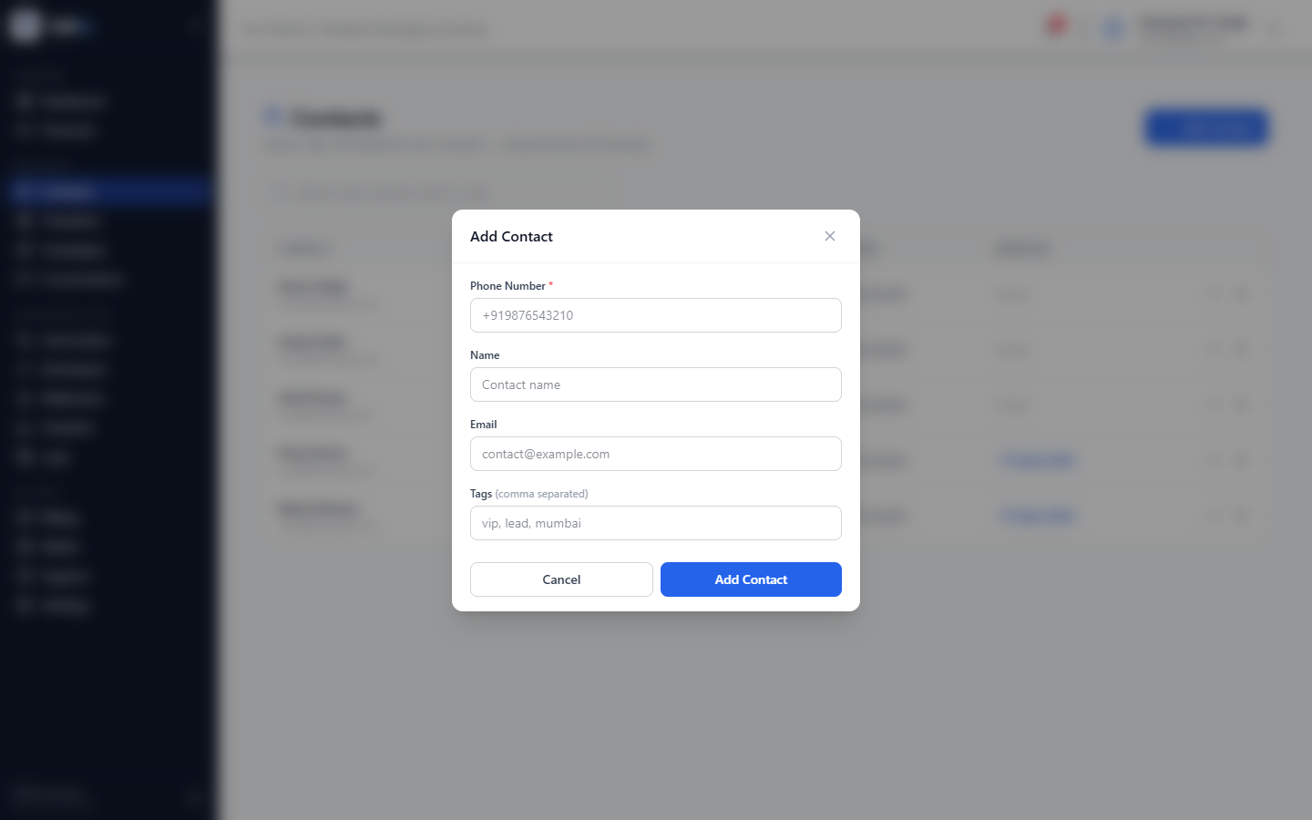
Add / Edit Contact
TalkEx Business
Create or update a contact record
Step-by-Step Guide
SatyaJeet Kr. Singh • CoreAxis Ventures | support@talkex.net | +91 9113107586 | web.talkex.net | talkex.net
9

Slide 10
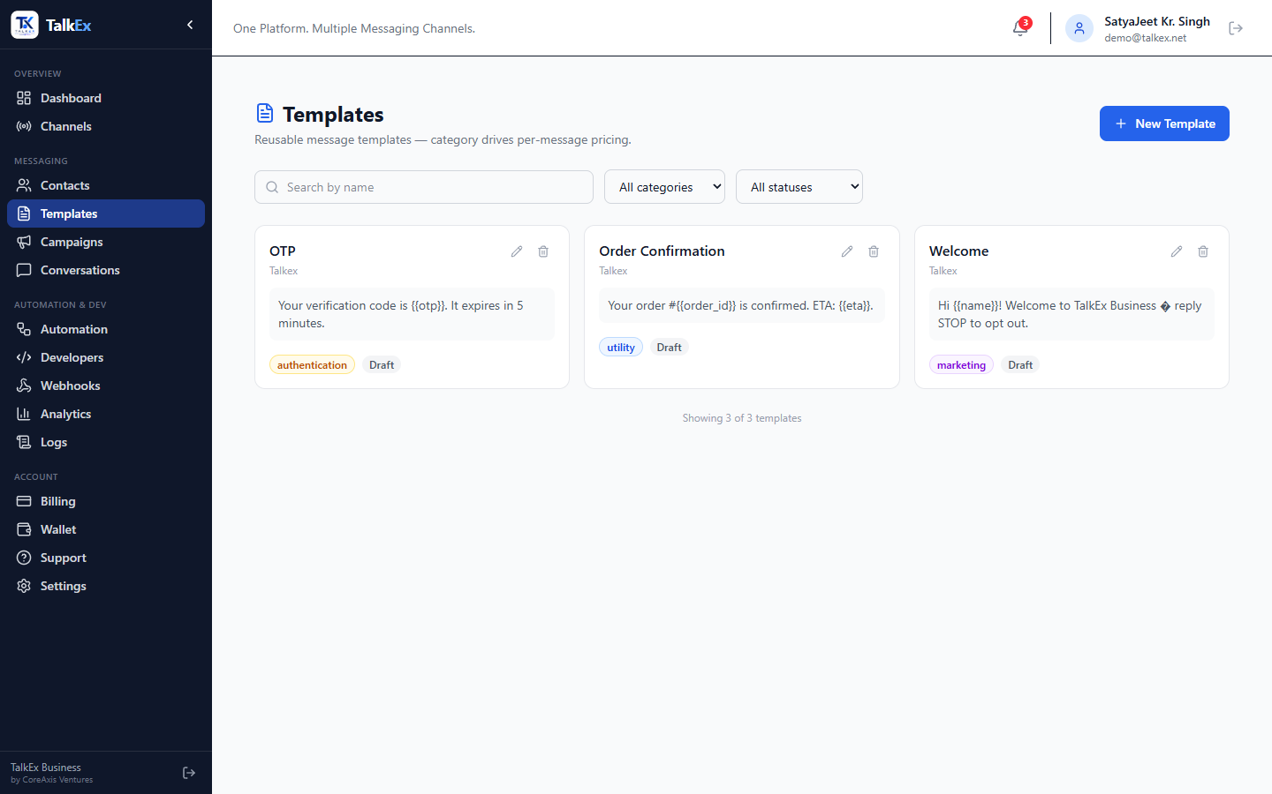
Message Templates
TalkEx Business
Pre-approved message templates for outbound messaging
Step-by-Step Guide
SatyaJeet Kr. Singh • CoreAxis Ventures | support@talkex.net | +91 9113107586 | web.talkex.net | talkex.net
10

Slide 11
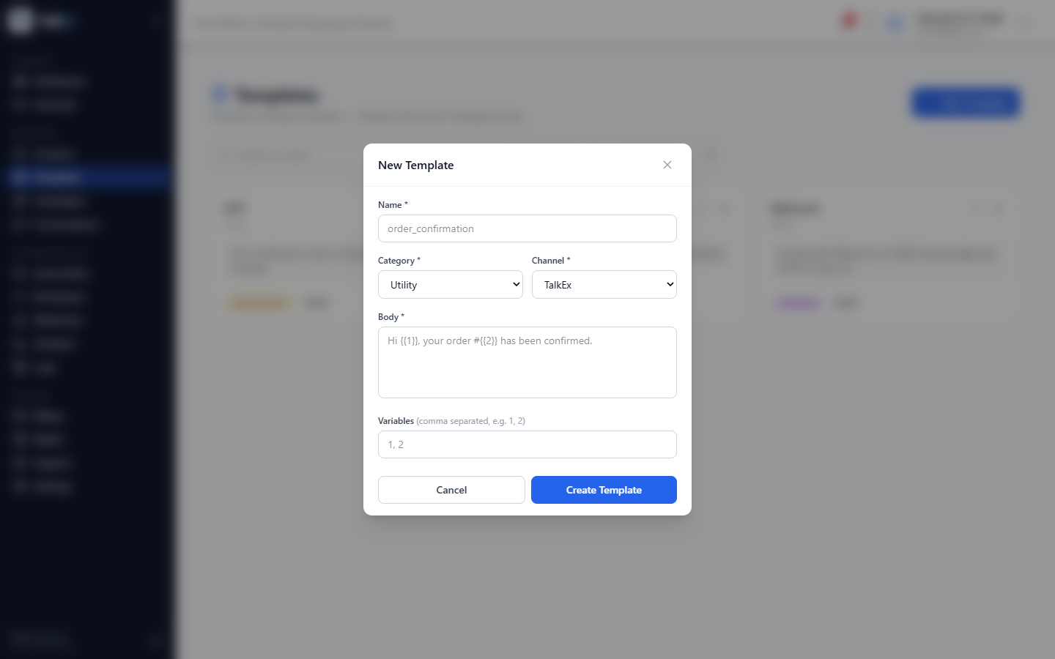
Create Template
TalkEx Business
Design a new message template
Step-by-Step Guide
SatyaJeet Kr. Singh • CoreAxis Ventures | support@talkex.net | +91 9113107586 | web.talkex.net | talkex.net
11

Slide 12
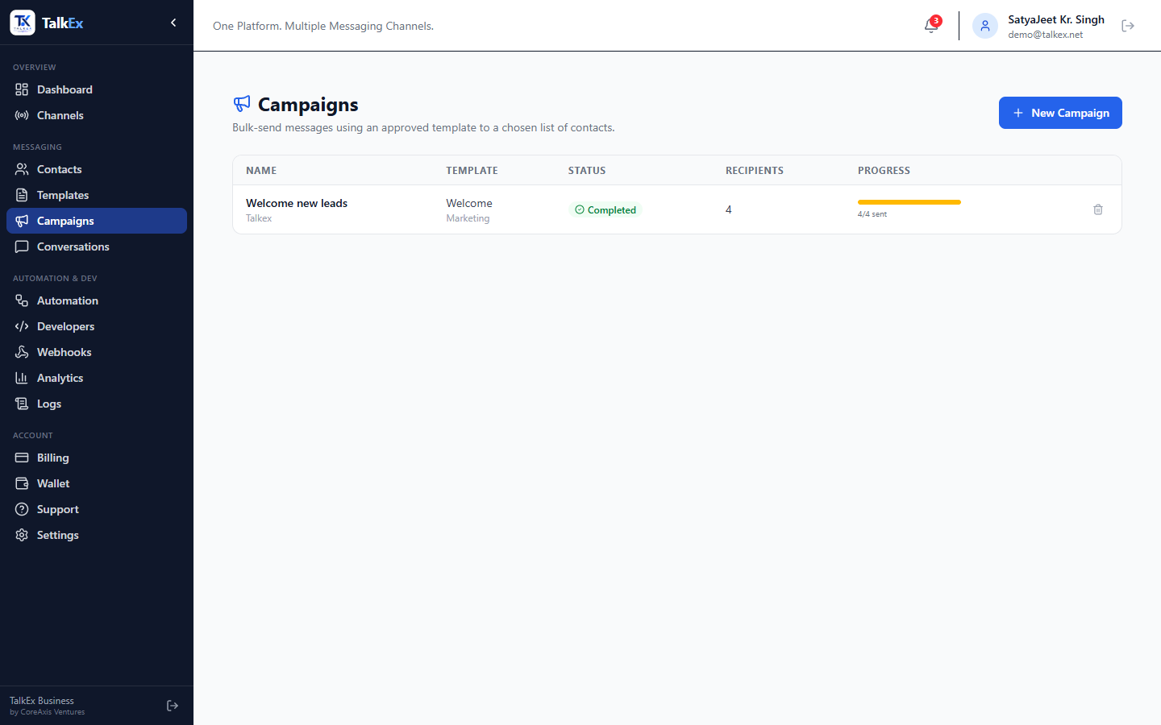
Campaigns
TalkEx Business
Bulk messaging campaigns to contact groups
Step-by-Step Guide
SatyaJeet Kr. Singh • CoreAxis Ventures | support@talkex.net | +91 9113107586 | web.talkex.net | talkex.net
12

Slide 13
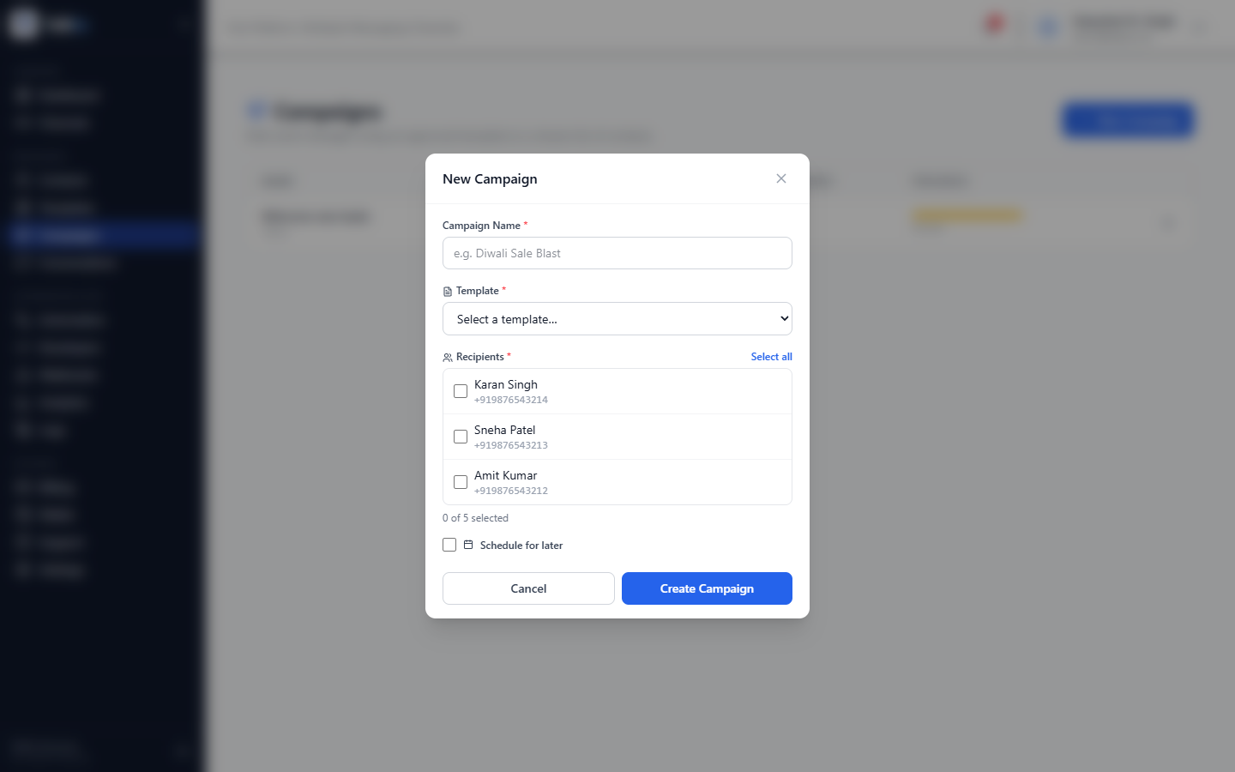
Create Campaign
TalkEx Business
Step-by-step campaign creation wizard
Step-by-Step Guide
SatyaJeet Kr. Singh • CoreAxis Ventures | support@talkex.net | +91 9113107586 | web.talkex.net | talkex.net
13

Slide 14
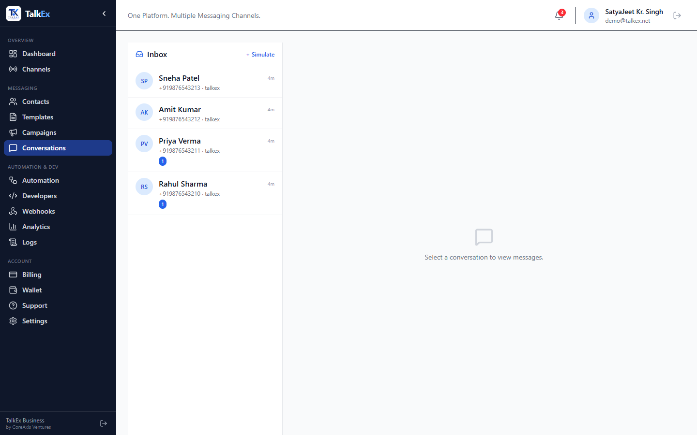
Conversations — Inbox
TalkEx Business
Real-time inbox view with all active chats
Step-by-Step Guide
SatyaJeet Kr. Singh • CoreAxis Ventures | support@talkex.net | +91 9113107586 | web.talkex.net | talkex.net
14

Slide 15
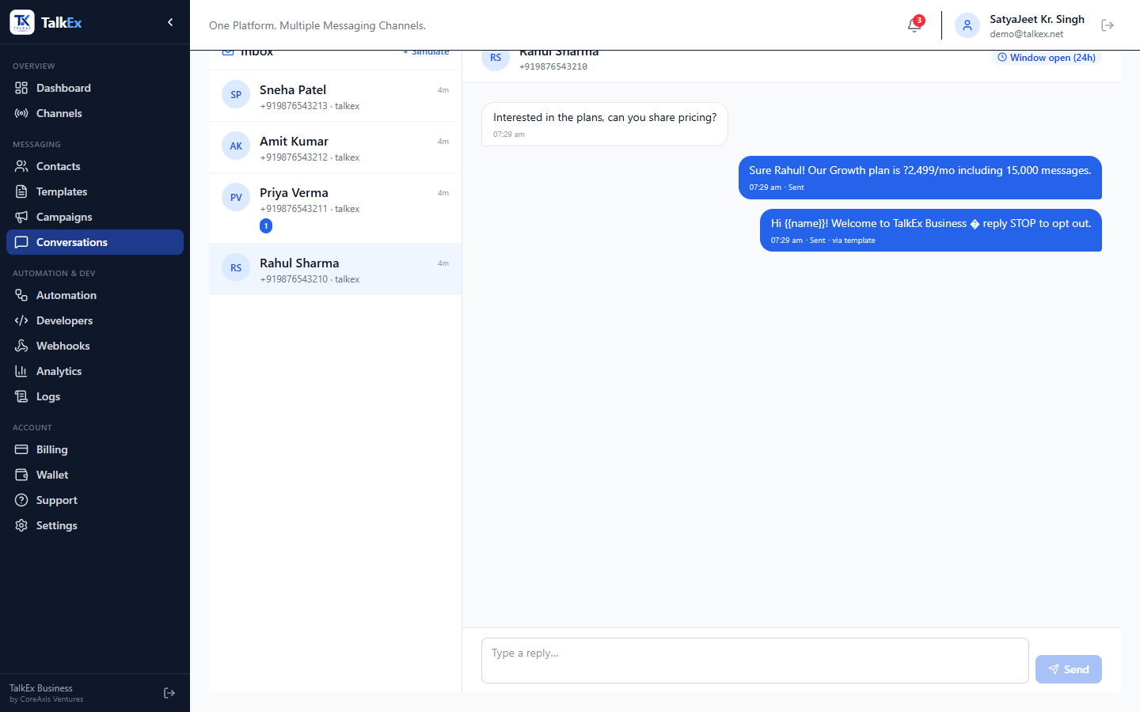
Conversations — Chat Thread
TalkEx Business
Message thread with send & receive
Step-by-Step Guide
SatyaJeet Kr. Singh • CoreAxis Ventures | support@talkex.net | +91 9113107586 | web.talkex.net | talkex.net
15

Slide 16
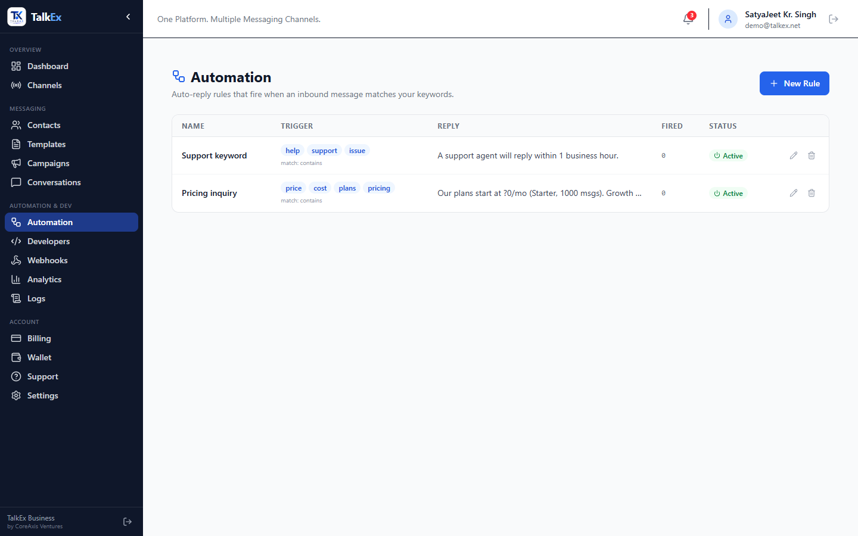
Automation Rules
TalkEx Business
Keyword-triggered auto-reply rules
Step-by-Step Guide
SatyaJeet Kr. Singh • CoreAxis Ventures | support@talkex.net | +91 9113107586 | web.talkex.net | talkex.net
16

Slide 17
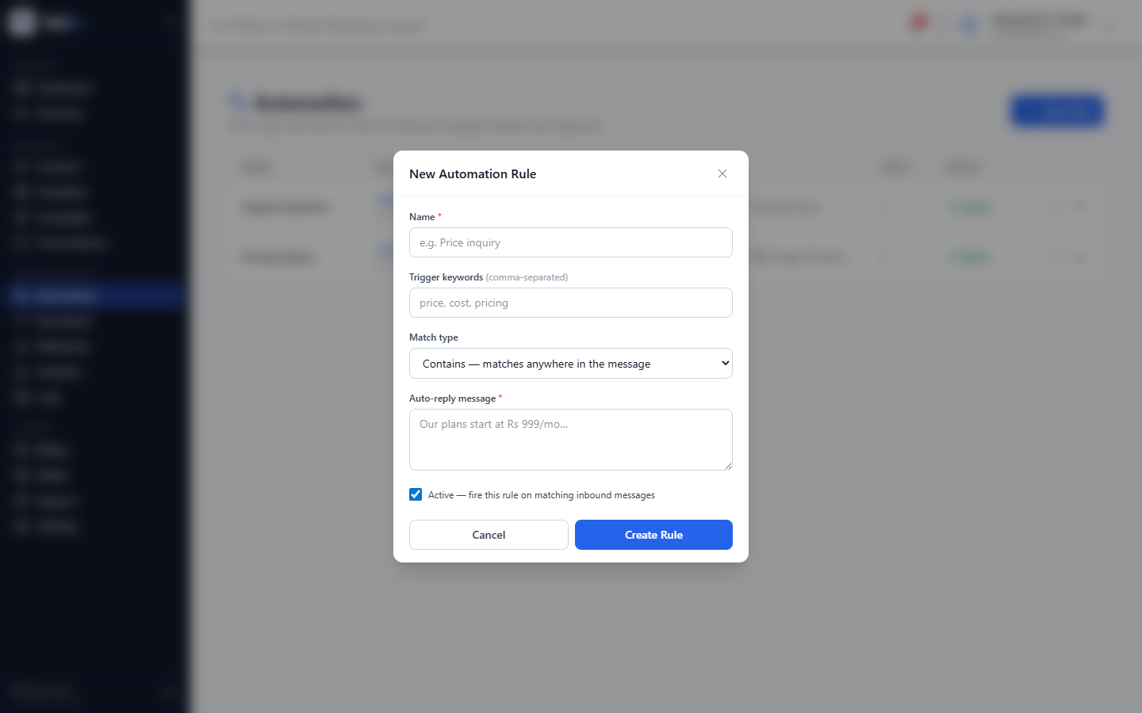
Create Automation Rule
TalkEx Business
Set up auto-reply triggers
Step-by-Step Guide
SatyaJeet Kr. Singh • CoreAxis Ventures | support@talkex.net | +91 9113107586 | web.talkex.net | talkex.net
17

Slide 18
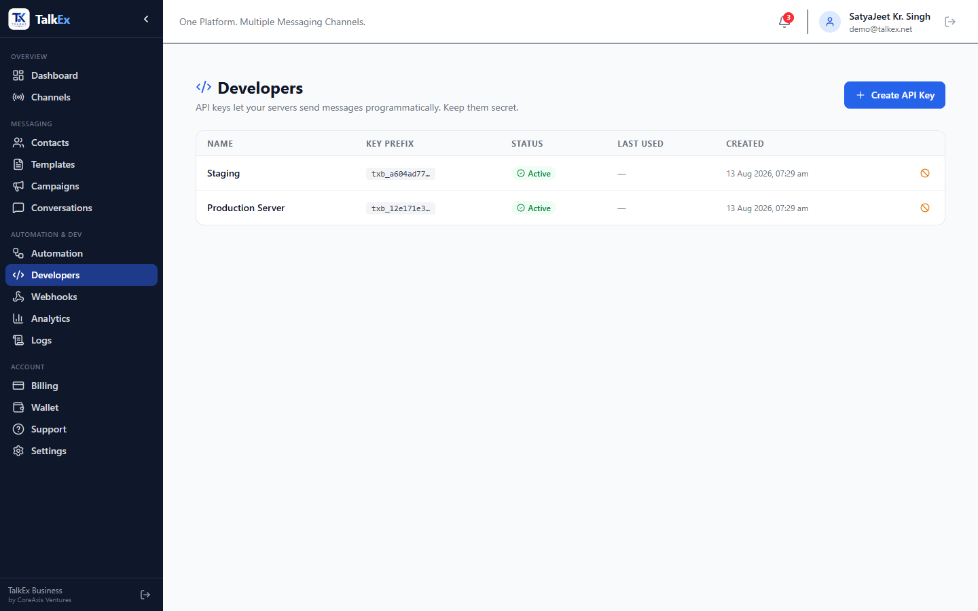
Developers — API Keys
TalkEx Business
Manage API keys for server-to-server integration
Step-by-Step Guide
SatyaJeet Kr. Singh • CoreAxis Ventures | support@talkex.net | +91 9113107586 | web.talkex.net | talkex.net
18

Slide 19
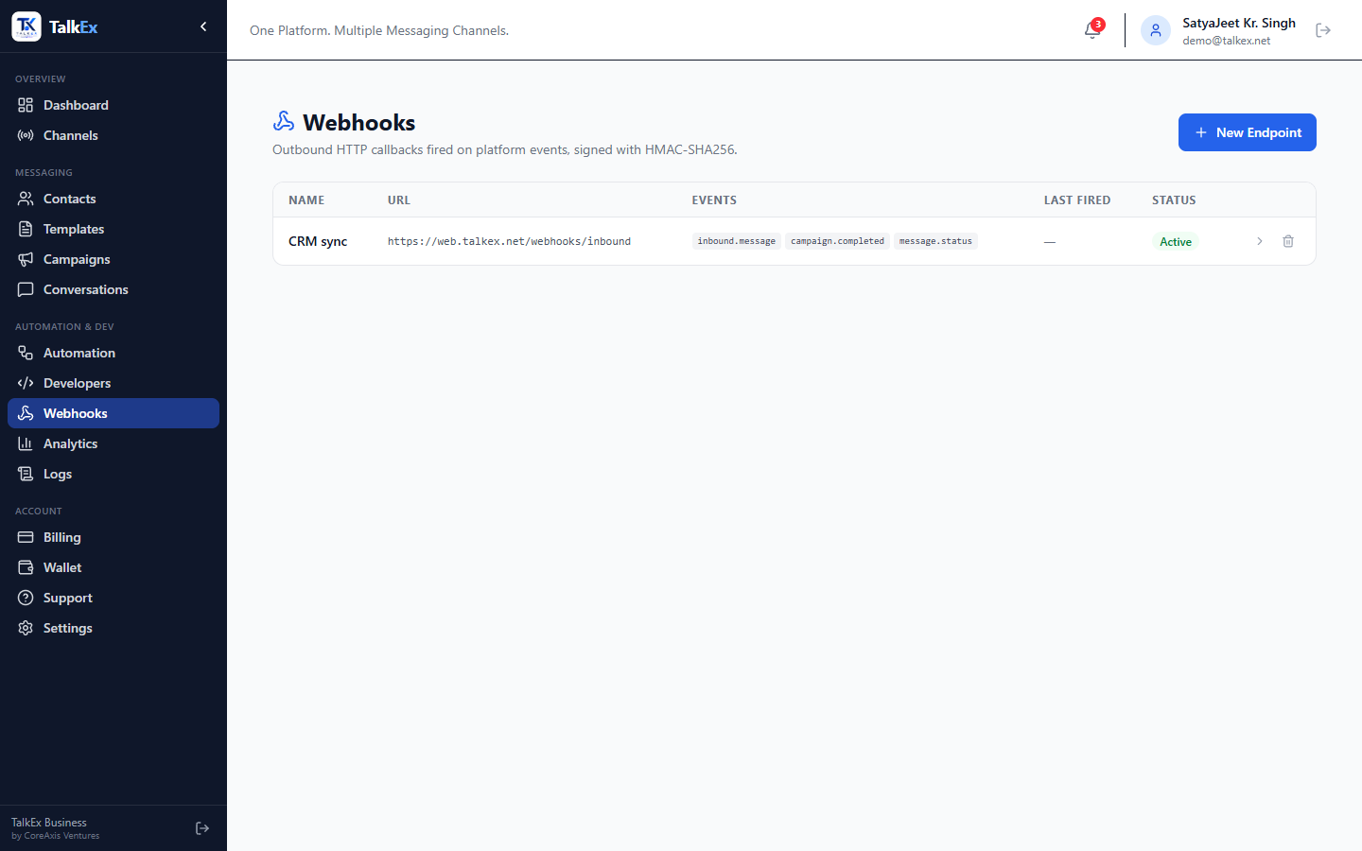
Webhooks
TalkEx Business
Outbound event delivery to your server
Step-by-Step Guide
SatyaJeet Kr. Singh • CoreAxis Ventures | support@talkex.net | +91 9113107586 | web.talkex.net | talkex.net
19

Slide 20
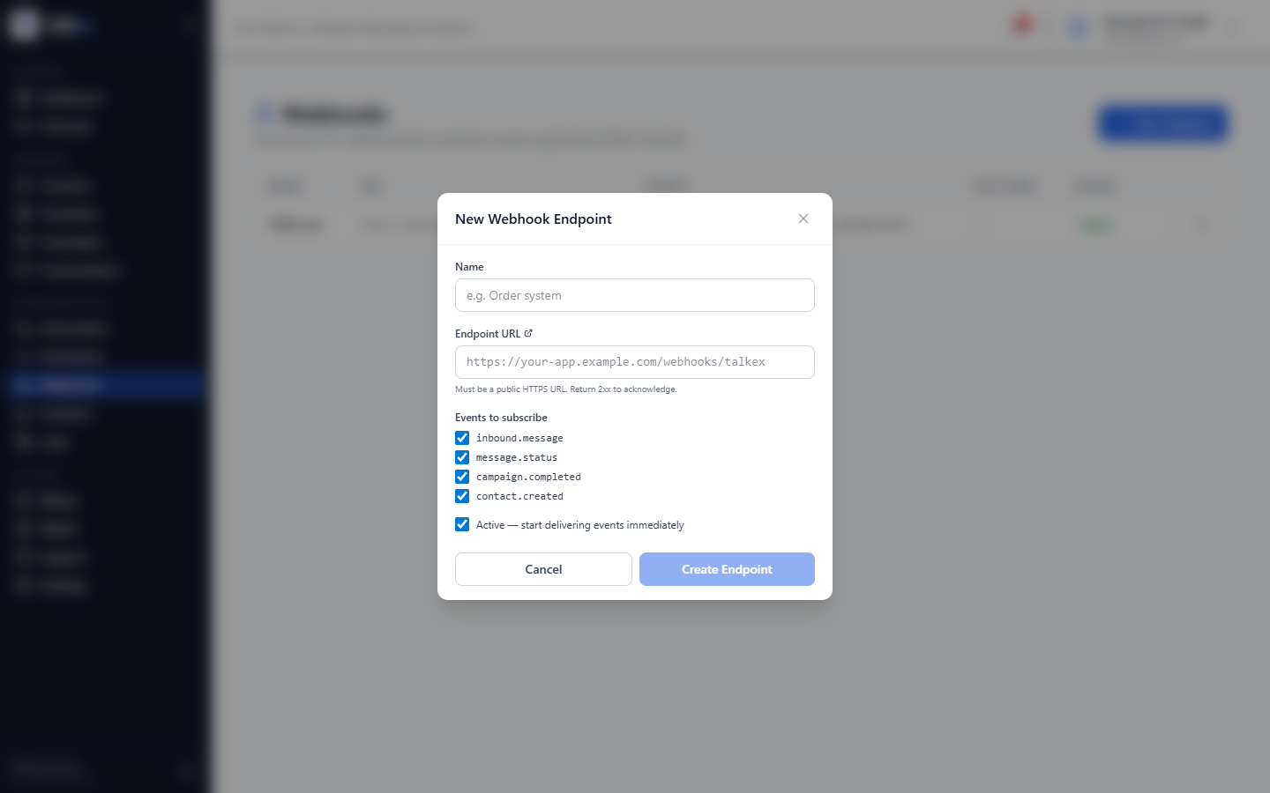
Create Webhook Endpoint
TalkEx Business
Subscribe your server to TalkEx events
Step-by-Step Guide
SatyaJeet Kr. Singh • CoreAxis Ventures | support@talkex.net | +91 9113107586 | web.talkex.net | talkex.net
20

Slide 21
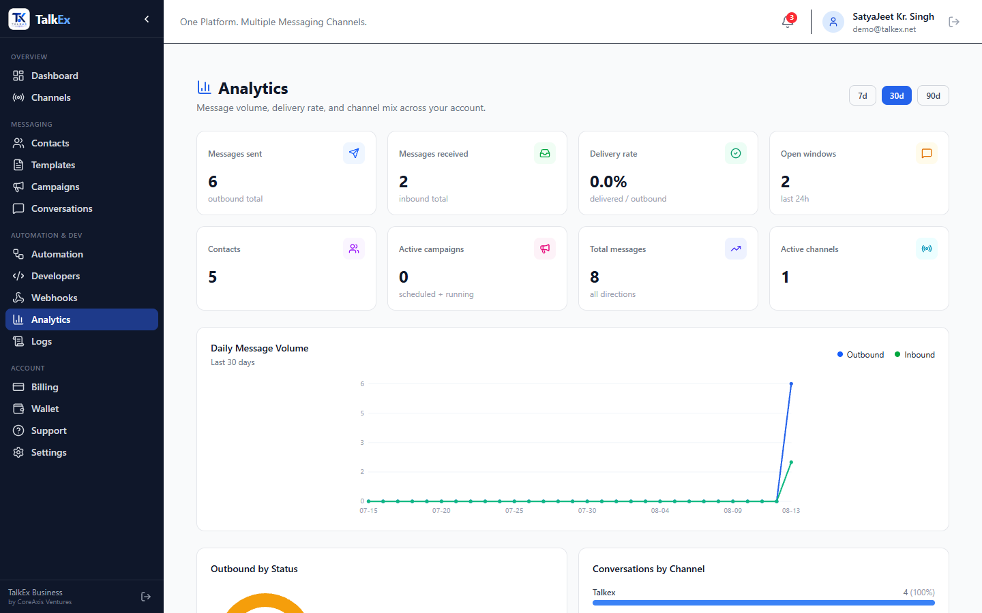
Analytics
TalkEx Business
Charts, KPIs & message insights across all channels
SatyaJeet Kr. Singh • CoreAxis Ventures | support@talkex.net | +91 9113107586 | web.talkex.net | talkex.net
21

Slide 22
Analytics — Details
TalkEx Business
Understanding your analytics dashboard
Step-by-Step Guide
SatyaJeet Kr. Singh • CoreAxis Ventures | support@talkex.net | +91 9113107586 | web.talkex.net | talkex.net
22

Slide 23
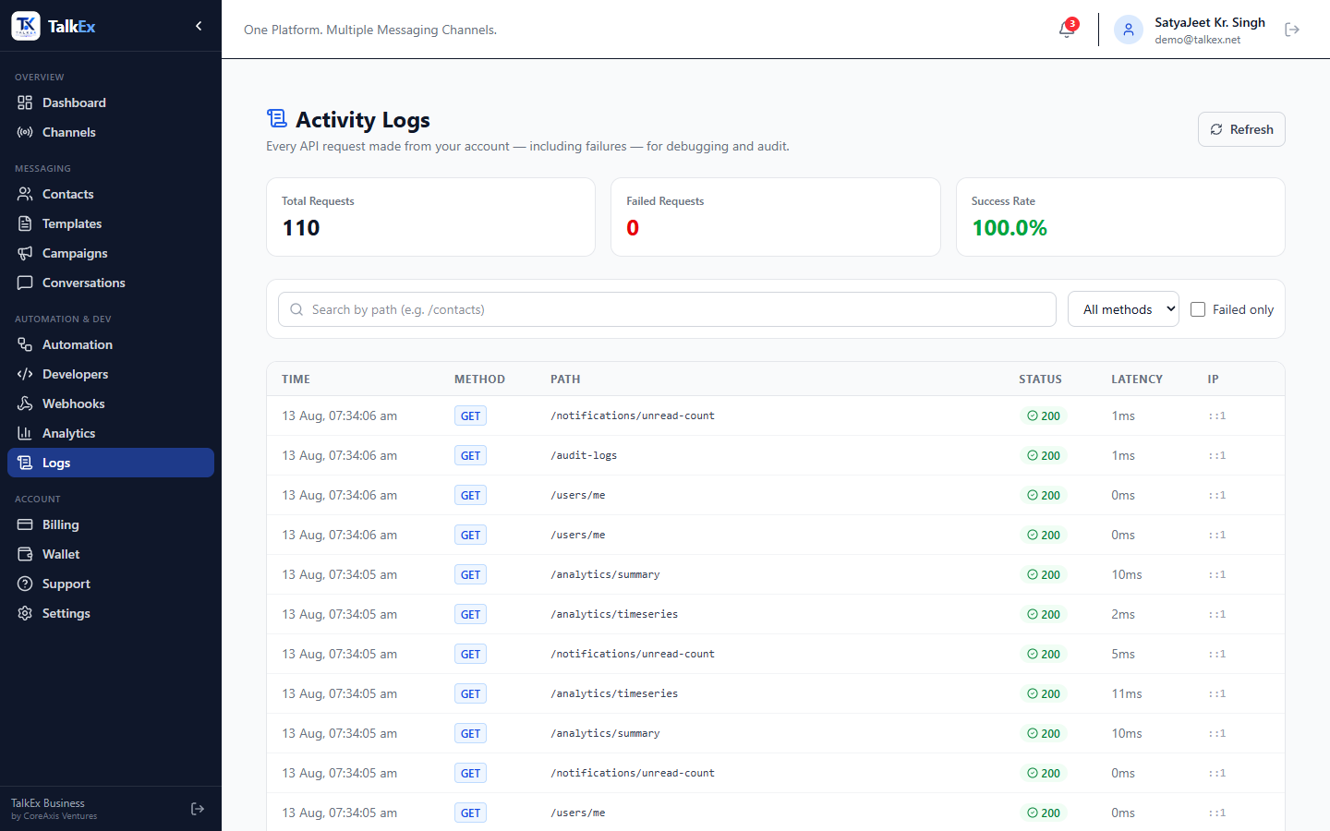
Activity Logs
TalkEx Business
Audit trail for every API request
Step-by-Step Guide
SatyaJeet Kr. Singh • CoreAxis Ventures | support@talkex.net | +91 9113107586 | web.talkex.net | talkex.net
23

Slide 24
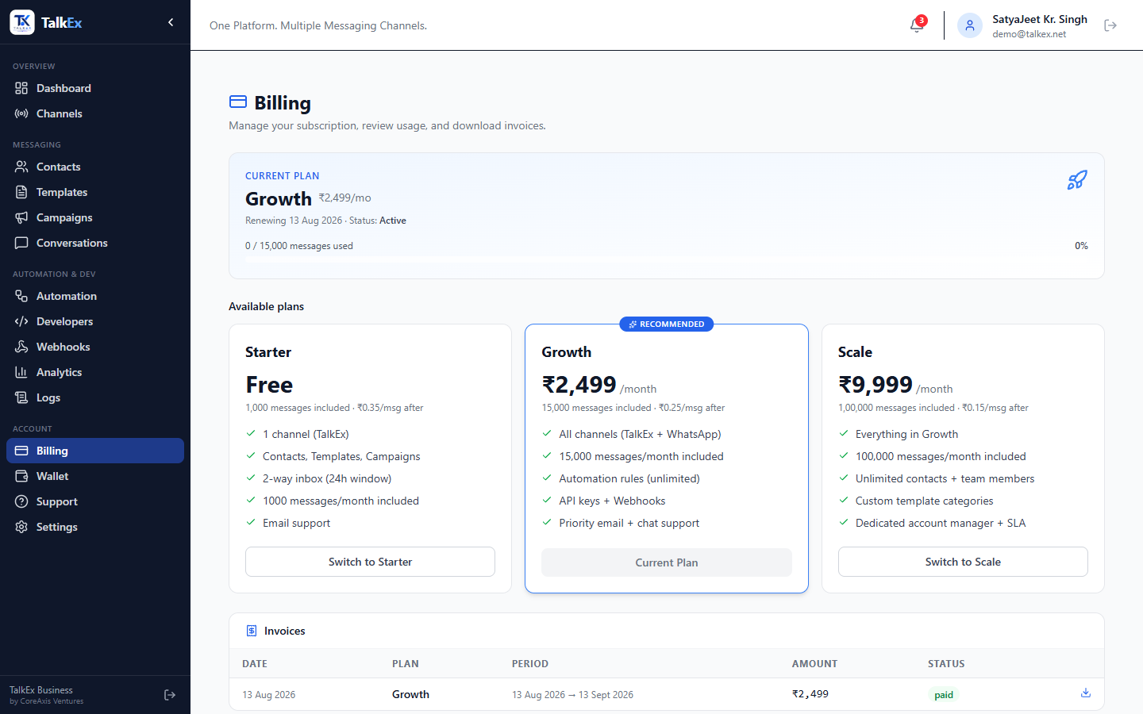
Billing
TalkEx Business
Plans, subscriptions & invoices
Step-by-Step Guide
SatyaJeet Kr. Singh • CoreAxis Ventures | support@talkex.net | +91 9113107586 | web.talkex.net | talkex.net
24

Slide 25
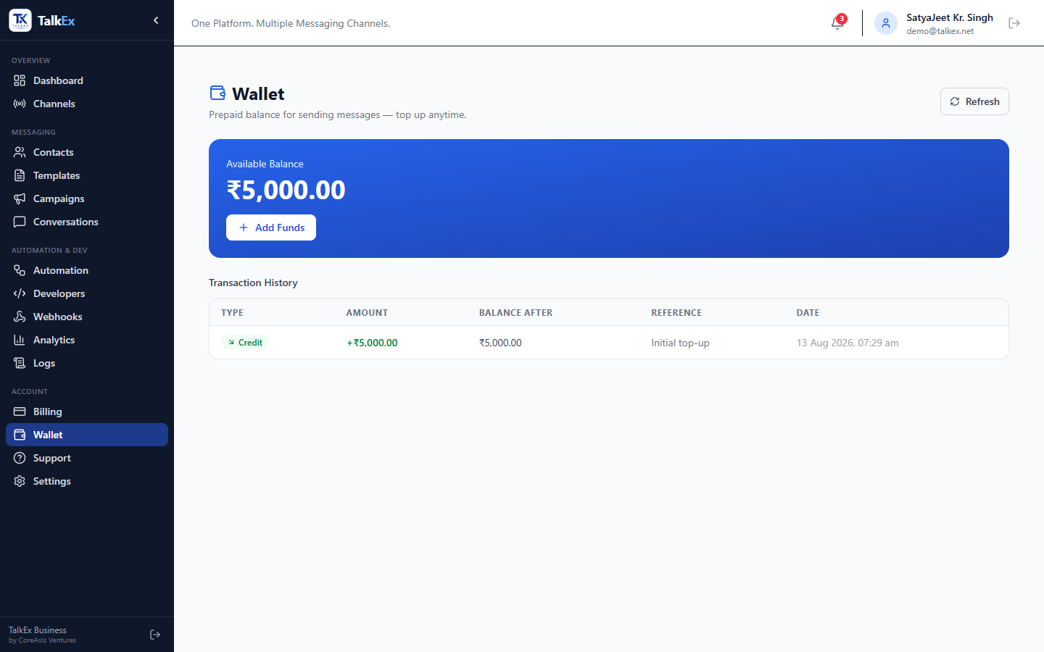
Wallet
TalkEx Business
Prepaid balance & transaction history
Step-by-Step Guide
SatyaJeet Kr. Singh • CoreAxis Ventures | support@talkex.net | +91 9113107586 | web.talkex.net | talkex.net
25

Slide 26
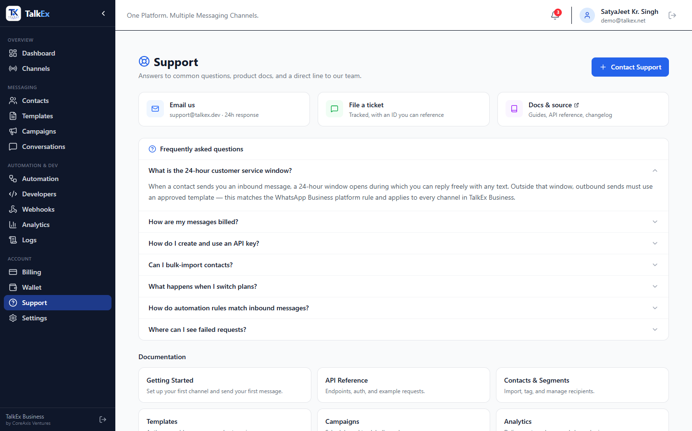
Support — Help Center
TalkEx Business
FAQs, documentation & contact channels
Step-by-Step Guide
SatyaJeet Kr. Singh • CoreAxis Ventures | support@talkex.net | +91 9113107586 | web.talkex.net | talkex.net
26

Slide 27
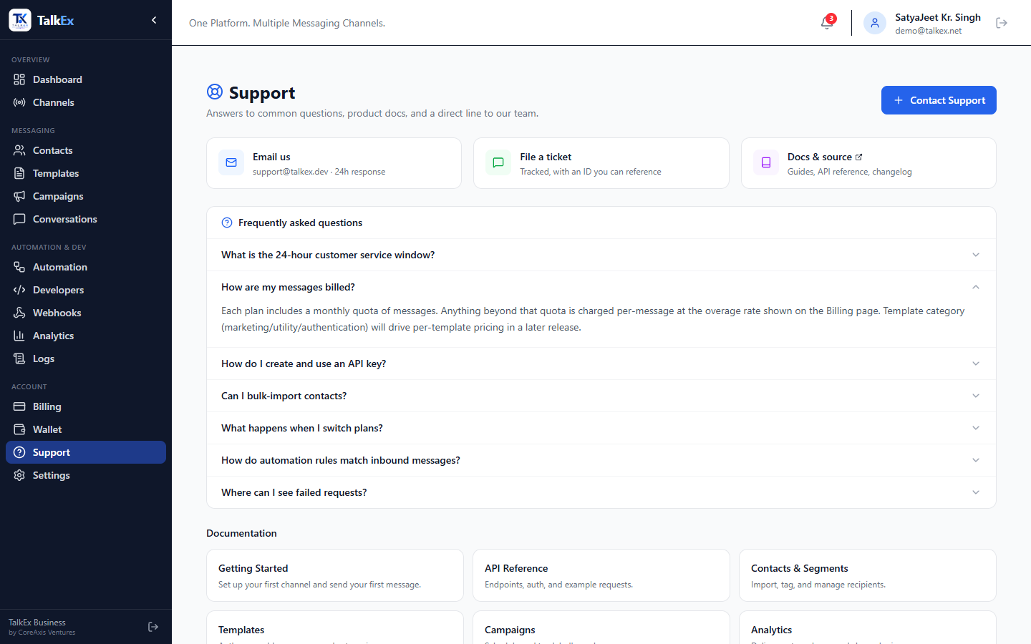
Support — FAQ Expanded
TalkEx Business
Detailed FAQ answers
Step-by-Step Guide
SatyaJeet Kr. Singh • CoreAxis Ventures | support@talkex.net | +91 9113107586 | web.talkex.net | talkex.net
27

Slide 28
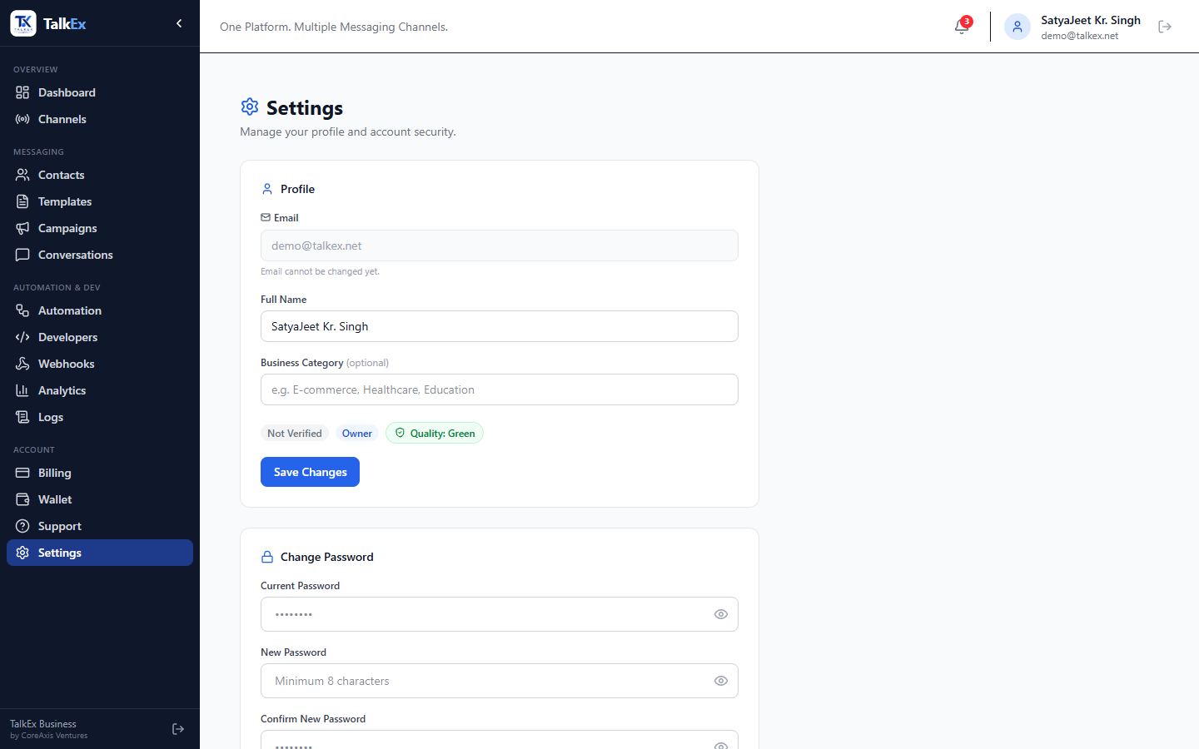
Settings
TalkEx Business
Profile & account configuration
Step-by-Step Guide
SatyaJeet Kr. Singh • CoreAxis Ventures | support@talkex.net | +91 9113107586 | web.talkex.net | talkex.net
28

Slide 29
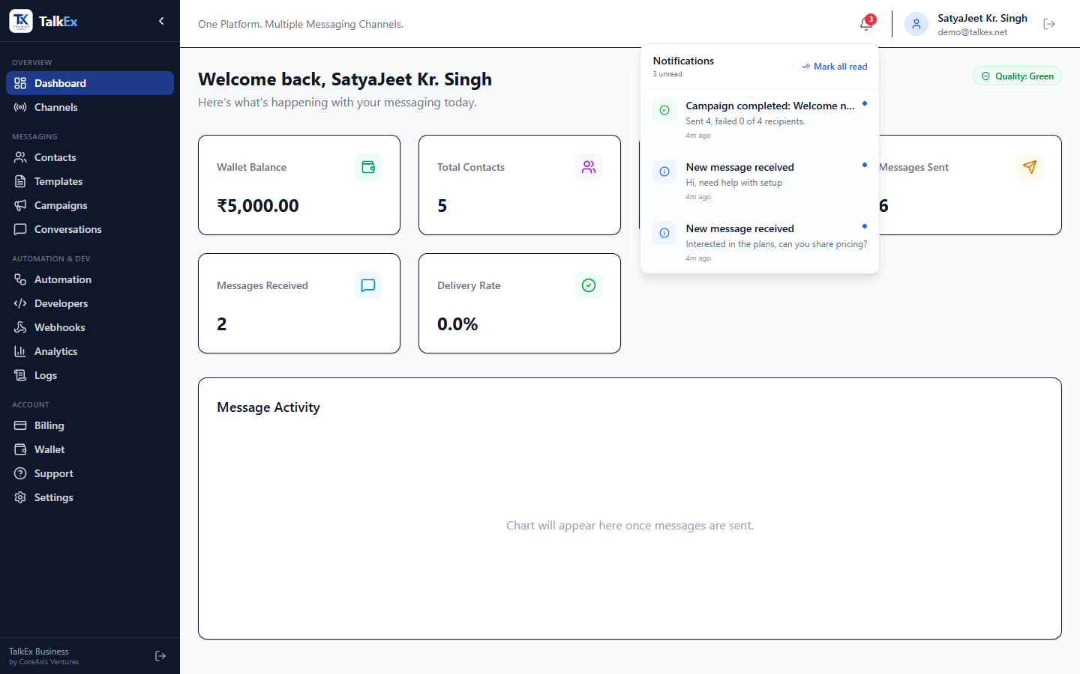
Notifications
TalkEx Business
In-app notification bell & center
Step-by-Step Guide
SatyaJeet Kr. Singh • CoreAxis Ventures | support@talkex.net | +91 9113107586 | web.talkex.net | talkex.net
29

Slide 30
Sidebar Navigation
TalkEx Business
Navigating the TalkEx Business dashboard
Step-by-Step Guide
SatyaJeet Kr. Singh • CoreAxis Ventures | support@talkex.net | +91 9113107586 | web.talkex.net | talkex.net
30

Slide 31
Quick Start Guide
TalkEx Business
Get up and running in 5 minutes
SatyaJeet Kr. Singh • CoreAxis Ventures | support@talkex.net | +91 9113107586 | web.talkex.net | talkex.net
31

Slide 32
API Integration Guide
TalkEx Business
Connect your backend to TalkEx Business
SatyaJeet Kr. Singh • CoreAxis Ventures | support@talkex.net | +91 9113107586 | web.talkex.net | talkex.net
32

Slide 33
Thank You!
TalkEx Business — Enterprise CPaaS Dashboard
Owner: SatyaJeet Kr. Singh Organization: CoreAxis Ventures Email: support@talkex.net Phone: +91 9113107586 Dashboard: web.talkex.net Website: talkex.net
SatyaJeet Kr. Singh • CoreAxis Ventures | support@talkex.net | +91 9113107586 | web.talkex.net | talkex.net
33

