Slide 1
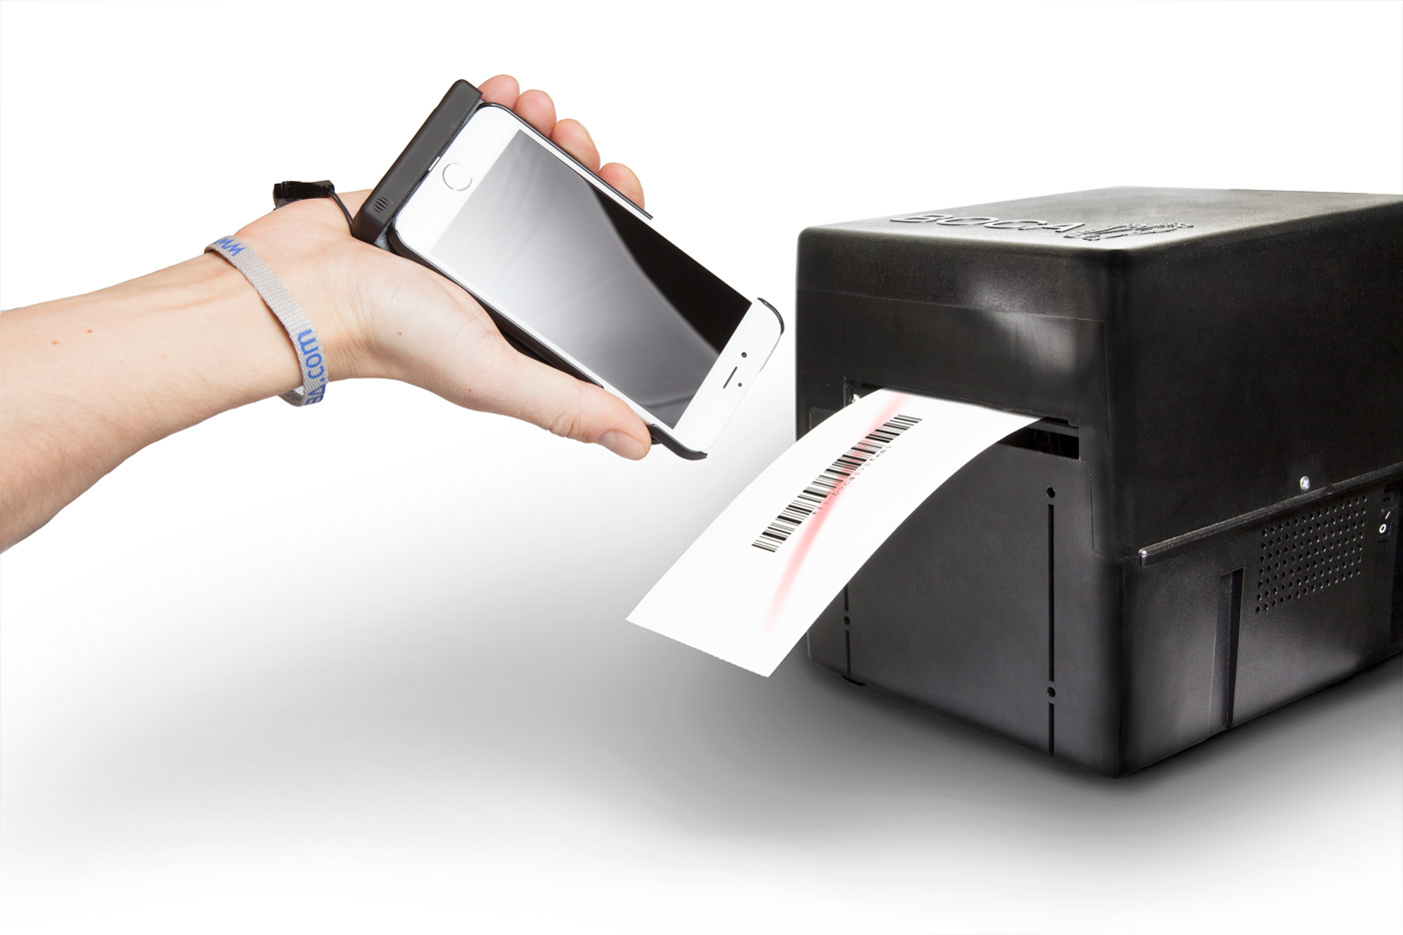

Slide 2
TLS - Boca Systems
Founded in 1995
Dutch company
Exclusive Boca Systems distributor for most EU countries
Active worldwide
40+ employees
Specializes in access control and ticketing
Delivers complete packages for RFID implementations: printers, tickets and scanners
Close cooperation with RFID products manufacturers
TLS - Boca Systems delivers high secure solutions to our customers!

Slide 3
Grabba part of a total solution
Application
+
Smartphone
+
Grabba Unit
Mobilize your organisation!

Slide 4
Available technologies
1D & 2D barcode scanners
MRZ (ID document) reader
RFID reader (UHF, ULF, HID, Mifare)
Contact smartcard reader/Belgium E-ID
Fingerprint reader
Magnetic stripe card-reader
Signature pad
Extended battery-pack
Up to 8 different technologies in 1 device!

Slide 5
Configure your Grabba for Apple
Secure direct Lightning Connection
Includes Lithium-ion rechargeable battery
Free SDK
12 months warranty
Upgradable to future smartphones
A solution for every customer!

Slide 6
Grabba Q-serie
Barcode scanner
RFID reader
Magnetic stripe card reader
Grabba Q-serie for Retail!

Slide 7
Apple Devices
Quick follow up for new devices!

Slide 8
Configure your Grabba for Samsung
Connect with USB
Integrated Li-On battery
Free SDK
12 months warranty
Upgradable to future smartphones
Charge Grabba & device at the same time
A solution for every customer!

Slide 9
Samsung Devices
Galaxy S7
Galaxy A9
Note 6 (Sept)
Tablet op project basis
Quick follow up for new devices!

Slide 10
Mobile identification
RFID reader Reading chipdata out of tickets or plastic cards fitted with a RFID chip
Specialized in mobile identification!

Slide 11
Grabba accessories
Chargers
Smartphone covers
Car Charger
Belt-holder for S-series
Belt-holder for Z-series
Useful Grabba accessories!

Slide 12
Questions?
Address: TLS - Boca Systems Rochussenstraat 291 B 3023 DE Rotterdam Netherlands
Contact: Sales department sales@tls-bocasystems.com +31 (0) 10-2210 660
Contact person for Grabba Europe!

