Slide 1
Lecture 18: Linear Regression Continued
Heather Mattie, PhD
October 29, 2026

Slide 2





Recipe of the Day!
Dia de los Muertos recipes

Slide 3
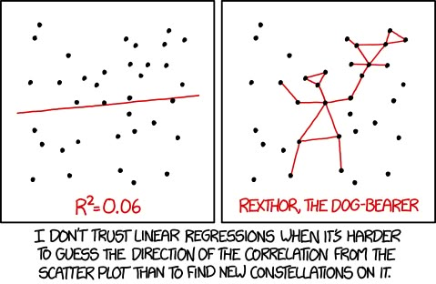
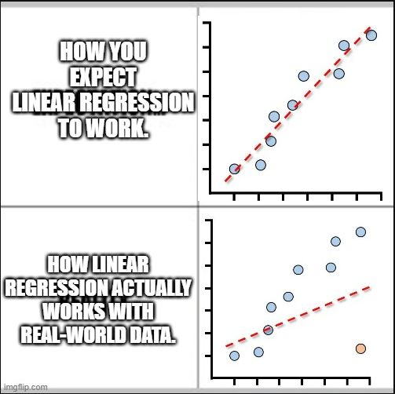
Announcements
There will be lab this week
Heather’s office hour:
  Today 12-1pm
Midterm due Friday, November 6th
  No late days may be used
No class November 24th and 26th

Slide 4
Coding question of the day
A survey has three linked alcohol questions:
“Have you ever had an alcoholic drink?” (ever_drink)
If yes: “Have you had a drink in the past 30 days?” (drink_30d)
If yes: “On days you drink, how many drinks do you have?” (drinks_per_day)
Create imputed versions of drink_30d and drinks_per_day that correctly fill in skipped values. Then count how many truly missing values remain in each imputed variable.
Run this code first:
survey <- data.frame( id = 1:10,
ever_drink = c("Yes", "No", "Yes", "No", "Yes", NA, "Yes", "No", "Yes", "Yes"),
drink_30d = c("Yes", NA, "No", NA, "Yes", NA, NA, NA, "Yes", "No"),
drinks_per_day = c(2, NA, NA, NA, NA, NA, NA, NA, 4, NA) )

Slide 5
Linear Regression
Heather Mattie, PhD

Slide 6
Linear Regression Roadmap
Correlation
Simple linear regression
Evaluation of model assumptions
Multivariate linear regression
Collinearity
Model selection

Slide 7
Linear Regression
Simple linear regression
Heather Mattie, PhD

Slide 8
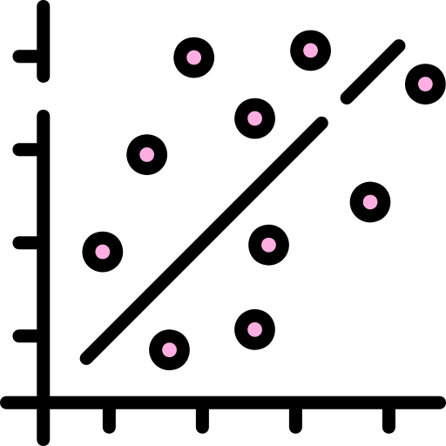
Linear regression
Like correlation analysis, linear regression can be used to investigate the linear relationship between two continuous random variables.
Relationships between a continuous outcome variable and one or more risk factors that can be continuous, discrete, or categorical (nominal or ordinal), or some combination of these.

Slide 9
Linear regression
Linear regression can be used to
Estimate or predict the value of a continuous outcome measurement given a set of risk factors
Adjust for confounders when examining the relationship between an exposure and a continuous outcome
Test for effect measure modification

Slide 10
Simple linear regression
Simple linear regression can be used to explore the nature of the relationship between two continuous variables
Regression looks at the change in one variable (outcome or response or dependent variable) that corresponds to a given change in the other variable (explanatory variable or exposure or predictor or covariate or independent variable)
y = mx + b
m: slope
b: y intercept

Slide 11
Assumptions
Linearity:
  The relationship between μ_{y|x} (mean of y given x) and x is linear
Normality:
  For a given value of x, y is normally distributed
Homoscedasticity:
  The standard deviation σ_{y|x} is constant for all x
Independence:
  We have n independent pairs of observations

Slide 12
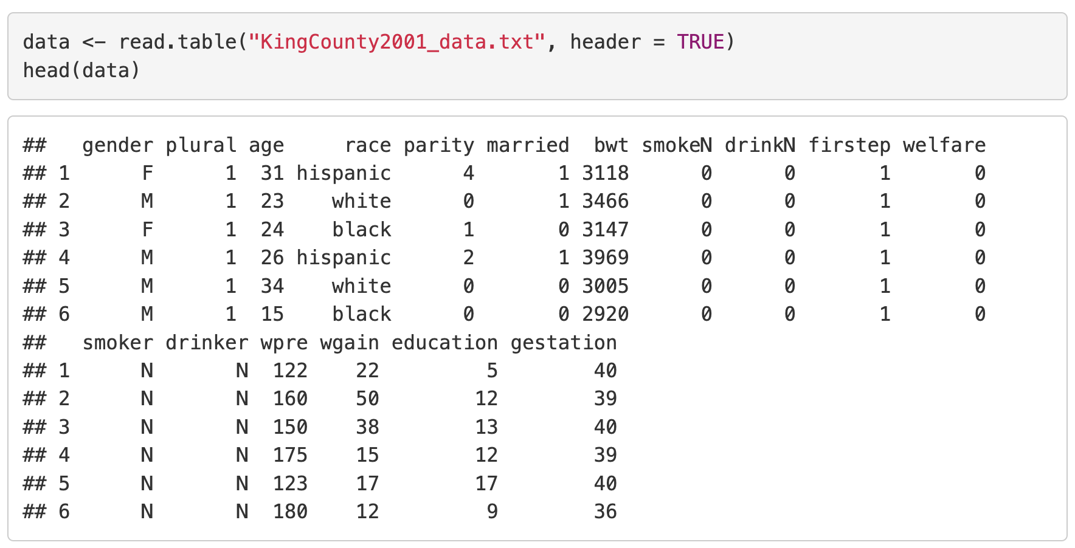
Example: Prenatal care

Slide 13
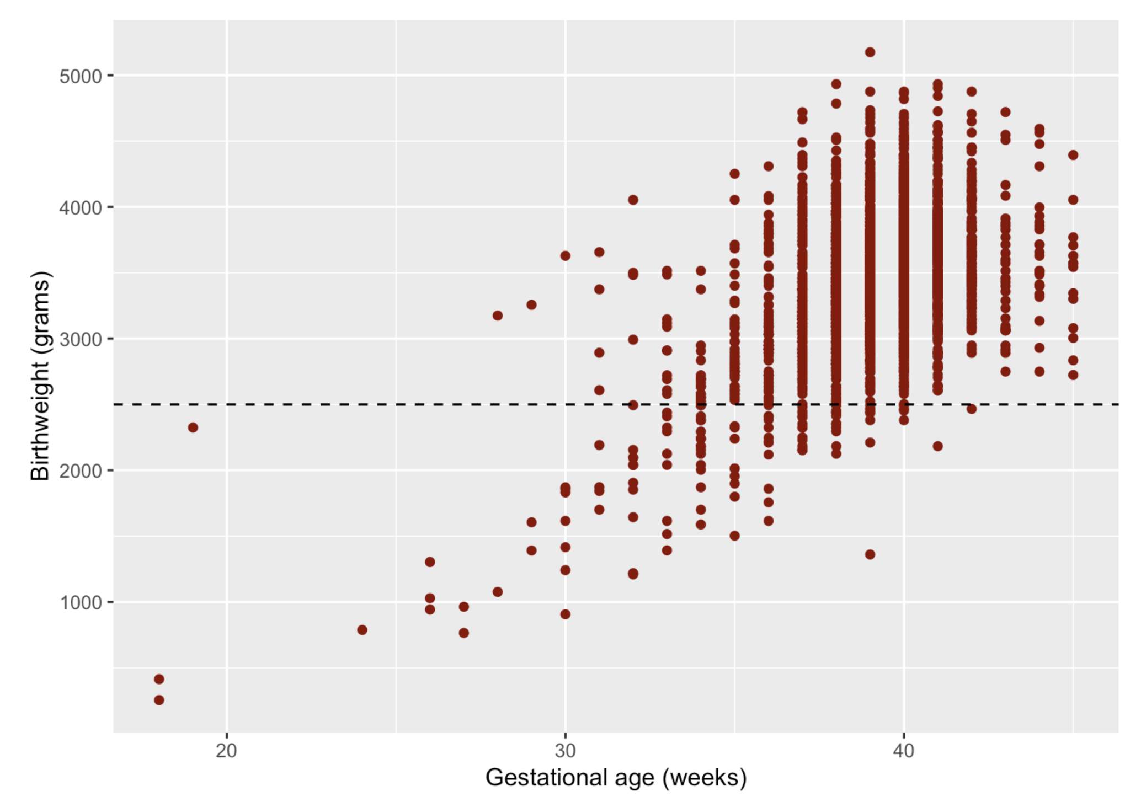
Example: Prenatal care
Suppose the outcome is birthweight in grams and the exposure is gestational age in weeks.
A linear regression model will quantify how birthweight and gestational age are associated

Slide 14
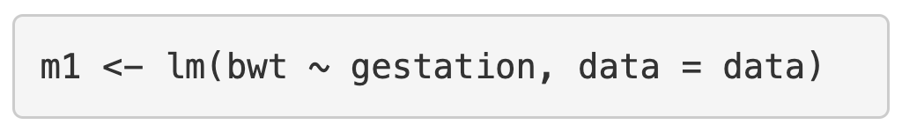
The lm function
The lm function stands for linear model and is used to fit a linear regression model
The primary inputs are formula and data
Simple linear regression formula: outcome ~ predictor
Regression line equation:
μ_{y|x} = β₁x + β₀
μ_{bwt|gestation} = β₁(gestation) + β₀

Slide 15
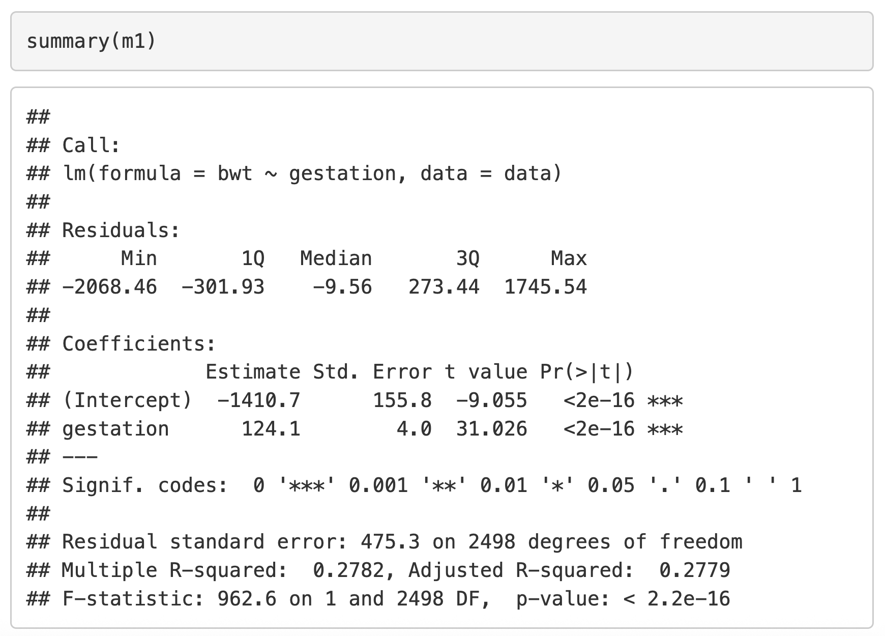
The lm function
The lm function stands for linear model and is used to fit a linear regression model
The summary function outputs details about the fit model
Fitted regression line equation:
Mean birthweight = 124.1(gestation) – 1410.7

Slide 16
Coefficient interpretation
Fitted regression line equation:
Mean birthweight = 124.1(gestation) – 1410.7
Slope interpretation: for every 1 week increase in gestational age, birthweight increases by 124.1 grams on average.
Intercept interpretation: the estimated mean birthweight when gestational age is 0 weeks is -1410.7 grams.

Slide 17
Coefficient of determination
R² is the coefficient of determination, which quantifies the proportion of the variance in the dependent variable that is explained by the independent variable.
Ranges from 0 to 1
A higher R² value indicates a better fit model
In simple linear regression, R² is the Pearson correlation coefficient squared

Slide 18
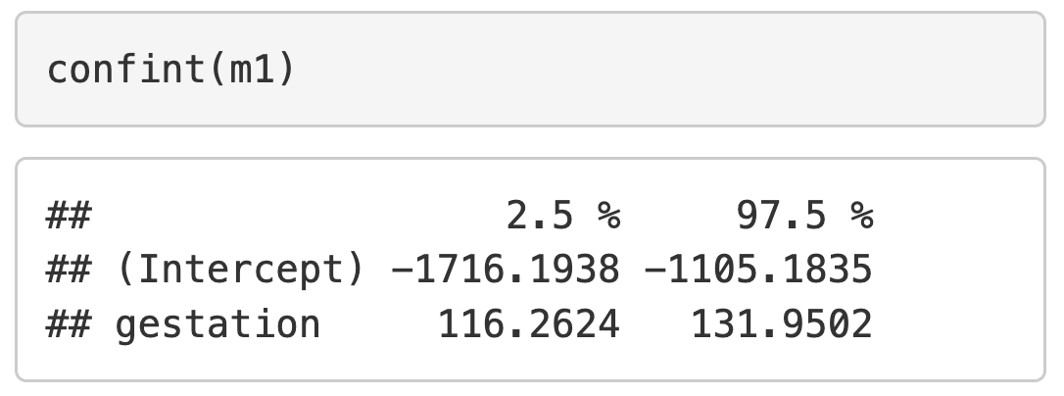
Confidence interval for slope
The confidence interval for all of the coefficients of the model, including the intercept, can be calculated using the confint function

Slide 19
Hypothesis tests
The p-value of the slope coefficient is used to test if the relationship between the outcome and exposure is significant
If the p-value is < 0.05, the slope is not equal to 0 and there is a statistically significant relationship between the outcome and exposure

Slide 20
Prediction
One important use of a linear regression model is prediction of a continuous outcome
Example: the predicted birthweight of a baby with gestational age equal to 40 weeks is 124.1(40) – 1410.7 = 3,553.3 grams.

Slide 21
Prediction
One important use of a linear regression model is prediction of a continuous outcome
Example: the predicted birthweight of a baby with gestational age equal to 28 weeks is 124.1(28) – 1410.7 = 2,064.1 grams.

Slide 22
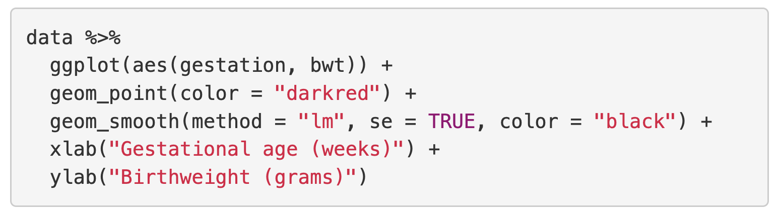
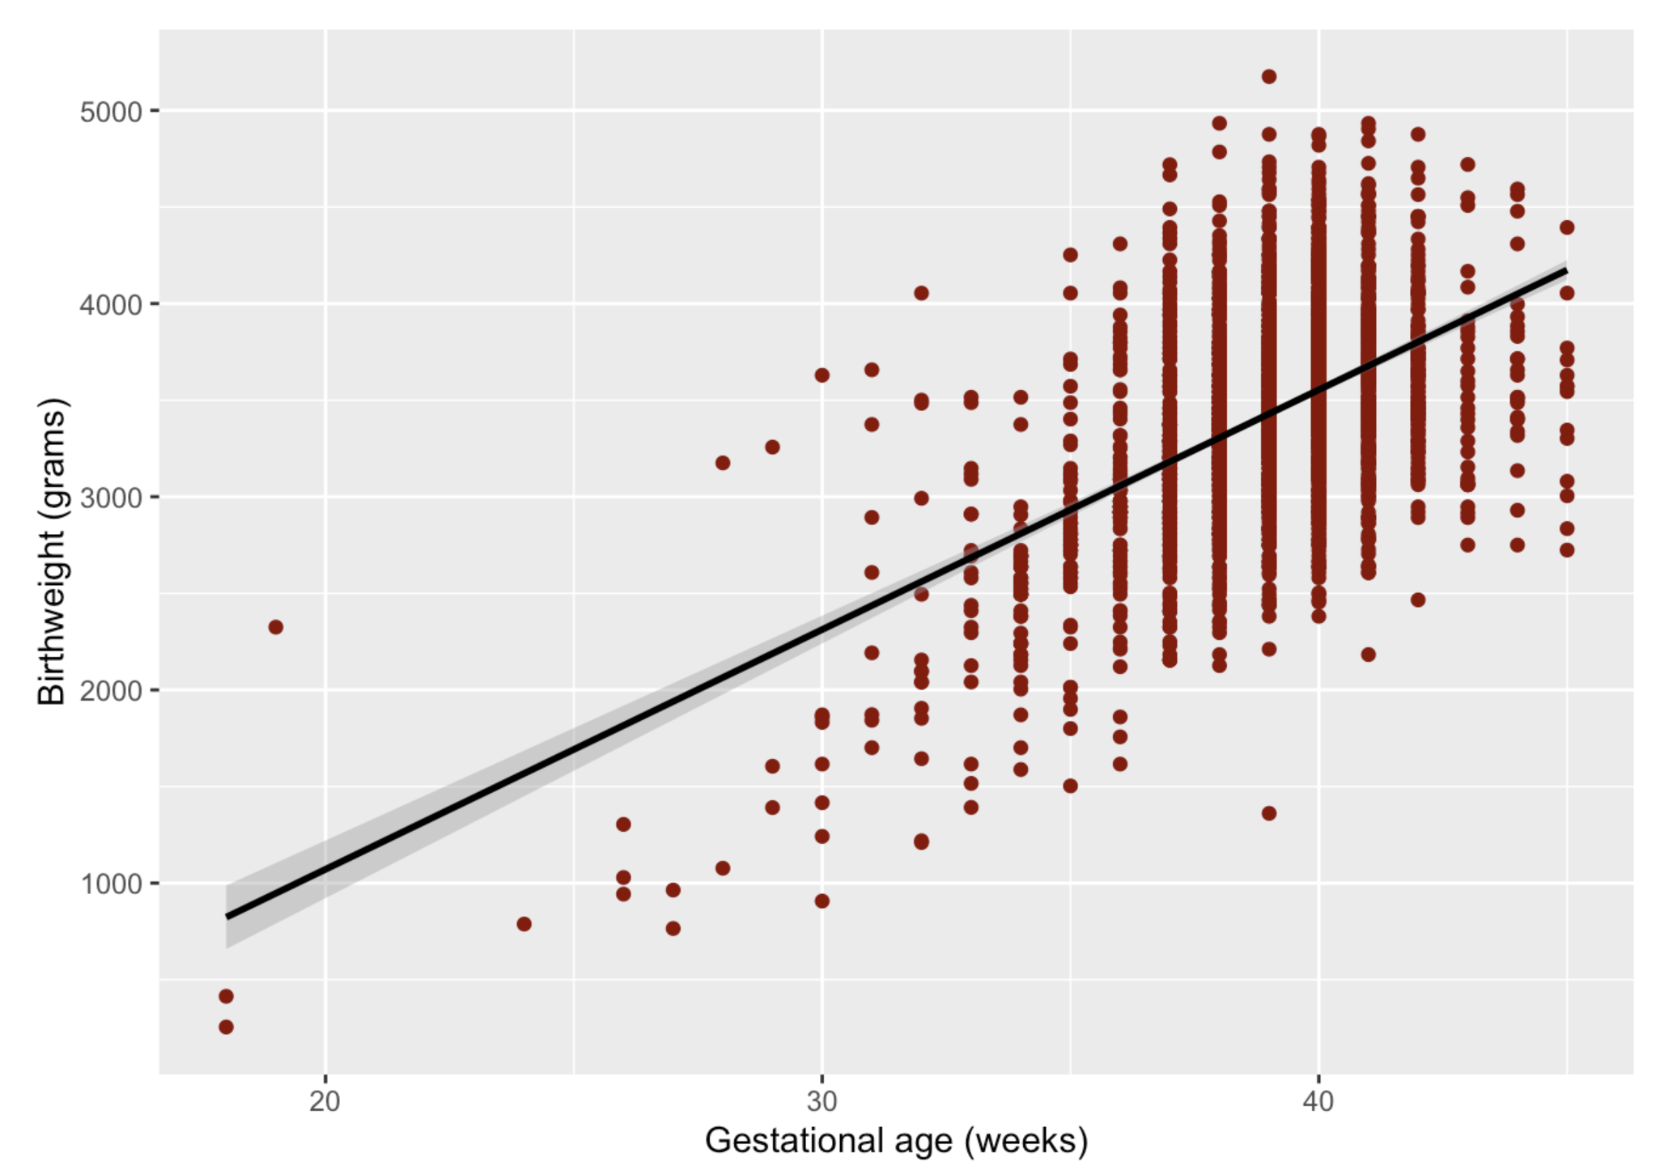
Regression line plot

Slide 23
Summary
Simple linear regression quantifies the relationship between two continuous variables
The lm function can be used to fit a linear regression model
The summary function outputs details about the model, including coefficient values and R²
A linear regression model can be used for prediction
A plot of the fitted regression line can be created using the geom_smooth geometry

Slide 24
Linear Regression
Evaluation of model assumptions
Heather Mattie, PhD

Slide 25
Linear regression assumptions
Linearity:
  The relationship between μ_{y|x} (mean of y given x) and x is a straight line
Normality:
  For a given value of x, y is normally distributed
Homoscedasticity:
  The standard deviation σ_{y|x} is constant for all x
Independence:
  We have n independent pairs of observations

Slide 26
Example: Prenatal care

Slide 27
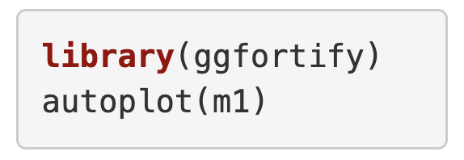
ggforitfy and autoplot
The function autoplot from the ggfortify package can be used to create plots to check if the assumptions of linear regression are met

Slide 28
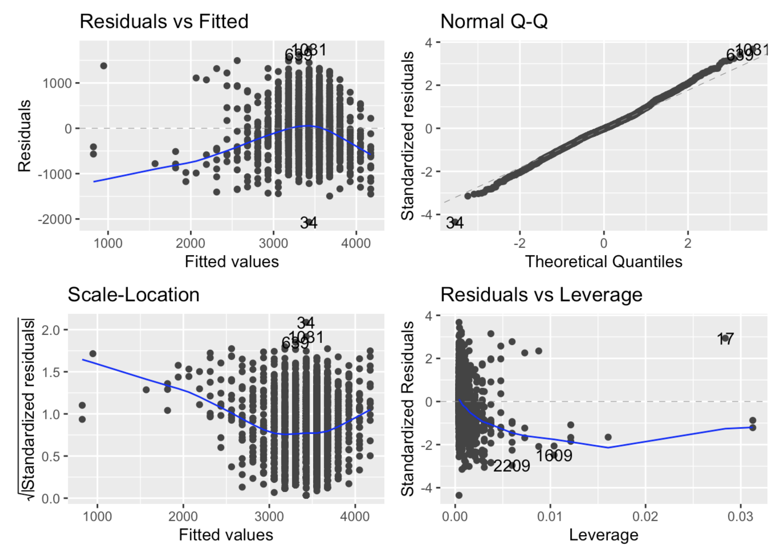
ggforitfy and autoplot
The function autoplot from the ggfortify package can be used to create plots to check if the assumptions of linear regression are met
Four plots are created, we will use 3 of those plots

Slide 29
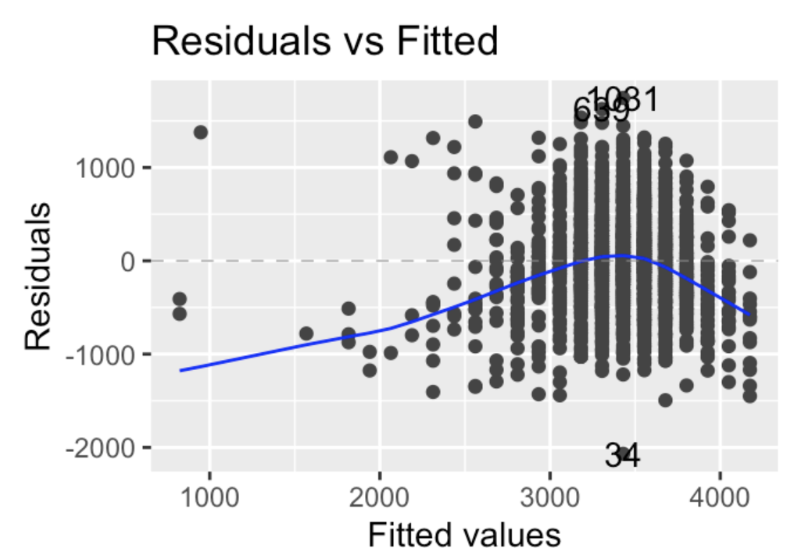
Linearity
A plot of the residuals (difference between the actual values and the values predicted with the regression line) versus the fitted values is used to check linearity.
A horizontal line, without distinct patterns is an indication for a linear relationship

Slide 30
Linearity
The linearity assumption is violated in our dataset
Due to the relatively small amount of data with lower values of gestational age
A potential solution would be to transform the exposure variable (log, square root, etc.)
Notes:
Turns out this doesn’t really help us with this dataset.

Slide 31
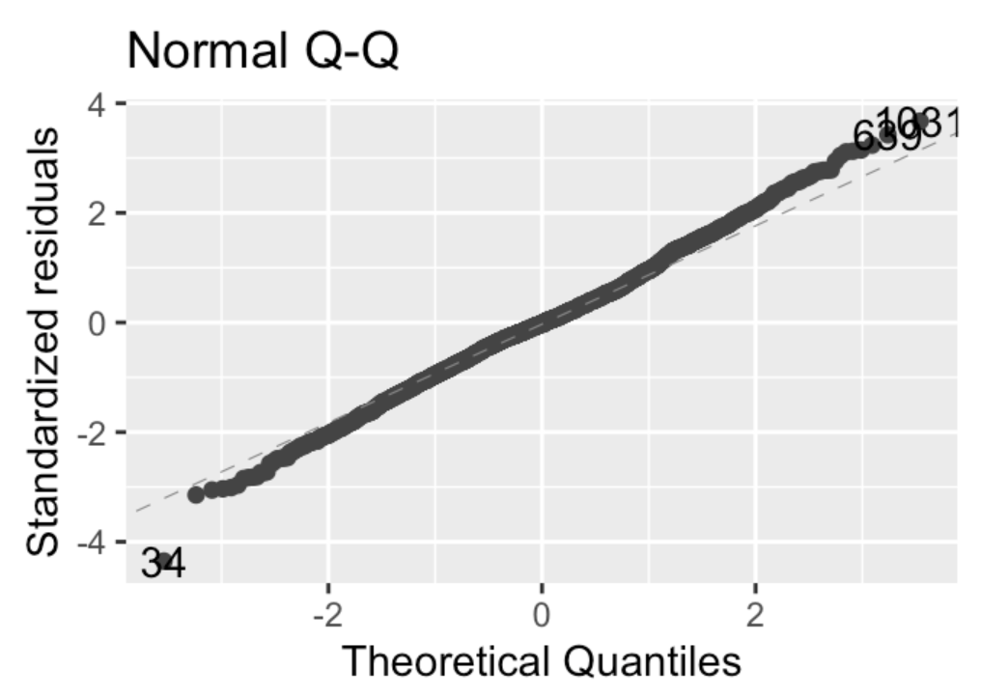
Normality
A quantile-quantile plot (Normal Q-Q plot) is used to check the normality assumption.
The normality assumption is met if the standardized residuals follow the straight dashed line

Slide 32
Normality
Looking at the plot, it’s difficult to be sure the normality assumption is met.
Can use the Shapiro-Wilk test to test the normality assumption

Slide 33
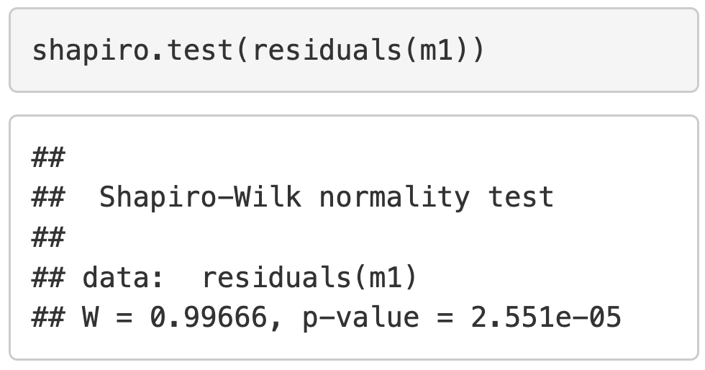
Normality
The normality assumption is not met in the dataset since the p-value is < 0.05.
A few potential solutions include
Applying data transformations to the exposure variable
Using robust regression methods that are less sensitive to non-normal data or outliers
Remove outliers

Slide 34
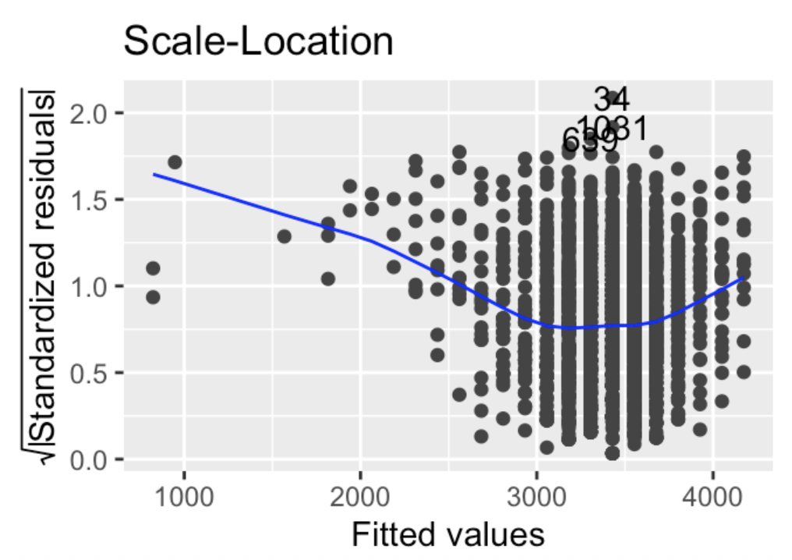
Homoscedasticity
A plot of the square root of the standardized residuals versus the fitted values is used to check the homoscedasticity assumption.
Called a scale-location or spread-location plot
A horizontal line with equally spread points is a good indication of homoscedasticity.

Slide 35
Homoscedasticity
The homoscedasticity assumption is violated in our dataset.
Due to the relatively small amount of data with lower values of gestational age
A potential solution would be to transform the outcome variable (log, square root, etc.)

Slide 36
Independence
The only way to check the independence assumption is having knowledge of the study / sampling design.
Contact those responsible for data collection
Read study documentation
Create a subset of the original dataset that only includes independent pairs of observations
The independence assumption holds for this dataset.

Slide 37
Summary
The assumptions of linear regression should be checked before choosing and interpreting a final model
The linearity assumption can be checked with a plot of the residuals versus the fitted values
The normality assumption can be checked with a Normal Q-Q plot or Shapiro-Wilk test
The homoscedasticity assumption can be checked with a plot of the square root of the standardized residuals versus the fitted values
The independence assumption can only be checked by verifying the study / sampling design for data collection

Slide 38
Linear Regression II
Multivariate linear regression
Heather Mattie, PhD

Slide 39
Multivariate linear regression
Multivariate linear regression can be used to explore more complex relationships involving a continuous outcome and two or more explanatory variables.
Regression line equation:
μ_{y|x} = β₀+ β₁x₁ + β₂x₂ + … + β_{q}x_{q}

Slide 40
Assumptions
Linearity:
  The relationship between μ_{y|x} (mean of y given x₁, x_{2, …,} x_{q}) and x is linear
Normality:
  For a fixed set of values for x₁, x_{2, …,} x_{q,} y is normally distributed
Homoscedasticity:
  The standard deviation σ_{y|x} is constant across all values of the explanatory variables
Independence:
  The observations are independent

Slide 41
Example: Prenatal care

Slide 42
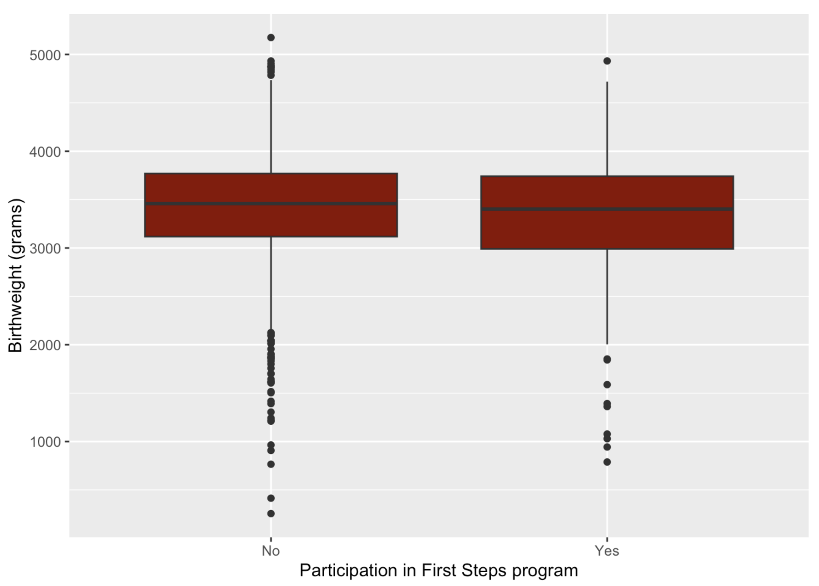
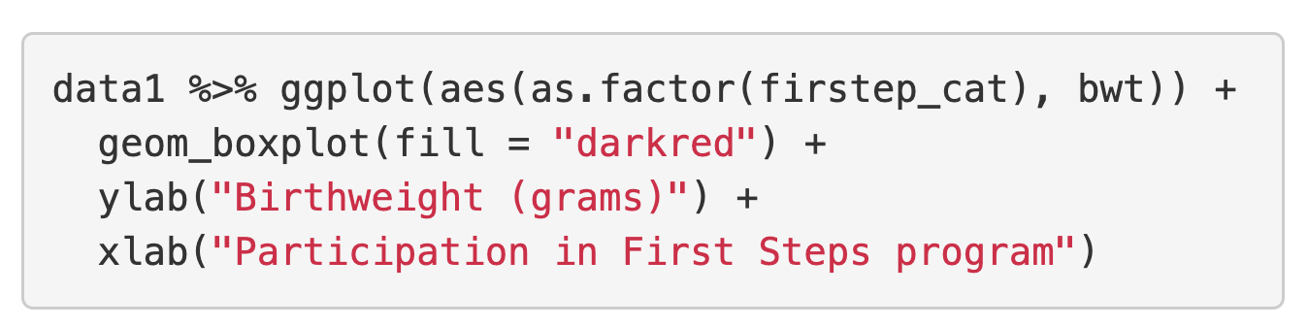
Example: Prenatal care
Suppose the outcome is birthweight in grams and the exposure is participation in the First Steps program.

Slide 43
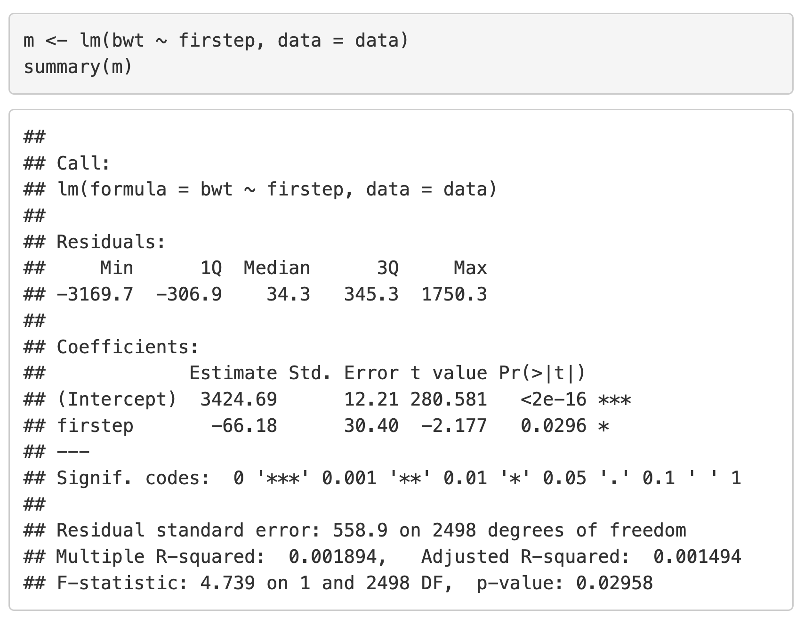
Crude model
A linear regression model with one explanatory variable (exposure) of interest is called a crude model.
No other covariates have been “adjusted” for, meaning no other covariates have been added to the model yet

Slide 44
Crude model
Mean bwt = -66.18(firstep = 1) + 3424.69
firstep is called an indicator variable
Interpretation:
Infants of participants in the First Steps program weighed, on average, 66.18 grams less at birth.
Mean bwt for program participants: 3358.51
Mean bwt for non-participants: 3424.69

Slide 45
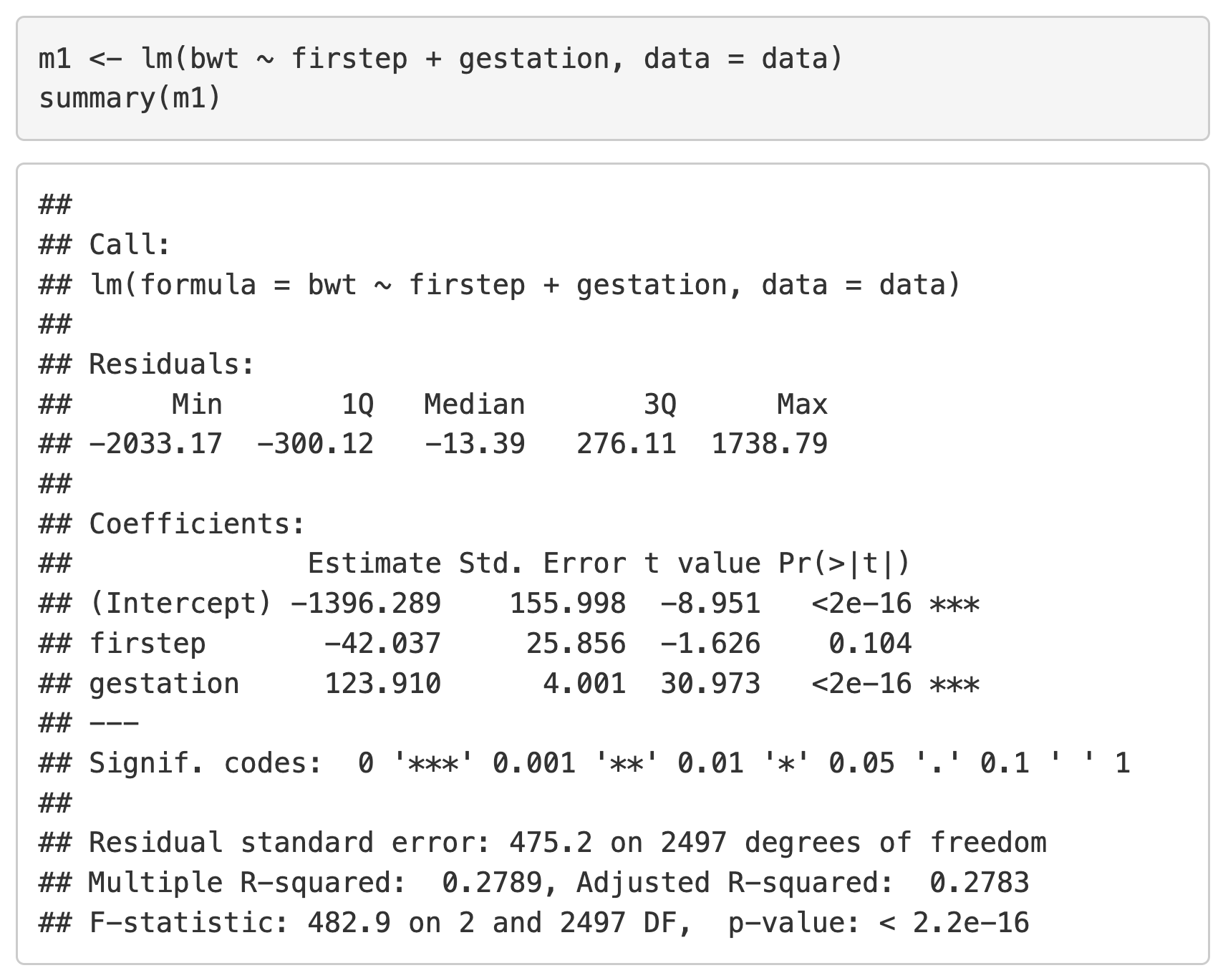
Adjusted model
When other covariates are added to the crude model, the model becomes an “adjusted model”.
Interpretations of coefficients change slightly

Slide 46
Adjusted model
Interpretations:
Infants of participants in the First Steps program weighed, on average, 42.037 grams less at birth, adjusting for gestational age.
For every 1 week increase in gestation, birthweight increases by 123.91 grams on average, holding all other covariates constant.

Slide 47
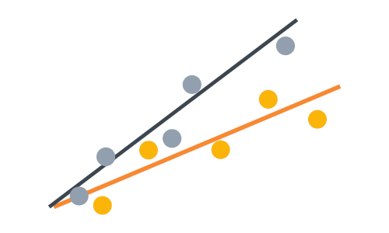
Interaction term
Suppose we wanted to test if the relationship between birthweight and gestational age is different for infants whose mothers participated in the First Steps program and those whose mothers did not participate
This is testing effect measure modification
Create an interaction term to test this

Slide 48
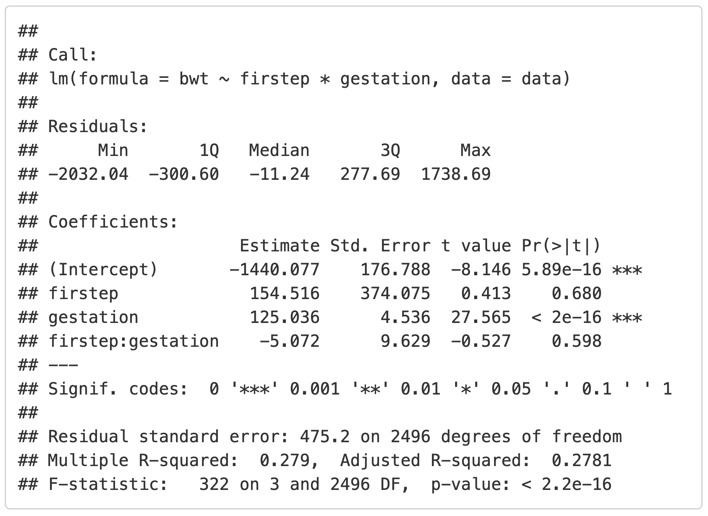
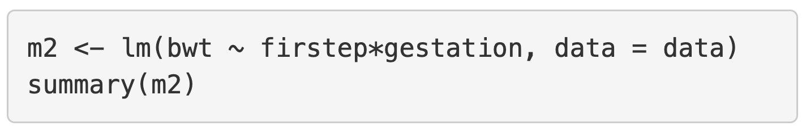
Interaction term
In R, the syntax
covariate₁ * covariate₂
fits a model with terms covariate₁, covariate₂, and covariate₁ * covariate₂ in it.

Slide 49
Interaction term
The p-value for the interaction term is not <0.05, so it should not be kept in the model.
No evidence of effect measure modification

Slide 50
Summary
A linear regression model with two or more explanatory variables is multivariate linear regression.
Multivariate linear regression can be used to evaluate more complex relationships involving an outcome and explanatory variables.
An interaction term is used to test if a covariate is an effect measure modifier.

Slide 51
Linear Regression II
Collinearity
Heather Mattie, PhD

Slide 52
Collinearity
Collinearity occurs when independent variables are highly correlated.
Difficult for the model to estimate individual effects on the outcome variable
Inflates variance of the regression coefficients leading to unstable estimates and wider CIs
Often, a decision about which to include in the final model is needed

Slide 53
Example: Prenatal care

Slide 54
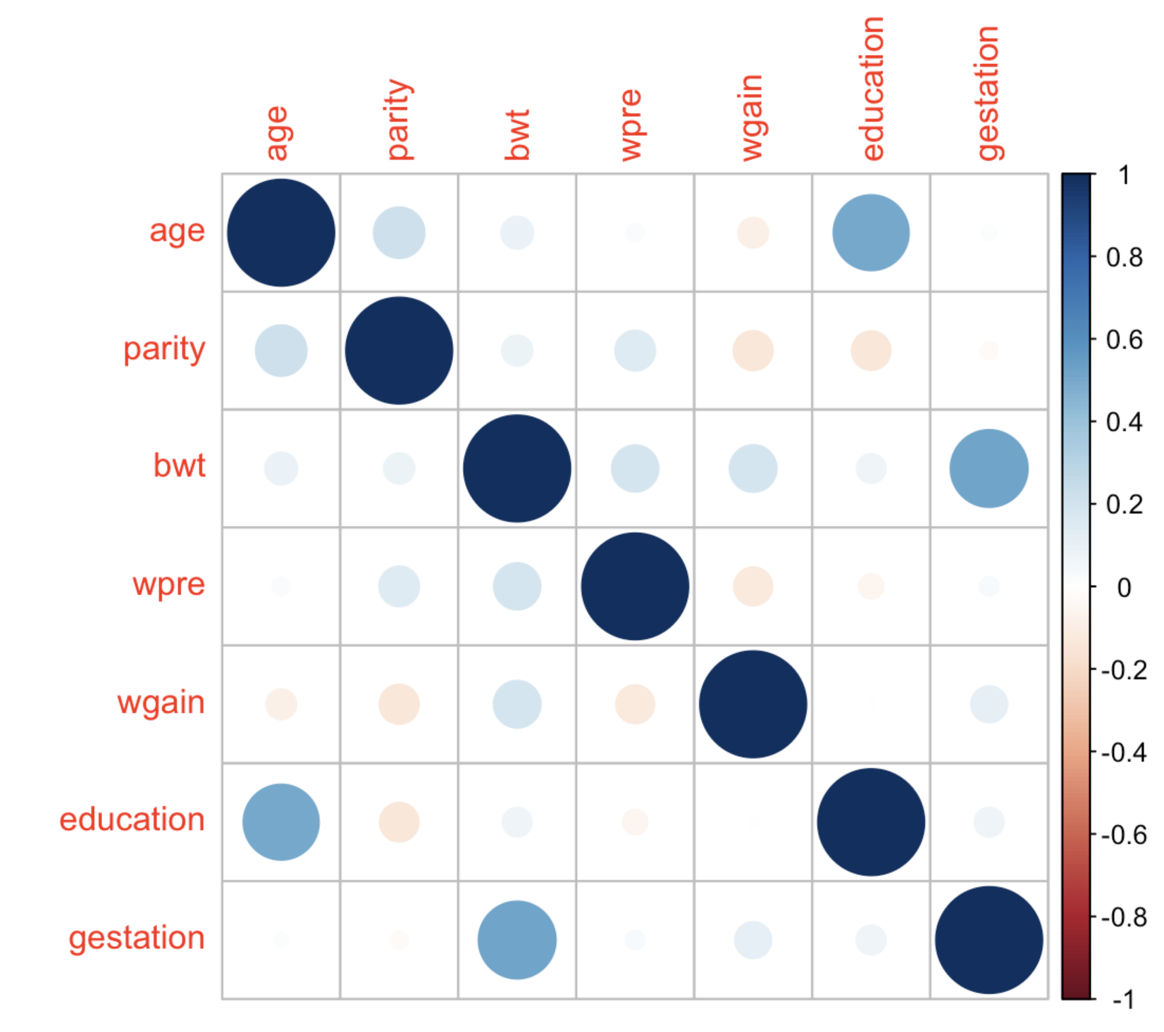
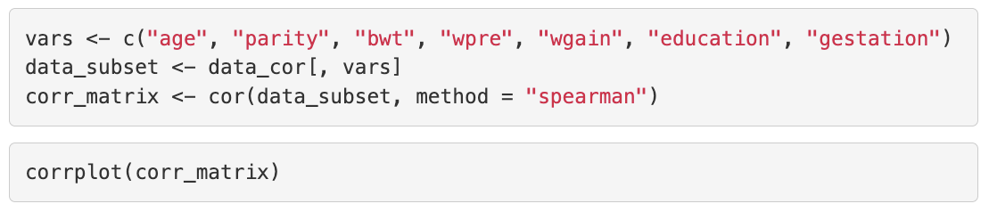
Correlation matrix
Collinearity is usually checked with a correlation matrix.
Only for continuous covariates
Can use Pearson or Spearman

Slide 55
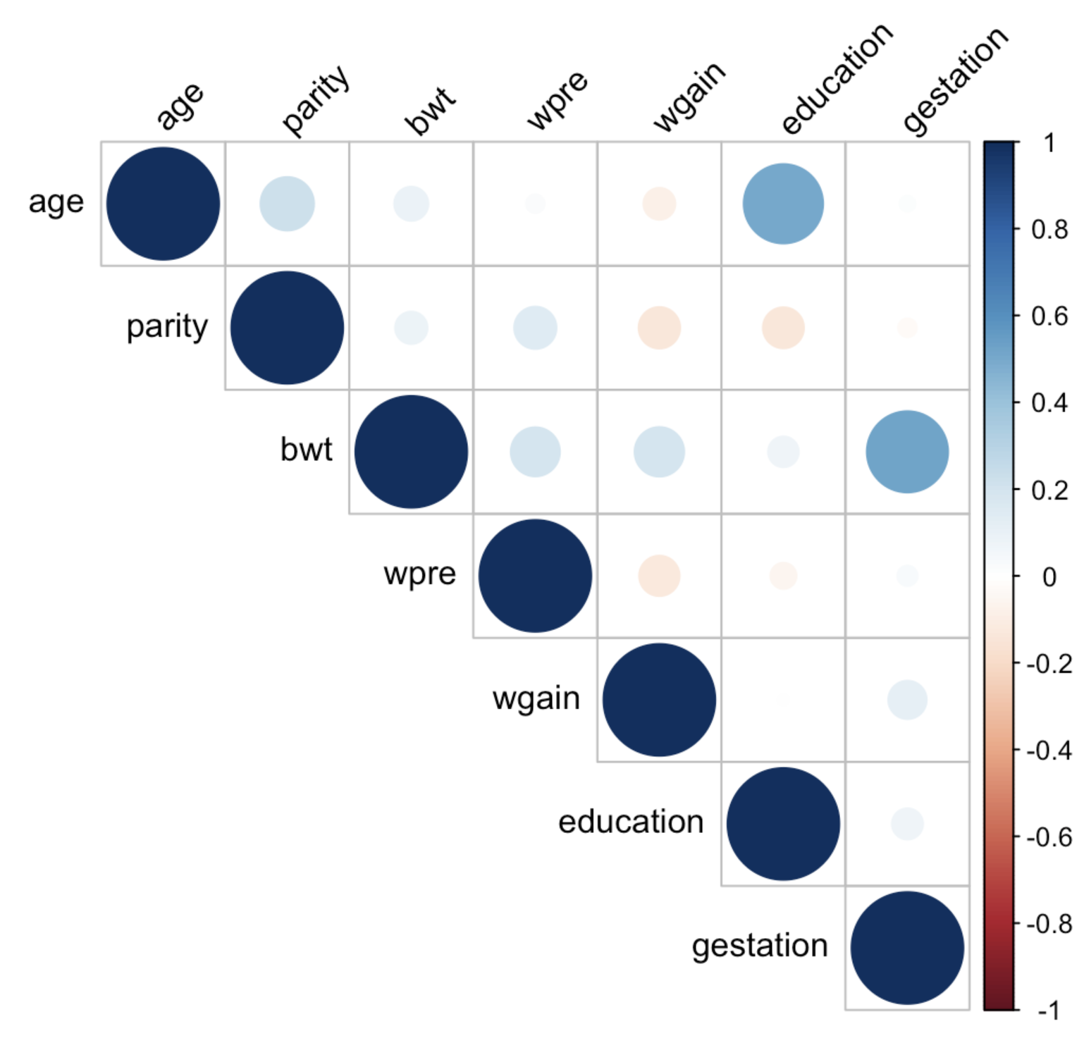
Correlation matrix
Collinearity is usually checked with a correlation matrix.
Only for continuous covariates
Can use Pearson or Spearman

Slide 56
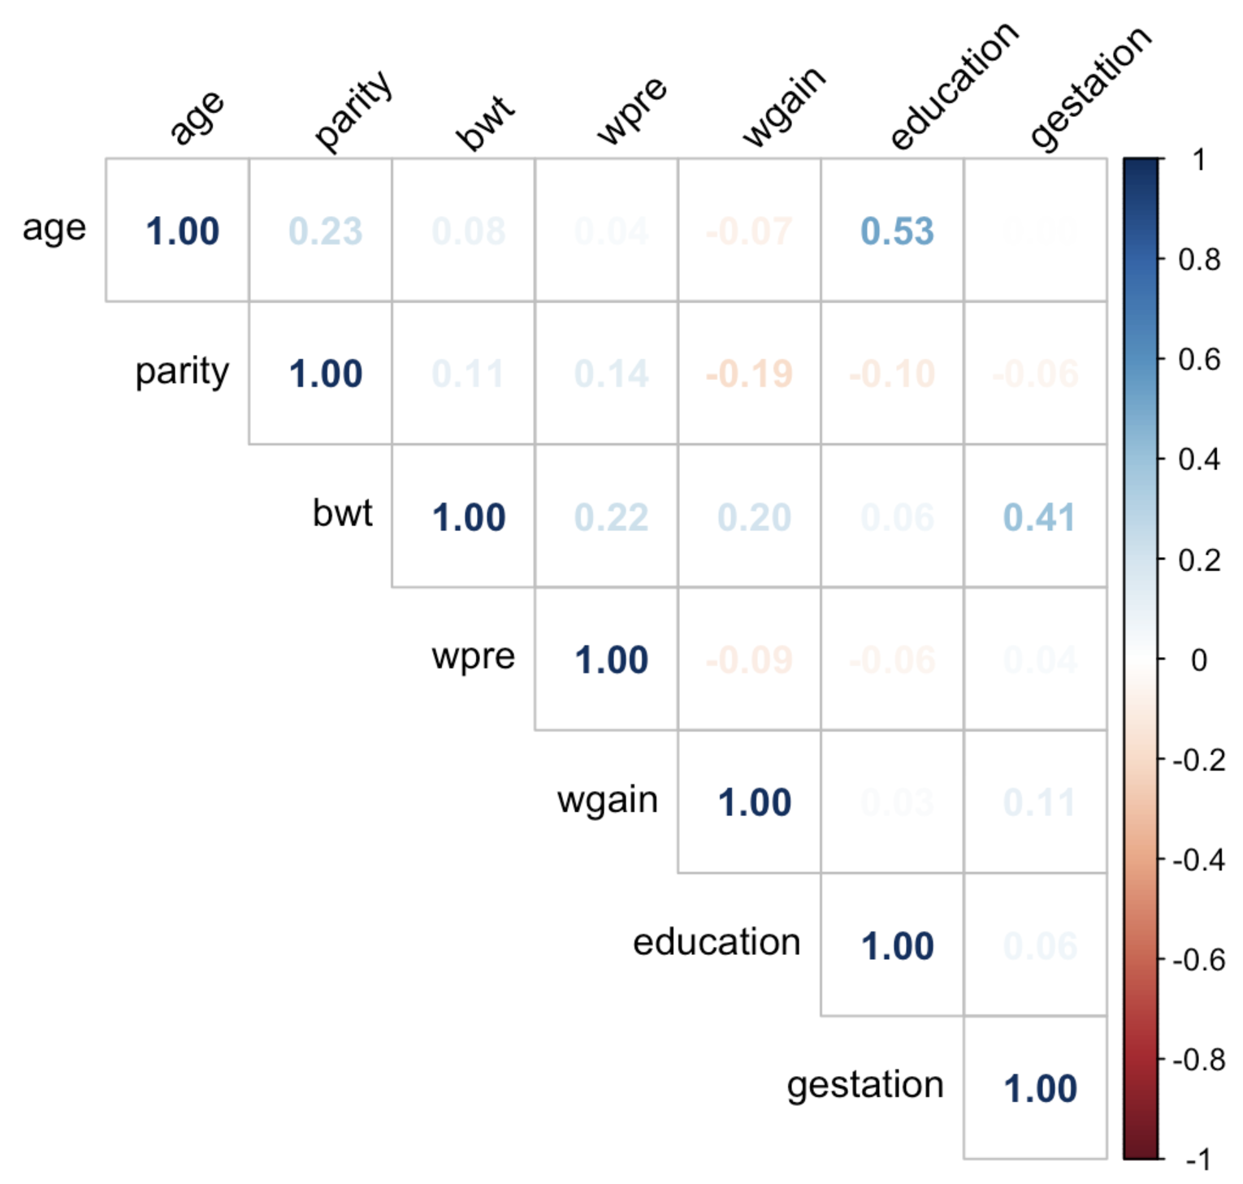
Correlation matrix
Collinearity is usually checked with a correlation matrix.
Only for continuous covariates
Can use Pearson or Spearman

Slide 57
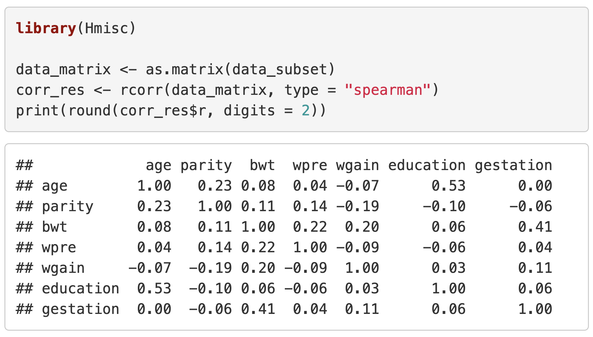
Correlation matrix
Collinearity is usually checked with a correlation matrix.
Only for continuous covariates
Can use Pearson or Spearman

Slide 58
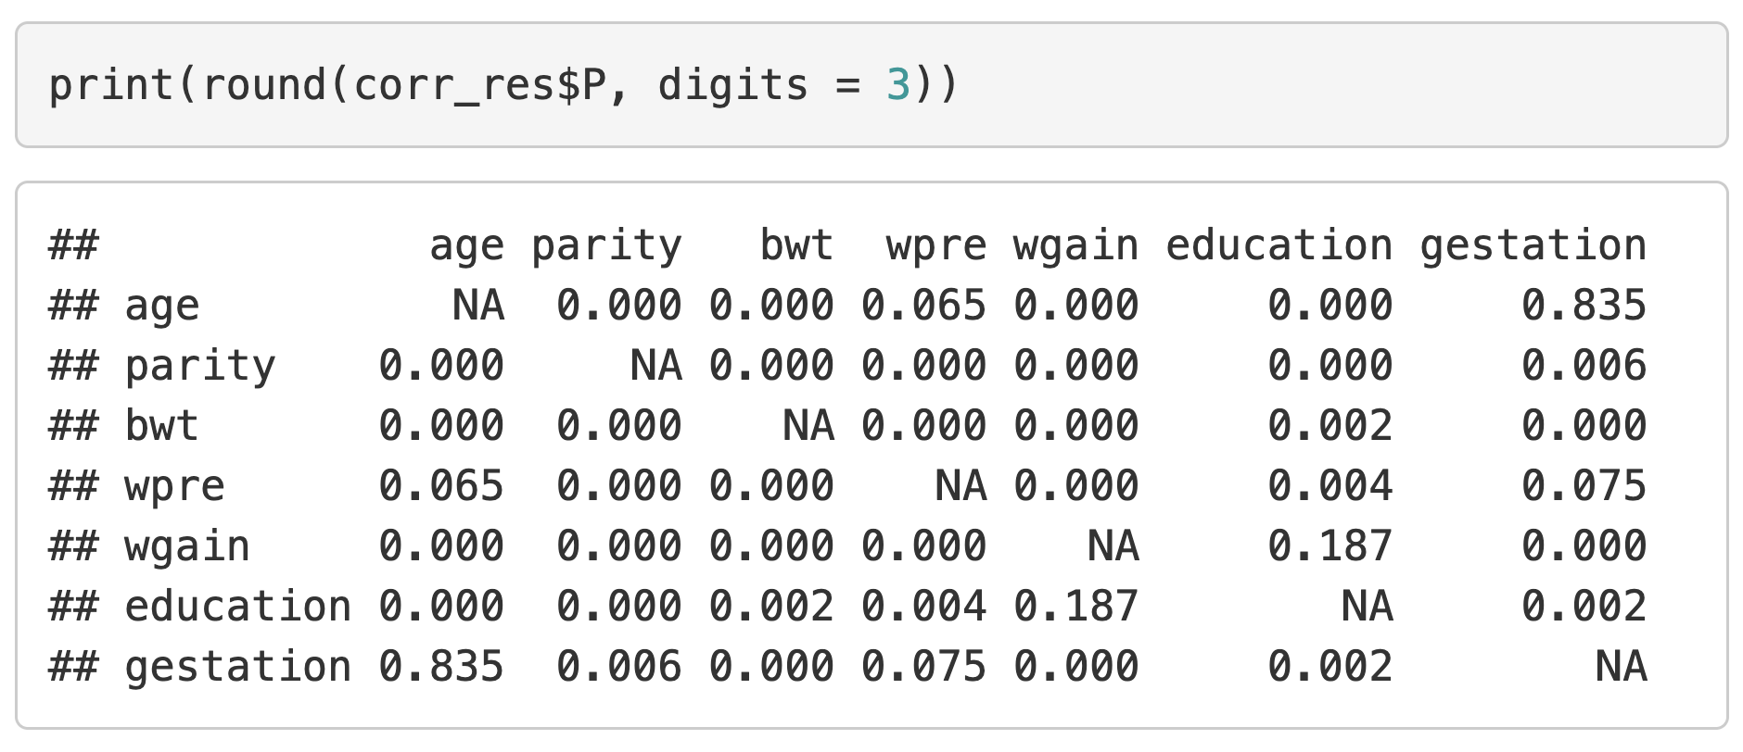
Correlation tests
The correlation value often isn’t enough and a test for each pair of covariates should be performed to see which correlations are significant.

Slide 59
Correlation tests
The correlation value often isn’t enough and a test for each pair of covariates should be performed to see which correlations are significant.
The boxed values show non-significant p-values (variables are not collinear)

Slide 60
Summary
Collinearity of explanatory variables must be checked before deciding on a final multivariate linear regression model to ensure none of the explanatory variables are highly correlated.
A correlation matrix can be created using the corrplot function.
A matrix of p-values from correlation tests can be created using the rcorr function from the Hmisc package.

Slide 61
Linear Regression II
Model selection
Heather Mattie, PhD

Slide 62

Model selection
Model selection is the process of identifying the best set of covariates for a model.
Depends on the type of model
Prediction models should be parsimonious
Causal models should control for known confounders and effect measure modification

Slide 63
Example: Prenatal care

Slide 64
Prediction models
Prediction models are used to make future predictions of the outcome from a set of values from the explanatory variables.
Only include explanatory variables that help predict or explain the variability in the outcome y
This is called a parsimonious model
Stepwise selection is often used for model selection
Variables are added or removed until the best performing model is found

Slide 65
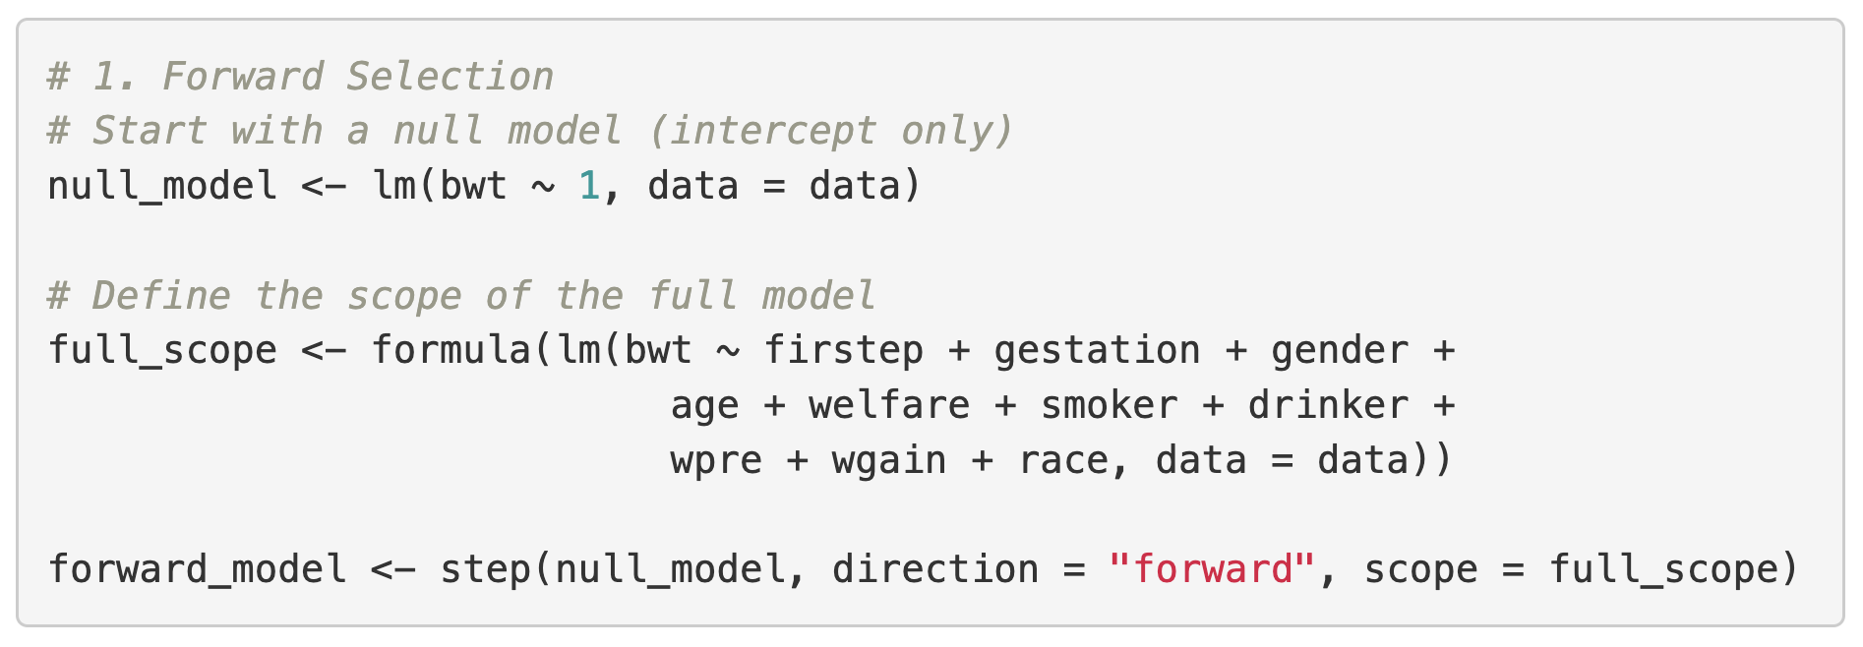
Forward selection
Forward selection starts with an empty model (containing only the intercept).
Adds variables one by one, selecting the variable that provides the most significant improvement in model fit at each step
Continues until adding no further variables significantly improves the model

Slide 66
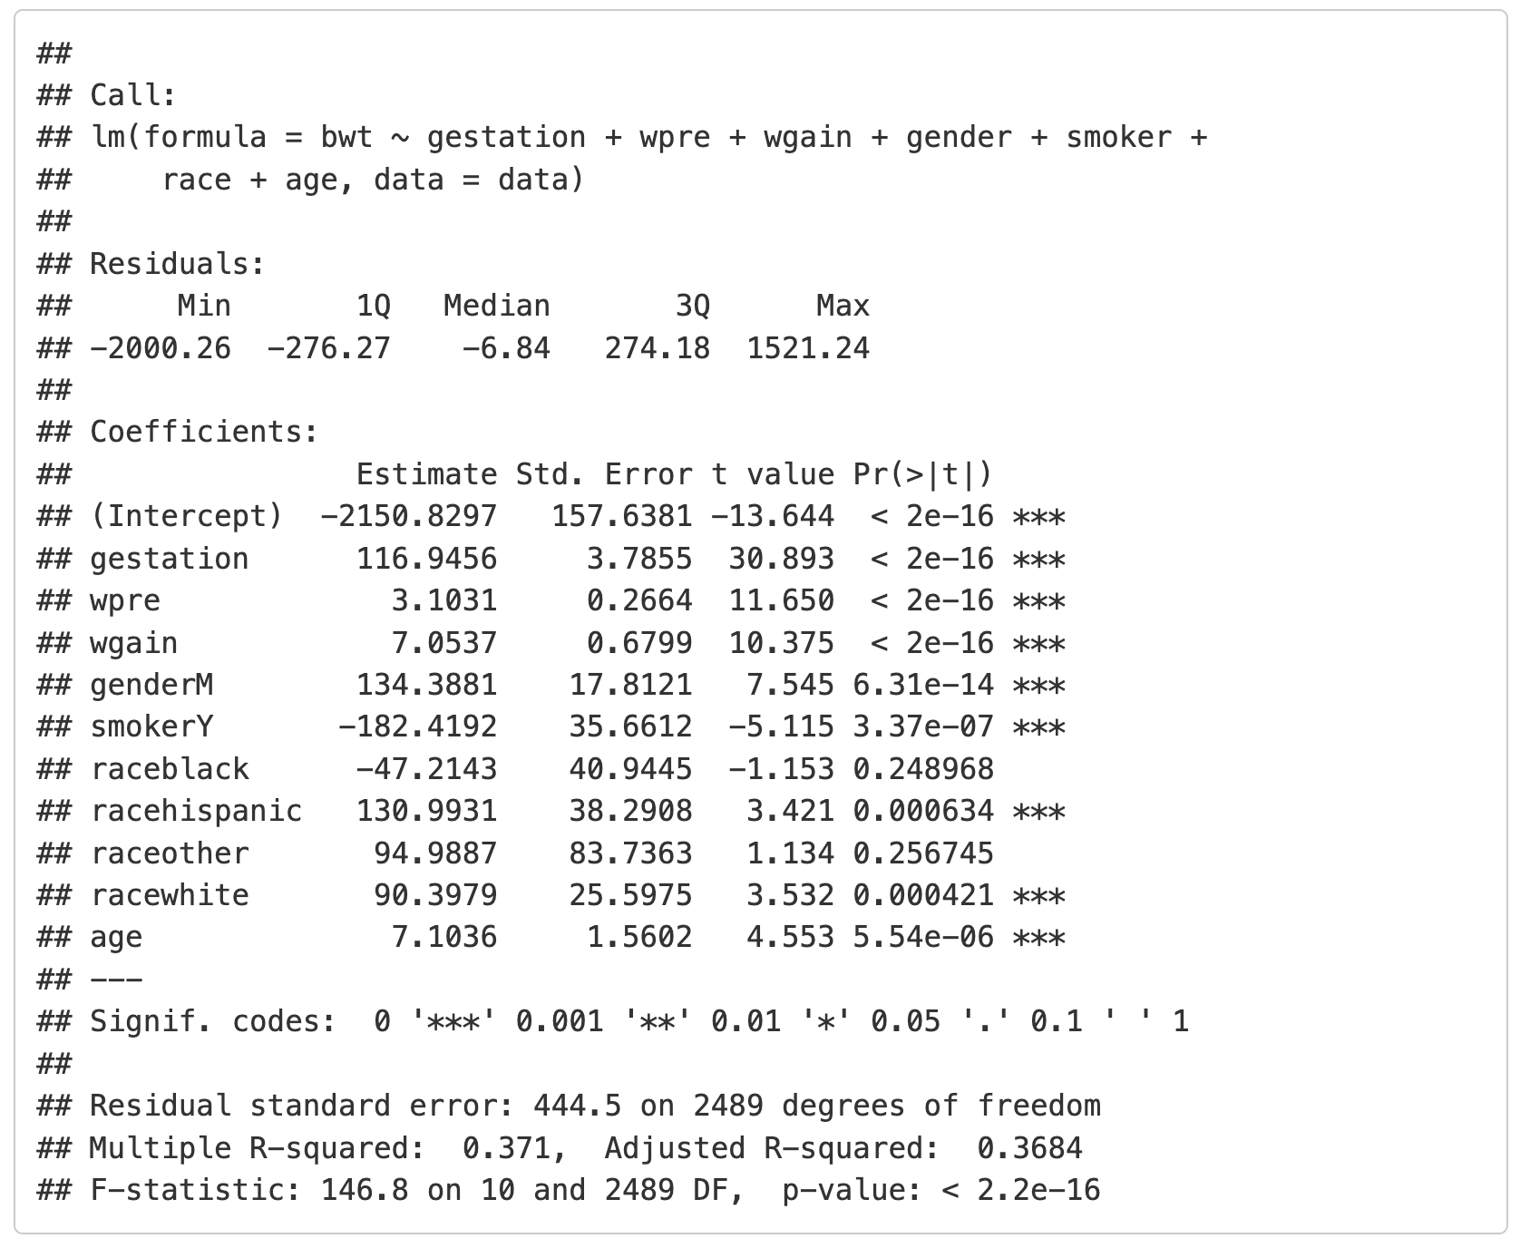
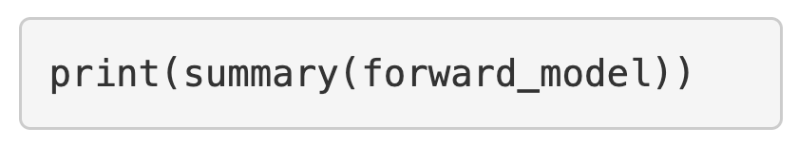
Forward selection
Output will show iterations
Use the summary function to display the final model
In this case the final model included gestation, wpre, wgain, gender, smoker, race, and age

Slide 67
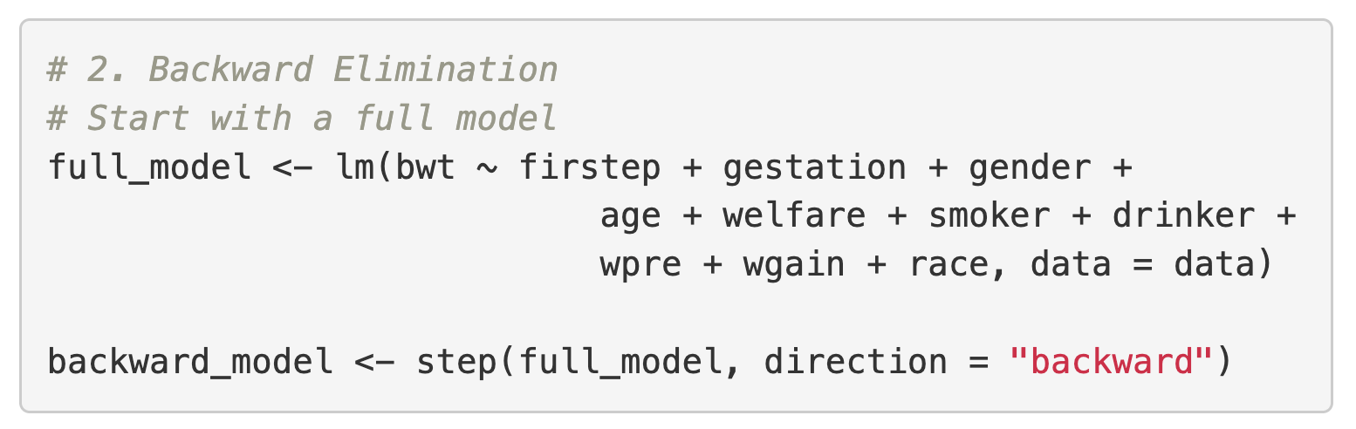
Backward elimination
Backward elimination starts with a full model.
Removes variables one by one, eliminating the variable that contributes the least to the model's fit
Continues until removing no further variables significantly improve the model or all remaining variables are deemed significant.

Slide 68
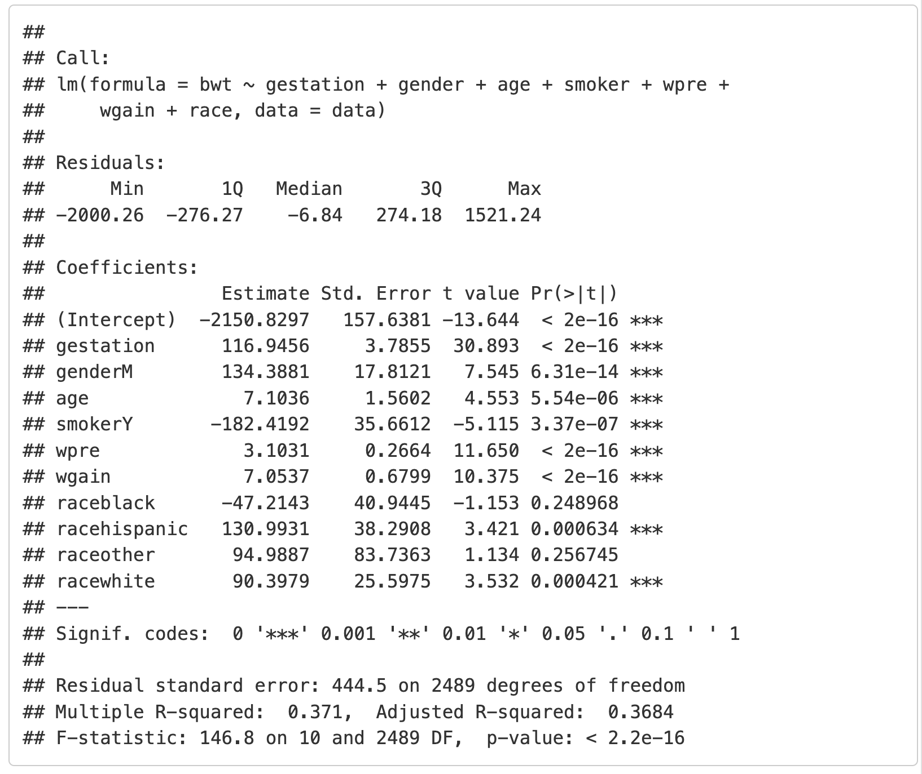
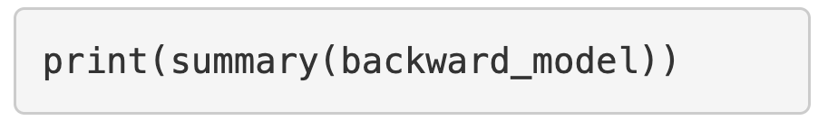
Backward elimination
Output will show iterations
Use the summary function to display the final model
In this case the final model included gestation, wpre, wgain, gender, smoker, race, and age

Slide 69
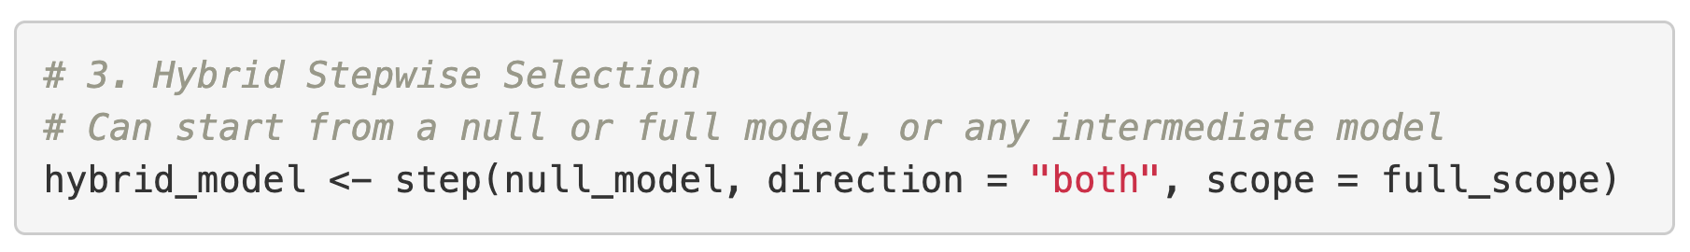
Hybrid (bidirectional) selection
Hybrid (bidirectional) selection combines both forward and backward movements at each step.
At each iteration, it considers adding a new variable (like forward selection) and removing an existing variable (like backward elimination)
It selects the action (add or remove) that results in the greatest improvement in model fit
This process continues until no further additions or removals improve the model

Slide 70
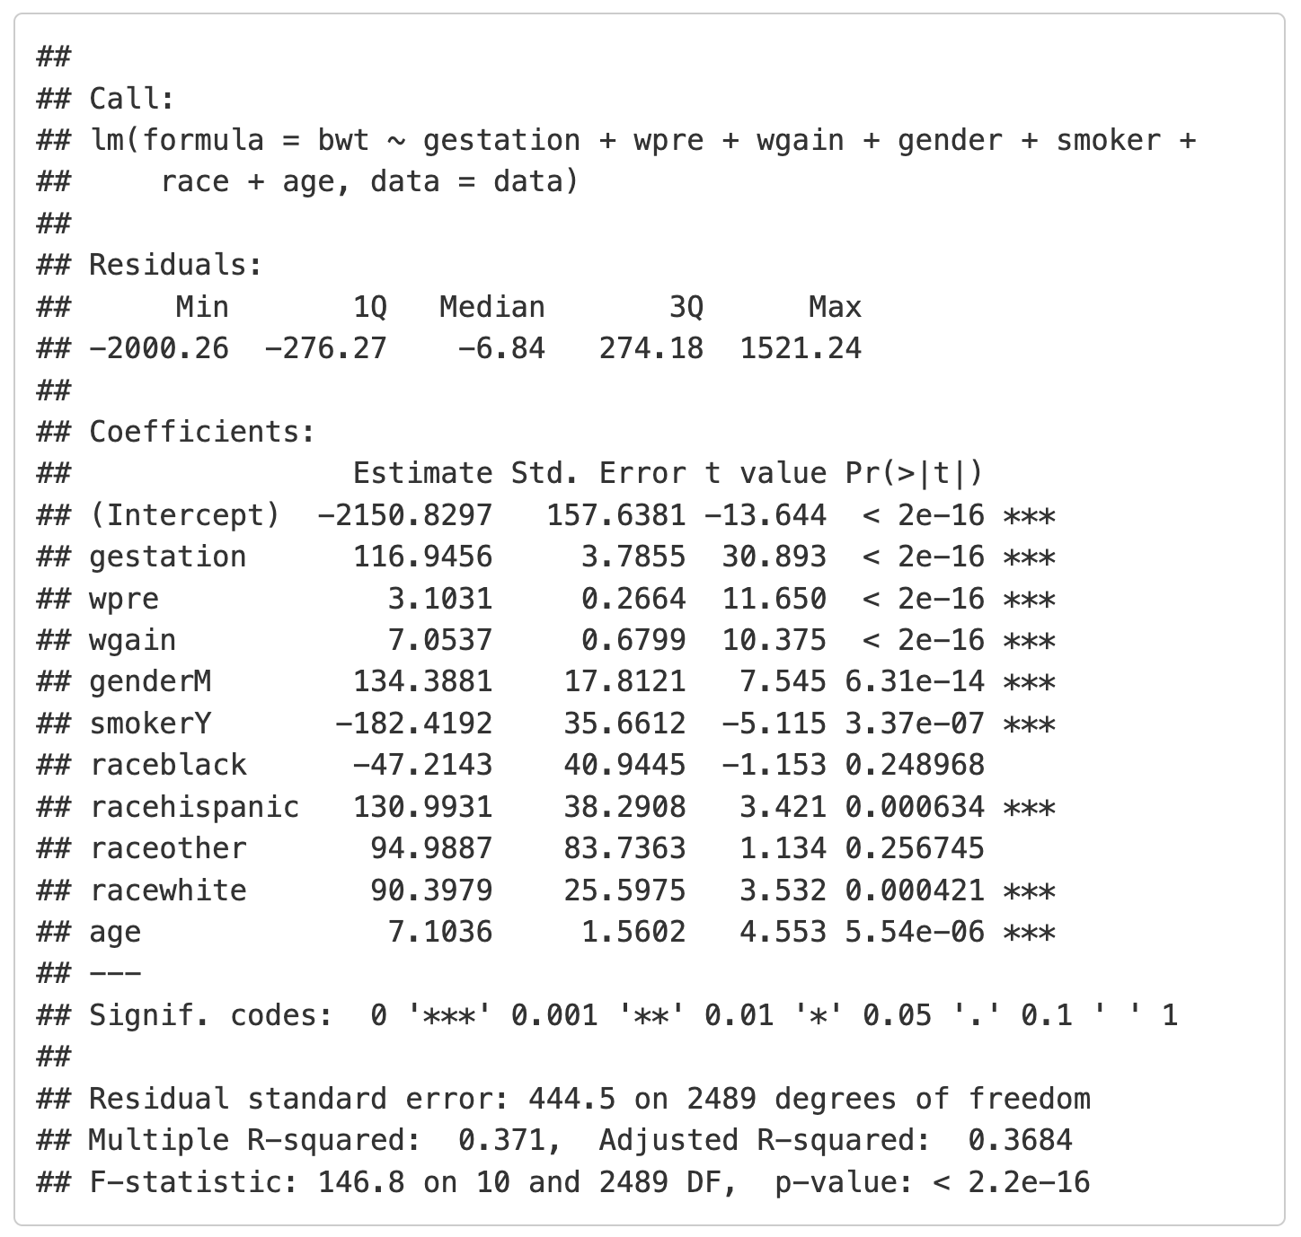
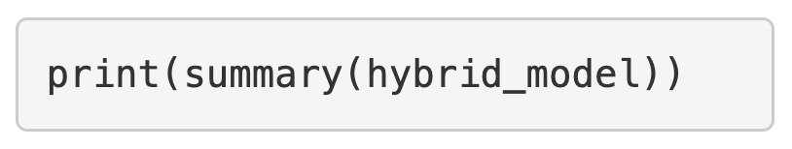
Hybrid (bidirectional) selection
Output will show iterations
Use the summary function to display the final model
In this case the final model included gestation, wpre, wgain, gender, smoker, race, and age

Slide 71
Causal models
Causal models estimate the effect of an exposure or intervention on an outcome, while accounting for confounding factors.
Control for confounding
Test and account for effect measure modification
Confounder
Exposure
Outcome
EMM
Exposure
Outcome

Slide 72
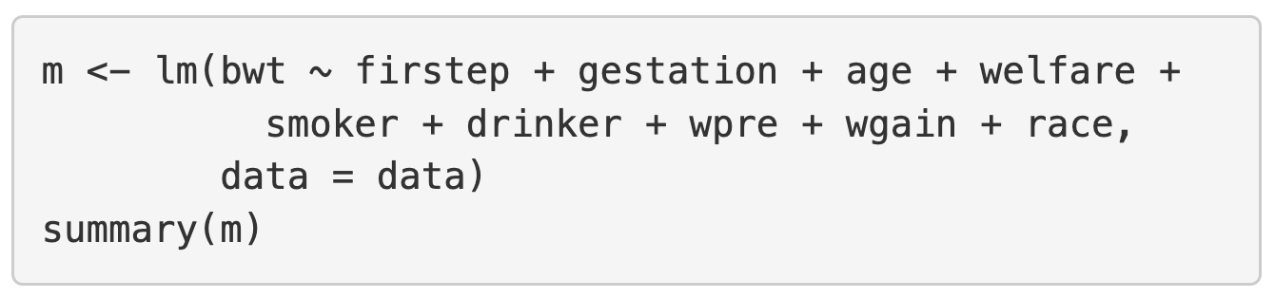
Causal model
Known confounders are retained in the model, whether statistically significant or not.
Effect measure modifiers are retained only if the interaction term is significant.

Slide 73
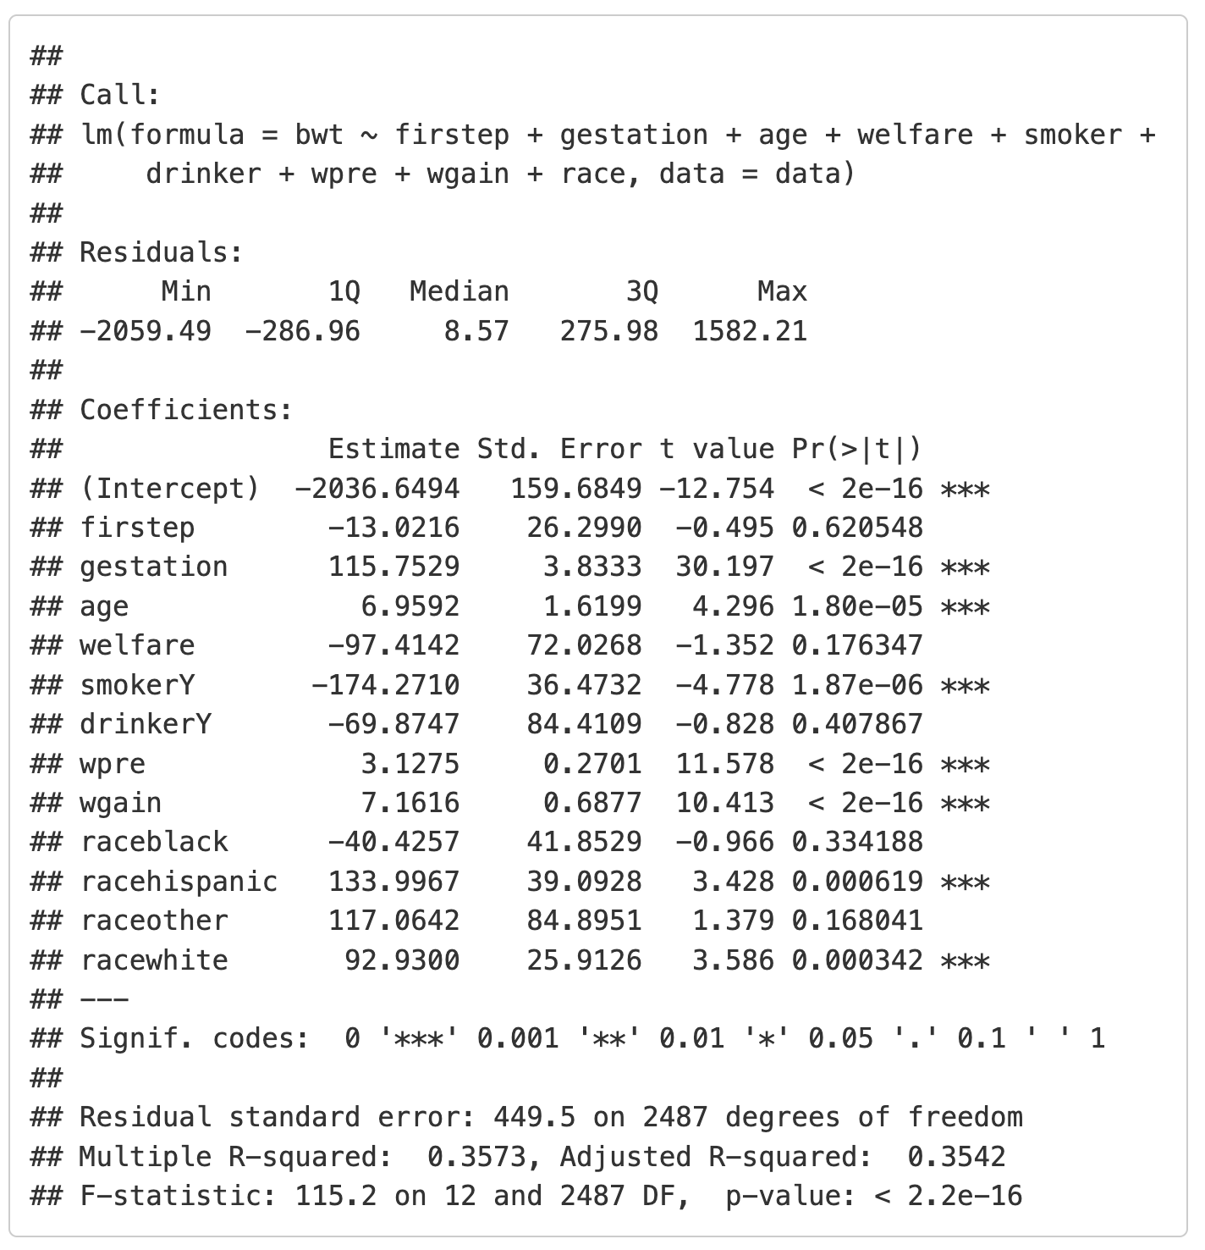
Causal model
Keep firstep because it is the exposure of interest
Keep all other covariates because they have been shown to be confounders in previous literature

Slide 74
Summary
Model selection depends on the purpose of the model.
When building a prediction model, the goal is to build a parsimonious model that includes explanatory variables that help predict the outcome.
When building a causal model, the goal is to build a model that focuses on the relationship between one exposure and outcome, and that adjusts for confounding and effect measure modification.

