Slide 1
Differential Analysis

Slide 2
Data analysis pipeline
Data used: 20201104-proteinGroups.txt ( 350198 bytes)
1. An intensity value is quantified if at least 1 unique peptides are identified. Raw intensities are logged (log2).
2. Reverse (potentially misidentified), Potential contaminants and Only identified by site proteins are deleted.
3. Filter 1 : only proteins with at least 6 quantified intensity values in a condition, and with a proportion of observed values superior to NA % in each condition, are kept. This filter is used to delete potentially misidentified proteins.
4. In each condition the intensity values are normalized. Within a same condition, they are centered on the mean of the medians of intensities in each sample of the condition.
5. Filter 2 : proteins absent in a condition and present in another are put aside. These proteins can directly be assumed differentially abundant between the conditions.
6. The remaining missing values of the dataset are imputed. The impute.mle function of the R package imp4p is used for this purpose.
7. Differential analysis is performed. First, a LIMMA t-test is used and the corresponding p-values are next adjusted using an adaptive Benjamini-Hochberg correction.
The FDR threshold is fixed to 0.01 and the proportion of differentially abundant proteins is estimated with the pounds method thanks to the R package cp4p. The proteins are considered significantly regulated if their adjusted p-value is below 0.01 and if their absolute log2(fold-change) is superior to 2 .

Slide 3
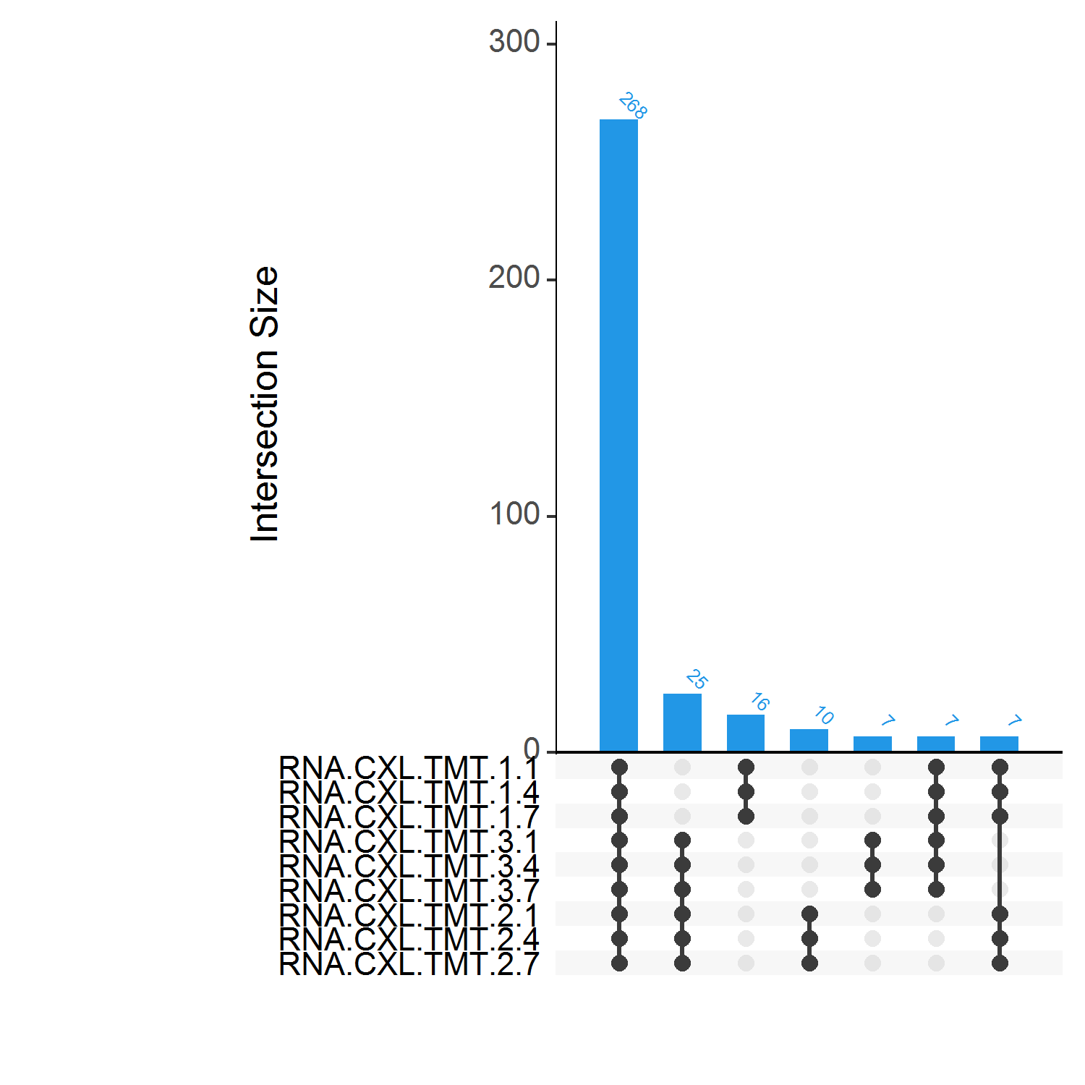
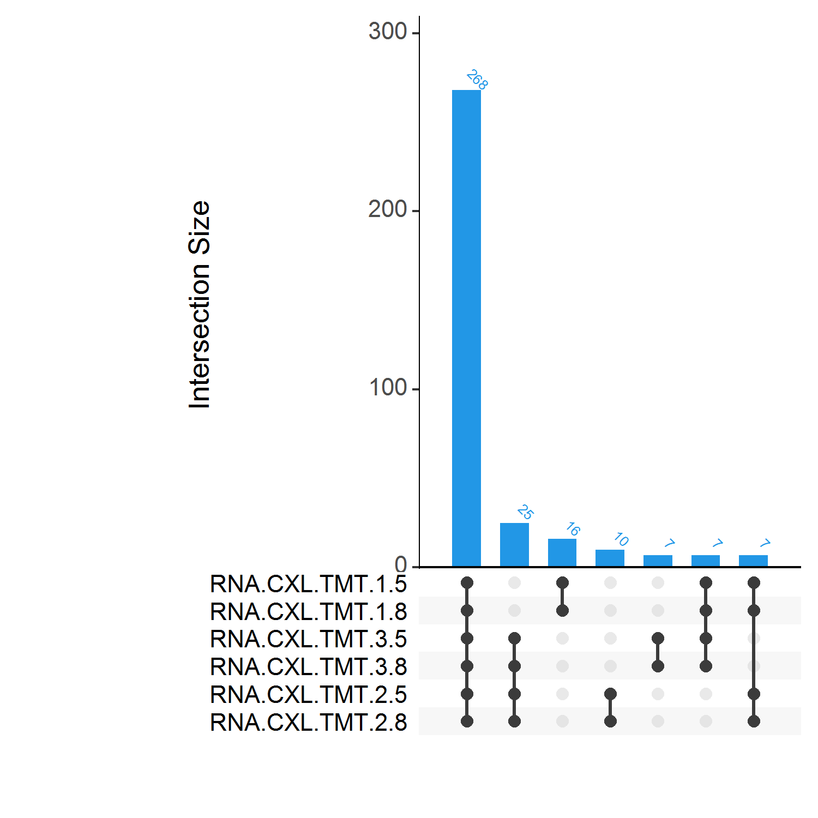
Number of identified proteins by replicates and conditions after deleting reverse, contaminants and only identified by site proteins

Slide 4
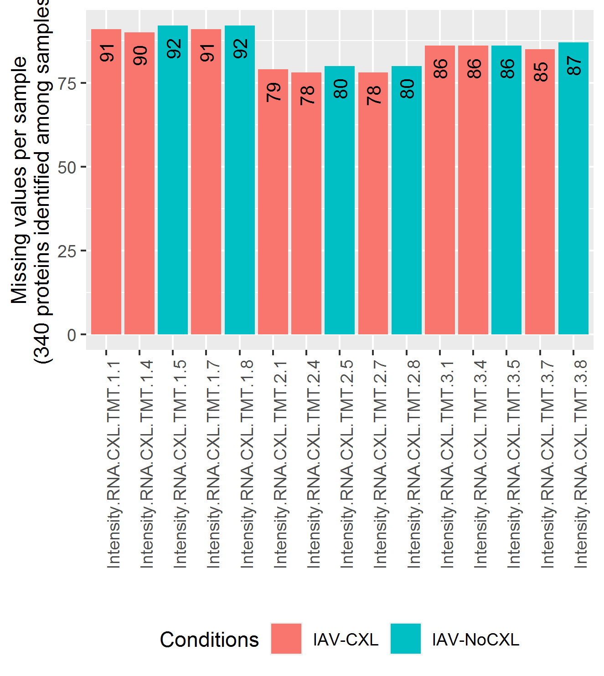
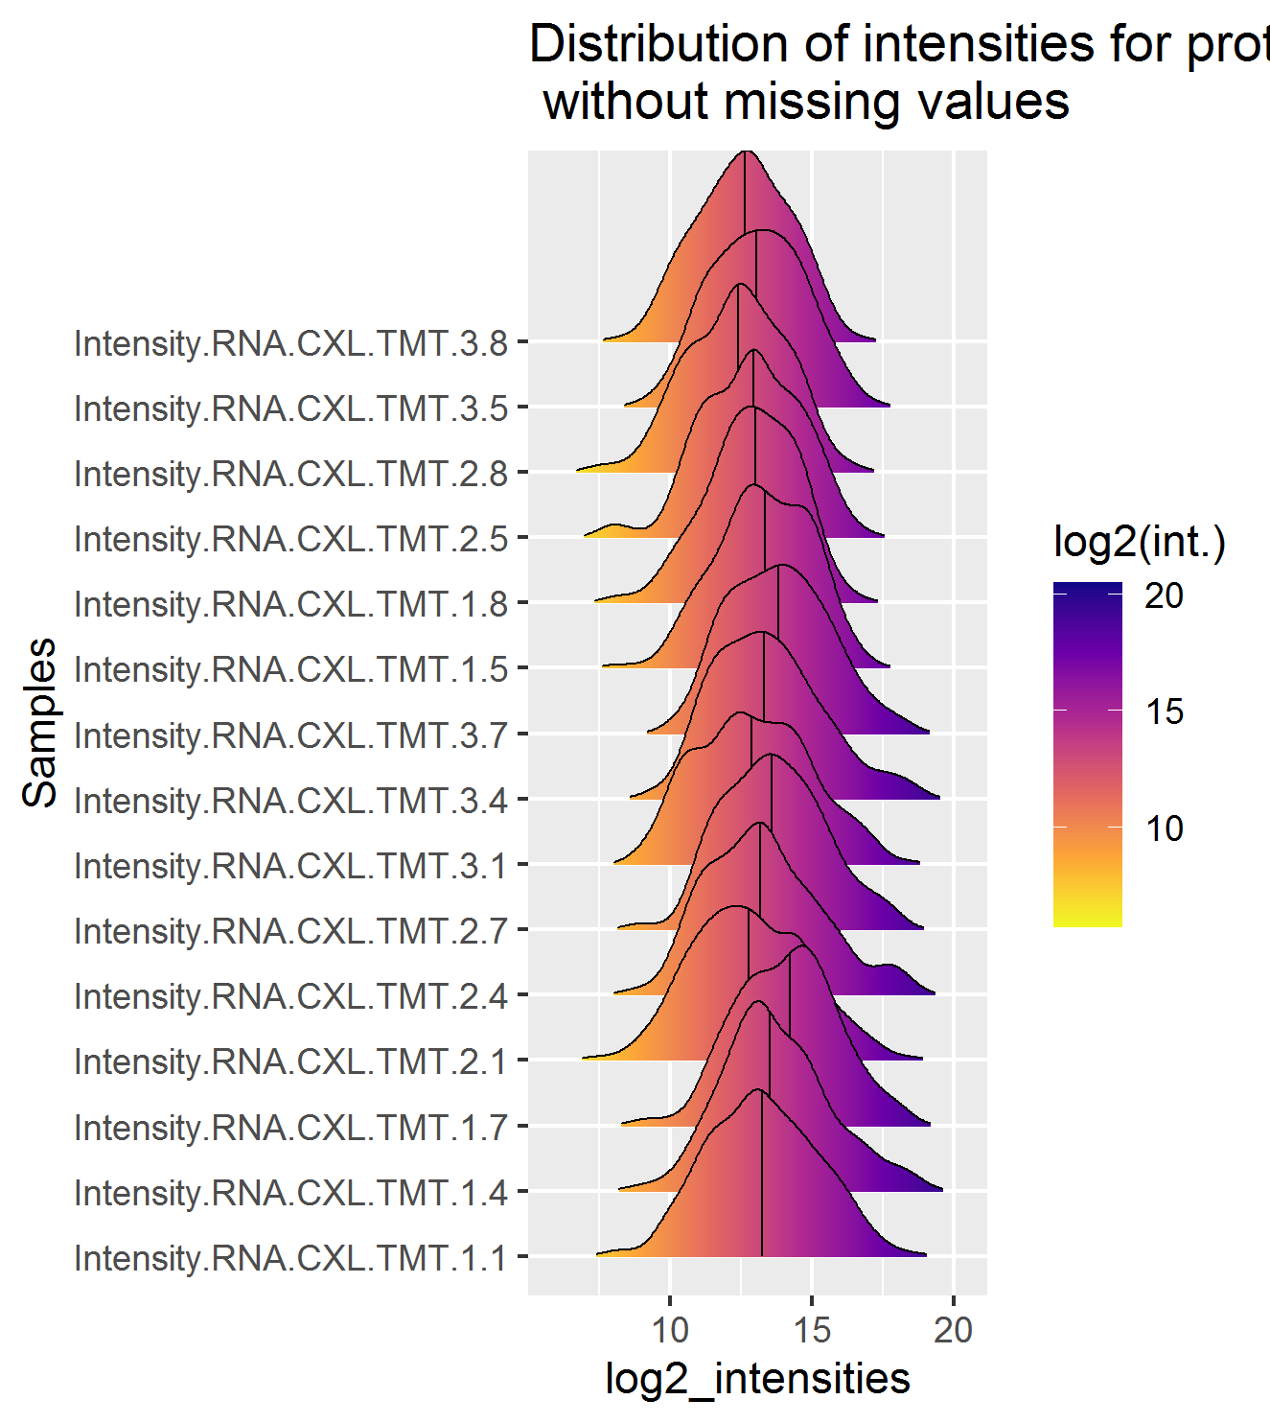
Missing values and distribution of quantified values by sample

Slide 5
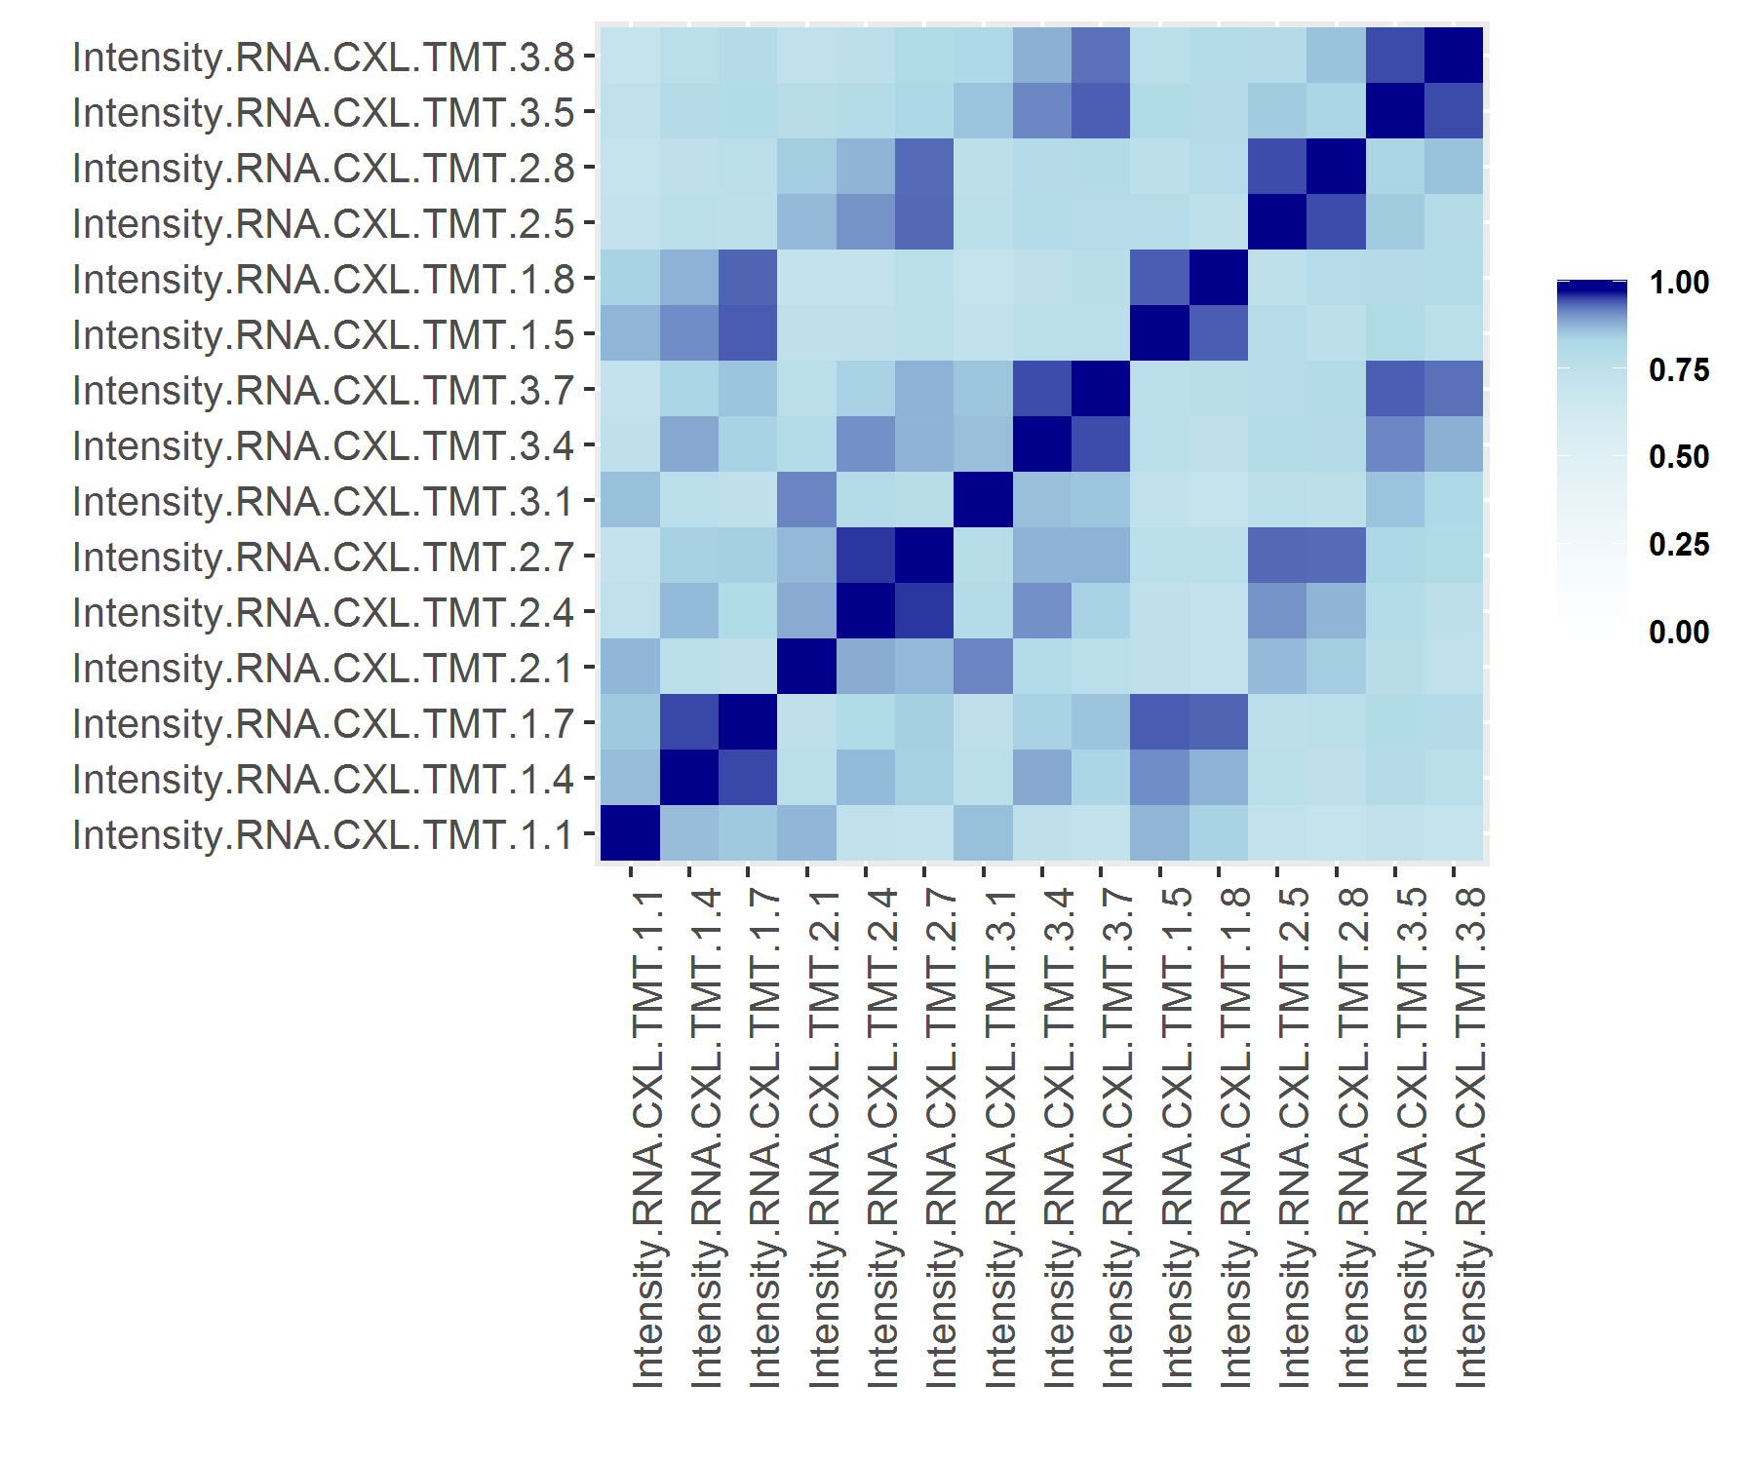
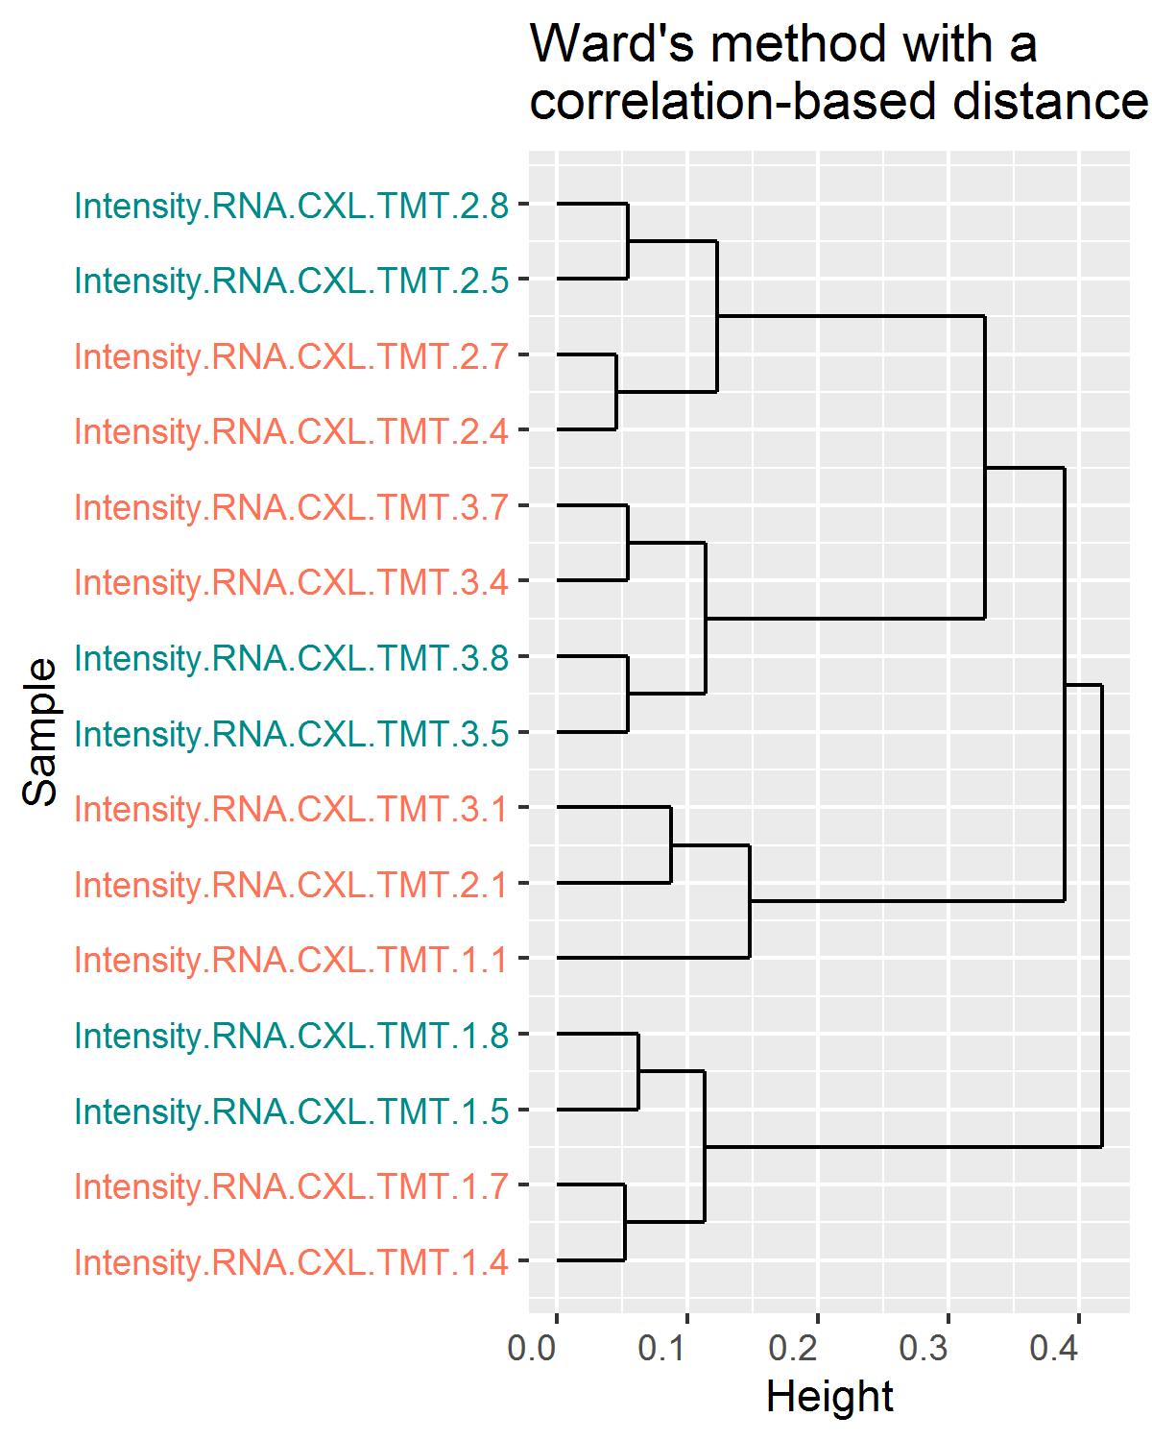
Clustering of samples using quantified values
Pearson correlation coefficient between each pair of samples is computed using all complete pairs of observations in these samples.
Min. corr. value = 0.709117996274401

Slide 6
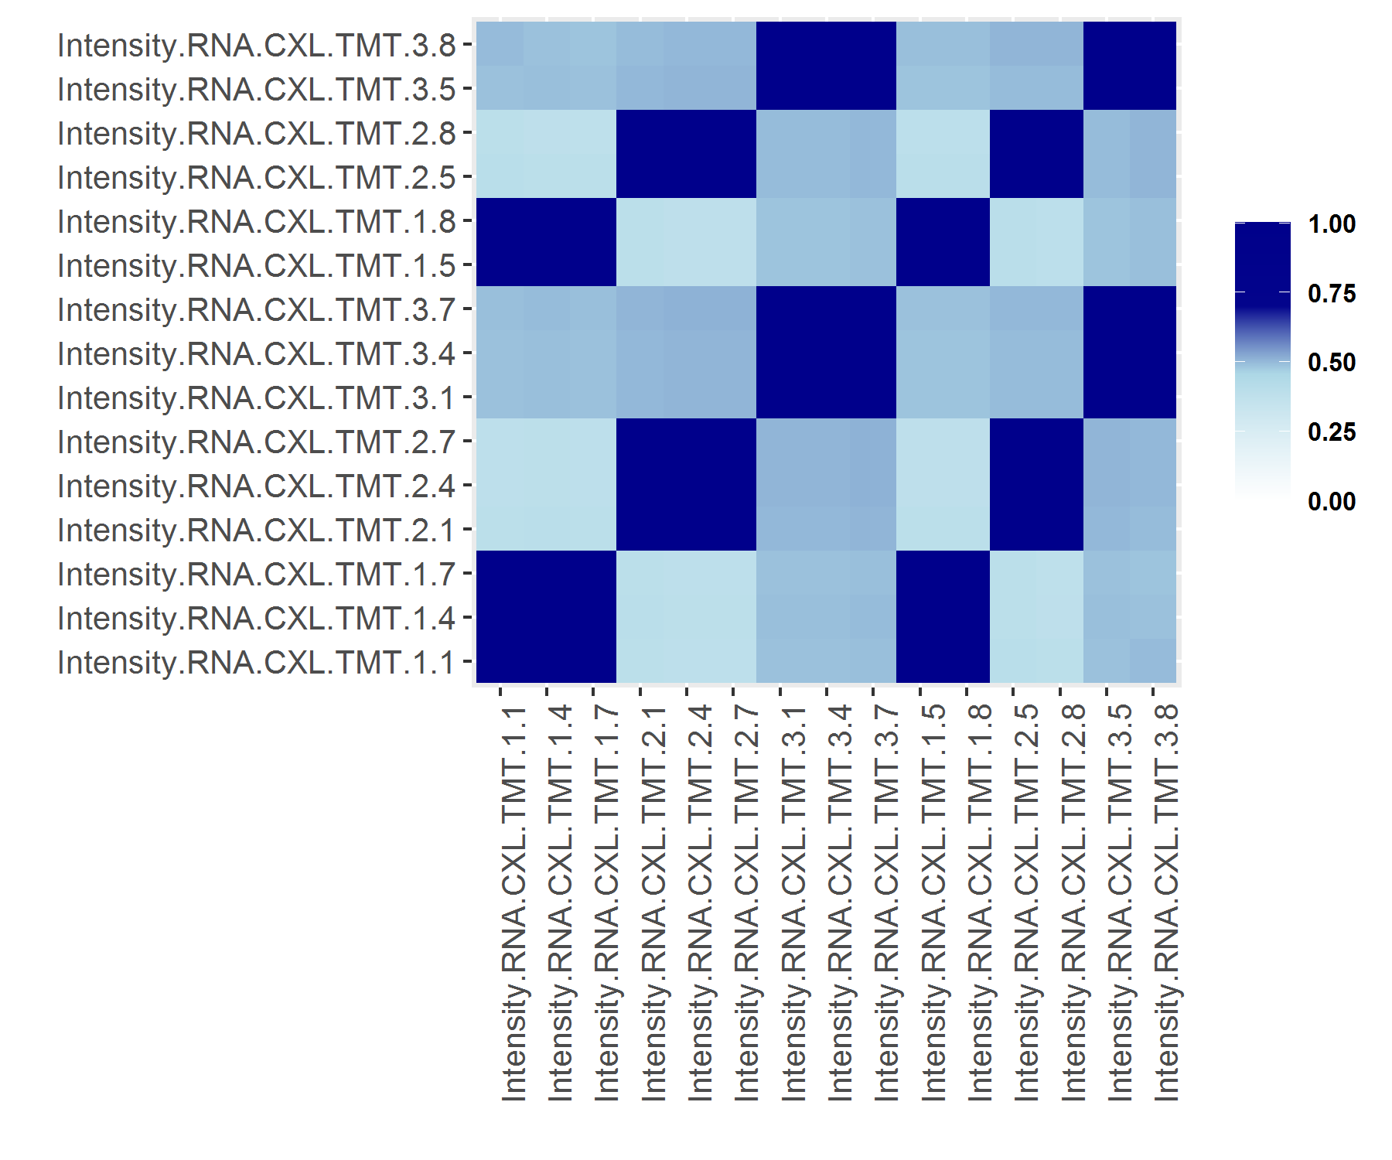
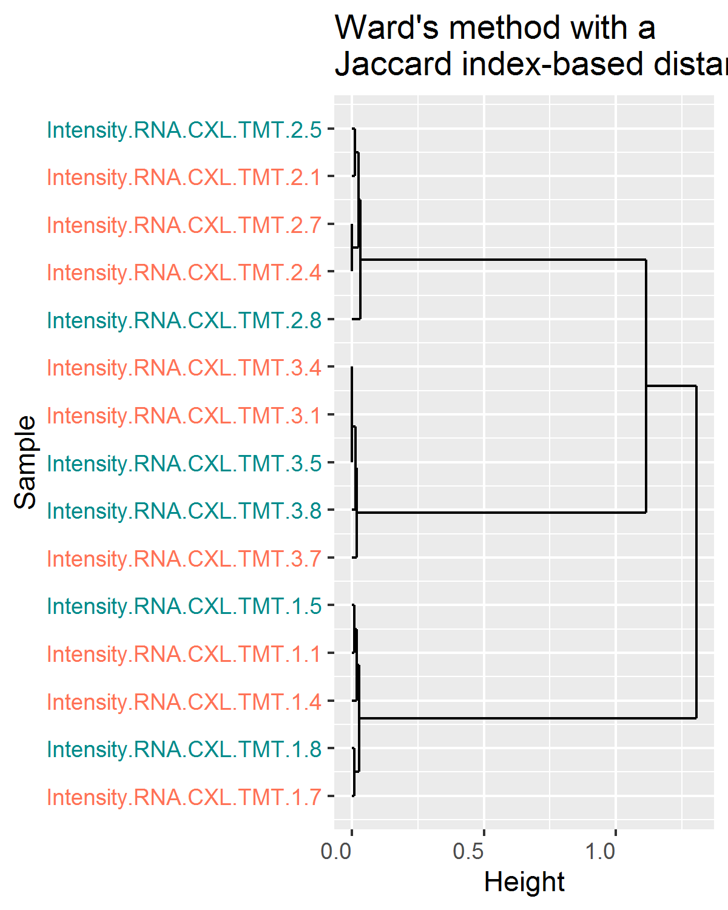
Clustering of samples using missing values
Jaccard index between each pair of samples is computed by replacing each missing value by 1 and each observed value by 0.
Min. Jaccard index = 0.379032258064516

Slide 7
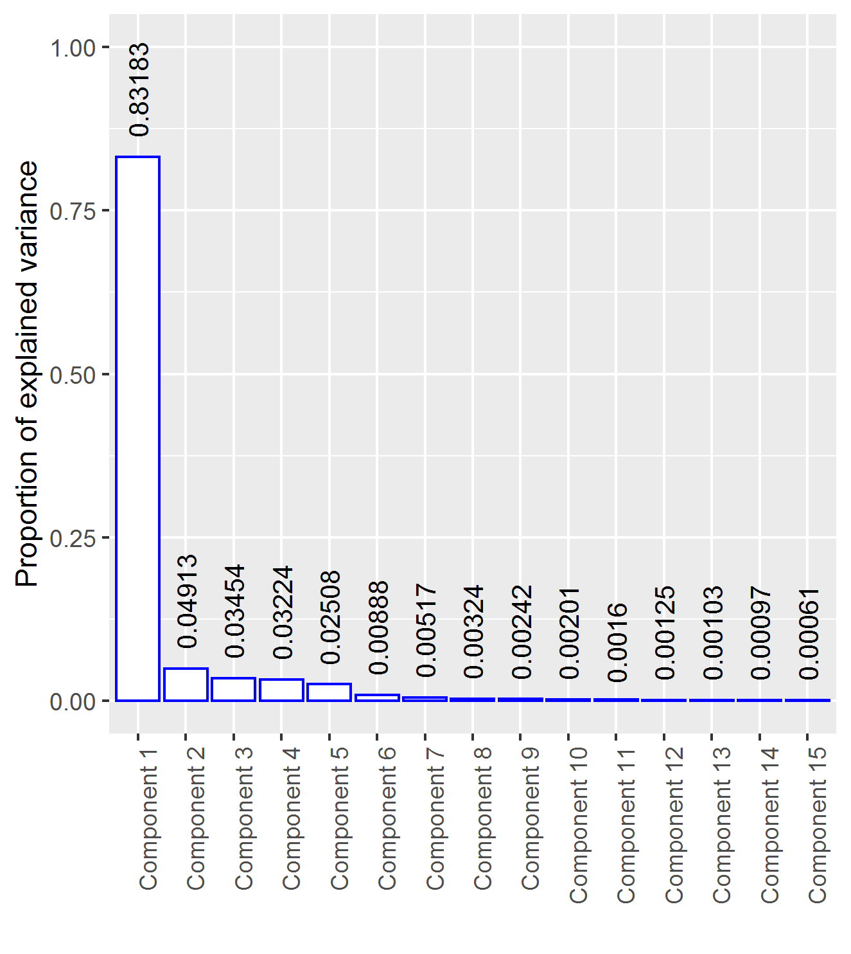
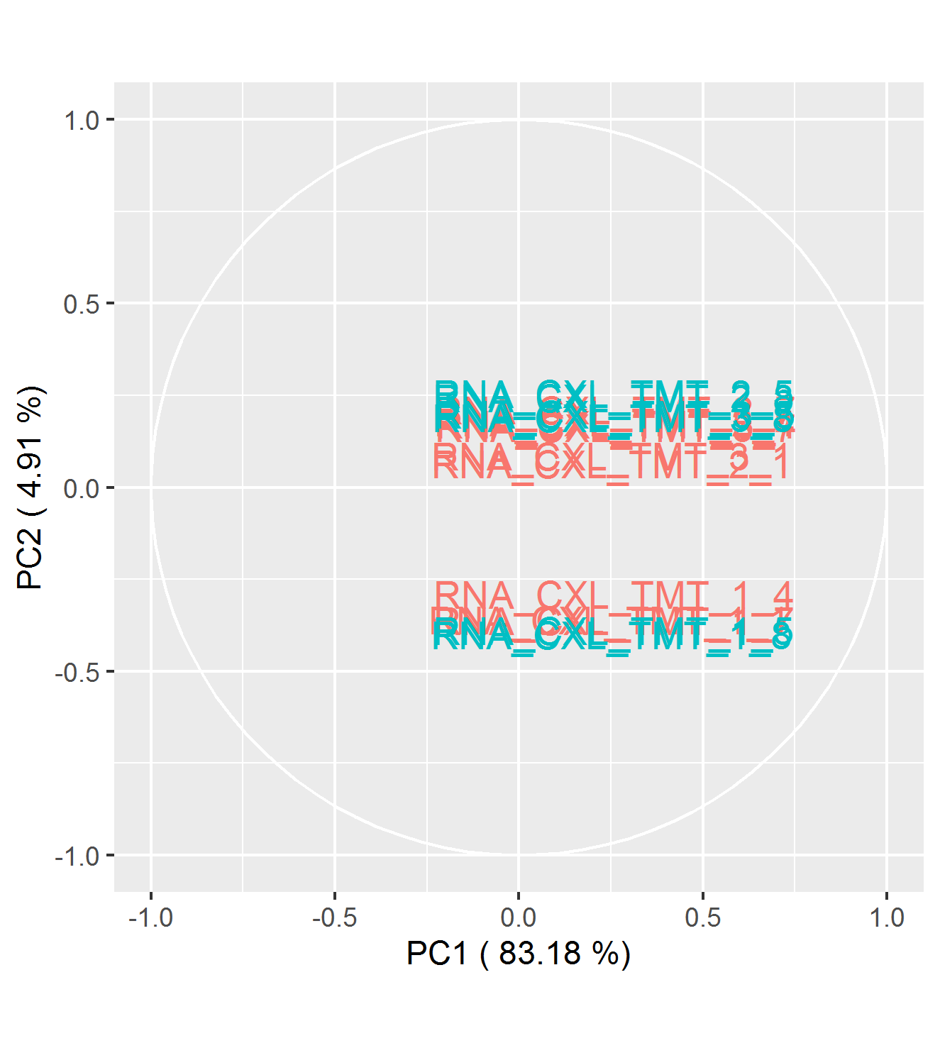
PCA between samples from 205 proteins without m.v.

Slide 8
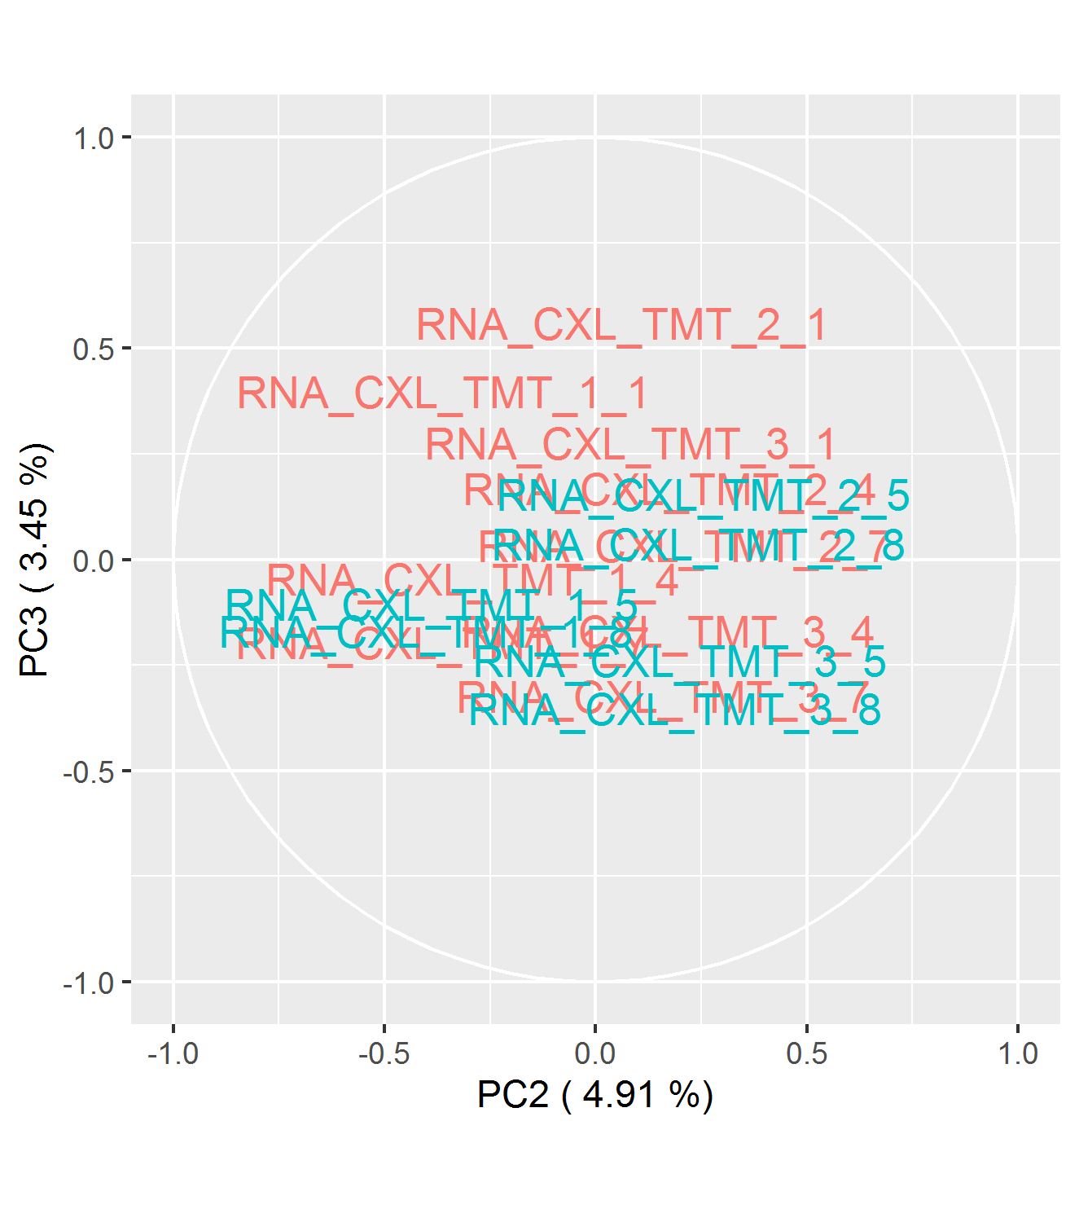
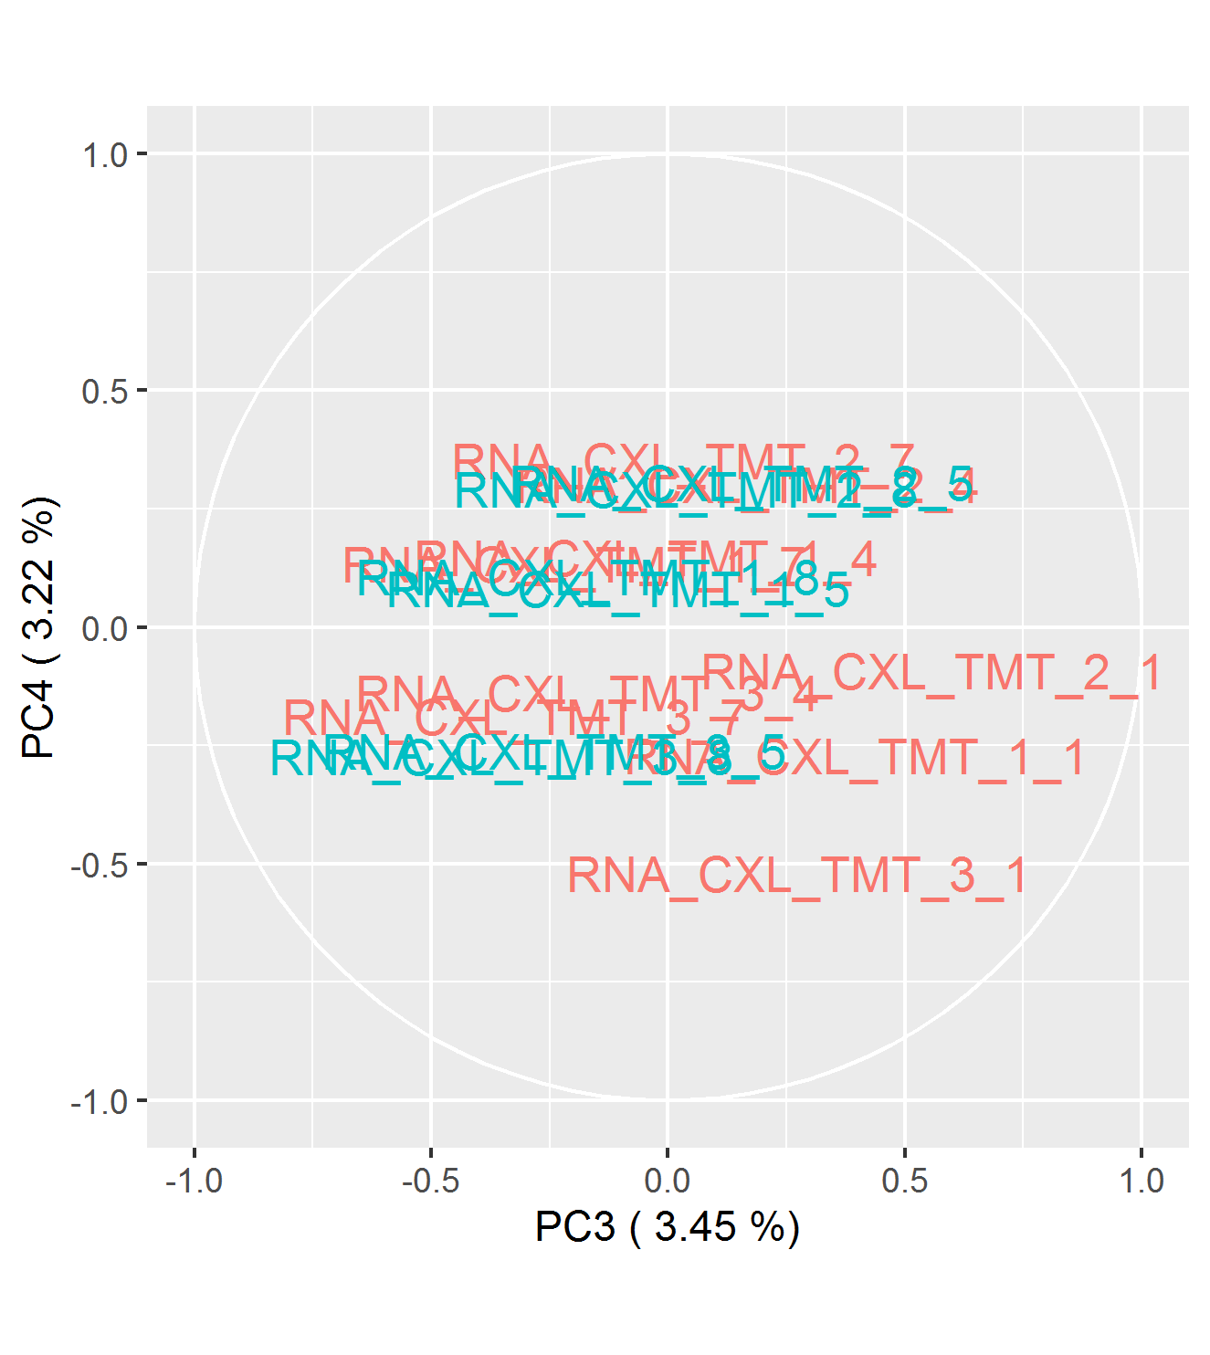
PCA between samples from 205 proteins without m.v.

Slide 9
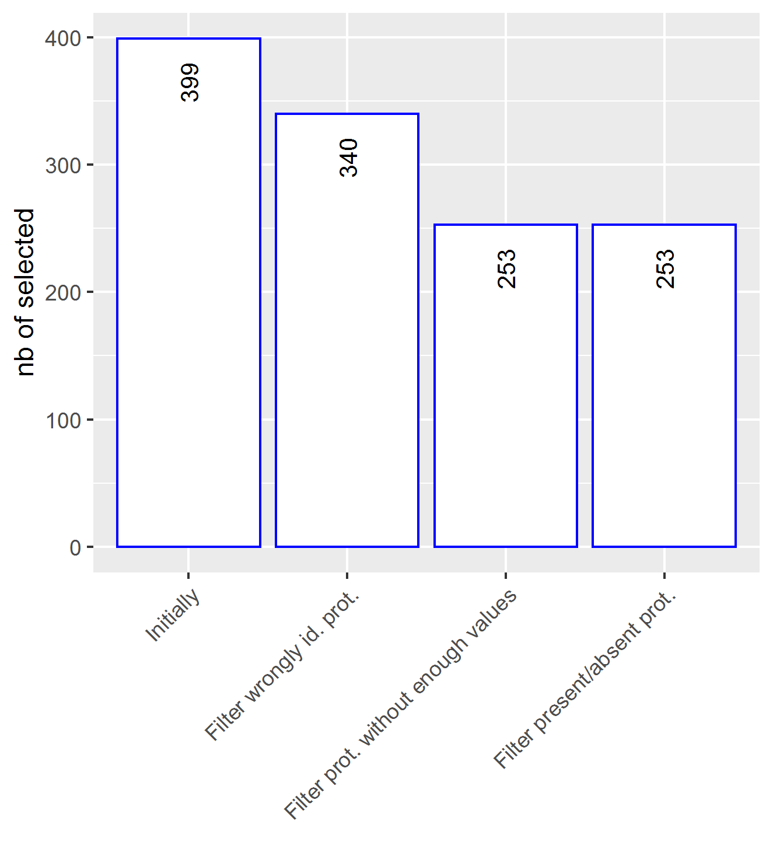
Number of selected proteins along the data analysis pipeline

Slide 10
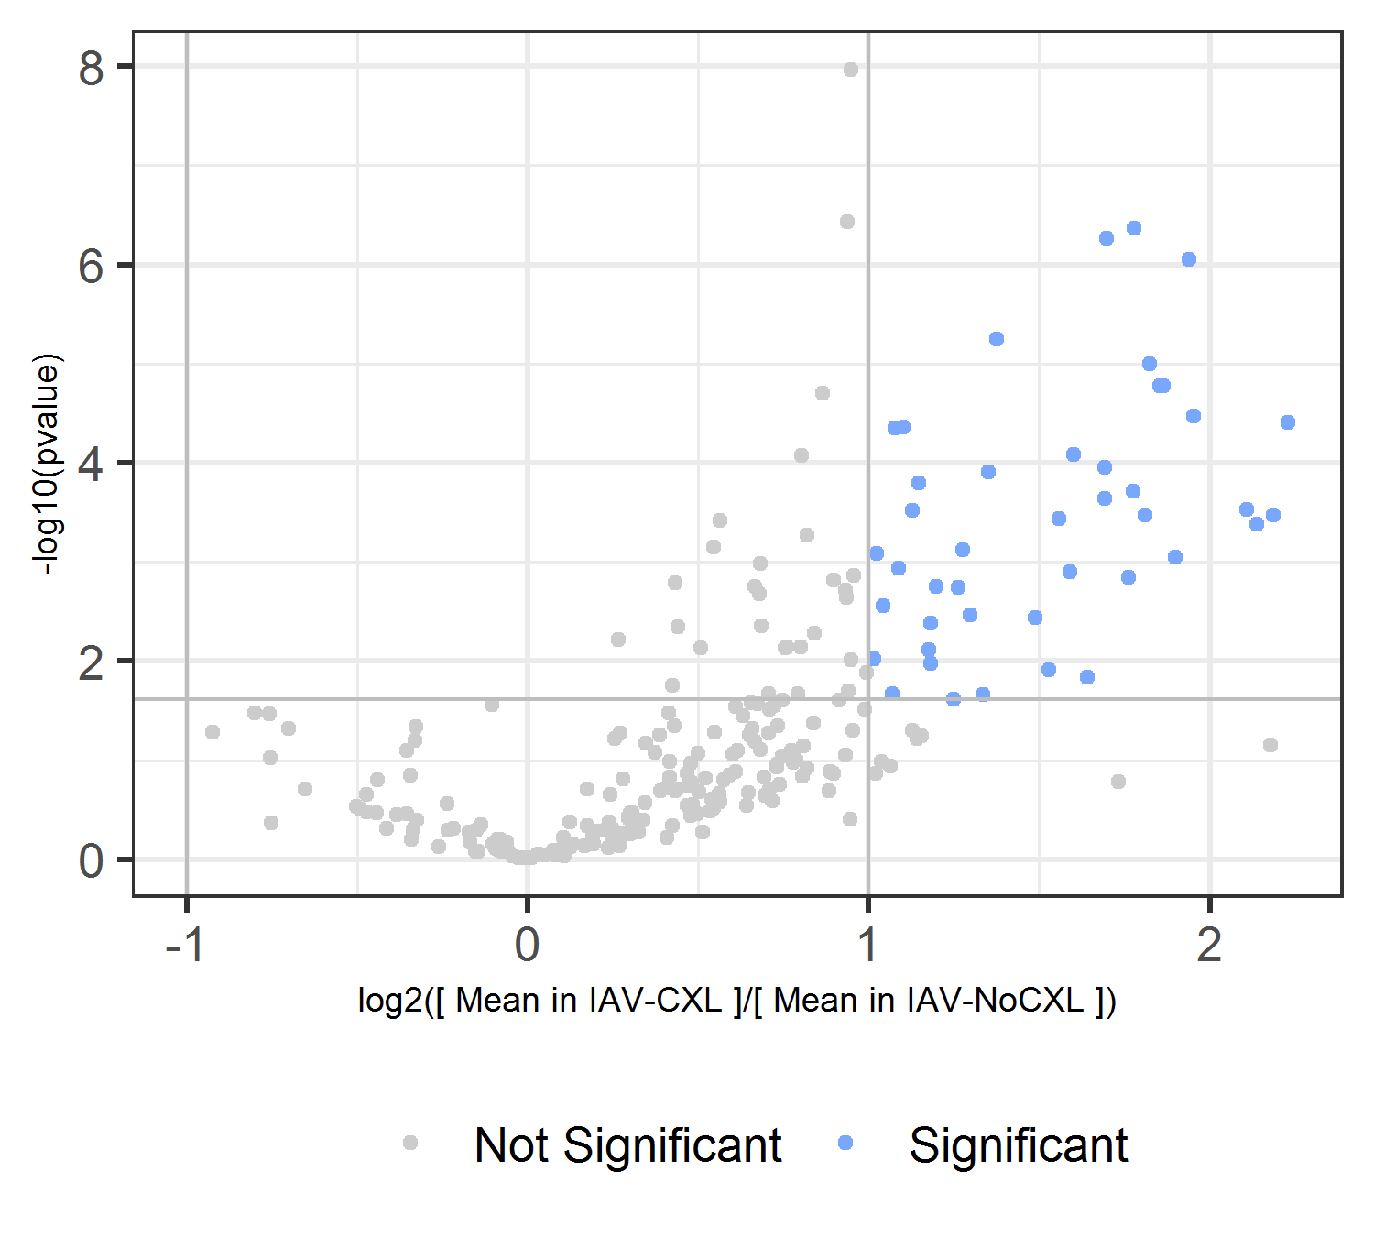
Differential Analysis with log2(Fold-Change) = 1 and FDR = 1 %.

Slide 11
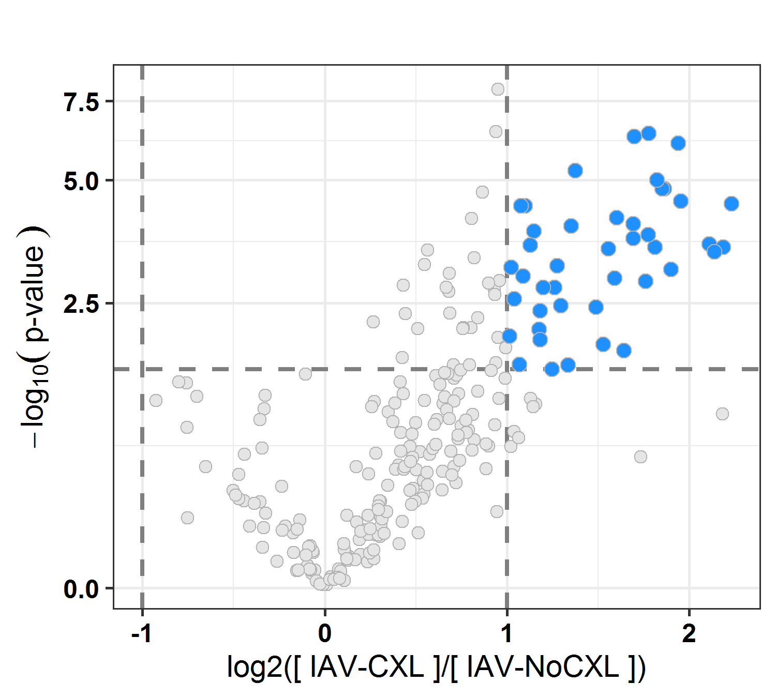
Differential Analysis with log2(Fold-Change) = 1 and FDR = 1 %.

Slide 12
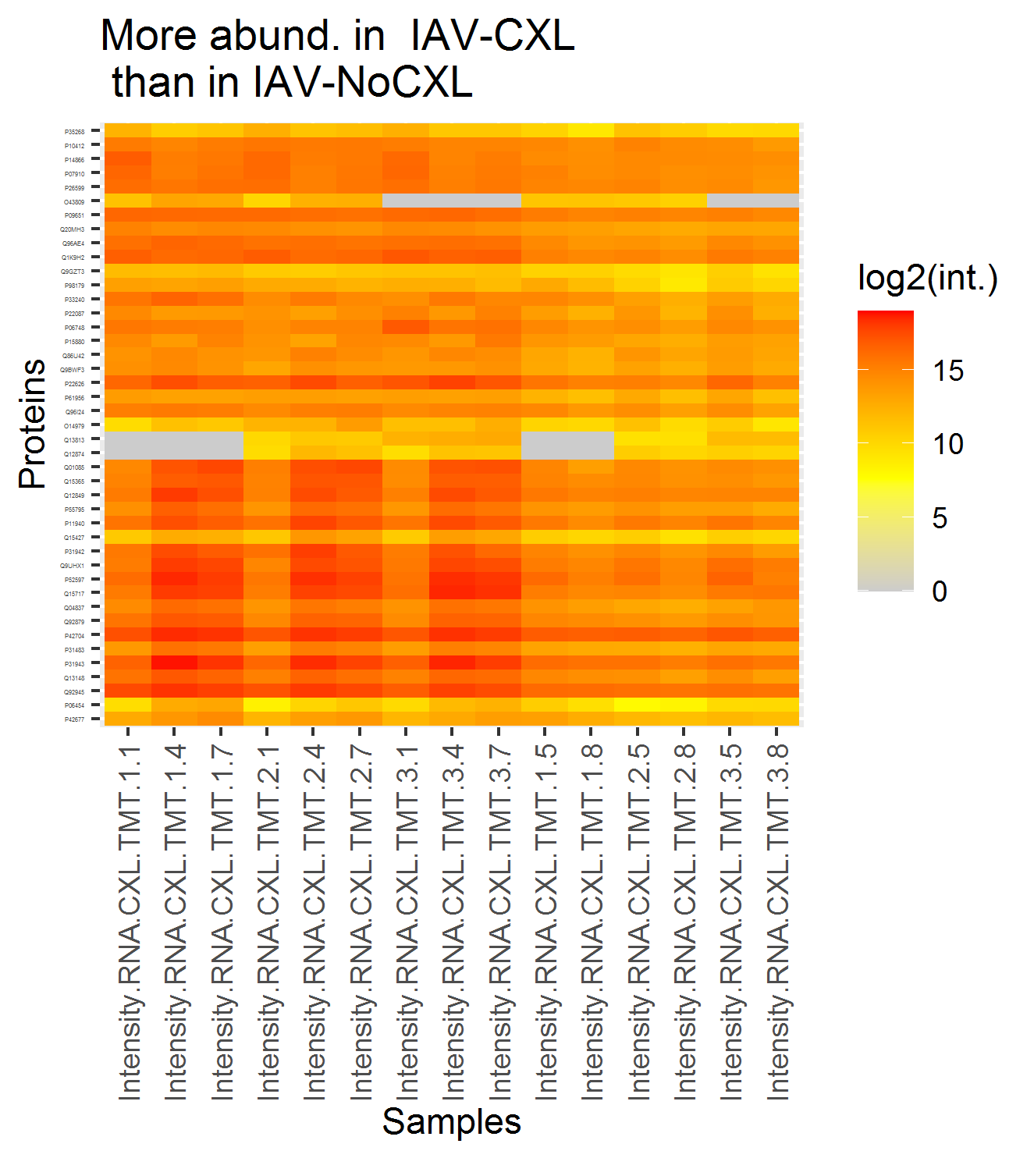
The proteins of interest

Slide 13
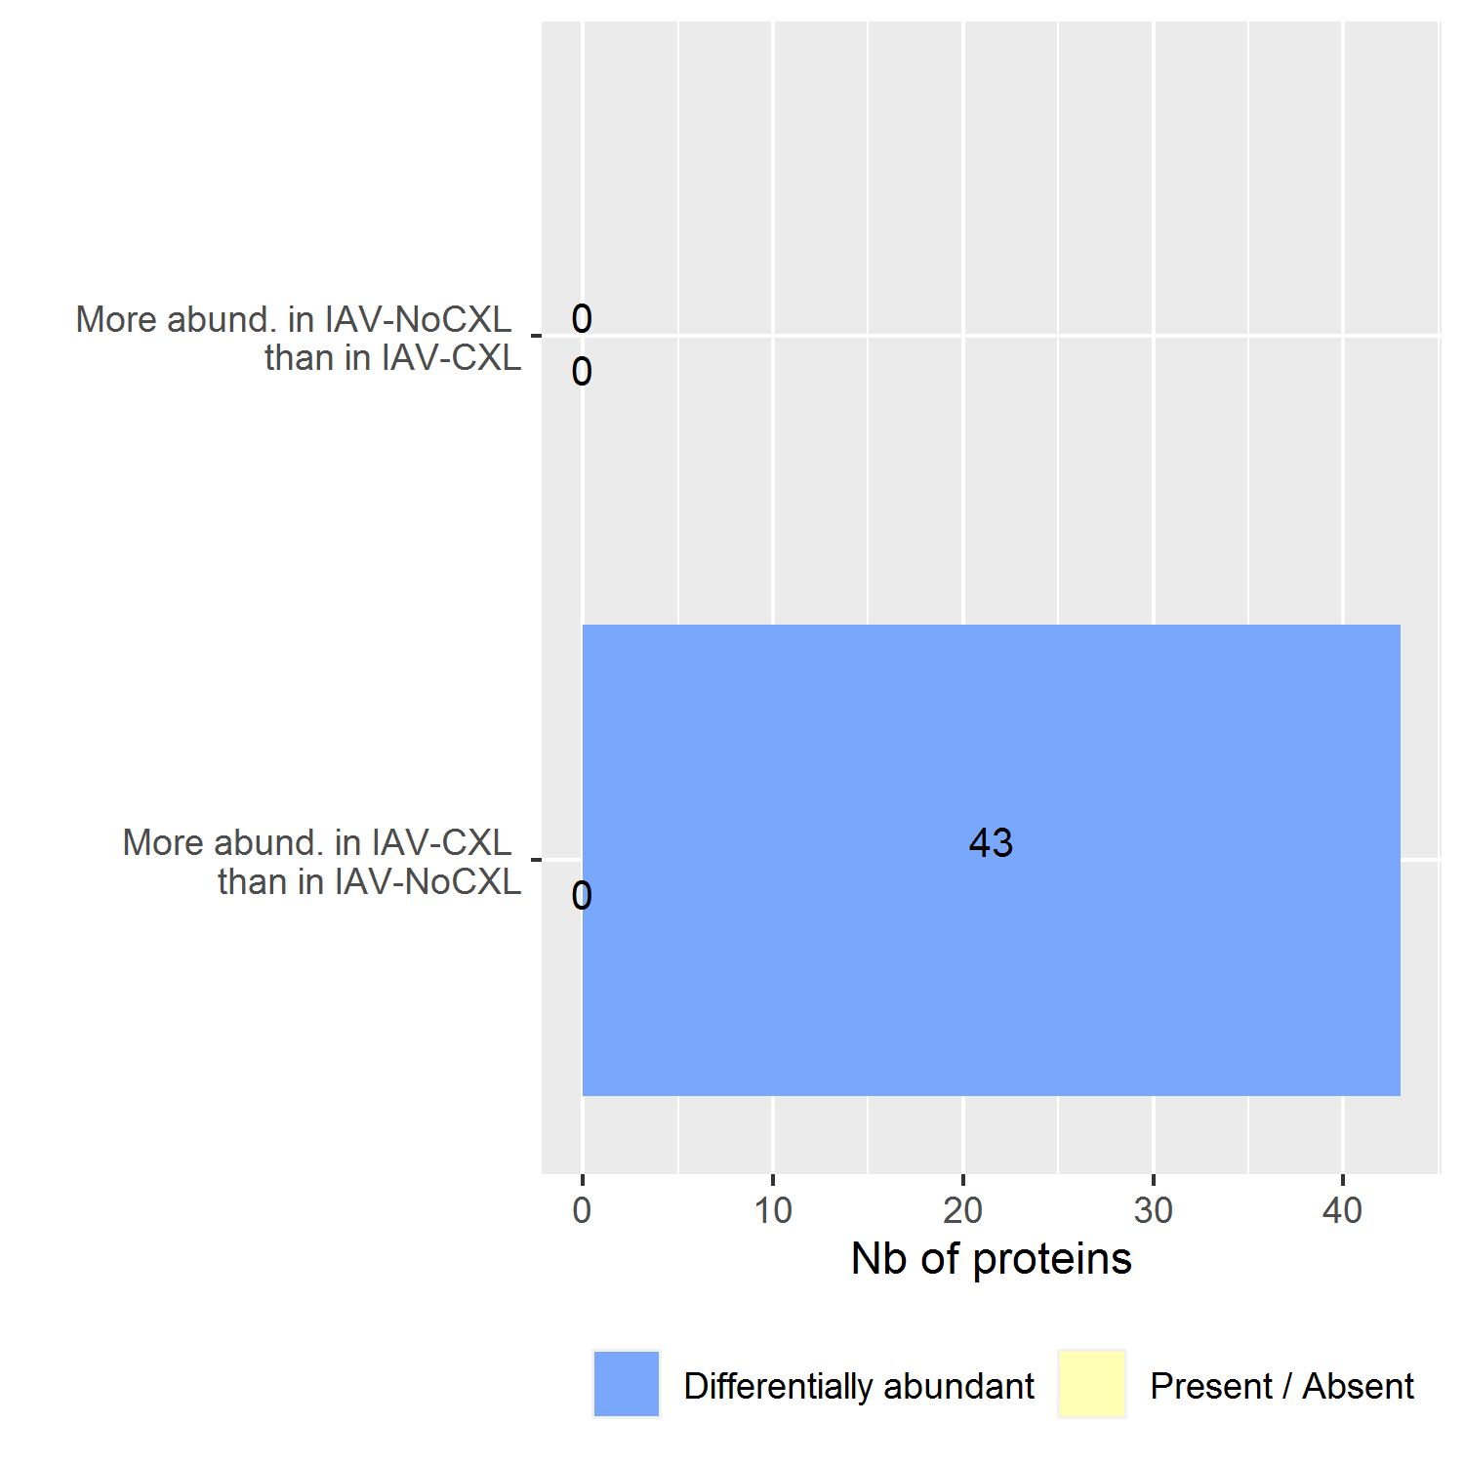
The proteins of interest

