Slide 1
Welcome to the DKFZ!

Slide 2
News from PCF at DKFZ
Martin Schneider

Slide 3
Topics from DKFZ
Spectronaut settings
missRanger
AlphaPept on Linux
Optimization HYE, fade-in fade-out, thoughts

Slide 4
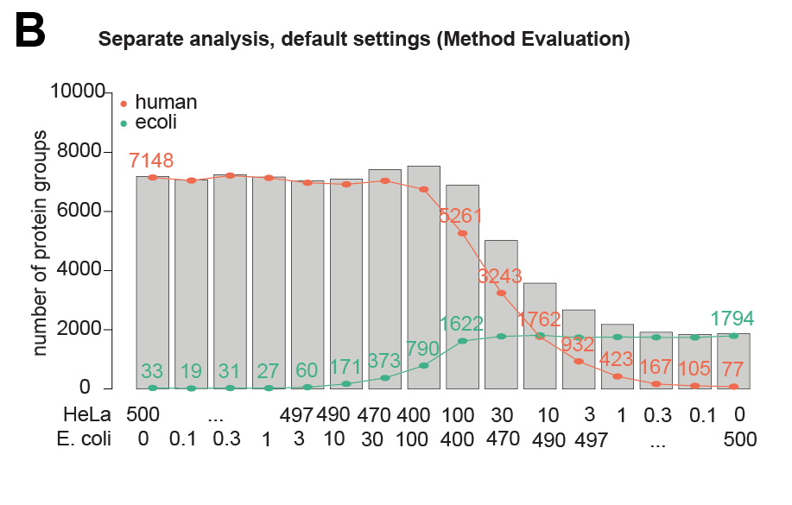
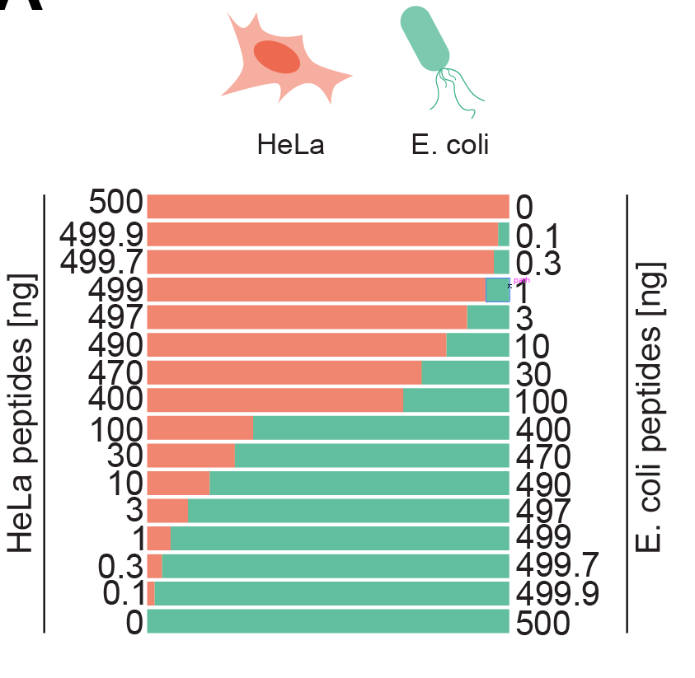
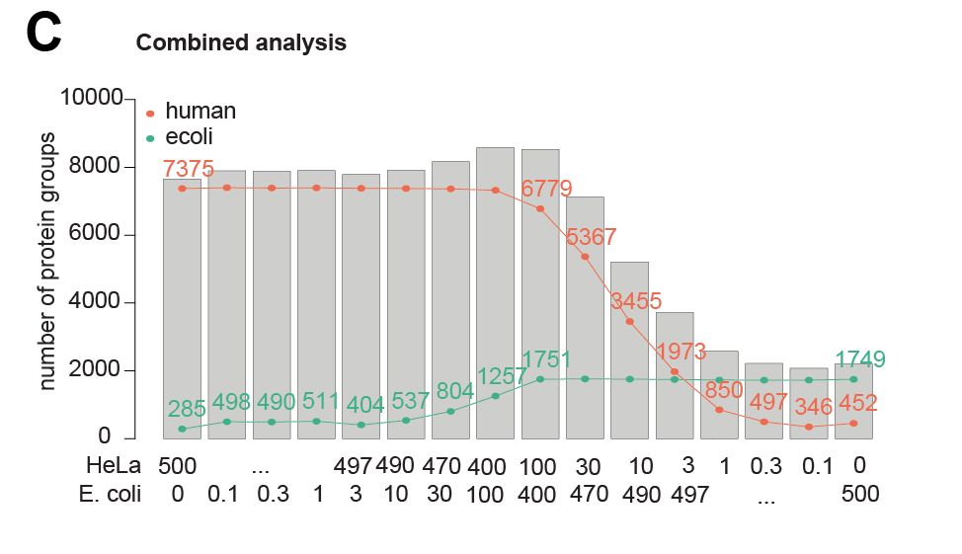
Spectronaut settings
Luisa Schwarzmüller luisa.schwarzmueller@dkfz.de

Slide 5
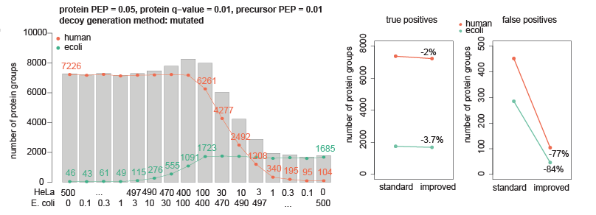
Spectronaut settings
Luisa Schwarzmüller luisa.schwarzmueller@dkfz.de

Slide 6
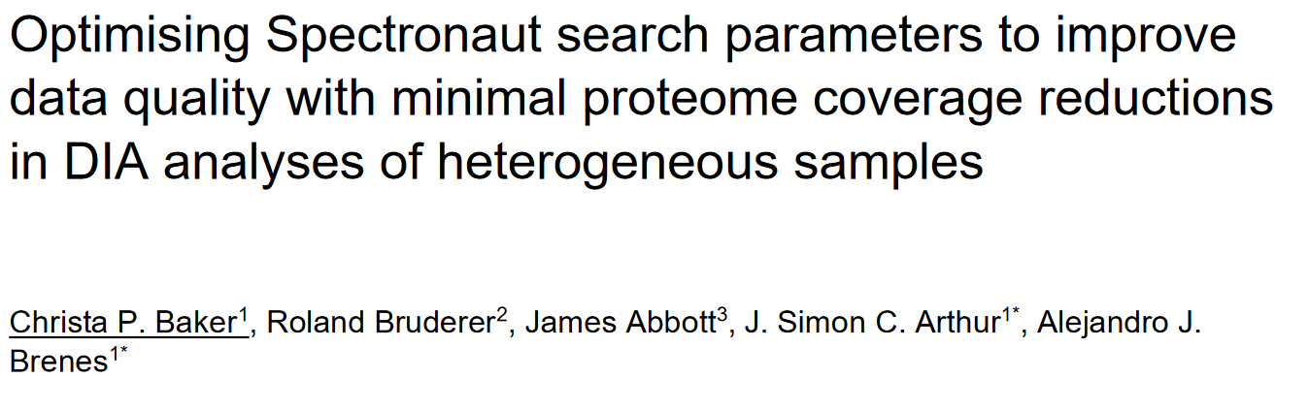
Spectronaut settings

Slide 7
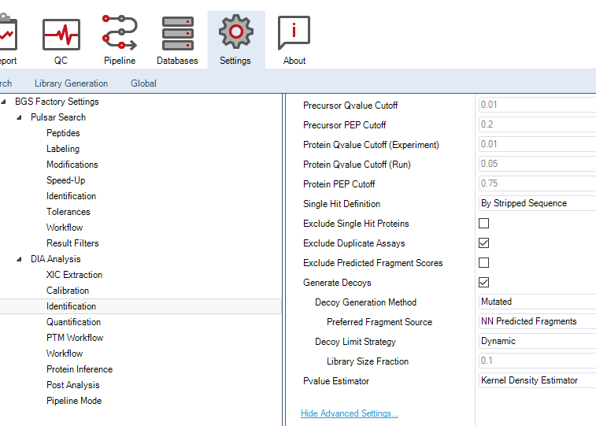
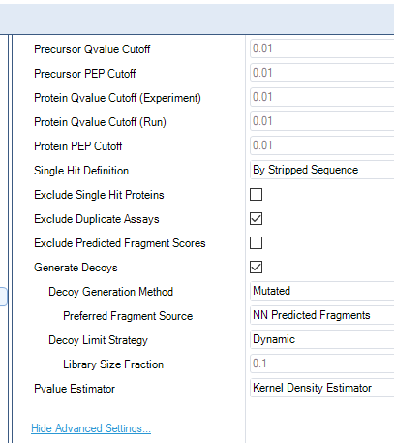
Spectronaut settings

Slide 8
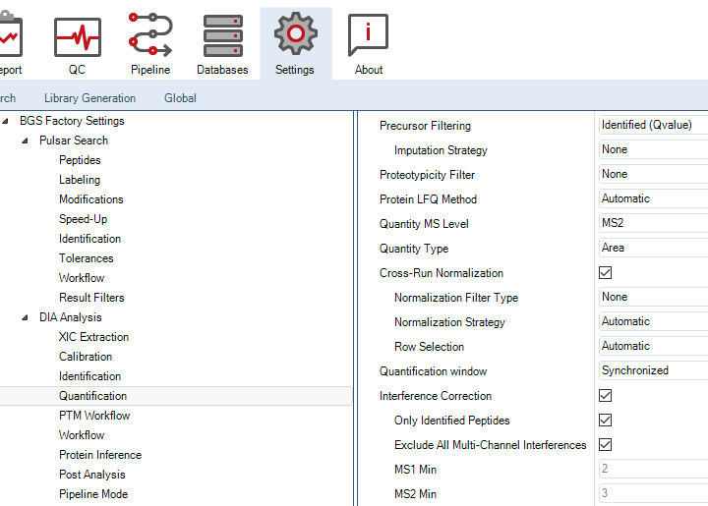
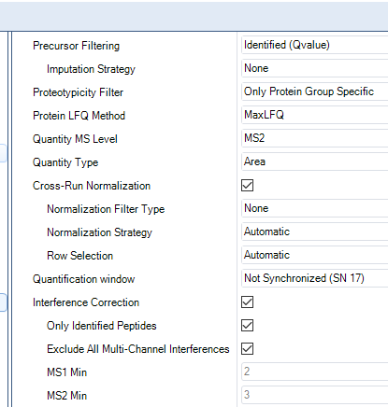
Spectronaut settings

Slide 9
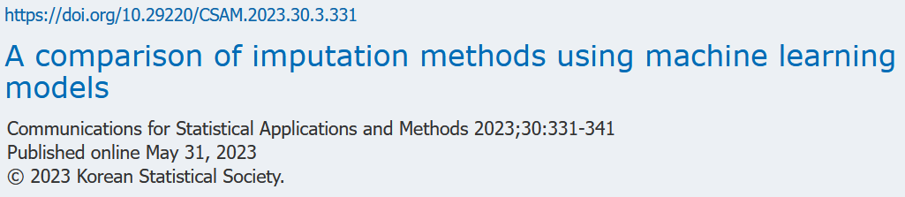
missRanger
missForest
Statistics benchmarks
Stekhoven, D.J. and Buehlmann, P. (2012), 'MissForest - nonparametric missing value imputation for mixed-type data’, Bioinformatics, 28(1) 2012, 112-118, doi: 10.1093/bioinformatics/btr597
We can see that missForest takes much longer to impute missing values than missRanger, while there is not much difference in performances.

Slide 10
AlphaPept on Linux
ShinyQC with MaxQuant ~1h
Speed + free + active development + feature rich
FragPipe / Comet / new MaxQuant v2.5.0.0 / AlphaPept

Slide 11
AlphaPept on Linux
FragPipe & Comet
Very fast ~5min
Poor on features like peak properties
MaxQuant v2.5.0.0
Slow ~45min
AlphaPept
Fast ~10min
Fully open source
Fails to run on Linux
Some MS level information missing

Slide 12
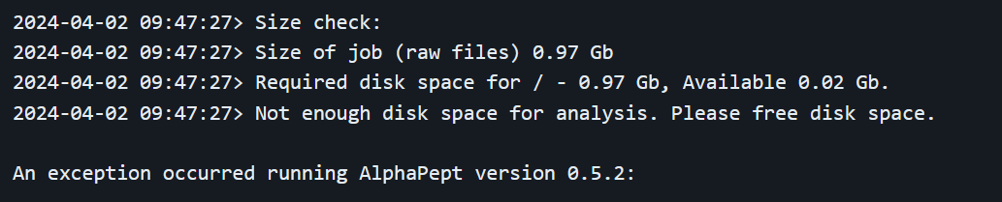
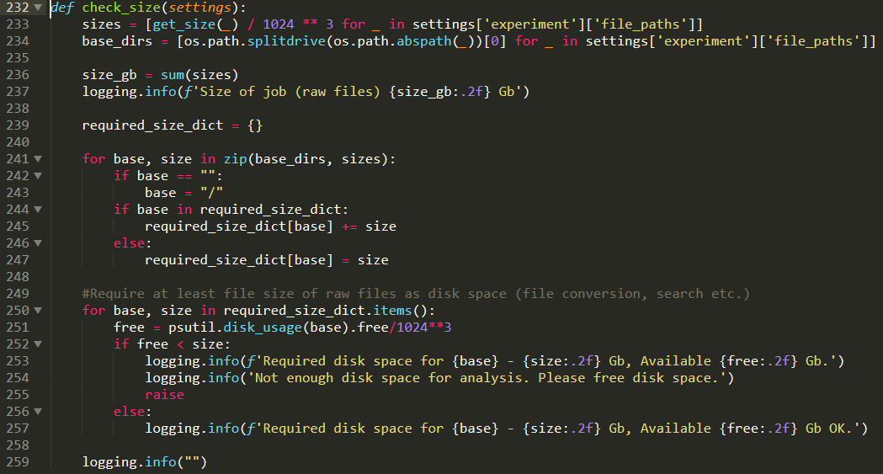
AlphaPept on Linux
Fails to run on Linux
Docker for ARM from scratch for AMD64
Not enough disk space

Slide 13


AlphaPept on Linux
Fix check_size
Additional info on MS level
Info on LC level
Thermo Raw File Reader
Own EXE for extracting LC info

Slide 14
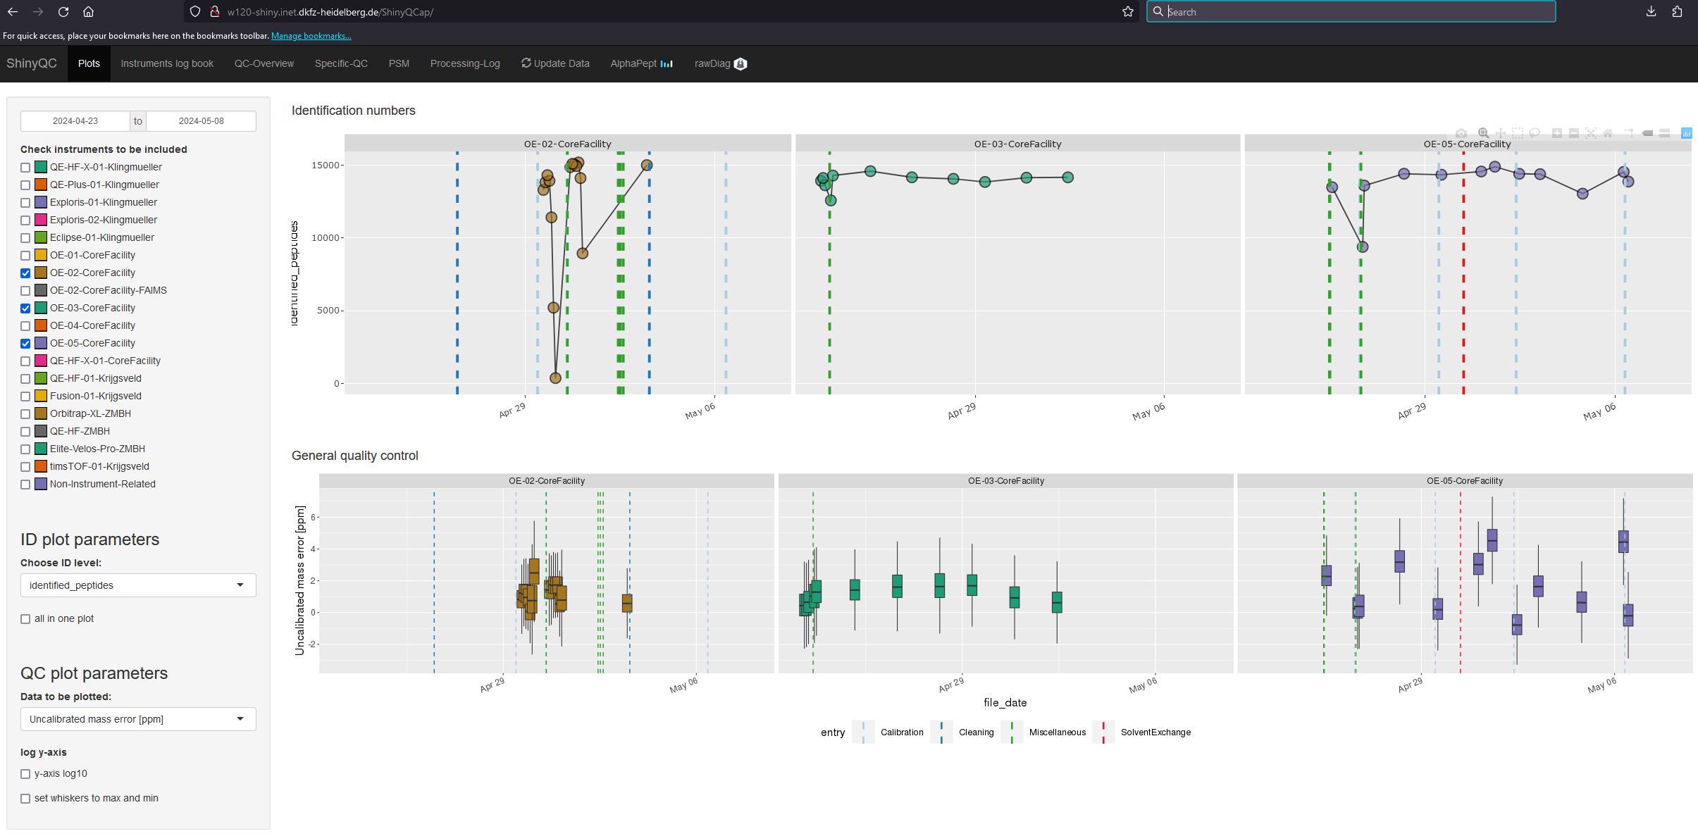
AlphaPept on Linux

Slide 15
Optimization HYE, fade-in fade-out, thoughts
What is carried over?
How much is in the washes?

Slide 16
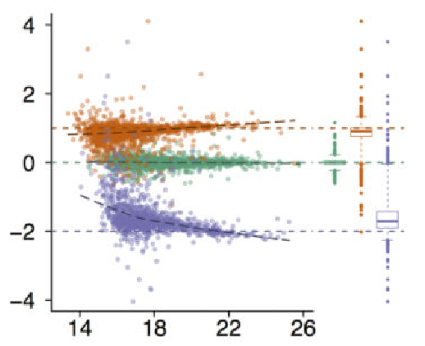
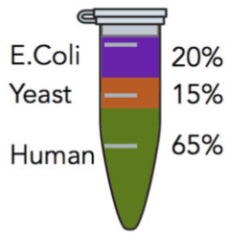
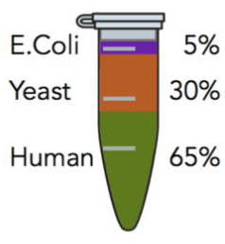
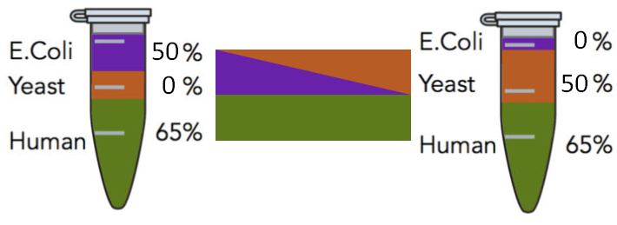


Optimization HYE, fade-in fade-out, thoughts
HYE with dilution series
Human with A. thaliana dilution

Slide 17
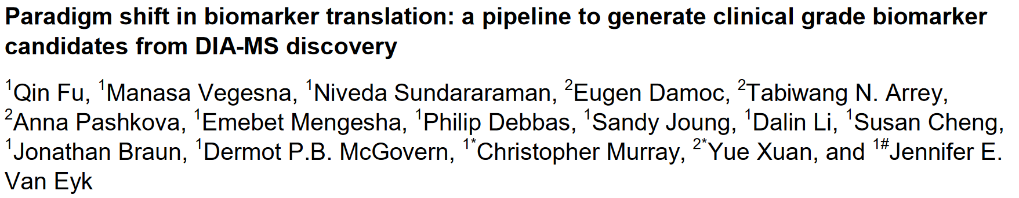
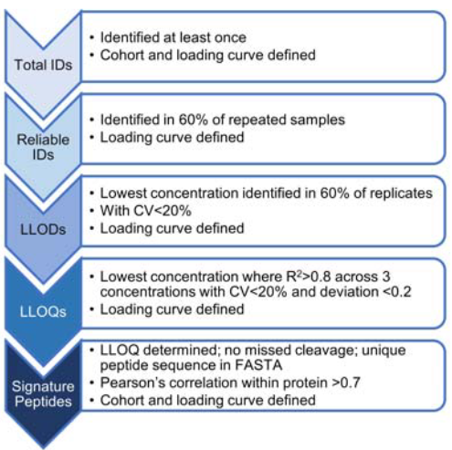
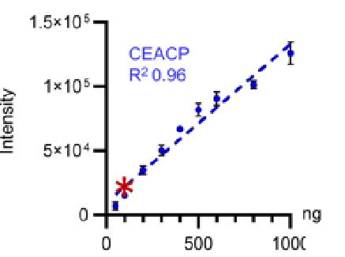
Optimization HYE, fade-in fade-out, thoughts

Slide 18
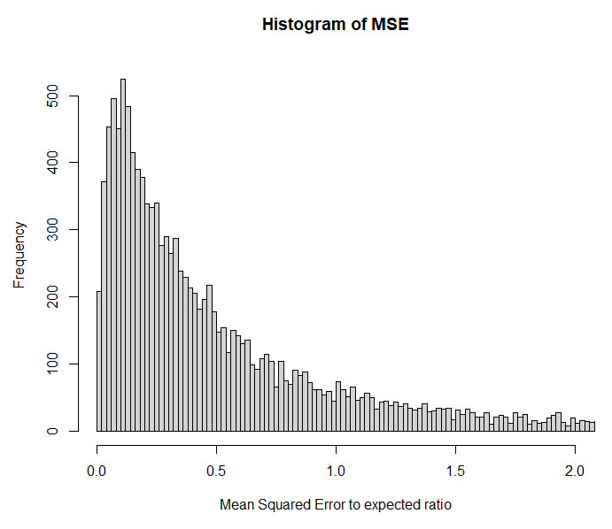
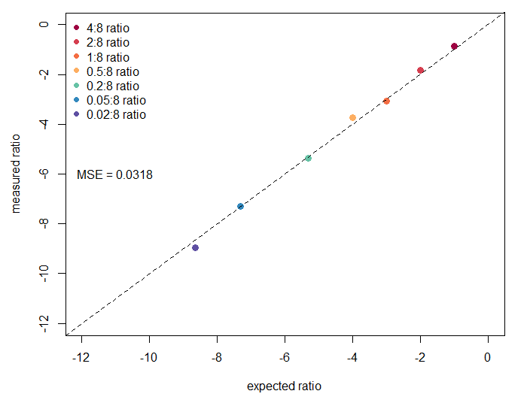
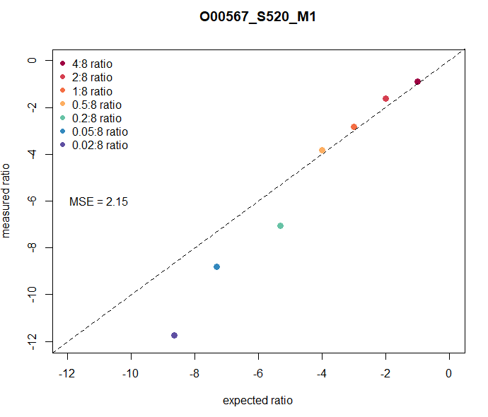
Optimization HYE, fade-in fade-out, thoughts
Replicates?
Luisa Schwarzmüller luisa.schwarzmueller@dkfz.de

Slide 19
Optimization HYE, fade-in fade-out, thoughts
Info on all proteins in different abundance
Pseudo ground truth → they should be on the line
Feed models HMM, random forest, deep learning
Which parameter combination good proxy for quality of:
Quantification
Detection

Slide 20
Thank you for your attention!
Further information on www.dkfz.de

