Slide 1
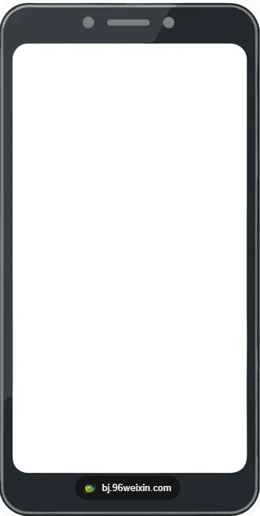


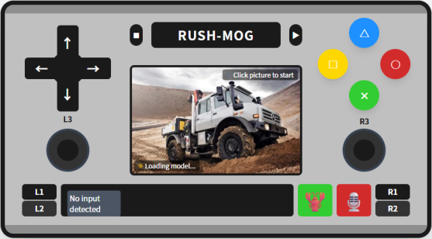








In-vehicle System
Phone/Pad…
JQ6500
ESP32-S3-CAM
STM32F103C8T6
Audio Exeutor
WIFI
VLA
Command
Receiver
Queue
Command
Consumer
Ps2 web server
VLA Infer
Armbot Exeutor
Motor Exeutor
Radar
Sensor Receiver
L298N

