Slide 1
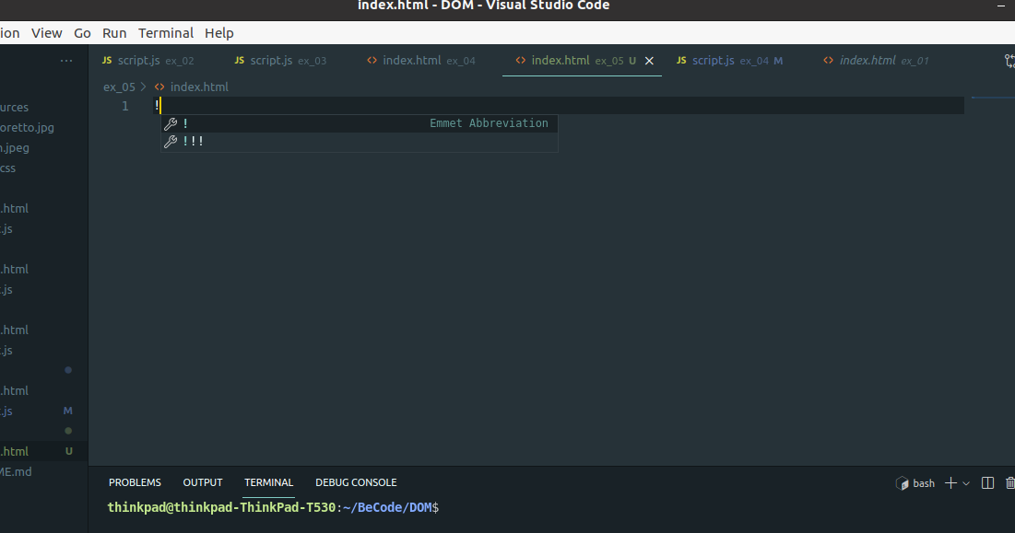
Emmet in VScode

Slide 2
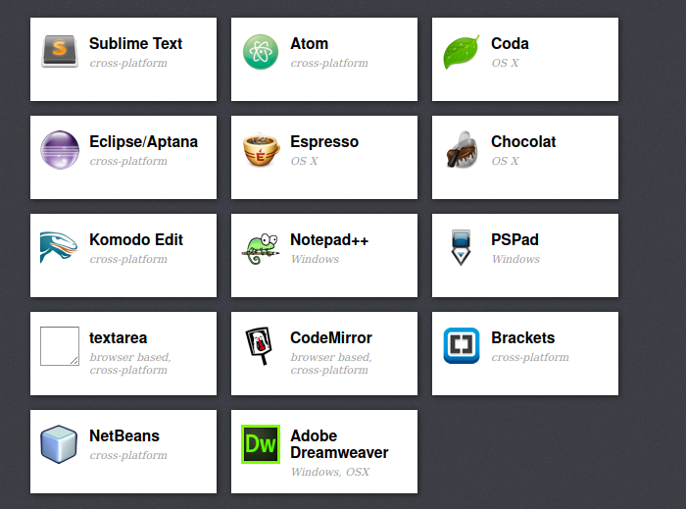
What is Emmet?
A little handy plugin for many text editors that speeds up working with HTML and CSS
Integrated in Vscode out-of-box
https://emmet.io/

Slide 3


Slide 4
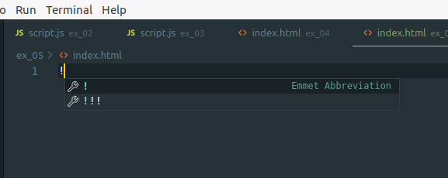
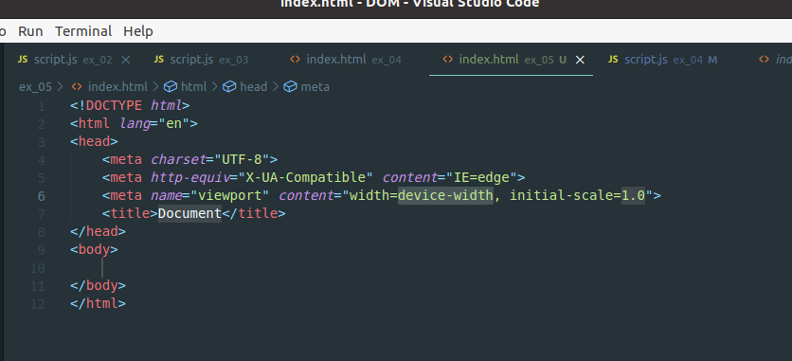
HTML structure

Slide 5
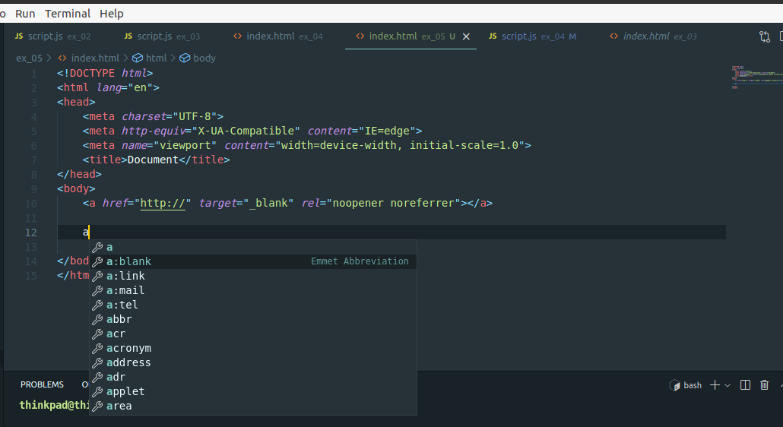
To activate Emmet you should type tag name without opening bracket “<”

Slide 6
Class, ID
Section.important
  <section class="important"></section>
Section#important
  <section id="important"></section>
Section.important#important
  <section class="important" id="important"></section>
.important
  <div class="important"></div>
section.dumb.idiot.thing
  <section class="dumb idiot thing"></section>

Slide 7
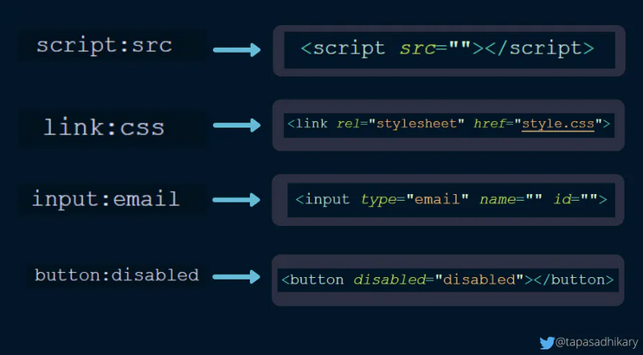
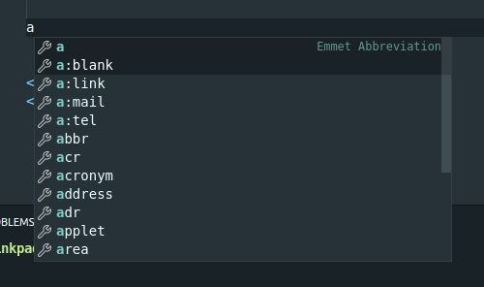
Atributes

Slide 8
Syblings
div+h1+p
  <div></div>
  <h1></h1>
  <p></p>
div.dontusediv+section#usesection
  <div class="dontusediv"></div>
  <section id="usesection"></section>

Slide 9
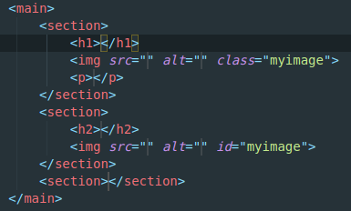
Nesting + grouping
div>h1
  <div>
<h1></h1>
  </div>
main>(section>h1+img.myimage+p)+(section>h2+img#myimage)+section

Slide 10
Text {}
p>h1{Big title}+h2{Smaller title}
  <p>
<h1>Big title</h1>
<h2>Smaller title</h2>
</p>
p{The link }>a{here}+{ goes nowhere.}
  <p>The link <a href="">here</a> goes nowhere.</p>

Slide 11
Multiplication
ul>li*5
  <ul>
<li></li>
<li></li>
<li></li>
<li></li>
<li></li>
</ul>

Slide 12
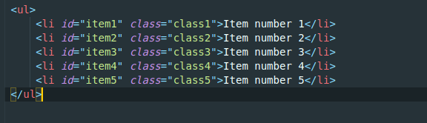
Numbering
ul>li#item$.class${Item number $}*5

Slide 13
Climbing UP ^
div>div>section+h2^^section{Hello Kitty!}
<div>
<div>
<section></section>
<h2></h2>
</div>
</div>
<section>Hello Kitty!</section>

Slide 14
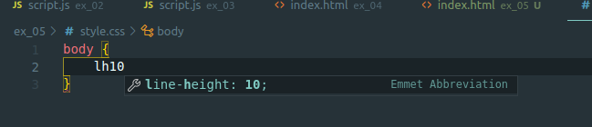
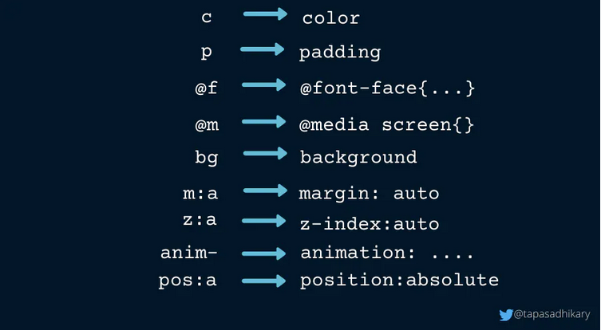
CSS
Mostly properties

Slide 15
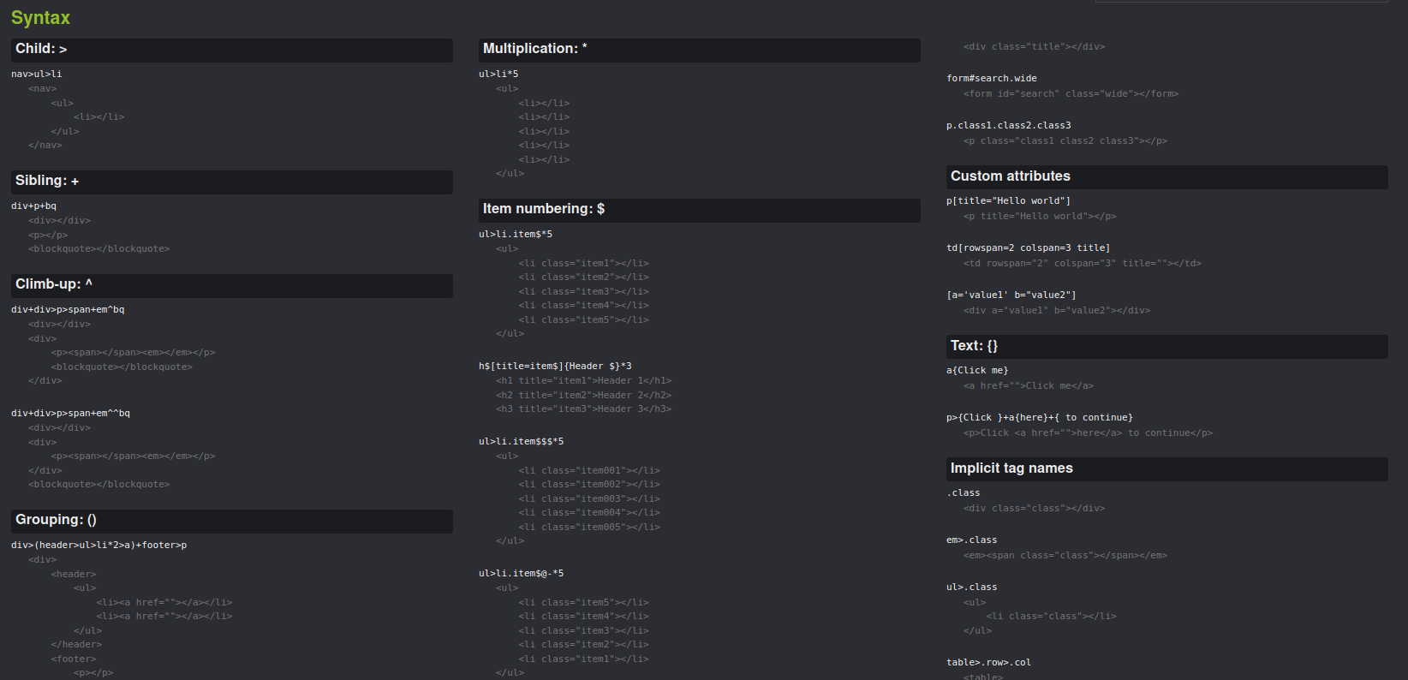
https://docs.emmet.io/cheat-sheet/

Slide 16
Links
https://www.youtube.com/watch?v=uCNgWcKrFfQ
https://emmet.io/
https://docs.emmet.io/cheat-sheet/
https://code.visualstudio.com/docs/editor/emmet
https://blog.greenroots.info/10-vs-code-emmet-tips-to-make-you-more-productive

Slide 17
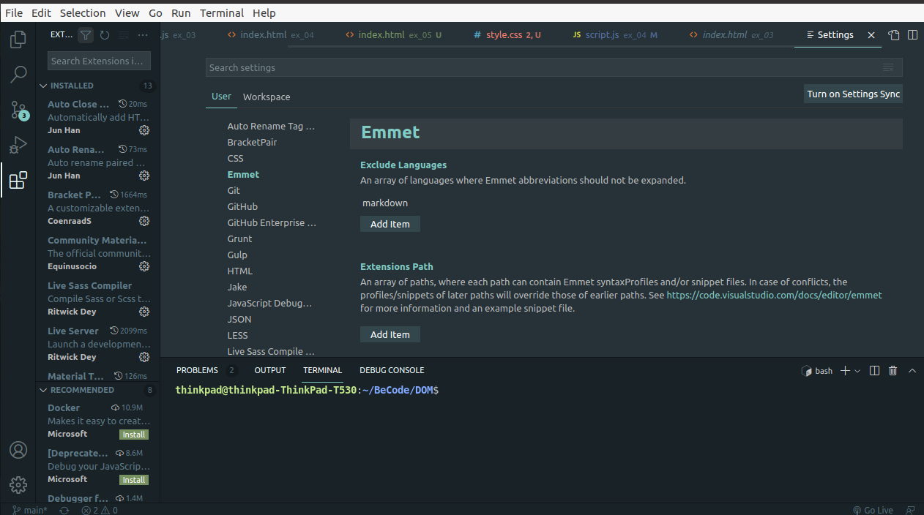
Parameters Emmet

Slide 18

Just use your ...
(header>nav>ul>(li#item${Item n°$}+a{here}+{is the link to item $})*6)+(main>section.MySection*3>h2+p+p+p+img)+(footer>nav>ul>li)+p
...

