Slide 1
HTML

Slide 2
HTML
Hypertext – use hyperlinks
Markup – use tags to format text

Slide 3
GML(generalized markup language)
1969-1970 Charles Goldfarb, Edward Mosher and Raymond Lorie .
Language used by IBM to format text with tags in documents(headers, paragraphs, lists, tables). After formatting the text could be sent to a printer or to a screen output.

Slide 4
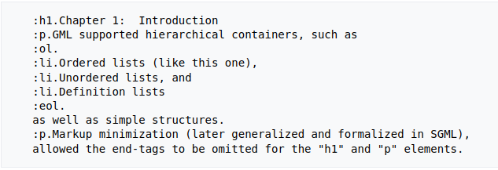
GML sample

Slide 5
SGML(standard generalized markup language)
Evolution of GML.
Original version 1986
Was used mostly for making machine-readable documents in governmental and aerospace projects. Was widely used in industrial print and publishing domain.
Was difficult to understand for ordinary people.
Father of HTML, also XML

Slide 6
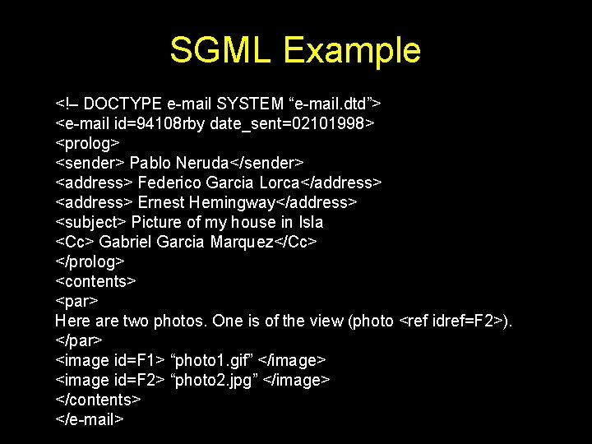
SGML sample

Slide 7
Tim Berners-Lee and HTML
Tim Berners-Lee, british physicist, working for CERN (conseil europeen pour la recherche nucleaire – largest physics laboratory in world)
HTML 1993
Language more human friendly, use tags to format text, and hyperlinks to cross-link pages and documents

Slide 8
HTML 1.0
Initial version of HTML
Not much text styling features
No support for tables, fonts

Slide 9
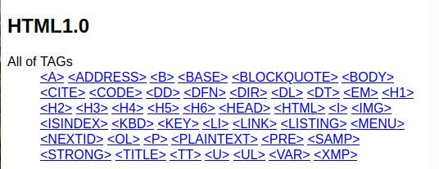
HTML 1.0

Slide 10
HTML 2.0 and W3C
HTML 2.0 developped in 1995, improving HTML 1.0
Standardization of HTML, rules for different browsers
Forms are added with basic tags like text boxes, buttons
Table tag is created.
W3C (world wide web consortium) Tim Berners-Lee
W3C make standards for internet, that are used by soft and hardware producers

Slide 11
HTML 3.0
Developped in 1997
HTML 2.0 improved (better support forms)
CSS support implemented (style HTML)

Slide 12
HTML 4.01
Developed in 1999
Some new tags added
Main feature, support of external CSS, no need to copy css style on each web page

Slide 13
HTML5
Current version
Came out in 2014
You activate html5 by typing <!DOCTYPE html>

Slide 14
HTML 5
Lots of new features
Password and email submit forms
Audio tag to embed audio and even autoplay
Canvas tag – a container in which you can draw, play video, make amimations…
Autofocus on a specific field
Time tag
Figure and figcaption tags

Slide 15
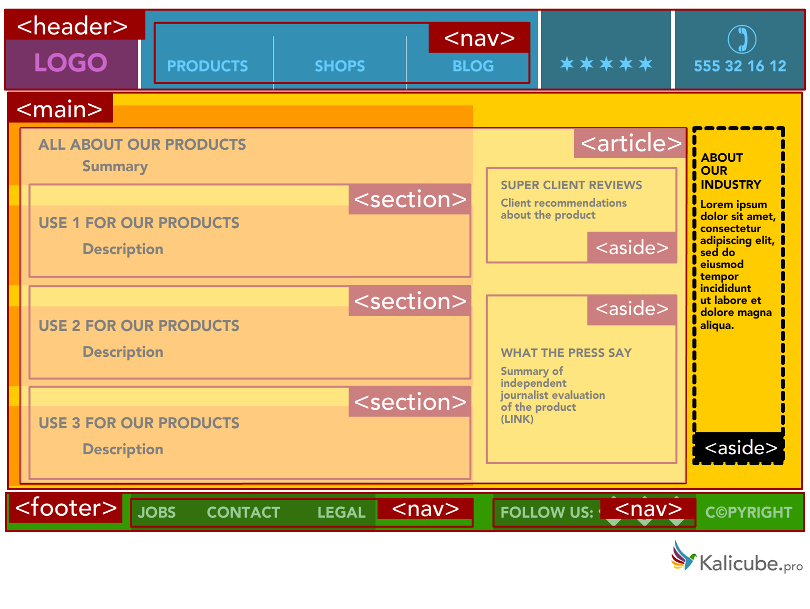
HTML 5
HTML document structure semantics

Slide 16
HTML6?
Will it be released one day or not?
It’s own specific tags :<html:html>, <html:head>, <html:title>, <html:body>…
Stronger authentication features
Control of the integrated camera
And more...

