Slide 1
Intro to Kite Dynamic Simulation Model
Jacob B. Fine

Slide 2
Overview
This presentation is intended to provide an introduction to and instructions on how to run the 6 DoF dynamic kite model
This presentation is organized as follows:
Section 1: Structure of the model
Section 2: Ingredients for running a simulation
Section 3: Simulation Demo

Slide 3
Prerequisites: Required Toolboxes
To run the model, you will need a copy of MATLAB 2022a (or newer) with the following libraries installed
Aerospace Blockset and Toolbox
Signal Processing Toolbox
Image Processing Toolbox
Navigation Toolbox
Control System Toolbox
DSP System Toolbox
Optimization Toolbox
Simulink
Stateflow

Slide 4
Prerequisites: Loading the Model
To run the model, you’ll need to pull the DoEOceanKite repo
https://github.com/NCSUCORE/DoEOceanKiteProject
Open MATLAB and open the file “OCTProject.prj”
If you have an additional folder containing specific plant parameters you would like to use, you'll also need add that directory to your path
Open “OCTModel.slx” to view the model

Slide 5
Section 1: Structure of the Model

Slide 6
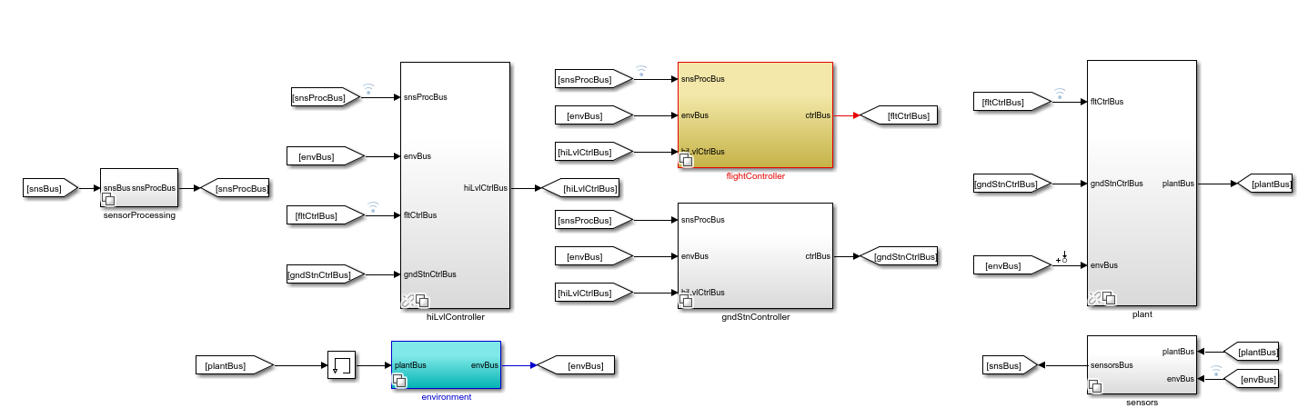
Anatomy of Dynamic Model
Four crucial components of the model
High-level controller (selects flight path shape and position)
Flight controller (generates control surface trajectory to track desired flight path)
Plant (dynamic model of the kite)
Environment (model of the flow environment)
Sensors and sensors processing blocks simulate ideal or realistic sensor measurements
Ground station controller (while seldom used) can be used to send control commands to simulated ground station

Slide 7
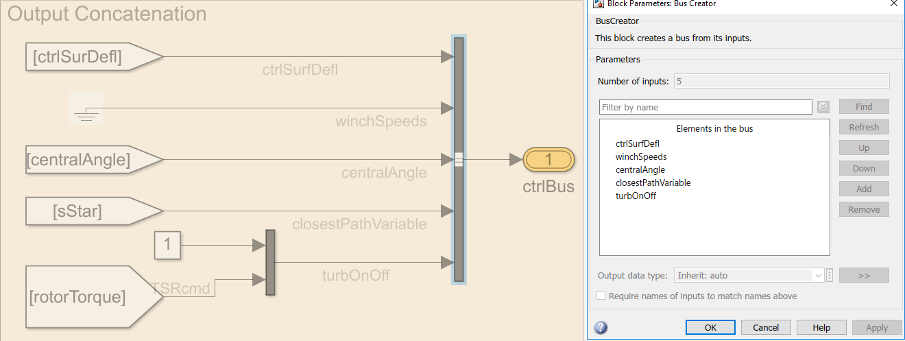
A Quick Note on Busses
Busses are structured signals of a predetermined size passed between sections of the model
Busses are packed using a bus creator
Signals can be extracted using a bus selector

Slide 8
Breakdown of Busses
The following are key busses used in the model
Bus Name | Contents
Environment Bus | Flow vector at each point
High Level Control Bus | ‘Basis Parameters’ describing path geometry
Plant Bus | States describing dynamics of the kite and tether (angular/Cartesian position and velocity and tension)
Flight Control Bus | Control surface deflection, winch speed, and turbine torque commands
Sensors Bus | Combined data from environment and plant bus (potentially transformed into “realistic” sensor measurements)
Sensors Processing Bus | Combined data from environment and plant bus (processed measurements if “realistic sensors” are used)

Slide 9
High Level Controller
Inputs | Outputs
Information about the flow-field and kite’s tracking behavior | A set of basis parameters (parameters that describe the desired size, shape, and location of the flight path)
When running a simulation sweep, unless the goal is explicitly to vary these parameters in response to a change in the environment or tracking performance, constant basis parameters are generally used within each simulation

Slide 10
Flight Controller
Inputs | Outputs
Basis parameters describing desired flight path, kite “sensor” measurements, and environmental conditions | Control surface deflection, winch speed, and turbine torque commands
Several flight controllers have been developed to test out different control strategies
Variant subsystems are used to select which controller to use

Slide 11
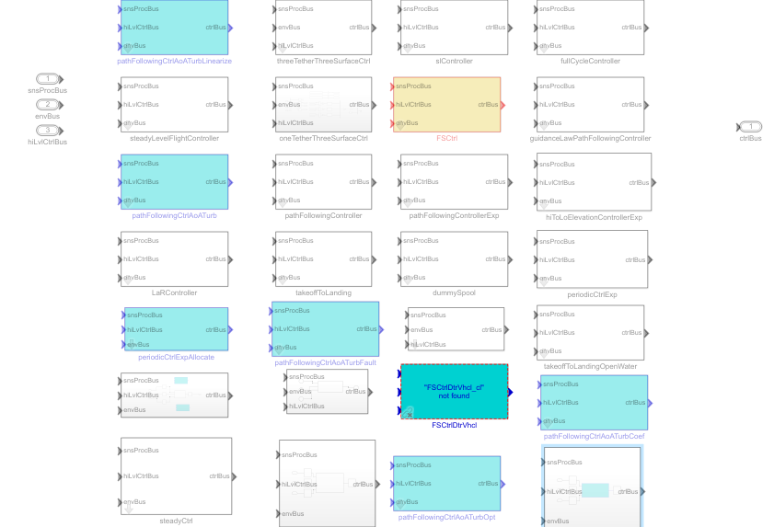
Flight Controller Continued
A specific flight controller is selected by changing the corresponding variant control variable
This is done automatically when a controller is loaded (details to follow in Section 2)
All major sections of the model use variant subsystems in this way

Slide 12
Plant
Inputs | Outputs
Control commands and environmental/flow profile | States representing the dynamics of the kite and tether (Cartesian position and velocity of the kite and each tether node, angular position and velocity of the kite, tether tension, and net power generation)
The plant block contains several subsystems and layers to model the dynamics of the kite and tether

Slide 13
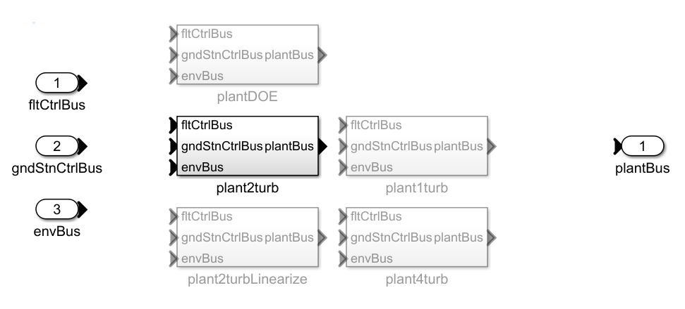
Plant Continued: Plant Variants
Multiple plant variants exist to model different types of kites
For example, a two-turbine kite uses the plant2turb variant while a 4-turbine kite uses the plant4turb variant

Slide 14
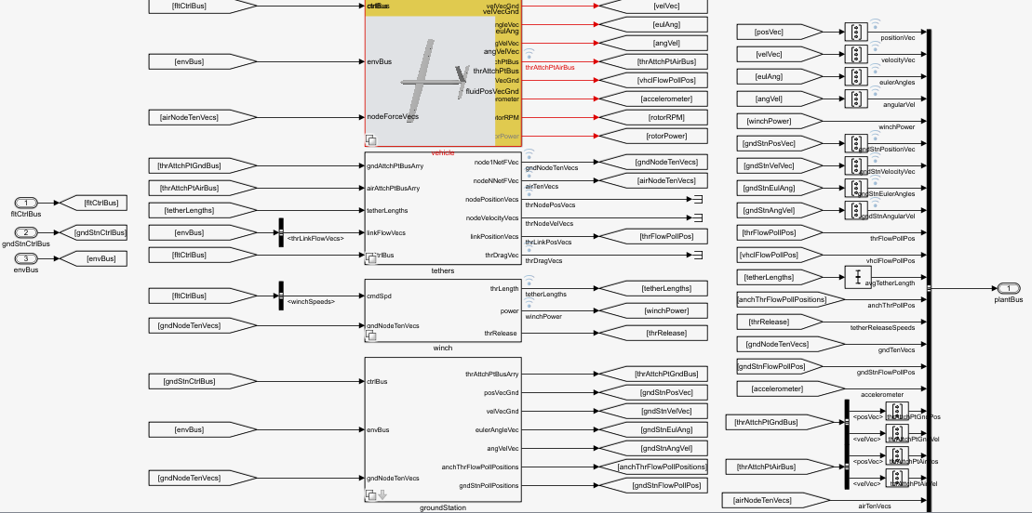
Plant Continued: Plant Components
Each plant variant contains a subsystem to model the dynamics of of the vehicle (kite), tether, winch (for spooling operation), and ground station
All of these are variant subsystems to allow for the selection of particular kite/tether/winch/ground station model

Slide 15
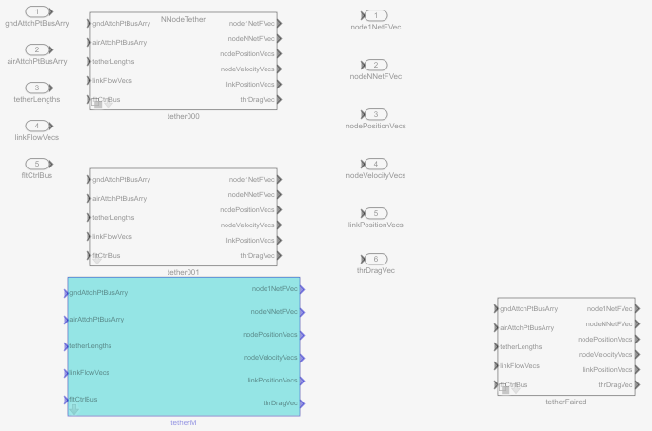
Plant Continued: Tether Model
The tether model subsystem is also selected as a variant
Some variants include fairings to reduce tether drag for a given segment of the tether

Slide 16
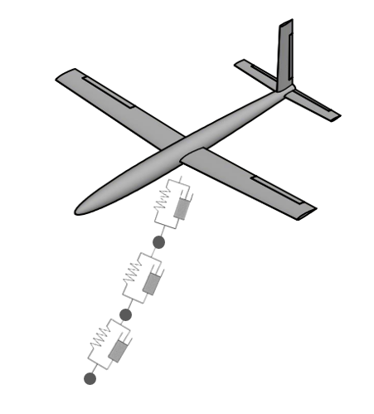
Plant Continued: Tether Model
All tethers are modeled as a chain of mass-spring-dampers connected by rigid nodes
Drag forces are computed based on the velocity at the midpoint between each node
Number of tether nodes can be increased to improve modeling fidelity at the cost of runtime

Slide 17
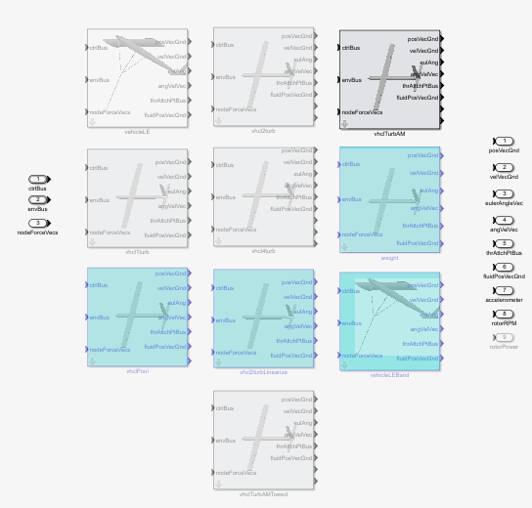
Plant Continued: Vehicle Model
The vehicle subsystem is also selected as a variant

Slide 18
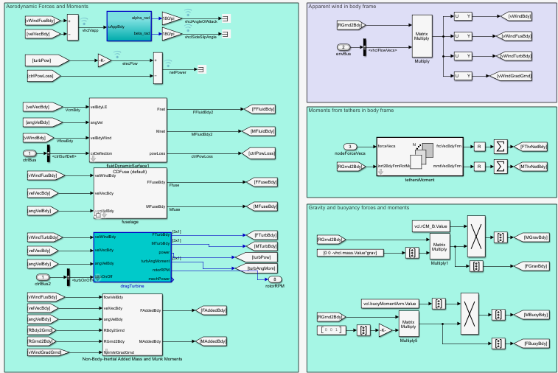
Plant Continued: Vehicle Model Forces and Moments
Within the vehicle model, forces and moments acting on the kite and turbines are calculated
Key Modeling Assumptions
Each wing, the fuselage, and the vertical and horizontal stabilizers are modeled individually
Surfaces and fuselage are rigid
All forces and moments act at the center of lift of each body

Slide 19
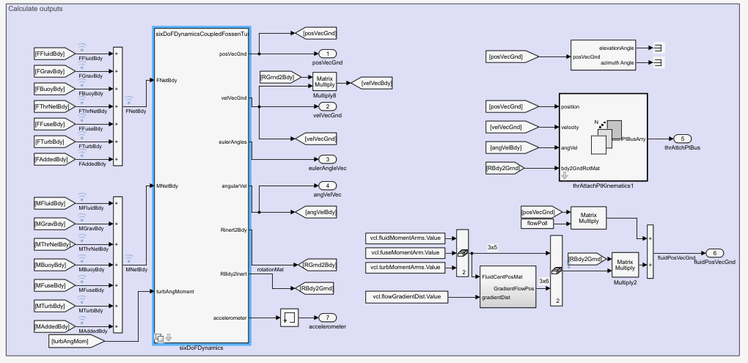
Plant Continued: Vehicle Model Dynamics
Combining forces and moments from lift, drag, gravity, buoyancy, added mass, the turbines, and the tether, the evolution of the kite’s Cartesian and angular position and velocity are calculated

Slide 20
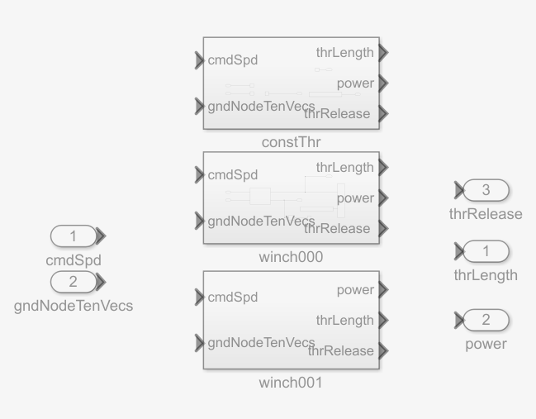
Plant Continued: Winch Model
Multiple winch variants exist to model winch dynamics and power consumption
First order dynamics are used to characterize change in tether length

Slide 21
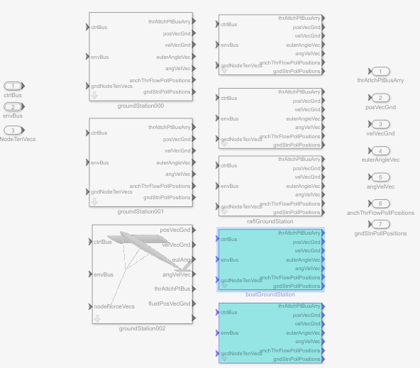
Plant Continued: Ground station
Several ground station models exist to model various modes of operation (towed flight, fixed ground station, etc.)
The ground station selected will determine the position of the first node of the tether
Depending on the variant chosen these dynamics may be coupled or decoupled to the kite

Slide 22
Environment
Inputs | Outputs
Position of tether nodes and kite | Flow vector at each provided position
The environment block models the flow at each important location (tether node, turbine hub, etc.)
Variants exist to model different flow fields (constant, shear profile, time-varying)

Slide 23
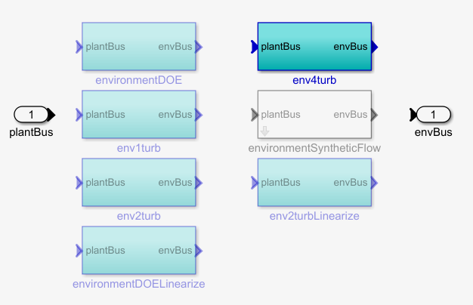
Environment Continued
Each high-level environment variant corresponds to a different plant model

Slide 24
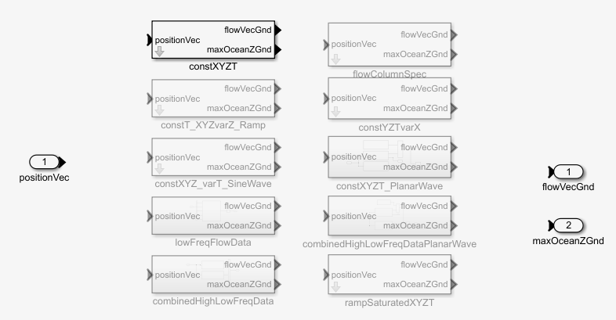
Environment Continued: Flow Variants
Within each high-level environment, a flow profile variant is selected
Each of these variants corresponds to a different spatiotemporally varying flow profile

Slide 25
Section 2: Ingredients for Running a Simulation

Slide 26
Overview
Before running a simulation, the following need to be loaded/initialized in the MATLAB workspace
Load vehicle, tether, controller, environment, sensor, and sensor processing models
Set high-level controller parameters
Set flight-controller gains
Set environmental conditions
Set vehicle and tether initial conditions
These objects are loaded in the context of a test script which is used to run simulations or sweeps

Slide 27
Loading a Model Component
Vehicles, tethers, high level controllers, flight controllers, environments, ground stations, and winches are all loaded as objects within MATLAB
These objects have properties that can be modified
Properties of objects are modified using the setValue function for a given object
e.g. vhcl.portWing.halfSpan.setValue(7,’m’) will set the half span of the port wing to 7m
Inputting *object*.*property* in the command terminal will provide a value and description of the property
The flight controller object (fltCtrl) and the high level controller object (hiLvlCtrl) can be modified in the same way to modify controller gains or flight path basis parameters
Similarly, environmental parameters can be modified in the environment (env) object
e.g. set the flow speed: env.water.setflowVec([flwSpd 0 0],'m/s');
A model component can be loaded using the custom MATLAB function loadComponent(‘compName’)
For example, the 4-turbine DoE kite is loaded using the command loadComponent('ultDoeKite')

Slide 28
Key Objects in the Model
The following is a list of the objects utilized within the simulation model
High Level Controller: hiLvlCtrl
Flight Controller: fltCtrl
Kite: vhcl
Environment: env
Winch: wnch
Turbines: vhcl.turbn (where n refers to the nth turbine)
Ground Station: gndStn
Sensors: sns
Sensors Processing: snsProc
Tether: thr, thr.tether1
Note that the number of nodes is set in the thr object while tether specific properties (like tether diameter) are set in the thr.tether1 object

Slide 29
Modifying Controller Parameters
All parameters and substructures of the flight controller can be viewed by examining the fltCtrl object
Gains can be adjusted by modified using the setValue using
Example changing the tangent roll derivative gain :
fltCtrl.tanRoll.kd.setValue(0.22,fltCtrl.tanRoll.kd.Unit)
Example changing the AoA curtailment proportional gain:
fltCtrl.alphaCtrl.kp.setValue(0.18,fltCtrl.alphaCtrl.kp.Unit)

Slide 30
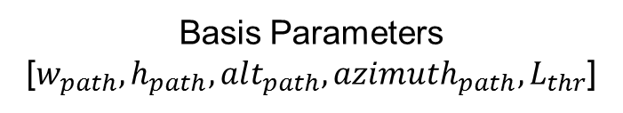
Setting Initial Conditions
For a simulation to run properly, the kite and tether states need to be initialized to reasonable values
The kite states are initialized using the custom function vhcl.setICsOnPath(pathIdx,PATHGEOMETRY,basisParams,gndStnPosVec,3*flwSpd)
Path Position index [0-1]
Path Shape (‘lemBoothNew’)
Ground Station Position Vector
Initial Kite Speed
Basis Parameters [$w_{path}, h_{path}, alt_{path}, azimuth_{path},L_{thr}$]
The tether ground node’s (the first tether node) position and velocity are set as equal to the ground station’s initial position and velocity
Similarly, the tether air node’s (the final tether node) position and velocity are set as equal to the kite’s initial position and velocity

Slide 31
Section 3: Simulation Demo

Slide 32
Simulation Demo
Open the OCTProject.prj file
Open the script DoEOceanKiteProject/testScripts/pathFollowingDemo_ts
On line 23, specify where you would like to save your simulation results
Set the “saveSim” flag on line 6 to 1 if you would like to save the simulation data
Run the script
All timeseries data is logged and saved within a “tsc” object. To view or plot any of this data, simply input tsc.*datastream*.plot (e.g. tsc.netPower.plot)
Create an animation of the simulation by inputting vhcl.animateSim(tsc,2,'tracerDuration',100)

Slide 33
Questions?

