Slide 1
How to Git
Git gud
By: Kavin (adapted from Alex Oladele)

Slide 2
What is a version control system (VCS)?
A system that keeps track of changes over time
Think of it as a time machine!

Slide 3
Applications with version control functionality
Office Processing Tools
Google Docs / Microsoft Word
Google Slides / Microsoft Powerpoint
Google Sheets / Microsoft Excel
File Storage providers
Google Drive
Dropbox
OneDrive
Box

Slide 4
What is Git?
Version control-based application typically used by coders to write code
Think of it like a time machine for your code
Can snapshot the code at different points in time
Allows different people to work on different parts of the same codebase* at the same time
Remembers all history changes forever for anyone to see!
Great for storing history of code 😄
Bad if you accidentally put a password in it 🙃
Is NOT GitHub
* Codebase in this context refers to just any file that can be opened in a text editor

Slide 5
What is GitHub?
An online platform for hosting codebases
Has other features on top of the basic git functionality
Can host a website on it
Can use it to deploy your code to servers
Cloud-hosted development environment
Wiki
Collaborative discussions

Slide 6
Git vs. GitHub?
GIT:
System to track changes to files over time
Works locally (does not require internet access)
Operates independently from GitHub (Bitbucket, GitLab, GitTea, etc..)
GITHUB:
Web-based central location for hosting git (and other version-control based) projects
Adds more collaboration features to git
Git is the local underlying technology
GitHub is the online platform that adds more collaboration to Git

Slide 7
Every important Git command
Or at least enough to get started

Slide 8
Making changes

Slide 9
git init
Make an existing folder (on your computer) a git repository* * Repository / repo: a central location where data or files are stored and managed

Slide 10
git clone [url]
Download an existing repository from another location to your computer

Slide 11
git add [file]
After changing a file, tell git that you’ve made changes that you want it to remember

Slide 12
git commit -m [describe changes]
After telling git about the file(s) you’ve changed, describe the changes you made to the files! (This is for Humans to know what you’ve done and is one of the most important steps)

Slide 13
git push
Send changes to central server (GitHub) so that others can finally see the changes!

Slide 14
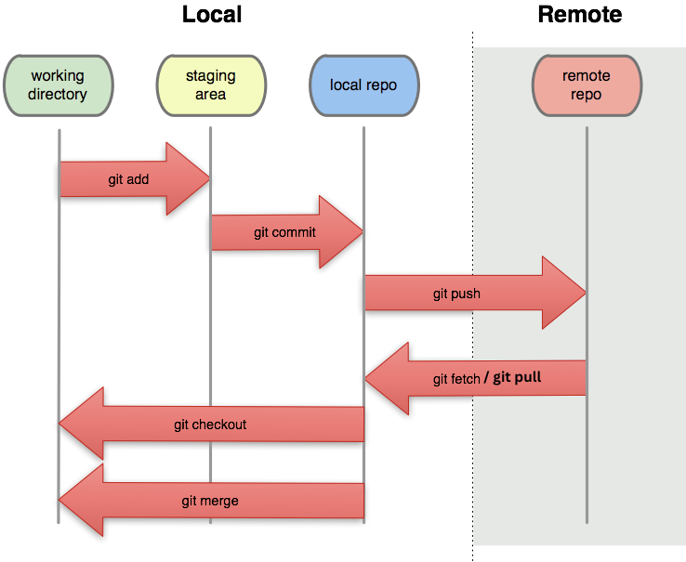

Slide 15
Getting changes

Slide 16
git pull
Pull in and apply the changes that someone else has made to the code on the central server (GitHub)

Slide 17
git fetch
This is technically git pull, except it doesn’t actually apply the changes to your local version of the files

Slide 18
git checkout [branch]
Switch your local version of the code to someone else’s version

Slide 19
git checkout -b [branch]
Create a new branch locally

Slide 20
Wait.… what is a branch?

Slide 21
Collaborative Git!
aka: git with friends

Slide 22
Work towards same goal: Branching
Allows you to create an independent / isolated area of development directly within the project
Think about writing an essay with a group
Everyone works on different paragraphs and have to bring them together
Speeds up collaborative development
Merge changes back to main branch with a Pull Request

Slide 23
Let’s do an activity!
CORE Lab’s Github

Slide 24
Lab Github Organization!
https://github.com/corelab-umich
Organizations are a way to collect multiple repositories under a “shared account”
Everybody has their own private account with access to the organization
Allows for collaboration and sharing easily
When students graduate, we don’t lose code!!!

Slide 25
Additional Resources

Slide 26
SSH Keys
Github “requires” SSH Keys for you to push/pull code
SSH Keys are a way for Github to make sure your computer is yours
It a secret passphrase that your computer creates and you give to github
Whenever you push/pull code, they will make sure the passphrase matches
How to set up SSH Keys:
https://docs.github.com/en/authentication/connecting-to-github-with-ssh/generating-a-new-ssh-key-and-adding-it-to-the-ssh-agent

Slide 27
Work towards same goals: Forking
An extreme form of branching
Creates your own remote copy of the main project that you have complete control over
Helps keep control of access permissions for the project
Always keeps a link back to the original project

Slide 28
Work towards different goals: Forking
Sometimes visions change and people disagree on the direction of where the project should be going
“I’m going to make my own project! And it’s going to be better than yours!”
Still retain the link to the original project
Allows you to pick up changes from it as needed

Slide 29
Good resources
Git cheat sheet
Codecademy Git Course
GitHub git guides
GitHub ‘Hello World’ tutorial

