Slide 1
CS 4911 Capstone
If you’re reading this through a web browser, it worked!

Slide 2
Test
This is the 2nd slide

Slide 3
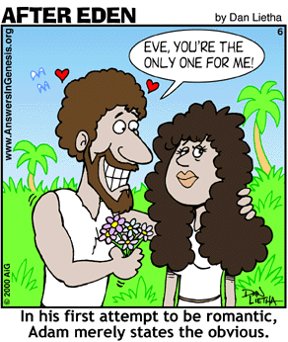
Test
This is the 3rd slide

Slide 4
DONE DONE DONE

