Slide 1
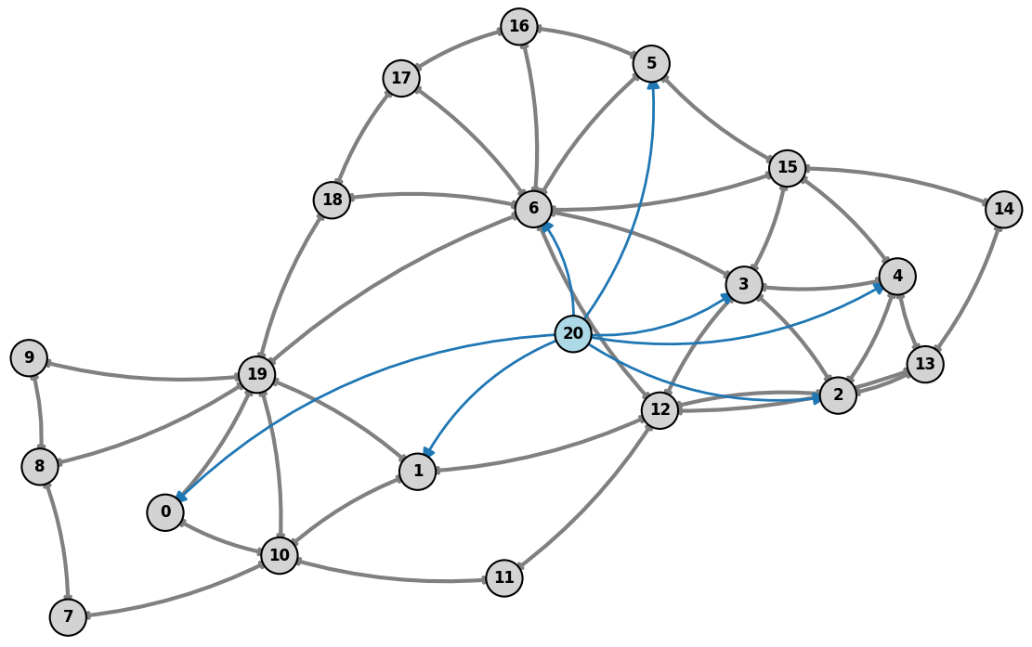
Graph-Structured Multi-Agent Reinforcement Learning for Power Grid Topology Control
Corentin Plumet
April 2026
Notes:
Today i ll present the refinement of my msc thesis on graph-structured multi-agent reinforcement learning for power grid topology control and the results of the first baseline i implemented.
The goal is to improve how reinforcement learning can scale and coordinate decisions in realistic power grid environments.”

Slide 2
Why This Thesis Topic
Motivation
TSO need fast congestion management under renewable variability and unforeseen events.
Topology actions are attractive because they can reroute flows before using costly redispatch.
RL is appealing for sequential decisions, but the control space is huge and safety-critical.
Problem Statement: Power grid operation requires:
Real-time decisions under uncertainty
Maintaining safety constraints (line limits, demand balance)
Operating over large, combinatorial action spaces
Limitations of current approaches
Optimization (OPF) is not scalable and too slow
Single-Agent RL: ignores decentralization
Existing MARL: struggles with coordination and scalability
Notes:
Power grid operation is a challenging control problem.
Operators need to make real-time decisions under uncertainty, while maintaining strict safety constraints like line limits and supply-demand balance.
One important control mechanism is topology actions, which allow rerouting power flows by modifying the grid structure.
Reinforcement learning is promising for this type of sequential decision-making problem, but the action space is extremely large.
Current approaches have limitations:
- optimization methods are too slow and don’t scale well and they don't enable real time monitoring
- single-agent RL ignores decentralization that is happening in real life
- and existing multi-agent RL still struggles with coordination and scalability.

Slide 3
Short Literature Review
Hybrid Systems
Recent surveys show that strong controllers are rarely pure end-to-end RL; they are hybrid systems.
Dominant ingredients are action-space reduction, rule-based safety logic, simulator filtering, and imitation bootstrapping.
Learning Methods
Topology control is the main transmission-grid use case, with PPO, DQN variants, SMAAC, MCTS, and multi-agent methods.
Graph encoders are increasingly used because the grid is naturally relational and topology changes alter the graph itself.
Takeaway
Structure in the controller matters at least as much as the RL algorithm choice.
Notes:
In the literature, topology control is mainly tackled using reinforcement learning methods like PPO, DQN variants, SMAAC, or MCTS.
A key observation is that structure of the whole pipeline matters as much as the RL algorithm itself.
Many successful approaches are not pure RL, but hybrid systems that include:
- action-space reduction
- safety heuristics
- or simulation-based filtering
Another important trend is the use of graph encoders, since the grid is naturally a graph and topology changes directly affect that structure.

Slide 4
Dive Into the Main Solutions Developped
One RL Agent with Safety Layers
[7] uses a GCN with Double-Q and verifies top-Q actions with power-flow simulation.
[1] trains PPO with dynamic action masking so infeasible busbar actions are never sampled.
These methods keep one global controller but rely on hard engineering tricks to stay safe.
Typical tricks are do-nothing fallback, pruning of symmetric actions, and simulator-based validation.
Their weakness is sample efficiency: the agent still sees a huge discrete action space.
Predict a target topology, not a raw switch
[8] SMAAC and [3] predict a goal topology, then a low-level policy realizes it.
Their key idea is the afterstate: learn from the resulting topology, not only from the raw switch action.
That matters because different switching sequences can lead to the same effective substation configuration.
First decide where to intervene, then decide how.
Notes:
To dive a little deeper i have been looking at a survey that summarize all the algorithms that won the l2rpn challenge and this is the main categories of succesfull agentthat won the challenge.
Some approaches rely on a single global agent with strong engineering tricks.
For example, they use graph neural networks combined with value-based RL, and validate actions using power-flow simulations.
Others reduce the action space using masking or pruning.
These methods can work, so mixing a single agent with rules, but they suffer because the action space remains very large.”
Another important idea is to predict a target topology instead of raw actions.
This is used in SMAAC, where the agent learns an afterstate representation—basically the resulting topology after an action.
This helps because multiple sequences of actions can lead to the same configuration. So it reduces the action space

Slide 5
Dive Into the Main Solutions Developped
Multi-agent and Imitation-enhanced GRL
[4] uses hierarchical multi-agent PPO/SAC where higher levels detect critical areas and lower levels act.
Multi-agent decomposition reduces the effective action space by assigning local responsibility to components.
[2] and [9] use expert demonstrations or imitation learning to improve sample efficiency.
The logic is practical: start from expert behavior, then let RL improve beyond it through interaction.
Notes:
In parallel, multi-agent approaches distribute control across the grid, or allows one agent to choose the substation on which we need to work and then another agent choose the action to take on this substation.
which improves scalability, but introduces coordination challenges.
Some works also use imitation learning to improve sample efficiency.

Slide 6
MARL2Grid: Multi-Agent RL for Power Grid Control [10]
The paper introduces the first benchmark for multi-agent reinforcement learning in realistic power-grid control.
It studies two types of tasks: discrete topology control and continuous redispatch / curtailment.
The benchmark is built on Grid2Op and models decentralized control with multiple agents acting on different parts of the grid.
It includes local or global observations, shared rewards, safety constraints, and an idle heuristic to simplify learning.
The authors evaluate standard MARL methods such as MAPPO, QPLEX, MASAC, and LagrMAPPO.
Main conclusion: current MARL methods can handle some settings, but still struggle on realistic topology control because of partial observability, coordination difficulty, and large combinatorial action spaces.
Notes:
The MARL2GRID paper is central to my work.
It introduces the first standardized benchmark for multi-agent reinforcement learning in realistic power grid operations.
It includes:
- decentralized control across substations
- partial observability
- safety constraints
- idle heuristics
Agents act on different parts of the grid but must coordinate through the environment.
They evaluate standard MARL methods like MAPPO and QPLEX.
The key result is that:
- MARL works reasonably well on small systems
- but fails to scale to realistic topology control tasks
This is mainly due to:
- combinatorial action spaces
- strong coupling between agent
- difficult credit assignment problem (what action what actually beneficial, who gets the credit)
So this paper clearly shows that current MARL methods are not sufficient.”

Slide 7
Research Gap
Limits of these studies
No standardized Evalution: Evaluation protocols differ a lot across papers: rewards, seeds, horizons, contingencies, and grid sizes are inconsistent.
Mostly Proof-of-Concept: Most studies rely on Grid2Op and relatively small IEEE-style benchmarks, with limited stressed-condition testing.
Limit in MARL:
Limited scalability to large grids (e.g., bus118)
Weak coordination under decentralization
Poor representation of grid structure in MARL baselines
Missing:
Graph-structured MARL
Efficient coordination under partial observability
Better abstraction of topology actions
Notes:
“From both the literature and MARL2GRID, we can identify clear gaps.
First, while MARL2GRID provides a benchmark, current methods still:
- do not scale well
- struggle with coordination
- and do not exploit the graph structure effectively
So what is missing is:
- graph-structured MARL
- better coordination mechanisms under partial observability
- and improved action abstractions to handle combinatorial complexity.”

Slide 8
Thesis Refinement
Main Goal:
Develop a graph-structured multi-agent reinforcement learning framework for power grid topology control that improves:
Coordination
Scalability
Generalization
Research Questions:
Does a GNN encoder improve performance vs standard MARL baselines?
Can latent communication improve coordination under partial observability?
Is it better to predict: raw topology actions or topology targets (after-state)
Does any improvements generalize to larger grid (bus14 to bus 118)
Notes:
“My goal is to develop a graph-structured multi-agent reinforcement learning framework that improves coordination, scalability, and generalization.
The idea is to combine:
- graph-based representations
- latent communication between agents
- and possibly topology-target abstractions inspired by afterstates.”
which leads us to 4 main questions:
-
-
-
-

Slide 9
Method Overview
Proposed Architecture
Graph Encoder (GNN)
Shared across agents
Captures grid topology and physical structure
Decentralized Agents
Each agent acts on its local region
Uses local graph embeddings
Latent Communication (optional)
Low-dimensional messages between agents
Encodes intent or risk
Action Head
raw topology actions
OR topology targets (extension)
Evaluation Protocol
Environments:
MARL2GRID: bus14, bus36, bus118
Baselines:
MAPPO / QPLEX
MLP vs GNN
Ablations:
No communication vs latent communication
Raw actions vs topology targets
Metrics:
Episode survival
Number of interventions
Safety violations
Sample efficiency
Notes:
“The proposed architecture is based on three components.
First, a shared graph encoder, which captures the grid structure.
Then, decentralized agents that act on local regions using these embeddings.
(((During training, we use centralized learning, but execution remains decentralized.)))
We also introduce optional latent communication, where agents exchange compact information.
Finally, we compare two action representations:
- direct topology actions
- or higher-level topology targets.”
“For evaluation, I will use the MARL2GRID benchmark.
I will compare:
- standard MARL baselines like MAPPO
- MLP vs GNN encoders
- with and without communication
And I will run ablations on action representations.
Performance will be measured using:
survival time
overload metrics
safety violations
and sample efficiency.”

Slide 10
Timeline
April: Baselines
Set up MARL2GRID
May: Graph Models
Implement GNN Encoder
June: MARL + Communication
Add latent communication
July: Action Abstraction
August: Evaluation
Add topology-target prediction
Large-scale experiments
Implement MAPPO
Baselines
Evaluate coordination
Compare vs MLP
Abalation studies
Final comparison
Notes:
“The timeline is structured in four stages:
- First, implementing baselines.
- Then adding the GNN encoder.
- Then introducing communication.
- And finally testing topology-target abstractions and scaling to larger grids.”

Slide 11
Agent logic
Greedy Agent
At each step, the agent generates feasible actions and simulates them
If the grid is safe (max rho < 0.95), it does nothing
It periodically checks whether returning to the reference topology is useful.
If the grid is stressed, it tests:
topology changes on the most relevant substations
reconnection of disconnected lines
disconnection of overloaded lines
It then selects the action that:
avoids failure
minimizes max rho
Reduces the number of overloaded lines
Maximizes immediate reward
PPO Baseline [11]
The agent acts only when ρ_max > 0.95; otherwise it does nothing.
It uses a reduced 133 action space, line reconnection, and no revert-to-reference-topology or simulation-based steering.
The input contains active power features, line loads ρ, overflow timer, and topology configuration.
The reward is RMargins, encouraging safe margins below thermal limits.
The policy network is a 3-layer FCNN (256-256-256, ReLU).
Training uses 100k environment interactions
Notes:
“The first baseline is a greedy agent based on simulation.
At each step:
- it generates a set of feasible actions
- and simulates their effect on the grid
If the grid is safe, meaning the maximum line load is below a threshold, it does nothing.
If the grid is stressed, it tests different actions such as:
- topology changes on critical substations
- reconnection of disconnected lines
- or disconnection of overloaded lines
Then it selects the action that:
- avoids failure
- minimizes the maximum line load
- reduces overloads
- and maximizes immediate reward.”
“The second baseline is a PPO agent.
- It follows a simplified strategy:
- it only acts when the grid is stressed
- otherwise it does nothing
The action space is reduced to 133 actions, mainly focusing on line reconnections.
The input includes:
- line loads
- power flows
- topology configuration
The reward encourages maintaining safe margins below thermal limits.
The policy is a simple fully connected neural network trained for about 100,000 interactions.”

Slide 12
Baseline Results
 | Environment | Nb Episodes | Mean length | % of completion | Episode survival | Interventions | Safety Violations
Do Nothing | 14 bus | 10 | 1205.4 | 14.9% | 0.0% | 0 | 2
 | 36 bus | 10 | 4610.3 | 57.2% | 20.0% | 0 | 27
Greedy | 14 bus | 10 | 8064.0 | 100.0% | 100.0% | 21 | 3
 | 36 bus | 10 | 5136.3 | 63.7% | 40.0% | 7 | 43
Random | 14 bus | 10 | 3.3 | 0.0% | 0.0% | 6 | 6
 | 36 bus | 10 | 67.1 | 0.8% | 0.0% | 34 | 7
PPO baseline | 14 bus | 10 | 7040.7 | 87.3% | 80.0% | na | na
Notes:
“The ‘do nothing’ agent performs poorly, especially on the 14-bus system where it quickly fails.
This shows that active control is necessary.”
“The random agent performs extremely poorly, confirming that the action space is highly structured and cannot be explored naively.”
“The greedy agent performs very well on the 14-bus system, achieving full survival.
However, performance drops on the 36-bus system.
This highlights that: => heuristic approaches do not scale well to more complex grids.”
“The PPO baseline achieves strong performance on the 14-bus system, with around 80% survival.
This shows that learning-based methods can capture useful strategies, but still do not reach perfect reliability.”

Slide 13
References
[1] Batanero, E.A., Fernández, Á., Barbero, Á. Graph-enhanced model-free reinforcement learning agents for efficient power grid topological control (2025)
[2] Fabrizio, C., Losapio, G., Mussi, M., Metelli, A.M., Restelli, M. Power grid control with graph-based distributed reinforcement learning (2025)
[3] Qiu, Z., Zhao, Y., Shi, W., Su, F., Zhu, Z. Distribution Network Topology Control Using Attention Mechanism-Based Deep Reinforcement Learning (2022)
[4] Sar, E., Zocca, A., Bhulai, S. Multi-Agent Reinforcement Learning for Power Grid Topology Optimization (2023)
[5] Taha, S., Poland, J., Knezovic, K., Shchetinin, D. Learning to Run a Power Network under Varying Grid Topology (2022)
[6] Xu, P., Duan, J., Zhang, J., Pei, Y., Shi, D., Wang, Z., Dong, X., Sun, Y. Active Power Correction Strategies Based on Deep Reinforcement Learning—Part I: A Simulation-driven Solution for Robustness (2022)
[7] Xu, P., Pei, Y., Zheng, X., Zhang, J. A simulation-constraint graph reinforcement learning method for line flow control (2020)
[8] Yoon, D., Hong, S., Lee, B.J., Kim, K.E. Winning the L2RPN Challenge: Power Grid Management via Semi-Markov Afterstate Actor-Critic (2021)
[9] Zhao, Y., Liu, J., Liu, X., Yuan, K., Ren, K., Yang, M. A graph-based deep reinforcement learning framework for autonomous power dispatch on power systems with changing topologies (2022)
[10] Marchesini, E., Boguslawski, E., Leite, A., Amato, C., Dussartre, M., Schoenauer, M., Donnot, B., Donti, P.L. MARL2GRID-TR: A Multi-Agent RL Benchmark in Power Grid Operations (2026)
[11] van der Sar, E., Zocca, A., Bhulai, S. Optimizing Power Grid Topologies with Reinforcement Learning: A Survey of Methods and Challenges (2025).

