Slide 1
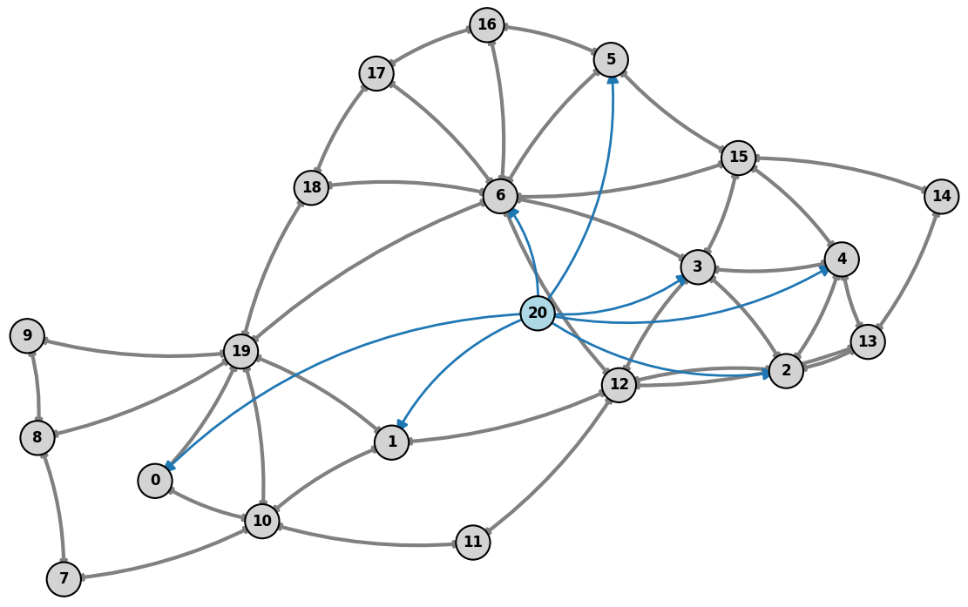
Research Plan:
Reliable Graph Reinforcement Learning for
Transmission Grid Topology Control
Corentin Plumet
Master Thesis Proposal
Grid2Op + reliability-oriented evaluation
Underexplored direction: busbar-aware heterogeneous GRL
April 2026

Slide 2
Why This Thesis Topic
Motivation
Transmission operators need fast congestion management under renewable variability and unforeseen events.
Topology actions are attractive because they can reroute flows before using costly redispatch.
Reinforcement learning is appealing for sequential decisions, but the control space is huge and safety-critical.
Problem Statement
Traditional optimization methods:
Struggle with scalability
Are too slow for real time decision making
RL approaches:
Remain mostly proof-of-concept on benchmark grids and simplified operating assumptions.
The open question is not only whether GRL can act, but whether it acts reliably under nominal and stressed conditions.

Slide 3
Short Literature Review
Hybrid Systems
Recent surveys show that strong controllers are rarely pure end-to-end RL; they are hybrid systems.
Dominant ingredients are action-space reduction, rule-based safety logic, simulator filtering, and imitation bootstrapping.
Learning Methods
Topology control is the main transmission-grid use case, with PPO, DQN variants, SMAAC, MCTS, and multi-agent methods.
Graph encoders are increasingly used because the grid is naturally relational and topology changes alter the graph itself.
Takeaway
Structure in the controller matters at least as much as the RL algorithm choice.

Slide 4
Dive Into the Main Solutions Developped
One RL Agent with Safety Layers
[7] uses a GCN with Double-Q / dueling RL and verifies top-Q actions with power-flow simulation.
[1] trains PPO with dynamic action masking so infeasible busbar actions are never sampled.
These methods keep one global controller but rely on hard engineering tricks to stay safe.
Typical tricks are do-nothing fallback, pruning of symmetric actions, and simulator-based validation.
Their weakness is sample efficiency: the agent still sees a huge discrete action space.
Planning and Model-based Methods
[5] learns a GCN world model that predicts line loading for candidate topologies.
MCTS expands a search tree over future actions and selects promising branches instead of brute-force exploration.
Only states with acceptable predicted loading are kept, which prunes catastrophic branches early.
[6] also uses MCTS, but combines it with double-dueling sub-agents on a reduced action space.
This family trades extra planning cost for better action selection in a combinatorial control problem.

Slide 5
Dive Into the Main Solutions Developped
Predict a target topology, not a raw switch
[8] SMAAC and [3] predict a goal topology, then a low-level policy realizes it.
Their key idea is the afterstate: learn from the resulting topology, not only from the raw switch action.
That matters because different switching sequences can lead to the same effective substation configuration.
First decide where to intervene, then decide how.
Multi-agent and Imitation-enhanced GRL
[4] uses hierarchical multi-agent PPO/SAC where higher levels detect critical areas and lower levels act.
[2] distributes control to line-level agents and shares a GAT encoder for local context.
Multi-agent decomposition reduces the effective action space by assigning local responsibility to components.
[2] and [9] use expert demonstrations or imitation learning to improve sample efficiency.
The logic is practical: start from expert behavior, then let RL improve beyond it through interaction.

Slide 6
Research Gap
Limits of these studies
No standardized Evalution: Evaluation protocols differ a lot across papers: rewards, seeds, horizons, contingencies, and grid sizes are inconsistent.
Mostly Proof-of-Concept: Most studies rely on Grid2Op and relatively small IEEE-style benchmarks, with limited stressed-condition testing.
Key ideas exist but not combined
Imitation learning
Advanced graph representation
Safe RL

Slide 7
Thesis Refinement
Main Goal: Develop a hybrid GRL framework that improves
Learning efficiency
Robustness
Safety
For power grid topology control
Research Questions:
Do better graph representations improve performance ?
Can imitation learning speed up training ?
Do safety mechanisms improve stability ?
How sensitive are results to evaluation setup ?
For power grid topology control

Slide 8
Approach
Proposed Approach
Graph representation of grid
Imitation learning (pretraining)
Reinforcement learning (fine-tuning)
Safety mechanism (action filtering)
Combine strengths of all components
Methodology
System Design
Graph Encoder: GNN heterogeneous
Policy Model: PPO
Training Pipeline
Stage 1: Imitation learning
Stage 2: RL optimization
Safety Layer
Action masking
Feasibility checks

Slide 9
Timeline
April - Baselines
Set up Grid2Op pipeline
Implement baseline
Define metrics & run initial experiments
July – Reinforcement Learning
Fine-tune with RL (PPO)
Add safety mechanisms (action masking)
Abalation studies
May – Graph Models
Design heterogeneous graph representation
Implement & compare GNN architectures
Analyze impact vs baseline
August – Evaluation
Test on multiple scenarios & grids
Evaluate generalization
Compare with baselines
June – Imitation Learning
Generate expert data (heuristics)
Train via behavioral cloning
Evaluate pretraining performance

Slide 10
References
[1] Batanero, E.A., Fernández, Á., Barbero, Á. Graph-enhanced model-free reinforcement learning agents for efficient power grid topological control (2025)
[2] Fabrizio, C., Losapio, G., Mussi, M., Metelli, A.M., Restelli, M. Power grid control with graph-based distributed reinforcement learning (2025)
[3] Qiu, Z., Zhao, Y., Shi, W., Su, F., Zhu, Z. Distribution Network Topology Control Using Attention Mechanism-Based Deep Reinforcement Learning (2022)
[4] Sar, E., Zocca, A., Bhulai, S. Multi-Agent Reinforcement Learning for Power Grid Topology Optimization (2023)
[5] Taha, S., Poland, J., Knezovic, K., Shchetinin, D. Learning to Run a Power Network under Varying Grid Topology (2022)
[6] Xu, P., Duan, J., Zhang, J., Pei, Y., Shi, D., Wang, Z., Dong, X., Sun, Y. Active Power Correction Strategies Based on Deep Reinforcement Learning—Part I: A Simulation-driven Solution for Robustness (2022)
[7] Xu, P., Pei, Y., Zheng, X., Zhang, J. A simulation-constraint graph reinforcement learning method for line flow control (2020)
[8] Yoon, D., Hong, S., Lee, B.J., Kim, K.E. Winning the L2RPN Challenge: Power Grid Management via Semi-Markov Afterstate Actor-Critic (2021)
[9] Zhao, Y., Liu, J., Liu, X., Yuan, K., Ren, K., Yang, M. A graph-based deep reinforcement learning framework for autonomous power dispatch on power systems with changing topologies (2022)

