Slide 1
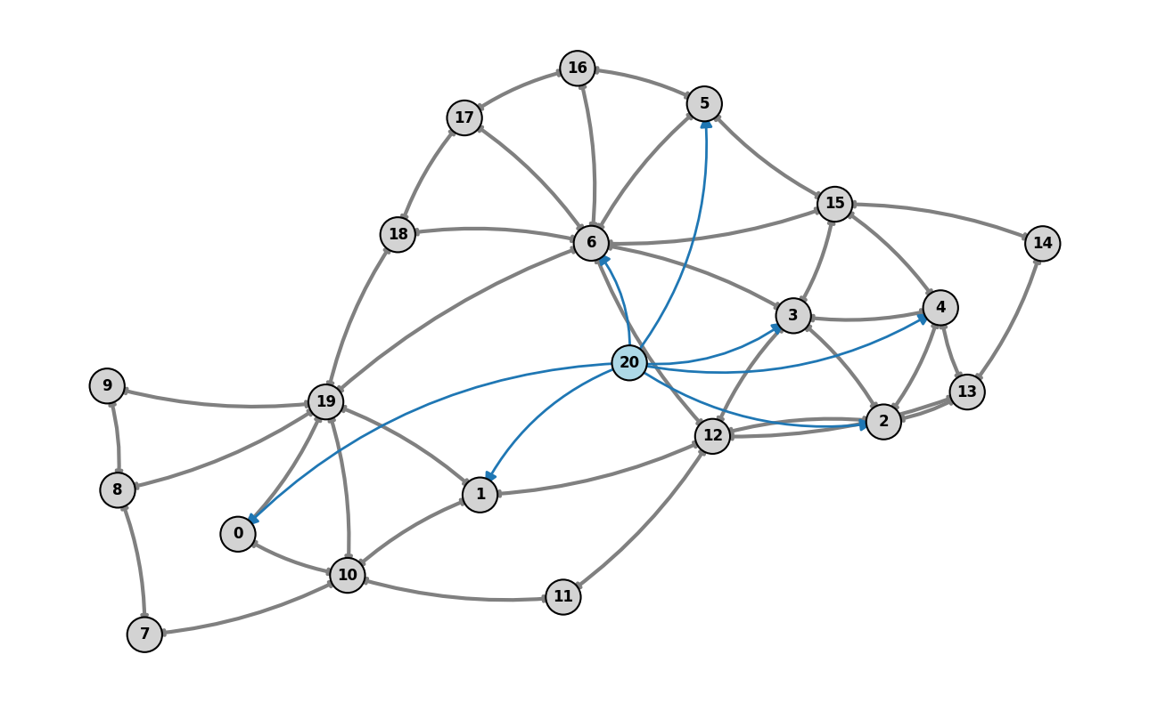

Topology Task
MARL2Grid
Multi-Agent Thesis Plan
Research Plan:
Building on MARL2Grid for
Multi-Agent Topology Control
From benchmark understanding to new decentralized learning methods for transmission-grid operation
Core thesis idea
Use MARL2Grid's topology benchmark as the testbed, then study how graph structure, coordination, and safe local control improve multi-agent performance.
Benchmark-first thesis framing
Instead of proposing a controller in isolation, the plan is to start from MARL2Grid's released topology benchmark and ask what genuinely helps multi-agent control scale.
Corentin Plumet
Master Thesis Proposal
April 2026
Research plan update: MARL2Grid-centered and explicitly multi-agent

Slide 2
Why this direction now
2
Operational relevance meets a benchmark that actually exposes the MARL problem
The opportunity is not just to do graph RL on grids, but to study decentralized topology control under realistic coordination constraints.
Operational pressure
Why MARL2Grid matters
Thesis stance
•
Topology control can reroute flows before using costly redispatch.
•
It formulates realistic topology control as a multi-agent benchmark, not as a toy decomposition.
Build on MARL2Grid instead of inventing a private evaluation setup.
Use the benchmark to ask a sharper question:
What helps decentralized topology controllers coordinate, generalize, and remain reliable?
•
Decisions must be made fast, under renewable variability and contingencies.
•
It exposes agent partitions, local vs global observations, heuristic transitions, and constraints.
•
Local interventions can create distant effects, so coordination matters by design.
•
It already provides baselines and released code on the topology side.
•
The action space is combinatorial and safety-critical.
benchmark realism
decentralized control
MARL2Grid topology research plan

Slide 3
Reframing the thesis
3
The original plan becomes stronger if we move from a single-agent reliability story to a MARL2Grid-driven coordination story
Previous framing
Updated framing
•
Main focus on graph representation for one controller.
•
Start from MARL2Grid's topology benchmark and released baselines.
•
Reliability is an evaluation lens layered on top of standard RL.
•
Center the thesis on coordination, partial observability, and decentralized action structure.
•
Safety layers and imitation are extra modules around a single decision-maker.
•
Use graph structure as a tool for multi-agent representation and communication.
shift the center of gravity
•
Benchmarking risk: harder to separate method gains from evaluation choices.
•
Treat reliability as a first-class benchmark outcome, not just an add-on metric.
Net effect: the project becomes more original, easier to justify experimentally, and much better aligned with the MARL2Grid paper and codebase.
MARL2Grid topology research plan

Slide 4
What MARL2Grid gives us
4
The topology side already defines a complete experimental stack for decentralized power-grid control
Environment
Multi-agent setup
Training stack
Safety & realism
•
Grid2Op-based topology task
•
Agent-to-substation partitions
•
MAPPO, QPLEX, LagrMAPPO
•
Idle heuristic
•
bus14, bus36, bus118
•
Difficulty 0: paper partitions
•
Async vectorized env wrapper
•
Constraint variants
•
5-minute control steps
•
Difficulty 1: one agent per substation
•
Evaluation hooks + checkpoints
•
Line overload logic
•
Substation-level topology actions
•
Local or global observations
•
Paper-aligned reward components
•
Long-horizon chronics
Implication for the thesis
The benchmark is not just a dataset or simulator. It already defines the decomposition, observability, and evaluation protocol, which lets the thesis focus on method design rather than benchmark creation.
MARL2Grid topology research plan

Slide 5
Research gap
5
MARL2Grid already shows the problem is not solved, especially for realistic topology control
Key signal from the paper: on the topology task, MAPPO performs well on bus14 but current baselines still fail to scale cleanly to harder settings like bus118.
Coordination
Representation
Agents act locally but affect distant lines through shared AC dynamics. That makes naive decentralization brittle.
Per-agent MLP observations may discard useful graph structure about neighboring substations and boundary lines.
Exploration
Evaluation
Topology actions are combinatorial, and the idle heuristic can reduce the already narrow windows where agents actually learn to coordinate.
A good thesis must compare methods across agent partitions, observation regimes, constraints, and scaling levels, not only one favorable setup.
MARL2Grid topology research plan

Slide 6
Objective and questions
6
The thesis should ask what makes decentralized topology control work better on MARL2Grid, not only whether a graph encoder helps
Main objective
Develop and evaluate graph-aware multi-agent methods for MARL2Grid topology control, with a focus on coordination, safe local decision-making, and scaling behavior.
1
Can graph-aware local policies outperform vanilla MAPPO/QPLEX on the topology benchmark?
2
Which decentralization choices matter most: agent partition, observation scope, or explicit communication?
3
How should safe action filtering or heuristic guidance be integrated without harming learning?
4
What evaluation protocol best captures reliability, margin management, and scalability across bus14, bus36, and bus118?
MARL2Grid topology research plan

Slide 7
Proposed method stack
7
A layered approach that starts simple, then adds graph structure, coordination, and safety
1. Benchmark layer
2. Representation layer
3. Coordination layer
4. Safe action layer
MARL2Grid topology env
fixed partitions
local/global observations
paper baselines
substation + line encoder
shared or partially shared
boundary-aware context
centralized critic
optional communication
neighbor-zone reasoning
local proposal + pruning
symmetry reduction
fallbacks for risky actions
Execution plan
Milestone A: reproduce MARL2Grid topology baselines and evaluation.
Milestone B: replace the local MLP policy with a graph-aware multi-agent encoder.
Milestone C: study explicit coordination and safe local action selection.
Milestone D: evaluate across partitions, observability regimes, and grid scales.
MARL2Grid topology research plan

Slide 8
Experimental plan
8
The contribution should be visible both in method design and in how rigorously the benchmark is used
Baselines
Single-agent PPO, MAPPO, QPLEX, LagrMAPPO from the MARL2Grid codebase
Method variants
MLP vs graph encoder, shared vs agent-specific parameters, no-comm vs comm, with/without safety filtering
Benchmark axes
bus14 → bus36 → bus118, fixed partitions vs one-agent-per-substation, decentralized vs global observations
Metrics
survival, line margin, overload cost, topology distance, seed variance, and sample efficiency
Success criterion: not only better peak performance on bus14, but a better scaling trend and clearer coordination behavior as the task becomes harder.
MARL2Grid topology research plan

Slide 9
Timeline
9
A realistic thesis schedule should move from benchmark mastery to method contribution, then to evaluation
April
May
June
July
August
1
2
3
4
5
Reproduce topology baselines
Formalize graph MARL setup
Implement graph-aware baseline
Coordination + safety ablations
Final evaluation and writing
Audit the MARL2Grid code,
run the reference baselines,
and lock an evaluation protocol.
Define state/action abstractions,
pick graph encoders,
and choose the first MARL variant.
Integrate the first graph-based
multi-agent controller
and compare against MAPPO/QPLEX.
Add communication or
coordination modules,
plus filtering or pruning studies.
Run the full benchmark matrix,
synthesize the results,
and write the thesis narrative.
MARL2Grid topology research plan

Slide 10
Expected contributions
10
A strong thesis outcome combines a clean benchmark story, a method contribution, and reusable evaluation practice
What the thesis should deliver
Anchor references
•
A MARL2Grid-centered research pipeline for topology control.
Marchesini et al. (2026) MARL2Grid-TR
Yu et al. (2022) MAPPO
Wang et al. (2021) QPLEX
Marchesini et al. (2025) RL2Grid
Recent graph-RL / multi-agent topology-control papers from the original plan
•
At least one graph-aware multi-agent baseline that is stronger than the released reference methods.
•
A clear ablation map of what helps: graph structure, coordination, observability, or safety logic.
•
A reusable evaluation protocol for future MARL topology work.
The proposal becomes sharper if the benchmark is the backbone and the method question is explicitly multi-agent.
Updated deck built from the original research plan and redirected toward MARL2Grid

