Slide 1
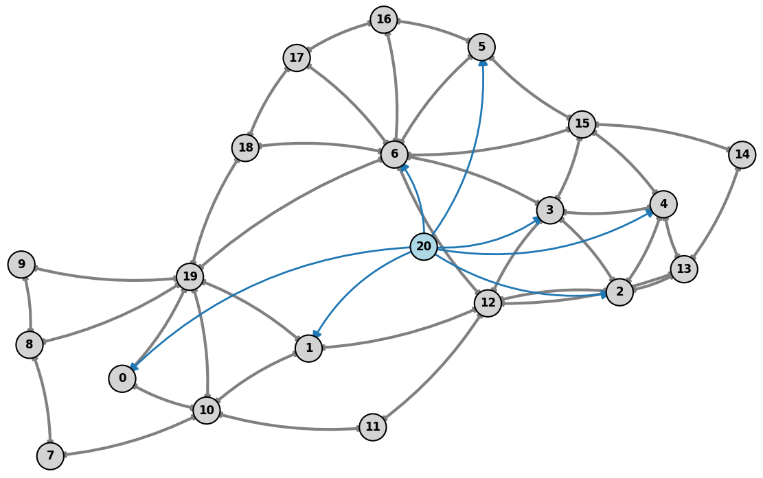
After-State Guided Multi-Agent Reinforcement Learning with Latent Communication for Power Grid Control
Corentin Plumet
April 2026

Slide 2
Why This Thesis Topic
Motivation
Transmission operators need fast congestion management under renewable variability and unforeseen events.
Topology actions are attractive because they can reroute flows before using costly redispatch.
Reinforcement learning is appealing for sequential decisions, but the control space is huge and safety-critical.
Problem Statement
Traditional optimization methods:
Struggle with scalability
Are too slow for real time decision making
RL approaches:
Remain mostly proof-of-concept on benchmark grids and simplified operating assumptions.
The open question is not only whether GRL can act, but whether it acts reliably under nominal and stressed conditions.

Slide 3
Why This Thesis Topic
Limitations of Traditional Optimization
Struggle with high-dimensional and combinatorial decision spaces
Require solving nonlinear, non-convex power flow equations in real time
Poorly handle uncertainty from renewable energy and demand fluctuations
Become computationally intractable for large-scale grids and long horizons
=> Not suitable for real-time, large-scale grid operation
Limitations of Single-Agent RL
Most existing RL approaches assume centralized control and ignore the decentralized nature of the real monitoring of power systems
Struggle with.
Scalability
Partial observability
Coordination across regions
=> Remain mostly proof of concept on simplified benchmarks
Why Mutli Agent RL is promising
Real grids are naturally decentralized: different operators per regions
Decision are locally observed but globally coupled: local action affects distant parts of the grid
Requires: Coordination under partial infromation, scalable distributed decision making, joint handling of safety constraints
=> MARL provides a framework for cooperative, scalable amd close to reality control

Slide 4
Short Literature Review
Hybrid Systems
Recent surveys show that strong controllers are rarely pure end-to-end RL; they are hybrid systems.
Dominant ingredients are action-space reduction, rule-based safety logic, simulator filtering, and imitation bootstrapping.
Learning Methods
Topology control is the main transmission-grid use case, with PPO, DQN variants, SMAAC, MCTS, and multi-agent methods.
Graph encoders are increasingly used because the grid is naturally relational and topology changes alter the graph itself.
Takeaway
Structure in the controller matters at least as much as the RL algorithm choice.

Slide 5
Dive Into the Main Solutions Developped
One RL Agent with Safety Layers
[7] uses a GCN with Double-Q / dueling RL and verifies top-Q actions with power-flow simulation.
[1] trains PPO with dynamic action masking so infeasible busbar actions are never sampled.
These methods keep one global controller but rely on hard engineering tricks to stay safe.
Typical tricks are do-nothing fallback, pruning of symmetric actions, and simulator-based validation.
Their weakness is sample efficiency: the agent still sees a huge discrete action space.
Planning and Model-based Methods
[5] learns a GCN world model that predicts line loading for candidate topologies.
MCTS expands a search tree over future actions and selects promising branches instead of brute-force exploration.
Only states with acceptable predicted loading are kept, which prunes catastrophic branches early.
[6] also uses MCTS, but combines it with double-dueling sub-agents on a reduced action space.
This family trades extra planning cost for better action selection in a combinatorial control problem.

Slide 6
Dive Into the Main Solutions Developped
Predict a target topology, not a raw switch
[8] SMAAC and [3] predict a goal topology, then a low-level policy realizes it.
Their key idea is the afterstate: learn from the resulting topology, not only from the raw switch action.
That matters because different switching sequences can lead to the same effective substation configuration.
First decide where to intervene, then decide how.
Multi-agent and Imitation-enhanced GRL
[4] uses hierarchical multi-agent PPO/SAC where higher levels detect critical areas and lower levels act.
[2] distributes control to line-level agents and shares a GAT encoder for local context.
Multi-agent decomposition reduces the effective action space by assigning local responsibility to components.
[2] and [9] use expert demonstrations or imitation learning to improve sample efficiency.
The logic is practical: start from expert behavior, then let RL improve beyond it through interaction.

Slide 7
EPFL
Research Gap
6
What current studies still miss
After-state
Communication
Evidence
Promising in topology control, but rarely studied as an explicit coordination signal in decentralized MARL.
Coordination is mostly implicit through rewards or centralized training, not through learned agent-to-agent messaging.
Results remain fragmented across small grids and inconsistent evaluation setups, so it is still unclear what really scales.
Open research gap for this thesis
Representation gap
Coordination gap
Benchmark gap
Local observations do not tell an agent enough about the grid state it will create after a topology switch.
Neighboring agents still lack a compact way to share intent or expected after-state information across zone boundaries.
MARL2Grid has not yet been used to test whether after-state prediction and learned communication improve topology control.

Slide 8
Thesis Refinement
Main Goal:
Develop a scalable and coordinated multi-agent reinforcement learning framework that uses after state as a goal to reach.
Research Questions:
After state
How can after-state prediction improve decision-making in power grid control ?
Coordination
How can agents coordinate using latent communication instead of full state sharing ?
Does sharing compressed intent representations improve multi-agent cooperation ?
Scalability
Can combining after-state prediction and latent communication improve performance in large-scale, combinatorial environments ?
Does the approach generalize from small grids to more realistic larger systems ?

Slide 9
EPFL
Approach
8
Investigate whether after-state prediction and lightweight communication improve decentralized topology control on MARL2Grid.
1
Local observations
2
Latent communication
3
After-state predictor
4
Action selection
Each agent observes its zone, boundary lines, and local grid features from the MARL2Grid topology task.
Neighboring agents exchange compressed messages that summarize intent or boundary-state information.
A predictor estimates the post-action local topology and overload evolution before the switch is applied.
A MAPPO-style policy uses the communicated state and predicted after-state to choose the topology action.
Training setup
Evaluation on MARL2Grid
•
MAPPO backbone with an auxiliary after-state prediction loss.
•
Topology benchmark under decentralized and centralized observation settings.
•
Message bottleneck controls how much agents can share.
•
Metrics: survival, margins, overload reduction, sample efficiency.
•
Ablations: baseline, after-state only, communication only, both.
•
Scalability study from smaller grids to harder MARL2Grid scenarios.

Slide 10
EPFL
Timeline
15
April - MARL2Grid setup
July - Joint MARL training
•
Reproduce topology baselines and environment setup
•
Integrate after-state and communication into MAPPO
•
Fix metrics, seeds, and agent partitions
•
Run ablations for each component
•
Define the after-state targets
•
Tune under decentralized observations
May - After-state prediction
August - Evaluation and writing
•
Design boundary-aware after-state representations
•
Benchmark on MARL2Grid topology scenarios
•
Train the predictor on collected rollouts
•
Study scalability and failure cases
•
Test whether prediction quality helps control
•
Write the thesis and final presentation
June - Communication module
•
Implement latent messages between neighboring agents
•
Compare bottlenecks and neighborhood choices
•
Check whether communication improves coordination

Slide 11
References
[1] Batanero, E.A., Fernández, Á., Barbero, Á. Graph-enhanced model-free reinforcement learning agents for efficient power grid topological control (2025)
[2] Fabrizio, C., Losapio, G., Mussi, M., Metelli, A.M., Restelli, M. Power grid control with graph-based distributed reinforcement learning (2025)
[3] Qiu, Z., Zhao, Y., Shi, W., Su, F., Zhu, Z. Distribution Network Topology Control Using Attention Mechanism-Based Deep Reinforcement Learning (2022)
[4] Sar, E., Zocca, A., Bhulai, S. Multi-Agent Reinforcement Learning for Power Grid Topology Optimization (2023)
[5] Taha, S., Poland, J., Knezovic, K., Shchetinin, D. Learning to Run a Power Network under Varying Grid Topology (2022)
[6] Xu, P., Duan, J., Zhang, J., Pei, Y., Shi, D., Wang, Z., Dong, X., Sun, Y. Active Power Correction Strategies Based on Deep Reinforcement Learning—Part I: A Simulation-driven Solution for Robustness (2022)
[7] Xu, P., Pei, Y., Zheng, X., Zhang, J. A simulation-constraint graph reinforcement learning method for line flow control (2020)
[8] Yoon, D., Hong, S., Lee, B.J., Kim, K.E. Winning the L2RPN Challenge: Power Grid Management via Semi-Markov Afterstate Actor-Critic (2021)
[9] Zhao, Y., Liu, J., Liu, X., Yuan, K., Ren, K., Yang, M. A graph-based deep reinforcement learning framework for autonomous power dispatch on power systems with changing topologies (2022)

