Slide 1
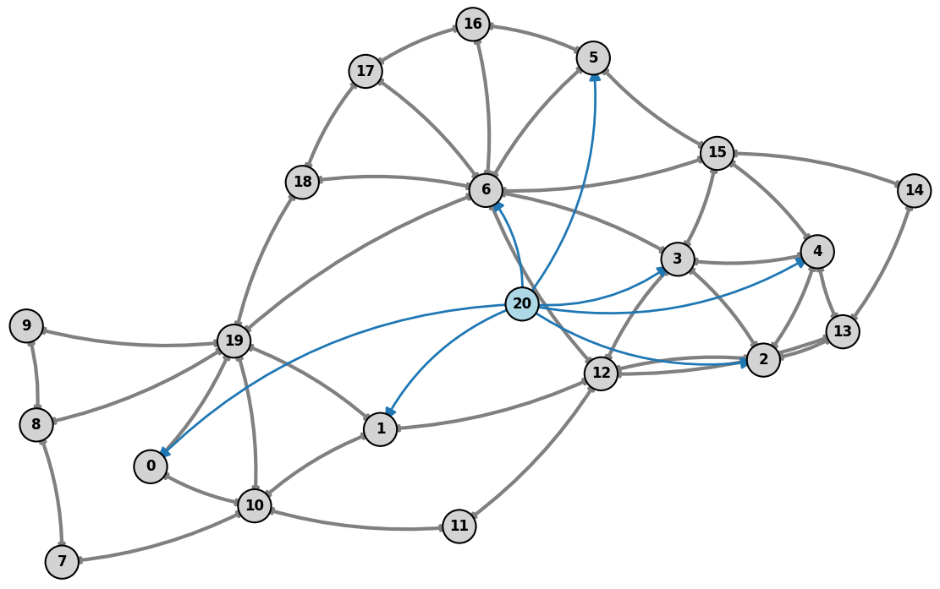

Graph-Structured Multi-Agent Reinforcement Learning for Power Grid Topology Control
Corentin Plumet
April 2026
Notes:
Today i ll present the refinement of my msc thesis on graph-structured multi-agent reinforcement learning for power grid topology control and the results of the first baseline i implemented.
The goal is to improve how reinforcement learning can scale and coordinate decisions in realistic power grid environments.”

Slide 2
Motivation
Motivation
TSO need fast congestion management under renewable variability and unforeseen events.
Topology actions are attractive because they can reroute flows before using costly redispatch.
Problem Statement: Power grid operation requires:
Real-time decisions under uncertainty
Maintaining safety constraints (line limits, demand balance)
Operating over large, combinatorial action spaces
Limitations of current approaches
Optimization (OPF) is not scalable and too slow
Single-Agent RL: ignores decentralization
Research Questions:
Does a GNN encoder improve performance vs standard MARL baselines?
Can a Multi agent approach match single agent approach under partial observability?
Does any improvements generalize to larger grid (bus14 to bus 36)?
Can the agent learn how to behave in a « human » operator way ?
Notes:
Power grid operation is a challenging control problem.
Operators need to make real-time decisions under uncertainty, while maintaining strict safety constraints like line limits and supply-demand balance.
One important control mechanism is topology actions, which allow rerouting power flows by modifying the grid structure.
Reinforcement learning is promising for this type of sequential decision-making problem, but the action space is extremely large.
Current approaches have limitations:
- optimization methods are too slow and don’t scale well and they don't enable real time monitoring
- single-agent RL ignores decentralization that is happening in real life
- and existing multi-agent RL still struggles with coordination and scalability.

Slide 3
Literature Review
Setting | Representative work | Main idea
Single agent | Subramanian et al. (2021) | A centralized DRL agent selects topology changes on IEEE-14; demonstrated generalization across unseen chronics. Paper
Single agent | Yoon et al. (2021) | Hierarchical SMAAC agent combining graph attention, action decomposition and afterstate evaluation; won L2RPN WCCI-2020. Paper
Single agent + search | Zhou et al. (2021) | Policy proposes a small action set, then Grid2Op simulation filters and selects safe actions. Paper
Multi-agent | van der Sar et al. (2023) | Substation-level agents trained using independent/dependent PPO or discrete SAC; competitive with single-agent RL on a small grid. Paper
Coordinated multi-agent | de Mol et al. (2025) | Regional agents propose actions and a central coordinator selects one; improves scalability and sample efficiency, especially on harder grids. Paper
Decentralized benchmark | Marchesini et al. (2026) | MARL2Grid-TR introduces configurable substation/generator agents, local observations and topology or redispatch tasks. Paper
Notes:
In the literature, topology control is mainly tackled using reinforcement learning methods like PPO, DQN variants, SMAAC, or MCTS.
A key observation is that structure of the whole pipeline matters as much as the RL algorithm itself.
Many successful approaches are not pure RL, but hybrid systems that include:
- action-space reduction
- safety heuristics
- or simulation-based filtering
Another important trend is the use of graph encoders, since the grid is naturally a graph and topology changes directly affect that structure.

Slide 4
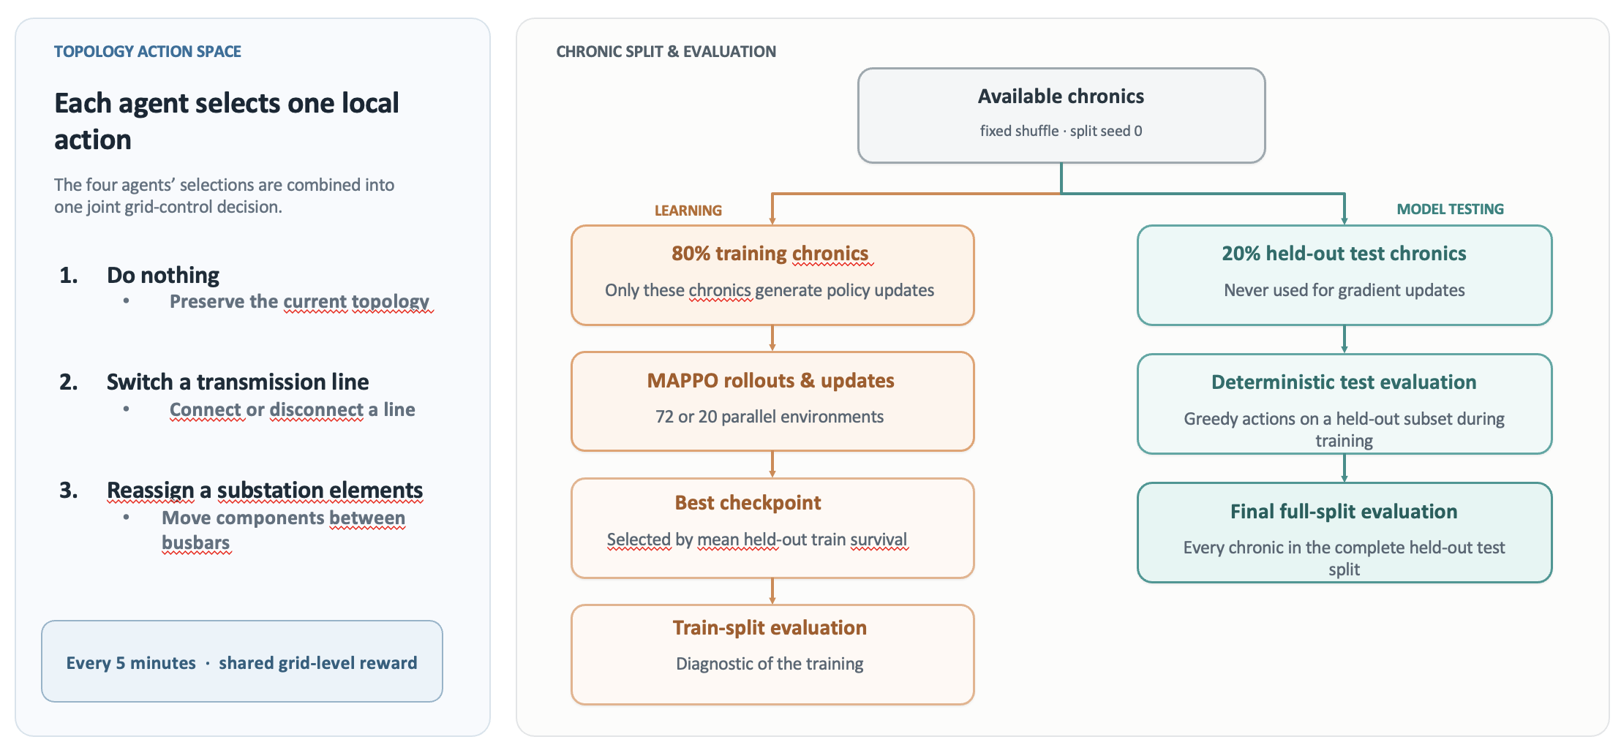
General Data Splitting and Actions
Notes:
“A chronic is a complete time series of load, generation and possible disturbances. I create the train/test split once using a fixed seed. Training workers only access the 80% training subset. During training, I periodically evaluate greedily on held-out chronics and select the best checkpoint using test survival. The final reported performance is computed over the entire held-out split rather than a small sample.”

Slide 5
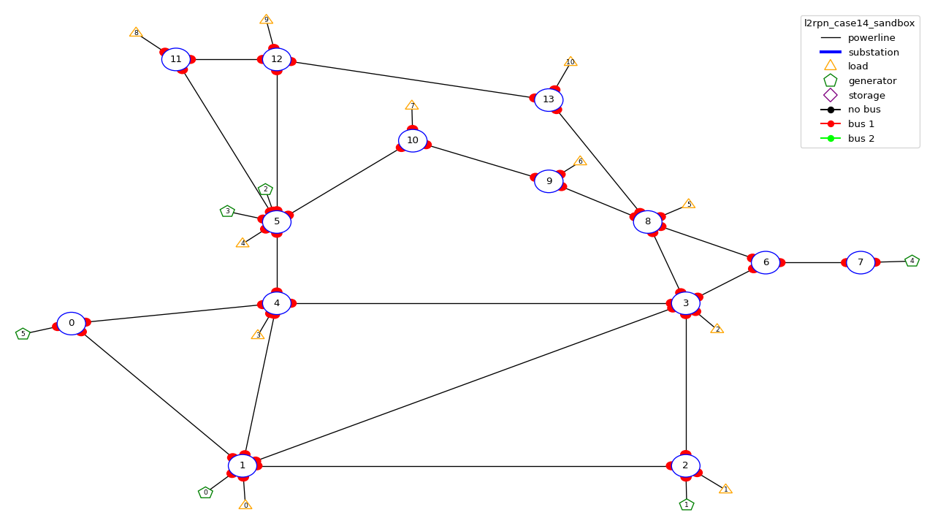
IEEE 14: environment setup
Agent | Controlled substations | Local action space
Agent 0 | 0, 1, 2, 4 | 61 actions
Agent 1 | 3, 6, 7, 8 | 55 actions
Agent 2 | 5, 9, 10, 11, 12, 13 | 89 actions
Table 1: Agent-to-substation assignments and action space for the local observation setup of bus14
Fig 1: Substations controlled by each agents, l2rpn_sandbox environment
Notes:
“The grid is partitioned into three strongly connected regions. Each decentralized actor controls only its assigned substations, but its decisions affect the entire grid through the AC power flow. Coordination is therefore implicit: an action that solves a local overload can create congestion in another agent’s region.”

Slide 6
IEEE 14: Baseline, Original Hyperparameters
Hyperparameter | Value
TRAINING
Total timesteps | 25M
Rollout steps per environment | 2,000
Total rollout batch | 20,000
Evaluation frequency | 80,000
NETWORK
Actor architecture | MLP · 256 × 3
Critic architecture | MLP · 256 × 3
Activation | ReLU
Hyperparameter | Value
PPO OPTIMIZATION
Actor learning rate | 3 × 10⁻⁵
Critic learning rate | 3 × 10⁻⁵
Learning-rate schedule | Linear decay
Discount factor γ | 0.99
GAE parameter λ | 0.95
Update epochs | 80
Minibatches | 4
Clip coefficient ε | 0.20
Target KL | 0.02
Maximum gradient norm | 10.0
Entropy coefficient | 0.01
Value-loss coefficient | 0.50
Table 2: original parameters of the baseline paper for MAPPO training
Source: original IEEE-14 MAPPO baseline hyperparameters
Notes:
To dive a little deeper i have been looking at a survey that summarize all the algorithms that won the l2rpn challenge and this is the main categories of succesfull agentthat won the challenge.
Some approaches rely on a single global agent with strong engineering tricks.
For example, they use graph neural networks combined with value-based RL, and validate actions using power-flow simulations.
Others reduce the action space using masking or pruning.
These methods can work, so mixing a single agent with rules, but they suffer because the action space remains very large.”
Another important idea is to predict a target topology instead of raw actions.
This is used in SMAAC, where the agent learns an afterstate representation—basically the resulting topology after an action.
This helps because multiple sequences of actions can lead to the same configuration. So it reduces the action space

Slide 7
IEEE 14: Baseline, New Hyperparameters
Hyperparameter | New Value | Paper Baseline
Environment
n_envs (number parallel environment) | 20 | 10
PPO OPTIMIZATION
Total time step | 20,000,000 | 25,000,000
Actor learning rate | 1e-4 | 3e-5
Critic architecture | 1e-4 | 3e-5
Gamma | 0.9 | 0.99
Update epochs | 10 | 80
Minibatches | 16 | 4
Maximum gradient norm | 1.0 | 10.0
Structural changes
Reward Normalization (how does it work ?)
Do-Nothing initialization prior
1 critic update per batch instead of n_agent
Extra shaping rewards ???
Table 3: new hyperparameters for MAPPO training
Source: original IEEE-14 MAPPO baseline hyperparameters
Notes:
To dive a little deeper i have been looking at a survey that summarize all the algorithms that won the l2rpn challenge and this is the main categories of succesfull agentthat won the challenge.
Some approaches rely on a single global agent with strong engineering tricks.
For example, they use graph neural networks combined with value-based RL, and validate actions using power-flow simulations.
Others reduce the action space using masking or pruning.
These methods can work, so mixing a single agent with rules, but they suffer because the action space remains very large.”
Another important idea is to predict a target topology instead of raw actions.
This is used in SMAAC, where the agent learns an afterstate representation—basically the resulting topology after an action.
This helps because multiple sequences of actions can lead to the same configuration. So it reduces the action space

Slide 8
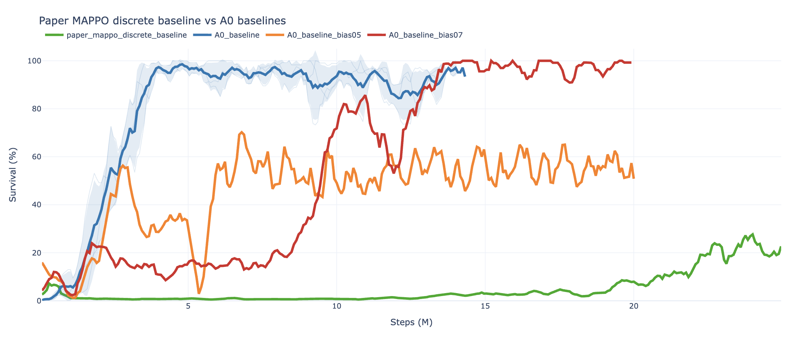
IEEE 14: Baseline, Results
Fig 2: Episodic survival during trainin of the paper baseline vs our baselines with new hyperparameter and structure
Notes:
To dive a little deeper i have been looking at a survey that summarize all the algorithms that won the l2rpn challenge and this is the main categories of succesfull agentthat won the challenge.
Some approaches rely on a single global agent with strong engineering tricks.
For example, they use graph neural networks combined with value-based RL, and validate actions using power-flow simulations.
Others reduce the action space using masking or pruning.
These methods can work, so mixing a single agent with rules, but they suffer because the action space remains very large.”
Another important idea is to predict a target topology instead of raw actions.
This is used in SMAAC, where the agent learns an afterstate representation—basically the resulting topology after an action.
This helps because multiple sequences of actions can lead to the same configuration. So it reduces the action space

Slide 9
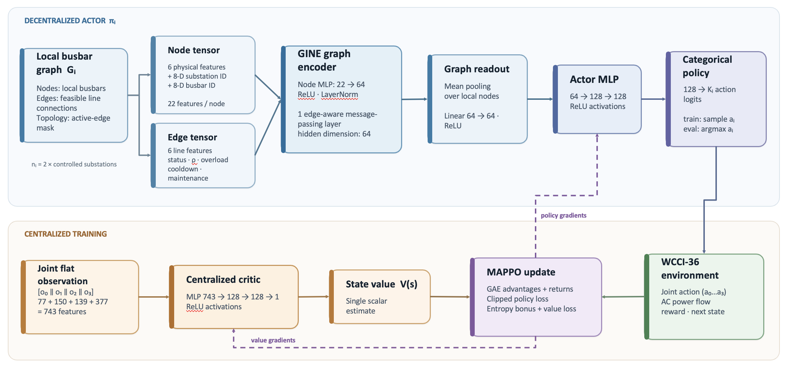
IEEE 14: Graph variations, structure
Notes:
To dive a little deeper i have been looking at a survey that summarize all the algorithms that won the l2rpn challenge and this is the main categories of succesfull agentthat won the challenge.
Some approaches rely on a single global agent with strong engineering tricks.
For example, they use graph neural networks combined with value-based RL, and validate actions using power-flow simulations.
Others reduce the action space using masking or pruning.
These methods can work, so mixing a single agent with rules, but they suffer because the action space remains very large.”
Another important idea is to predict a target topology instead of raw actions.
This is used in SMAAC, where the agent learns an afterstate representation—basically the resulting topology after an action.
This helps because multiple sequences of actions can lead to the same configuration. So it reduces the action space

Slide 10
Observation features
Feature category | Observation variables | Graph feature attribution
Generation | gen_p, gen_theta | Node
Demand | load_p, load_theta | Node
Line loading | rho | Edge
Line status | line_status | Edge + mask
Overload duration | timestep_overflow | Edge
Line cooldown | time_before_cooldown_line | Edge
Substation cooldown | time_before_cooldown_sub | Node
Topology | topo_vect | Busbar nodes + edge mask
Maintenance forecast | time_next_maintenance, duration_next_maintenance | Edge (for WCCI36)
Redispatch state | target_dispatch, actual_dispatch, gen_margin_up/down | —
Curtailment state | gen_p_before_curtail, curtailment, curtailment_limit | —
Controlled region | Agent’s assigned substations | domain_mask node feature
Table 4: Observation features available and how they are used in a graph representation
Notes:
To dive a little deeper i have been looking at a survey that summarize all the algorithms that won the l2rpn challenge and this is the main categories of succesfull agentthat won the challenge.
Some approaches rely on a single global agent with strong engineering tricks.
For example, they use graph neural networks combined with value-based RL, and validate actions using power-flow simulations.
Others reduce the action space using masking or pruning.
These methods can work, so mixing a single agent with rules, but they suffer because the action space remains very large.”
Another important idea is to predict a target topology instead of raw actions.
This is used in SMAAC, where the agent learns an afterstate representation—basically the resulting topology after an action.
This helps because multiple sequences of actions can lead to the same configuration. So it reduces the action space

Slide 11
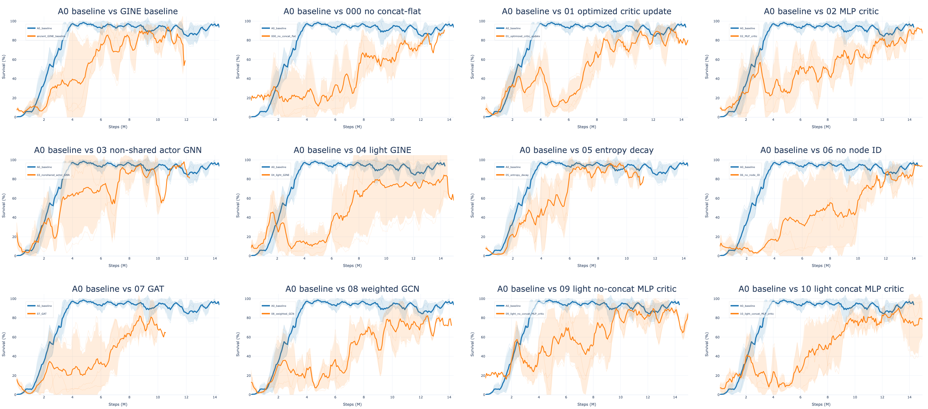
IEEE 14: Graph variations, results
Fig 3: Episodic survival during training of different GINE architecture compared to the baseline
Notes:
To dive a little deeper i have been looking at a survey that summarize all the algorithms that won the l2rpn challenge and this is the main categories of succesfull agentthat won the challenge.
Some approaches rely on a single global agent with strong engineering tricks.
For example, they use graph neural networks combined with value-based RL, and validate actions using power-flow simulations.
Others reduce the action space using masking or pruning.
These methods can work, so mixing a single agent with rules, but they suffer because the action space remains very large.”
Another important idea is to predict a target topology instead of raw actions.
This is used in SMAAC, where the agent learns an afterstate representation—basically the resulting topology after an action.
This helps because multiple sequences of actions can lead to the same configuration. So it reduces the action space

Slide 12
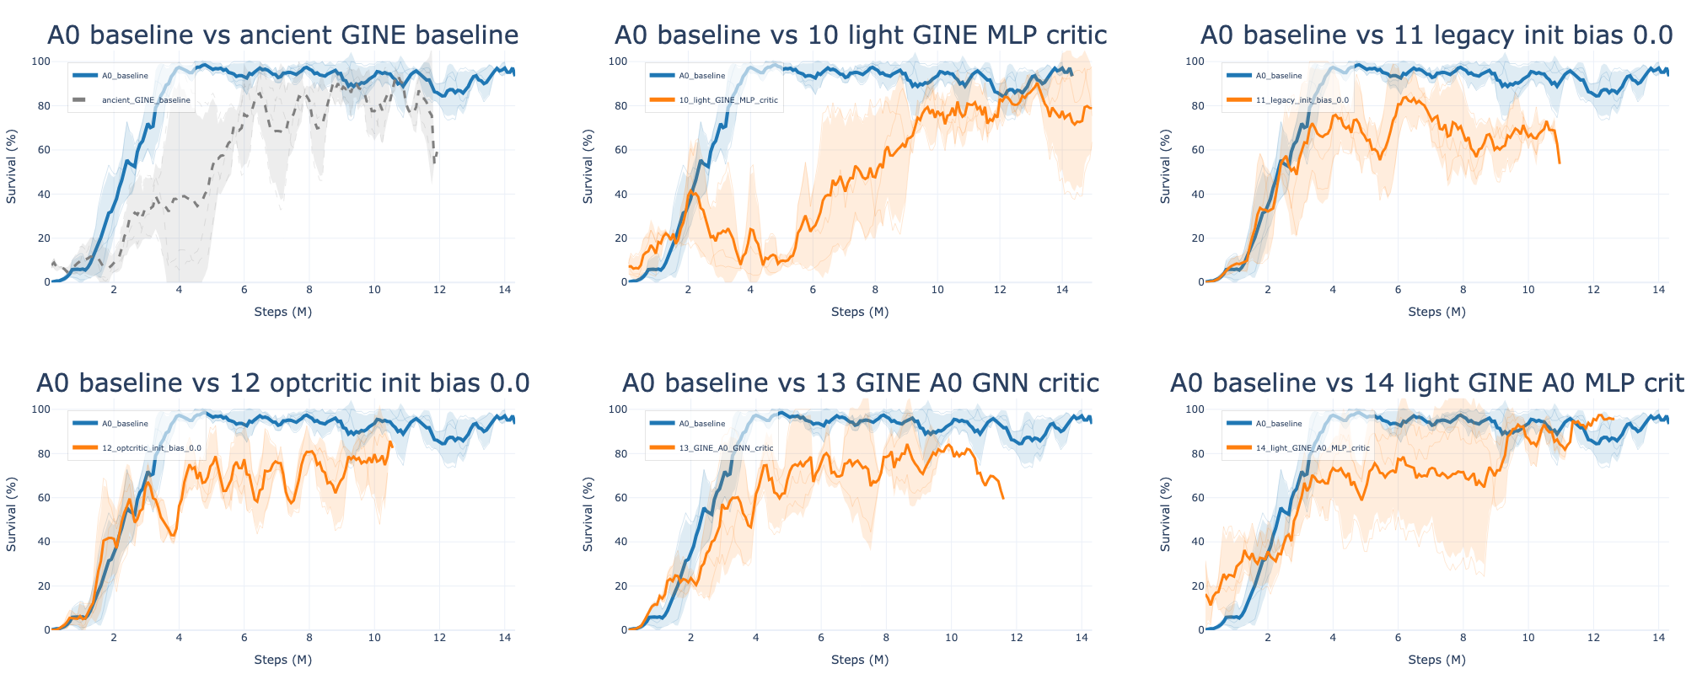
IEEE 14: Graph variations, results
Fig 4: Episodic survival during training of different GINE architecture compared to the baseline
Notes:
To dive a little deeper i have been looking at a survey that summarize all the algorithms that won the l2rpn challenge and this is the main categories of succesfull agentthat won the challenge.
Some approaches rely on a single global agent with strong engineering tricks.
For example, they use graph neural networks combined with value-based RL, and validate actions using power-flow simulations.
Others reduce the action space using masking or pruning.
These methods can work, so mixing a single agent with rules, but they suffer because the action space remains very large.”
Another important idea is to predict a target topology instead of raw actions.
This is used in SMAAC, where the agent learns an afterstate representation—basically the resulting topology after an action.
This helps because multiple sequences of actions can lead to the same configuration. So it reduces the action space

Slide 13
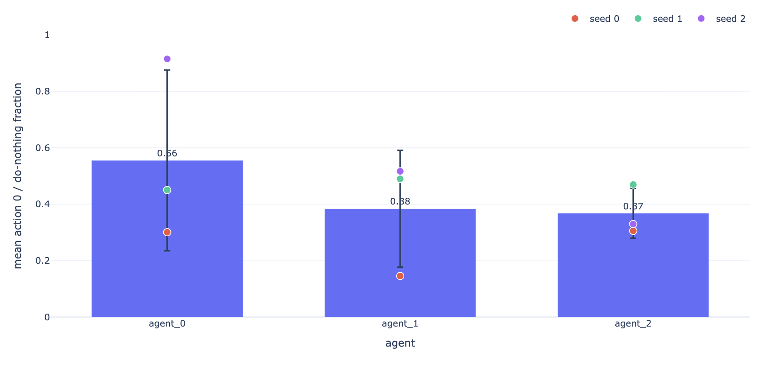
IEEE 14: Realistic behavior
Statement: The simple MLP baseline might have good performances but the agents act too much, and it is not a sustainable behavior in a realistic scenario.
Fig 5: Average of the action 0 usage over seeds at best-checkpoints for the mlp baseline
Objective: Determine if using a GNN Actor/Critic can be useful, and match the simple MLP performance
Notes:
To dive a little deeper i have been looking at a survey that summarize all the algorithms that won the l2rpn challenge and this is the main categories of succesfull agentthat won the challenge.
Some approaches rely on a single global agent with strong engineering tricks.
For example, they use graph neural networks combined with value-based RL, and validate actions using power-flow simulations.
Others reduce the action space using masking or pruning.
These methods can work, so mixing a single agent with rules, but they suffer because the action space remains very large.”
Another important idea is to predict a target topology instead of raw actions.
This is used in SMAAC, where the agent learns an afterstate representation—basically the resulting topology after an action.
This helps because multiple sequences of actions can lead to the same configuration. So it reduces the action space

Slide 14
IEEE 14: Realistic behavior — gating
Evaluation-time rho override [Lehna et al., 2023]
Local: ρlocal(i) = max{ρℓ : line ℓ touches region i}
Global: ρglobal = maxℓ ρℓ
aexec(i)=0 if the selected ρ<0.90; otherwise execute the policy proposal ā(i).
Diagnostic only: training is unchanged; deterministic evaluation is overridden.
Intervention-gated actor [Manczak et al., 2023; van der Sar et al., 2023]
Two heads: πgate(g|o), g∈{0,1}; πnonidle(b|o), b∈{1,…,|Aᵢ|−1}.
Final-action MAP: P(aᵢ=0)=P(gᵢ=0); P(aᵢ>0)=P(gᵢ=1)P(bᵢ=aᵢ | gᵢ=1).
Hierarchical greedy: choose 0 if P(gᵢ=0)>P(gᵢ=1); otherwise argmax over the non-idle head.
Execution remains decentralized: no coordinator or inter-agent communication.
Notes:
To dive a little deeper i have been looking at a survey that summarize all the algorithms that won the l2rpn challenge and this is the main categories of succesfull agentthat won the challenge.
Some approaches rely on a single global agent with strong engineering tricks.
For example, they use graph neural networks combined with value-based RL, and validate actions using power-flow simulations.
Others reduce the action space using masking or pruning.
These methods can work, so mixing a single agent with rules, but they suffer because the action space remains very large.”
Another important idea is to predict a target topology instead of raw actions.
This is used in SMAAC, where the agent learns an afterstate representation—basically the resulting topology after an action.
This helps because multiple sequences of actions can lead to the same configuration. So it reduces the action space

Slide 15
IEEE 14: Realistic behavior — sparse control
Fixed topology cost [Lautenbacher et al., 2025]
r′(i,t) = r(i,t) − λfixed · I[a(i,t)≠0]
Flat or gated actor; the training reward changes, but evaluation uses the learned policy without an override.
Adaptive intervention budget [Achiam et al., 2017; Carrara et al., 2019; Stooke et al., 2020]
cᵢ = I[aᵢ≠0] · σ(k(ρsafe−ρlocal(i))), r′ᵢ = rᵢ−λᵢcᵢ
λᵢ ← clip(λᵢ + η(Ĉᵢ−d), 0, λmax)
The local penalty self-tunes toward E[cᵢ]≤d; actions stay available during training.
Imitation learning — behavior-cloning warm start
Dᵢ={(oᵢ,aᵢheur)}, LBC = −E(o,a)∼Dᵢ [log πᵢ(a|o)]
Fine-tune each local actor on heuristic demonstrations, then continue decentralized MAPPO training.
Notes:
To dive a little deeper i have been looking at a survey that summarize all the algorithms that won the l2rpn challenge and this is the main categories of succesfull agentthat won the challenge.
Some approaches rely on a single global agent with strong engineering tricks.
For example, they use graph neural networks combined with value-based RL, and validate actions using power-flow simulations.
Others reduce the action space using masking or pruning.
These methods can work, so mixing a single agent with rules, but they suffer because the action space remains very large.”
Another important idea is to predict a target topology instead of raw actions.
This is used in SMAAC, where the agent learns an afterstate representation—basically the resulting topology after an action.
This helps because multiple sequences of actions can lead to the same configuration. So it reduces the action space

Slide 16
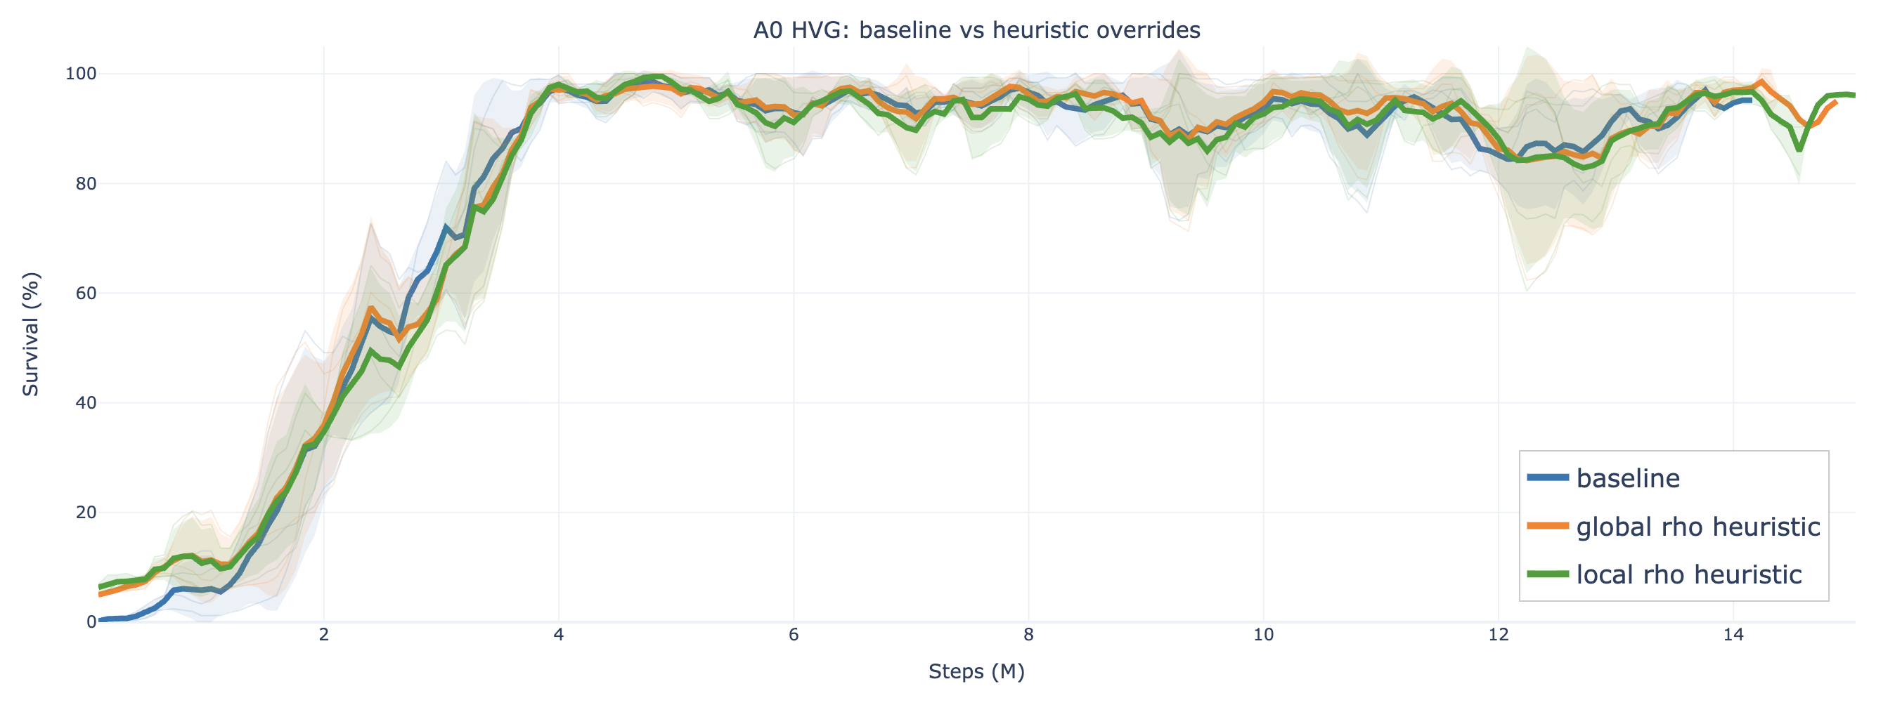
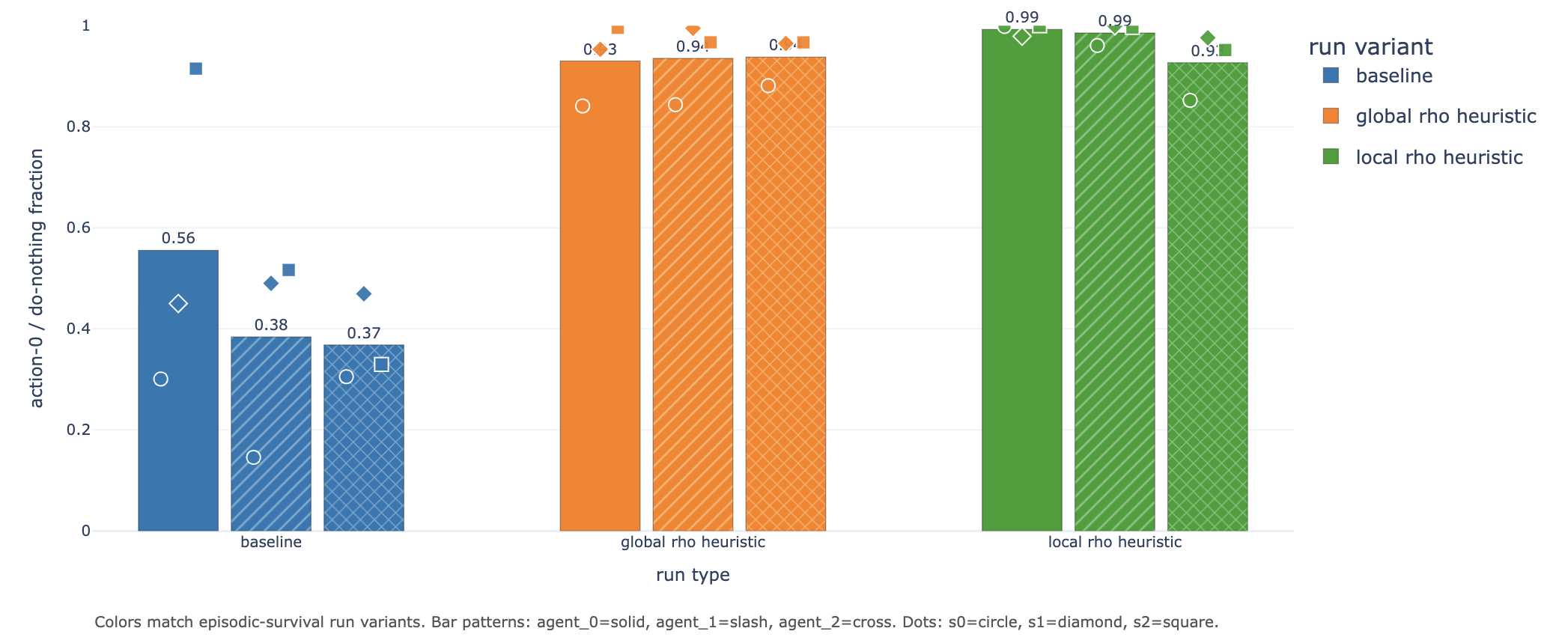
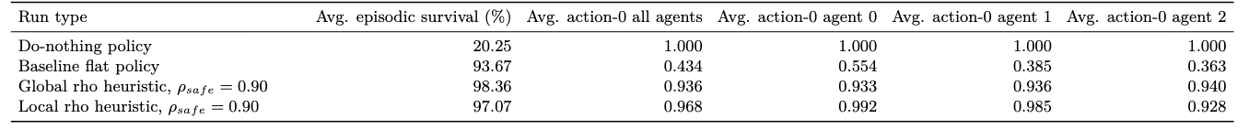
IEEE 14: Realistic behavior, Results
Fig 6: Episodic survival during training, heuristic overrides
Fig 7: action-0 fraction per agent, heurisitc overrides
Table 5: Full-test summary for heuristic overrides
Notes:
To dive a little deeper i have been looking at a survey that summarize all the algorithms that won the l2rpn challenge and this is the main categories of succesfull agentthat won the challenge.
Some approaches rely on a single global agent with strong engineering tricks.
For example, they use graph neural networks combined with value-based RL, and validate actions using power-flow simulations.
Others reduce the action space using masking or pruning.
These methods can work, so mixing a single agent with rules, but they suffer because the action space remains very large.”
Another important idea is to predict a target topology instead of raw actions.
This is used in SMAAC, where the agent learns an afterstate representation—basically the resulting topology after an action.
This helps because multiple sequences of actions can lead to the same configuration. So it reduces the action space

Slide 17
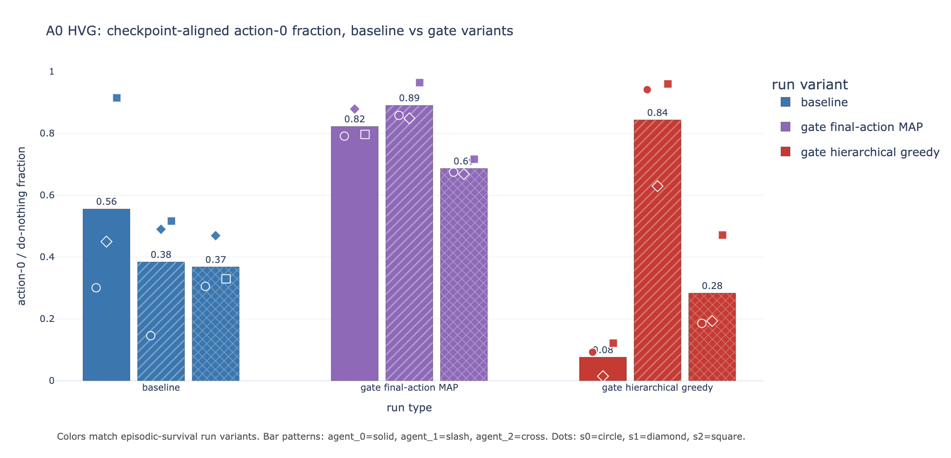
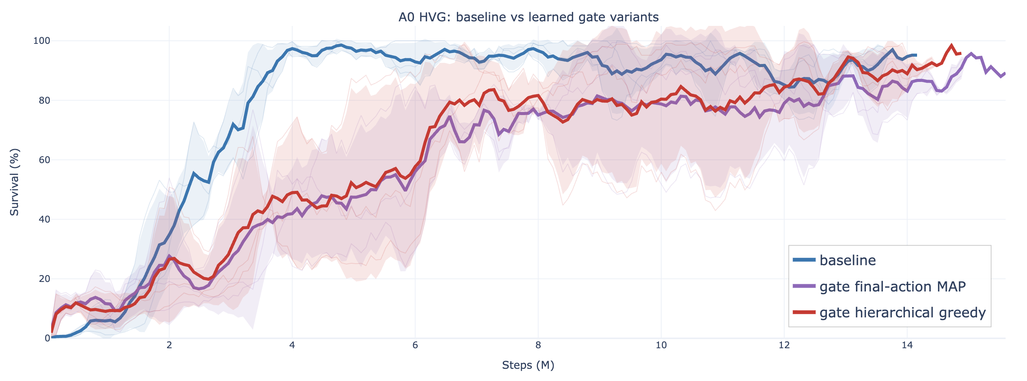
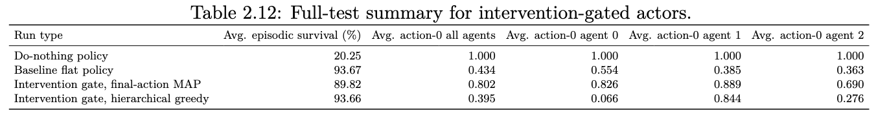
IEEE 14: Realistic behavior, Results
Fig 8: Episodic survival during training, intervention gated actors
Fig 9: action-0 fraction per agent, intervention gated actors
Table 6: Full-test summary for intervention gated actors
Notes:
To dive a little deeper i have been looking at a survey that summarize all the algorithms that won the l2rpn challenge and this is the main categories of succesfull agentthat won the challenge.
Some approaches rely on a single global agent with strong engineering tricks.
For example, they use graph neural networks combined with value-based RL, and validate actions using power-flow simulations.
Others reduce the action space using masking or pruning.
These methods can work, so mixing a single agent with rules, but they suffer because the action space remains very large.”
Another important idea is to predict a target topology instead of raw actions.
This is used in SMAAC, where the agent learns an afterstate representation—basically the resulting topology after an action.
This helps because multiple sequences of actions can lead to the same configuration. So it reduces the action space

Slide 18
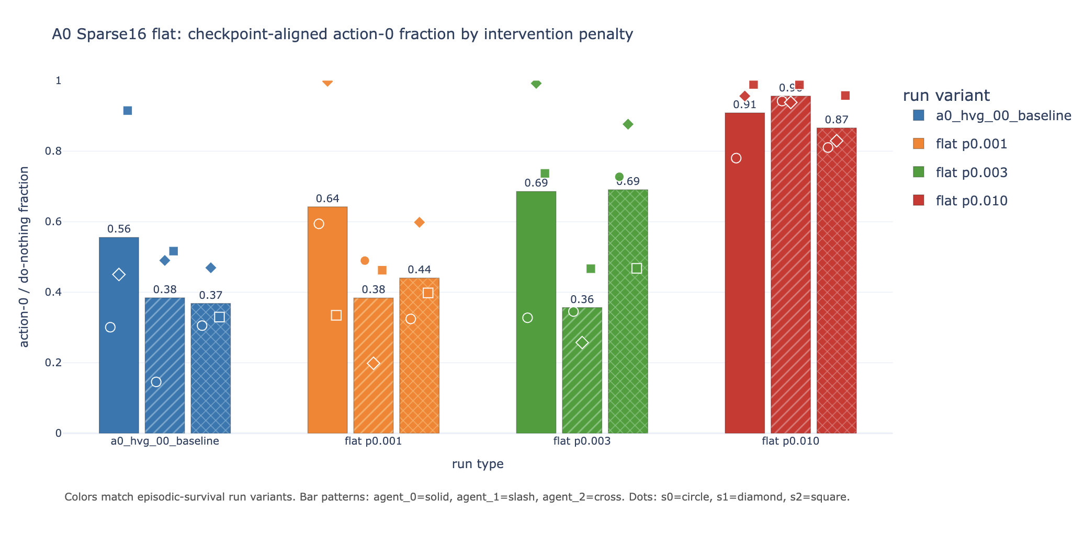
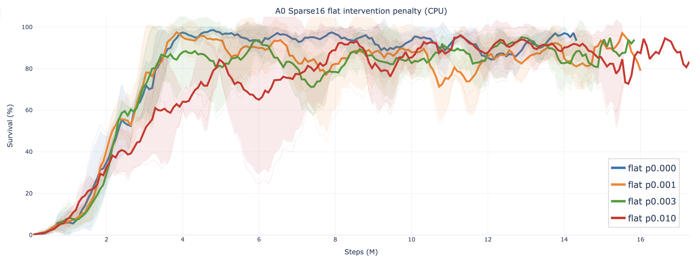
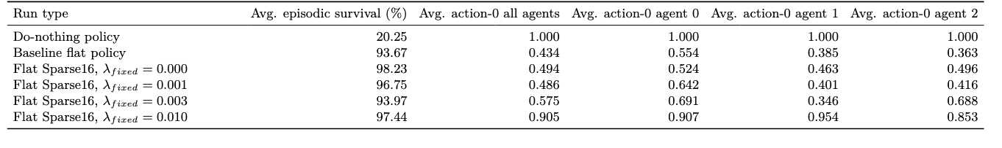
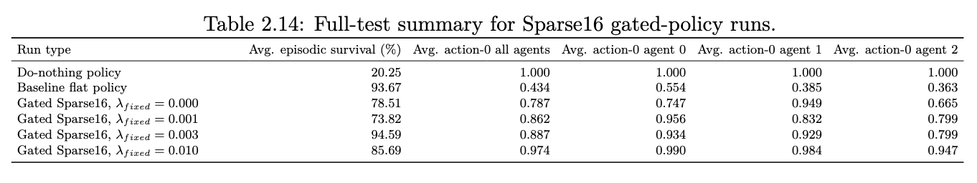
IEEE 14: Realistic behavior, Results
Fig 10: Episodic survival during training, flat intervention penalty
Fig 11: action-0 fraction per agent, flat intervention penalty
Table 7: Full-test summary for flat intervention penalty
Notes:
To dive a little deeper i have been looking at a survey that summarize all the algorithms that won the l2rpn challenge and this is the main categories of succesfull agentthat won the challenge.
Some approaches rely on a single global agent with strong engineering tricks.
For example, they use graph neural networks combined with value-based RL, and validate actions using power-flow simulations.
Others reduce the action space using masking or pruning.
These methods can work, so mixing a single agent with rules, but they suffer because the action space remains very large.”
Another important idea is to predict a target topology instead of raw actions.
This is used in SMAAC, where the agent learns an afterstate representation—basically the resulting topology after an action.
This helps because multiple sequences of actions can lead to the same configuration. So it reduces the action space

Slide 19
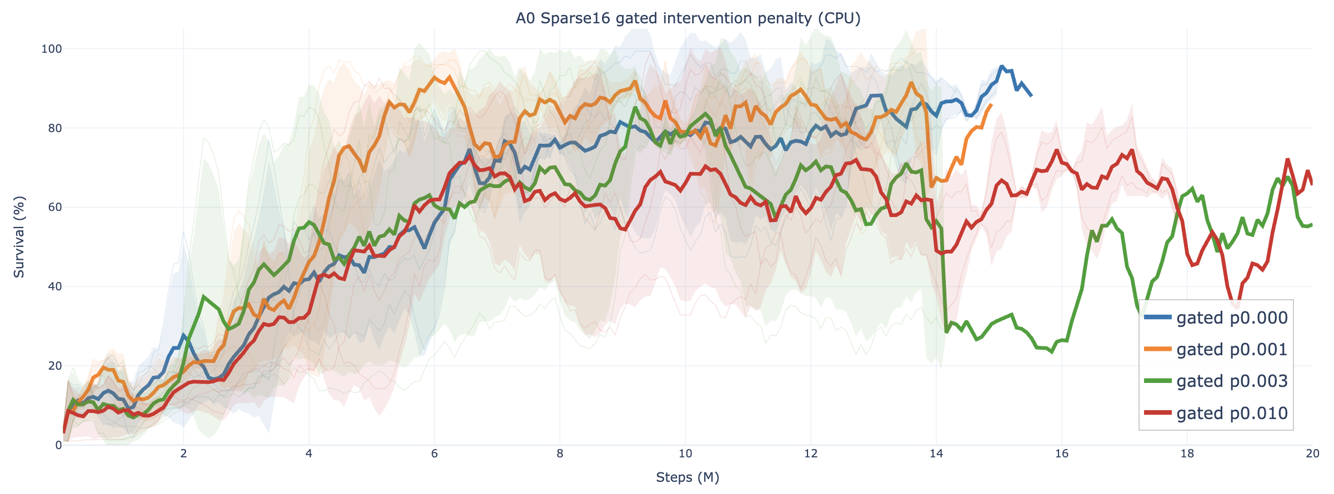
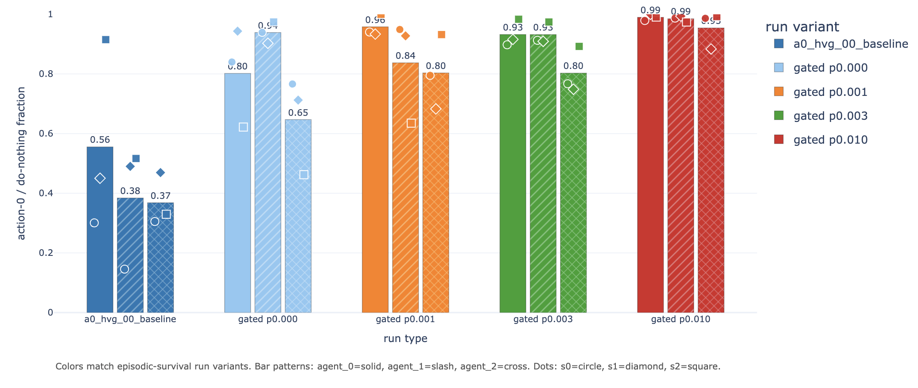
IEEE 14: Realistic behavior, Results
Fig 12: Episodic survival during training, gated intervention penalty
Fig 13: action-0 fraction per agent, gated intervention penalty
Table 8: Full-test summary for gated intervention penalty
Notes:
To dive a little deeper i have been looking at a survey that summarize all the algorithms that won the l2rpn challenge and this is the main categories of succesfull agentthat won the challenge.
Some approaches rely on a single global agent with strong engineering tricks.
For example, they use graph neural networks combined with value-based RL, and validate actions using power-flow simulations.
Others reduce the action space using masking or pruning.
These methods can work, so mixing a single agent with rules, but they suffer because the action space remains very large.”
Another important idea is to predict a target topology instead of raw actions.
This is used in SMAAC, where the agent learns an afterstate representation—basically the resulting topology after an action.
This helps because multiple sequences of actions can lead to the same configuration. So it reduces the action space

Slide 20
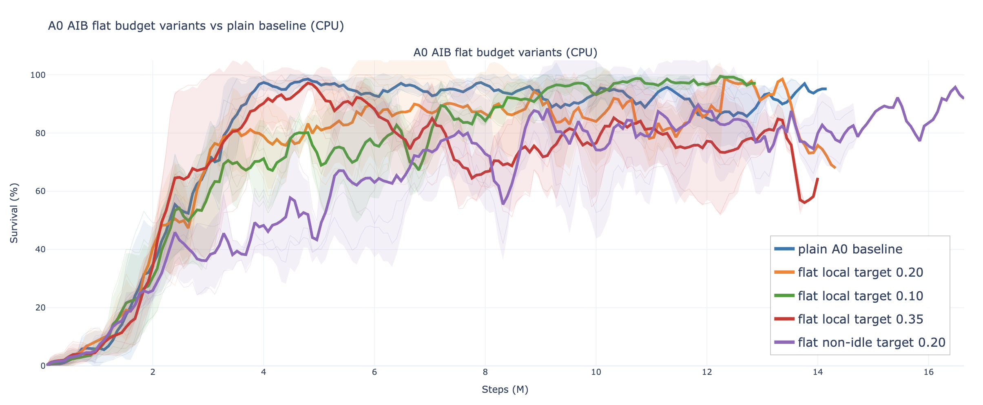
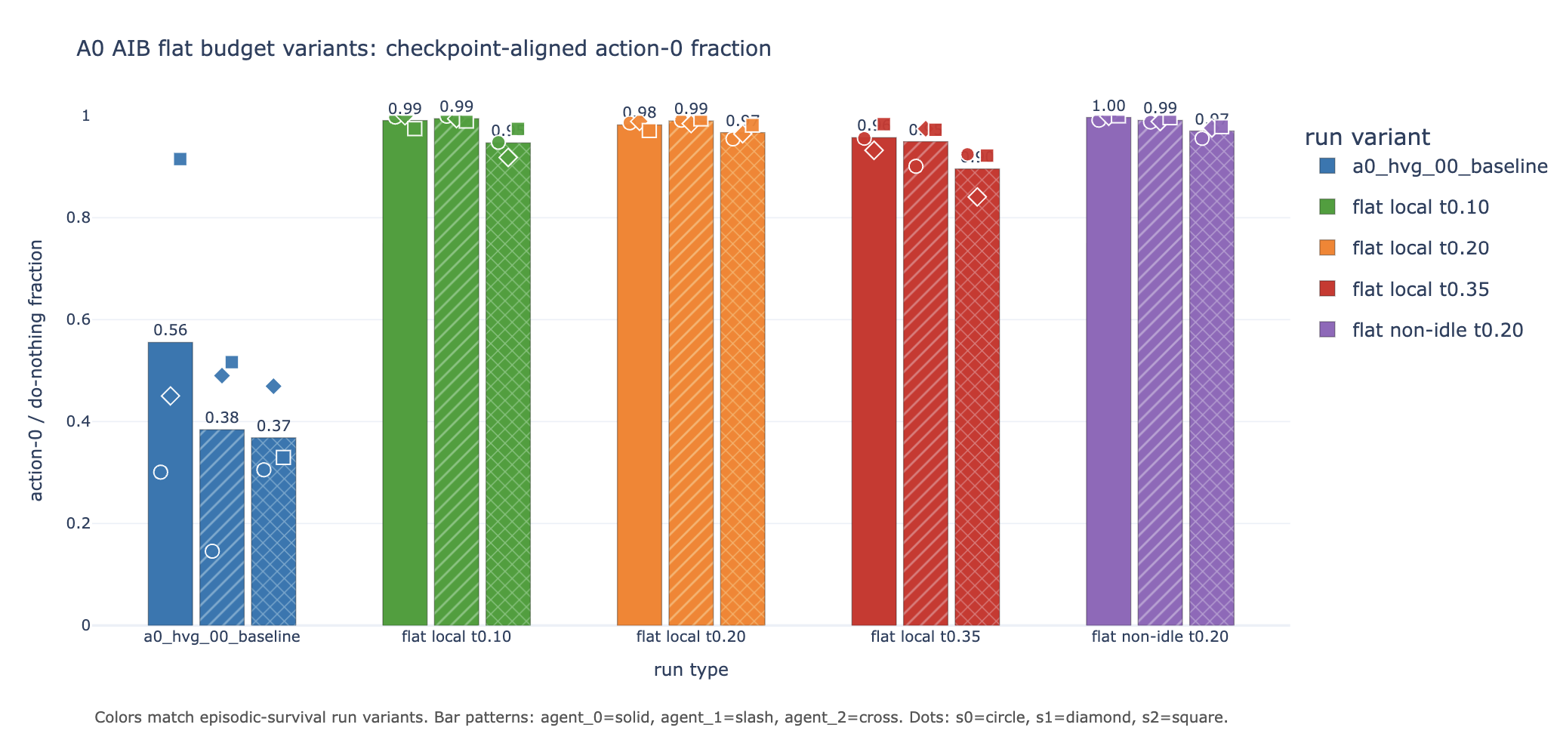
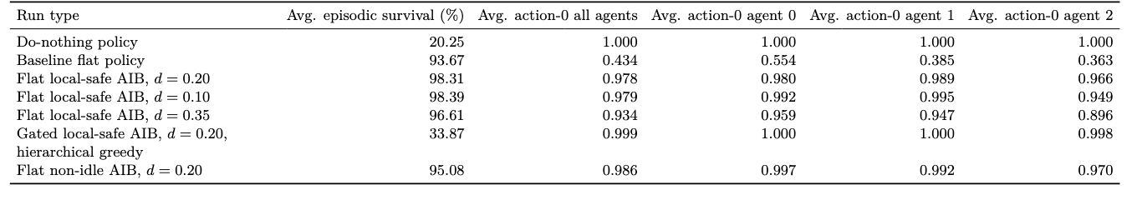
IEEE 14: Realistic behavior, Results
Fig 14: Episodic survival during training, adaptative intervention budget
Fig 15: action-0 fraction per agent, adaptative intervention budget
Table 9: Full-test summary adaptative intervention budget
Notes:
To dive a little deeper i have been looking at a survey that summarize all the algorithms that won the l2rpn challenge and this is the main categories of succesfull agentthat won the challenge.
Some approaches rely on a single global agent with strong engineering tricks.
For example, they use graph neural networks combined with value-based RL, and validate actions using power-flow simulations.
Others reduce the action space using masking or pruning.
These methods can work, so mixing a single agent with rules, but they suffer because the action space remains very large.”
Another important idea is to predict a target topology instead of raw actions.
This is used in SMAAC, where the agent learns an afterstate representation—basically the resulting topology after an action.
This helps because multiple sequences of actions can lead to the same configuration. So it reduces the action space

Slide 21
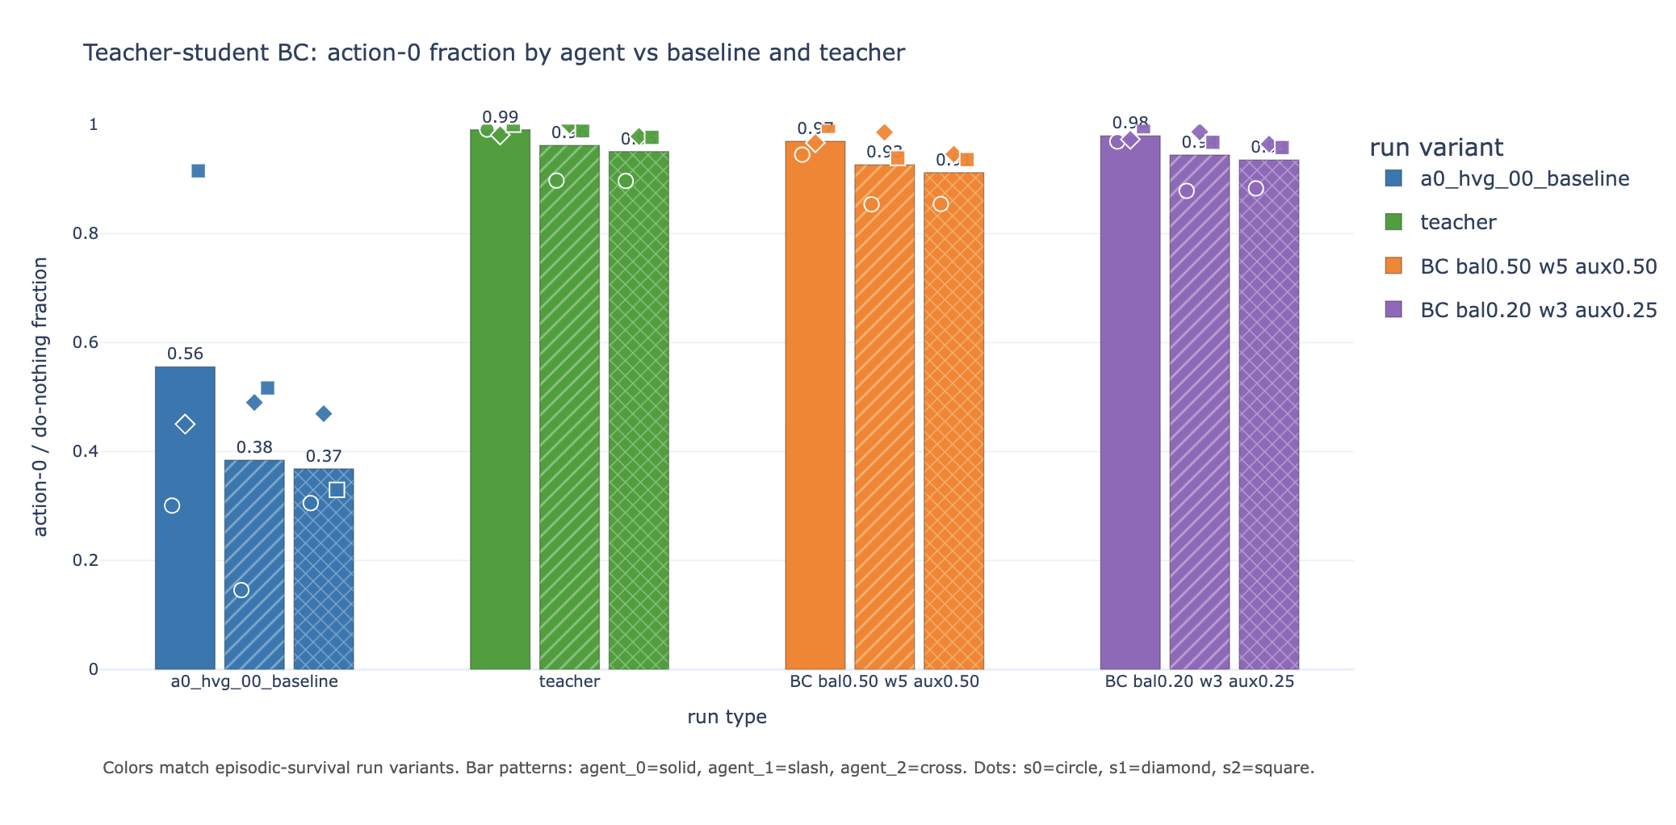
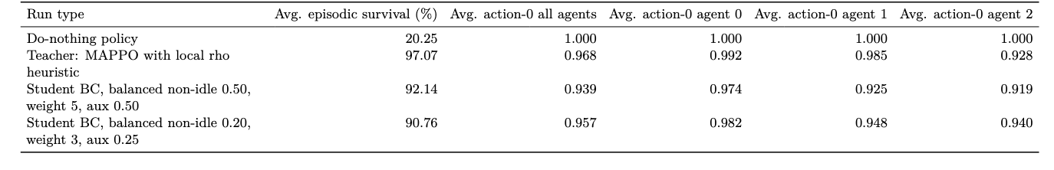
IEEE 14: Realistic behavior, Results
Fig 15: action-0 fraction per agent, student/teacher
Table 10: Full-test summary, student/teacher
Notes:
To dive a little deeper i have been looking at a survey that summarize all the algorithms that won the l2rpn challenge and this is the main categories of succesfull agentthat won the challenge.
Some approaches rely on a single global agent with strong engineering tricks.
For example, they use graph neural networks combined with value-based RL, and validate actions using power-flow simulations.
Others reduce the action space using masking or pruning.
These methods can work, so mixing a single agent with rules, but they suffer because the action space remains very large.”
Another important idea is to predict a target topology instead of raw actions.
This is used in SMAAC, where the agent learns an afterstate representation—basically the resulting topology after an action.
This helps because multiple sequences of actions can lead to the same configuration. So it reduces the action space

Slide 22
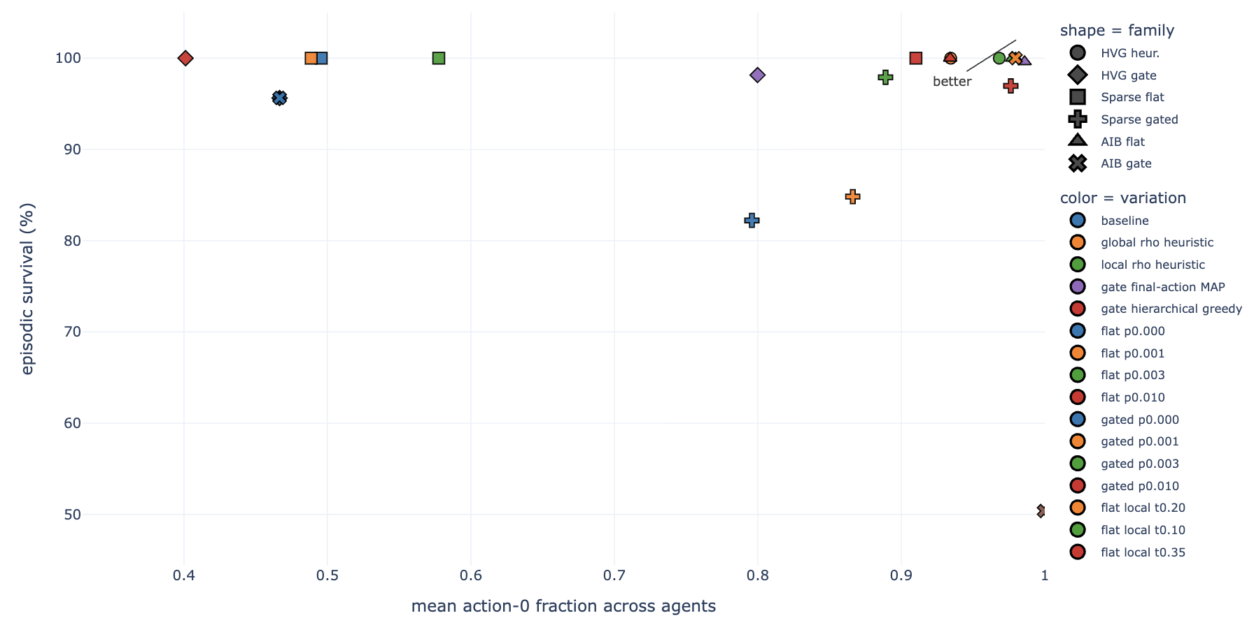
IEEE 14: Realistic behavior, Results
Fig 16: Action-0 / episodic survival tradeoff for all runs
Notes:
To dive a little deeper i have been looking at a survey that summarize all the algorithms that won the l2rpn challenge and this is the main categories of succesfull agentthat won the challenge.
Some approaches rely on a single global agent with strong engineering tricks.
For example, they use graph neural networks combined with value-based RL, and validate actions using power-flow simulations.
Others reduce the action space using masking or pruning.
These methods can work, so mixing a single agent with rules, but they suffer because the action space remains very large.”
Another important idea is to predict a target topology instead of raw actions.
This is used in SMAAC, where the agent learns an afterstate representation—basically the resulting topology after an action.
This helps because multiple sequences of actions can lead to the same configuration. So it reduces the action space

Slide 23
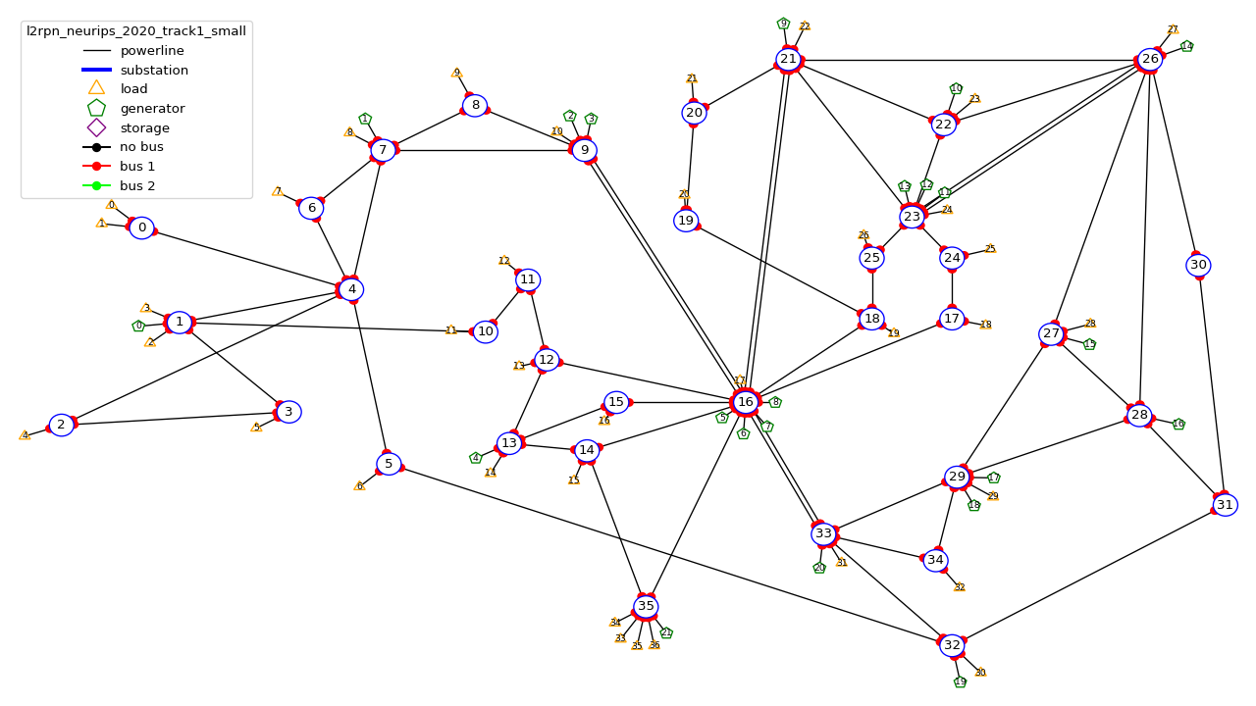
WCCI 2020 (36 substations): environment setup
Agent | Controlled substations | Local discrete action space
Agent 0 | 0, 1, 2, 3, 4 | 77 actions
Agent 1 | 6, 7, 8, 9, 16 | 65,642 actions
Agent 2 | 5, 10, 11, 12, 13, 14, 15, 32, 35 | 127 actions
Agent 3 | 17–31, 33, 34 | 1,119 actions
Table 11: Agent-to-substation assignments and action space for the local observation setup of WCCI
Fig 17: Substations controlled by each agents WCCI environment
Notes:
To dive a little deeper i have been looking at a survey that summarize all the algorithms that won the l2rpn challenge and this is the main categories of succesfull agentthat won the challenge.
Some approaches rely on a single global agent with strong engineering tricks.
For example, they use graph neural networks combined with value-based RL, and validate actions using power-flow simulations.
Others reduce the action space using masking or pruning.
These methods can work, so mixing a single agent with rules, but they suffer because the action space remains very large.”
Another important idea is to predict a target topology instead of raw actions.
This is used in SMAAC, where the agent learns an afterstate representation—basically the resulting topology after an action.
This helps because multiple sequences of actions can lead to the same configuration. So it reduces the action space

Slide 24
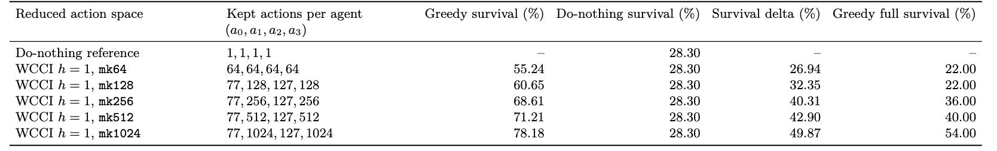
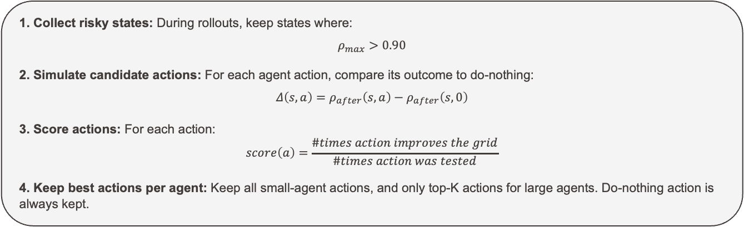
WCCI 2020 (36 substations): Action Space Reduction
Collect risky states: During rollouts, keep states where:
$$ρ_{max}>0.90$$
2. Simulate candidate actions: For each agent action, compare its outcome to do-nothing:
$$Δ\left(s,a\right)=ρ_{after}\left(s,a\right)−ρ_{after}\left(s,0\right)$$
3. Score actions: For each action:
$$score\left(a\right)=\frac{\#times action improves the grid}{\#times action was tested}$$
4. Keep best actions per agent: Keep all small-agent actions, and only top-K actions for large agents. Do-nothing action is always kept.
Table 12: One-step greedy evalaution of WCCI reduced action spaces on 50 random test chronics
Notes:
To dive a little deeper i have been looking at a survey that summarize all the algorithms that won the l2rpn challenge and this is the main categories of succesfull agentthat won the challenge.
Some approaches rely on a single global agent with strong engineering tricks.
For example, they use graph neural networks combined with value-based RL, and validate actions using power-flow simulations.
Others reduce the action space using masking or pruning.
These methods can work, so mixing a single agent with rules, but they suffer because the action space remains very large.”
Another important idea is to predict a target topology instead of raw actions.
This is used in SMAAC, where the agent learns an afterstate representation—basically the resulting topology after an action.
This helps because multiple sequences of actions can lead to the same configuration. So it reduces the action space

Slide 25
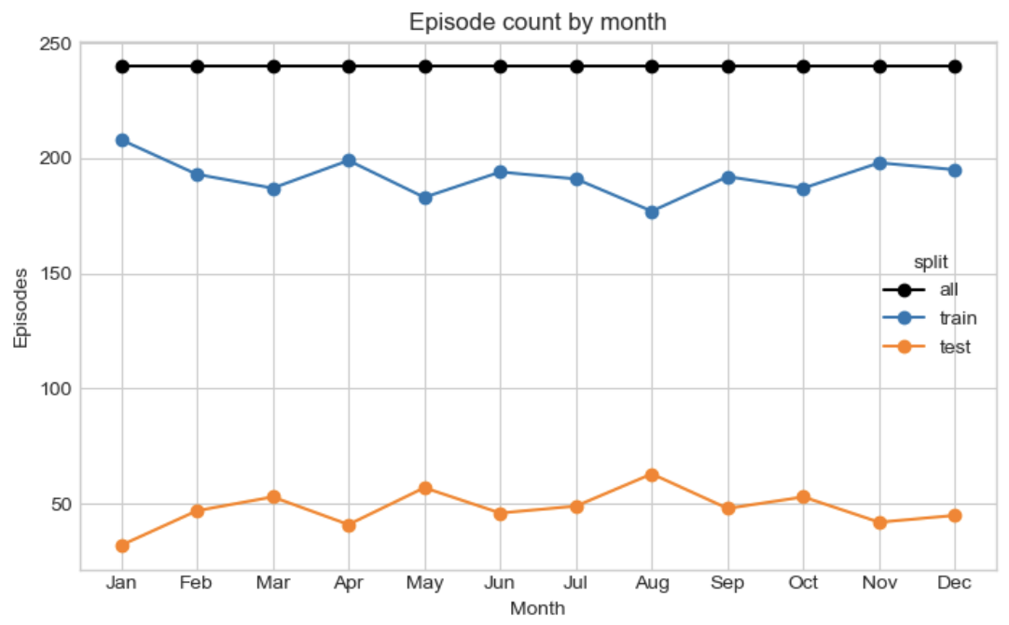
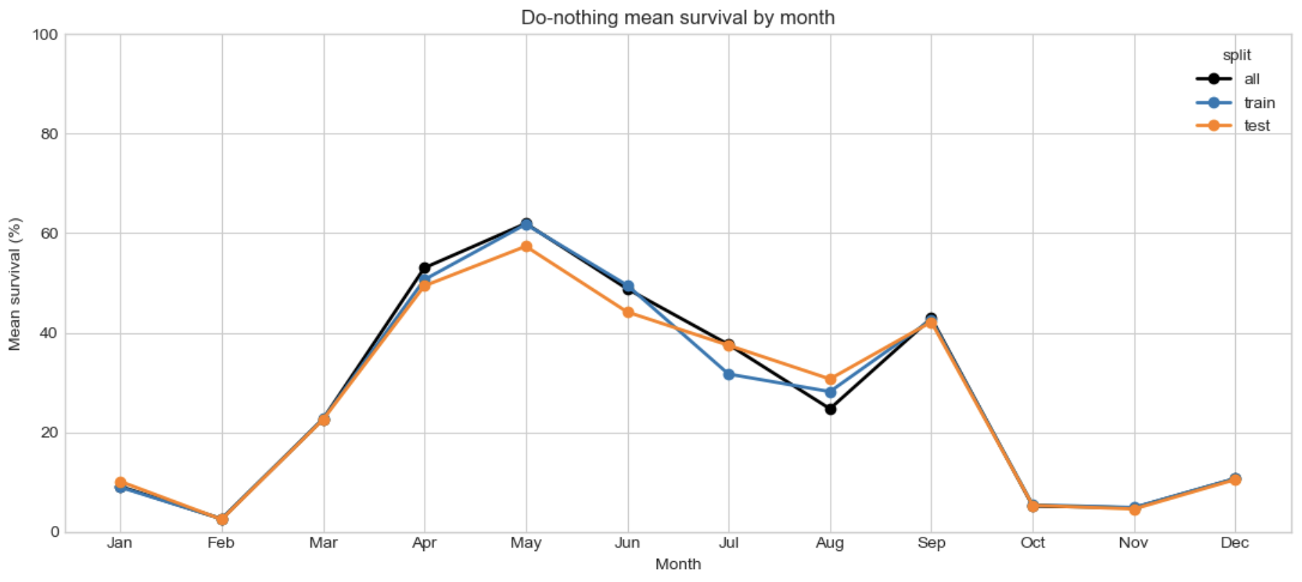
WCCI 2020 (36 substations): Results
Fig 18: Do Nothing mean survival by month on WCCI 36 environment
Fig 19: Do Nothing mean survival by month on WCCI 36 environment
Notes:
To dive a little deeper i have been looking at a survey that summarize all the algorithms that won the l2rpn challenge and this is the main categories of succesfull agentthat won the challenge.
Some approaches rely on a single global agent with strong engineering tricks.
For example, they use graph neural networks combined with value-based RL, and validate actions using power-flow simulations.
Others reduce the action space using masking or pruning.
These methods can work, so mixing a single agent with rules, but they suffer because the action space remains very large.”
Another important idea is to predict a target topology instead of raw actions.
This is used in SMAAC, where the agent learns an afterstate representation—basically the resulting topology after an action.
This helps because multiple sequences of actions can lead to the same configuration. So it reduces the action space

Slide 26
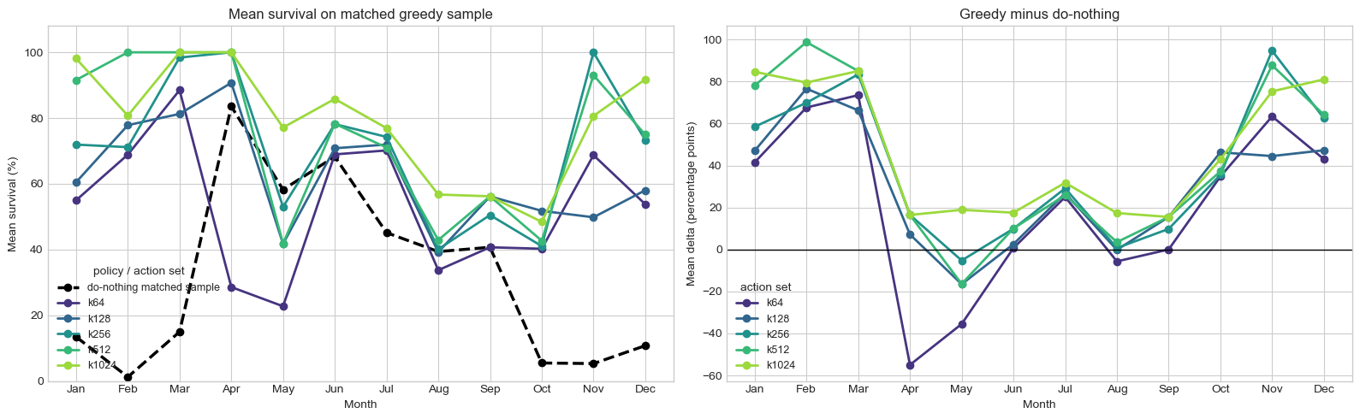
WCCI 2020 (36 substations): Results
Fig 20: mean episodic survival rate depending on the month and the action space size
Fig 21: Difference in surival rate between do-nothing and greedy evaluation depending on the month and the action space size
Notes:
To dive a little deeper i have been looking at a survey that summarize all the algorithms that won the l2rpn challenge and this is the main categories of succesfull agentthat won the challenge.
Some approaches rely on a single global agent with strong engineering tricks.
For example, they use graph neural networks combined with value-based RL, and validate actions using power-flow simulations.
Others reduce the action space using masking or pruning.
These methods can work, so mixing a single agent with rules, but they suffer because the action space remains very large.”
Another important idea is to predict a target topology instead of raw actions.
This is used in SMAAC, where the agent learns an afterstate representation—basically the resulting topology after an action.
This helps because multiple sequences of actions can lead to the same configuration. So it reduces the action space

