Slide 1
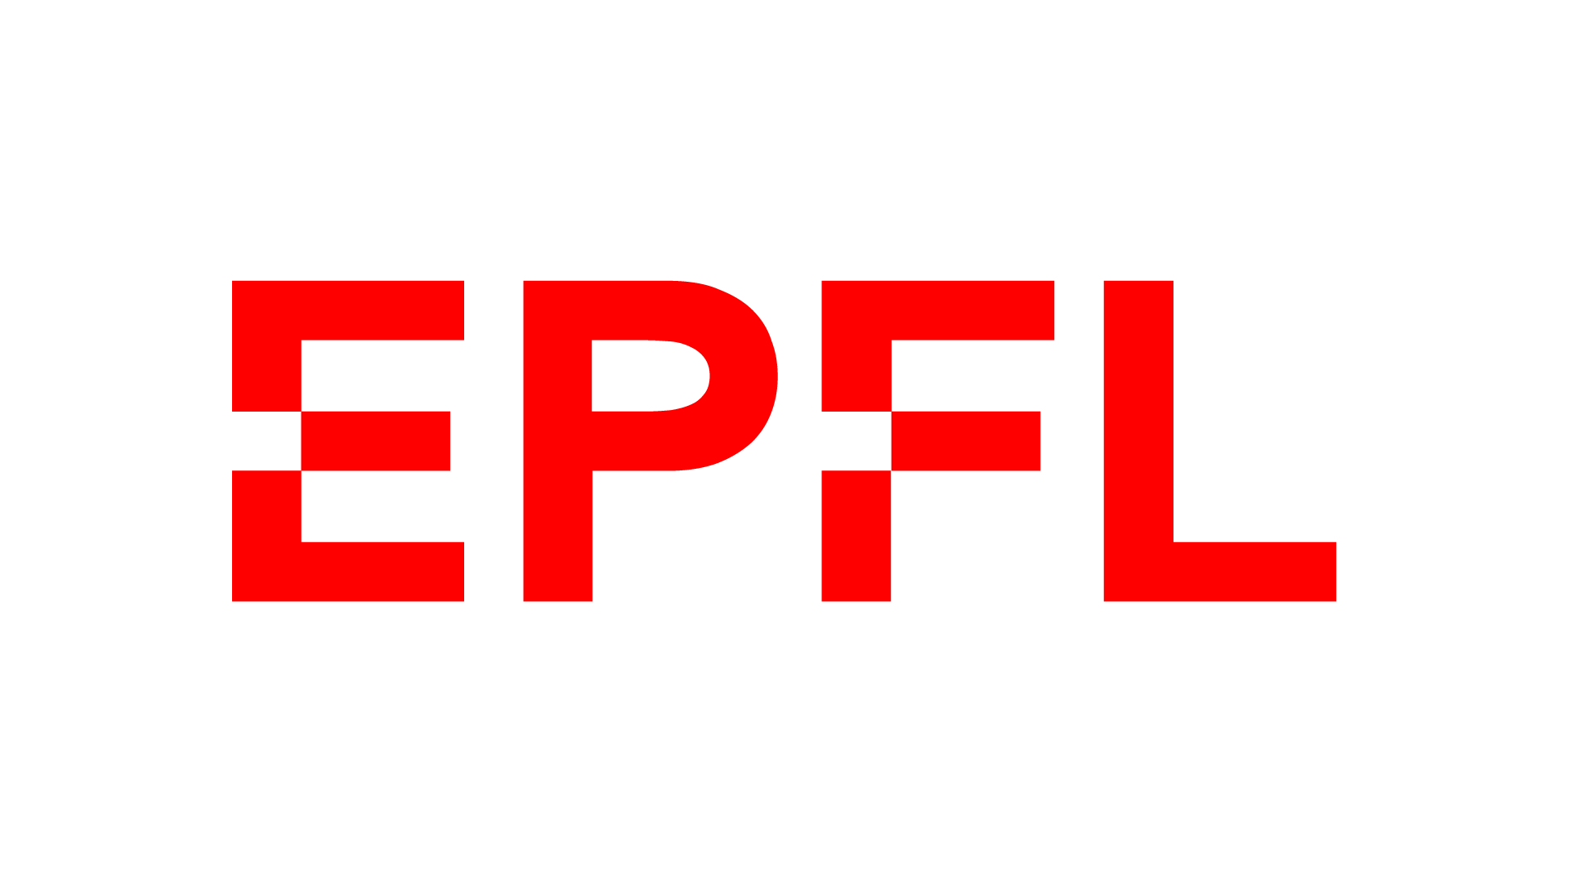

Multi-Agent Reinforcement Learning for Power Grid Topology Control
Corentin Plumet
Supervised by:
Dr. Nejjar
Prof. Peng
July 2026
Notes:
Today i ll present the refinement of my msc thesis on graph-structured multi-agent reinforcement learning for power grid topology control and the results of the first baseline i implemented.
The goal is to improve how reinforcement learning can scale and coordinate decisions in realistic power grid environments.”

Slide 2
Motivation
Purpose
TSO need fast congestion management under renewable variability and unforeseen events.
Topology actions are attractive because they can reroute flows before using costly redispatch.
Problem Statement: Power grid operation requires:
Real-time decisions under uncertainty
Maintaining safety constraints (line limits, demand balance)
Operating over large, combinatorial action spaces
Limitations of current approaches
Optimization (OPF) is not scalable and too slow
Single-Agent RL: ignores decentralization
Research Questions:
Does a GNN encoder improve performance vs standard MARL baselines?
Can a Multi agent approach/match single agent approach under partial observability?
Does any improvements generalize to larger grid (bus14 to bus 36)?
Can the agents learn how to behave in a « human operator » way ?
Notes:
Power grid operation is a challenging control problem.
Operators need to make real-time decisions under uncertainty, while maintaining strict safety constraints like line limits and supply-demand balance.
One important control mechanism is topology actions, which allow rerouting power flows by modifying the grid structure.
Reinforcement learning is promising for this type of sequential decision-making problem, but the action space is extremely large.
Current approaches have limitations:
- optimization methods are too slow and don’t scale well and they don't enable real time monitoring
- single-agent RL ignores decentralization that is happening in real life
- and existing multi-agent RL still struggles with coordination and scalability.

Slide 3
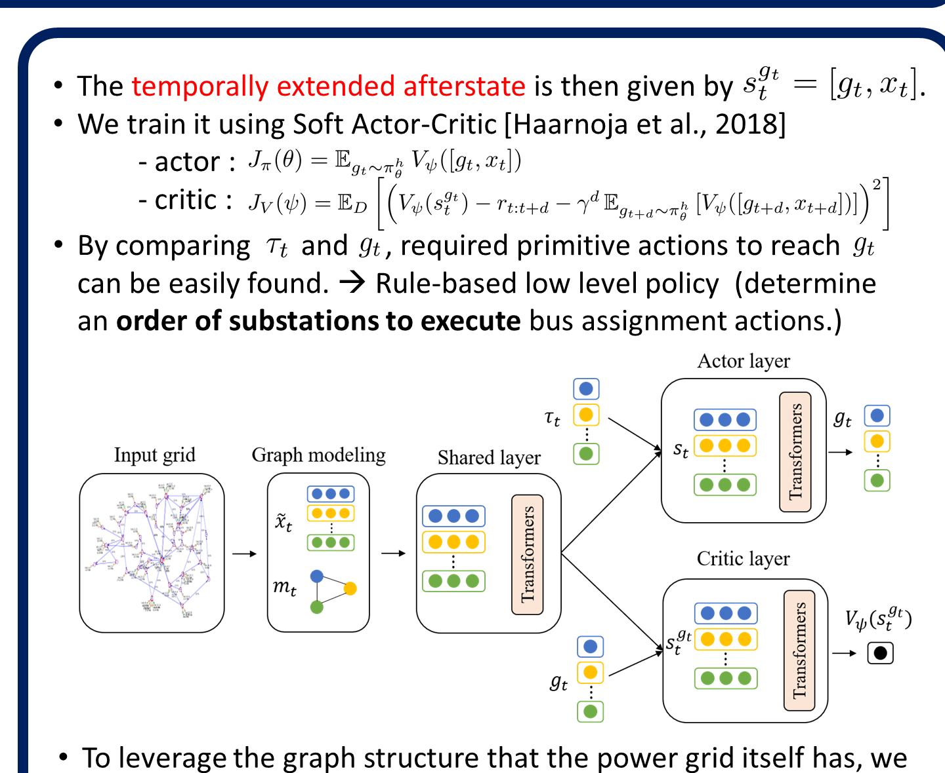
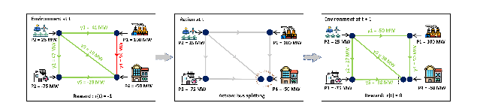
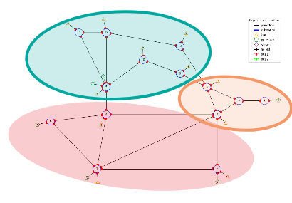
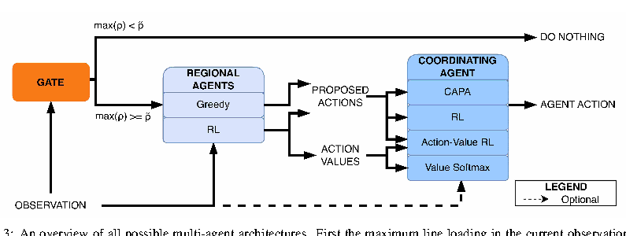
Literature Review: Control Architectures
Single Agent
Single Agent + Heuristic
One policy observes and controls the complete network.
Rules trigger intervention; RL selects from a reduced action space.
Global state → one grid action
Heuristic gate → RL action
Yoon et al., ICLR 2021 (SMAAC)
Chauhan et al., AAAI 2023 (PowRL)
Multi-Agent — Coordinated
Multi-Agent — Decentralized
Regional agents propose actions; a central coordinator chooses one.
Local policies control assigned regions and execute a joint grid decision.
Local proposals → coordinator
Local observations → joint action
de Mol et al., ACM e-Energy 2025
van der Sar et al., 2023; Marchesini et al., ICLR 2026
Notes:
The strongest Grid2Op agents are rarely “pure RL.” They combine learning with action reduction, hierarchy, heuristics, simulation, search, curriculum learning, or safety constraints. Multi-agent topology control is much newer and is still mostly based on hierarchical or centrally coordinated decompositions.

Slide 4
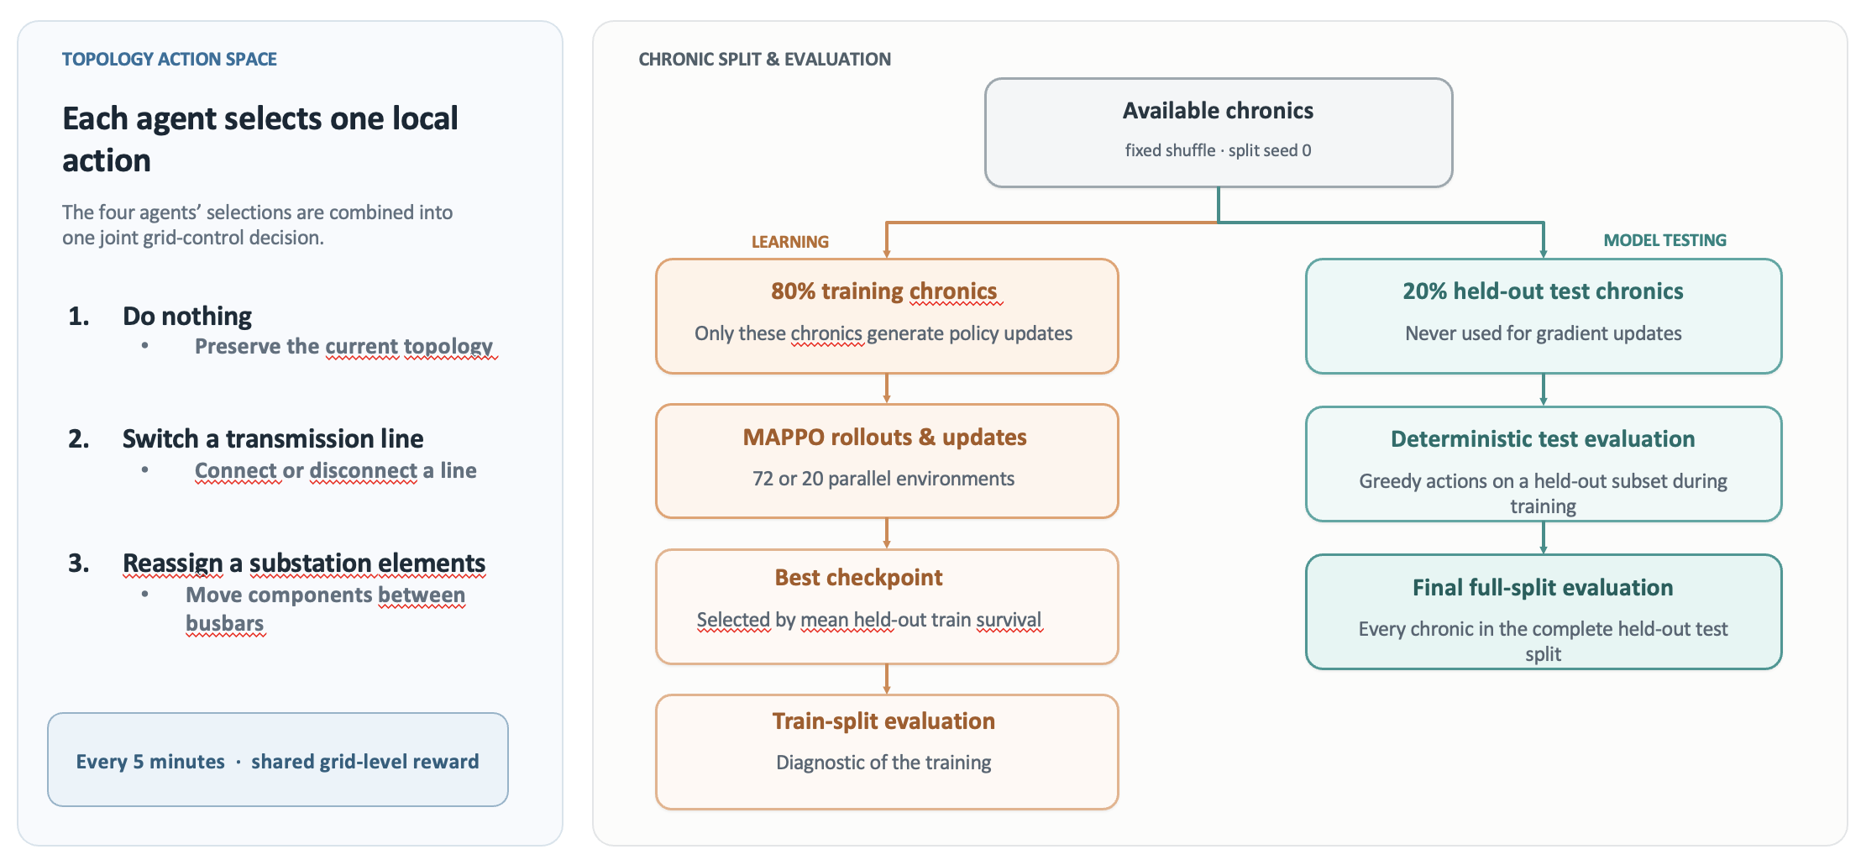
General Data Splitting and Actions
Notes:
“A chronic is a complete time series of load, generation and possible disturbances. I create the train/test split once using a fixed seed. Training workers only access the 80% training subset. During training, I periodically evaluate greedily on held-out chronics and select the best checkpoint using test survival. The final reported performance is computed over the entire held-out split rather than a small sample.”

Slide 5
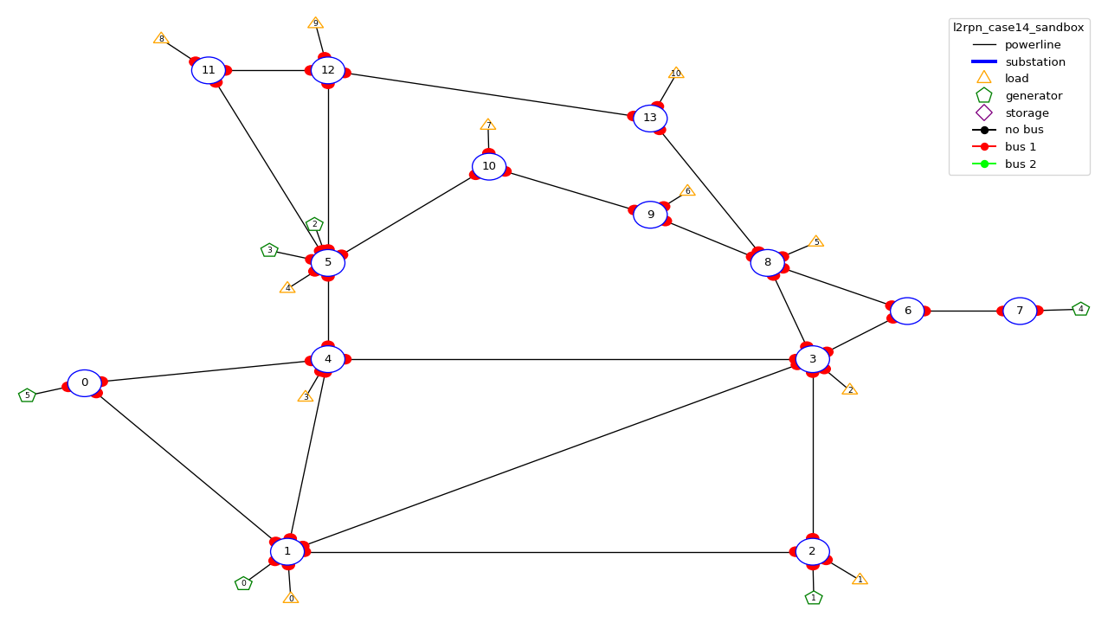
IEEE 14: environment setup
Agent | Controlled substations | Local action space
Agent 0 | 0, 1, 2, 4 | 61 actions
Agent 1 | 3, 6, 7, 8 | 55 actions
Agent 2 | 5, 9, 10, 11, 12, 13 | 89 actions
Table 1: Agent-to-substation assignments and action space for the local observation setup of bus14
Fig 1: Substations controlled by each agents, l2rpn_sandbox environment
Notes:
“The grid is partitioned into three strongly connected regions. Each decentralized actor controls only its assigned substations, but its decisions affect the entire grid through the AC power flow. Coordination is therefore implicit: an action that solves a local overload can create congestion in another agent’s region.”

Slide 6
IEEE 14: Baseline, Original Hyperparameters
Hyperparameter | Value
TRAINING
Total timesteps | 25M
Rollout steps per environment | 2,000
Total rollout batch | 20,000
Evaluation frequency | 80,000
NETWORK
Actor architecture | MLP · 256 × 3
Critic architecture | MLP · 256 × 3
Activation | ReLU
Hyperparameter | Value
PPO OPTIMIZATION
Actor learning rate | 3 × 10⁻⁵
Critic learning rate | 3 × 10⁻⁵
Learning-rate schedule | Linear decay
Discount factor γ | 0.99
GAE parameter λ | 0.95
Update epochs | 80
Minibatches | 4
Clip coefficient ε | 0.20
Target KL | 0.02
Maximum gradient norm | 10.0
Entropy coefficient | 0.01
Value-loss coefficient | 0.50
Table 2: Original parameters of the baseline paper for MAPPO training
Source: original IEEE-14 MAPPO baseline hyperparameters
Notes:
To dive a little deeper i have been looking at a survey that summarize all the algorithms that won the l2rpn challenge and this is the main categories of succesfull agentthat won the challenge.
Some approaches rely on a single global agent with strong engineering tricks.
For example, they use graph neural networks combined with value-based RL, and validate actions using power-flow simulations.
Others reduce the action space using masking or pruning.
These methods can work, so mixing a single agent with rules, but they suffer because the action space remains very large.”
Another important idea is to predict a target topology instead of raw actions.
This is used in SMAAC, where the agent learns an afterstate representation—basically the resulting topology after an action.
This helps because multiple sequences of actions can lead to the same configuration. So it reduces the action space

Slide 7
IEEE 14: Baseline, New Hyperparameters
Hyperparameter | New Value | Paper Baseline
ENVIRONMENT
n_envs (number parallel environment) | 20 | 10
PPO OPTIMIZATION
Total time step | 20,000,000 | 25,000,000
Actor learning rate | 1e-4 | 3e-5
Critic architecture | 1e-4 | 3e-5
Gamma | 0.9 | 0.99
Update epochs | 10 | 80
Minibatches | 16 | 4
Maximum gradient norm | 1.0 | 10.0
Structural changes
Reward Normalization
Do-Nothing initialization prior
1 critic update per batch instead of n_agent
Table 3: New hyperparameters for MAPPO training
Source: original IEEE-14 MAPPO baseline hyperparameters
Notes:
To dive a little deeper i have been looking at a survey that summarize all the algorithms that won the l2rpn challenge and this is the main categories of succesfull agentthat won the challenge.
Some approaches rely on a single global agent with strong engineering tricks.
For example, they use graph neural networks combined with value-based RL, and validate actions using power-flow simulations.
Others reduce the action space using masking or pruning.
These methods can work, so mixing a single agent with rules, but they suffer because the action space remains very large.”
Another important idea is to predict a target topology instead of raw actions.
This is used in SMAAC, where the agent learns an afterstate representation—basically the resulting topology after an action.
This helps because multiple sequences of actions can lead to the same configuration. So it reduces the action space

Slide 8
Observation features
Feature category | Observation variables, MLP | Graph feature attribution
Generation | gen_p, gen_theta | Node
Demand | load_p, load_theta | Node
Line loading | rho | Edge
Line status | line_status | Edge + mask
Overload duration | timestep_overflow | Edge
Line cooldown | time_before_cooldown_line | Edge
Substation cooldown | time_before_cooldown_sub | Node
Topology | topo_vect | Busbar nodes + edge mask
Maintenance forecast | time_next_maintenance, duration_next_maintenance | Edge (for WCCI36)
Redispatch state (not used) | target_dispatch, actual_dispatch, gen_margin_up/down | —
Curtailment state (not used) | gen_p_before_curtail, curtailment, curtailment_limit | —
Controlled region | Agent’s assigned substations | domain_mask node feature
Table 4: Observation features available and how they are used in a graph representation
Notes:
To dive a little deeper i have been looking at a survey that summarize all the algorithms that won the l2rpn challenge and this is the main categories of succesfull agentthat won the challenge.
Some approaches rely on a single global agent with strong engineering tricks.
For example, they use graph neural networks combined with value-based RL, and validate actions using power-flow simulations.
Others reduce the action space using masking or pruning.
These methods can work, so mixing a single agent with rules, but they suffer because the action space remains very large.”
Another important idea is to predict a target topology instead of raw actions.
This is used in SMAAC, where the agent learns an afterstate representation—basically the resulting topology after an action.
This helps because multiple sequences of actions can lead to the same configuration. So it reduces the action space

Slide 9
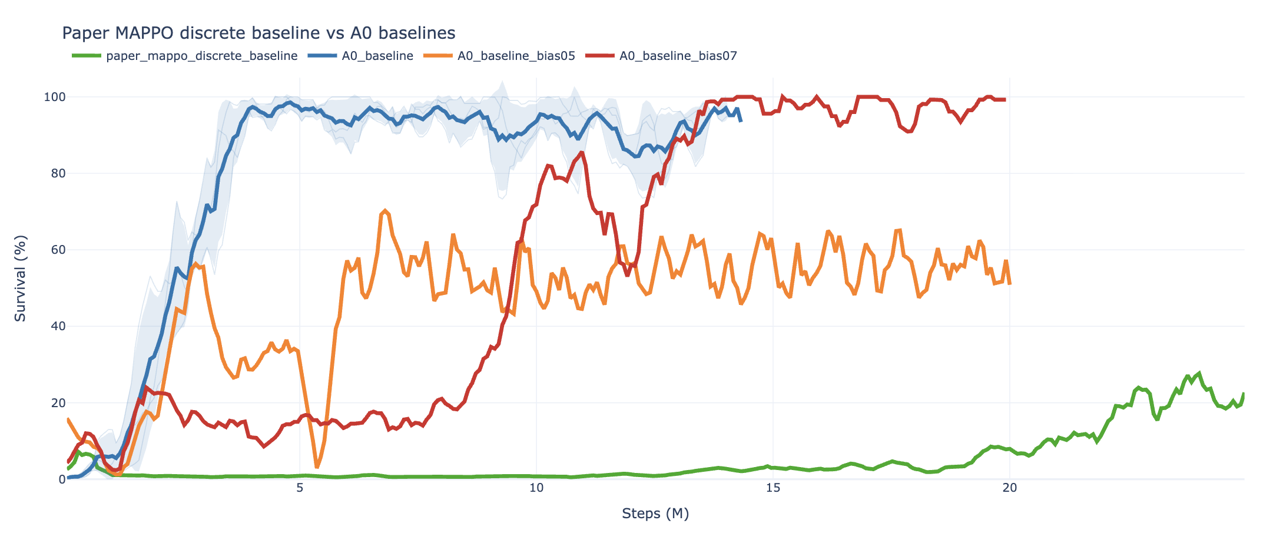
IEEE 14: Baseline, Results
Fig 2: Episodic survival during training of the paper baseline vs our baselines with new hyperparameter and structure
Notes:
To dive a little deeper i have been looking at a survey that summarize all the algorithms that won the l2rpn challenge and this is the main categories of succesfull agentthat won the challenge.
Some approaches rely on a single global agent with strong engineering tricks.
For example, they use graph neural networks combined with value-based RL, and validate actions using power-flow simulations.
Others reduce the action space using masking or pruning.
These methods can work, so mixing a single agent with rules, but they suffer because the action space remains very large.”
Another important idea is to predict a target topology instead of raw actions.
This is used in SMAAC, where the agent learns an afterstate representation—basically the resulting topology after an action.
This helps because multiple sequences of actions can lead to the same configuration. So it reduces the action space

Slide 10
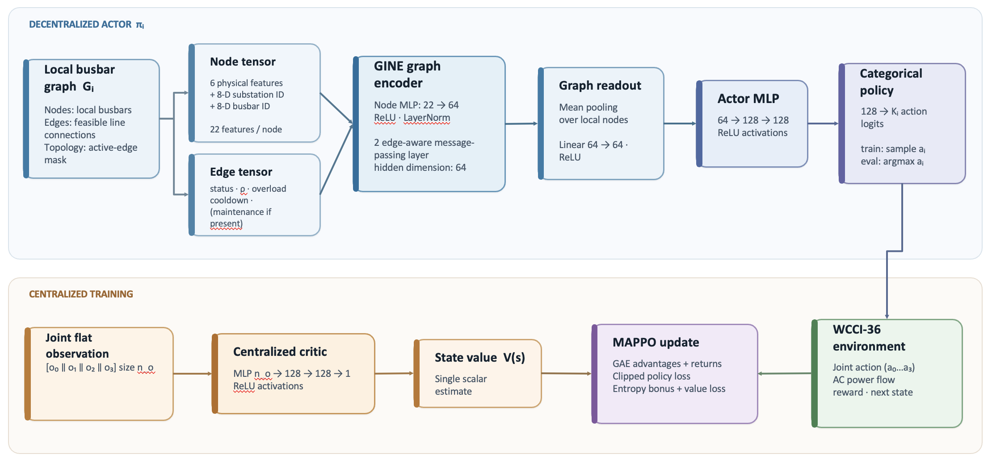
IEEE 14: Graph variations, structure
Notes:
To dive a little deeper i have been looking at a survey that summarize all the algorithms that won the l2rpn challenge and this is the main categories of succesfull agentthat won the challenge.
Some approaches rely on a single global agent with strong engineering tricks.
For example, they use graph neural networks combined with value-based RL, and validate actions using power-flow simulations.
Others reduce the action space using masking or pruning.
These methods can work, so mixing a single agent with rules, but they suffer because the action space remains very large.”
Another important idea is to predict a target topology instead of raw actions.
This is used in SMAAC, where the agent learns an afterstate representation—basically the resulting topology after an action.
This helps because multiple sequences of actions can lead to the same configuration. So it reduces the action space

Slide 11
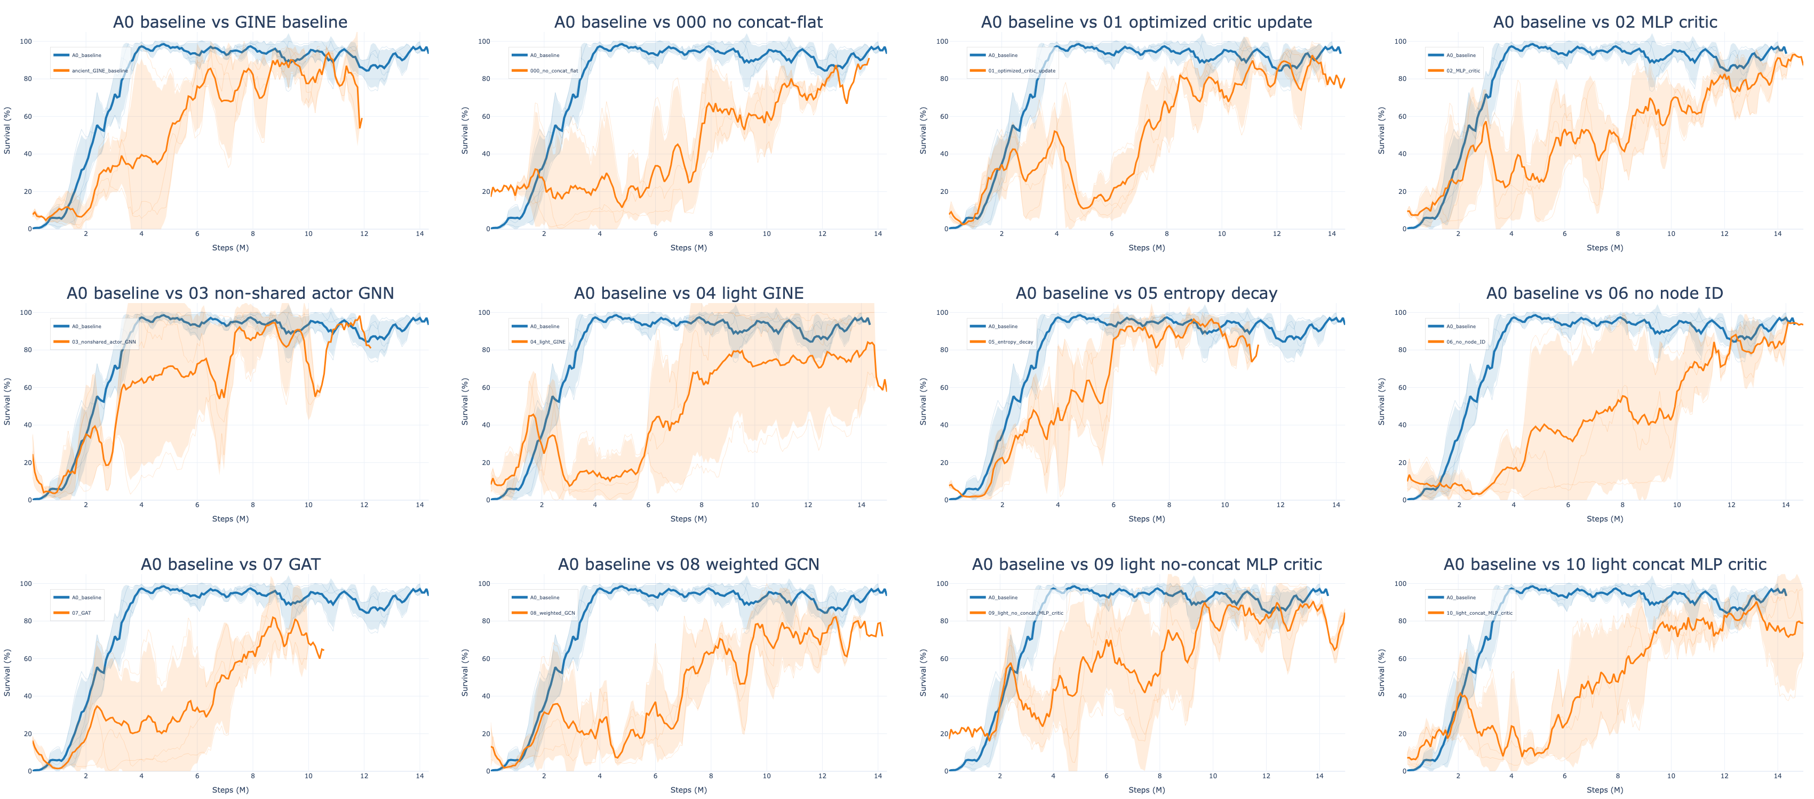
IEEE 14: Graph variations, results
Fig 3: Episodic survival during training of different GINE architecture compared to the baseline
Notes:
To dive a little deeper i have been looking at a survey that summarize all the algorithms that won the l2rpn challenge and this is the main categories of succesfull agentthat won the challenge.
Some approaches rely on a single global agent with strong engineering tricks.
For example, they use graph neural networks combined with value-based RL, and validate actions using power-flow simulations.
Others reduce the action space using masking or pruning.
These methods can work, so mixing a single agent with rules, but they suffer because the action space remains very large.”
Another important idea is to predict a target topology instead of raw actions.
This is used in SMAAC, where the agent learns an afterstate representation—basically the resulting topology after an action.
This helps because multiple sequences of actions can lead to the same configuration. So it reduces the action space

Slide 12
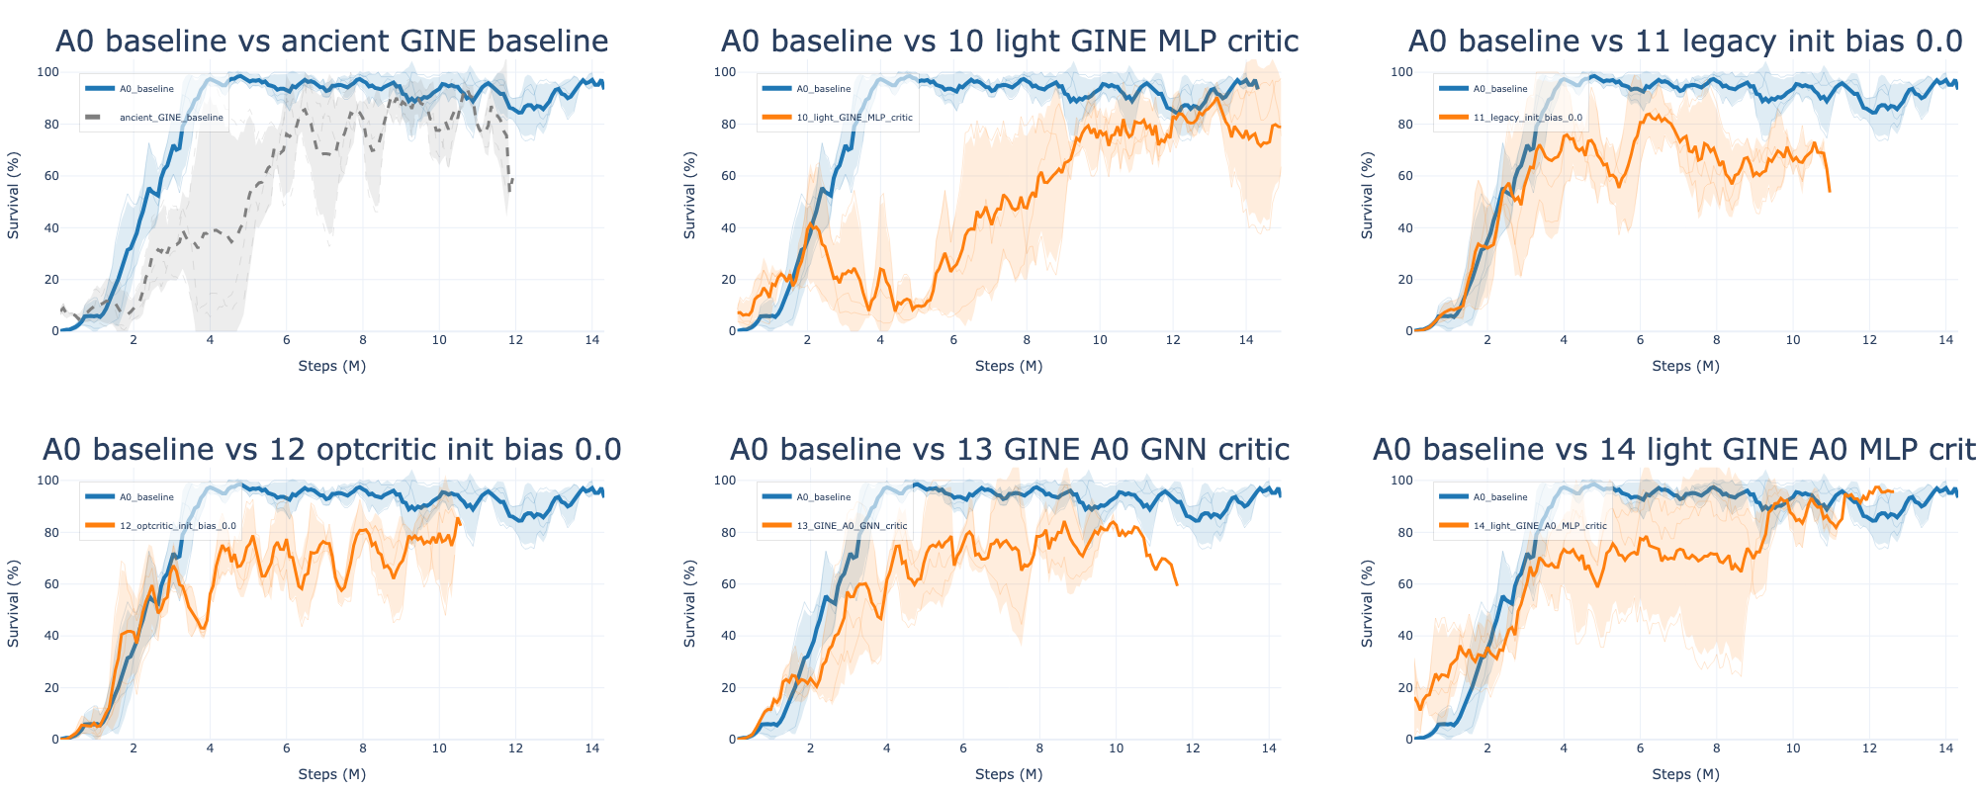
IEEE 14: Graph variations, results
Fig 4: Episodic survival during training of different GINE architecture compared to the baseline
Notes:
To dive a little deeper i have been looking at a survey that summarize all the algorithms that won the l2rpn challenge and this is the main categories of succesfull agentthat won the challenge.
Some approaches rely on a single global agent with strong engineering tricks.
For example, they use graph neural networks combined with value-based RL, and validate actions using power-flow simulations.
Others reduce the action space using masking or pruning.
These methods can work, so mixing a single agent with rules, but they suffer because the action space remains very large.”
Another important idea is to predict a target topology instead of raw actions.
This is used in SMAAC, where the agent learns an afterstate representation—basically the resulting topology after an action.
This helps because multiple sequences of actions can lead to the same configuration. So it reduces the action space

Slide 13
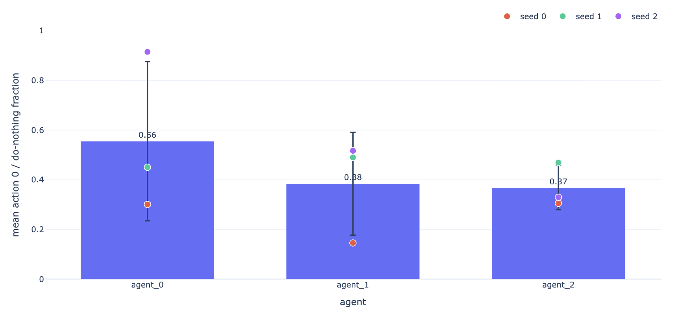
IEEE 14: Realistic behavior
Statement: The simple MLP baseline might have good performances, but the agents change the topology too often, and it is not a sustainable behavior in a realistic scenario.
Fig 5: Average of the action 0 usage over seeds at best-checkpoints for the mlp baseline
Objective: Implement a learnable method that reduces the number of topology changes done by each agent, without lowering the performance
Notes:
To dive a little deeper i have been looking at a survey that summarize all the algorithms that won the l2rpn challenge and this is the main categories of succesfull agentthat won the challenge.
Some approaches rely on a single global agent with strong engineering tricks.
For example, they use graph neural networks combined with value-based RL, and validate actions using power-flow simulations.
Others reduce the action space using masking or pruning.
These methods can work, so mixing a single agent with rules, but they suffer because the action space remains very large.”
Another important idea is to predict a target topology instead of raw actions.
This is used in SMAAC, where the agent learns an afterstate representation—basically the resulting topology after an action.
This helps because multiple sequences of actions can lead to the same configuration. So it reduces the action space

Slide 14
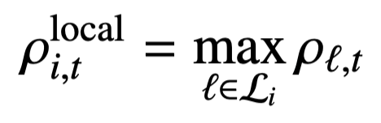
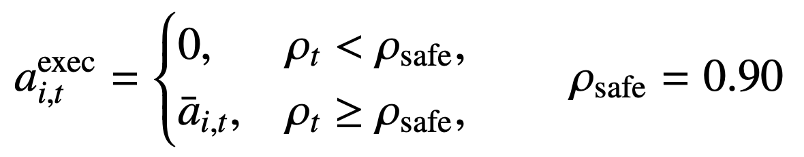
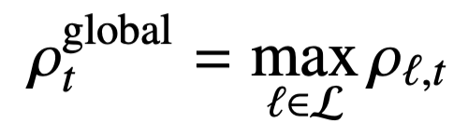
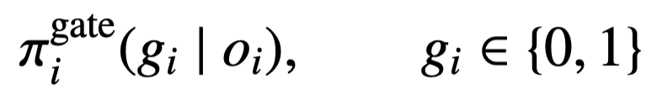
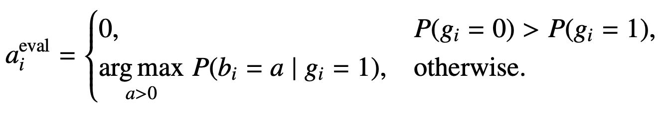
IEEE 14: Realistic behavior, Models
Flat, Heuristic:
Override the action chose by the agents by do nothing if $$max ρ < 90\%$$ localy or globally.
Gate: Manczak and al. (2023)
The actors have 2 MLP Head:
one with 2 outputs that predicts “act” vs “do nothing”
one n_action – 1 size that assign a score to each actions
We have a MAP structure where the action depends on the combination of both scores:
We have a Hierarchical structure where we look at each score sequentially:
Notes:
To dive a little deeper i have been looking at a survey that summarize all the algorithms that won the l2rpn challenge and this is the main categories of succesfull agentthat won the challenge.
Some approaches rely on a single global agent with strong engineering tricks.
For example, they use graph neural networks combined with value-based RL, and validate actions using power-flow simulations.
Others reduce the action space using masking or pruning.
These methods can work, so mixing a single agent with rules, but they suffer because the action space remains very large.”
Another important idea is to predict a target topology instead of raw actions.
This is used in SMAAC, where the agent learns an afterstate representation—basically the resulting topology after an action.
This helps because multiple sequences of actions can lead to the same configuration. So it reduces the action space

Slide 15

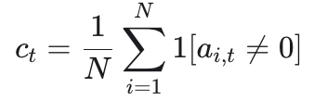


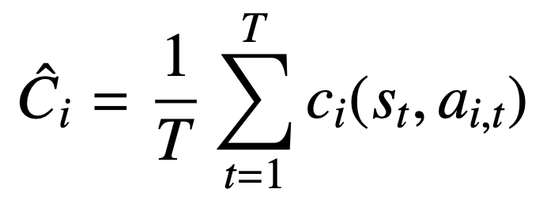

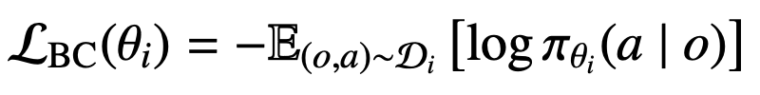
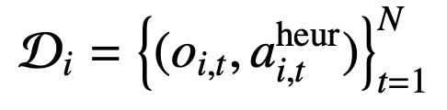
IEEE 14: Realistic behavior, Models
Topology Cost: Lautenbacher and al. (2025)
Each time an agent takes an action, we subtract a constant value to the reward for this step.
Adaptative Intervention Budget: Achiam and al. (2017); Stooke and al. (2020)
Each time an agent takes an action, we subtract an adaptative value to the reward for this step. The value of the penalty depends on the situation in which the network is, and how much the agent has already acted before.
Imitation Learning: Meppelink and al. (2025); de Jong and al. (2025)
From the local Heuristic Model we construct a dataset (observations -> actions) for each agent. Then from the trained model, we fine tune the weight of the actors using this new dataset.
Notes:
To dive a little deeper i have been looking at a survey that summarize all the algorithms that won the l2rpn challenge and this is the main categories of succesfull agentthat won the challenge.
Some approaches rely on a single global agent with strong engineering tricks.
For example, they use graph neural networks combined with value-based RL, and validate actions using power-flow simulations.
Others reduce the action space using masking or pruning.
These methods can work, so mixing a single agent with rules, but they suffer because the action space remains very large.”
Another important idea is to predict a target topology instead of raw actions.
This is used in SMAAC, where the agent learns an afterstate representation—basically the resulting topology after an action.
This helps because multiple sequences of actions can lead to the same configuration. So it reduces the action space

Slide 16
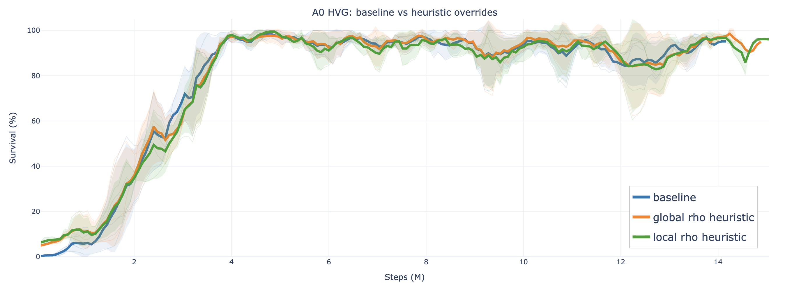
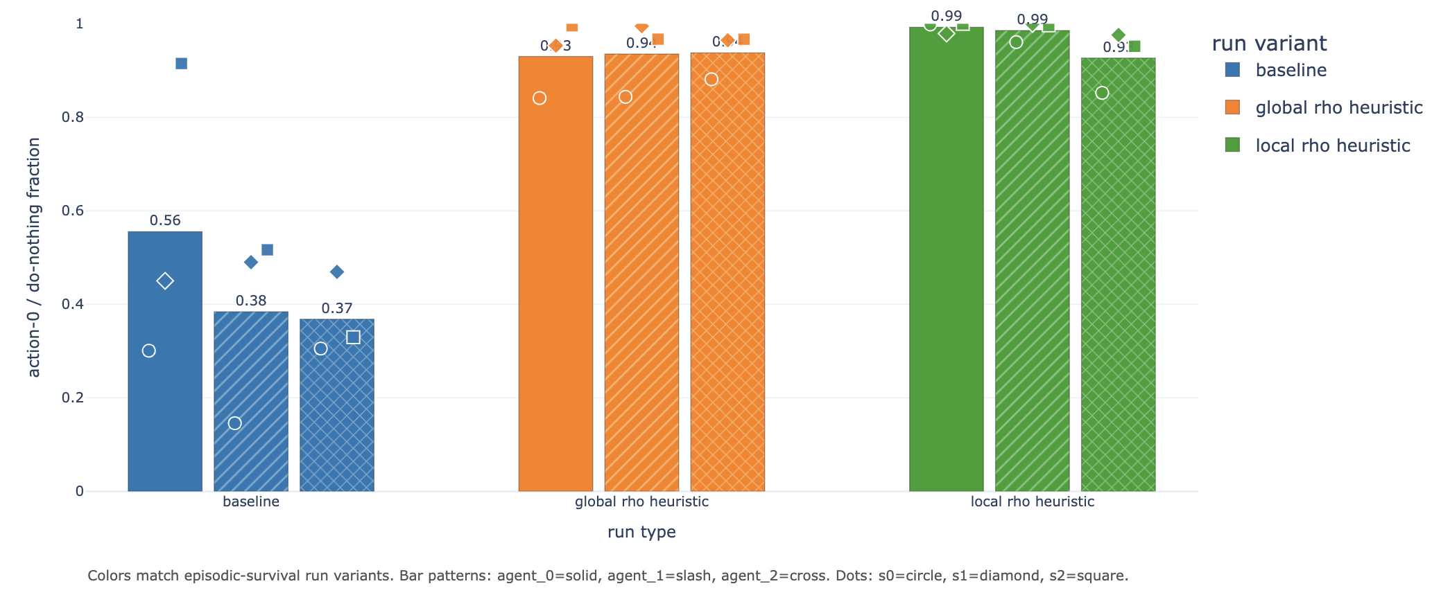
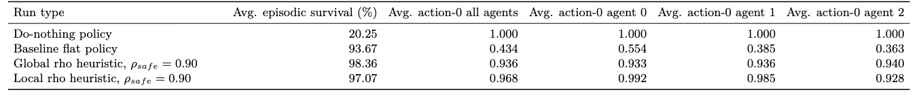
IEEE 14: Realistic behavior, Results
Fig 6: Episodic survival during training, heuristic overrides
Fig 7: Action-0 fraction per agent, heurisitc overrides
Table 5: Full-test summary for heuristic overrides
Notes:
To dive a little deeper i have been looking at a survey that summarize all the algorithms that won the l2rpn challenge and this is the main categories of succesfull agentthat won the challenge.
Some approaches rely on a single global agent with strong engineering tricks.
For example, they use graph neural networks combined with value-based RL, and validate actions using power-flow simulations.
Others reduce the action space using masking or pruning.
These methods can work, so mixing a single agent with rules, but they suffer because the action space remains very large.”
Another important idea is to predict a target topology instead of raw actions.
This is used in SMAAC, where the agent learns an afterstate representation—basically the resulting topology after an action.
This helps because multiple sequences of actions can lead to the same configuration. So it reduces the action space

Slide 17
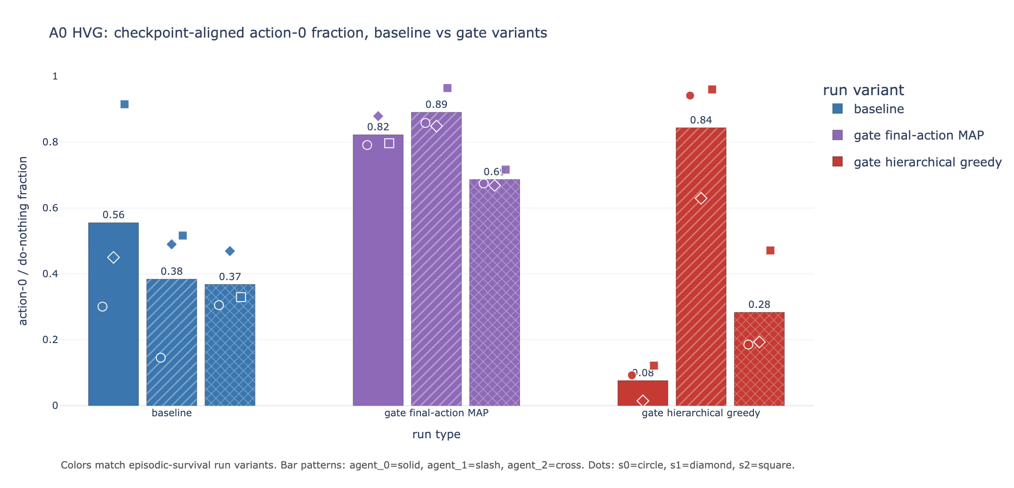
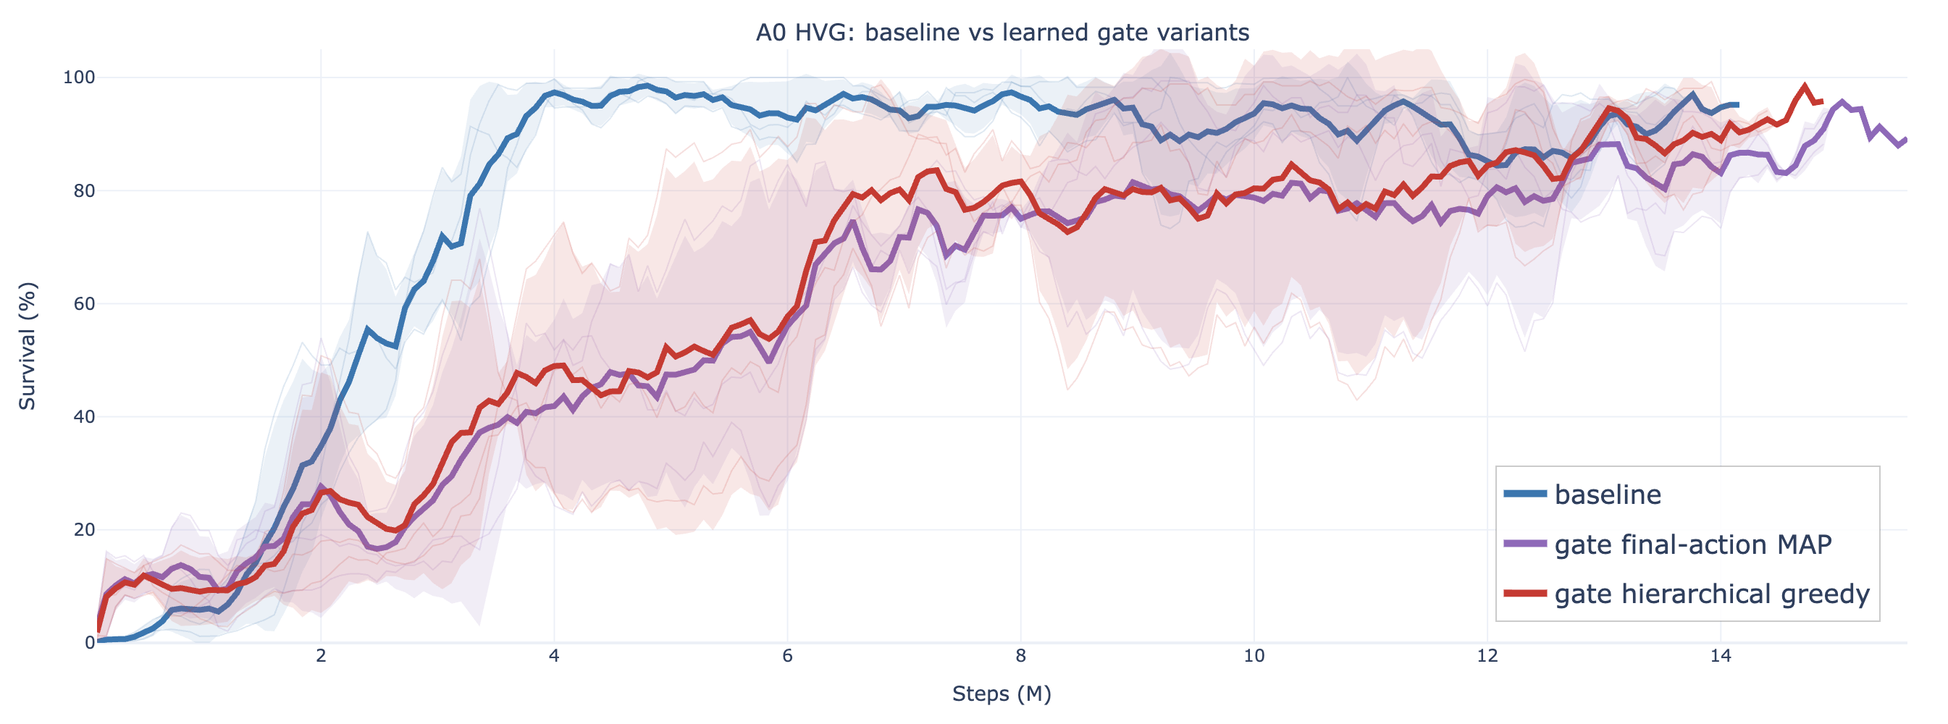
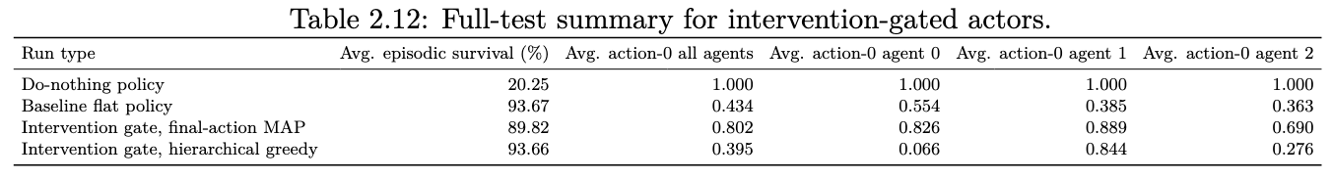
IEEE 14: Realistic behavior, Results
Fig 8: Episodic survival during training, intervention gated actors
Fig 9: Action-0 fraction per agent, intervention gated actors
Table 6: Full-test summary for intervention gated actors
Notes:
To dive a little deeper i have been looking at a survey that summarize all the algorithms that won the l2rpn challenge and this is the main categories of succesfull agentthat won the challenge.
Some approaches rely on a single global agent with strong engineering tricks.
For example, they use graph neural networks combined with value-based RL, and validate actions using power-flow simulations.
Others reduce the action space using masking or pruning.
These methods can work, so mixing a single agent with rules, but they suffer because the action space remains very large.”
Another important idea is to predict a target topology instead of raw actions.
This is used in SMAAC, where the agent learns an afterstate representation—basically the resulting topology after an action.
This helps because multiple sequences of actions can lead to the same configuration. So it reduces the action space

Slide 18
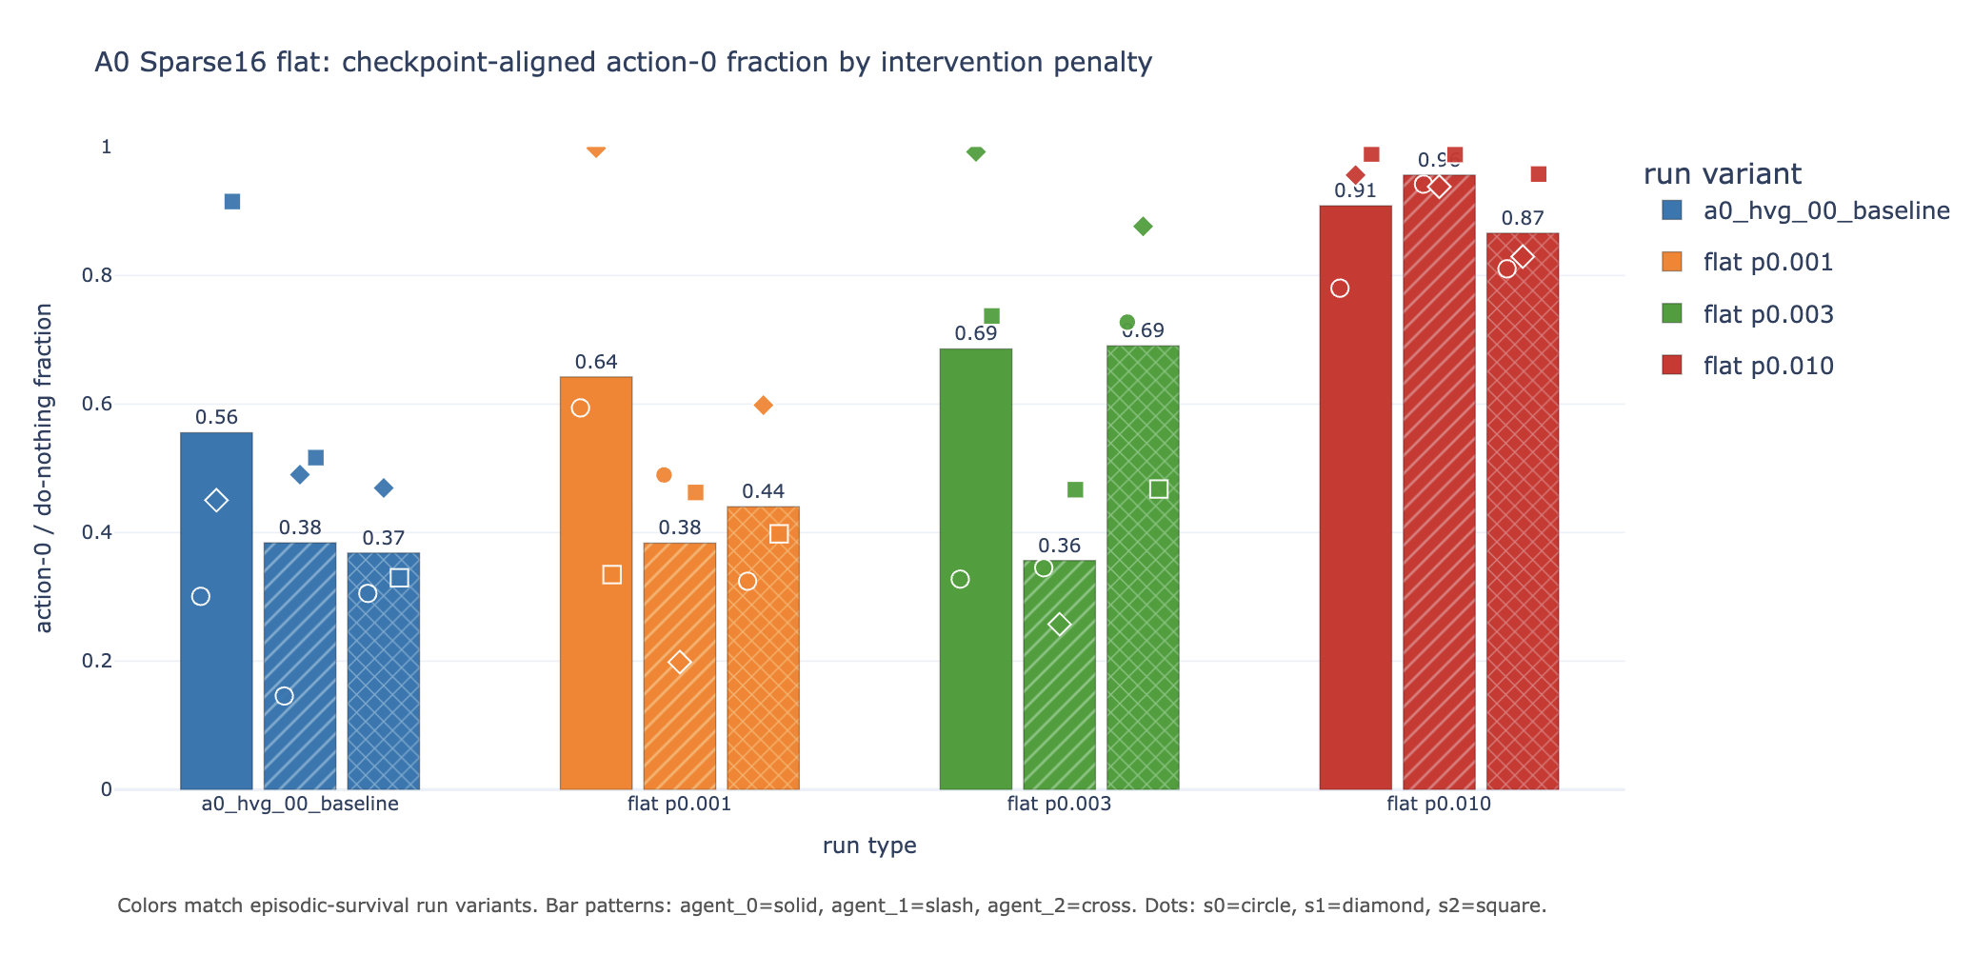
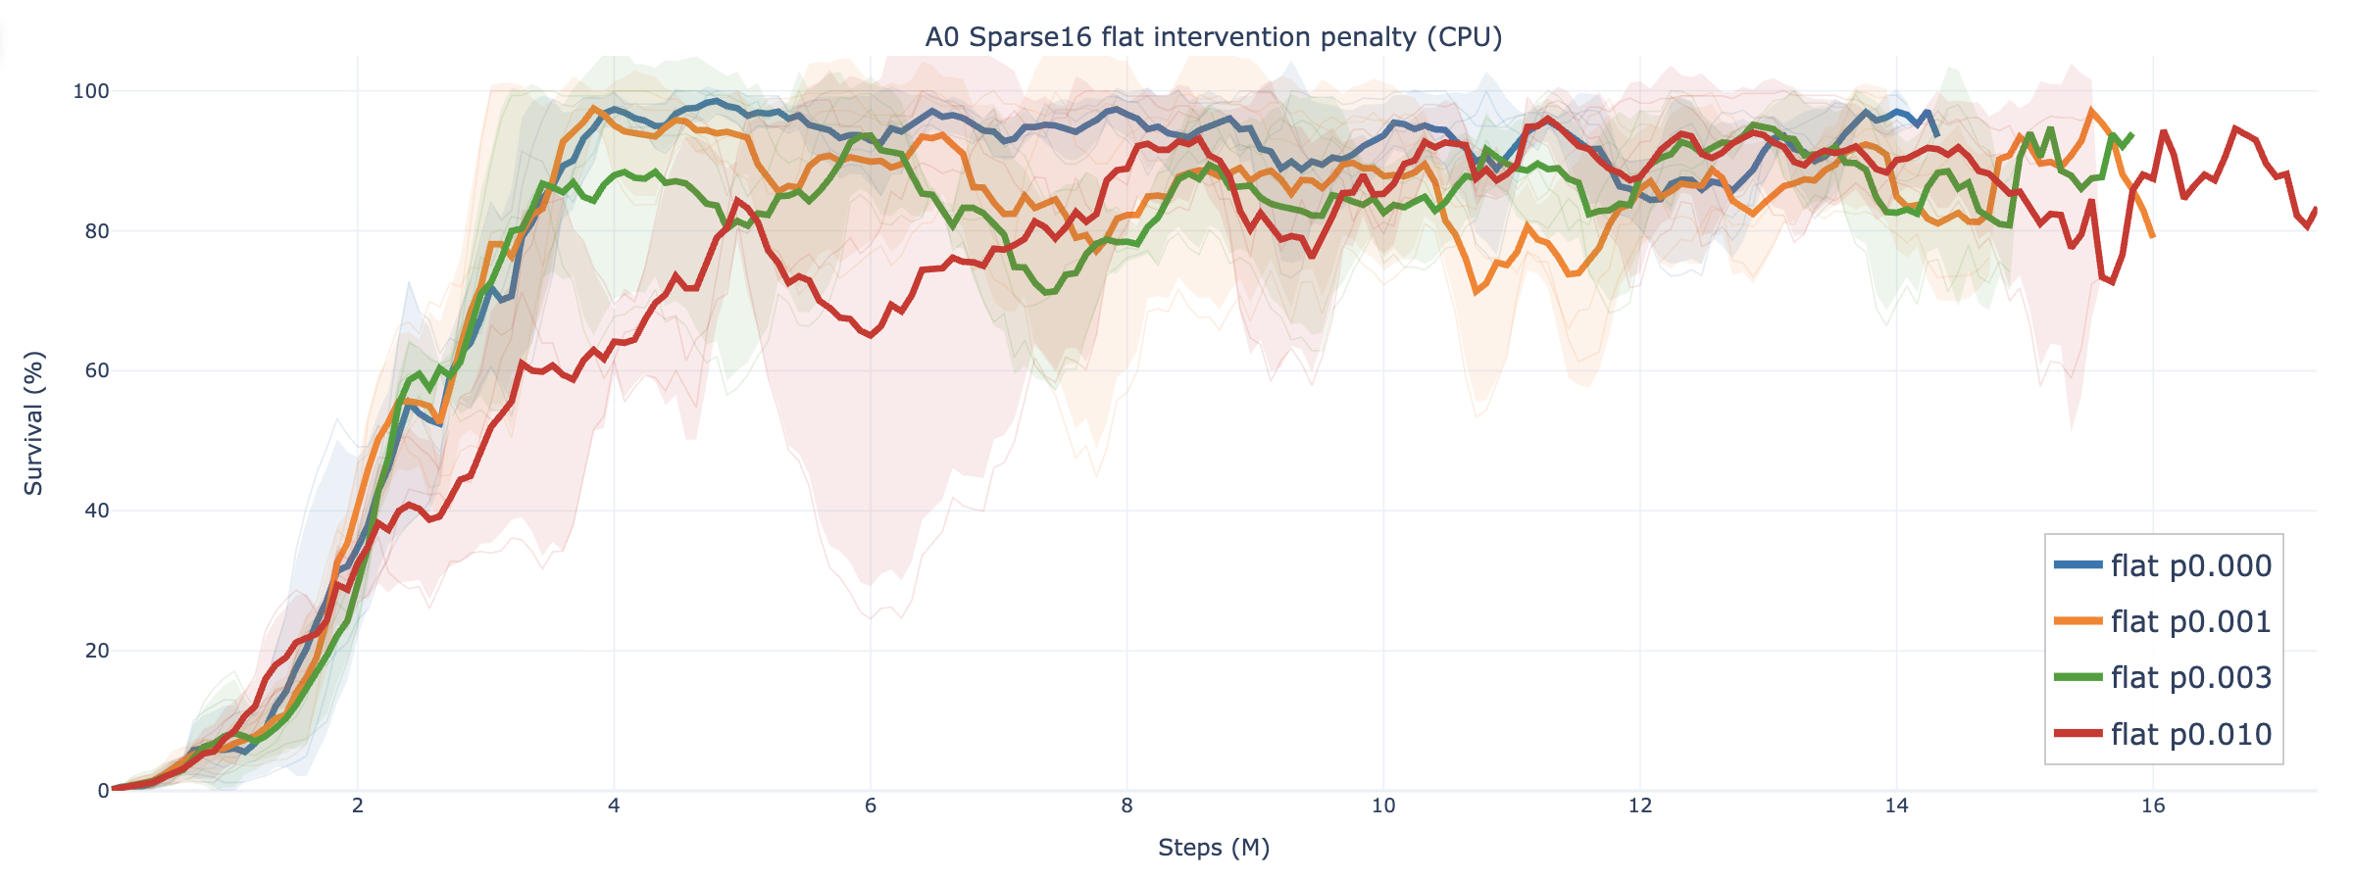
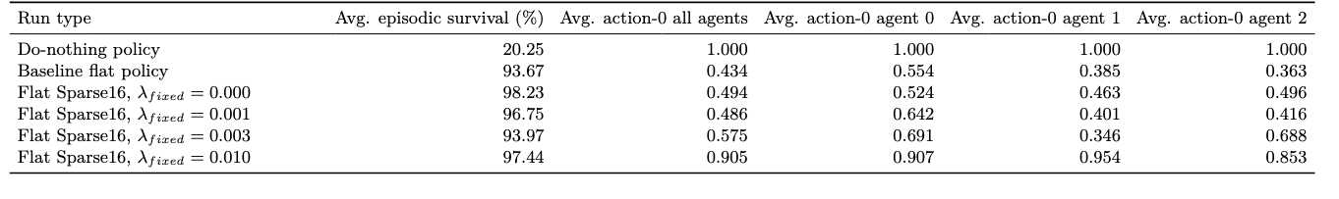
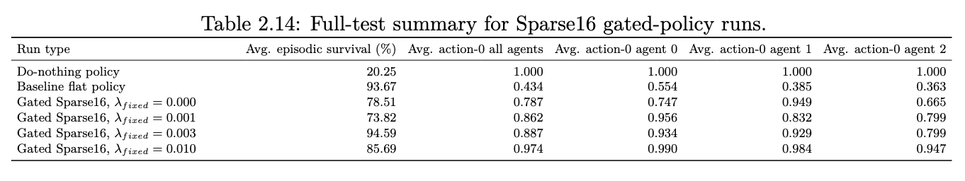
IEEE 14: Realistic behavior, Results
Fig 10: Episodic survival during training, flat intervention penalty
Fig 11: Action-0 fraction per agent, flat intervention penalty
Table 7: Full-test summary for flat intervention penalty
Notes:
To dive a little deeper i have been looking at a survey that summarize all the algorithms that won the l2rpn challenge and this is the main categories of succesfull agentthat won the challenge.
Some approaches rely on a single global agent with strong engineering tricks.
For example, they use graph neural networks combined with value-based RL, and validate actions using power-flow simulations.
Others reduce the action space using masking or pruning.
These methods can work, so mixing a single agent with rules, but they suffer because the action space remains very large.”
Another important idea is to predict a target topology instead of raw actions.
This is used in SMAAC, where the agent learns an afterstate representation—basically the resulting topology after an action.
This helps because multiple sequences of actions can lead to the same configuration. So it reduces the action space

Slide 19
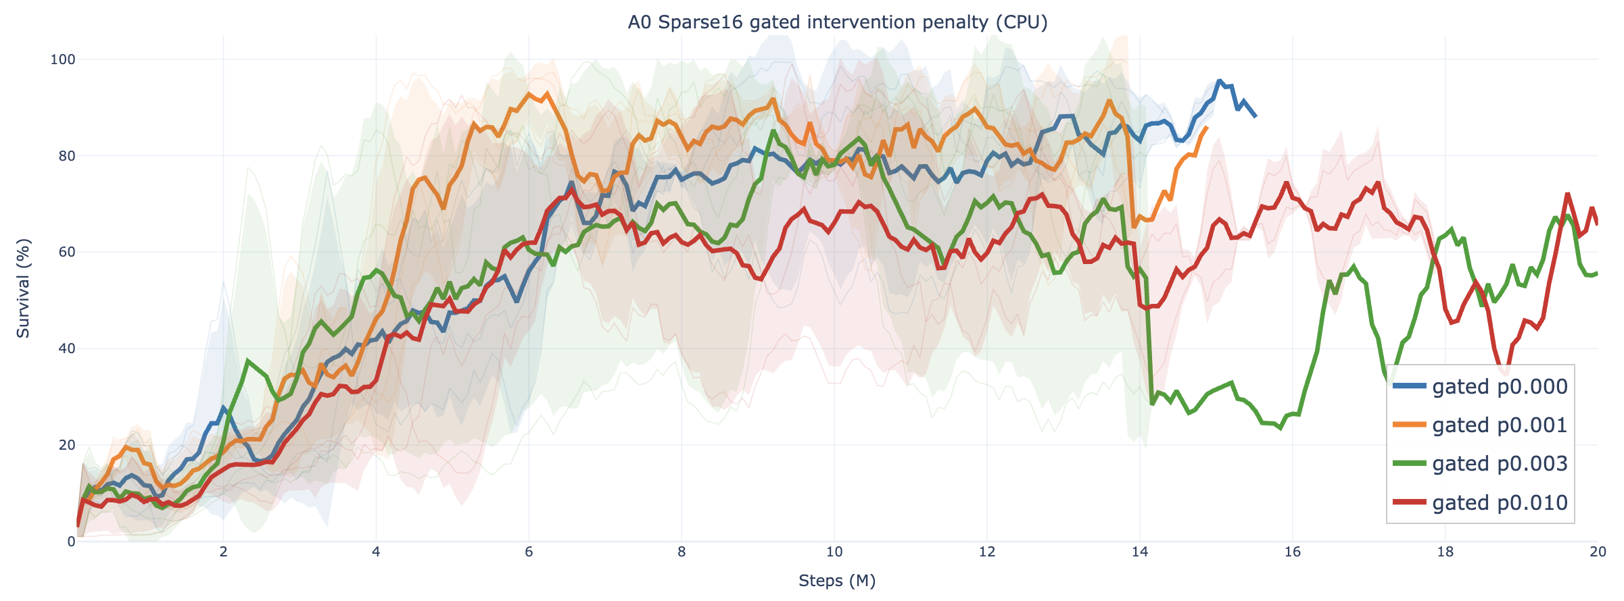
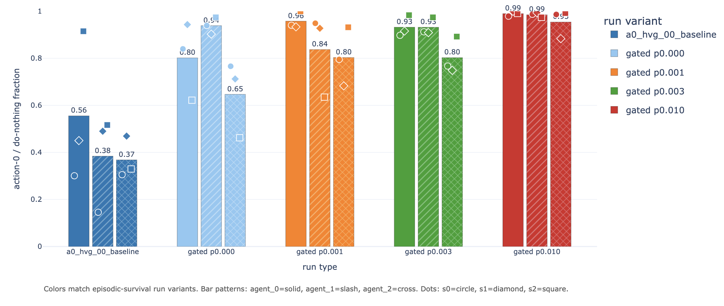
IEEE 14: Realistic behavior, Results
Fig 12: Episodic survival during training, gated intervention penalty
Fig 13: Action-0 fraction per agent, gated intervention penalty
Table 8: Full-test summary for gated intervention penalty
Notes:
To dive a little deeper i have been looking at a survey that summarize all the algorithms that won the l2rpn challenge and this is the main categories of succesfull agentthat won the challenge.
Some approaches rely on a single global agent with strong engineering tricks.
For example, they use graph neural networks combined with value-based RL, and validate actions using power-flow simulations.
Others reduce the action space using masking or pruning.
These methods can work, so mixing a single agent with rules, but they suffer because the action space remains very large.”
Another important idea is to predict a target topology instead of raw actions.
This is used in SMAAC, where the agent learns an afterstate representation—basically the resulting topology after an action.
This helps because multiple sequences of actions can lead to the same configuration. So it reduces the action space

Slide 20
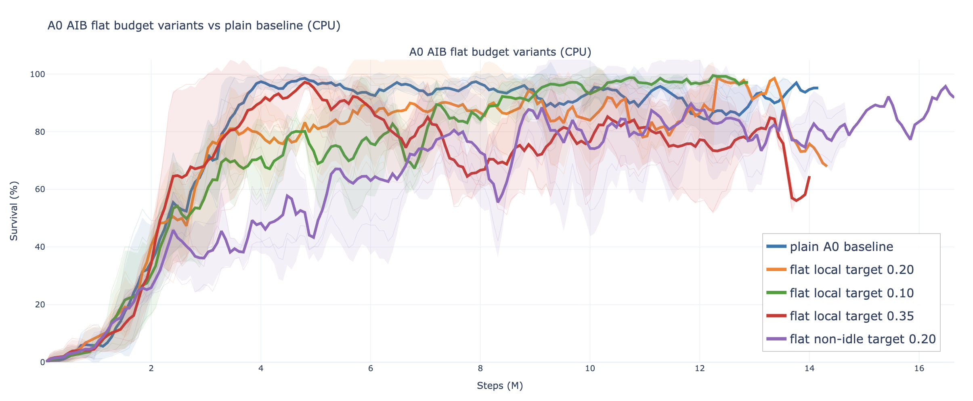
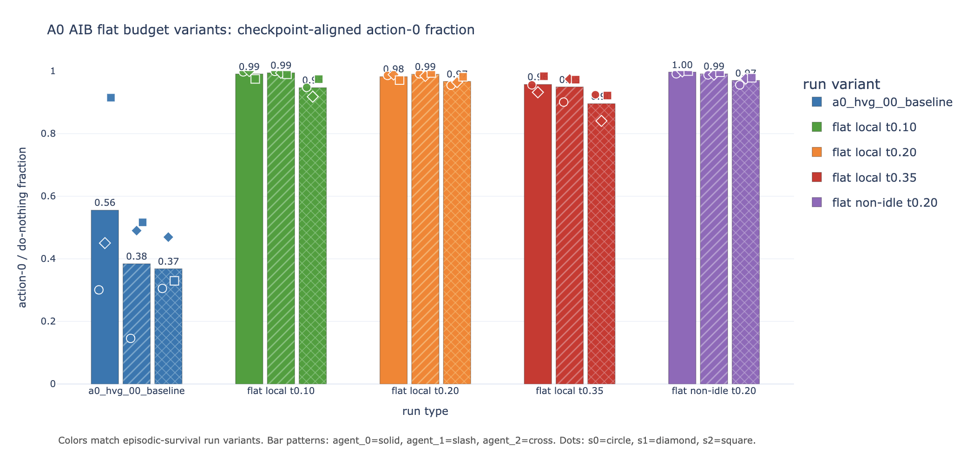
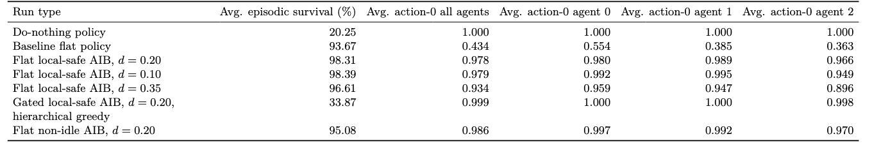
IEEE 14: Realistic behavior, Results
Fig 14: Episodic survival during training, adaptative intervention budget
Fig 15: Action-0 fraction per agent, adaptative intervention budget
Table 9: Full-test summary adaptative intervention budget
Notes:
To dive a little deeper i have been looking at a survey that summarize all the algorithms that won the l2rpn challenge and this is the main categories of succesfull agentthat won the challenge.
Some approaches rely on a single global agent with strong engineering tricks.
For example, they use graph neural networks combined with value-based RL, and validate actions using power-flow simulations.
Others reduce the action space using masking or pruning.
These methods can work, so mixing a single agent with rules, but they suffer because the action space remains very large.”
Another important idea is to predict a target topology instead of raw actions.
This is used in SMAAC, where the agent learns an afterstate representation—basically the resulting topology after an action.
This helps because multiple sequences of actions can lead to the same configuration. So it reduces the action space

Slide 21
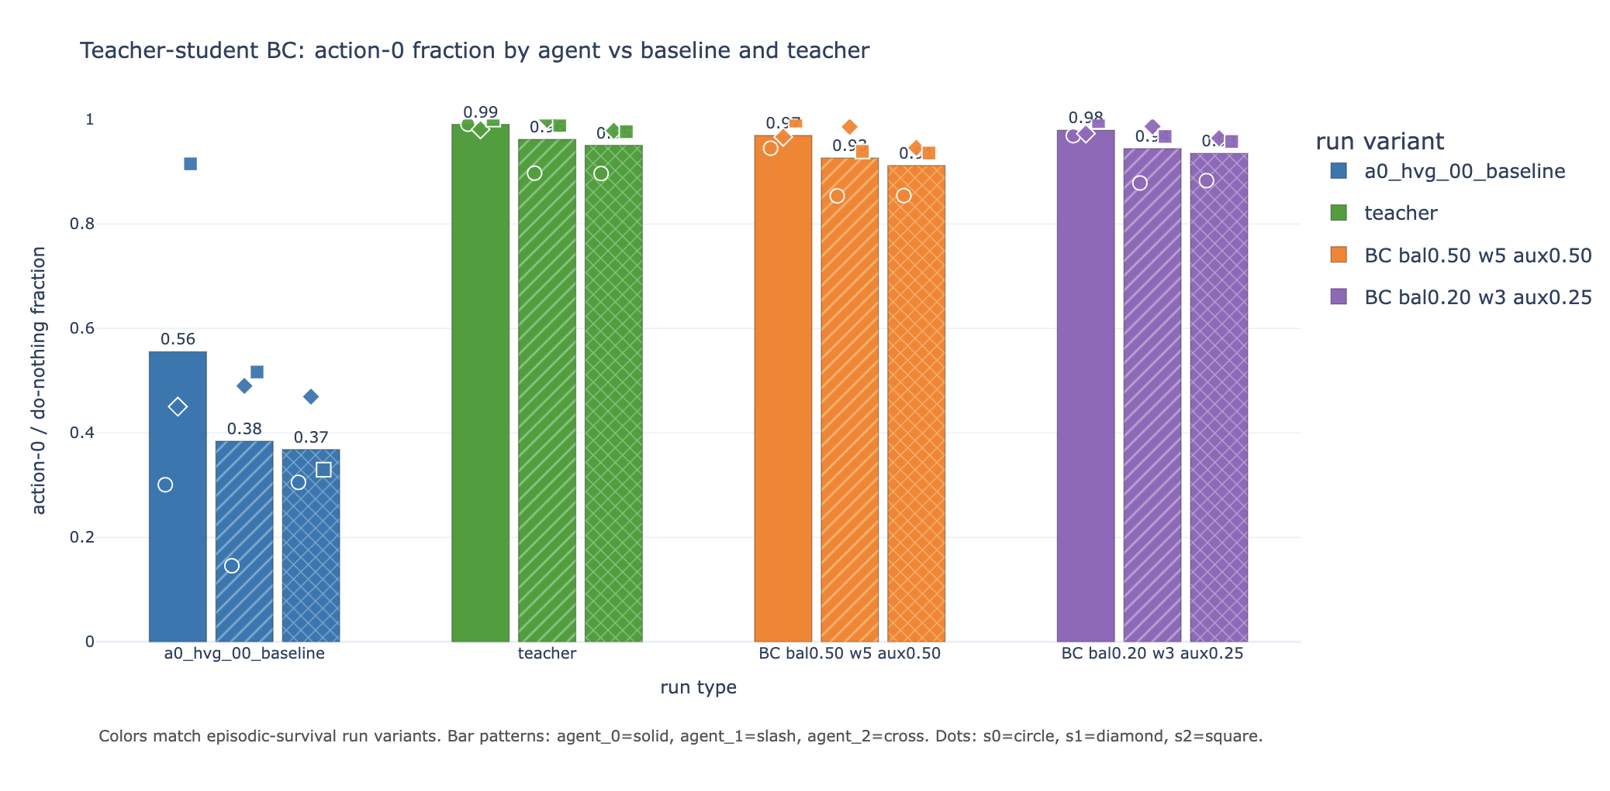
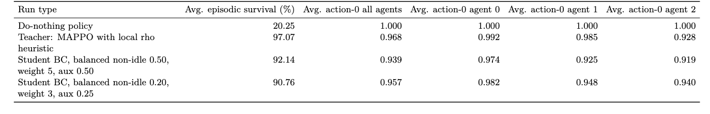
IEEE 14: Realistic behavior, Results
Fig 15: Action-0 fraction per agent, student/teacher
Table 10: Full-test summary, student/teacher
Notes:
To dive a little deeper i have been looking at a survey that summarize all the algorithms that won the l2rpn challenge and this is the main categories of succesfull agentthat won the challenge.
Some approaches rely on a single global agent with strong engineering tricks.
For example, they use graph neural networks combined with value-based RL, and validate actions using power-flow simulations.
Others reduce the action space using masking or pruning.
These methods can work, so mixing a single agent with rules, but they suffer because the action space remains very large.”
Another important idea is to predict a target topology instead of raw actions.
This is used in SMAAC, where the agent learns an afterstate representation—basically the resulting topology after an action.
This helps because multiple sequences of actions can lead to the same configuration. So it reduces the action space

Slide 22
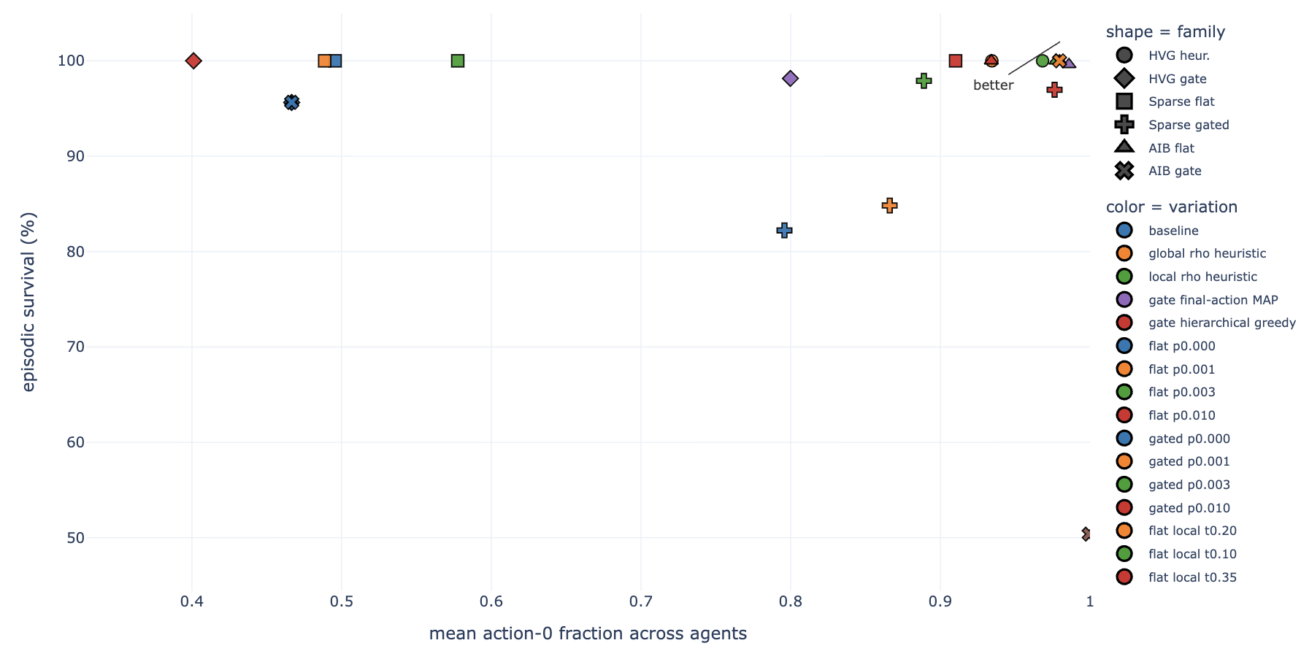
IEEE 14: Realistic behavior, Results
Fig 16: Action-0 / episodic survival tradeoff for all runs
Notes:
To dive a little deeper i have been looking at a survey that summarize all the algorithms that won the l2rpn challenge and this is the main categories of succesfull agentthat won the challenge.
Some approaches rely on a single global agent with strong engineering tricks.
For example, they use graph neural networks combined with value-based RL, and validate actions using power-flow simulations.
Others reduce the action space using masking or pruning.
These methods can work, so mixing a single agent with rules, but they suffer because the action space remains very large.”
Another important idea is to predict a target topology instead of raw actions.
This is used in SMAAC, where the agent learns an afterstate representation—basically the resulting topology after an action.
This helps because multiple sequences of actions can lead to the same configuration. So it reduces the action space

Slide 23
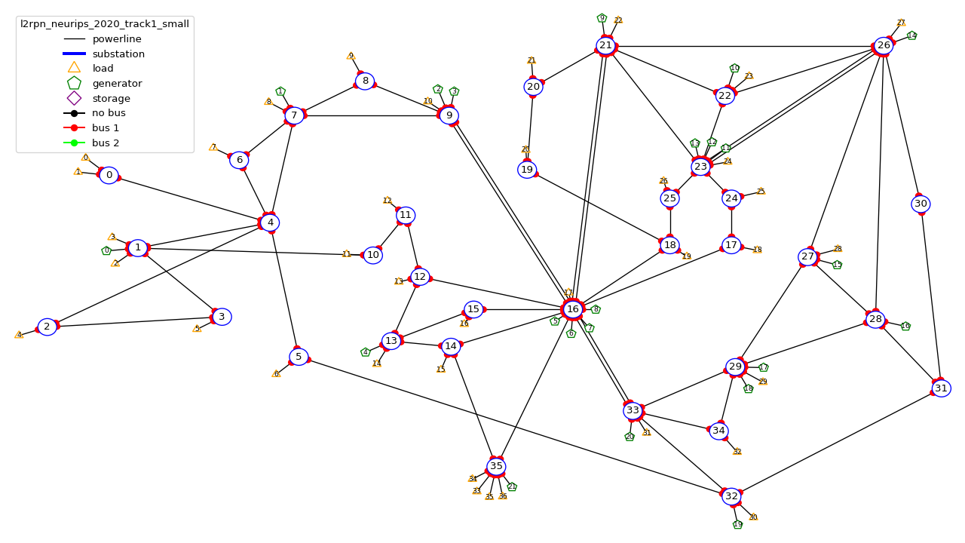
WCCI 2020 (36 substations): environment setup
Agent | Controlled substations | Local discrete action space
Agent 0 | 0, 1, 2, 3, 4 | 77 actions
Agent 1 | 6, 7, 8, 9, 16 | 65,642 actions
Agent 2 | 5, 10, 11, 12, 13, 14, 15, 32, 35 | 127 actions
Agent 3 | 17–31, 33, 34 | 1,119 actions
Table 11: Agent-to-substation assignments and action spaces for the local observation setup of WCCI
Fig 17: Substations controlled by each agent WCCI environment
Notes:
To dive a little deeper i have been looking at a survey that summarize all the algorithms that won the l2rpn challenge and this is the main categories of succesfull agentthat won the challenge.
Some approaches rely on a single global agent with strong engineering tricks.
For example, they use graph neural networks combined with value-based RL, and validate actions using power-flow simulations.
Others reduce the action space using masking or pruning.
These methods can work, so mixing a single agent with rules, but they suffer because the action space remains very large.”
Another important idea is to predict a target topology instead of raw actions.
This is used in SMAAC, where the agent learns an afterstate representation—basically the resulting topology after an action.
This helps because multiple sequences of actions can lead to the same configuration. So it reduces the action space

Slide 24
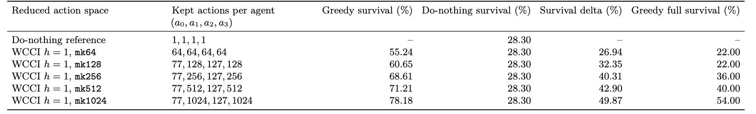
WCCI 2020 (36 substations): Action Space Reduction
Collect risky states: During rollouts, keep states where:
$$ρ_{max}>0.90$$
2. Simulate candidate actions: For each agent action, compare its outcome to do-nothing:
$$Δ\left(s,a\right)=ρ_{after}\left(s,a\right)−ρ_{after}\left(s,0\right)$$
3. Score actions: For each action:
$$score\left(a\right)=\frac{\#times action improves the grid}{\#times action was tested}$$
4. Keep best actions per agent: Keep all small-agent actions, and only top-K actions for large agents. Do-nothing action is always kept.
Table 12: One-step greedy evalaution of WCCI reduced action spaces on 50 random test chronics
Notes:
To dive a little deeper i have been looking at a survey that summarize all the algorithms that won the l2rpn challenge and this is the main categories of succesfull agentthat won the challenge.
Some approaches rely on a single global agent with strong engineering tricks.
For example, they use graph neural networks combined with value-based RL, and validate actions using power-flow simulations.
Others reduce the action space using masking or pruning.
These methods can work, so mixing a single agent with rules, but they suffer because the action space remains very large.”
Another important idea is to predict a target topology instead of raw actions.
This is used in SMAAC, where the agent learns an afterstate representation—basically the resulting topology after an action.
This helps because multiple sequences of actions can lead to the same configuration. So it reduces the action space

Slide 25
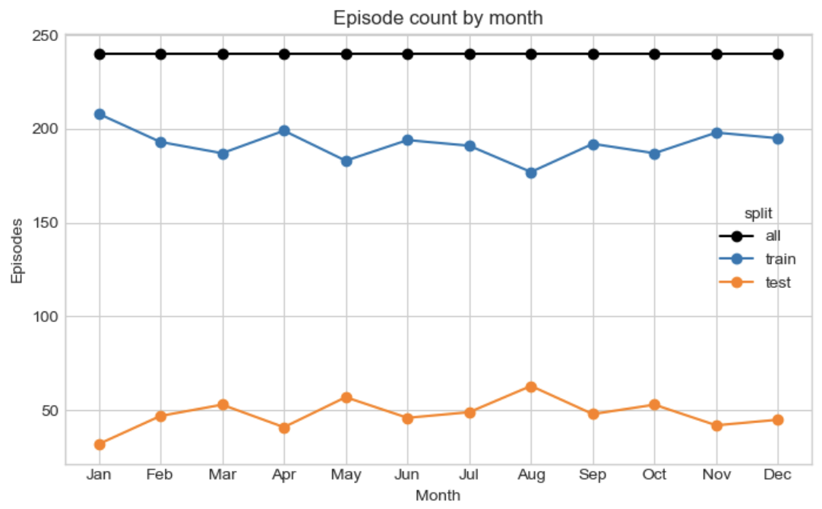
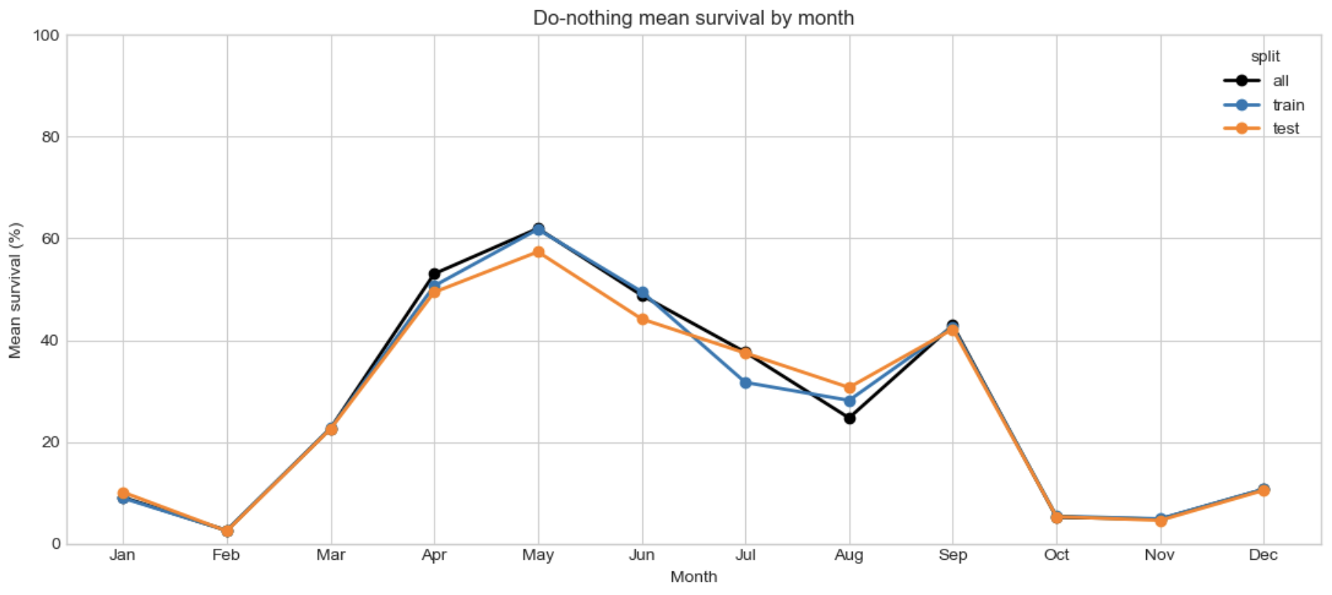
WCCI 2020 (36 substations): Results
Fig 18: Do Nothing mean survival by month on WCCI 36 environment
Fig 19: Do Nothing mean survival by month on WCCI 36 environment
Notes:
To dive a little deeper i have been looking at a survey that summarize all the algorithms that won the l2rpn challenge and this is the main categories of succesfull agentthat won the challenge.
Some approaches rely on a single global agent with strong engineering tricks.
For example, they use graph neural networks combined with value-based RL, and validate actions using power-flow simulations.
Others reduce the action space using masking or pruning.
These methods can work, so mixing a single agent with rules, but they suffer because the action space remains very large.”
Another important idea is to predict a target topology instead of raw actions.
This is used in SMAAC, where the agent learns an afterstate representation—basically the resulting topology after an action.
This helps because multiple sequences of actions can lead to the same configuration. So it reduces the action space

Slide 26
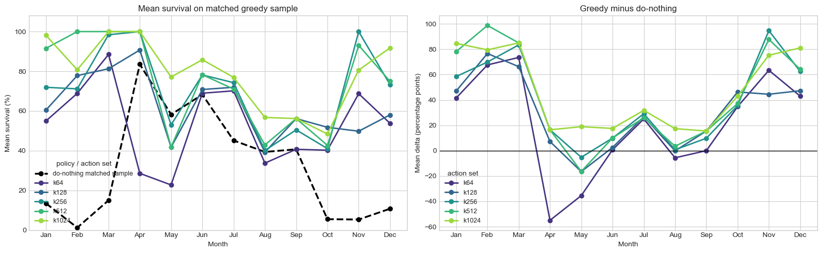
WCCI 2020 (36 substations): Results
Fig 20: Mean episodic survival rate depending on the month and the action space size
Fig 21: Difference in surival rate between do-nothing and greedy evaluation depending on the month and the action space size
Notes:
To dive a little deeper i have been looking at a survey that summarize all the algorithms that won the l2rpn challenge and this is the main categories of succesfull agentthat won the challenge.
Some approaches rely on a single global agent with strong engineering tricks.
For example, they use graph neural networks combined with value-based RL, and validate actions using power-flow simulations.
Others reduce the action space using masking or pruning.
These methods can work, so mixing a single agent with rules, but they suffer because the action space remains very large.”
Another important idea is to predict a target topology instead of raw actions.
This is used in SMAAC, where the agent learns an afterstate representation—basically the resulting topology after an action.
This helps because multiple sequences of actions can lead to the same configuration. So it reduces the action space

Slide 27
Next Steps
Scale architecture validation
Transfer the proposed model variations to WCCI36
Goal: determine which improvements remain effective at larger scale.
Retry the graph policy at scale
Revisit and improve the existing GNN implementation
Adapt the graph construction and feature mapping to WCCI36
Compare GNN and MLP policies under the same MAPPO configuration
Goal: determine whether the graph policy can improve generalization and scalability on a larger network.
Add event-triggered communication
Trigger communication when a line exceeds a loading threshold: $$ρ_{line}>ρ_{comm}$$
Share the overloaded line, loading level and affected region with neighboring agents
Compare no communication, fixed communication and event-triggered communication
Goal: improve coordination while limiting communication overhead.
Notes:
To dive a little deeper i have been looking at a survey that summarize all the algorithms that won the l2rpn challenge and this is the main categories of succesfull agentthat won the challenge.
Some approaches rely on a single global agent with strong engineering tricks.
For example, they use graph neural networks combined with value-based RL, and validate actions using power-flow simulations.
Others reduce the action space using masking or pruning.
These methods can work, so mixing a single agent with rules, but they suffer because the action space remains very large.”
Another important idea is to predict a target topology instead of raw actions.
This is used in SMAAC, where the agent learns an afterstate representation—basically the resulting topology after an action.
This helps because multiple sequences of actions can lead to the same configuration. So it reduces the action space

