Slide 1
MASTER THESIS · AUGUST 2026
Graph Neural Networks for Decentralized Multi-Agent Reinforcement Learning in Power-Grid Topology Control
Corentin Plumet
Can a decentralized graph policy trained on a 14-bus grid still control a 36-substation grid?
IEEE 14-bus → L2RPN WCCI 2020
Supervisors Prof. Fink · Prof. Peng · Dr. Nejjar
Environment Grid2Op / L2RPN · built on MARL2Grid
Notes:
0:20 — slide 1 of 25 · cumulative 0:20
Title.
Good morning. My thesis asks whether a decentralized reinforcement-learning
policy for power-grid topology control, trained on a small 14-bus grid, can
still be useful on a grid two and a half times larger. Everything is built on
Grid2Op and on the MARL2Grid decentralized framework.

Slide 2
0
The argument in four steps
Topology control is nearly free flexibility — but every published policy is welded to the grid it was trained on.
1
2
3
4
The problem
The design
The evidence
The answer
Almost-free flexibility. Combinatorial search. Regional operation.
State and action interface both independent of grid size.
bus14 → WCCI36. Zero-shot, from scratch, fine-tuned.
Incomplete — but 3× do-nothing, and better than retraining.
Ordered by what the evidence supports, not by how the work happened.
Notes:
0:25 — slide 2 of 25 · cumulative 0:45
Roadmap.
Four steps. First why topology control is worth automating and why nobody can
move a trained policy between grids. Second the design: the state and the
action interface both have to stop depending on grid size. Third the evidence
on a real target grid. Fourth what it means. The report follows the
chronological order of the work; this talk is ordered by importance.

Slide 3
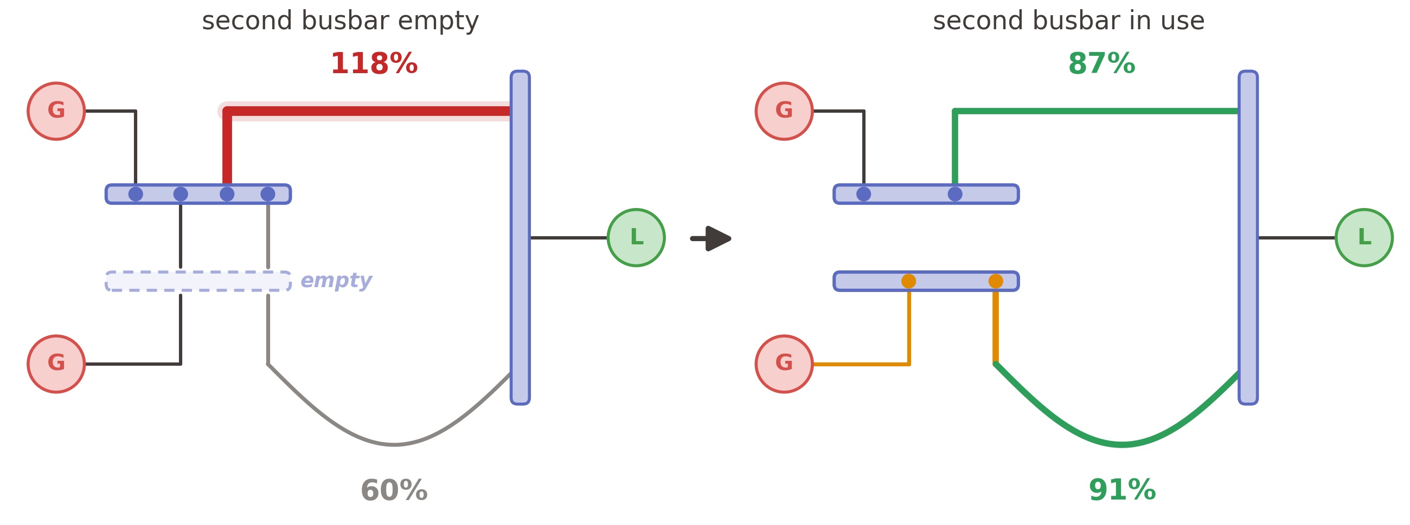
0
How a topology action relieves an overload
Same lines, same generation, same demand. Only the switch positions changed.
Notes:
1:00 — slide 3 of 25 · cumulative 1:45
The mechanism, in one picture. Take your time on this slide.
Two generators on the left, one load on the right, two corridors between the
substations. Every substation has two busbars; on the left panel everything is
switched to the first one and the second sits there empty. The upper corridor is
the short one, so by impedance it takes most of the flow and sits at 118 percent
of its thermal limit while the long corridor runs at only 60. Nothing is broken
— the power simply follows the path of least resistance.
Now move one generator and one line onto the second busbar — that is the orange
part. The two corridors are no longer fed from the same node, so the flow has to
share: 87 and 91 percent. The overload is gone.
Nothing physical changed. Same lines, same generation, same demand, and no new
equipment — the second busbar was already there. Only the switch positions
moved. That is the entire lever this thesis automates, and it is why the
marginal cost is essentially zero.

Slide 4
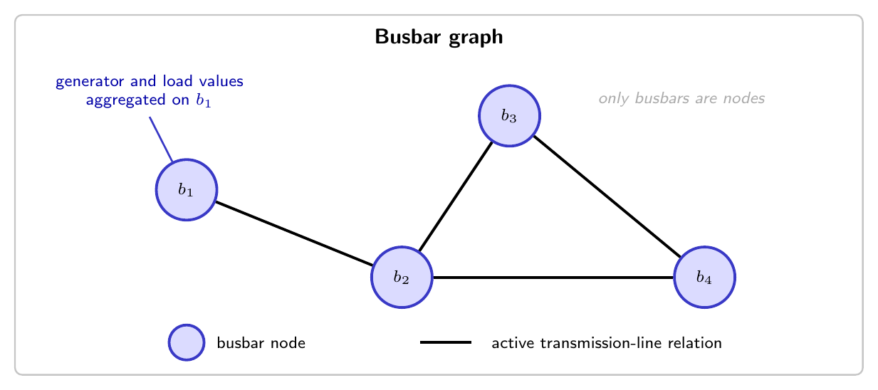
0
The problem, in three steps
Almost-free flexibility · an action space too large to search · a grid already operated region by region.
1 · TOPOLOGY CONTROL
2 · TOO BIG TO SEARCH
3 · ALREADY REGIONAL
178 → 66,965
centralized critic
bus14 → WCCI36
actor 1
actor 2
actor 3
unitary topology actions
critic discarded after training
Reconfigure busbars, not generation.
2^{d} assignments per substation.
One control centre per region.
Marginal cost ≈ 0.
Cooldowns couple decisions in time.
A central actor grows with the grid.
Today: a short offline list.
→ Reinforcement learning.
CTDE: global critic, training only.
Grid2Op / L2RPN supply the simulator, time series and operating rules · built on MARL2Grid: 3 agents on bus14, 52 / 50 / 76 non-idle actions · Fisher 2008, Viebahn 2022.
Notes:
1:30 — slide 4 of 25 · cumulative 3:15
Three ideas, quickly — left to right.
Topology control. A transmission grid is usually drawn as a fixed graph, but
operators can change it: inside every substation the connected elements sit on
busbars, and moving one element or splitting the substation redirects the power
flow. The switchgear is already installed, so the marginal cost is essentially
zero — unlike redispatch or curtailment, which you pay for every time. In
practice operators use a short list of remedial actions prepared offline, so
most of this flexibility is never used.
Too big to search. A substation with d elements and two busbars has two-to-the-d
assignments, so the 14-bus grid already has 178 unitary actions and the WCCI grid
has almost sixty-seven thousand. And the decisions are coupled in time —
an action now changes which contingencies you can still handle, and cooldowns can
lock a substation for several steps. No closed form, one very clear objective:
keep the grid alive. That is a reinforcement-learning problem, and Grid2Op gives
us the simulator and the operating rules.
Already regional. Almost all published work uses one agent for the whole grid,
which is not how systems are operated — they are split into regions, each with
its own control centre. Decentralization is also the only structure that scales,
because a central actor's input and output both grow with the grid. Centralized
training with decentralized execution gives us the best of both: a global critic
during training only, local actors at deployment.

Slide 5
0
State of the art: four families, one shared limitation
Existing methods shrink the search or coordinate centrally. None produces a policy you can move to another grid.
Family | Representative work | What it does | Why it stays put
Single-agent | SMAAC · Subramanian 2021 | Afterstate actor–critic, hierarchical where / how | Action space reduced or factorized per grid
Policy + heuristics | PowRL | Act only when loading is high; overload manager | The rule sits outside the policy
Hierarchical / centrally coordinated | Manczak · van der Sar · de Mol | Split when / where / how; central arbitration | A component still sees the whole grid
Fully decentralized | MARL2Grid (starting point) | Local observations, no communication, no selector | Fixed-width actors welded to one grid
The gap. A graph encoder frees the state from grid size. The action interface — one output row per action index — does not.
Notes:
0:45 — slide 5 of 25 · cumulative 4:00
State of the art.
Four families. Single-agent methods like SMAAC, the WCCI 2020 winner, work well
but need the action space reduced or factorized first. Policy-plus-heuristic
methods like PowRL win competitions by only querying the agent when the grid is
stressed, but the rule lives outside the policy. Hierarchical and centrally
coordinated multi-agent methods split the decision but still have a component
that sees the whole grid. Fully decentralized control has had much less
attention; MARL2Grid is my starting point there. All four share one limitation:
the actor's output layer has one row per action index, so the policy cannot be
moved. Graph encoders fix the state side. The action interface is the part
nobody has fixed.

Slide 6
0
One encoder, two levels of sharing
A GNN is size-invariant — and regions of comparable size make the same encoder work across grids too.
bus14 · 3 regions
WCCI36 · 4 regions
agent 1
agent 2
agent 3
→
ONE SHARED GNN ENCODER
←
agent 1
agent 2
agent 3
agent 4
invariant to node and edge count
1 same weights for every agent
2 same weights on the other grid
Regions are the same order of size — 4–6 substations on bus14, 5–17 on WCCI36 — so the encoder always reads a local graph, never a whole grid of 14 against 36.
THE STATE TRANSFERS
THE ACTION HEAD DOES NOT
One weight set reads any local graph, on either grid.
→ the bus14 encoder loads on WCCI36 unchanged
One output row per action index, and |A| differs by agent and by grid.
→ score actions in a way independent of |A|
Third condition, separately: the same channel must carry a comparable number on both grids.
Notes:
1:10 — slide 6 of 25 · cumulative 5:10
Why a GNN, and where it stops helping.
A graph network is size-invariant: the same weights read a graph with any
number of nodes and edges. That is the obvious argument for using one, and it
buys the first level of sharing — inside bus14, all three agents run the same
encoder even though their regions differ in shape and size.
The second level is the one that matters for this thesis, and it is not
automatic. Because the grid is partitioned into regions, an agent never sees
the whole network — it sees a local graph of four to six substations on bus14,
five to seventeen on WCCI. Those are the same order of magnitude, which is
emphatically not true of fourteen substations against thirty-six. So the same
encoder can read both grids: the bus14 checkpoint loads on WCCI unchanged.
But size-invariance of the state is not transferability of the policy. The
action head still has one output row per action index, and the number of
actions differs by agent and by grid — so that head cannot move. Full
transferability needs a way to score an action that does not depend on how many
actions there are. That is the next slide.

Slide 7
0
PART 2
1. The problem and the gap
2. Designing a policy that can move
3. Does it cross grids?
4. What it means
Designing a policy that can move
The two mechanisms that let one set of weights read a different grid — and the input transformation that makes the numbers comparable.
Notes:
0:05 — slide 7 of 25 · cumulative 5:15
Section divider — say the part title and move on.

Slide 8
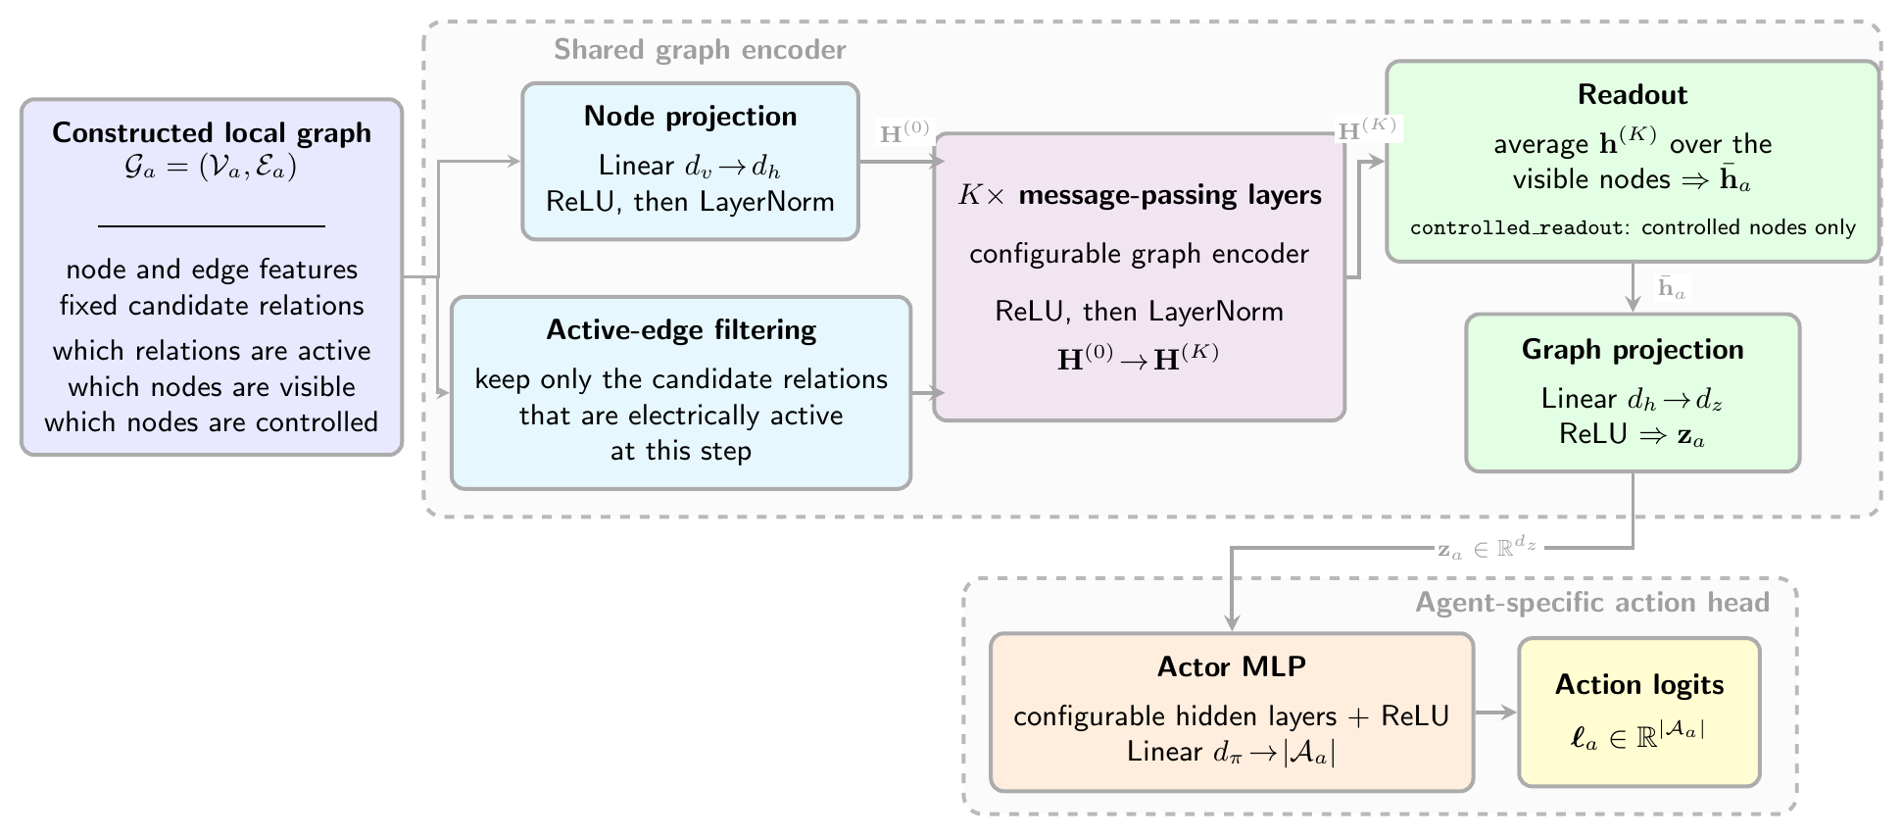
0
Method I — one shared encoder, one local graph per agent
The state stops depending on grid size: the same weights read any local neighbourhood.
Local graph
Own substations and every line touching them. Across a boundary: the shared line only.
Dynamic masking
Fixed tensor shape; inactive edges dropped before message passing.
Shared weights
One encoder for every agent; only the action head is agent-specific.
Centralized critic
A separate MLP over the global state, discarded after training.
Local graph → active-edge filtering → shared GINE encoder → readout → agent-specific head.
What the graph and the encoder can be: next two slides.
Notes:
0:45 — slide 8 of 25 · cumulative 6:00
Method I.
The actor is a shared graph encoder. Each agent builds a local graph: its own
substations, every line touching them, and across a boundary only the shared
line — never the neighbour's private generators and loads. The candidate graph
has a fixed shape and a dynamic mask switches edges on and off, so a topology
change rewires connectivity without rebuilding the tensor. The encoder is GINE
with two message-passing layers at width 128; edge features carry line status,
loading, overflow and cooldown, which matters because GINE folds the edge vector
into every message. Readout over the energized nodes gives one vector per agent.
The critic stays a centralized MLP and is thrown away after training.

Slide 9
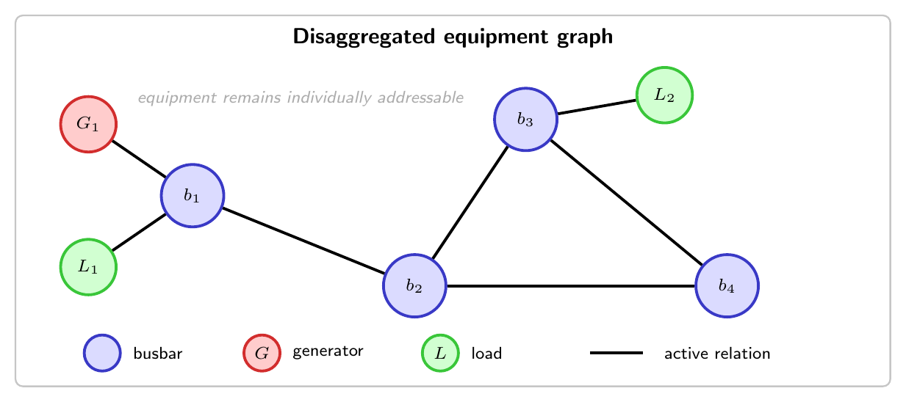
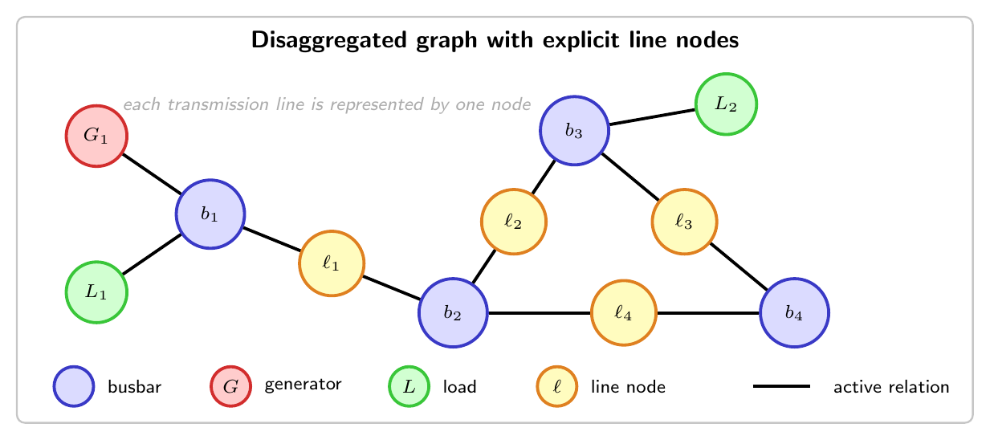
0
Three graph representations
How much of the substation the encoder actually sees — and what that leaves visible across a regional boundary.
Busbar
Disaggregated
Line-node
one node per busbar; power summed onto it
generators and loads become their own nodes
every transmission line becomes a node
 | What a local actor sees of its neighbour
Busbar | the shared line and the far-end busbar, with its aggregated power and angle
Disaggregated | the shared line and the far-end busbar — but no neighbouring generator or load
Line-node | the shared line node only — no neighbouring busbar, equipment or attachment
The line-node graph is the one carried into transfer: a boundary line stays addressable without constructing the neighbour's busbar.
Notes:
0:55 — slide 9 of 25 · cumulative 6:55
Three graph representations.
The busbar graph has one node per busbar, with generator and load power summed
onto it. The disaggregated graph promotes each generator and load to its own
node, so their state stays individual. The line-node graph goes one step
further and makes every transmission line a node as well.
The table underneath is the reason the third one is what I use for transfer.
Look at what an agent sees of its neighbour. In the busbar graph it sees the
far-end busbar with the neighbour's aggregated power and angle — that is
somebody else's private state. In the disaggregated graph it still constructs
that far-end busbar. In the line-node graph it sees only the shared line node:
no neighbouring busbar, no equipment, no attachment. That is both the cleanest
information boundary and the one that makes a boundary line addressable without
having to build any part of the neighbour's region.

Slide 10
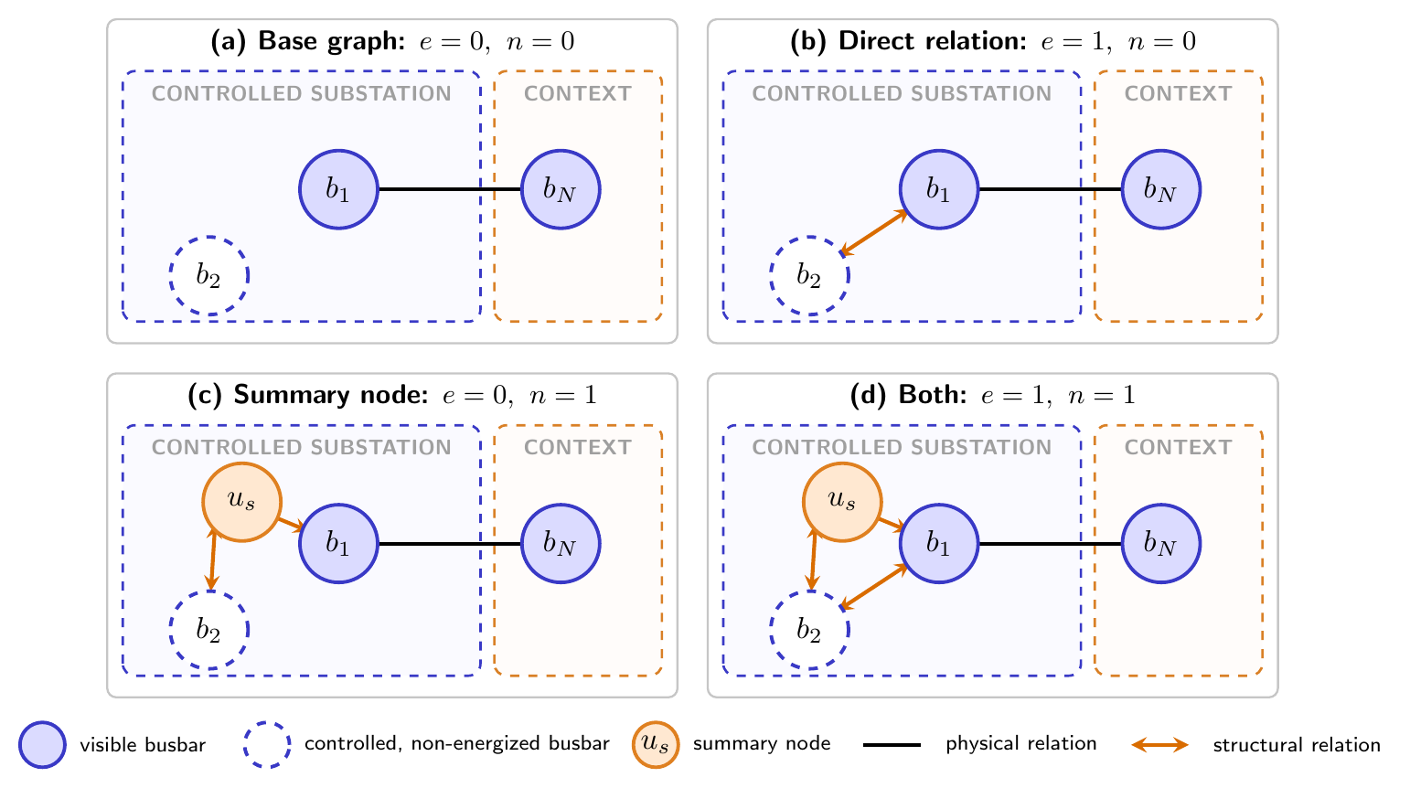
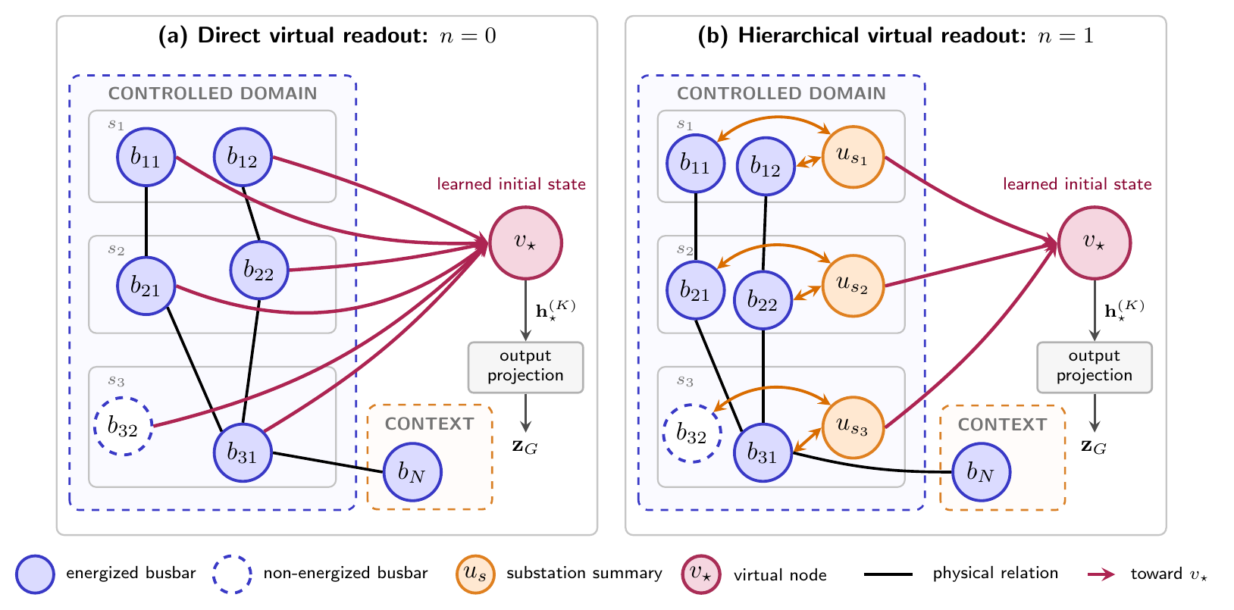
0
Three optional augmentations
Extra structure, zero extra measurement — and never extended into a neighbouring region.
e direct same-substation edge n summary node
v virtual-node readout
The two busbars of a substation exchange messages in one hop, or in two through a learned hub.
The hub is initialised from structure only, not identity.
One learned node collects from the controlled busbars and replaces the readout entirely.
Edges point one way: it cannot send back into the graph.
Three binary factors — the 2³ cells of Screen D.
Notes:
1:10 — slide 10 of 25 · cumulative 8:05
Three optional augmentations.
None of these adds a measurement — every physical channel on an added edge is
zero. They only change how quickly information moves.
On the left, factors e and n. The base graph does not connect the two busbars
of a substation to each other at all. Factor e adds a direct edge between them,
so they exchange messages in one hop. Factor n instead inserts a learned summary
node, which does the same job in two hops, and is initialised purely from
structure: the number of busbars, lines, generators and loads. The bottom-right
panel shows both enabled together.
On the right, factor v: one learned virtual node collects from the controlled
busbars and its final state replaces the readout entirely. The edges point one
way — it can gather but cannot send back into the physical graph.
All three are restricted to controlled substations. Adding them in a neighbour
would expose part of another agent's action space and create a communication
path that does not physically exist. Three binary factors, eight cells: that is
Screen D, and the answer turns out to be that none of them pays for itself.

Slide 11
0
What the encoder can be
Message-passing operator, capacity, and readout — the three knobs settled by Screens A, B and C.
OPERATOR screen A
CAPACITY screen B
READOUT screen C
GINE vs GAT
16
32
64
128
which nodes | mean | max
all visible | · | ·
controlled | · | ·
energized | • | •
controlled ∩ energized | · | ·
m_{u→v} = ReLU( h_{u} + W_{e}e_{uv} )
K=1
K=2
Edge features enter every message.
K=3
layers × width selected K = 2, width 128
8 readouts or one virtual node instead
CARRIED FORWARD INTO EVERY LATER EXPERIMENT
GINE · K = 2 layers · width 128 · readout over energized nodes · no augmentation
Screen results on slide 14. Depth, width, readout and augmentation heatmaps in the backup slides.
Notes:
1:05 — slide 11 of 25 · cumulative 9:10
What the encoder can be.
Three knobs. The operator: GINE against GAT. GINE is the one I keep, and the
reason is on the slide — the edge vector is projected and added into every
message, so two identical nodes still send different messages when one edge is
an overloaded line and the other is an asset attachment. GAT weights neighbours
by attention and lets edges only gate that weighting.
Capacity: message-passing depth from one to three layers, crossed with width
sixteen to one hundred twenty-eight. Twelve cells. Depth controls reach — one
layer crosses one line, two layers combine information across two.
Readout: after message passing I still need one fixed vector, and that is two
independent choices — which nodes go in, and how they are combined. Four node
populations, mean or a component-wise maximum, so eight readouts; or the virtual
node replaces the whole thing.
Everything downstream in this talk uses the row at the bottom: GINE, two layers,
width 128, readout over the energized nodes, no augmentation. The evidence for
each of those is three slides ahead.

Slide 12
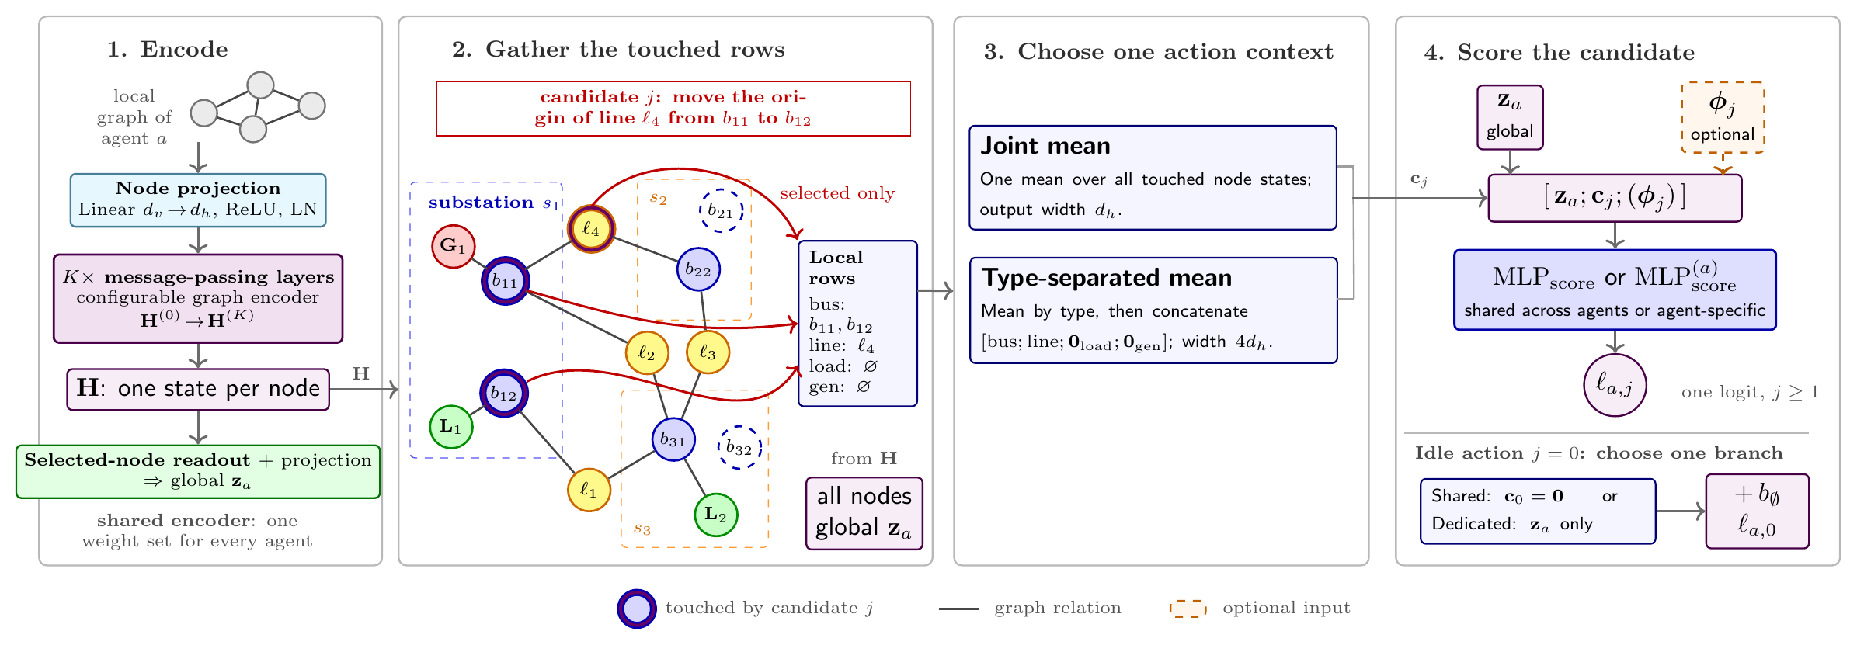
0
Method II — score each action from the nodes it touches
The piece missing from the literature: the head stops depending on the number of actions.
DEFAULT HEAD
ℓ_{a} = MLP_{a}(z_{a}) one row per action index
CANDIDATE SCORING
ℓ_{a,j} = score(z_{a}, c_{j}, φ_{j}) one shared scorer
Why it transfers
Three choices → 8 variants
Parameters do not grow with |A|. Actions are compared through the graph nodes they affect.
Pooling: joint or typed mean · descriptor on / off · idle action: shared or dedicated head.
Notes:
0:50 — slide 12 of 25 · cumulative 10:00
Method II. This is the core contribution.
A normal discrete head has one output row per action index, so the network has
to learn separately what each index means and the head gets wider as the grid
grows. Instead I score each action from the graph nodes it actually modifies. A
Grid2Op action names the line endpoints, generators, loads and substations it
changes; those map once to graph rows. Gather those rows, pool them into a
context c-j, concatenate the global embedding and optionally a small static
descriptor, and push it through one shared scalar-output MLP. The same
parameters score every action, so the head no longer grows with the action
space, and two actions are compared through the physical objects they touch.
There are three binary choices in that head, so eight variants.

Slide 13
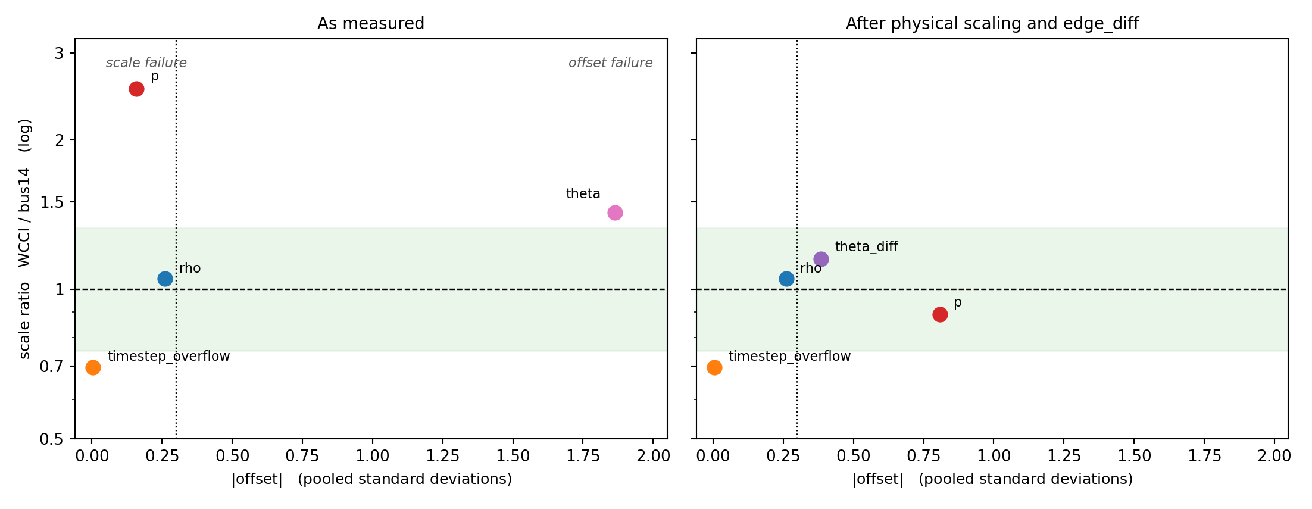
0
Making a feature mean the same number on both grids
A shared encoder is worthless if a channel learned on bus14 arrives on a different scale or reference.
ρ already transfers
Ratio 1.05 — divided by its own thermal limit.
Angles were the worst
Offset +1.86 SD, KS 0.678 — different slack buses.
Fix: line-angle difference Δθ
No reference bus. KS 0.678 → 0.230.
Power is a real trade-off
Spread 2.54 → 0.89, but KS 0.201 → 0.511.
Offset against scale ratio, per node feature. Bottom-left is compatible. 426k bus14 and 1.24M WCCI node observations.
Standardization cannot align
NL original inputs
NLS power ÷ largest generator, absolute angles → Δθ
Frozen source statistics leave KS unchanged.
Notes:
0:55 — slide 13 of 25 · cumulative 10:55
Cross-grid inputs.
A GNN can process any grid size, but that does not mean the numbers mean the
same thing. I sampled 426 thousand bus14 and 1.24 million WCCI node
observations under do-nothing and compared every channel. Loading rho already
transfers, because it is divided by each line's own thermal limit — grid-
relative quantities cross for free. The absolute voltage angle was the worst
channel, shifted by 1.9 pooled standard deviations, and most of that is just
the different slack bus. Replacing it with the angle difference across a line
removes the reference entirely and cuts KS from 0.68 to 0.23. Power is a real
trade-off: scaling by the largest generator fixes the spread but worsens the
offset, because typical output is 39% of the biggest unit on bus14 and only 20%
on WCCI. So I keep both conditions, NL and NLS, and let the transfer
experiments decide.

Slide 14
0
PART 3
1. The problem and the gap
2. Designing a policy that can move
3. Does it cross grids?
4. What it means
Does it cross grids?
One source grid, one target grid, one fixed evaluation protocol — and four ways of getting a policy onto the target.
Notes:
0:05 — slide 14 of 25 · cumulative 11:00
Section divider — say the part title and move on.

Slide 15
0
The experimental frame
Overall survival hides the cases that matter. The evidence is the 24 chronics where doing nothing already fails.
 | bus14 source | WCCI36 target
Substations | 14 | 36
Transmission lines | 20 | 59
Decentralized agents | 3 | 4 (5, 5, 9, 17 substations)
Chronics | 1,004 | 2,880
Unitary actions | 178 | 66,965 → capped at k
Maintenance | none | disabled
Mean survival
Survived steps ÷ maximum episode length.
50 fixed WCCI chronics
Do nothing completes 26 — easy. The other 24 are the difficult cohort.
Greedy is a reference, not a ceiling
It queries the simulator at every step.
Maintenance is off so a transferred policy is not tested on a hazard absent from its source grid: do-nothing survival moves 27.3% → 57.3%.
56.0%
do nothing, all 50
8.34%
do nothing, 24 difficult
The line-node graph used for transfer.
The number every controller here is trying to beat.
Notes:
0:50 — slide 15 of 25 · cumulative 11:50
Experimental frame. Please keep this slide in mind for the rest.
Source is the IEEE 14-bus grid: 14 substations, 20 lines, 3 agents, 178
actions. Target is the WCCI 2020 grid: 36 substations, 59 lines, 4 very unequal
regions, and almost sixty-seven thousand actions which have to be capped at k
per agent. I disable scheduled maintenance on WCCI so that a transferred policy
is not tested on a hazard that never existed in its source environment — that
alone moves do-nothing survival from 27 to 57 percent. Evaluation is one fixed
set of 50 chronics. Do nothing completes 26 of them, so those are the easy
cohort; the other 24 are the difficult cohort, and that is where all the real
evidence is. Do nothing gets 56% overall but only 8.34% on the difficult
cohort. That 8.34 is the number to beat.

Slide 16
0
On the source grid, the design questions are settled
Six controlled screens on bus14. The best actors — including the transferable one — exceed 99% mean survival.
 | Screened factor | Result | Carried forward
A | Message-passing operator | GINE 94.72 vs GAT 91.06 | GINE
B | Depth × width (3 × 4) | No monotone rule; mp2_h128 converges first and holds | K = 2, width 128
C | Readout scope × reducer (4 × 2) | Energized nodes lead: 99.39 max, 98.93 mean | energized / max
D | Structural augmentations (2³) | None earns its cost; virtual readout collapses to 18–77 | unaugmented e0n0v0
E | Asset message direction (3 × 3) | gen a2b + load b2a 99.12; bidirectional 99.02 | both kept
F | Candidate head (2³) | 6 of 8 cells ≥ 98.2, best 99.52; no factor dominates | all 8 kept
Two branches leave this chapter. A–E keep a fixed-index head → only the encoder transfers. F keeps the whole interface → the complete policy crosses grids, at no source-grid cost.
One seed per cell; best checkpoint scored on all 201 held-out bus14 chronics.
Notes:
0:50 — slide 16 of 25 · cumulative 12:40
Source-grid screens.
Six controlled screens, each varying one thing against its own baseline. GINE
beats GAT by nearly four points, so GINE everywhere. Depth and width show no
monotone rule, but two layers at width 128 converges fastest and most stably, so
that is the default. Readout scope matters a lot: pooling only the energized
nodes reaches 99.4%. The structural augmentations do not pay for themselves and
virtual-node readout is actively destructive. Asset message direction is a
coin-flip at one seed, so I keep both. And crucially, Screen F shows the
candidate-action head is not a compromise: six of eight cells are above 98%,
the best is 99.5%. The transferable interface costs essentially nothing on the
source grid. That gives two branches — encoder-only transfer from A to E, and
complete-policy transfer from F.

Slide 17
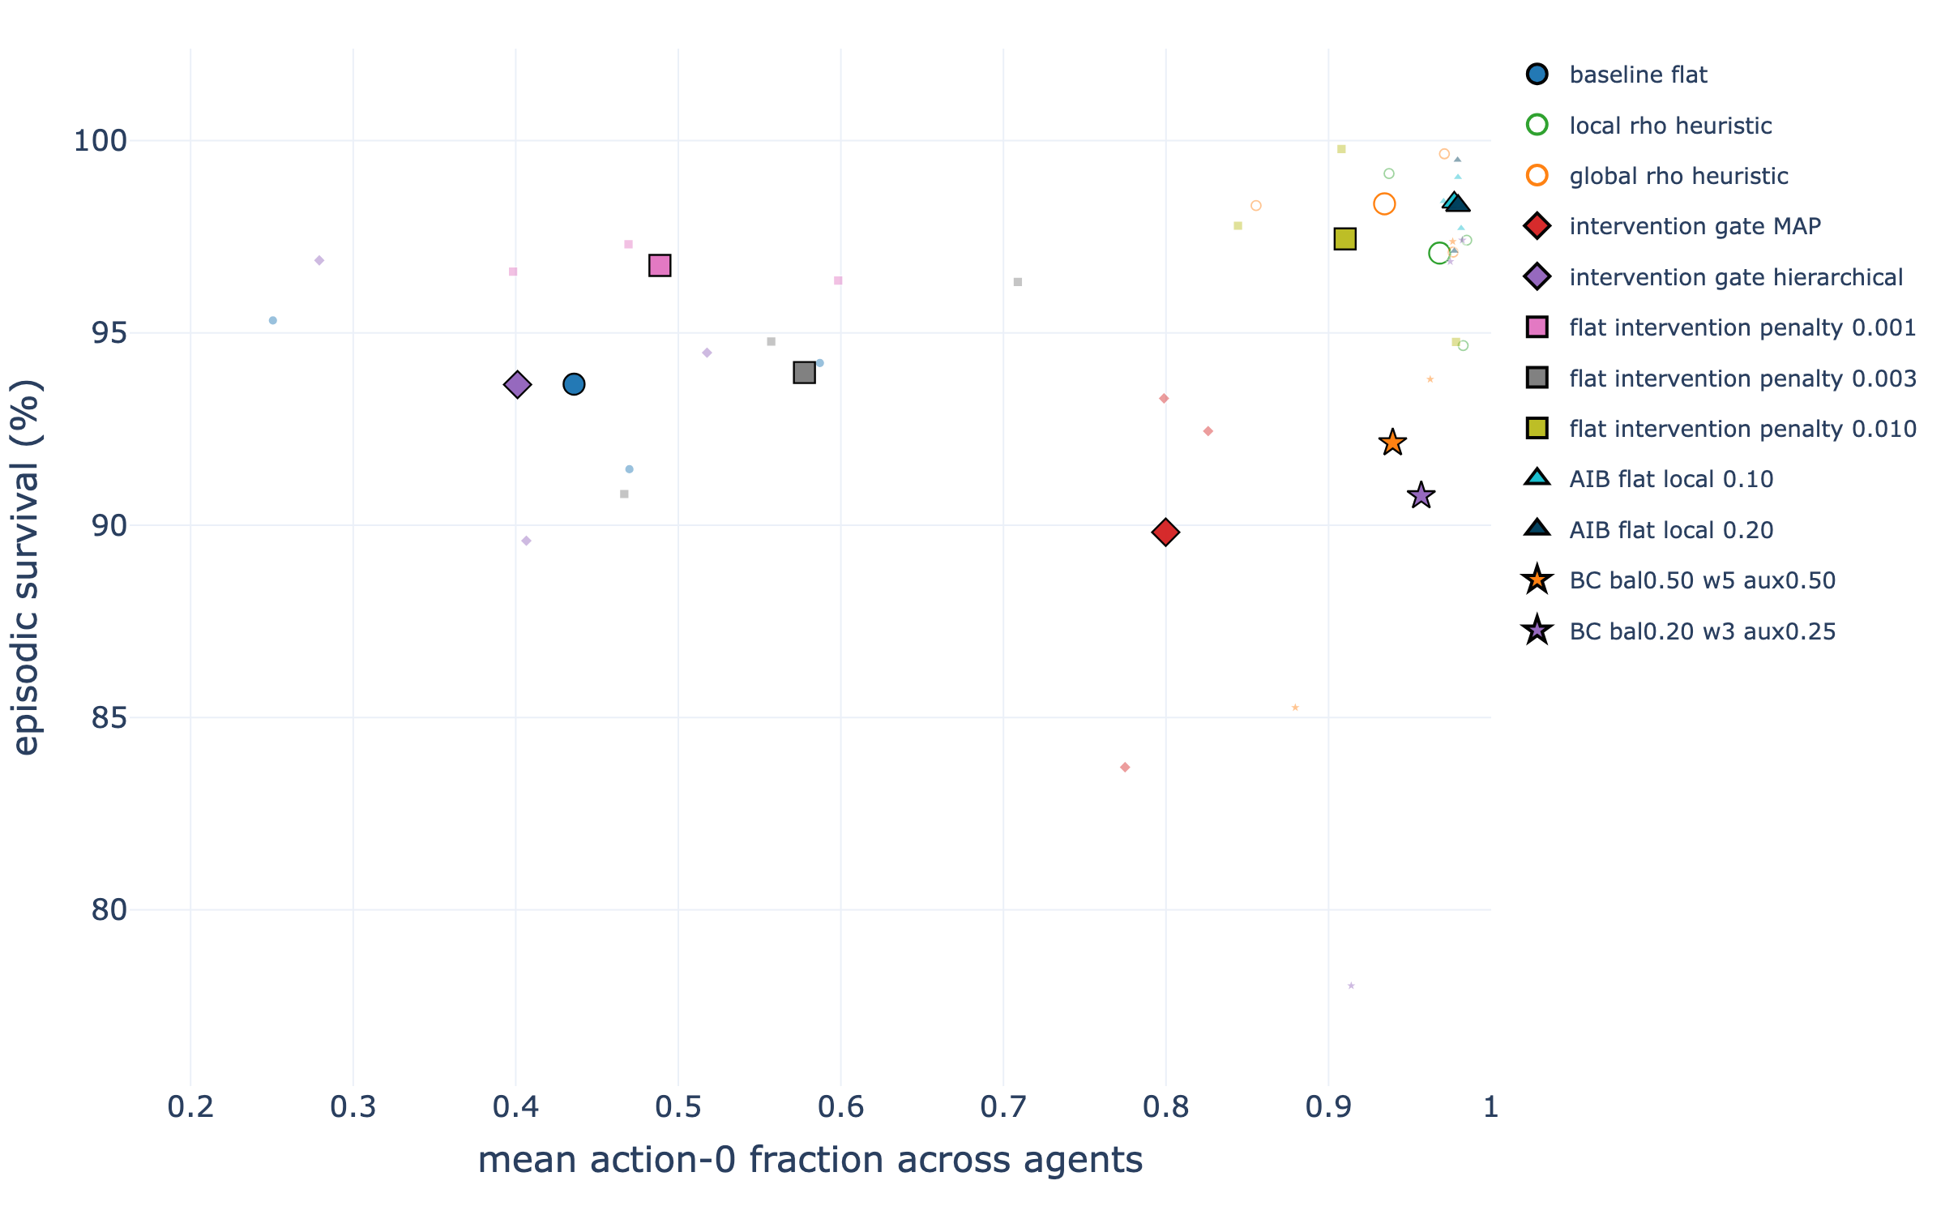
0
…and the controller can learn to act rarely
A policy that reconfigures at every opportunity is unusable in a control room. Sparsity can be learned, not imposed.
FIVE MECHANISMS TESTED
— Evaluation-time ρ overrides
— Learned intervention gate
— Fixed non-idle penalty
— Adaptive intervention budget (AIB)
— Behavioural cloning
Local-safe AIB wins on both axes
Each agent adapts its own penalty from the loading it can see.
93.7 → 98.4%
mean survival
56.6 → 2.1%
non-idle actions
Mean survival against the fraction of do-nothing decisions.
The same local-ρ idea returns at transfer time as a safety gate.
Notes:
0:50 — slide 17 of 25 · cumulative 13:30
Sparse intervention.
Survival alone is not enough: a policy that reconfigures substations at every
opportunity would never be trusted in a control room. Most of the literature
hard-codes a loading threshold outside the policy. I tested five ways of making
it learned instead. The winner is the adaptive intervention budget with a local
safety weight: each agent has its own penalty coefficient, adjusted after every
rollout against a target budget, and the cost of acting is high when its own
lines are relaxed and low when they are stressed. It improves both objectives at
once — survival from 93.7 to about 98.4 percent while non-idle actions drop from
57 percent of decisions to about two. And it stays fully decentralized. Keep the
local-rho idea in mind, because it comes back at transfer time.

Slide 18
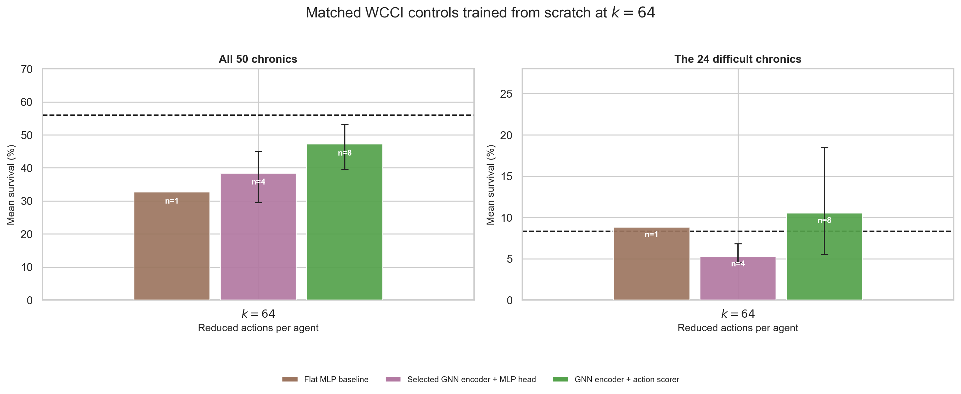
0
First surprise: retraining on the target does not solve it
Every model family retrained directly on WCCI stays below do-nothing overall — including the graph actors.
ALL 50 CHRONICS
Flat MLP 32.6%
GNN + fixed head 38.4%
GNN + action scorer 47.2%
Do nothing 56.0%
THE 24 DIFFICULT CHRONICS
GNN + fixed head 5.3%
Do nothing 8.34%
Flat MLP 8.8%
GNN + action scorer 10.5%
its best cell 18.5%
Matched controls trained from scratch at k = 64. Bars are family means, whiskers min–max.
The ordering flips. Only the candidate scorer is clearly above do nothing here.
Overall survival is the wrong headline. It is dominated by the 26 easy chronics do-nothing already completes.
Notes:
0:55 — slide 18 of 25 · cumulative 14:25
Target difficulty.
Before testing transfer I need to know what target training alone can do. This
is the first surprise. At a matched action cap of 64, the flat MLP averages 33
percent, the graph encoders with fixed heads 38, the candidate scorers 47 — and
all three are below the 56 percent you get by doing nothing. That sounds like a
failure, but look at the right panel: overall survival is dominated by the 26
easy chronics that do-nothing already completes. On the 24 difficult chronics
the ordering flips. The candidate scorer averages 10.5 percent against 8.3 for
do nothing, with a best cell at 18.5, while the fixed-head GNN is actually worse
than inaction. So difficult-cohort survival is the metric, and the candidate
scorer is both the best target learner and the only architecture whose full
policy can be moved.

Slide 19
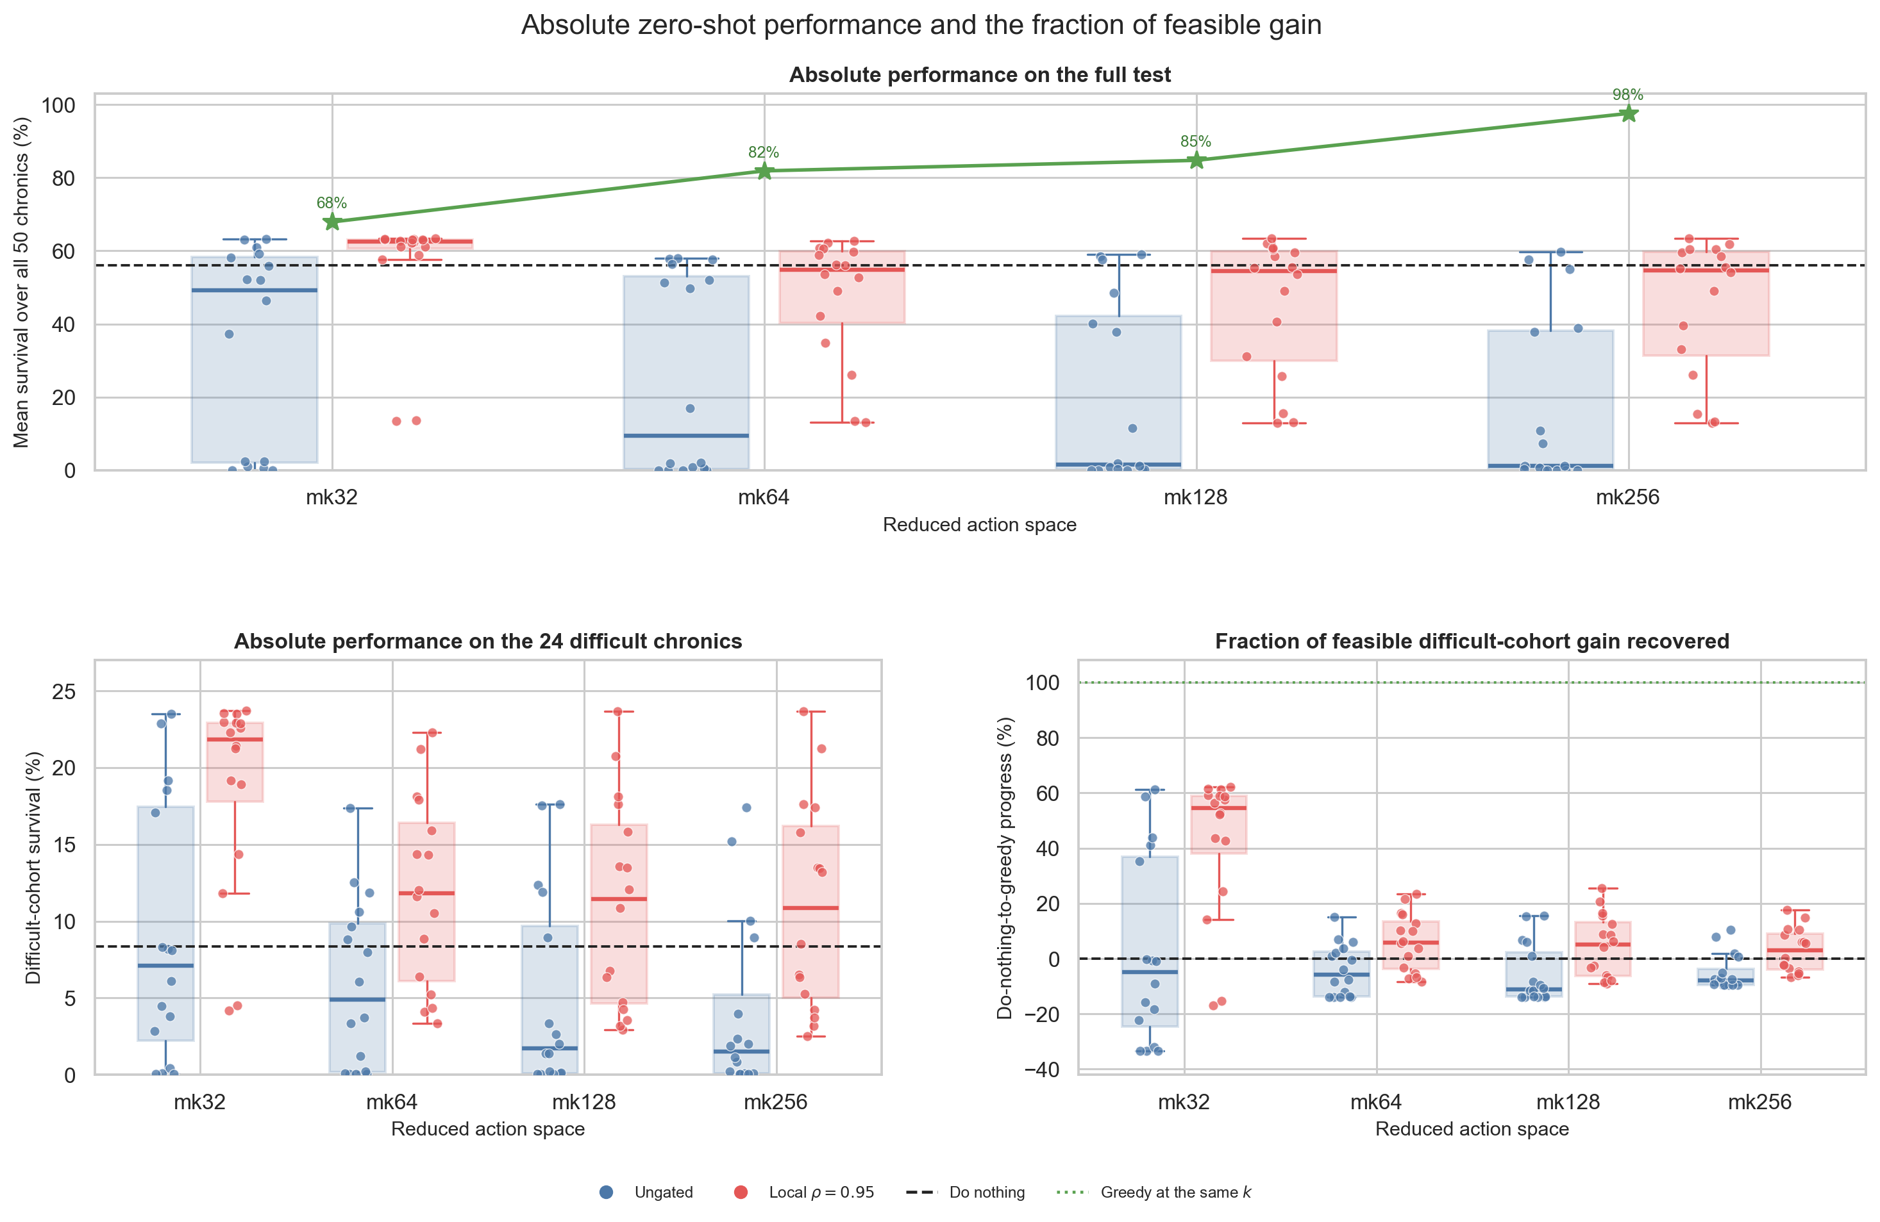
0
Zero-shot: the bus14 actor does control WCCI — conditionally
It works with a small action set and a local safety gate. More actions make the policy worse, not better.
Gated, k = 32
62.5% overall, 21.9% difficult — 54.6% of the gain greedy makes available.
Then it collapses
5.8 · 5.2 · 2.9% recovered at k = 64, 128, 256 — while greedy climbs 68 → 98%.
Ungated stays below do nothing
At every action-space size.
Selection is the constraint
Not availability. A longer list is harder to rank.
16 architecture cells per box. Green stars: greedy at the same k. Dashed: do nothing. Gate blocks an agent while its own maximum loading is below 0.95.
Notes:
0:55 — slide 19 of 25 · cumulative 15:20
Zero-shot transfer. This is the central result.
Take the actor trained on bus14, change nothing, and run it on WCCI. With the
local safety gate and the smallest action set it reaches 62.5 percent overall
and 21.9 percent on the difficult chronics. To judge that fairly I normalize
against the greedy policy available at the same k: zero is do-nothing, a hundred
is greedy. At k=32 the transferred actor recovers 55 percent of that gain. Then
it collapses — 5.8, 5.2, 2.9 percent at 64, 128 and 256 — even though greedy
itself keeps getting better, from 68 to 98 percent. So the extra actions are
genuinely useful; the policy just cannot rank them. Without the gate the median
is below do-nothing everywhere. The binding constraint is the selection problem,
not the size of the action set, and you only see that with the relative metric.

Slide 20
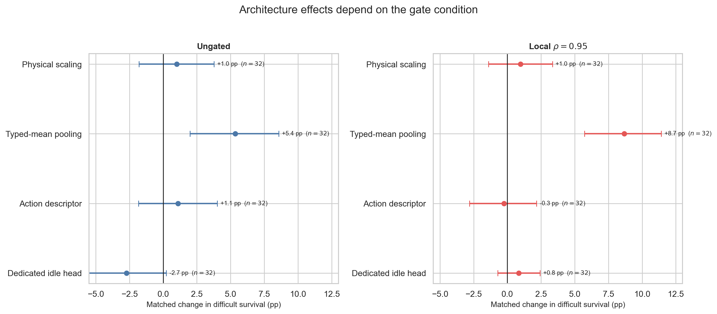
0
What actually survives the change of grid
One architectural choice transfers clearly: keeping the physical roles of the touched nodes separate.
Typed-mean pooling
+5.4 pts ungated, +8.7 gated. Bus, line, load and generator averaged separately.
Physical scaling
≈ +1 pt — less than the input analysis promised.
Descriptor ≈ 0, idle head negative
−2.7 pts ungated, neutral gated.
Matched change in difficult-cohort survival, one factor at a time. Bars are bootstrap intervals over 32 matched pairs.
DECISION-TIME CHANGES
Gmax-delta +4.6 pts · adaptive budget +6.0 pts.
THE GATE IS NOT A UNIVERSAL SAFETY LAYER
+7.2 pts zero-shot, but −2.2 on the scratch scorer and −2.8 on the flat MLP. Validate per policy.
Notes:
0:50 — slide 20 of 25 · cumulative 16:10
What transfers.
Which design choices actually survive the grid change? Matched comparisons on
the difficult cohort. Typed-mean candidate pooling is the clear winner: plus 5.4
points ungated and plus 8.7 with the gate. That is the choice that averages the
busbar, line, load and generator embeddings separately instead of mixing them
into one vector — keeping the physical roles apart is what preserves meaning
across grids. Physical scaling adds about a point, less than the distribution
analysis promised. The static descriptor is neutral and a dedicated idle head
actually hurts without the gate. Two decision-time changes help as well. And an
important negative: the local gate is not a free safety layer — it adds seven
points to the transferred actor but costs the scratch-trained scorer and the
flat MLP. You have to validate it per policy.

Slide 21
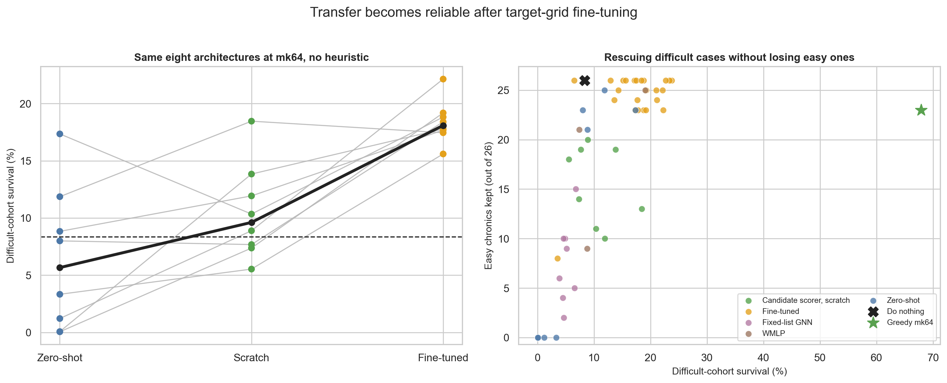
0
Source initialization is worth more than target training
Fine-tuning beats zero-shot in 8 of 8 cells and scratch in 7 of 8 — on a third of the budget.
Median difficult-cohort survival
Matched gains
The trade-off that matters
5.7% zero-shot → 9.6% scratch → 18.1% fine-tuned.
+12.0 pts over zero-shot, +7.9 over scratch. ≈5M target steps against 15M.
Upper-right corner: rescue difficult chronics without losing easy ones.
Notes:
0:50 — slide 21 of 25 · cumulative 17:00
Adaptation.
Last question: if zero-shot is incomplete, is the source checkpoint still worth
anything as an initialization? Yes, and this is the most consistent result in
the thesis. Same eight architectures, same action cap, three routes. Median
difficult-cohort survival goes from 5.7 percent zero-shot to 9.6 from scratch to
18.1 after fine-tuning. Fine-tuning beats zero-shot in all eight cells by twelve
points on average and beats scratch in seven of eight by about eight — on
roughly five million target steps against fifteen million from scratch. The
right panel adds the qualification I care about: some actors buy difficult
chronics by breaking easy ones. The useful region is the top right, and the
fine-tuned points are the ones that get there. All of them are still far below
greedy, so there is a lot left in the action space.

Slide 22
0
Still open: does the encoder alone carry the transfer?
The complete-policy branch is done; the encoder-only branch is still running.
THE DESIGN IS FIXED
REQUIRED BEFORE THE DEFENCE
Freeze the bus14 encoder, discard its action heads, learn new WCCI heads. Four representations × four routes:
— Target scratch — random encoder, all trainable
— Random frozen — random encoder, heads only
— NL frozen — bus14 checkpoint, original inputs
— NLS frozen — bus14 checkpoint, scaled inputs + Δθ
Random-frozen is the control. New heads can learn even from arbitrary features.
Outputs
□ Matched learning curves, four routes
□ 4 × 4 difficult-cohort endpoint table
□ Overall survival, rescues, easy chronics kept
Protocol fields still pending
□ Action cap and dataset path
□ Target training budget
□ Seed set
□ Head optimizer and learning rate
□ Checkpoint-selection score
□ Gate condition at evaluation
The interpretation rules are already fixed in the chapter, so the conclusion cannot be chosen after seeing the data.
Notes:
0:45 — slide 22 of 25 · cumulative 17:45
Placeholder. Be upfront about this, then move on quickly.
One branch is not finished. Chapter 9 asks a narrower question: forget the
action interface, does the encoder alone carry anything? Freeze the bus14
encoder, throw away the heads, learn new WCCI heads. The critical control is
random-frozen, because an actor can still learn through fresh heads even if the
frozen features are noise. The design and the interpretation rules are already
fixed in writing, so the conclusion cannot be picked after seeing the numbers.
Missing: the matched curves, the four-by-four table, and six protocol fields.
If asked — the complete-policy result I just showed is stronger evidence anyway,
because it transfers the interface as well as the encoder.

Slide 23
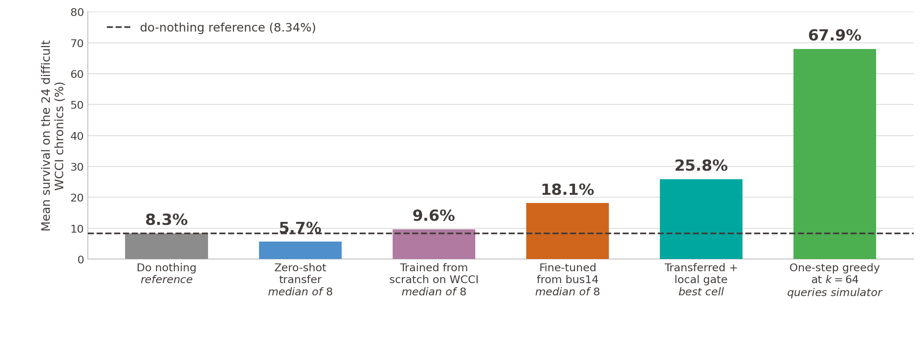
0
What crosses, and what does not
Transfer is incomplete — but about three times do-nothing, and better than retraining the same actor from scratch.
What transferred
What did not
What is still uncertain
The candidate-action interface. 21.9% on the difficult cohort at k = 32 with the gate.
Ranking large action sets: 55% of feasible gain at k = 32, 3% at k = 256.
One seed, 50 chronics. Matched differences hold; small cross-block gaps do not.
Compiled from Chapters 7 and 10. Medians across the eight NLS candidate-scorer architectures at k = 64.
Notes:
0:50 — slide 23 of 25 · cumulative 18:35
Summary.
One picture for the whole thesis, on the difficult cohort. Do nothing is 8.3
percent. A naive zero-shot median is below that at 5.7. Retraining the same
architecture from scratch on the target gets you to 9.6 — barely above
inaction. Fine-tuning from the source checkpoint reaches 18.1, and the best
transferred cell with the local gate reaches 25.8, roughly three times do
nothing. Greedy, which cheats by querying the simulator every step, is at 68 —
so there is a lot of headroom left. What transferred is the candidate-action
interface. What did not is the ability to rank large action sets. And the honest
caveat is one seed and fifty chronics, so I trust matched differences inside a
block and not small gaps between unrelated ones.

Slide 24
0
Limitations and where this goes next
Limitation | What it means for the claims | Next step
One seed per cell | Intervals describe architecture spread, not training runs. | Repeat the transfer block over seeds.
Two grids, one direction | Nothing tests the reverse direction or a third topology. | Add a third grid; is the k = 32 advantage general?
Unequal training budgets | Comparisons hold inside a block, not across blocks. | Re-run cross-block comparisons at one budget.
Static offline action reduction | Candidates ranked once; the policy never revisits the list. | Curriculum or state-dependent candidate sets.
The design conclusion is more robust than any single number. Portable interface, separate node roles, per-policy gate, conservative fine-tuning.
Notes:
0:40 — slide 24 of 25 · cumulative 19:15
Limitations and outlook.
Four honest limitations. One seed per cell, so I report matched differences and
avoid architecture rankings. Two grids in one direction, so I cannot separate
"small action sets are better" from "this particular pair behaves this way". Some
campaigns ran at different budgets, so cross-block gaps are not comparable. And
the action reduction is offline and static — given that the k=32 collapse points
straight at the selection problem, a state-dependent or curriculum candidate set
is the obvious next thing to try. The design conclusion survives all of that:
make the interface portable, keep the node roles separate, validate the gate per
policy, and prefer fine-tuning.

Slide 25
0
Thank you
NUMBERS TO HAVE READY
Do nothing, 24 difficult 8.34%
Best bus14 actor 99.5%
Scratch on WCCI, difficult 9.6%
Zero-shot median, difficult 5.7%
Fine-tuned median, difficult 18.1%
Best transferred + gate 25.8%
Greedy at k = 64, difficult 67.9%
Typed-mean pooling effect +8.7 pts
Local gate on zero-shot +7.2 pts
Angle KS, raw → Δθ 0.678 → 0.230
Questions welcome — supplementary slides follow.
Supervisors: Prof. Fink · Prof. Peng · Dr. Nejjar
Notes:
0:15 — slide 25 of 25 · cumulative 19:30
Thank you.
Leave this slide up during questions; the right-hand panel is my own cheat
sheet. Supplementary slides follow for the detailed screens, the feature-shift
analysis, the full result matrices and the reproducibility settings.

Slide 26
0
BACKUP
Supplementary material
Protocols · complete screening results · feature-shift analysis · full transfer matrices · reproducibility.
Notes:
Backup section begins here. Not part of the 20-minute talk.

Slide 27
0
PROTOCOL
Evaluation protocol and checkpoint selection
Every reported endpoint is a checkpoint selected on training-split rollouts, then scored once on a held-out set.
Campaign | Environment and budget | Checkpoint selection | Statistical scope
Stable MLP baseline | bus14; 15M steps; 20 parallel envs | Periodic deterministic 20-chronic training-split rollouts; keep the highest rollout mean | 80/20 chronic split; multi-seed core comparisons
Screens B–F | bus14; 15M steps; 72 envs, 576 rollout steps | Evaluation every 82,944 steps on a changing 20-chronic training rollout; the selected checkpoint is then scored on all 201 held-out chronics | One seed per factorial cell (seed 0)
Input-distribution study | bus14 and WCCI; 6,000 do-nothing steps; 300-step cap per chronic | No learned checkpoint; every visible local-graph node is recorded | 426,000 and 1,236,000 node observations
WCCI transfer and adaptation | bus36_wcci_nomaint; zero-shot, 15M-step scratch, or ≈5M-step fine-tuning | Zero-shot uses the selected source checkpoint; WCCI-trained actors use their final checkpoint | Seed 0; the same 50 chronics — 26 easy, 24 difficult
Mean survival for one chronic is the number of survived time steps divided by that chronic's maximum episode length; the reported value is the unweighted mean over the evaluated chronics.
Notes:
Protocol backup. Use if asked how checkpoints were chosen or whether the test set was reused.

Slide 28
0
PROTOCOL
Shared MAPPO settings and the tuned MLP baseline
Screens B–F share one optimization recipe so each factorial changes only the named architectural choice.
Component | Fixed setting (Screens B–F)
Optimization | 10 update epochs, 16 minibatches, LR 1e-4 with linear decay, max gradient norm 1.0
Returns and PPO | γ = 0.9, GAE λ = 0.95, clip ratio 0.2, target KL 0.02, entropy coefficient 0.01
Actor and critic | Shared graph encoder with two 128-unit action-head layers; centralized 3 × 256 MLP critic
Preprocessing | Normalized flat observations and rewards; graph physical scaling and sparse control disabled during the screens
Exploration | No initial do-nothing prior, no action-0 logit bonus
Hyperparameter | Tuned | MARL2Grid paper
Parallel environments | 20 | 10
Total environment steps | 15,000,000 | 25,000,000
Actor learning rate | 1e-4 | 3e-5
Critic learning rate | 1e-4 | 3e-5
Discount γ | 0.9 | 0.99
Update epochs | 10 | 80
Minibatches | 16 | 4
Max gradient norm | 1.0 | 10.0
Reward normalization and one critic update per batch (instead of one per agent) are the other two changes; together they take the flat MLP baseline to 93.4% final / 98.6% peak mean survival on bus14.
Notes:
MAPPO settings and the tuned baseline hyperparameters.

Slide 29
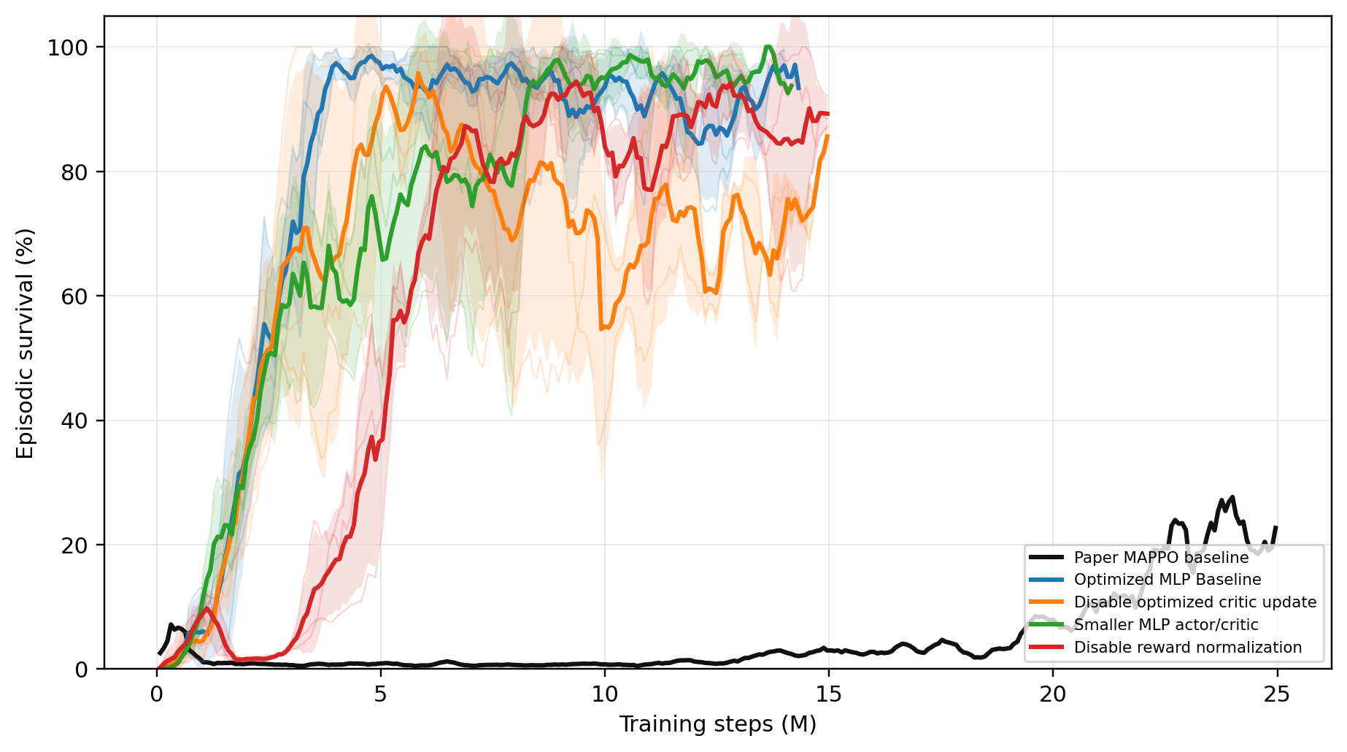
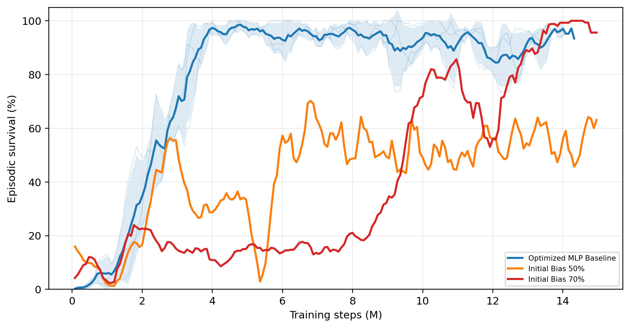
0
CHAPTER 3
Flat MLP baseline: core ablations and do-nothing bias
The reference is chosen for its convergence trajectory, not for the largest isolated endpoint.
All core MLP baseline rerun survival curves on one axis.
Optimized baseline against initial do-nothing bias 50% and 70%.
Run | Final (%) | Peak (%)
Optimized MLP baseline | 93.4 | 98.6
Disable optimized critic update | 93.1 | 95.8
Smaller MLP actor/critic | 93.7 | 100.0
Disable reward normalization | 81.8 | 97.1
Initial bias 50% | 50.8 | 70.2
Initial bias 70% | 99.3 | 100.0
A 70% do-nothing bias finishes highest but learns slowly; a 50% bias is unstable. The zero-bias actor reaches the high-survival regime earliest and holds it, so it is the reference used downstream.
Notes:
Chapter 3 backup: the exact baseline ablations.

Slide 30
0
CHAPTER 4
Sparse intervention: the five mechanisms
Each mechanism acts at a different point — training objective, action factorization, or evaluation-time override.
Method | Training effect | Evaluation effect | Main risk
Baseline | Samples from the flat policy | Greedy argmax by default | No explicit mechanism favouring sparse control
ρ heuristic | No training change | Hard no-op override in safe states | Evaluation is manually changed
Intervention gate | Changes the action factorization and sampling | Final-action MAP or hierarchical greedy | Gate collapse can starve non-idle exploration
Fixed penalty | Fixed reward penalty on non-idle actions | No action override | The penalty coefficient must be tuned
AIB local-safe | Adaptive state-dependent reward penalty | No action override | Depends on the local-ρ safety-weight design
Behavioural cloning | Distils the heuristic into actor weights | No action override | Struggles with extreme action-0 class imbalance
Selected endpoints on bus14. Baseline 93.67% survival at a 0.44 action-0 fraction · fixed penalty λ = 0.010 → 97.44% at 0.905 · local-safe AIB d = 0.10 and 0.20 → ≈98.4% at ≈0.98 · evaluation-time ρ heuristics 97–98% at 0.94–0.97, but imposed after the policy acts.
AIB update. λ_{i} ← clip( λ_{i} + η(Ĉ_{i} − d), 0, λ_{max} ) after every rollout, with cost weighted by σ(k(ρ_safe − ρ_local)).
Notes:
Chapter 4 backup: mechanism comparison and exact endpoints.

Slide 31
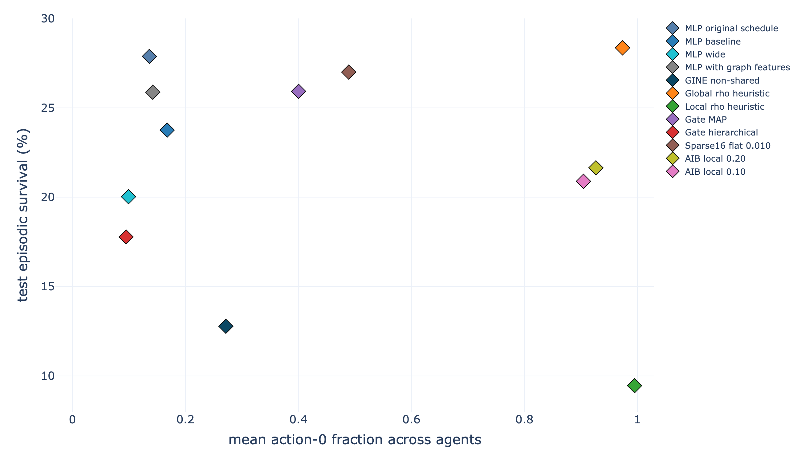
0
CHAPTER 4 · APPENDIX
Sparse control: the early WCCI stress test
This pilot changes grid, action space and maintenance at the same time — it motivates the graph actor but isolates nothing.
Method | Mean survival (%) | Action-0
Matched MLP baseline | 23.75 ± 7.70 | 0.168
Global ρ heuristic, ρ = 0.90 | 28.35 ± 11.06 | 0.974
Local ρ heuristic, ρ = 0.90 | 9.46 ± 3.54 | 0.995
Intervention gate, final-action MAP | 25.92 ± 10.69 | 0.400
Flat fixed penalty λ = 0.010 | 27.00 ± 12.13 | 0.489
Flat local-safe AIB, d = 0.20 | 21.65 ± 2.21 | 0.927
Three seeds, 60M steps, maintenance enabled, no bus14 weights transferred. Values are the final deterministic test evaluation over ten held-out episodes per seed — not full-test estimates. Mechanisms move the intervention frequency but none reliably improves survival, and the differences are small relative to seed variation.
Action-0 / mean-survival trade-off for the maintenance-enabled WCCI pilot. Fixed-width MLP actors, trained from scratch.
Notes:
Chapter 4 backup: why the WCCI pilot cannot isolate transfer.

Slide 32
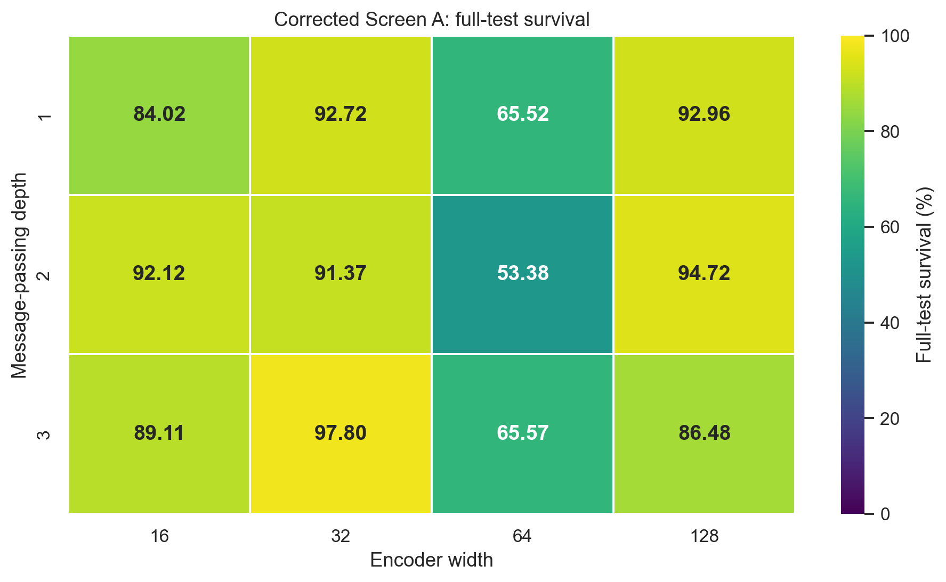
0
CHAPTER 6
Screen B: encoder depth and width
No monotone rule in depth or width. mp2_h128 is selected on convergence, not on its single best checkpoint.
Architecture | To 90% (M) | Curve mean (%) | Final-20 mean (%)
mp2_h128 | 6.22 | 71.40 | 94.04
mp1_h16 | 6.88 | 70.92 | 84.93
mp3_h32 | 7.88 | 69.63 | 91.28
mp2_h16 | 8.79 | 69.16 | 88.21
mp1_h128 | 11.03 | 68.50 | 91.11
mp1_h32 | 6.64 | 63.13 | 93.77
mp3_h128 | — | 58.58 | 80.20
mp1_h64 | — | 51.60 | 63.37
mp3_h64 | — | 49.80 | 67.58
mp3_h16 | — | 48.82 | 60.00
mp2_h32 | 13.69 | 46.51 | 91.08
mp2_h64 | — | 45.00 | 53.41
Convergence measured from the complete training curves. mp3_h32 has the best single checkpoint (97.80%) but a slower, less stable trajectory. Screen A: GINE 94.72% vs GAT 91.06% under a matched busbar/mean-readout setting.
Full-test mean survival of each run's best checkpoint, seed 0.
Notes:
Screen A and B backup.

Slide 33
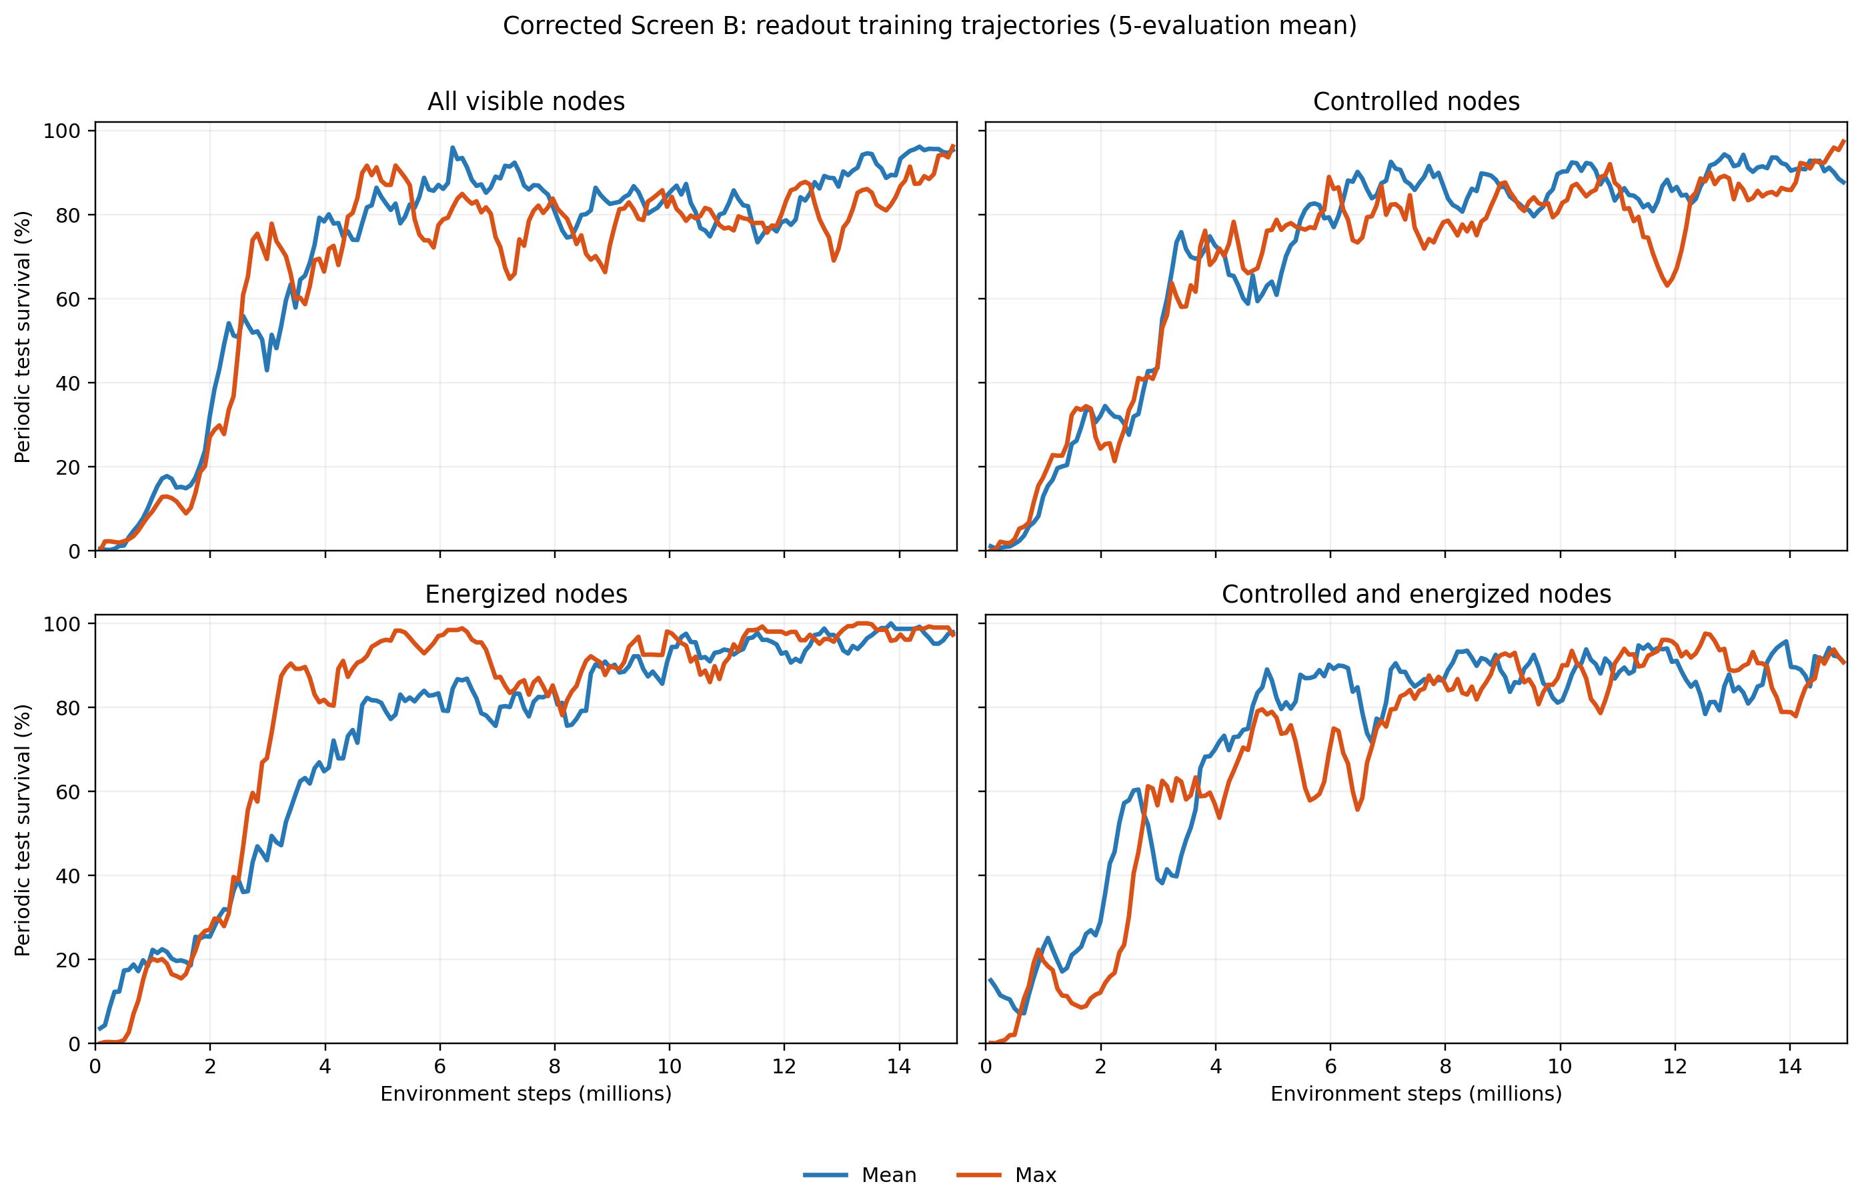
0
CHAPTER 6
Screen C: graph-readout scope and reducer
Restricting readout to energized nodes is the single largest source-grid gain in the screens.
Readout scope | Mean | Max
All visible | 94.72 | 96.31
Controlled | 94.60 | 94.79
Energized | 98.93 | 99.39
Controlled ∩ energized | 91.45 | 96.47
Full-test mean survival (%) by scope and reducer, seed 0. The all-visible/mean cell is inherited from Screen B.
Scope / reducer | To 90% (M) | Curve mean | Final-20 mean | Final-20 std
Energized / max | 3.40 | 79.26 | 97.79 | 4.12
Energized / mean | 8.71 | 73.59 | 98.01 | 2.90
Ctrl ∩ energized / mean | 5.97 | 72.97 | 91.18 | 8.59
All visible / mean | 6.22 | 71.40 | 94.04 | 5.29
Controlled / mean | 6.47 | 70.94 | 91.21 | 6.08
Ctrl ∩ energized / max | 8.88 | 68.65 | 86.31 | 8.80
All visible / max | 4.73 | 68.38 | 88.57 | 8.08
Controlled / max | 10.87 | 68.27 | 90.67 | 6.81
Smoothed training survival by readout scope and reducer.
Notes:
Screen C backup.

Slide 34
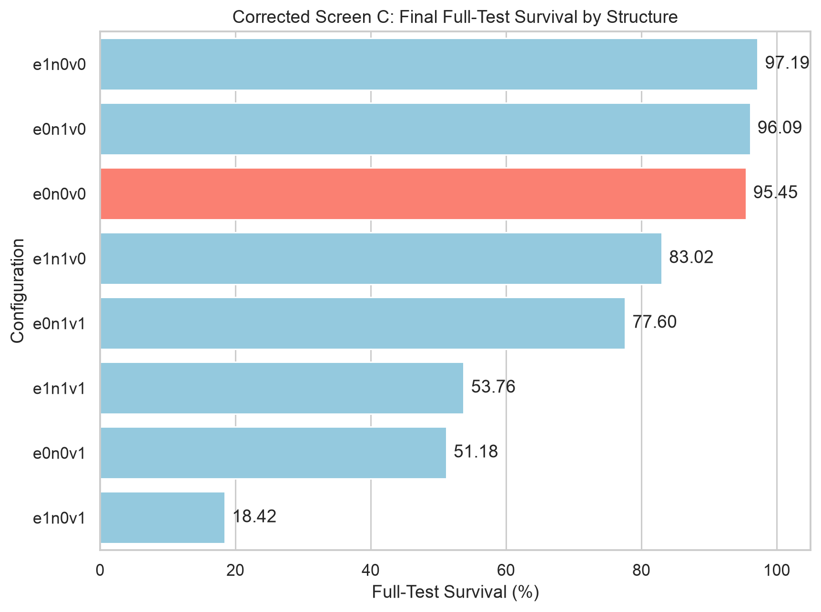
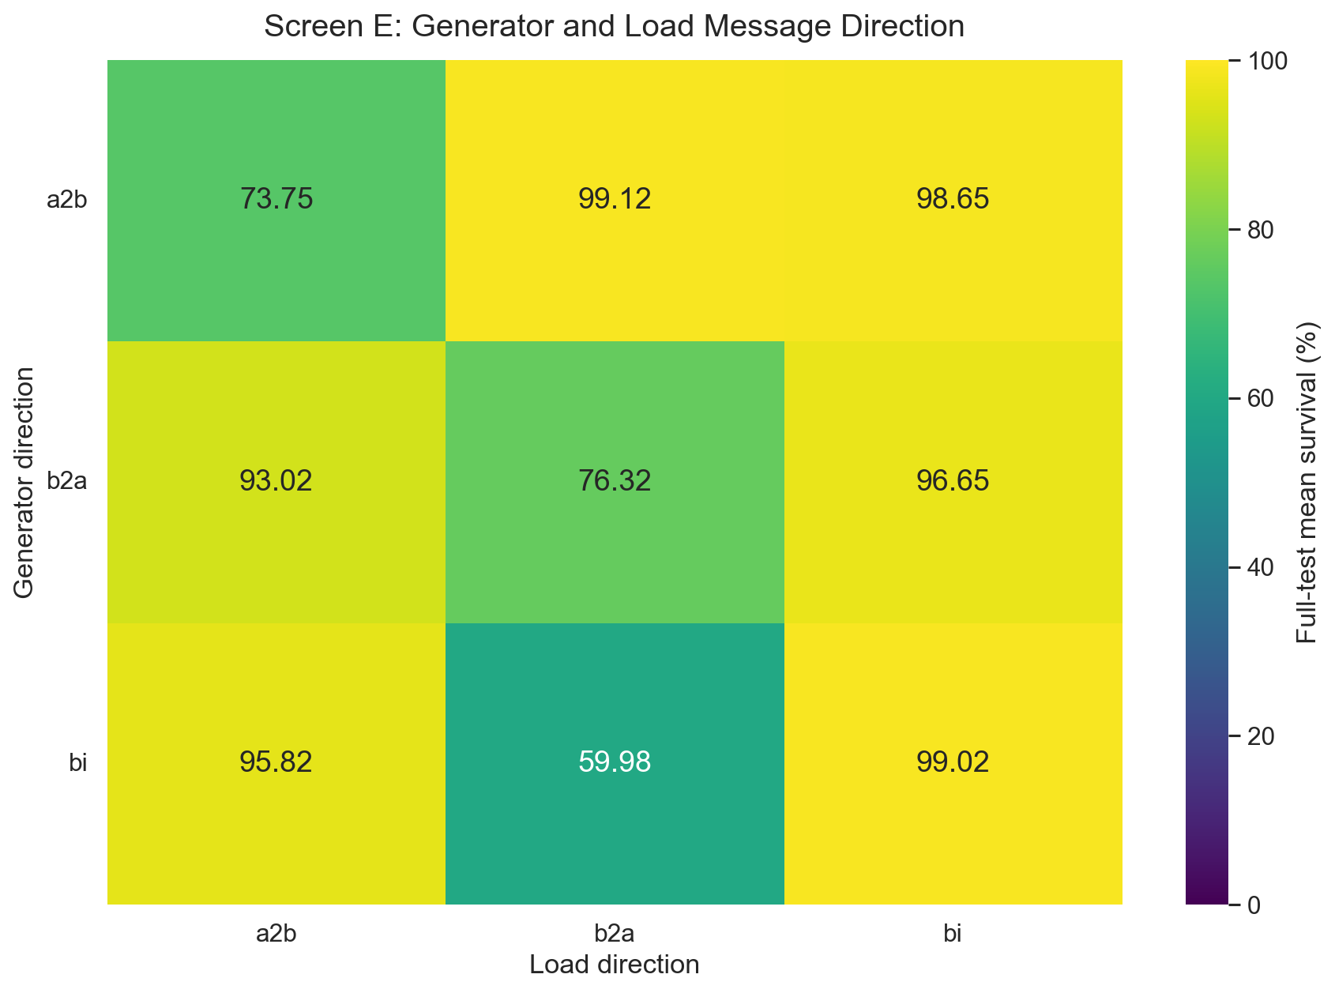
0
CHAPTER 6
Screens D and E: augmentations and asset message direction
Structural augmentations do not pay for themselves; asset direction is a coin-flip at one seed.
Screen D. Full 2³ factorial over same-substation edges (e), substation-summary nodes (n) and virtual-node readout (v). Baseline e0n0v0 highlighted.
Screen E. Full-test survival by generator direction (rows) and load direction (columns) on the disaggregated graph. Best cell gen a2b / load b2a at 99.12%; bi/bi at 99.02%.
Why virtual-node readout collapses (18–77%). Stacking several aggregation hubs restricts information flow inside a two-layer encoder: the summary and virtual nodes consume hops that the busbars need for physical message passing.
Notes:
Screens D and E backup.

Slide 35
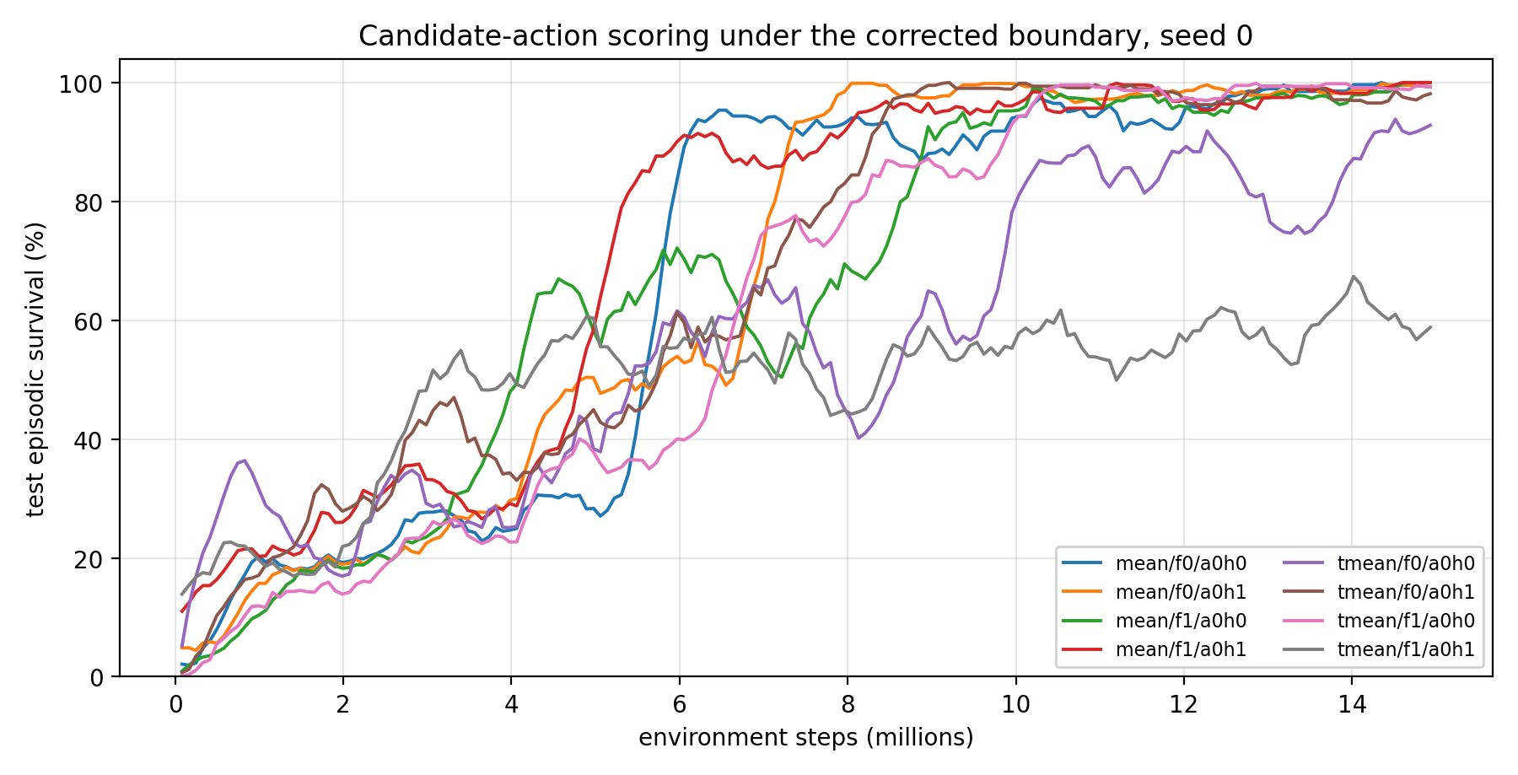
0
CHAPTER 6
Screen F: the candidate-action head on bus14
Six of eight cells clear 98.2%. No single factor separates the design, so all eight are carried into transfer.
Candidate pooling | Descriptor | Idle head | Mean survival (%) | Best checkpoint
mean | f0 | a0h1 | 99.52 | 14,929,920
typed_mean | f1 | a0h0 | 99.50 | 14,929,920
mean | f0 | a0h0 | 99.18 | 14,929,920
mean | f1 | a0h1 | 98.66 | 14,929,920
mean | f1 | a0h0 | 98.32 | 14,846,976
typed_mean | f0 | a0h1 | 98.17 | 14,764,032
typed_mean | f0 | a0h0 | 92.50 | 12,358,656
typed_mean | f1 | a0h1 | 57.84 | 11,612,160
Full-test mean survival on 201 held-out bus14 chronics, one seed per cell.
Training survival for the eight candidate-head cells.
Reading it honestly. The apparent marginal gaps — mean 98.9% against typed_mean 87.0%, f0 97.3% against f1 88.6% — are driven by two low interaction cells. Removing the single 57.84% failure brings the pooling gap to about one point. Typed-mean only shows its value after the grid change.
Notes:
Screen F backup. Important: typed_mean looks worse on bus14 and clearly better after transfer — the single most interesting reversal in the thesis.

Slide 36
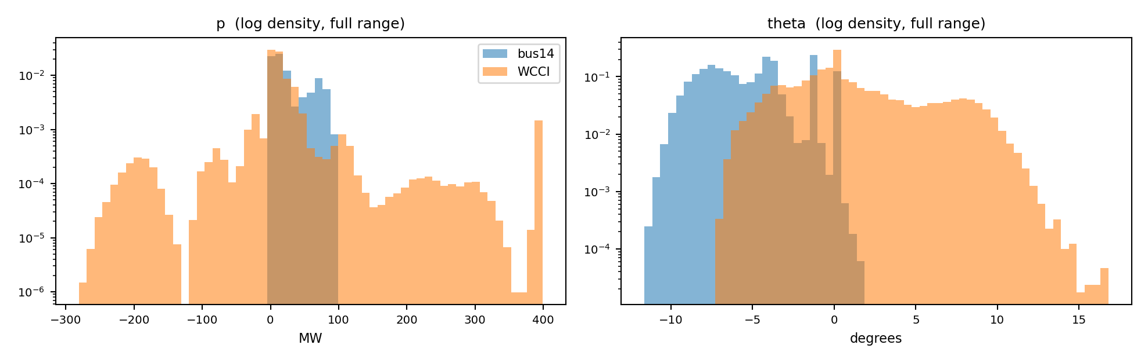
0
CHAPTER 8
Cross-grid feature shift: the complete table
Structural zeros hide the mismatch. Only the applicable-row view compares the physical measurements.
zeros (%)
all sampled rows
applicable rows only
Channel | zeros bus14 | zeros WCCI | offset | ratio | KS | offset | ratio | KS
theta | 77.5 | 73.8 | +0.653 | 0.83 | 0.157 | +1.864 | 1.43 | 0.678
p | 77.8 | 76.7 | −0.037 | 2.14 | 0.042 | −0.158 | 2.54 | 0.201
rho | 63.4 | 63.6 | −0.088 | 0.92 | 0.053 | −0.260 | 1.05 | 0.141
line_status | 63.4 | 63.6 | −0.005 | 1.00 | 0.002 | constant at one
timestep_overflow | 100 | 100 | −0.002 | 0.70 | 0.000 | −0.004 | 0.70 | 0.000
is_busbar | 60.6 | 65.0 | −0.093 | 0.98 | 0.045 | — | — | —
is_generator | 91.5 | 89.3 | +0.076 | 1.11 | 0.022 | — | — | —
is_load | 84.5 | 82.0 | +0.066 | 1.06 | 0.025 | — | — | —
is_transmission_line | 63.4 | 63.6 | −0.004 | 1.00 | 0.002 | — | — | —
Full range of the two asset channels on a log density scale: WCCI carries a negative net-injection tail absent from bus14.
Divisor | bus14 | WCCI | p ratio
Maximum P_max (used) | 140 | 400 | 0.89
Total P_max | 540 | 2,450 | 0.56
Generator count | 6 | 22 | 0.69
Median P_max | 85 | 71 | 3.04
Offset in pooled standard deviations; ratio is WCCI ÷ bus14; KS is the maximum ECDF gap. Cooldown channels are constant under do-nothing and omitted from the right block.
Candidate power normalizers. A ratio of 1.00 is ideal; unscaled it is 2.54.
Notes:
Chapter 8 backup: the complete shift table and the normalizer choice.

Slide 37
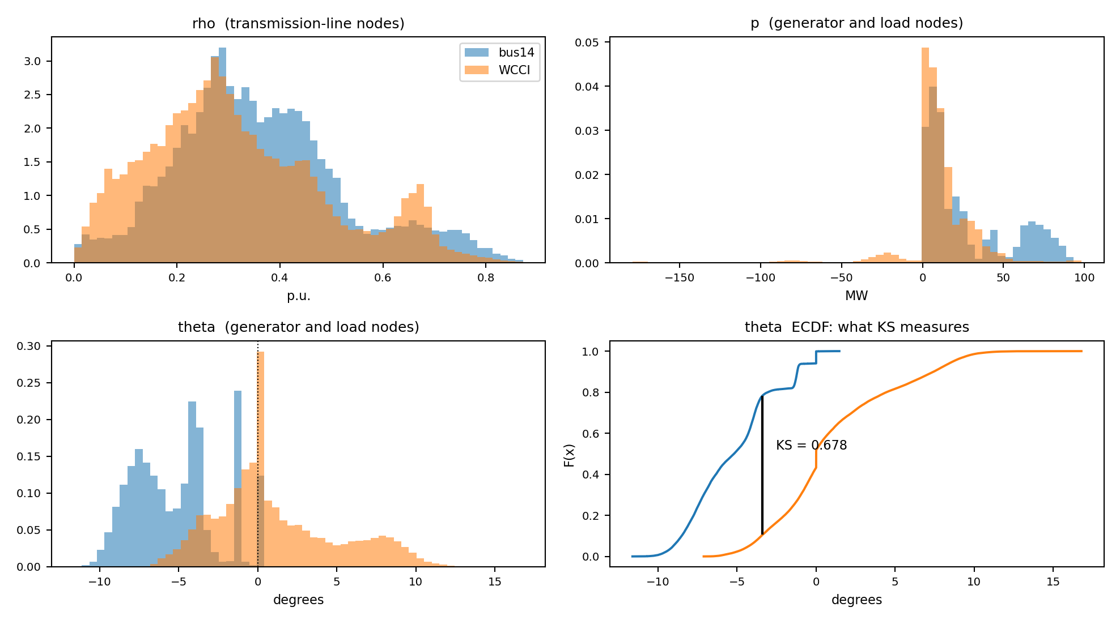
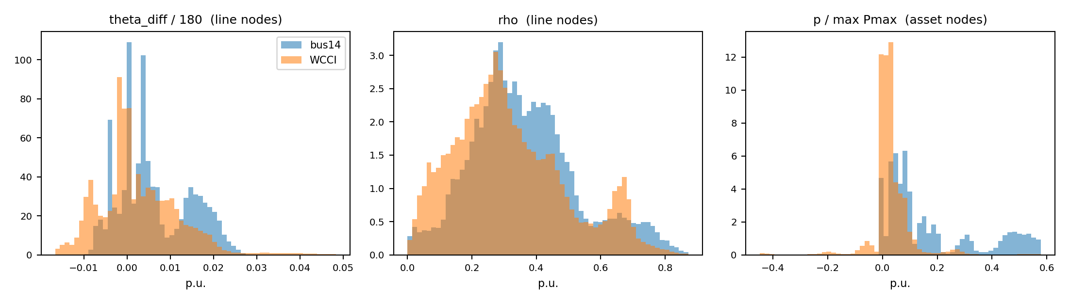
0
CHAPTER 8
Feature distributions before and after the transformations
The angle difference behaves like ρ. Power gains a matched spread but a worse centre.
Raw inputs on the rows where each channel is defined.
After gnn_angle_representation = edge_diff and gnn_physical_scaling = true.
original
transformed
Channel | offset | ratio | KS | offset | ratio | KS
theta | +1.864 | 1.43 | 0.678 | replaced
theta_diff | — | — | — | −0.383 | 1.15 | 0.230
p | −0.158 | 2.54 | 0.201 | −0.808 | 0.89 | 0.511
rho | −0.260 | 1.05 | 0.141 | −0.260 | 1.05 | 0.141
Notes:
Chapter 8 backup: the visual before/after.

Slide 38
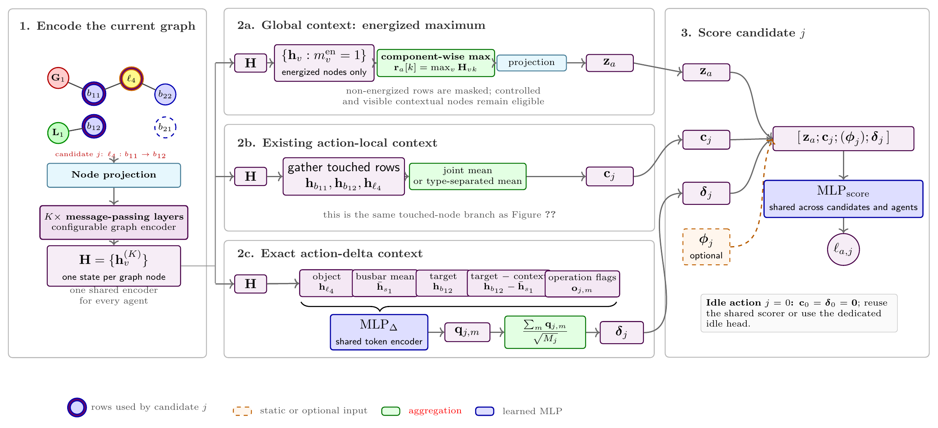
0
CHAPTER 5
The Gmax-delta variant
Same shared scorer, different information: maximum readout plus an explicit encoding of each object modification.
Global vector
Action delta δ
Effect after transfer
z uses a component-wise maximum over energized nodes instead of a mean, so a single stressed node is not averaged away.
Every exact modification is encoded from the object changed, the mean embedding of its substation busbars, the target busbar, the target-minus-source difference, and static operation flags.
+4.6 matched points on the difficult cohort without the gate; median falls from 19.1% at k = 32 to 5.1% at k = 256, so it does not fix the ranking problem either.
Notes:
Chapter 5 backup: what Gmax-delta actually changes.

Slide 39
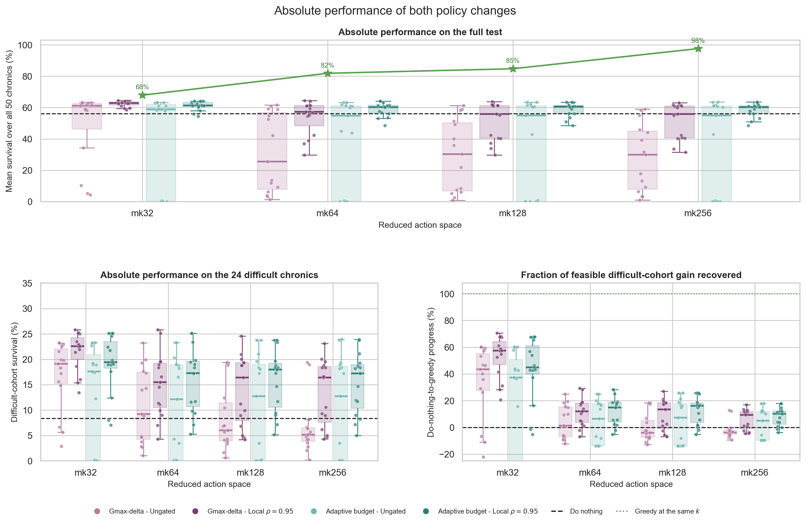
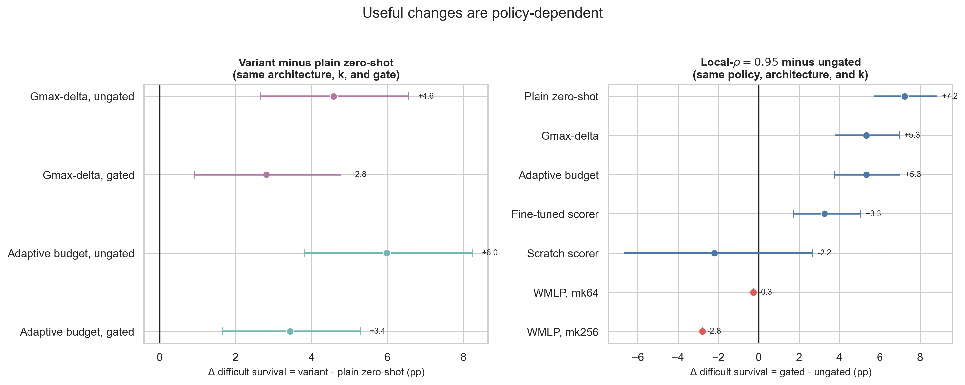
0
CHAPTER 10
Decision-time changes and the local gate, in full
The gate is worth more than either policy change — but only for the transferred actor.
Matched changes on the difficult cohort. Gmax-delta and the adaptive budget are compared against the same plain zero-shot architectures.
Absolute performance at each action-space size: two policy changes × gated and ungated evaluation.
Block sizes. The plain block contains all 64 matched architecture–k pairs; Gmax-delta and the adaptive budget contain 60 each, because their complete designs use 15 architectures rather than 16. The gate improves 58 of 64 plain cells (+7.2 pts) but costs the scratch-trained scorer 2.2 pts and the flat MLP up to 2.8.
Notes:
Chapter 10 backup: gate and policy-change detail.

Slide 40
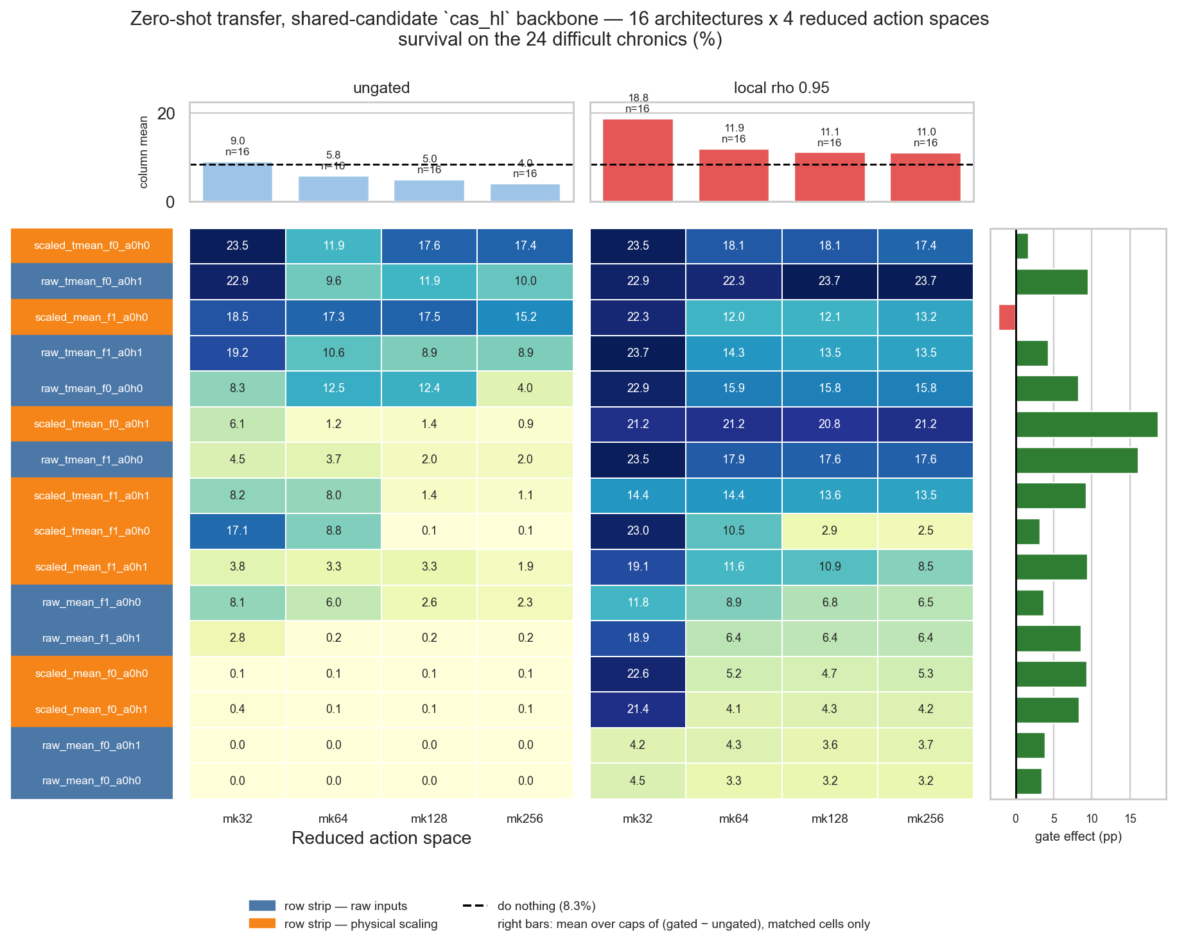
0
CHAPTER 10 · APPENDIX
Zero-shot result matrices
Difficult-cohort survival across input condition, candidate pooling, descriptor, idle head and action-space size.
HOW TO READ IT
Rows are architectures, named input · pooling · descriptor · idle head. The coloured strip on the left marks the input condition: blue = raw inputs, orange = physical scaling.
Columns are the four reduced action spaces, given twice — ungated on the left, local-ρ = 0.95 on the right.
The right-hand bars give the gate effect in points, averaged over caps on matched cells only. Every bar is positive: the gate helps every transferred architecture, though by very different amounts.
Top bars are column means; the dashed line is do nothing at 8.3%.
Companion matrices for the adaptive intervention budget and the Gmax-delta feature use the same layout and are in the report appendix.
Plain zero-shot actors, all 16 architectures × 4 action-space caps.
Notes:
Chapter 10 appendix: the full zero-shot matrix.

Slide 41
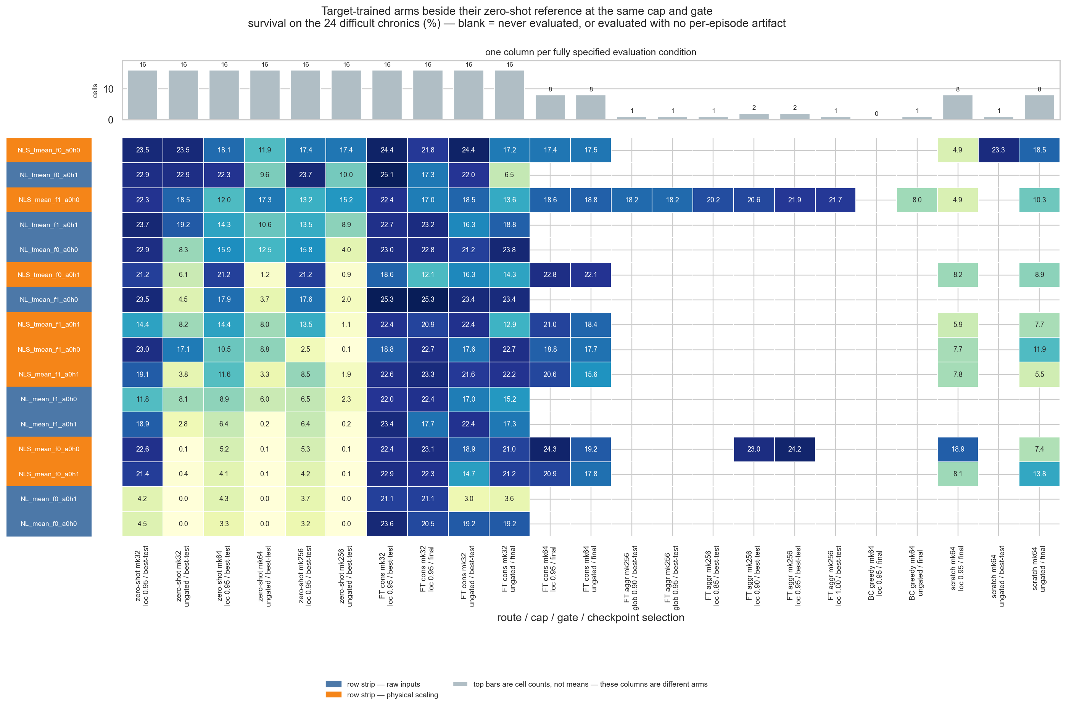
0
CHAPTER 7 · APPENDIX
Target-trained controls, in detail
The complete board behind the three family means on the scratch-training slide.
PER-AGENT ACTION COUNTS
Space | a0 | a1 | a2 | a3 | Total | Greedy
Full | 77 | 65,642 | 127 | 1,119 | 66,965 | —
k=32 | 32 | 32 | 32 | 32 | 128 | 33.1%
k=64 | 64 | 64 | 64 | 64 | 256 | 67.9%
k=128 | 77 | 128 | 127 | 128 | 460 | 68.2%
k=256 | 77 | 256 | 127 | 256 | 716 | 94.9%
Greedy is measured on the 24 difficult chronics of the fixed 50-chronic set, not on the full 576-chronic WCCI test split.
k is a cap, not a fixed size. Agents with fewer valid actions keep their complete list, which is why agent 0 stays at 77 and agent 2 at 127.
Actions are ranked offline before training: states are collected whenever ρ_max > 0.95, each candidate is simulated one step, and an action scores by the fraction of states in which it lowers post-action loading by more than ε.
Notes:
Chapter 7 appendix: the target-control board and the action-space reduction.

Slide 42
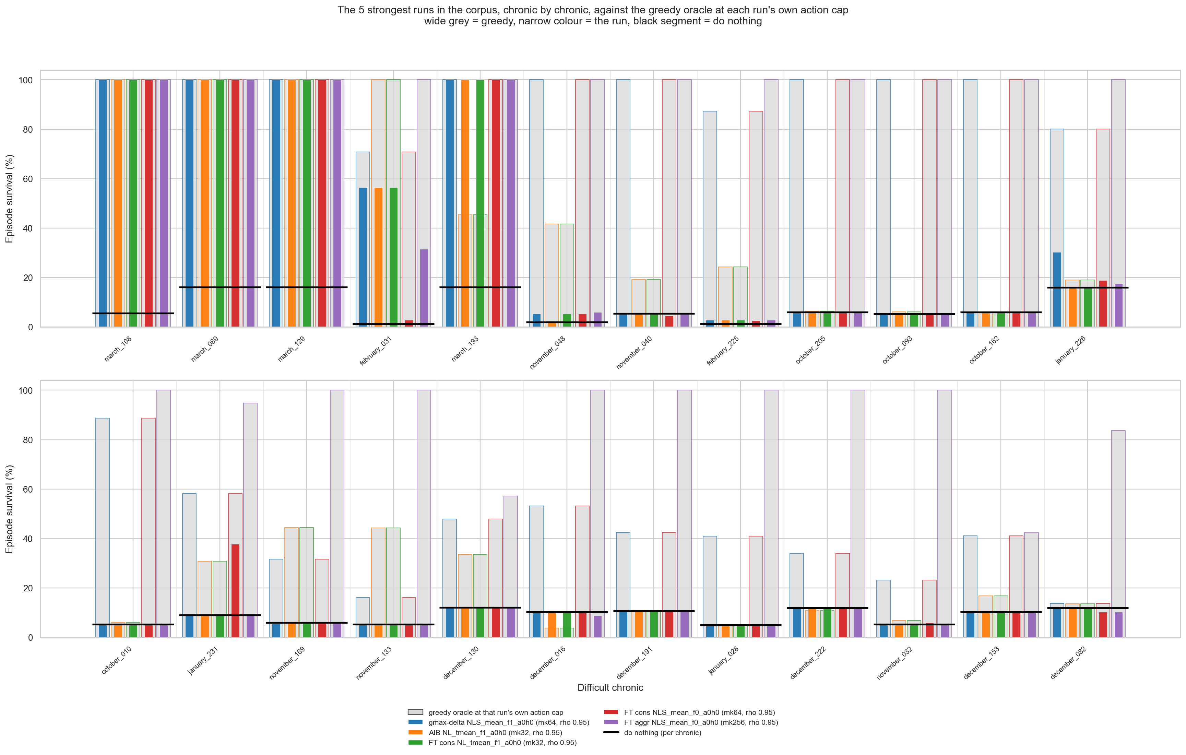
0
CHAPTER 10 · APPENDIX
Per-chronic diagnostic on the difficult cohort
Averages hide which specific scenarios a policy rescues and which it breaks.
HOW TO READ IT
Wide grey is the greedy oracle at that run's own action cap; the narrow coloured bars are the runs; the black segment is do nothing on that chronic.
What it shows. A handful of chronics are solved by almost every policy, and a handful by none. The mean is therefore driven by the middle group, where policies genuinely differ — which is why matched comparisons on the same cohort are more informative than absolute means.
The five strongest runs in the corpus, chronic by chronic, against the greedy oracle at each run's own action cap.
Notes:
Use if asked whether the mean is driven by a few episodes.

Slide 43
0
REFERENCE
Definitions and likely questions
Chronic One load and generation time series — a scenario. Episode length is up to 8,064 steps.
Mean survival Survived steps ÷ maximum episode length, averaged over the evaluated chronics.
Easy / difficult cohort Of the fixed 50 WCCI chronics, the 26 that do nothing completes and the 24 it does not.
Rescues The number of difficult chronics a policy completes.
ρ (rho) Line loading divided by that line's own thermal limit. Already grid-relative, which is why it transfers.
k Cap on the number of actions per agent after offline reduction. Agents with fewer valid actions keep their full list.
NL / NLS Original inputs / physical scaling plus line-angle differences.
Typed-mean pooling One mean per node type (bus, line, load, generator), concatenated — width 4·d_h instead of d_h.
Local-ρ gate Block an agent's action while the maximum loading on its own lines is below 0.95.
Greedy progress 100 · (S_π − S_DN) / (S_greedy,k − S_DN): 0% is do nothing, 100% is greedy at the same k.
Why difficult-cohort survival and not overall survival? Do nothing already completes 26 of the 50 chronics, so overall survival mostly measures how little damage a policy does to cases that never needed it.
Notes:
Glossary. Keep this one findable during questions.

