Slide 1


Graph policies for
power-grid topology control
MASTER THESIS · AUGUST 2026
EPFL × NUS
Master thesis
2026
PRESENTED BY
Corentin Plumet
Master thesis
Notes:
Open with the thesis question: can one decentralised graph policy cross from bus14 to a much larger power grid? State that the answer depends on the complete policy interface, not only the encoder.
[Sources]
- latex/main.tex
- latex/chapters/01_introduction.tex

Slide 2
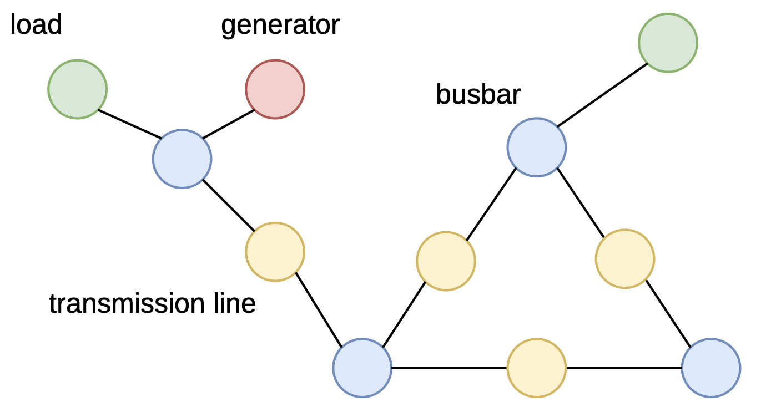
THESIS STORY
Why topology control?
A policy that can cross grids
Evidence: bus14 → WCCI
What transfers — and what does not
Notes:
Give the audience the non-chronological story: problem, complete transferable interface, source validation, target evidence, limitations.
[Sources]
- latex/chapters/01_introduction.tex
- latex/chapters/03_marl_graph_control.tex

Slide 3
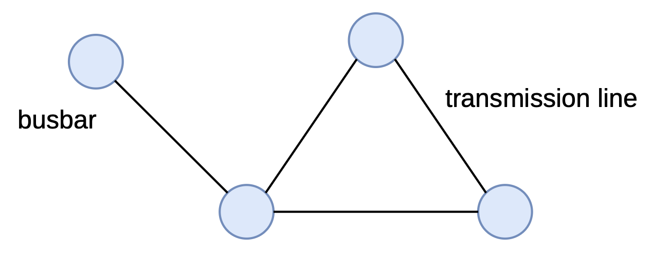
Topology control is cheap to actuate — hard to search
• Reconfigure busbars to redirect power flows
• Uses switching equipment already installed
• Decisions interact over time and cooldowns
178 unitary actions on bus14
≈66,965 on WCCI
Notes:
Explain the action: move elements between two busbars at a substation. The switching equipment exists; the difficulty is combinatorial, sequential, and safety-critical.
[Sources]
- latex/chapters/02_background.tex
- latex/chapters/07_wcci_transfer.tex

Slide 4
THE GAP: PORTABLE INPUTS ARE NOT ENOUGH IF THE ACTION INTERFACE STAYS GRID-SPECIFIC
Single-agent & hierarchical
• Strong benchmark results
• Reduced or factorised action sets
• Often centralised at execution
Heuristics & MARL
• Safety rules decide when to act
• Regional actors match grid operation
• Partial observability remains
Graph policies
• Parameters can ignore grid size
• Structure enters message passing
• Most action heads still use fixed indices
Notes:
Position the work at the intersection of MARL, graph policies, and action reduction. The under-addressed problem is cross-grid transfer when candidate action identities and counts change.
[Sources]
- latex/chapters/02_background.tex
- latex/chapters/03_marl_graph_control.tex

Slide 5
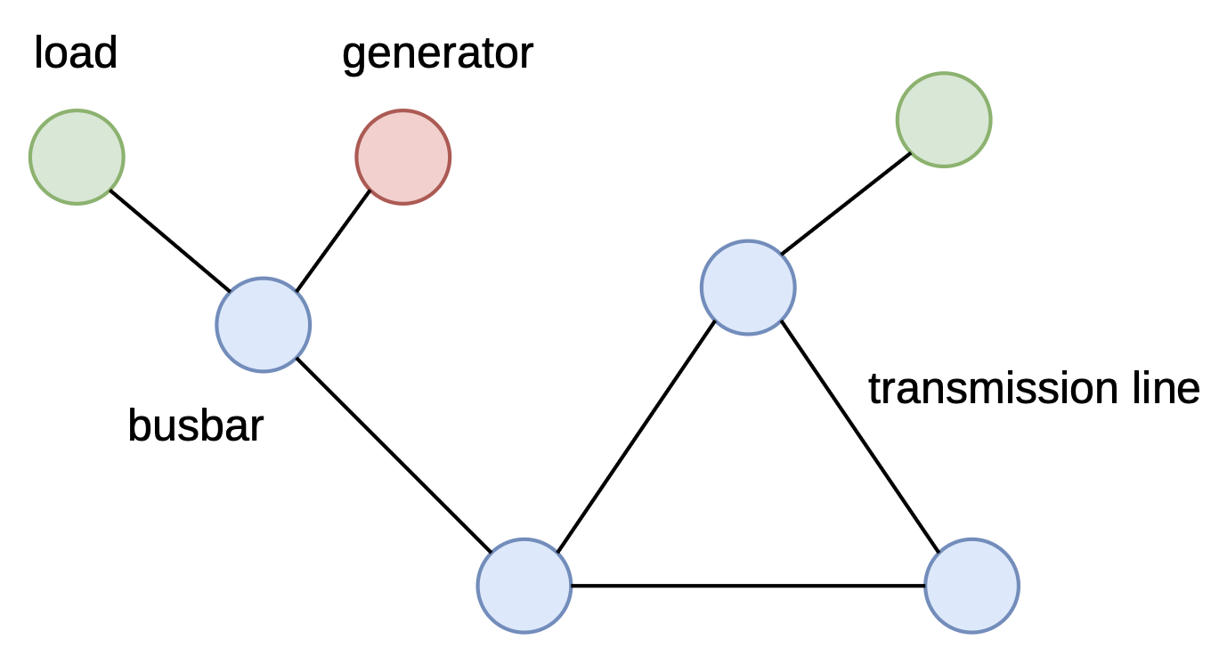
PORTABLE
1. LOCAL
DECENTRALISED EXECUTION
2. SHARED
GRAPH STATE ENCODER
3. PORTABLE
CANDIDATE SCORER
Notes:
Frame these as engineering requirements. A transferable encoder solves only the middle requirement; the action scorer is required for a different number of candidates.
[Sources]
- latex/chapters/03_marl_graph_control.tex
- latex/chapters/06_candidate_action_scoring.tex

Slide 6
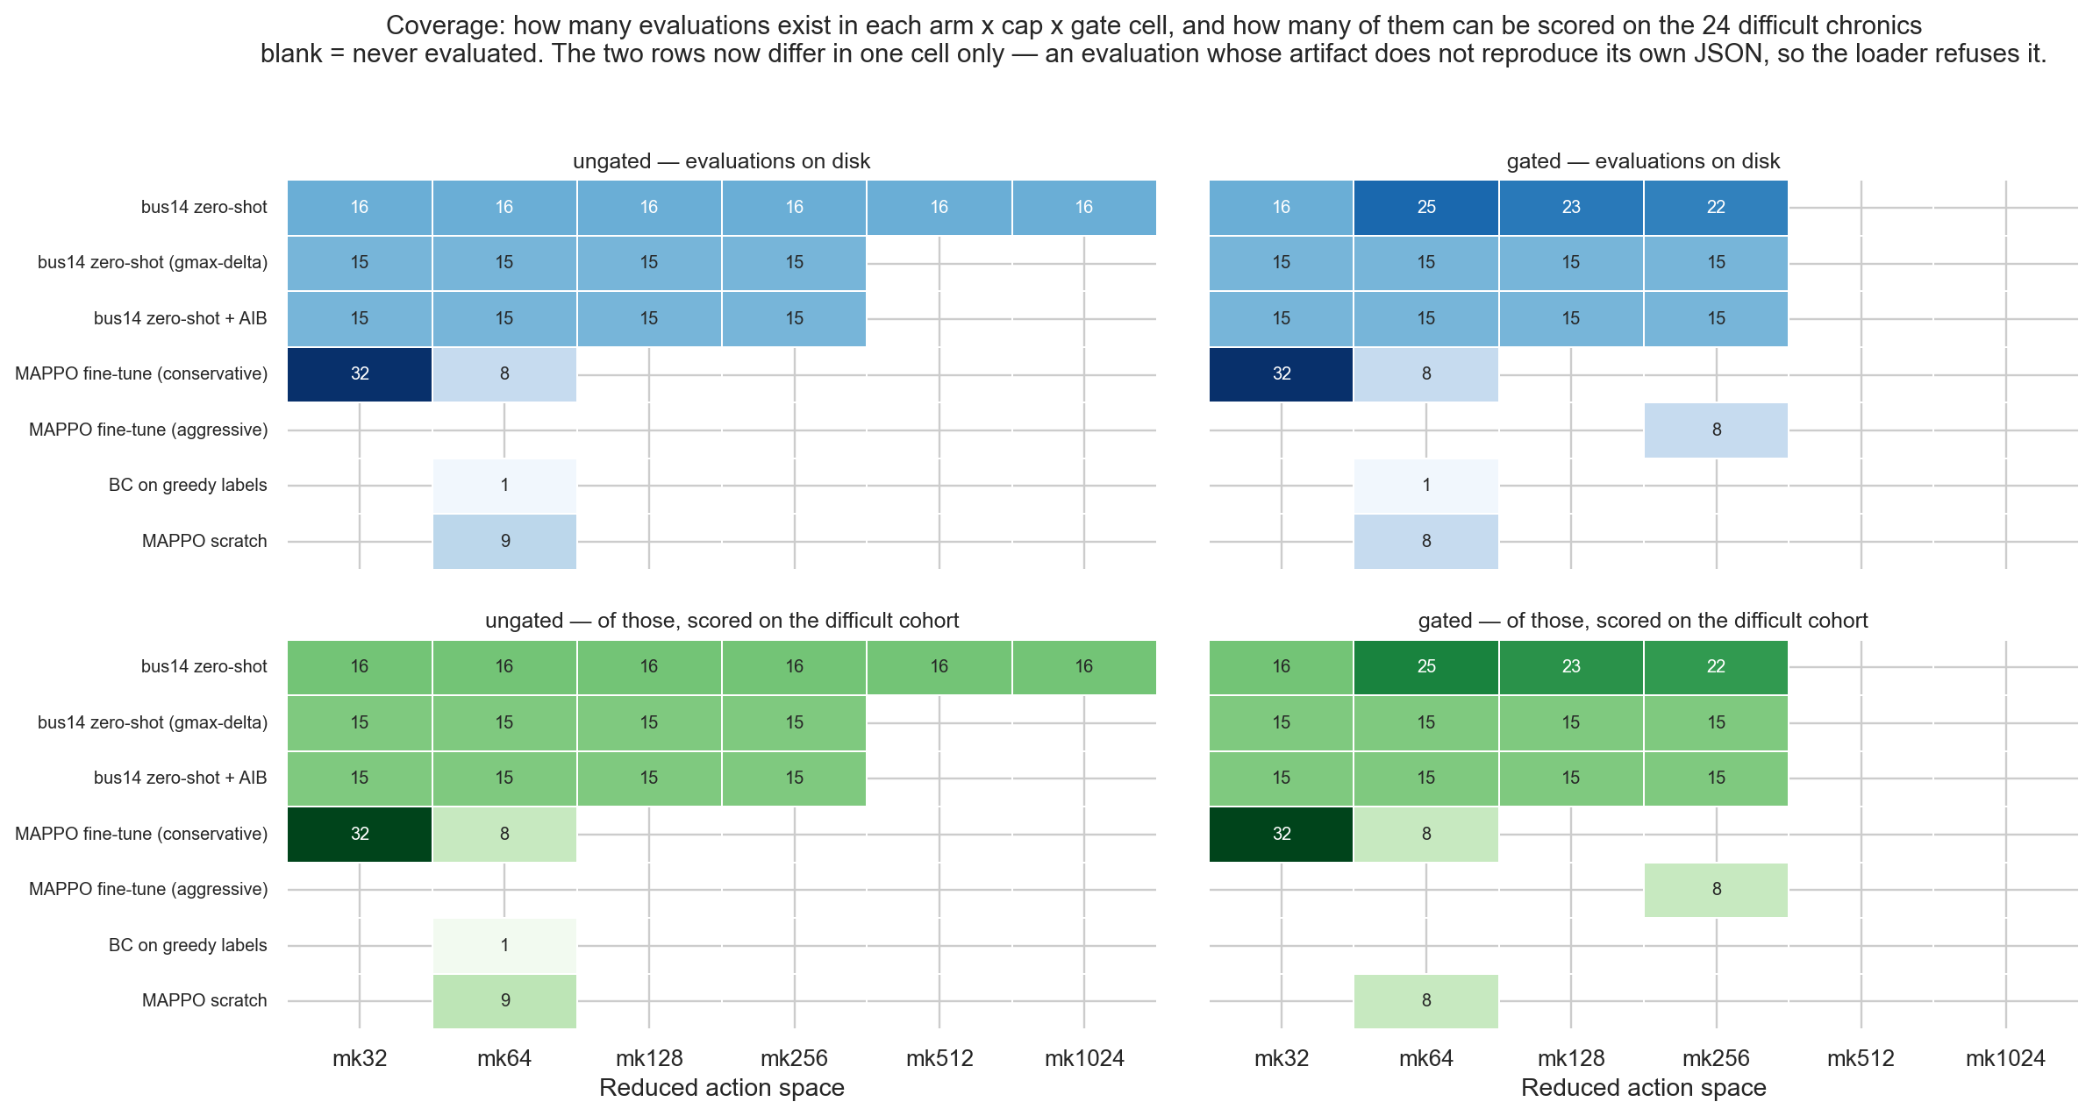
TWO GRIDS,
ONE POLICY
14
SOURCE
3 → 4
AGENTS
36
TARGET
201 / 50
CHRONICS
Transfer uses the same 50 WCCI chronics; 24 are difficult because do nothing fails.
Notes:
The source grid is used for design screens and source pretraining. WCCI is both larger and operationally different. The fixed cohort makes transfer comparisons auditable.
[Sources]
- latex/chapters/05_experiments_results.tex
- latex/chapters/07_wcci_transfer.tex

Slide 7
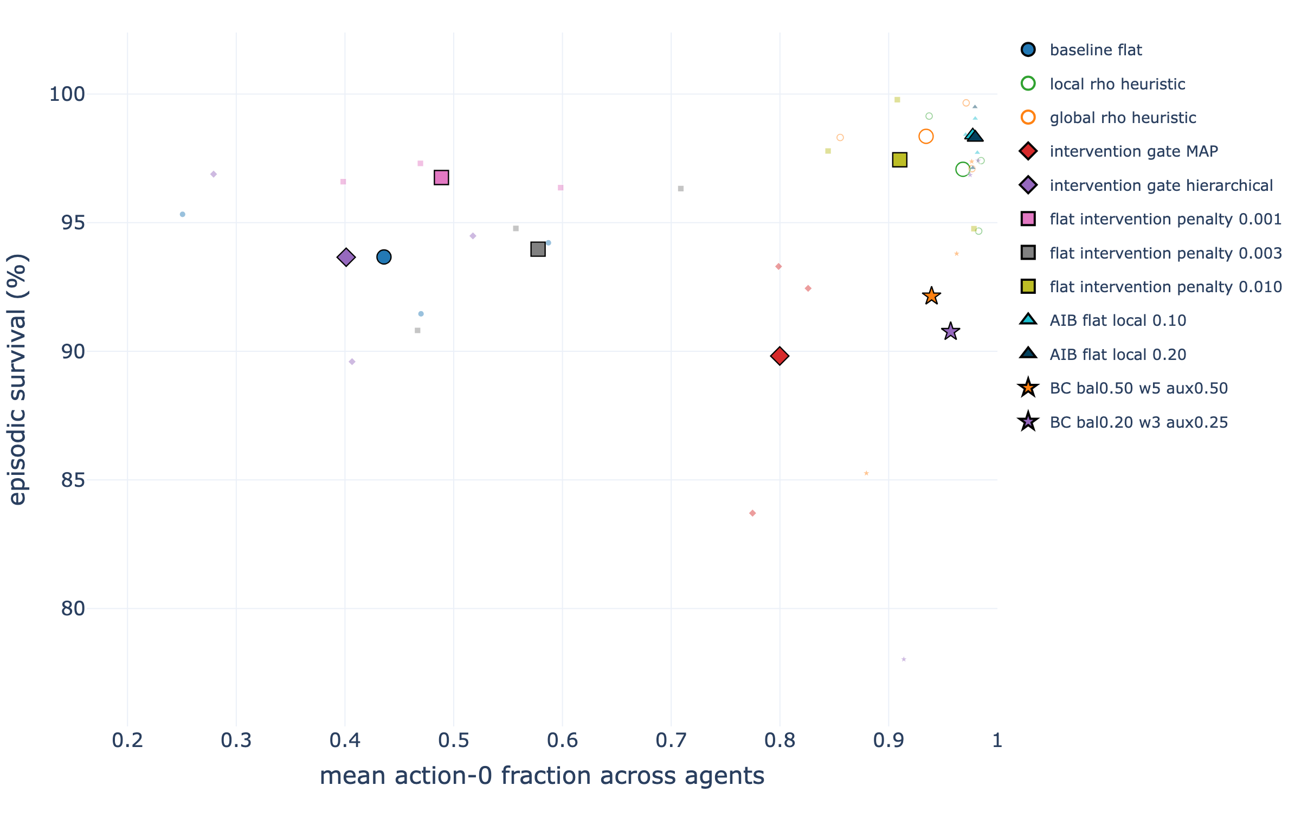
Safe control means knowing when not to act
• Survival alone rewards needless switching
• A local ρ rule blocks actions while the region is safe
• Local-safe adaptive budgets reach 98.4% survival with 0.98 idle-action usage
Notes:
Introduce the safety layer as a decision-time mechanism. It suppresses unnecessary actions, but later evidence will show that its value is policy-dependent.
[Sources]
- latex/chapters/05_experiments_results.tex
- latex/figures/sparse_control_fulltest_tradeoff.png

Slide 8
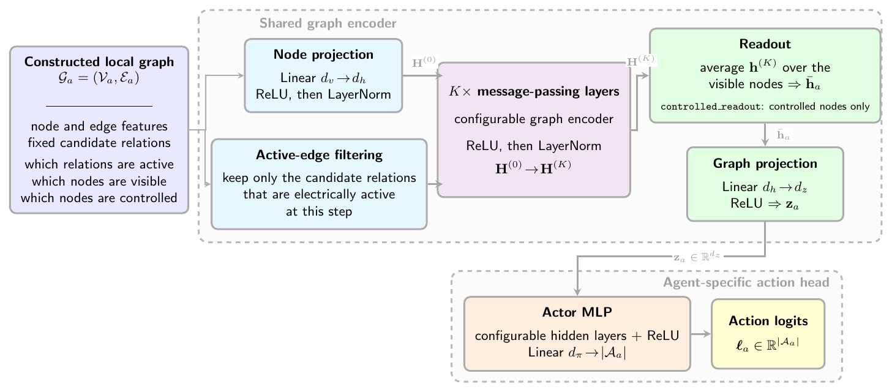
A shared local graph replaces the fixed input vector
• Each actor receives its regional graph plus one-hop context
• GINE shares weights across all agents
• MAPPO critic uses global state only during training
Notes:
Walk left-to-right: local observation, graph construction, shared GINE actor, decentralised action. The global critic is training-only.
[Sources]
- latex/chapters/05_experiments_results.tex
- latex/figures/graph_actor_pipeline.png

Slide 9
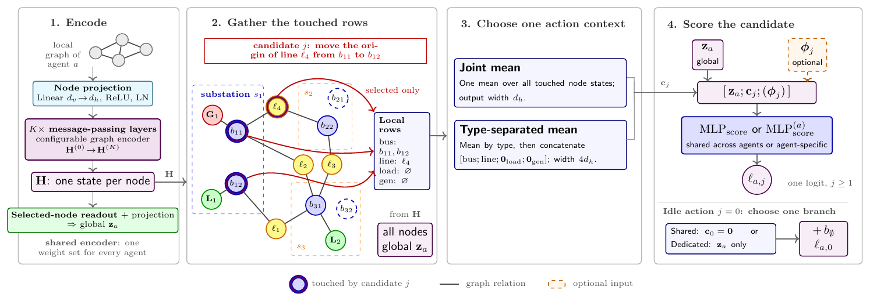
Candidate scoring removes the fixed action head
• Gather the node rows touched by candidate j
• Pool them into an action context cⱼ
• A shared scorer emits one logit per candidate — on any grid
Notes:
The scorer is permutation-equivariant over candidates and does not allocate one output parameter per action index. This is the key action-side transfer mechanism.
[Sources]
- latex/chapters/05_experiments_results.tex
- latex/figures/candidate_action_scoring_pipeline.png

Slide 10
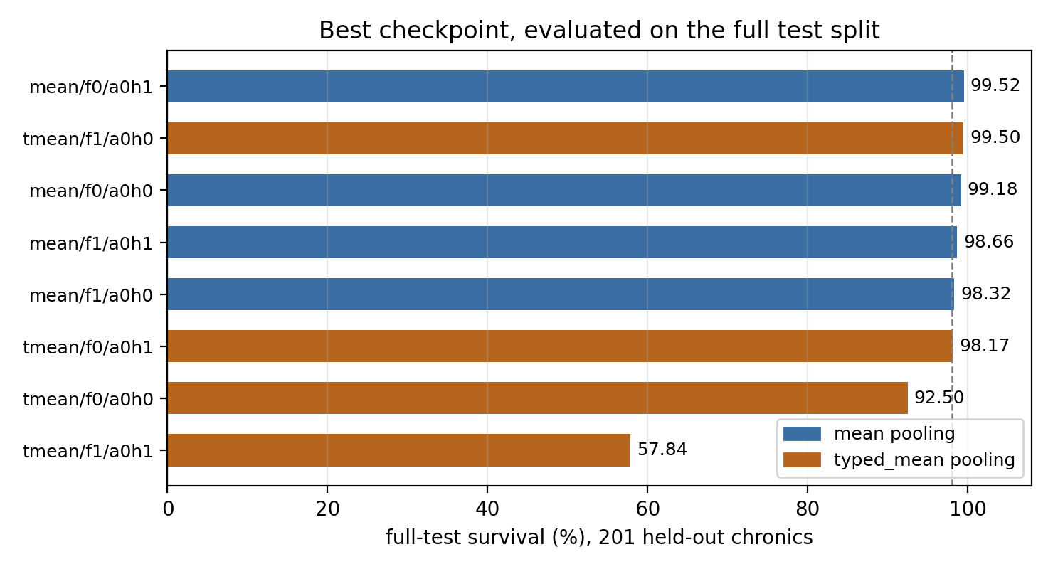
The transferable actor first has to solve the source grid
• All leading Screen-F variants exceed 98%
• Best full-test survival: 99.52%
• Source-grid accuracy does not predict target-grid learning
Notes:
Establish competence before transfer. Emphasise that several source variants are nearly tied, so target transfer is needed to distinguish them.
[Sources]
- latex/chapters/05_experiments_results.tex
- latex/figures/nl_cas_hl_fulltest.png

Slide 11
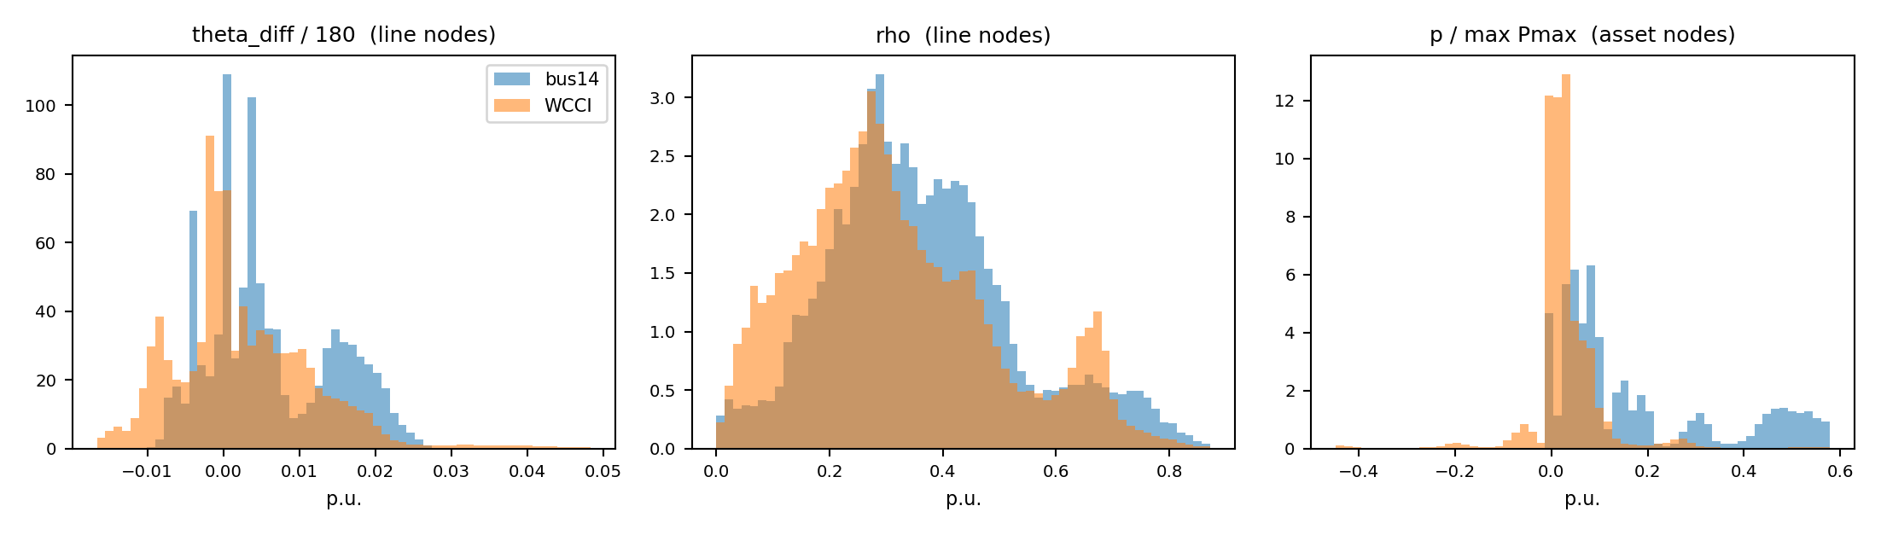
Physical inputs must mean the same thing on both grids
• Absolute power scales shift with grid capacity
• Absolute voltage angle is reference-dependent
• Use p / max Pmax and angle differences
• Freeze source statistics for strict zero-shot
Notes:
Explain the two portable transformations. These remove avoidable scale and reference choices, but do not eliminate every distribution shift.
[Sources]
- latex/chapters/05_experiments_results.tex
- latex/figures/wcci_feature_corrected.png

Slide 12
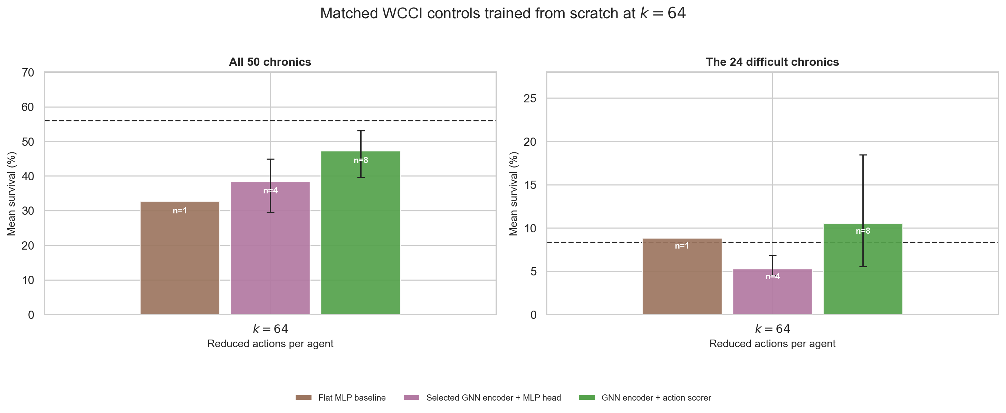
Training directly on WCCI is surprisingly weak
At k = 64, overall family means:
• Flat MLP: 32.6%
• Fixed-head GNN: 38.4%
• Candidate scorer: 47.2%
All remain below 56.0% do nothing overall.
Notes:
Do not hide the awkward baseline: overall survival is dominated by easy chronics. The candidate scorer is best among learned families, yet scratch learning remains unstable.
[Sources]
- latex/chapters/07_wcci_transfer.tex
- latex/figures/wcci_target_controls.png

Slide 13
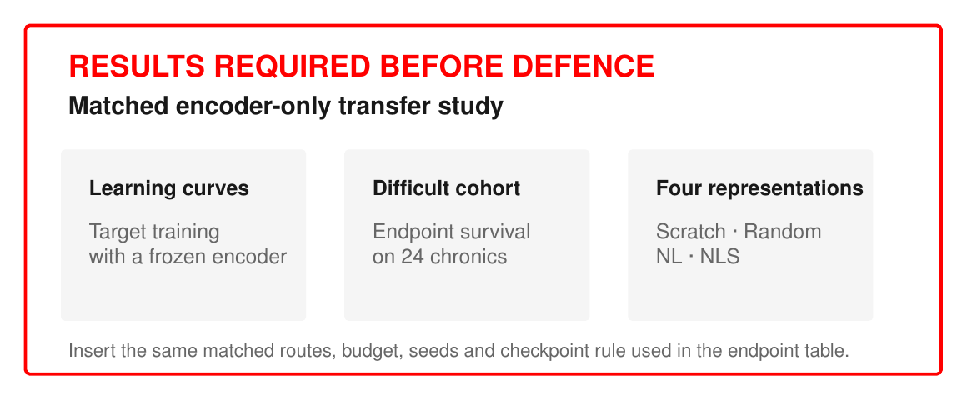
Encoder-only transfer: the key diagnostic is still missing
RESULTS REQUIRED BEFORE DEFENCE
Compare four source encoders under:
• target scratch
• random frozen encoder
• NL frozen transfer
• NLS frozen transfer
Notes:
Be explicit that this is a planned result, not evidence. If the study is not complete, remove this main slide or present only the protocol question.
[Sources]
- latex/chapters/07_wcci_transfer.tex
- latex/chapters/09_encoder_transfer_bridge.tex

Slide 14
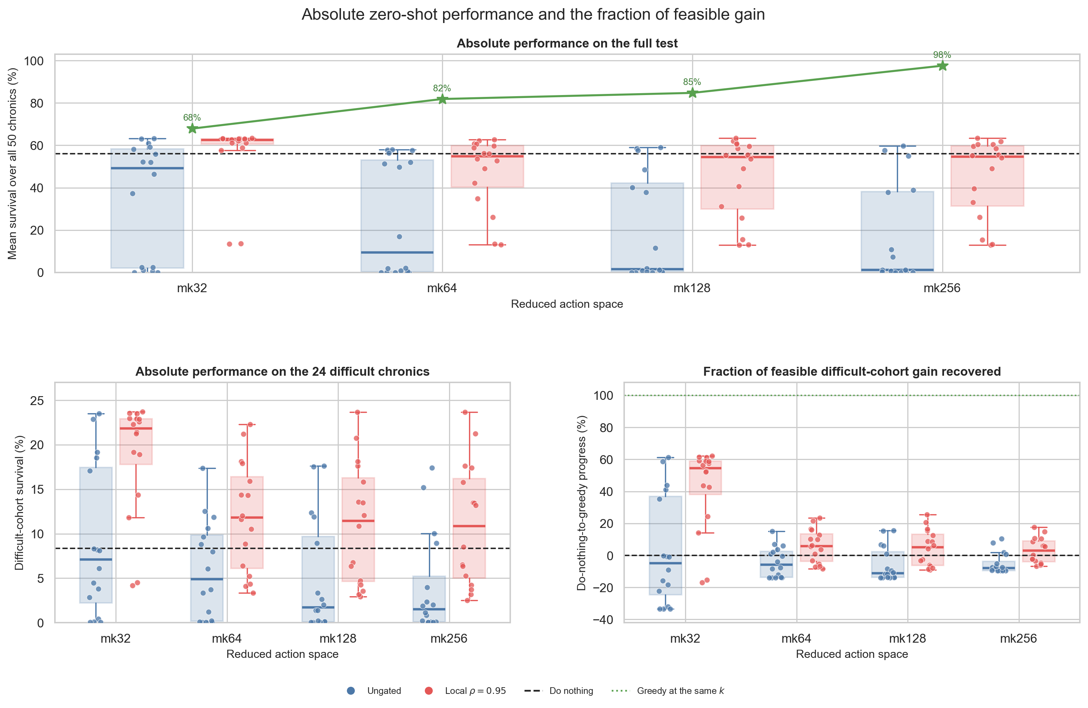
Zero-shot works best when the decision set stays small
With local ρ = 0.95:
• k = 32: 62.5% overall
• 21.9% on difficult cases
• 54.6% of feasible gain recovered
At k = 256, recovered gain falls to 2.9%.
Notes:
Larger candidate sets improve feasibility but make ranking harder. The policy has a finite ranking capacity: k=32 is the clearest zero-shot operating point.
[Sources]
- latex/chapters/07_wcci_transfer.tex
- latex/figures/wcci_zero_shot_determinants.png

Slide 15
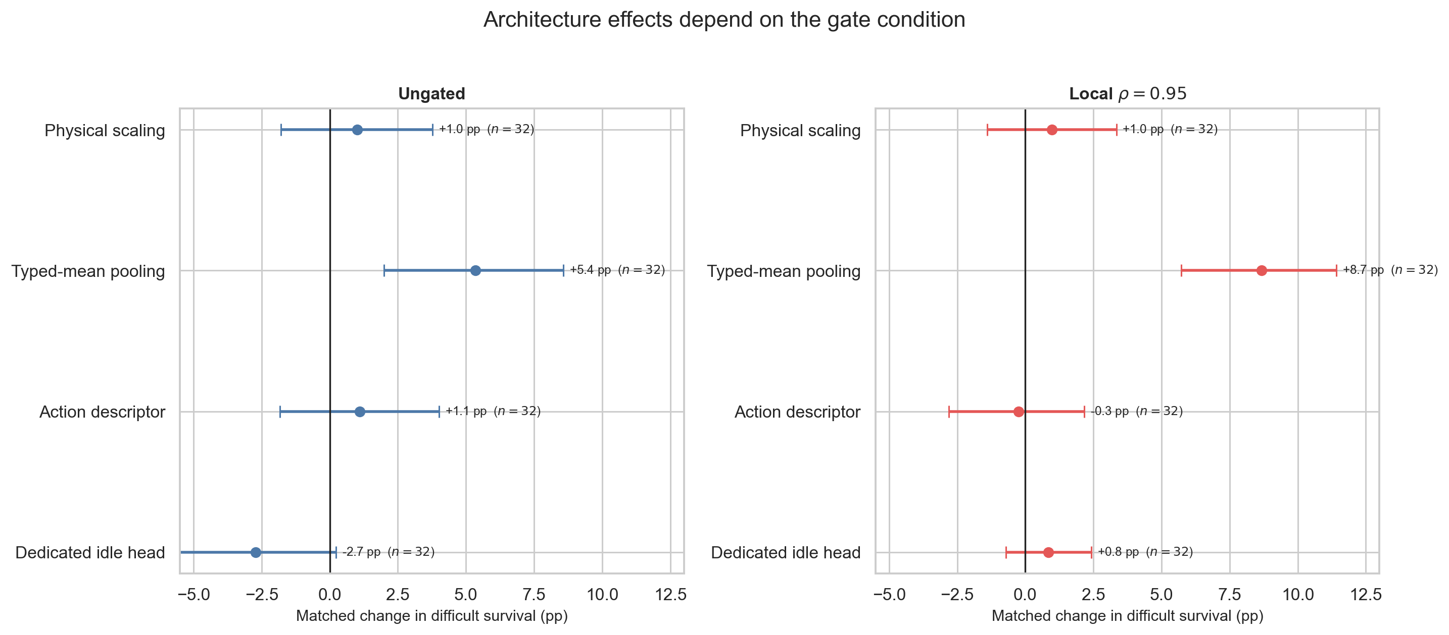
Typed candidate pooling is the clearest transfer gain
Matched difficult-cohort effects:
• +5.4 pp ungated
• +8.7 pp with local gate
• Physical scaling ≈ +1 pp
The dedicated idle head is harmful when ungated.
Notes:
Separate the effects. Typed mean pooling is the most repeatable architectural gain. Feature scaling helps modestly. The idle mechanism interacts negatively without gating.
[Sources]
- latex/chapters/07_wcci_transfer.tex
- latex/figures/wcci_zero_shot_architecture_effects.png

Slide 16
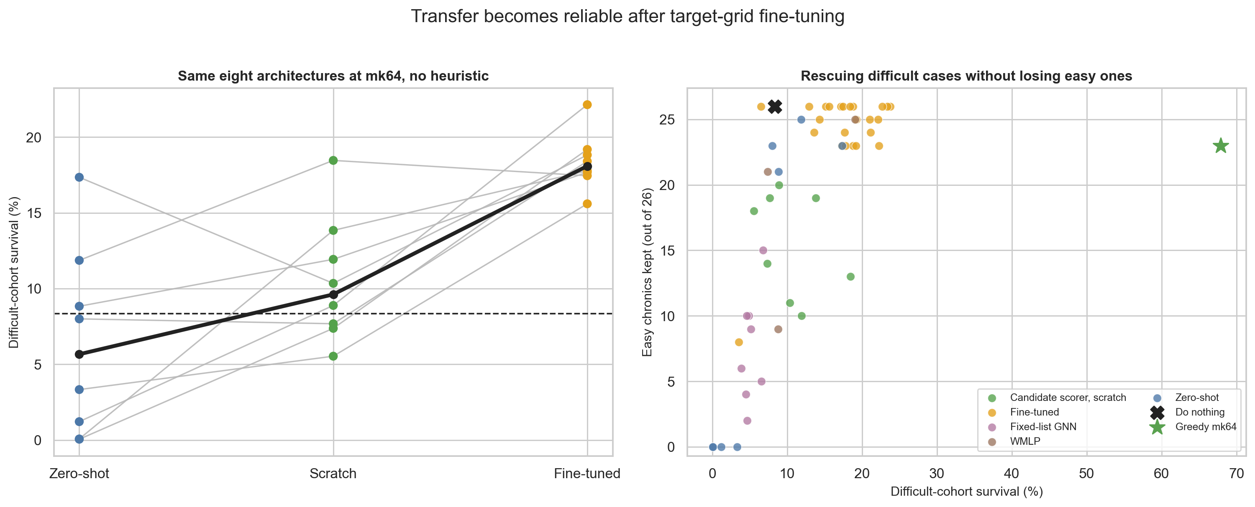
Source-initialised fine-tuning makes transfer reliable
Median difficult-cohort survival:
• 5.7% zero-shot
• 9.6% scratch
• 18.1% fine-tuned
Fine-tuning wins 7/8 matched comparisons vs scratch.
Notes:
Finish the evidence section with the robust route: source initialise and fine-tune. Keep the claim matched—same architecture and action cap.
[Sources]
- latex/chapters/07_wcci_transfer.tex
- latex/figures/wcci_adaptation_summary.png

Slide 17
TRANSFER NEEDS PORTABLE INTERFACES
WHAT TRANSFERRED
• Shared GINE encoder
• Candidate-wise scorer
• Typed action context
• Small reduced action sets
WHAT DID NOT
• Fixed-index heads
• Raw physical scales
• Larger k without ranking capacity
• Universal safety rule
EVIDENCE LIMITS
• One training seed
• 50 WCCI chronics
• Mixed target budgets
• No completed encoder-only endpoint
Notes:
Synthesize the evidence and its limits. The strongest conclusion concerns compatible representations and decision interfaces; it does not establish universal graph generalisation.
[Sources]
- latex/chapters/08_discussion_outlook.tex
- latex/chapters/09_encoder_transfer_bridge.tex

Slide 18
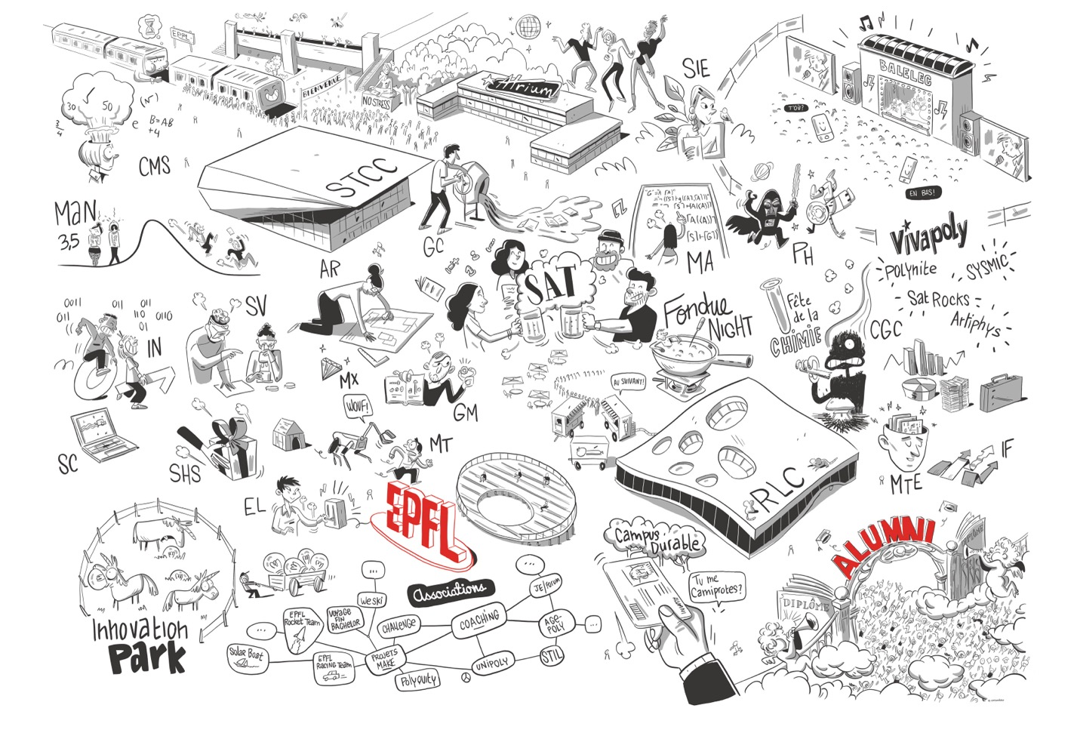
Three conclusions
1. Make state and actions portable
2. Validate safety per policy
3. Fine-tune conservatively on the target grid
Notes:
Land the talk with the three reusable lessons. The next step is a completed, seed-matched encoder-only study and broader target-grid validation.
[Sources]
- latex/chapters/08_discussion_outlook.tex

Slide 19

Questions?
MASTER THESIS
PRESENTED BY
Corentin Plumet
EPFL × NUS
Notes:
Pause here. Use the supplementary slides as return targets for methods, baselines, and chronic-level questions.
[Sources]
- latex/main.tex

Slide 20

SUPPLEMENTARY
Protocol & baselines
Graph-design screens
Transfer diagnostics
Notes:
Backup slides start here; they are not part of the 20-minute sequence.
[Sources]
- latex/main.tex

Slide 21
WCCI
EVALUATION
50
CHRONICS
24
DIFFICULT
26
EASY
8.34%
BASELINE
Maintenance is disabled to remove a hazard absent from bus14; on the full WCCI test it changes do-nothing survival from 27.3% to 57.3%.
Notes:
Use this slide to defend the cohort split and maintenance choice. Report difficult-cohort results whenever possible because overall survival saturates on easy chronics.
[Sources]
- latex/chapters/07_wcci_transfer.tex

Slide 22
More candidates help greedy — not the policy
FULL LIST
≈66,965
actions
k = 32
128
candidates
33.1% greedy
k = 64
256
candidates
67.9% greedy
k = 256
716
candidates
94.9% greedy
Feasible actions expand faster than the learned policy can rank them.
Notes:
The reduced list is decentralised, so total candidates exceed k. Greedy feasibility rises with k; policy performance does not, which diagnoses ranking difficulty rather than action absence.
[Sources]
- latex/chapters/07_wcci_transfer.tex
- latex/figures/wcci_appendix_coverage.png

Slide 23
Sparse-control mechanisms occupy different trade-offs
Best source-grid learned control:
• Local-safe AIB: 98.4% survival
• 0.98 mean idle-action usage
The local rule improves sparse behaviour at evaluation time.
Notes:
Answer questions about intervention frequency, survival, and the different heuristic variants.
[Sources]
- latex/chapters/05_experiments_results.tex
- latex/figures/sparse_control_fulltest_tradeoff.png

Slide 24
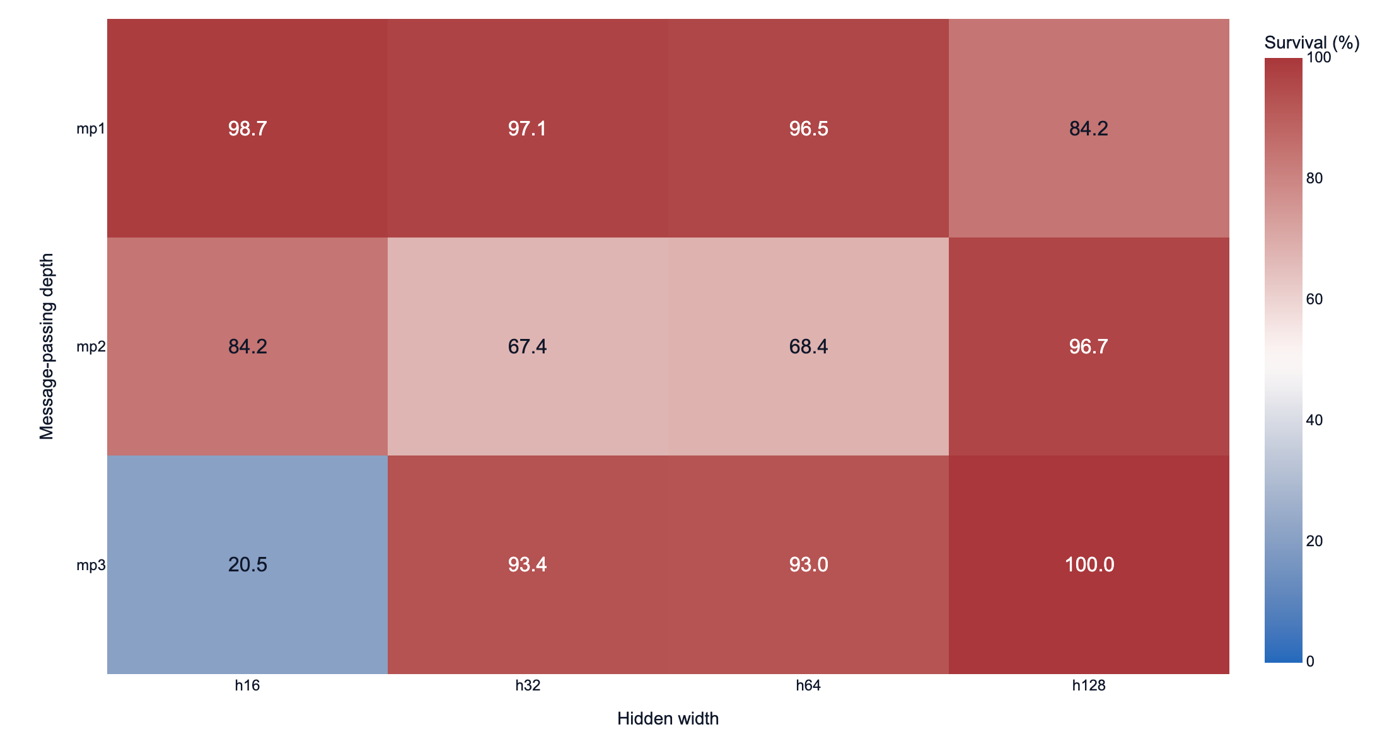
Two GINE layers and width 128 were the robust default
• K = 2, h = 128 crosses 90% earliest
• Highest time-weighted training mean
• Lower late-training variance
• Peak gaps remain within one-seed noise
Notes:
The selection criterion was not only the single best checkpoint; it combined learning speed, training mean, and stability.
[Sources]
- latex/chapters/05_experiments_results.tex
- latex/figures/gs_s3dw_depth_width_heatmap.png

Slide 25
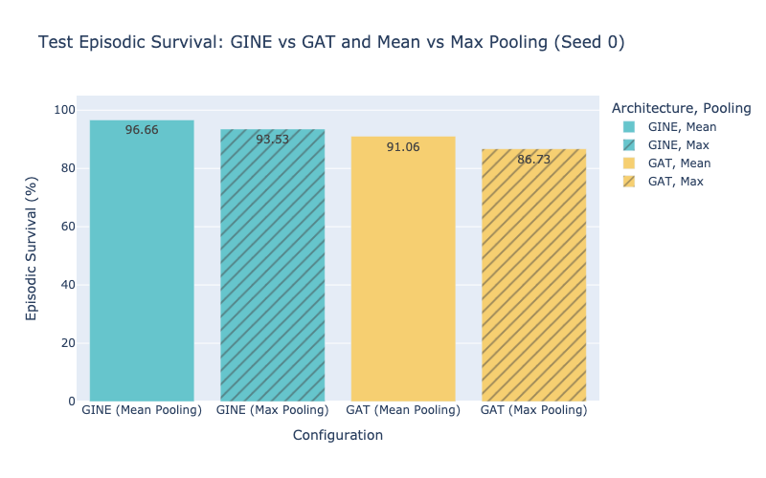
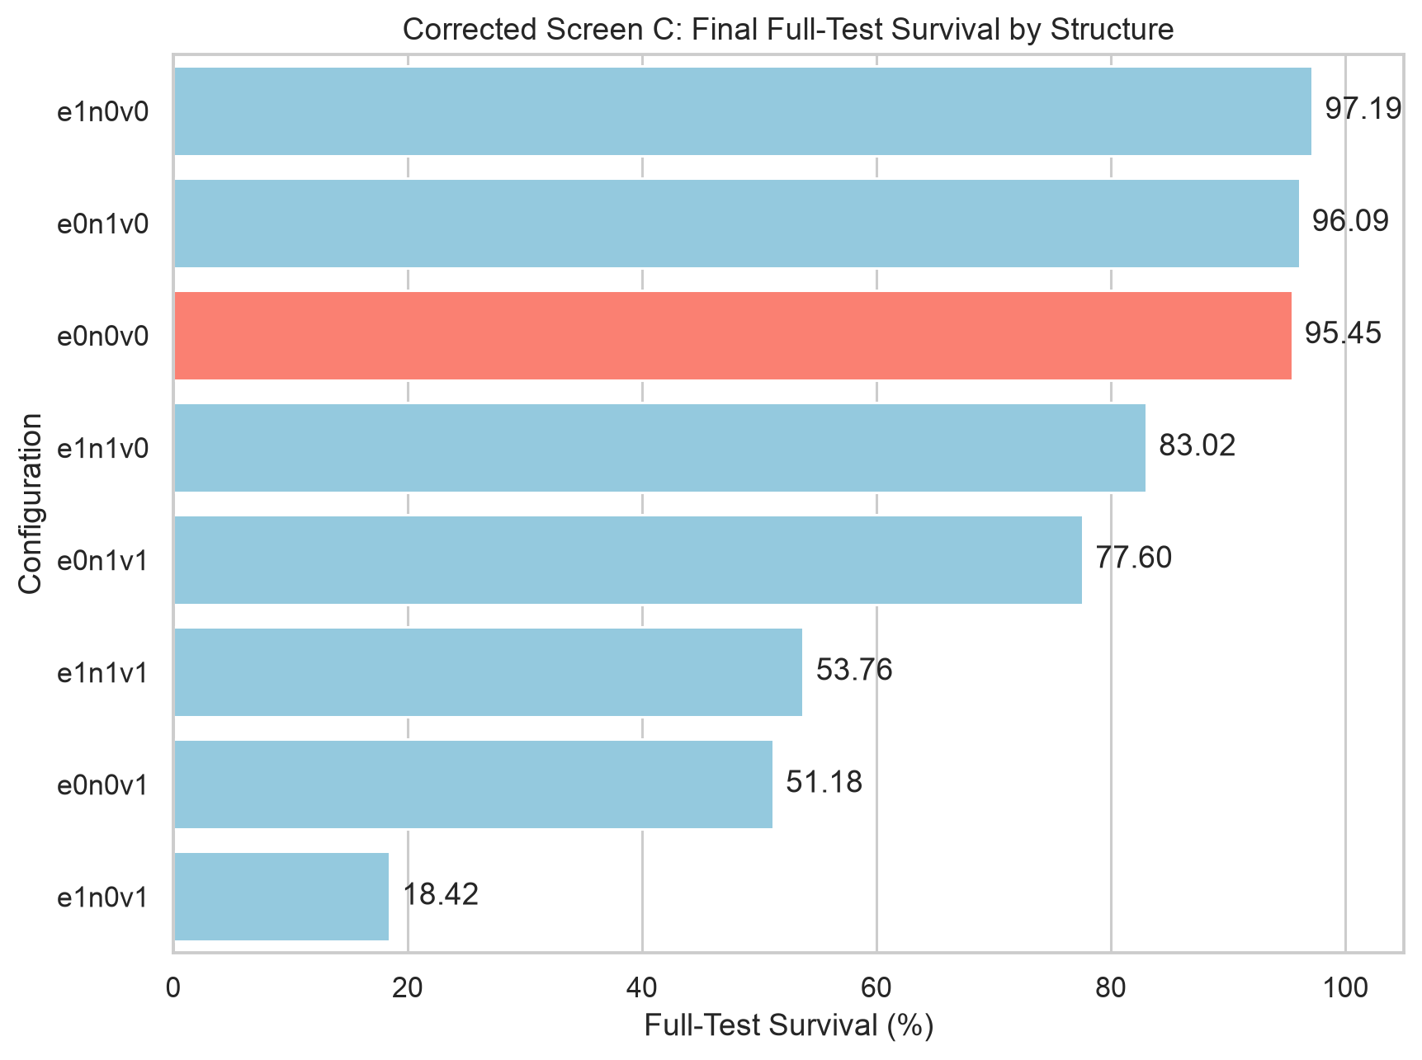
Readout > structural hubs
SCREEN C
Energized/max readout
99.39% full-test survival
SCREEN D
Simple unaugmented graph retained
Virtual nodes: 18–77%
Notes:
The energized/max readout was a clear gain. Most explicit structural hubs destabilised training or reduced survival, so the simpler graph was retained.
[Sources]
- latex/chapters/05_experiments_results.tex
- latex/figures/gs_s3p_bar.png
- latex/figures/gs_s2_structure_bar.png

Slide 26
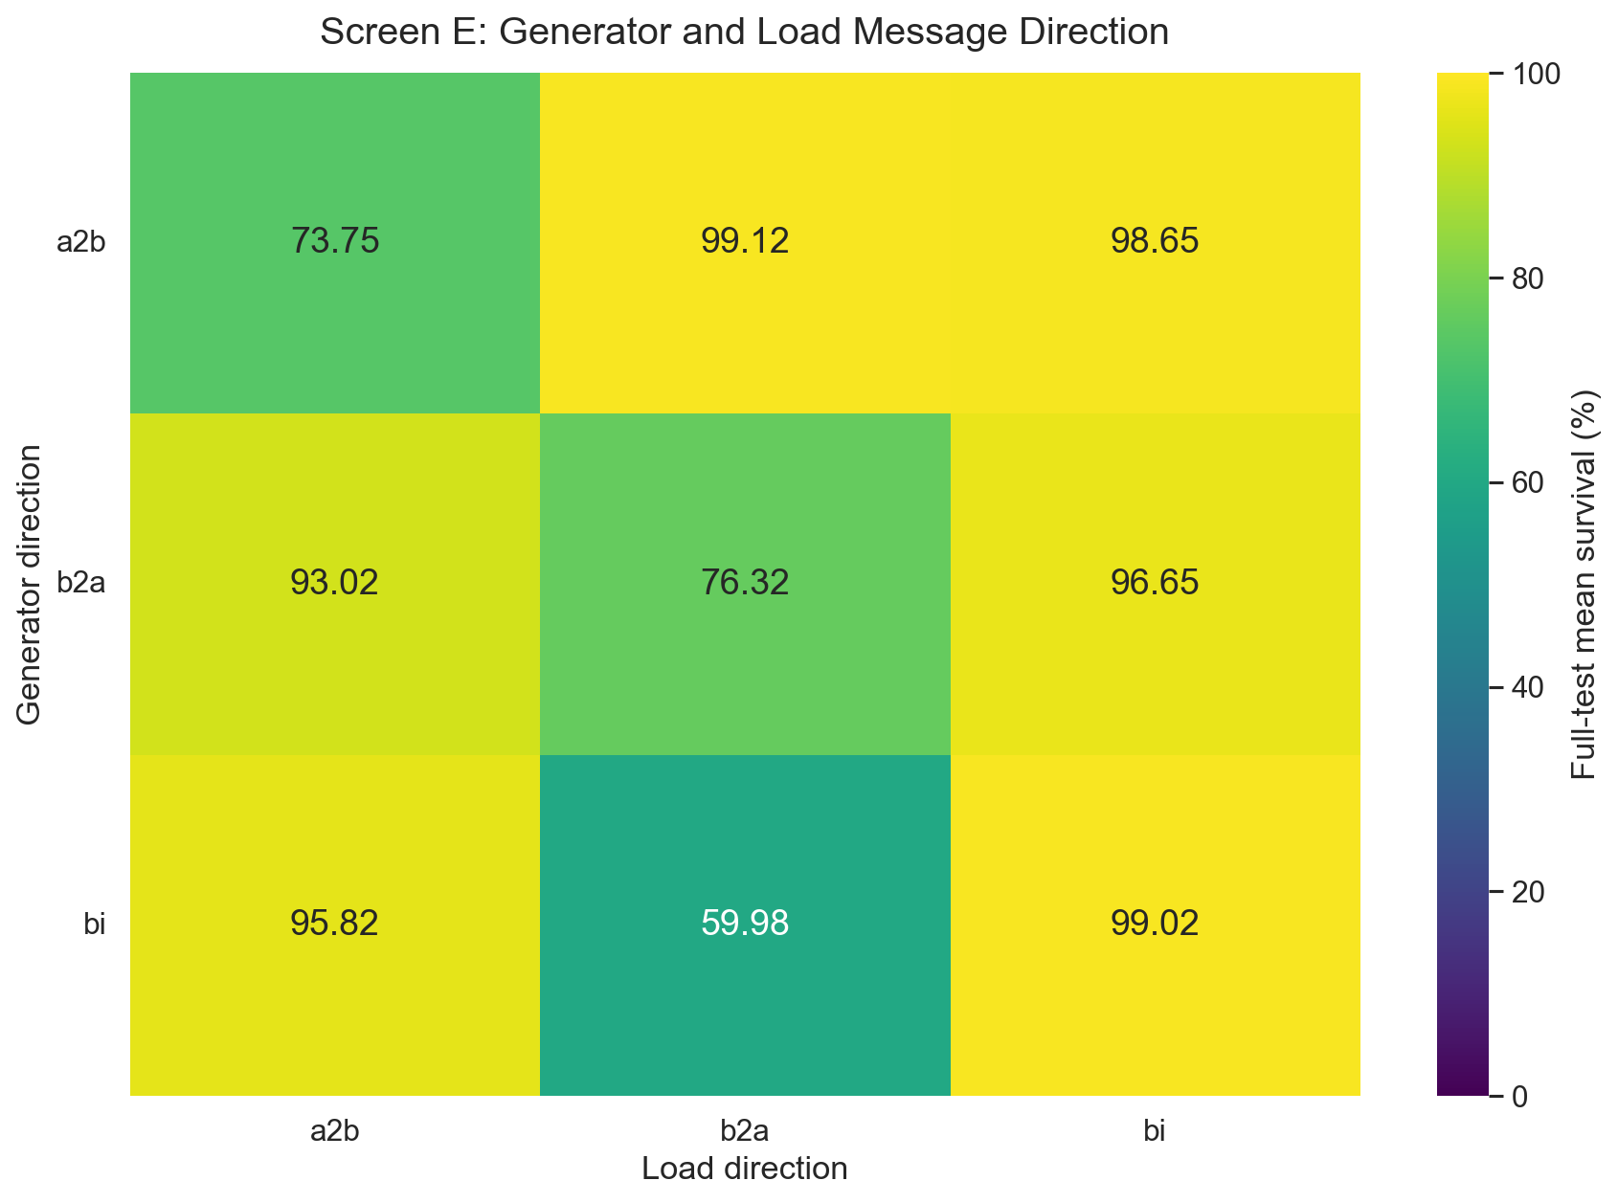
Direction + action context
SCREEN E
Best physical direction:
generator → busbar
load ← busbar
99.12%
SCREEN F
Leading candidate scorers
98–99.5% on bus14
Notes:
Direction encodes physical asymmetry and changes performance. Candidate scoring then provides the grid-size-independent action interface.
[Sources]
- latex/chapters/05_experiments_results.tex
- latex/chapters/06_candidate_action_scoring.tex

Slide 27
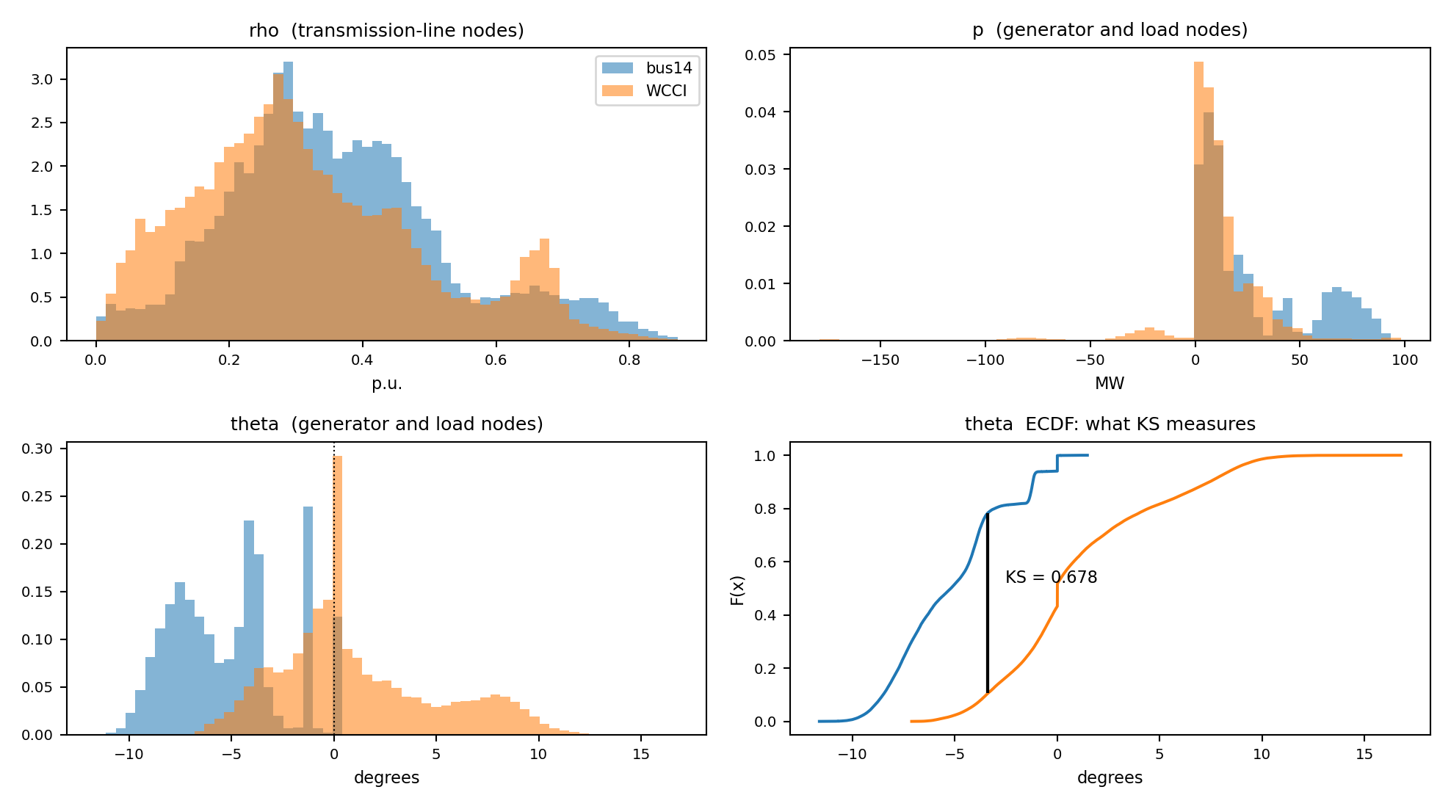
Scale physical inputs
BEFORE
Power and angle channels differ in scale, offset, and tails
AFTER
p / max Pmax and angle differences remove avoidable mismatch
Notes:
Use the before-and-after view to explain why portability is a semantics problem, not only numerical standardisation.
[Sources]
- latex/chapters/07_wcci_transfer.tex
- latex/figures/wcci_feature_distributions.png
- latex/figures/wcci_feature_corrected.png

Slide 28
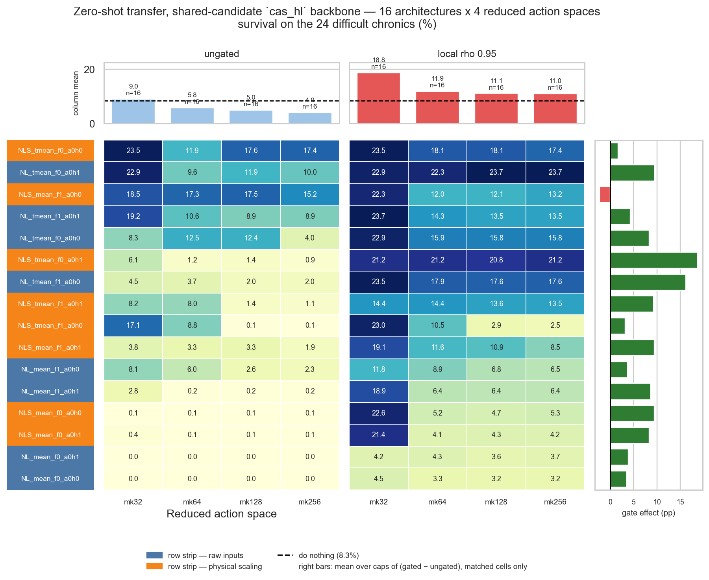
Zero-shot interactions
PLAIN ZERO-SHOT
Pooling, preprocessing and idle-head choices interact with k
ACTION-SPACE COVERAGE
Larger k expands feasibility faster than the policy can rank it
Notes:
This slide is for detailed architecture questions. Avoid reading every cell; point to interactions and the mismatch between feasibility and policy ranking.
[Sources]
- latex/chapters/07_wcci_transfer.tex
- latex/figures/wcci_appendix_zero_shot_matrix.png

Slide 29
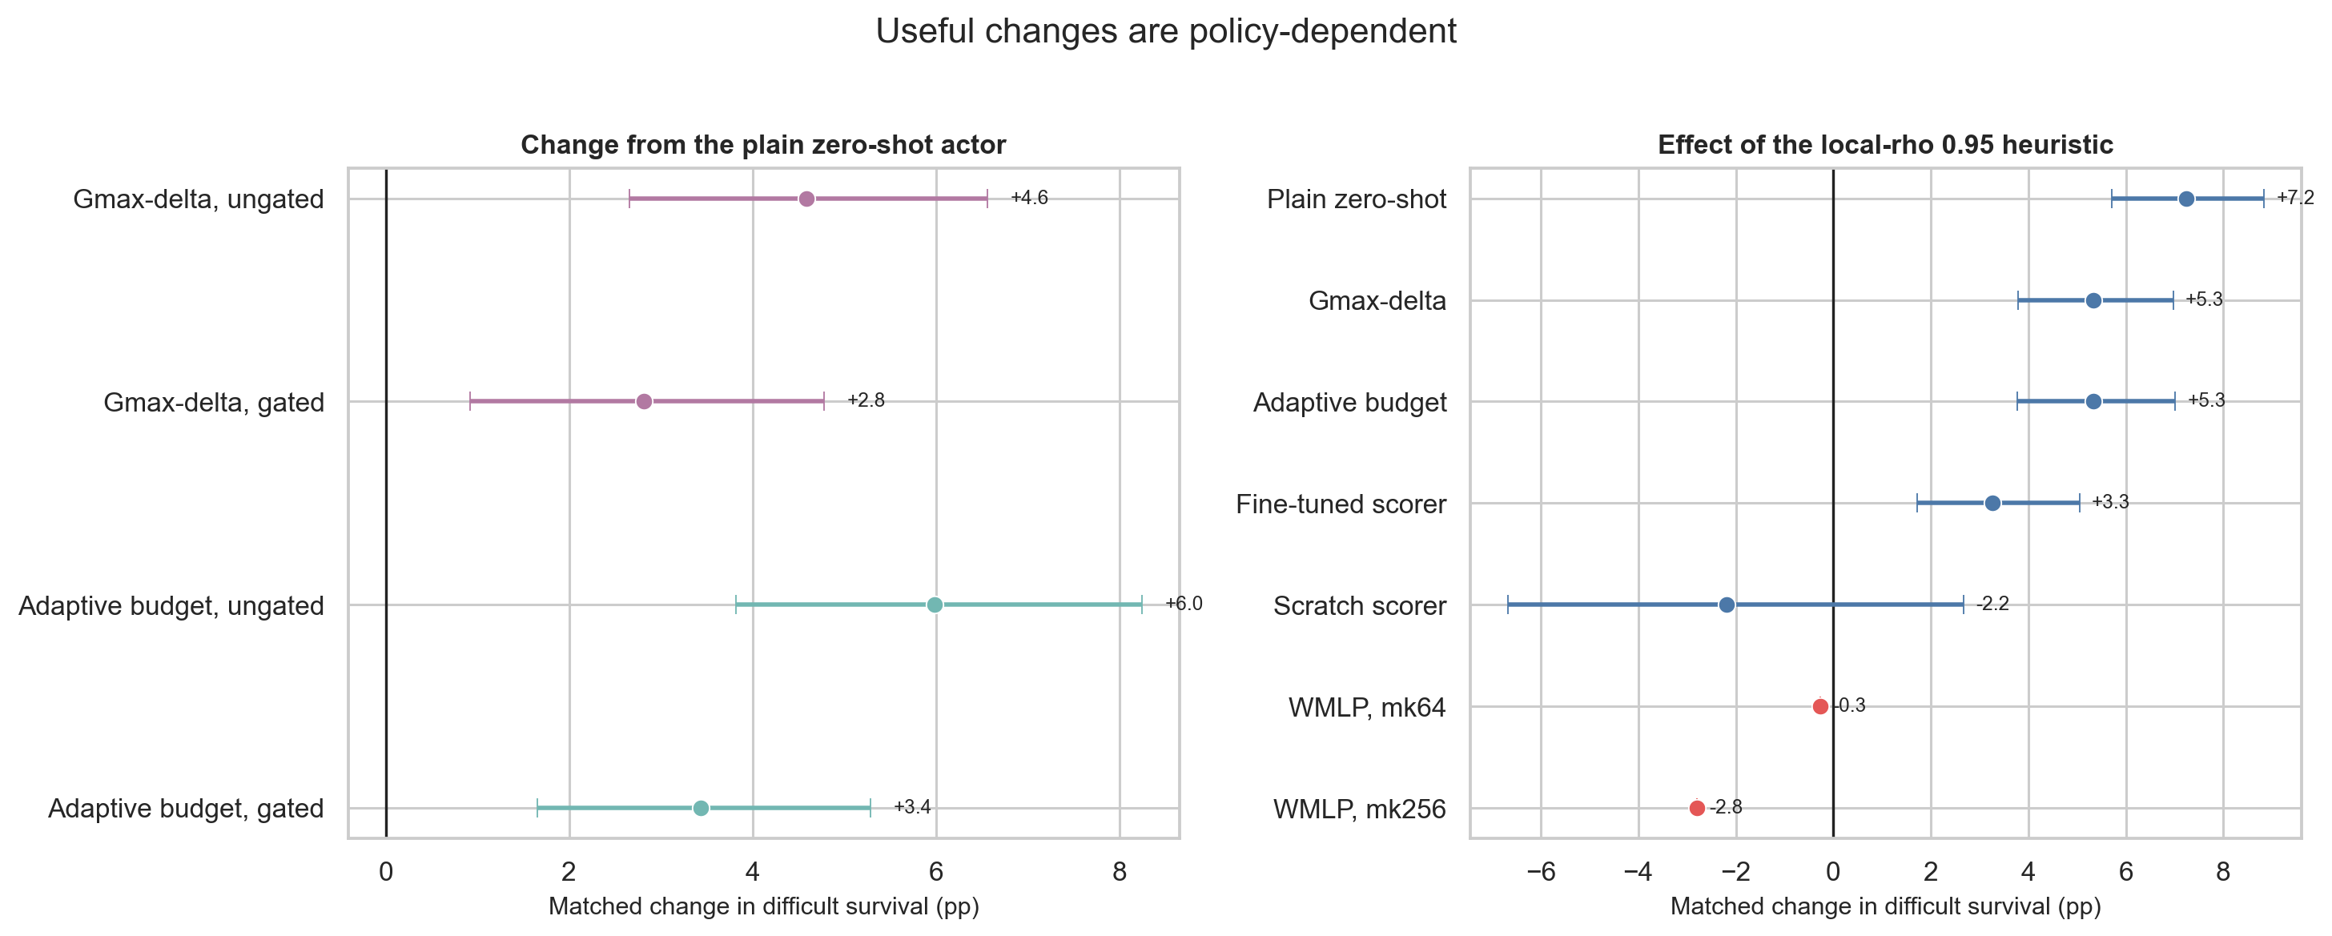
Decision-time changes help only in matched policy contexts
Matched difficult-cohort change:
• Gmax-delta: +4.6 pp ungated
• Adaptive budget: +6.0 pp ungated
• Local gate: +7.2 pp for plain zero-shot
• But −2.2 pp for scratch scorer
Notes:
The gate is not universally safe. It helps zero-shot policies but can suppress useful actions for policies trained to act without it.
[Sources]
- latex/chapters/07_wcci_transfer.tex
- latex/figures/wcci_intervention_gate_effects.png

Slide 30
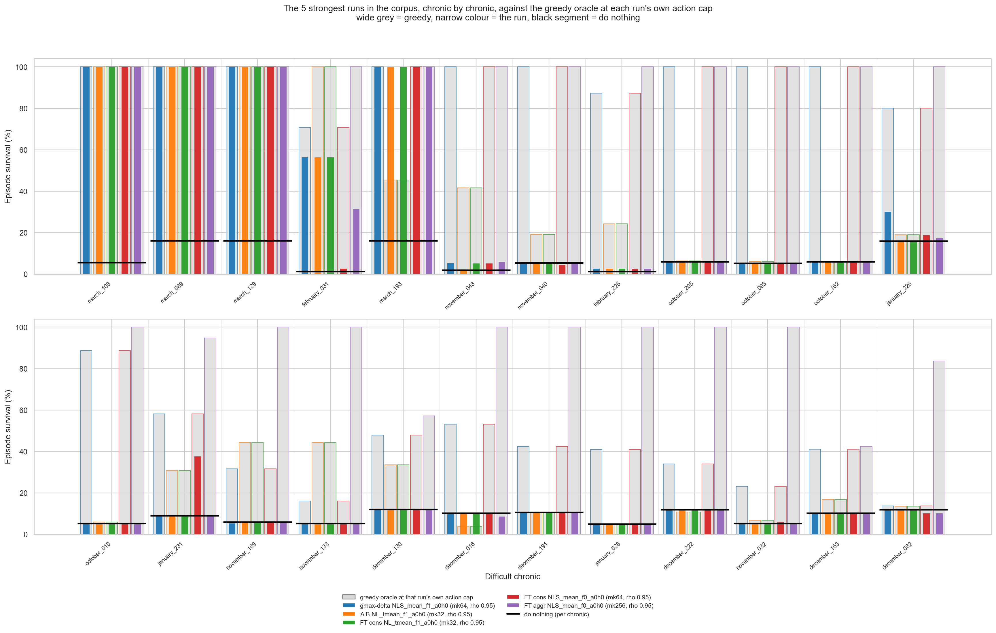
Aggregate gains hide chronic-specific failures
• Some difficult chronics remain near do nothing
• Greedy shows useful actions exist
• Ranking and long-horizon credit remain the bottlenecks
Notes:
Use this slide to show that mean gains are uneven. The greedy reference separates lack of feasible actions from failure to rank them.
[Sources]
- latex/chapters/07_wcci_transfer.tex
- latex/figures/wcci_appendix_chronics.png

Slide 31
COMPLETE THE MATCHED STUDY
PROTOCOL
• action cap + data path
• target step budget
• source/target seed set
OPTIMISATION
• head optimiser + LR
• checkpoint selection
• gate condition
OUTPUTS
• learning curves
• difficult endpoint table
• 4 × 4 route/representation plot
Notes:
This is the exact completion checklist. The thesis chapter currently contains pending protocol fields and placeholder results, so no numerical claim should be made yet.
[Sources]
- latex/chapters/09_encoder_transfer_bridge.tex

Slide 32
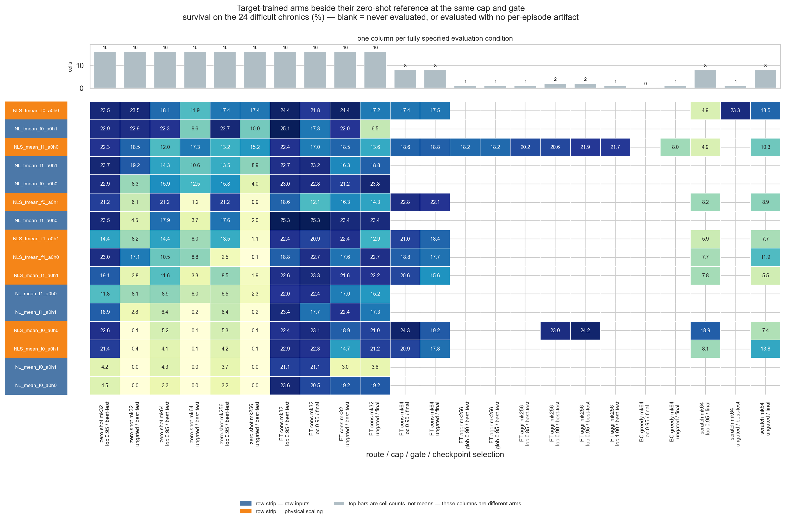
COMPARE LIKE WITH LIKE
SOURCE SCREENS
15M environment steps
201 held-out chronics
best periodic checkpoint
WCCI TRANSFER
fixed 50 chronics
24 difficult / 26 easy
seed 0
COMPARISON RULES
same k and architecture
report overall + difficult
show do nothing + greedy
Notes:
Use this slide to answer protocol and reproducibility questions. State clearly where evidence is single-seed and where intervals are across architectures rather than training seeds.
[Sources]
- latex/chapters/05_experiments_results.tex
- latex/chapters/07_wcci_transfer.tex

Slide 33
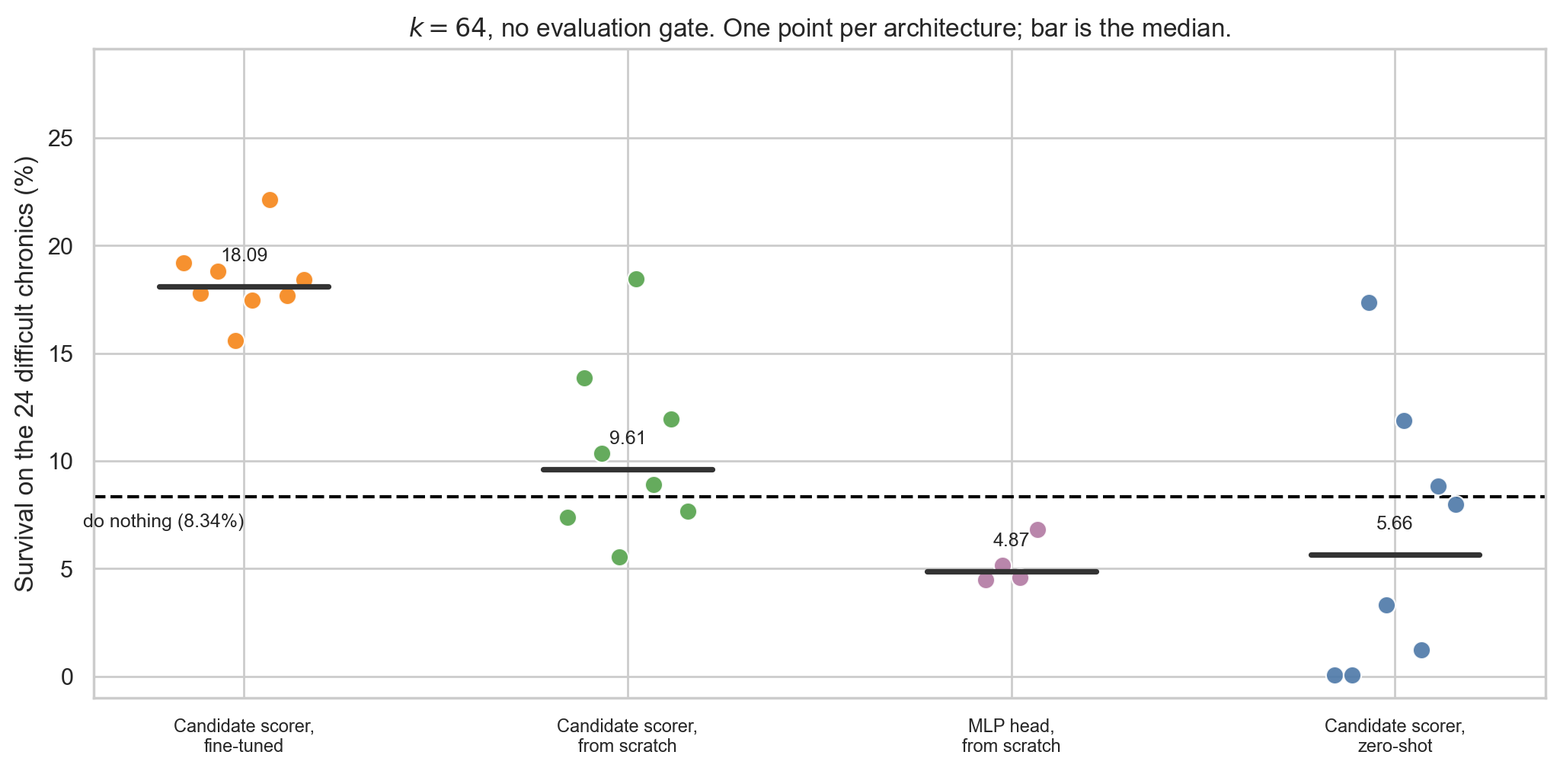
THREE DIFFERENT QUESTIONS
MEAN SURVIVAL
survived steps / episode length, averaged over chronics
LOCAL ρ GATE
block an agent action when its local maximum line loading < 0.95
FEASIBLE GAIN
progress from do nothing to the same-k greedy reference
Notes:
Definitions for metric questions. Feasible gain is normalised by the do-nothing-to-greedy interval at the same candidate cap.
[Sources]
- latex/chapters/04_sparse_control.tex
- latex/chapters/07_wcci_transfer.tex

Slide 34
Questions?
MASTER THESIS
PRESENTED BY
Corentin Plumet
EPFL × NUS
Notes:
Return target after a supplementary answer.
[Sources]
- latex/main.tex

