Slide 1
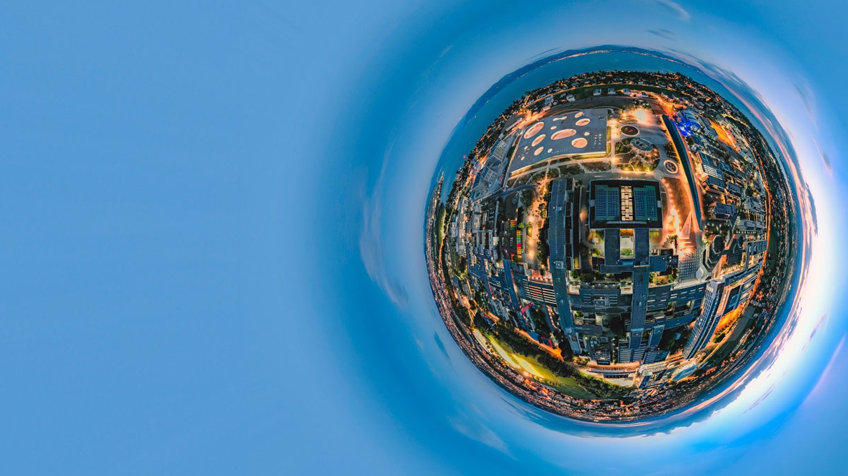

Welcome to EPFL
EVENT NAME
VENUE & DATE
Venue 2026
PRESENTED BY
Speaker Title

Slide 2
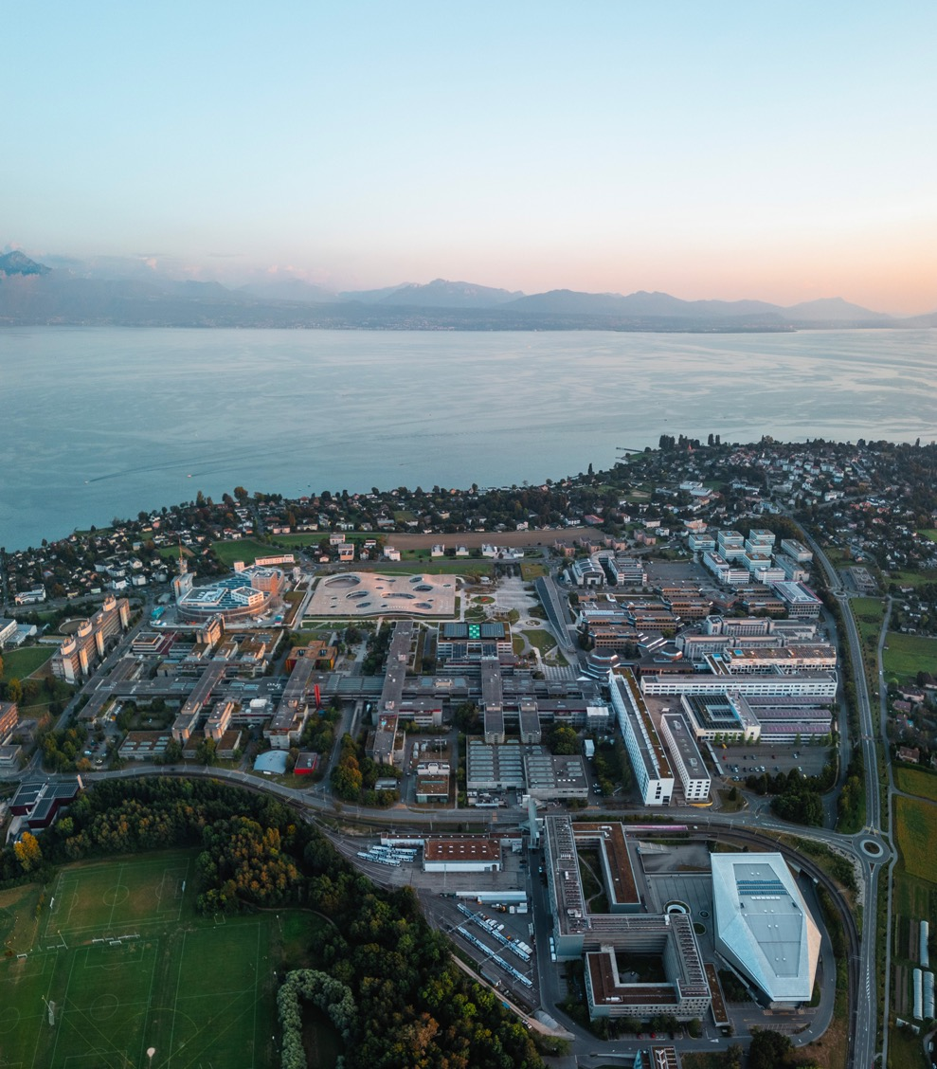
OUTLINE
EPFL at glance➜
Education
Research
Innovation & Impact
Collaborations
EPFL Alumni

Slide 3
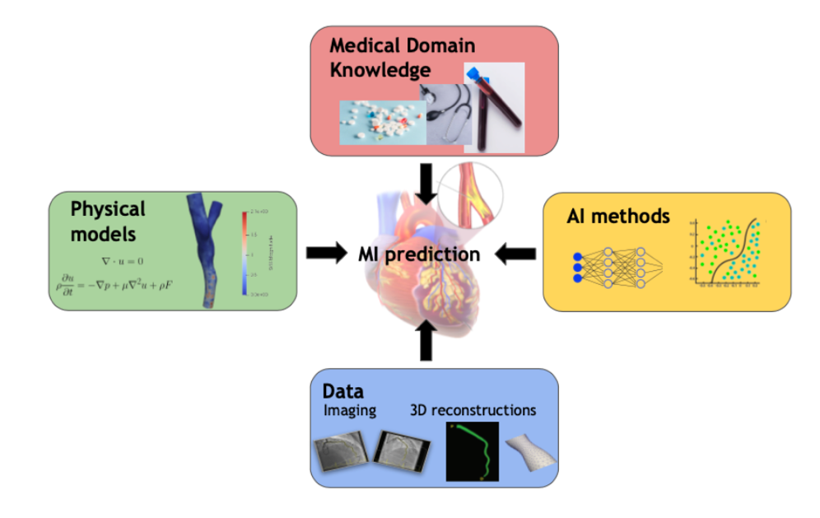

SwissCardIA
Cardiovascular diseases remain the leading cause of global mortality
Vision: Use AI to improve the diagnosis, evaluation and management of cardiovascular disease
Team: Interdisciplinary project between EPFL (Prof. Abbé) and CHUV (Dr. Thanou)

Slide 4
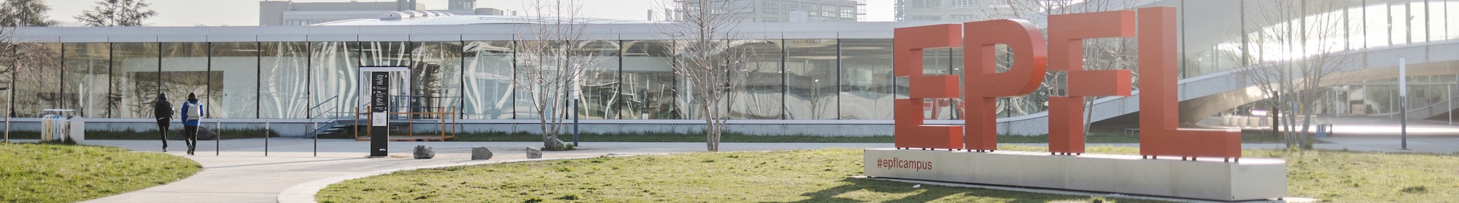
Important to stay connected & support EPFL!
Stay in touch
Activate & update your account on epflalumni.ch
Follow us on LinkedIn & Instagram
Take part in the network
Post jobs / internships for the community
Join in as a mentor or mentee for career/startups
Take part in events / visit us
Share your news
Collaborate / support EPFL
Startup ecosystem
Research collaborations
Student support program
For any information contact:
alumni@epfl.ch, leila.ojjeh@epfl.ch
Notes:
A big thank you to Azi and Salma for leading the Chapter since 2018!
Currently recruiting a new team to continue managing the community locally.
If you are interested please contact: alumni@epfl.ch
Thank you!

Slide 5
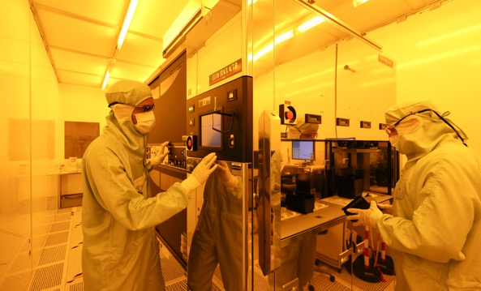

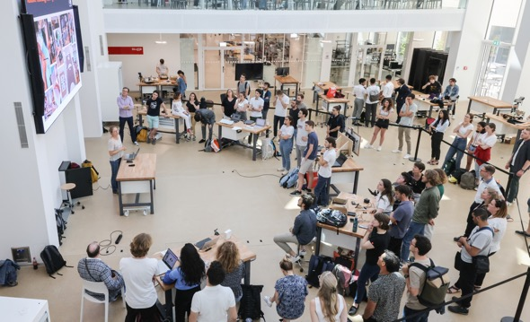
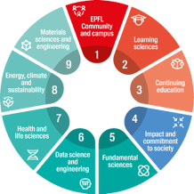
OUR AMBITION
1.
EPFL among the top technical universities in the world
2.
Address societal challenges through education and cutting-edge science and technology
3.
Form an open, cohesive, diverse and committed community

Slide 6
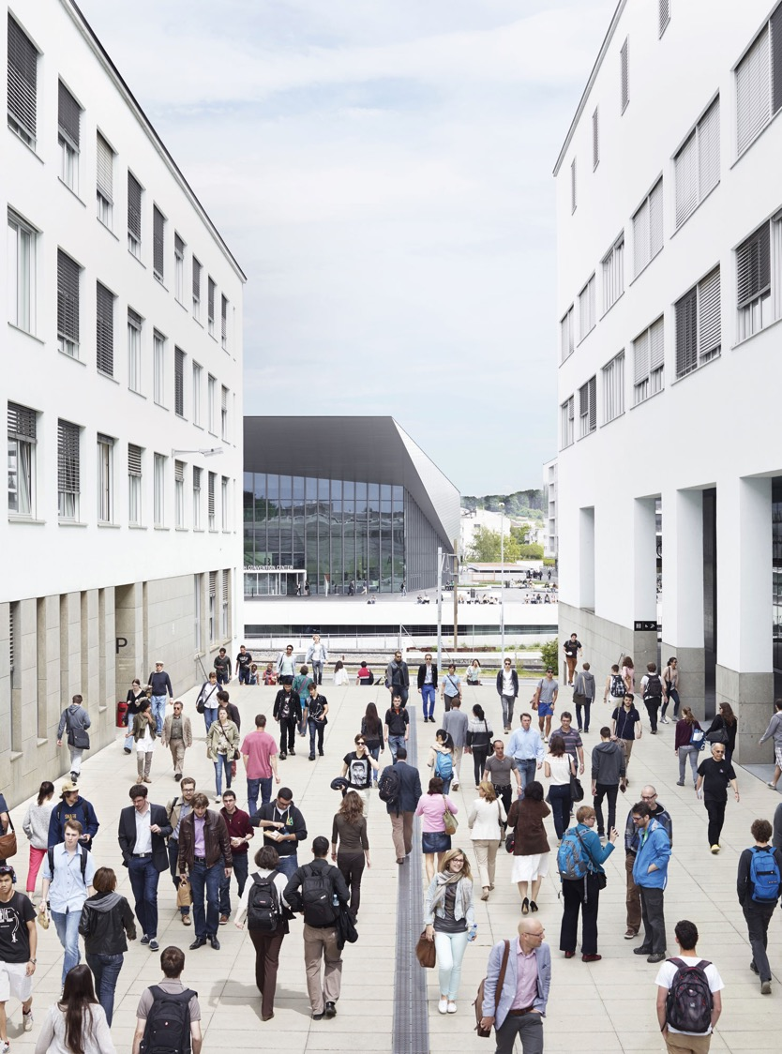



EPFL at glance
14’072* Students
372 Professors
6’530 Employees (incl. Phd)
+130 Nationalities
*Including BSc, MSc, PhD and Contiuned Education

Slide 7
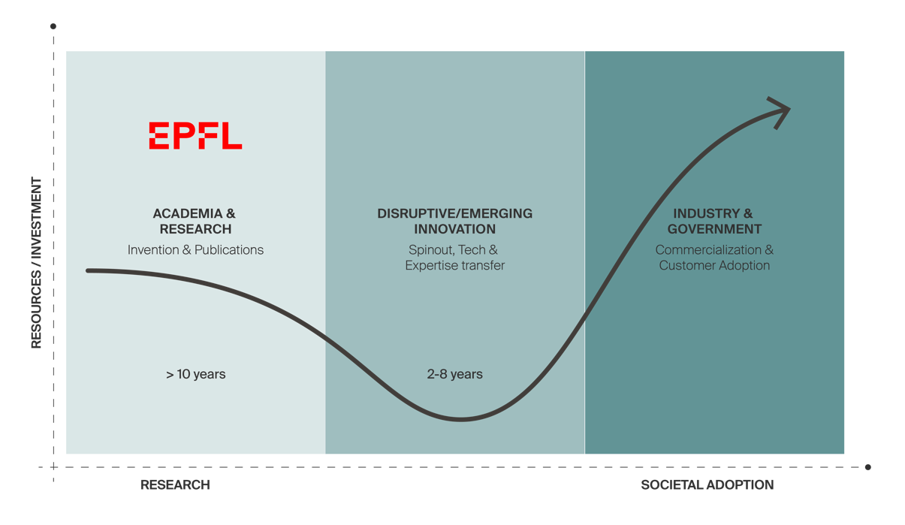
EPF’s as a Source of Disruptive Tech and Science Research
Challenge: to translate research into solution with real impact
We need to accelerate the societal adoption of academic research through efficient commercial translation of disruptive research

Slide 8
EPF’s as a Source of Disruptive Tech and Science Research
Challenge: to translate research into solution with real impact
We need to accelerate the societal adoption of academic research through efficient commercial translation of disruptive research

Slide 9
EPF’s as a Source of Disruptive Tech and Science Research
Challenge: to translate research into solution with real impact
We need to accelerate the societal adoption of academic research through efficient commercial translation of disruptive research

Slide 10
EPF’s as a Source of Disruptive Tech and Science Research
Challenge: to translate research into solution with real impact
We need to accelerate the societal adoption of academic research through efficient commercial translation of disruptive research

Slide 11
EPF’s as a Source of Disruptive Tech and Science Research
Challenge: to translate research into solution with real impact
We need to accelerate the societal adoption of academic research through efficient commercial translation of disruptive research

Slide 12
EPF’s as a Source of Disruptive Tech and Science Research
Challenge: to translate research into solution with real impact
We need to accelerate the societal adoption of academic research through efficient commercial translation of disruptive research

Slide 13
EPF’s as a Source of Disruptive Tech and Science Research
Challenge: to translate research into solution with real impact
We need to accelerate the societal adoption of academic research through efficient commercial translation of disruptive research

Slide 14
EPF’s as a Source of Disruptive Tech and Science Research
Challenge: to translate research into solution with real impact
We need to accelerate the societal adoption of academic research through efficient commercial translation of disruptive research

Slide 15
EPF’s as a Source of Disruptive Tech and Science Research
Challenge: to translate research into solution with real impact
We need to accelerate the societal adoption of academic research through efficient commercial translation of disruptive research

Slide 16
EPF’s as a Source of Disruptive Tech and Science Research
Challenge: to translate research into solution with real impact
We need to accelerate the societal adoption of academic research through efficient commercial translation of disruptive research

Slide 17
Important to stay connected & support EPFL!
Stay in touch
Activate & update your account on epflalumni.ch
Follow us on LinkedIn & Instagram
Take part in the network
Post jobs / internships for the community
Join in as a mentor or mentee for career/startups
Take part in events / visit us
Share your news
Collaborate / support EPFL
Startup ecosystem
Research collaborations
Student support program
For any information contact:
alumni@epfl.ch, leila.ojjeh@epfl.ch
Notes:
A big thank you to Azi and Salma for leading the Chapter since 2018!
Currently recruiting a new team to continue managing the community locally.
If you are interested please contact: alumni@epfl.ch
Thank you!

Slide 18
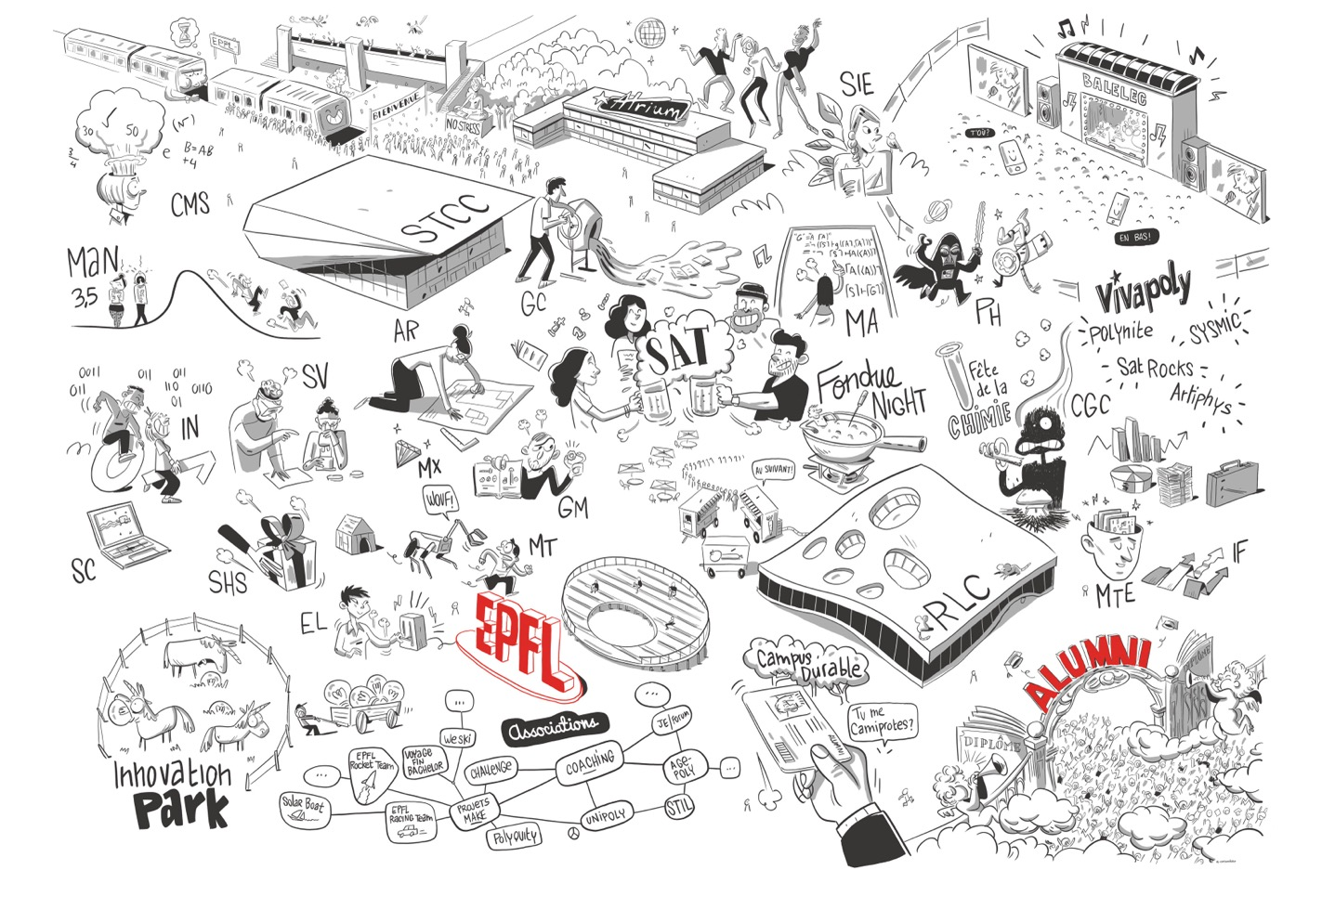
EPFL… an incredible school, campus and talent factory

Slide 19
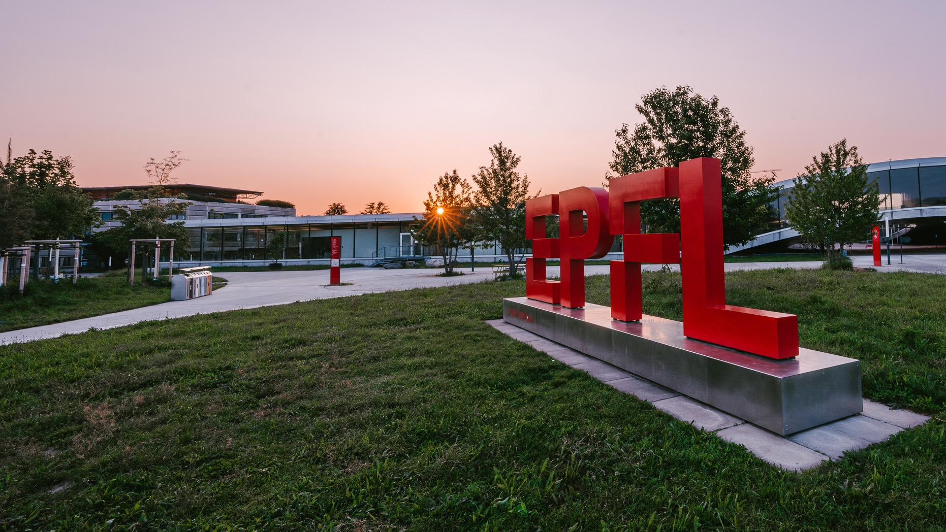
Thank you for your attention !
EVENT
PRESENTED BY
Speaker Title

Slide 20
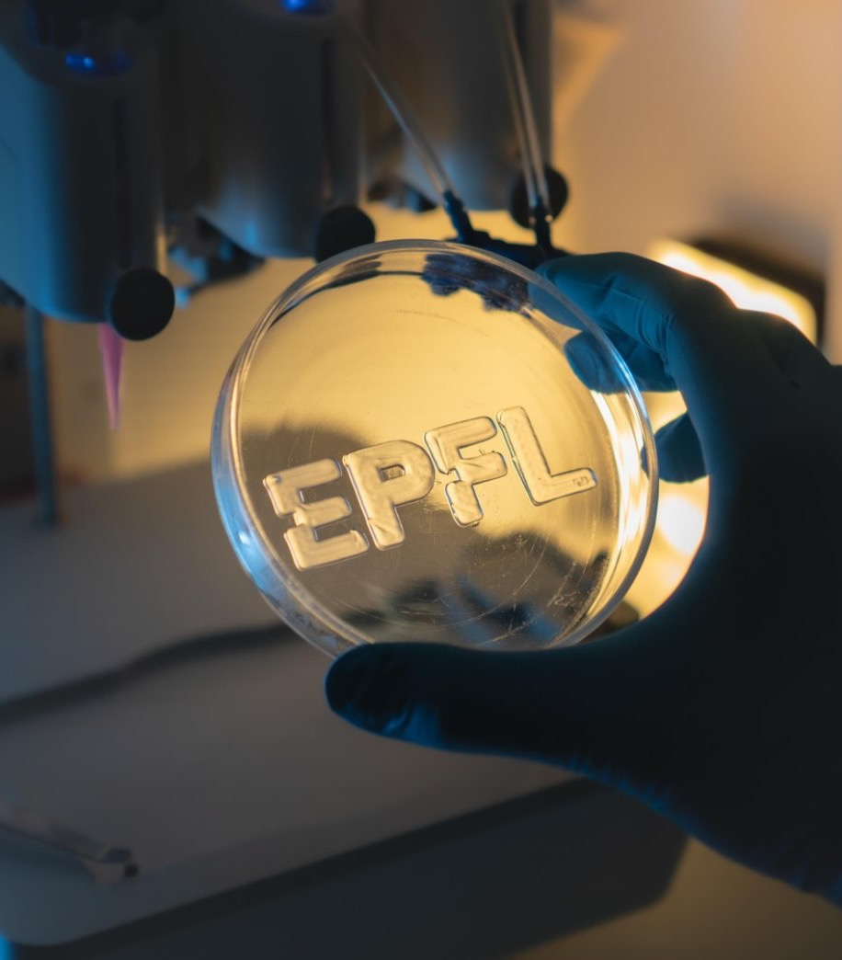
OUTLINE
EPFL at glance
Education
Research
Innovation & Impact ➜
Collaborations
EPFL Alumni

Slide 21
EPFL at glance
14’072* Students
372 Professors
6’530 Employees (incl. Phd)
+130 Nationalities
*Including BSc, MSc, PhD and Contiuned Education

Slide 22
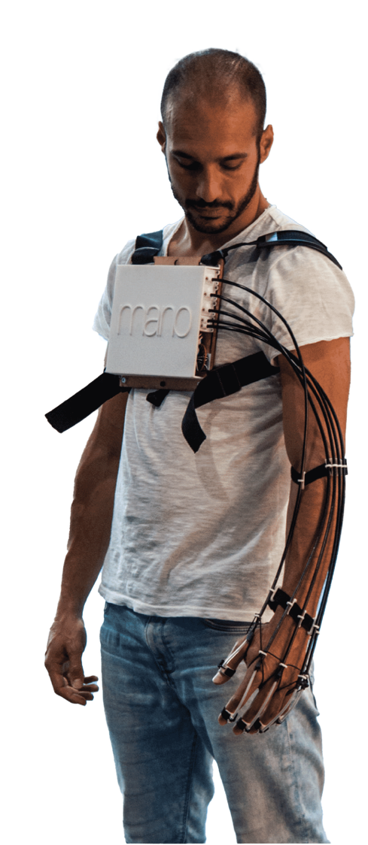
Innovation in 2025
35
LICENSES SIGNED
592 MCHF
RAISED BY EPFL STARTUPS
21.3 MCHF
85
PATENTS FILED
RAISED FROM INDUSTRIAL CONTRACTS (DIRECT FUNDING
39
8.8 MCHF
INVENTIONS & SOFTWARE
163
RAISED FROM INNOSUISSE PROJECTS
149
NEW STARTUPS
IN 2025 ON 576 IN TOTAL
COMPANIES ENGAGING WITH EPFL LAB

Slide 23
EPF’s as a Source of Disruptive Tech and Science Research
Challenge: to translate research into solution with real impact
We need to accelerate the societal adoption of academic research through efficient commercial translation of disruptive research

Slide 24
EPF’s as a Source of Disruptive Tech and Science Research
Challenge: to translate research into solution with real impact
We need to accelerate the societal adoption of academic research through efficient commercial translation of disruptive research

Slide 25
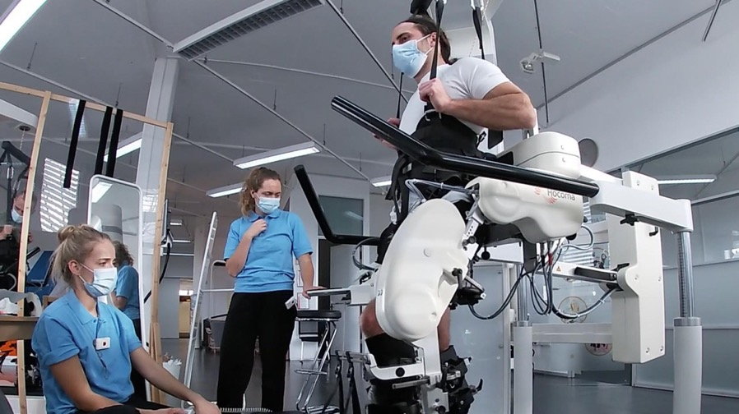
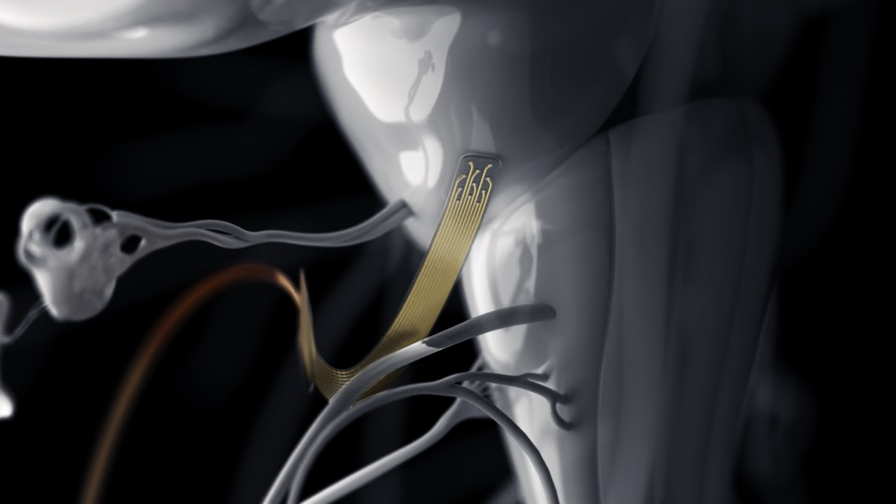
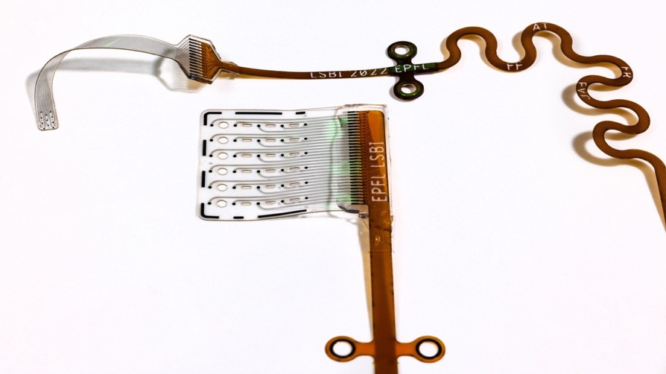
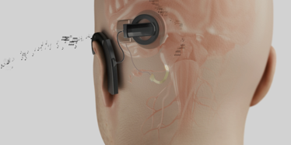
Research NEURO
Robotics and spinal stimulation restore movement in paralysis
Prof. Grégoire Courtine
Soft brainstem implant delivers high-resolution hearing
Prof. Stéphanie Lacour
Notes:
13.04.2025: La robotique et la stimulation spinale pour vaincre la paralysie - https://actu.epfl.ch/news/la-robotique-et-la-stimulation-spinale-pour-vaincr/#
Des scientifiques du centre .Neurorestore (EPFL/CHUV/UNIL) ont développé une approche qui combine la robotique de rééducation et la stimulation spinale pour rétablir le mouvement chez les personnes souffrant de lésions de la moelle épinière. Cette technologie optimise la rééducation et permet la pratique d’activités telles que le vélo et la marche en plein air.
18.04.25: Un implant cérébral souple pour une audition à haute résolution - https://actu.epfl.ch/news/un-implant-cerebral-souple-pour-une-audition-a-h-7/
Une équipe de l’EPFL a développé un implant auditif cérébral flexible qui épouse parfaitement la surface incurvée du tronc cérébral. Elle a démontré avec succès, chez le macaque, le potentiel de l’implant à restaurer une “audition prosthétique” à haute résolution.

Slide 26
Research NEURO
Robotics and spinal stimulation restore movement in paralysis
Prof. Grégoire Courtine
Soft brainstem implant delivers high-resolution hearing
Prof. Stéphanie Lacour
Notes:
13.04.2025: La robotique et la stimulation spinale pour vaincre la paralysie - https://actu.epfl.ch/news/la-robotique-et-la-stimulation-spinale-pour-vaincr/#
Des scientifiques du centre .Neurorestore (EPFL/CHUV/UNIL) ont développé une approche qui combine la robotique de rééducation et la stimulation spinale pour rétablir le mouvement chez les personnes souffrant de lésions de la moelle épinière. Cette technologie optimise la rééducation et permet la pratique d’activités telles que le vélo et la marche en plein air.
18.04.25: Un implant cérébral souple pour une audition à haute résolution - https://actu.epfl.ch/news/un-implant-cerebral-souple-pour-une-audition-a-h-7/
Une équipe de l’EPFL a développé un implant auditif cérébral flexible qui épouse parfaitement la surface incurvée du tronc cérébral. Elle a démontré avec succès, chez le macaque, le potentiel de l’implant à restaurer une “audition prosthétique” à haute résolution.

Slide 27
Research NEURO
Robotics and spinal stimulation restore movement in paralysis
Prof. Grégoire Courtine
Soft brainstem implant delivers high-resolution hearing
Prof. Stéphanie Lacour
Notes:
13.04.2025: La robotique et la stimulation spinale pour vaincre la paralysie - https://actu.epfl.ch/news/la-robotique-et-la-stimulation-spinale-pour-vaincr/#
Des scientifiques du centre .Neurorestore (EPFL/CHUV/UNIL) ont développé une approche qui combine la robotique de rééducation et la stimulation spinale pour rétablir le mouvement chez les personnes souffrant de lésions de la moelle épinière. Cette technologie optimise la rééducation et permet la pratique d’activités telles que le vélo et la marche en plein air.
18.04.25: Un implant cérébral souple pour une audition à haute résolution - https://actu.epfl.ch/news/un-implant-cerebral-souple-pour-une-audition-a-h-7/
Une équipe de l’EPFL a développé un implant auditif cérébral flexible qui épouse parfaitement la surface incurvée du tronc cérébral. Elle a démontré avec succès, chez le macaque, le potentiel de l’implant à restaurer une “audition prosthétique” à haute résolution.

Slide 28
Research NEURO
Robotics and spinal stimulation restore movement in paralysis
Prof. Grégoire Courtine
Soft brainstem implant delivers high-resolution hearing
Prof. Stéphanie Lacour
Notes:
13.04.2025: La robotique et la stimulation spinale pour vaincre la paralysie - https://actu.epfl.ch/news/la-robotique-et-la-stimulation-spinale-pour-vaincr/#
Des scientifiques du centre .Neurorestore (EPFL/CHUV/UNIL) ont développé une approche qui combine la robotique de rééducation et la stimulation spinale pour rétablir le mouvement chez les personnes souffrant de lésions de la moelle épinière. Cette technologie optimise la rééducation et permet la pratique d’activités telles que le vélo et la marche en plein air.
18.04.25: Un implant cérébral souple pour une audition à haute résolution - https://actu.epfl.ch/news/un-implant-cerebral-souple-pour-une-audition-a-h-7/
Une équipe de l’EPFL a développé un implant auditif cérébral flexible qui épouse parfaitement la surface incurvée du tronc cérébral. Elle a démontré avec succès, chez le macaque, le potentiel de l’implant à restaurer une “audition prosthétique” à haute résolution.

Slide 29
EPF’s as a Source of Disruptive Tech and Science Research
Challenge: to translate research into solution with real impact
We need to accelerate the societal adoption of academic research through efficient commercial translation of disruptive research

Slide 30
EPF’s as a Source of Disruptive Tech and Science Research
Challenge: to translate research into solution with real impact
We need to accelerate the societal adoption of academic research through efficient commercial translation of disruptive research

Slide 31
Important to stay connected & support EPFL!
Stay in touch
Activate & update your account on epflalumni.ch
Follow us on LinkedIn & Instagram
Take part in the network
Post jobs / internships for the community
Join in as a mentor or mentee for career/startups
Take part in events / visit us
Share your news
Collaborate / support EPFL
Startup ecosystem
Research collaborations
Student support program
For any information contact:
alumni@epfl.ch, leila.ojjeh@epfl.ch
Notes:
A big thank you to Azi and Salma for leading the Chapter since 2018!
Currently recruiting a new team to continue managing the community locally.
If you are interested please contact: alumni@epfl.ch
Thank you!

Slide 32
Important to stay connected & support EPFL!
Stay in touch
Activate & update your account on epflalumni.ch
Follow us on LinkedIn & Instagram
Take part in the network
Post jobs / internships for the community
Join in as a mentor or mentee for career/startups
Take part in events / visit us
Share your news
Collaborate / support EPFL
Startup ecosystem
Research collaborations
Student support program
For any information contact:
alumni@epfl.ch, leila.ojjeh@epfl.ch
Notes:
A big thank you to Azi and Salma for leading the Chapter since 2018!
Currently recruiting a new team to continue managing the community locally.
If you are interested please contact: alumni@epfl.ch
Thank you!

Slide 33
Important to stay connected & support EPFL!
Stay in touch
Activate & update your account on epflalumni.ch
Follow us on LinkedIn & Instagram
Take part in the network
Post jobs / internships for the community
Join in as a mentor or mentee for career/startups
Take part in events / visit us
Share your news
Collaborate / support EPFL
Startup ecosystem
Research collaborations
Student support program
For any information contact:
alumni@epfl.ch, leila.ojjeh@epfl.ch
Notes:
A big thank you to Azi and Salma for leading the Chapter since 2018!
Currently recruiting a new team to continue managing the community locally.
If you are interested please contact: alumni@epfl.ch
Thank you!

Slide 34
Thank you for your attention !
EVENT
PRESENTED BY
Speaker Title

