Slide 1
Quantum Dots
From Perturbation Theory to your shiny new TV

Slide 2
Today’s subjects
What are QDs?
Motivation
History
Theoretical approaches
Simple effective mass model
Color dependance on size

Slide 3
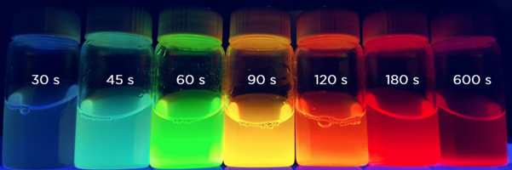
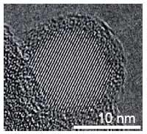
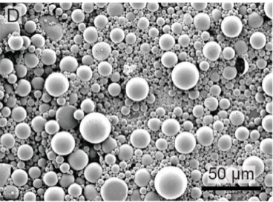
Quantum Dots (QDs)
Semiconductor nanocrystals
1-100 nm
Obtained through chemical synthesis
So small that quantum effects dominate
Physical size determines resonant color
Figure 1. Top: Fluorescing QDs. The longer the reaction time the bigger the colloidal QDs are, and the lower the optical gap. Left: TEM image of a Silicon QD. Right: SEM image of PMMA microparticles containing S10C5H QDs.

Slide 4
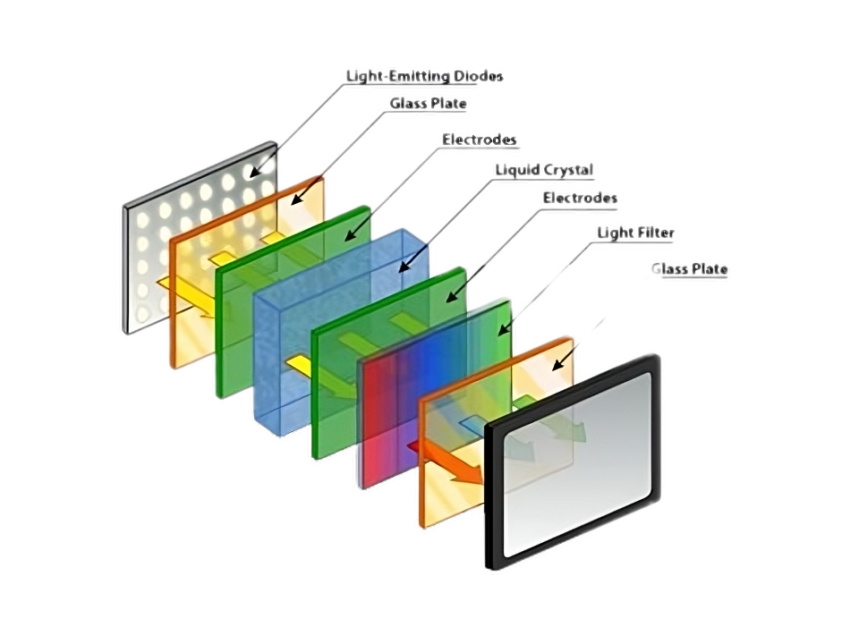
Motivation
Older LED TVs create colors by filtering white light.
This wastes power and limits color precision.

Slide 5
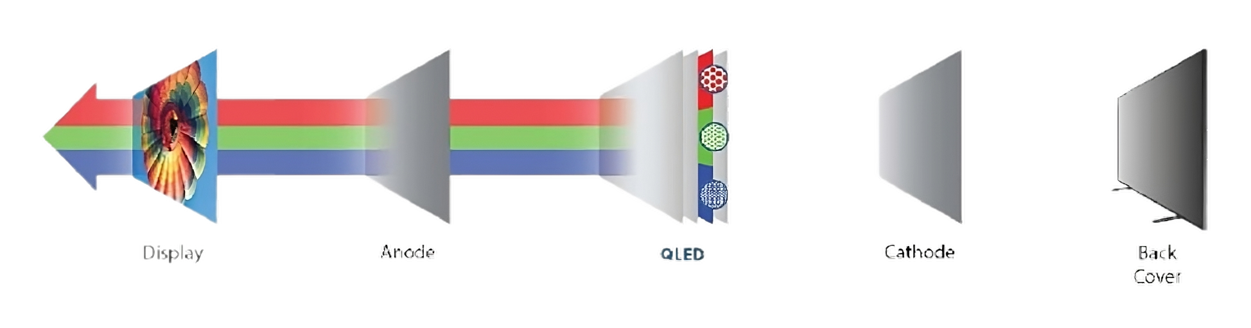
Motivation
QLED TVs first appear in 2013.
They create true colors by fluorescing appropriately sized QDs.
While also saving 30-50% of power consumption.

Slide 6
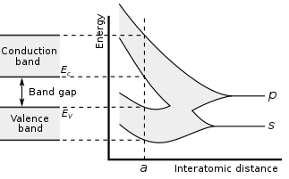
Quick solid-state background
In atoms, like Hydrogen, electrons have discrete energy levels.
Semiconductors are made of many such atoms packed in a lattice.
This causes the individual energy levels to merge into bands.
In a semiconductor, the bands are separated by a gap of forbidden energies called the band gap.

Slide 7
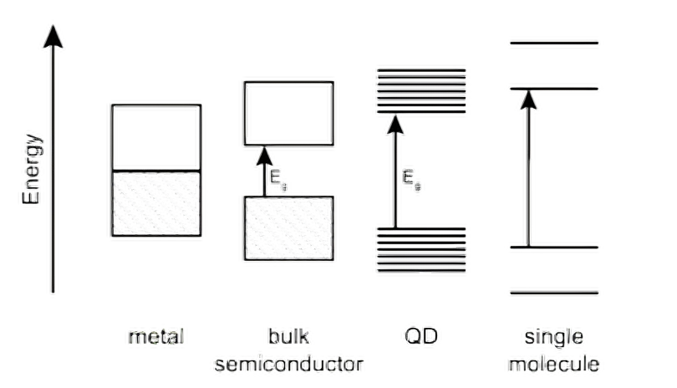
History
This transition has been long understood in principle but until the 80’s it was not observed experimentally.
QDs, first synthesized in 1981, are right at the tipping point.
Their first theoretical model arrived in 1982.

Slide 8
Theoretical approaches
Different goals require different theoretical approaches.
Choose the simplest model possible that describes the properties of interest.
Complexity
Computational cost

Slide 9
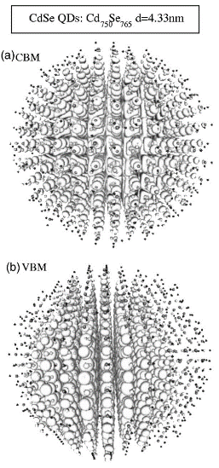
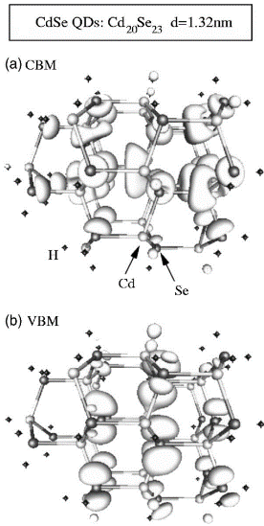
Advanced theoretical methods
Example uses:
Precise visualization of the inner structure (electrons wavefunctions)
Accurately predict the absorption spectra.
Can we use something simpler for the size dependence?
Simulated using density functional theory (DFT) under local density approximation (LDA) with self-consistent plane-wave pseudopotentials (PWP) method. From J. Li et al.

Slide 10
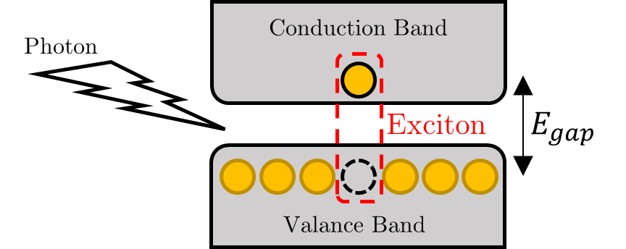

Quick solid-state background
Electrons fill the valence band and can be excited to the conduction band by interaction of more than $E_{gap}$ energy.
They leave behind a quasiparticle called hole.
The electron and hole form a bound state called Exciton due to coulomb attraction.

Slide 11
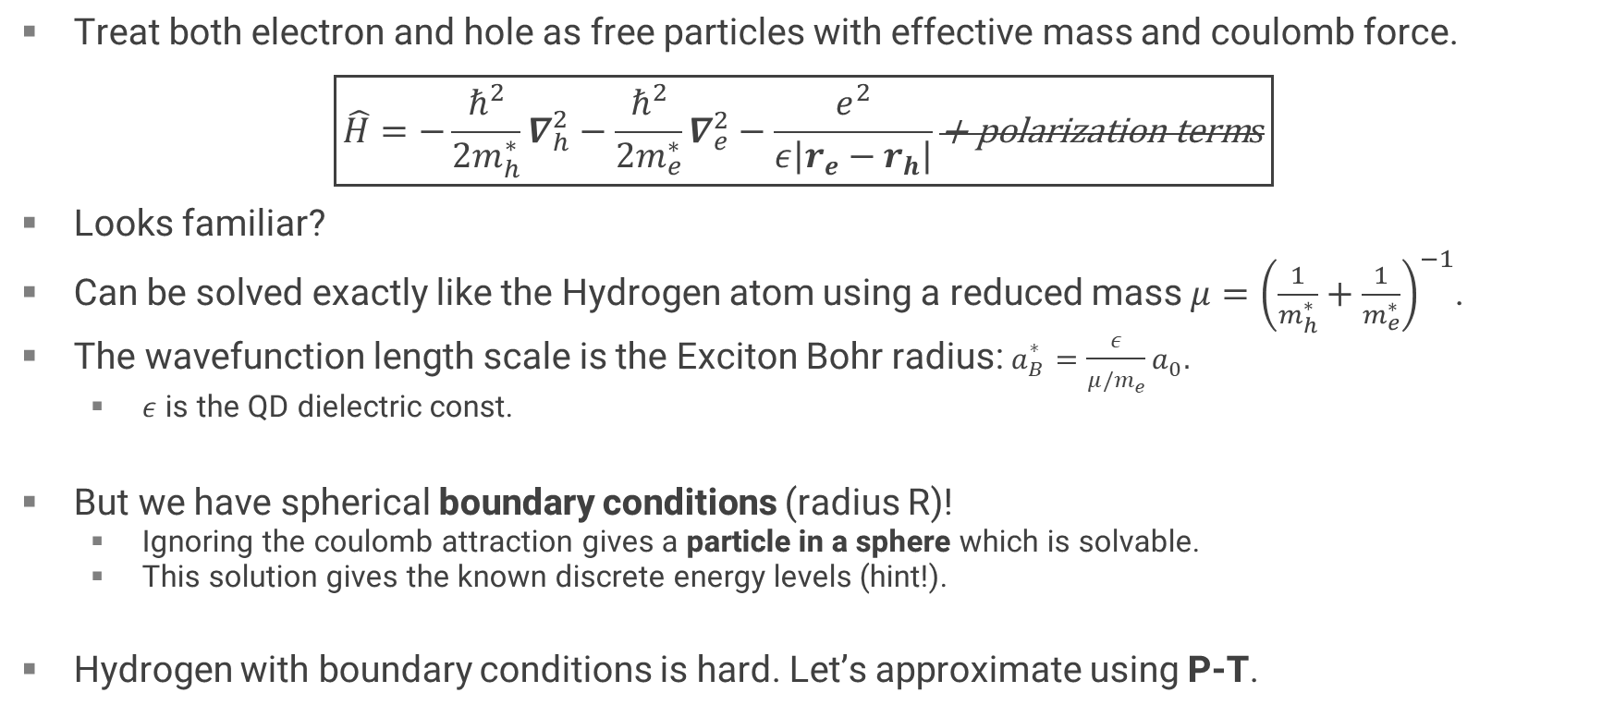
Effective mass model
Treat both electron and hole as free particles with effective mass and coulomb force.
$$\boxed{\hat{H}=−\frac{ℏ^{2}}{2m_{h}^{∗}}∇_{h}^{2}−\frac{ℏ^{2}}{2m_{e}^{∗}}∇_{e}^{2}−\frac{e^{2}}{ε\left|r_{e}−r_{h}\right|}\text{+ }\text{polarization} \text{term}s}$$
Looks familiar?
Can be solved exactly like the Hydrogen atom using a reduced mass $μ={\left(\frac{1}{m_{h}^{∗}}+\frac{1}{m_{e}^{∗}}\right)}^{−1}$.
The wavefunction length scale is the Exciton Bohr radius: $a_{B}^{∗}=\frac{ε}{μ/m_{e}}a_{0}.$
$ε$ is the QD dielectric const.
But we have spherical boundary conditions (radius R)!
Ignoring the coulomb attraction gives a particle in a sphere which is solvable.
This solution gives the known discrete energy levels (hint!).
Hydrogen with boundary conditions is hard. Let’s approximate using P-T.

Slide 12
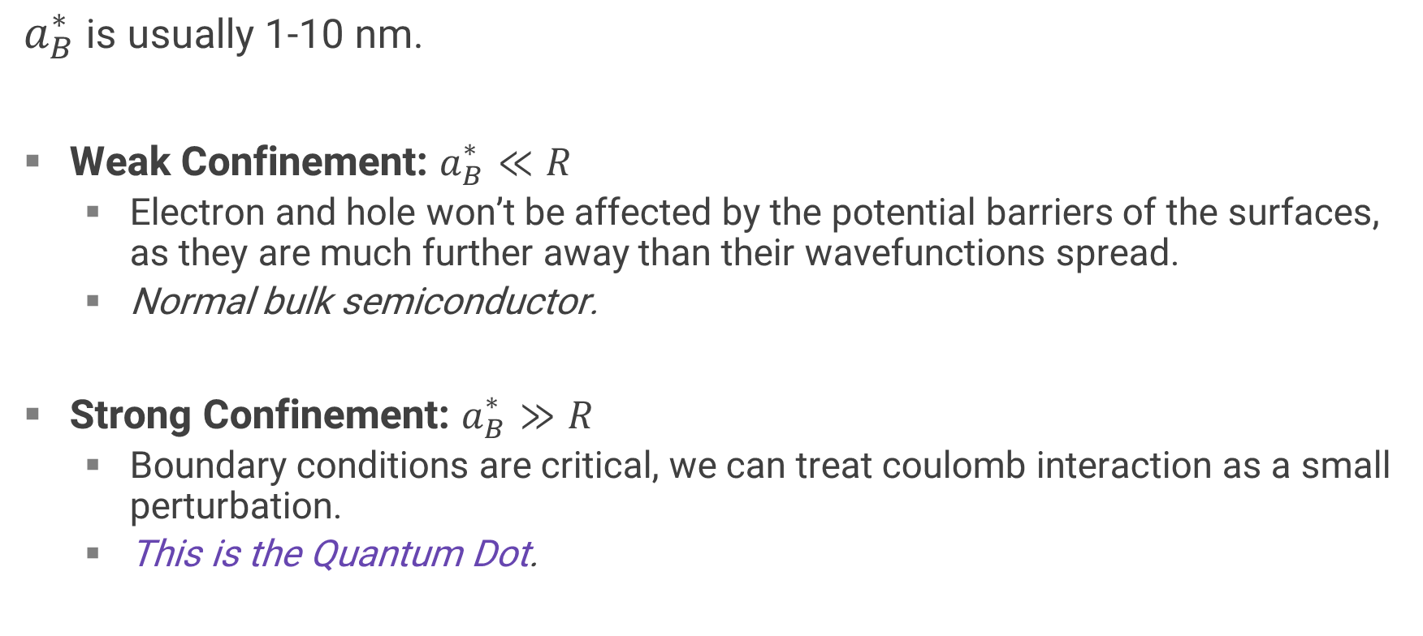
Confinement regimes
$a_{B}^{∗}$ is usually 1-10 nm.
Weak Confinement: $a_{B}^{∗}≪R$
Electron and hole won’t be affected by the potential barriers of the surfaces, as they are much further away than their wavefunctions spread.
Normal bulk semiconductor.
Strong Confinement: $a_{B}^{∗}≫R$
Boundary conditions are critical, we can treat coulomb interaction as a small perturbation.
This is the Quantum Dot.

Slide 13
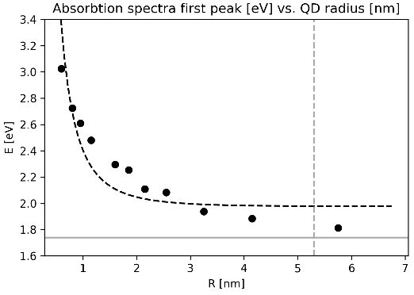

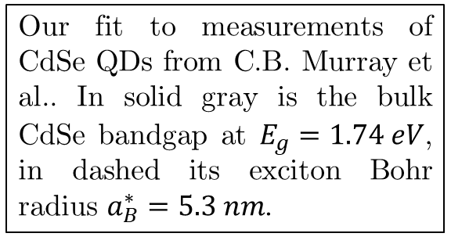
Solution and size dependence
Particle in a sphere, first energy level:
$$E_{0}=\frac{π^{2}ℏ^{2}}{2R^{2}}\left(\frac{1}{m_{e}^{∗}}+\frac{1}{m_{h}^{∗}}\right)=\frac{π^{2}ℏ^{2}}{2μR^{2}}=\frac{π^{2}}{2}⋅\frac{e^{4}μ}{ε^{2}ℏ^{2}}⋅{\left(\frac{a_{B}^{∗}}{R}\right)}^{2}$$
First order perturbation theory for the coulomb part:
$$∆E_{0}=\left\langle ψ_{0}\right|\frac{−e^{2}}{ε\left|r_{e}−r_{h}\right|}\left|ψ_{0}\right\rangle =−1.8\frac{e^{2}}{εR}=−1.8\frac{e^{4}μ}{ε^{2}ℏ^{2}}⋅\left(\frac{a_{B}^{∗}}{R}\right)$$
Total energy for the lowest excited state:
$$E_{excited}=E_{gap}+\frac{e^{4}μ}{ε^{2}ℏ^{2}}\left[\frac{π^{2}}{2}{\left(\frac{a_{B}^{∗}}{R}\right)}^{2}−\text{1}\text{.}\text{786}\left(\frac{a_{B}^{∗}}{R}\right)\right]\underset{→}{R→∞}E_{gap}$$
Our fit to measurements of CdSe QDs from C.B. Murray et al.. In solid gray is the bulk CdSe bandgap at $E_{g}=1.74 eV$, in dashed its exciton Bohr radius $a_{B}^{∗}=5.3 nm$.

Slide 14
QDs have many more uses!
Energy
More effective solar cells.
Military
Sensors for detecting explosives traces.
Health
Proposed micro-patches for invisible tracking of population vaccination.
Science
Single photon sources.
Active Research
2022 paper: Quantum interference of identical photons from remote QDs.

Slide 15
Questions?

