Slide 1
Prototypical Networks for Few Shot Learning
Ishrat Jahan Ananya

Slide 2
AGENDA
Introduction​
Foundational Concept
Dataset
Implementation
Results​

Slide 3
Introduction
Few Shot Learning is the next generation class of algorithms being researched currently for object categorization tasks in Computer vision with unseen data and without pre-training.
Some popular algorithms:
Matching networks for one shot learning’
’Learning to compare: Relation network for few-shot learning’
Prototypical Networks algorithm for few shot learning

Slide 4
Foundational Concepts
What the paper discusses

Slide 5
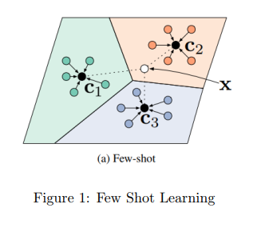
model must accommodate the new unseen classes with limited examples to train on.
The key feature is the introduction of prototypes
Which is used to calculate distances of example images from these prototypes in order to classify the newly introduced images.
Prototypes are mean embedding representation for all samples in each class that is mapped by using a Convolution Neural Network Architecture as a feature extractor.
The distance can be calculated using Euclidean distance between the unknown image and the nearest class prototype

Slide 6
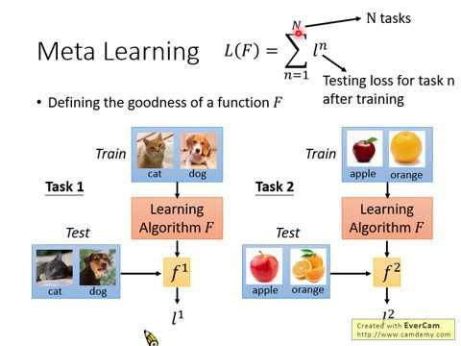
Two sets of input images: the Support set with its labels and the query set whose labels are to be predicted.
The model is trained on the few samples present in the support set and then use the query set for prediction.
Episodal training aka Meta Learning affects the training process of the few shot learning problem. The idea is to train the model on a specified number of tasks called episodes. The model learns to learn.
If there are 5 classes, each with 3 example images in the support set , then we can refer to it as a 5-way 3 shot classification problem.

Slide 7
Dataset

Slide 8
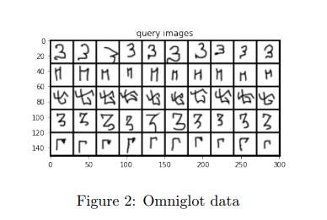
Omniglot dataset has 1623 handwritten characters collected from 50 alphabets.
There are 20 examples associated with each character, where each example is drawn by a different human subject.
To load the dataset in a custom data loader, EasyFSL library was used that arranged the dataset into torch data loader in such a way that, it became easy to retrieve the support images, support labels, query images and keep track of the episodes to be trained on, given the image path, number of shot, number of query images to retrieve and number of way is pre-specified.

Slide 9
Implementation

Slide 10
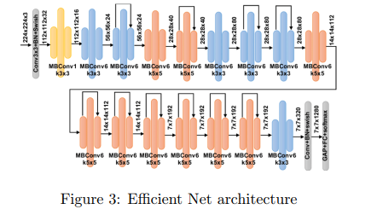
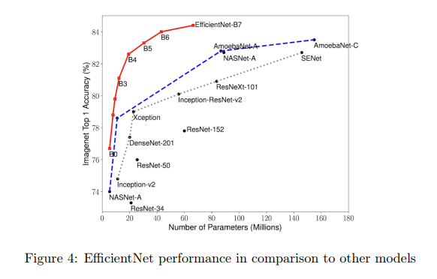
We used pretrained EfficientNet model in the backbone of our Network.
Efficientnet is a relatively larger architecture that is capable of richer feature extraction that allows for a more reliable embedding space.
it is much more computationally efficient in comparison to other networks such as Res-net, VGG.

Slide 11

After loading the model pretrained on Imagenet, the feature extractor is passed to a ProtoNet Class
which essentially calculates the prototypes for all classes present in the support images.
Next we calculate the Manhattan distance between the prototypes and query images.
The Manhattan distance is defined as the sum of the absolute differences of their Cartesian coordinates.

Slide 12
Results

Slide 13
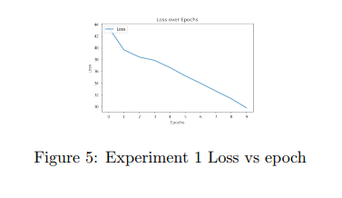
Experiment 1
First a 3 way 3 shot network was trained with 100 training episodes and 10epochs.
For loss , Cross entropy loss was used which is the most appropriateoption as it is a multi class classification and for optimiser,
Adam optimiser was picked with a learning rate of 0.001.
The choice of using Adam over Stochastic Gradient Decent as used in the original paper is because Adam is better at convergence and efficiency during training.
The first experiment took mean of loss for all episodes in each epoch and yielded a performance accuracy of 73 percent. Figure 5 shows the loss drop of the model over epochs.

Slide 14
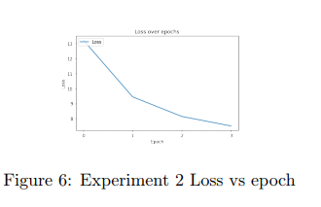
Experiment 2
Second experiment took this same concept a step further and trained a 5 way 5 shot classification model over 1500 episodes and only a few epochs. We kept the loss and optimiser constant for valid comparison.
The Second experiment implemented a 5 way 5 shot classification task with
1500 episodes per epoch and gave a performance accuracy of 88 percent.Figure
6 shows the loss drop of the model over epochs.

Slide 15
SUMMARY
The experiments demonstrates that if the model could be trained for much longer such as more than hundred epochs and more than two thousands episodes as done in the original paper the accuracy could be pushed further up.
Yet, with limited training the model showed promising results.
If a traditional training approach was acquired it would have severely overfit on this problem due to the few number of support images.
This proves the usefulness of few shot learning and its potential.

Slide 16
THANK YOU

