Slide 1

Pretty Paints
Drawing App for Kids
Group 7
Members: Ishrat Jahan Ananya 1631636042 Sarah Suad 1632282642
Nahian Noshin Nur 1510798642

Slide 2


What is Pretty Paints?
Pretty paint is a fun drawing app targeted towards young children.

Slide 3


Target Audience and Objective
Target Audience: This app is mainly targeted toward kids of age 3-6 years.
There are many drawing apps on the market but none of them are clean and simple enough for kids of this age limit.
Now a days little children get attracted to phones very early on as parents use it as a way to distract them. This app is made exactly with that in mind.
Objective: It will act as a educational “distraction” and not only help children enhance their brain development but will also be a source of lots of fun and excitement.

Slide 4
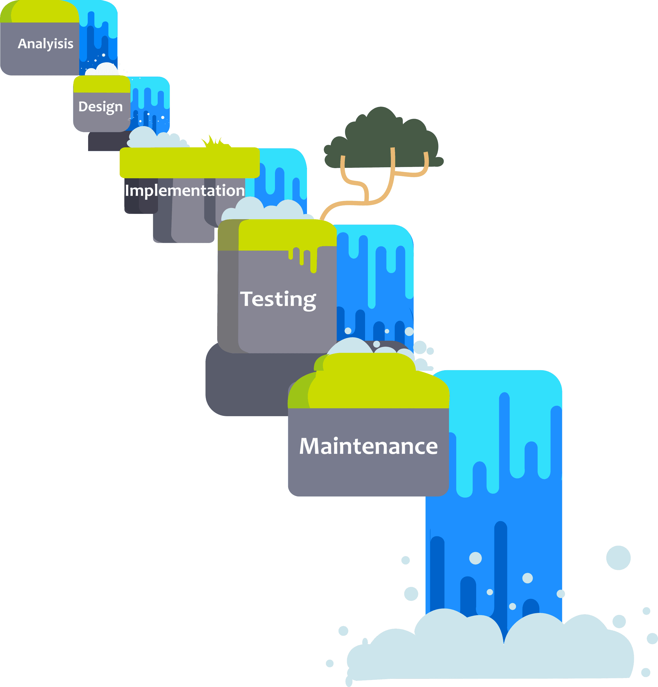
Software Process Model
Model Used: The Waterfall Model
It is the simplest model available. In this model, each phase depends on the phase that comes before it.
We chose this model because our project is very precise, and straightforward. The app development process in this project requires us to depend on the previous phases. This is why the waterfall model is our perfect fit.

Slide 5
Analysis
In this phase we studied on the interests of our target audience, and created our goal based on the following:
Features
Specifications
Timeline

Slide 6

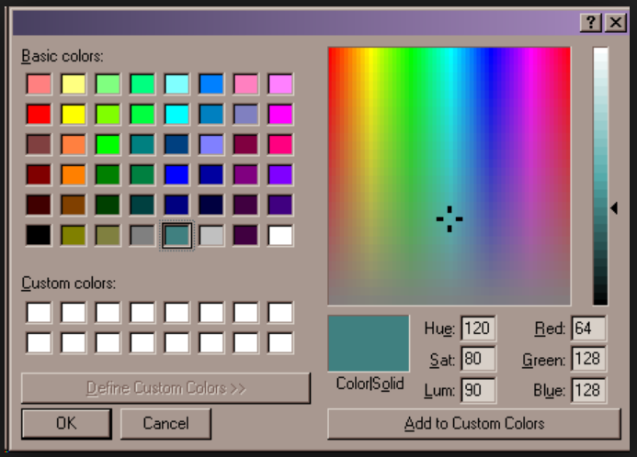
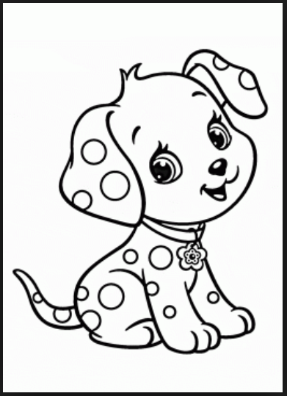
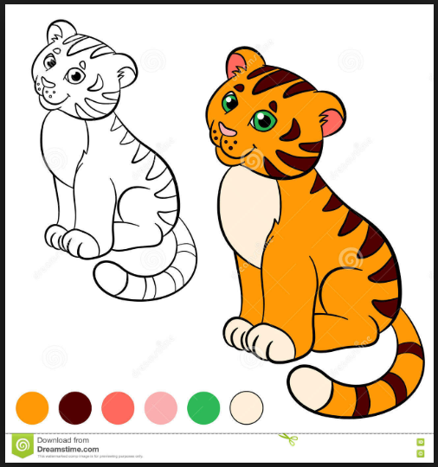
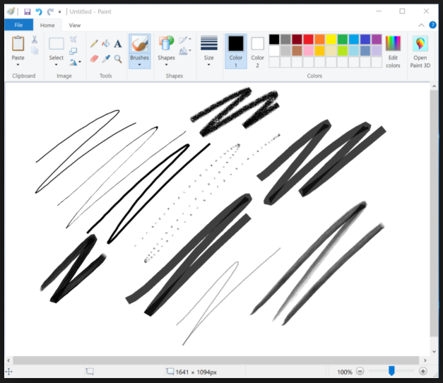
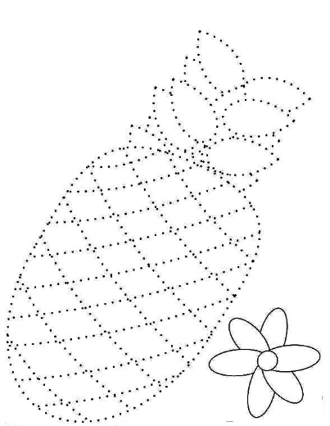
Analysis (cont.)
Features
Drawing and coloring tools
Slate for free hand drawing
Color wheel to select color from
Undo-Redo options
Save-Delete options

Slide 7
Analysis (cont.)
Specifications
Development platform - Android Studio
External Storage - Google’s Firebase
Version - min SDK version 16
Classes to be used - Paint,Bitmap,Hashmap,Canvas etc.

Slide 8
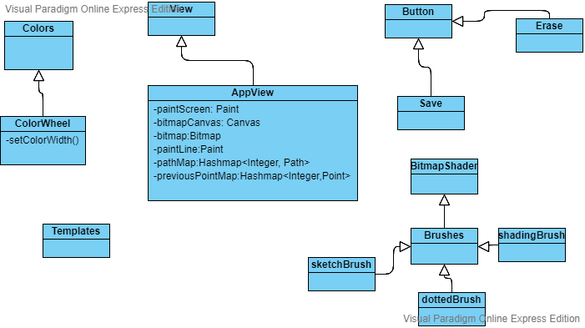
Design

Slide 9
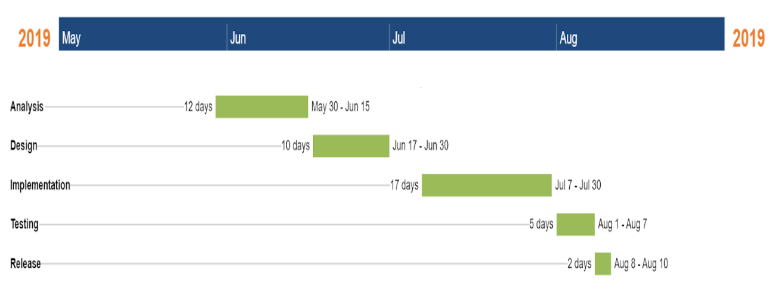
Analysis (cont.)
Estimated Timeline

Slide 10
Implementation and Integration
Module 1:
Creating basic UI layout
Setting up Canvas
Module 2:
Implementing touch recognition on Canvas and retrieving value of position on Canvas
Module 3:
Incorporating stroke feature for drawing
Incorporating erase feature

Slide 11
Implementation and Integration
Module 4:
Adding a ‘change brush size’ feature using a seekbar
Drawing strokes with different widths onto Canvas
Module 5:
Adding color picker feature
Creating custom dialog to view chosen color and color width
Module 6:
Adding ‘Save Image’ feature
Allowing users to type text onto Canvas

Slide 12
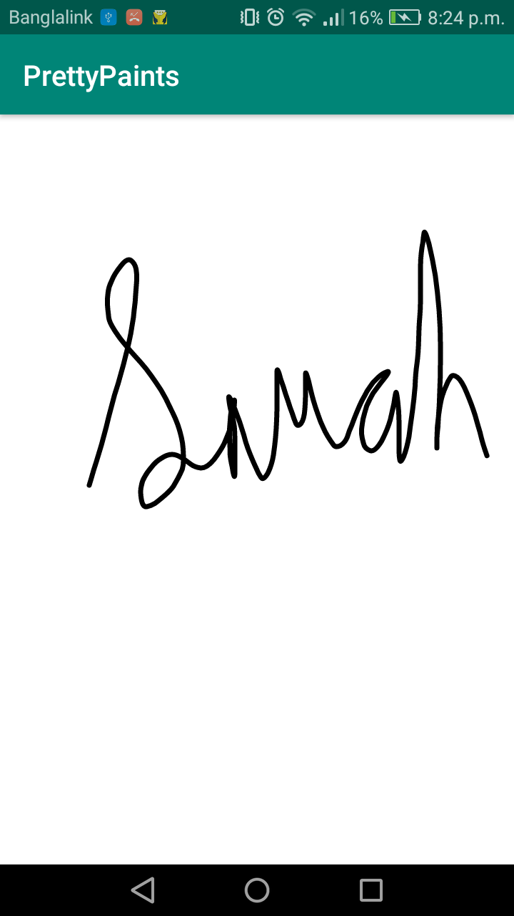
Testing (Features Tested)
Free-Hand Drawing/Sketching

Slide 13
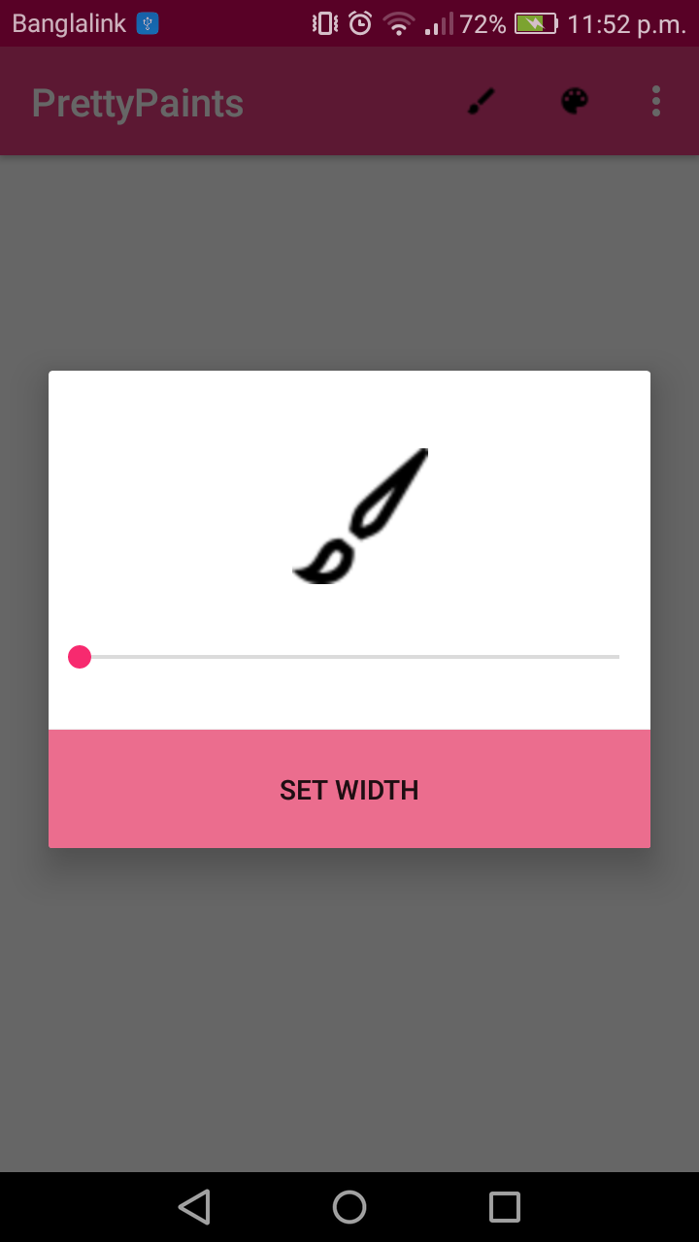
Testing (Features Tested)
Set Width Feature

Slide 14
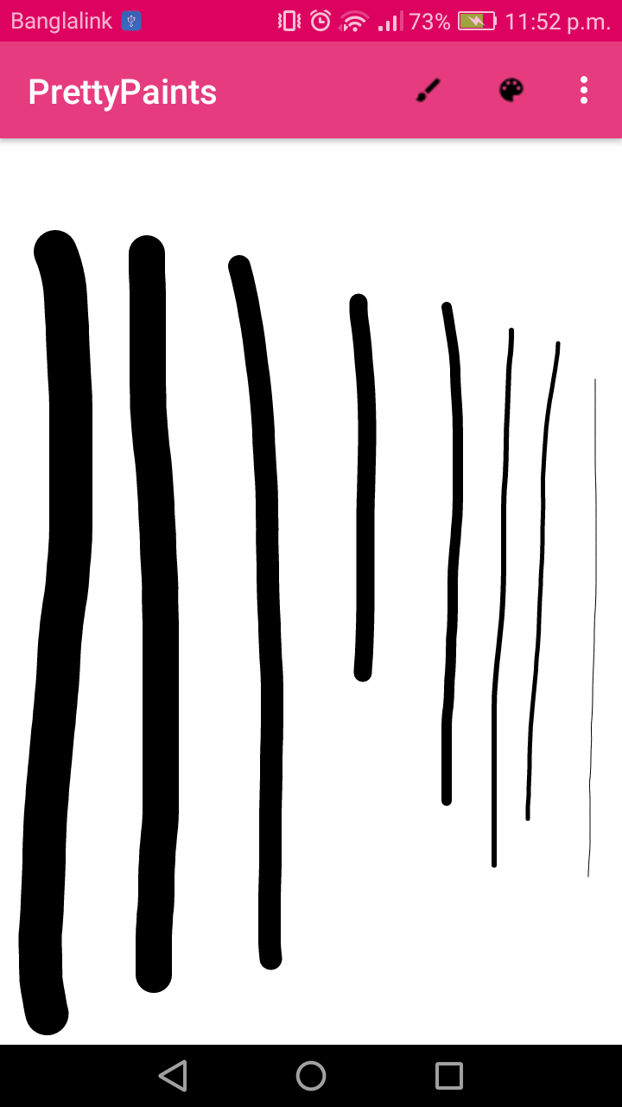
Testing (Features Tested)
Feature tested - using various width samples

Slide 15
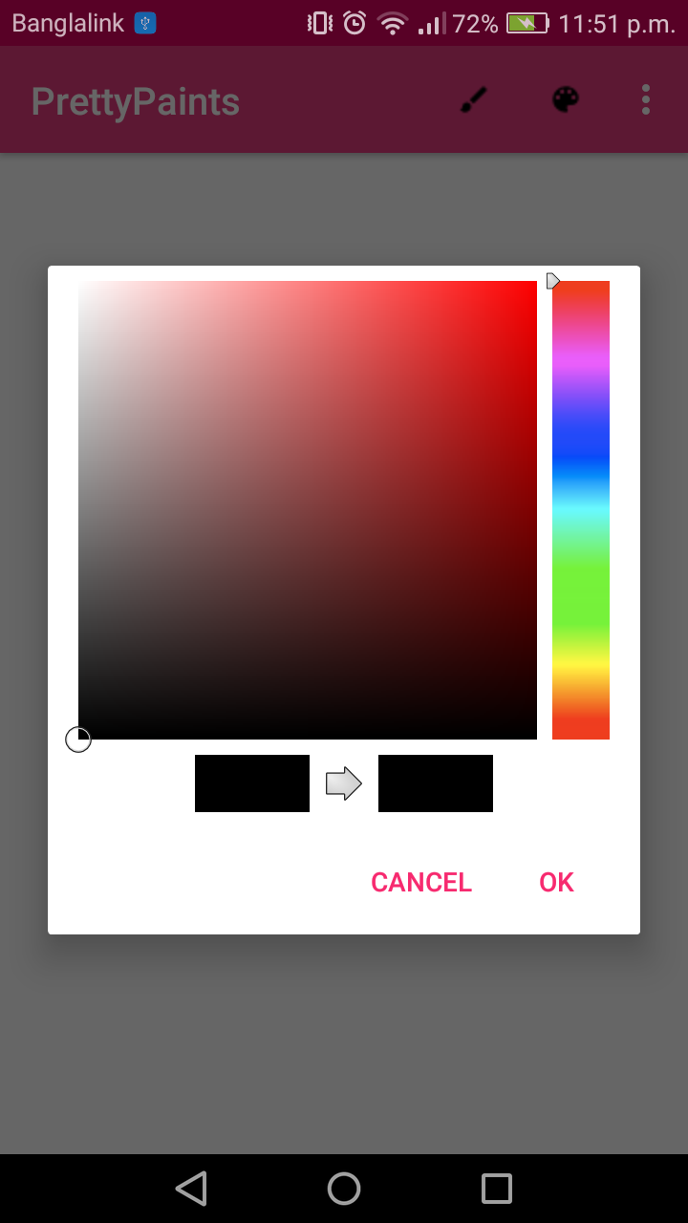
Testing (Features Tested)
Color Palette Feature

Slide 16
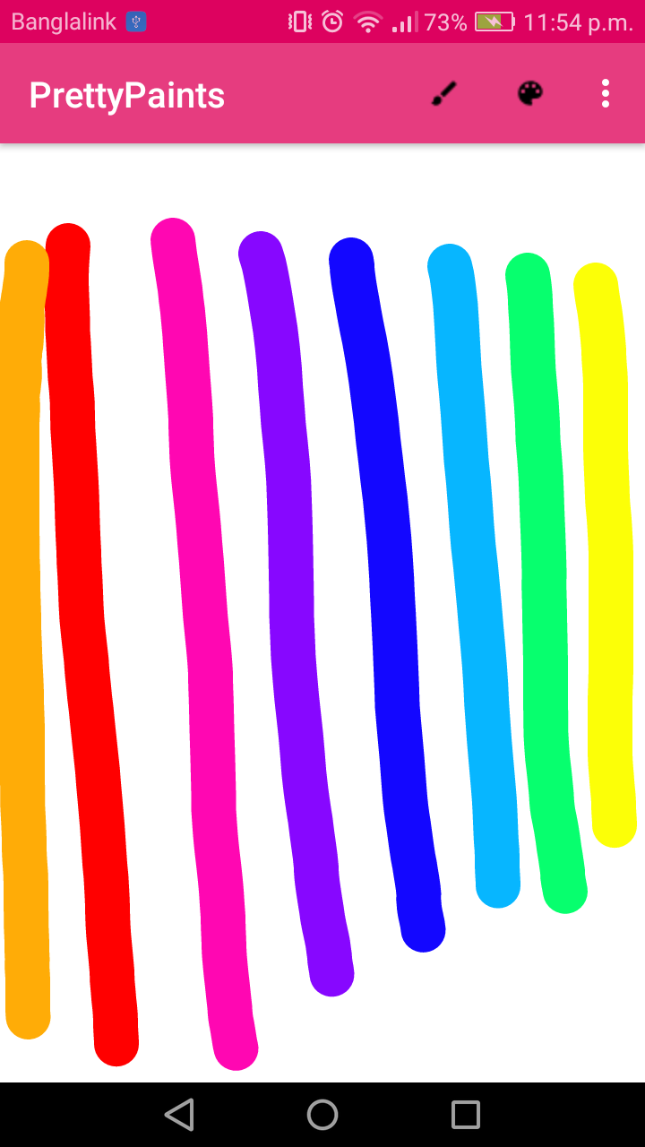
Testing (Features Tested)
Palette tested - using various colors

Slide 17
Member Contribution
Sarah Suad 1632282642:
- developing module 1,2,3,5,6
- debugging errors
-compiling the project
Ishrat Jahan Ananya 1631636042:
- Writing the report and analysis
- Organization of the project
- Testing and feedback
Nahian Noshin Nur 1510798642:
- Analysis on features and specifications - Presentation ppt and compilation - Testing and Feedback

Slide 18

Peeasee gib marks

