Slide 1

ArrowTrack:
Inventory Management System for Archers and Archery Clubs
Corey Richardson
github.com/corey-richardson/ArrowTrack

Slide 2
Application Executing

Slide 3
Final Project Plan

Slide 4
This project could be used by archers and archery clubs to track and help maintain the equipment they hold. This would also be useful to track the value of the inventory to assist in insurance calculations and track the items that may need replacing to help with budgeting.
Project Vision

Slide 5
Requirements, Planning and Design
The initial requirements analysis, planning, design, research and learning stages took place over the course of a month, serving as a foundation to build the ArrowTrack project on top off.
During this time, user stories were created to outline the desired functionality of the web application.
A significant portion of this stage was used to research and learn about technologies that would be used throughout the project, including HTML/CSS styling methodologies such as grids and flexboxes, JavaScript ES6 for web programming and JSON databasing.
Based on the design wireframes created during this stage and using knowledge acquired from research and learning, a project skeleton was created.

Slide 6
User Stories

Slide 7
As a club member, I want to be able to see what equipment is available for me to use so I can choose the items that best suits my needs (bow poundage, arrow length, arrow spine, etc). I also want to know which accessories are available for that bow.
Completed in part
The limitation of linking accessories to equipment was due to a limitation in the database structure; a flat-file JSON file rather than a relational database. This hindered integration leading to the incomplete representation of accessories as individual items as opposed to child-items.
As a club treasurer, I want to be able to see the values for equipment stored at each venue/range as well as the combined value to understand what the club has in inventory for insurance calculations.
Completed
Client-side JavaScript file ‘calculateValue.js’ handles totalling calculations of all equipment by combined value and by-location value.

Slide 8
As a club treasurer, I want to be able to see the condition of equipment in storage so I can prioritise spending towards items that are in direst need of replacing to help with budgeting
Completed
All items have an attribute ‘Condition’ with options Great, Good, Okay, Poor and Unsafe. This allows individuals and clubs to prioritise their budget allocation to items in direst need of repair or replacement. Items marked as unsafe are dynamically highlighted in red using jQuery’s CSS styling method.
As a user, I want to be able to add new items via a HTML form.
Completed
Items can be added via a HTML form.

Slide 9
As a club equipment officer, I want to be able to add and remove items from the database so that I can keep track of the equipment available for members to use.
Completed
Items can be edited and removed via a HTML form.
As a club equipment officer, I want to be able to edit/alter the condition of equipment as it gets used.
Completed
The “Condition” attribute of an item can be edited using the “Edit an Existing Item” HTML form.

Slide 10
As a club training coach, I want to be able to 'checkout' club-owned bows to members on training courses to ensure they are using the same bow throughout (and potentially beyond) their beginner’s course.
Completed
The “Checked Out” attribute of an item can be edited using the “Edit an Existing Item” HTML form. When an item is checked out by a user, the background colour of the item’s container gets changed to a darker shade of grey using jQuery’s CSS styling method to indicate that the item is not available for general use.
As the developer, I want these forms to only display menus related to that object type class. For example, ‘Target Face Size’ would not be an input option for ‘Arrows’.
Cancelled
All items now share the same set of attributes, eliminating the need for distinct classes for different item types; this issue no longer applies to the use case of the web application. This change was done due to the non-relational structure of the database. By standardising all items to use the same attributes, data management is simplified.

Slide 11
Sprints

Slide 12
GitHub Project Tracking
My approach to project management followed ‘Agile’ methodology.
I utilised GitHub and GitHub Projects as my platform for version control and project management.
This included a Kanban board with columns for User Stories, Product Backlog, In Progress, On Hold, Done and Cancelled.
By using an Agile approach to software development, I was able to iterate on features incrementally.
https://github.com/users/corey-richardson/projects/4

Slide 13
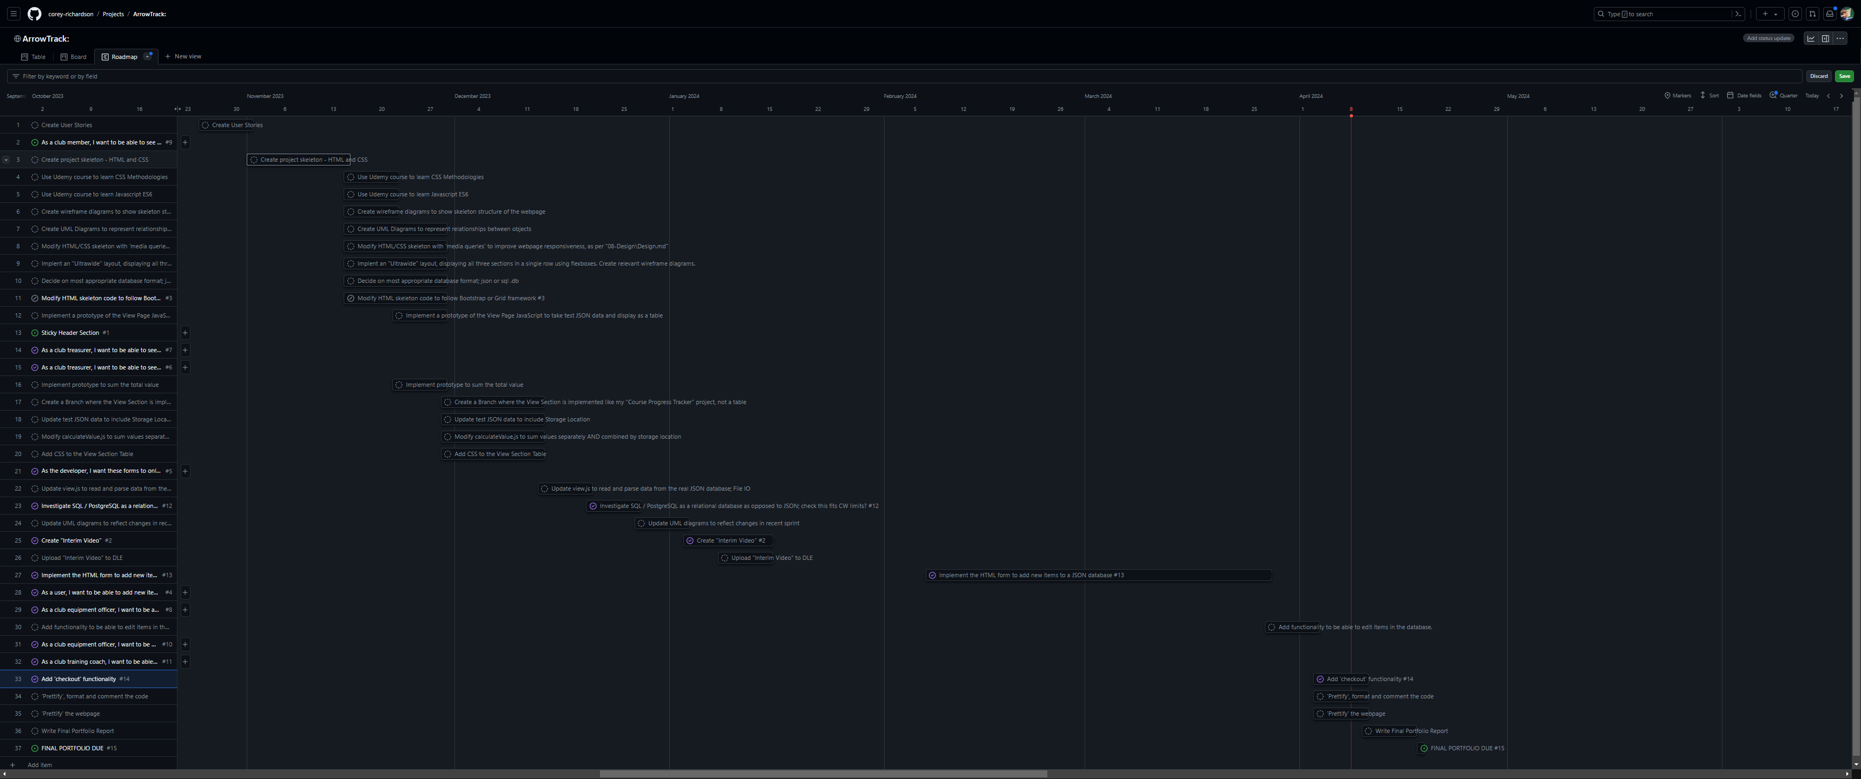

Slide 14
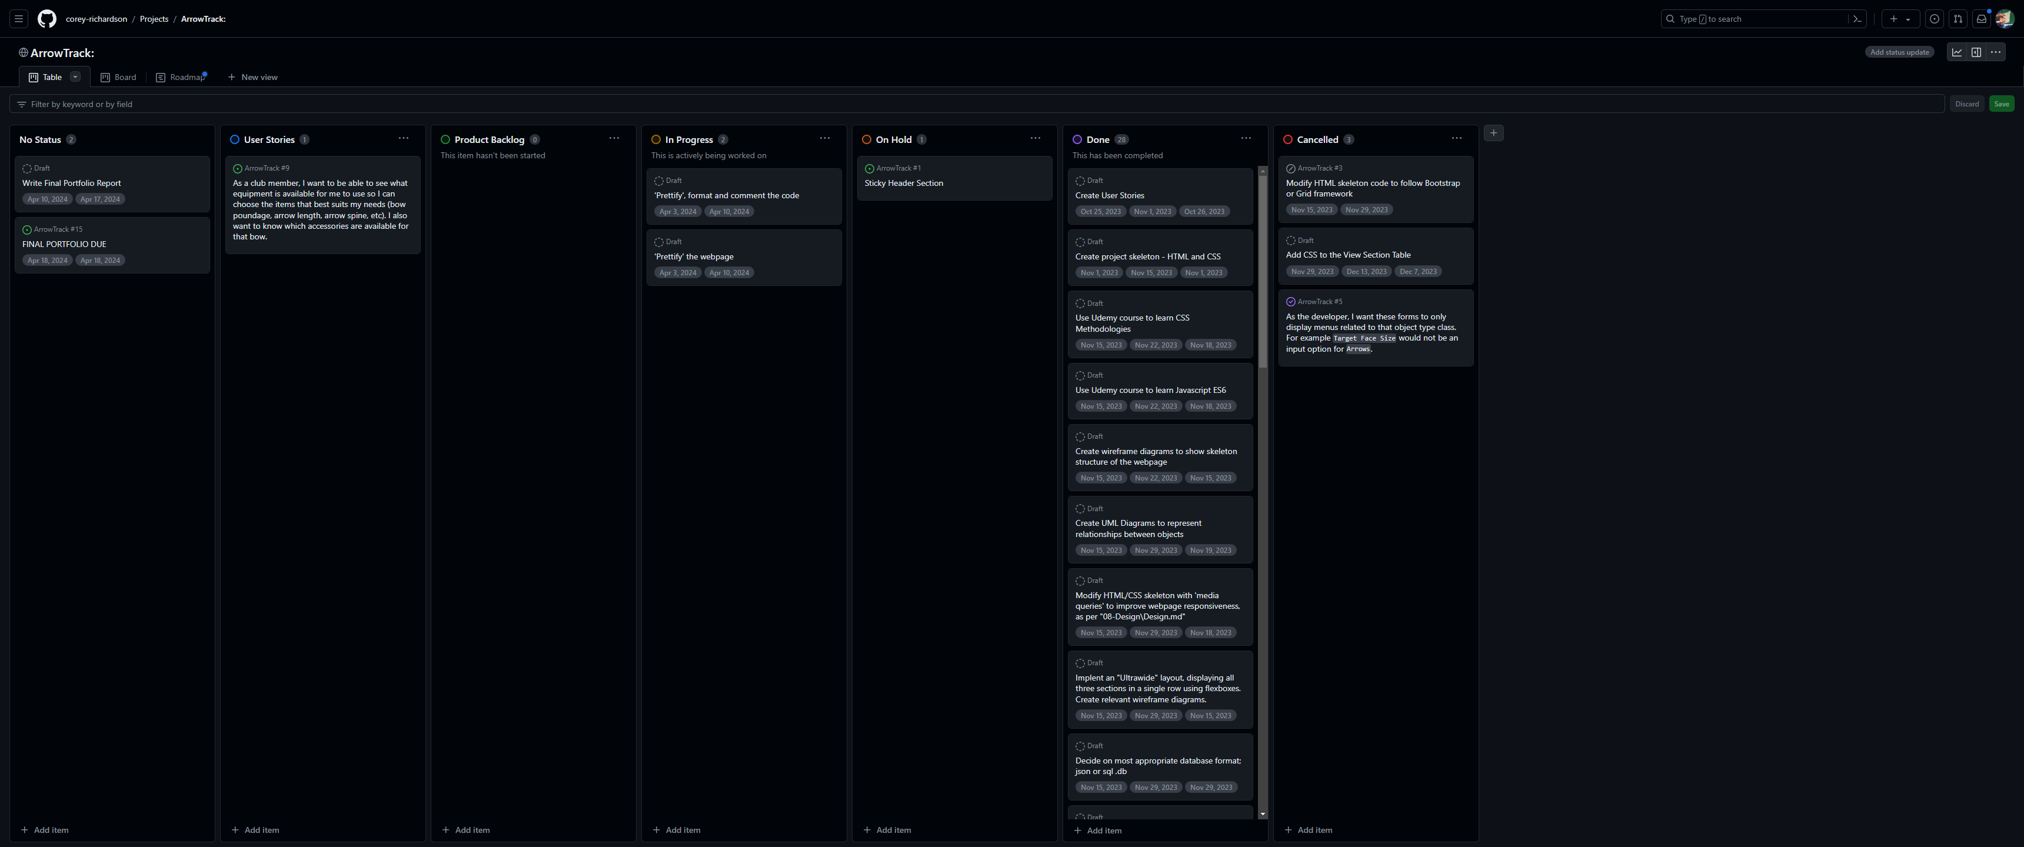

Slide 15
Requirements, Planning and Design
Oct 25 – Nov 1: Create User Stories
Nov 1 – Nov 15: Create Project Skeleton (HTML/CSS)
Nov 15 – Nov 22: Udemy Course to learn CSS Methodologies and JavaScript ES6.
Nov 15 – Nov 22: Create Wireframe Diagrams to represent structure of web app.
Nov 15 – Nov 29: Create UML Diagram to represent object relationships.
Nov 15 – Nov 29: Decide on database format: JSON or SQL.

Slide 16
Design Choices
Responsive Web Design (RWD) was a key design goal for this project.
By implementing RWD principles, I aimed to ensure that the web application was accessible on a range of devices and that the functionality of the application would seamlessly adapt to various display sizes.
Not only does this approach enhance the users experience by providing optimised layouts across devices, but it also assists with web accessibility.

Slide 17
Design Choices
Flexboxes and Media Queries have been used to implement RWD.
By using flex containers, the arrangement of elements dynamically changes based on the available screen size.
Queries are used to apply specific styling rulesets based on the current screen compared with the minimum targeted width thresholds.
Following a mobile-first design approach, media queries were used to affect the styling and layout of the page with progressively increasing viewport sizes.
Prioritising smaller, mobile screens – which the default styling does – improves the performance of the web application when it runs on these devices, which often have limited bandwidth when compared to larger devices.

Slide 18
Design Choices
As the web application is archery related, I wanted to select colours that would be appropriate for the theme, whilst still maintaining accessibility, readability, and being visually appealing to the user.
I chose yellow as the accent colour, drawing inspiration from the centre of an archery target that all archers aim to hit.
To ensure a visual balance between elements, I selected more neutral colours for the primary and secondary background colours: various shades of grey.
These colours allow the accent colour to stand out, whilst also ensuring that text remains readable, enhancing user experience and accessibility.

Slide 19
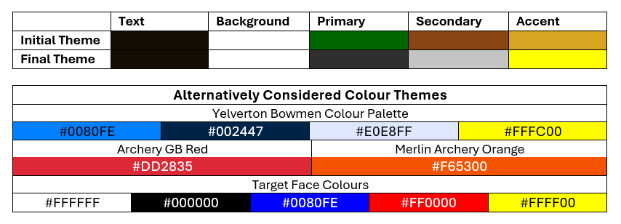
Design Choices

Slide 20
UML Diagrams

Slide 21
Wireframes
By using flex containers, the arrangement of elements dynamically changes based on the available screen size. Media Queries are used to apply specific styling rulesets based on the current screen compared with the minimum targeted width thresholds.

Slide 22
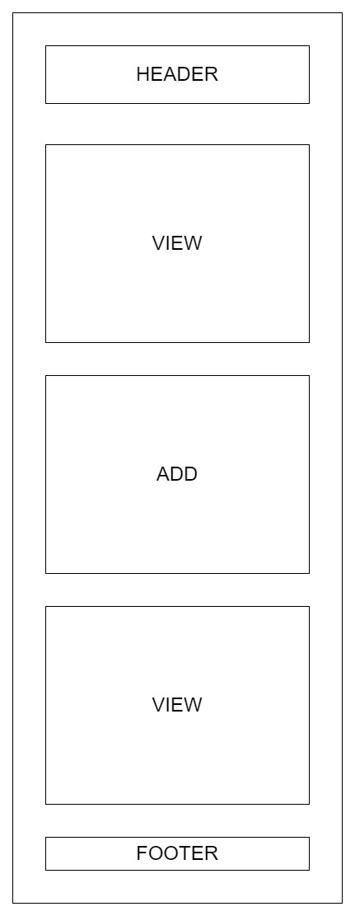
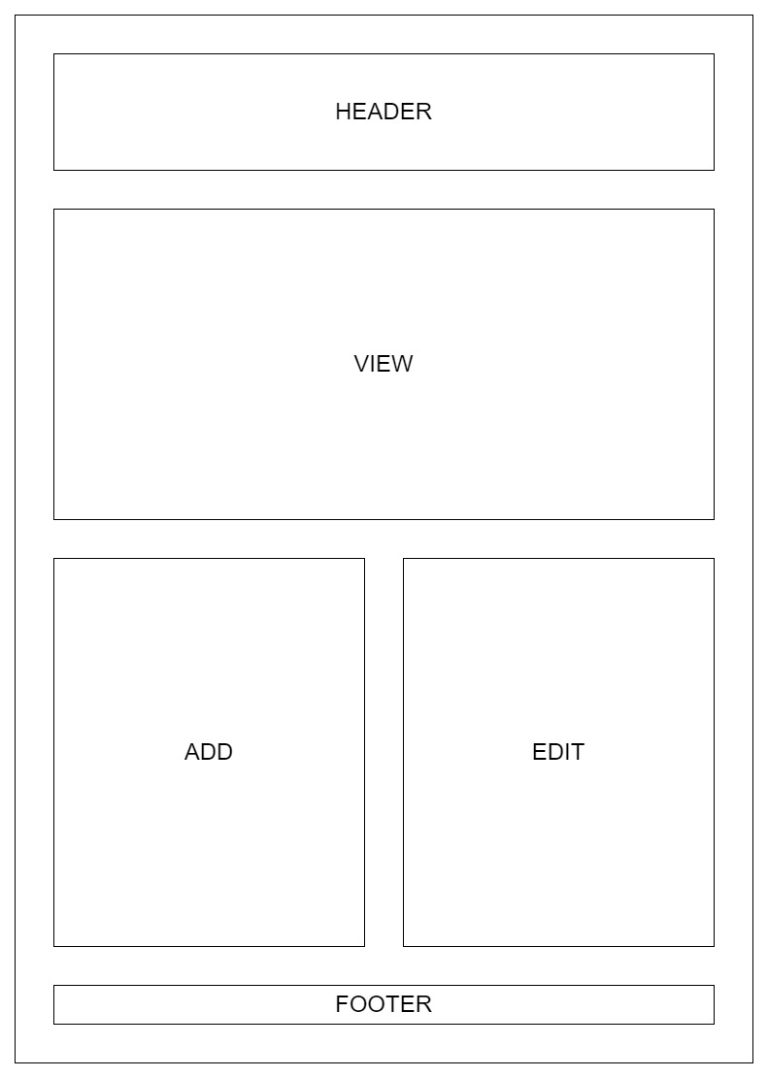

Slide 23
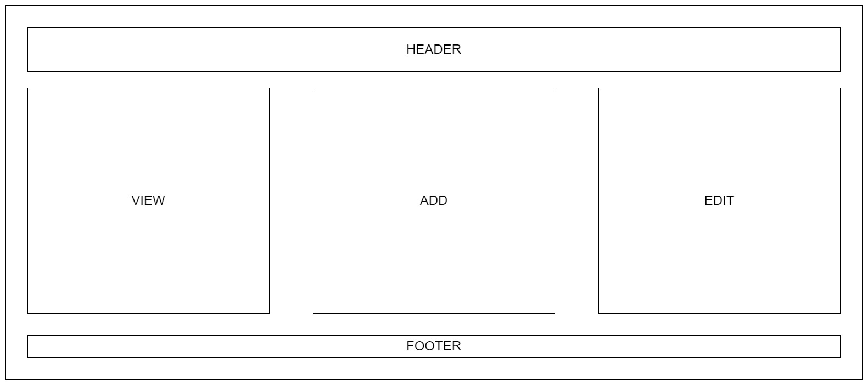

Slide 24
Use Case Diagrams
These diagrams show the paths the user may follow to interact with the web application.

Slide 25
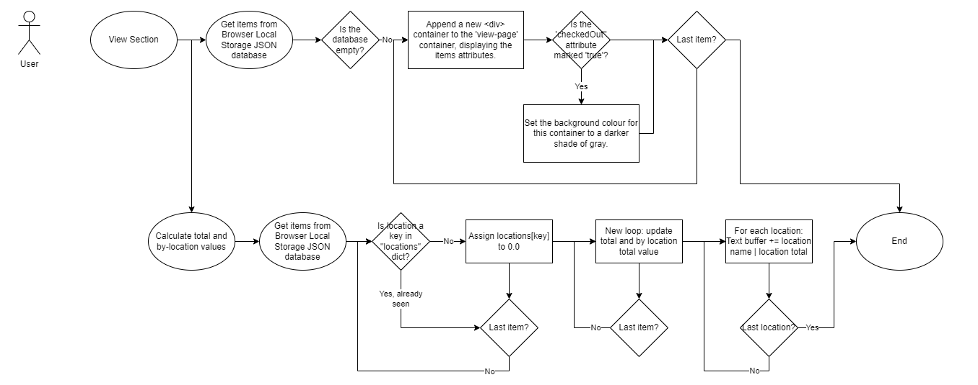

Slide 26
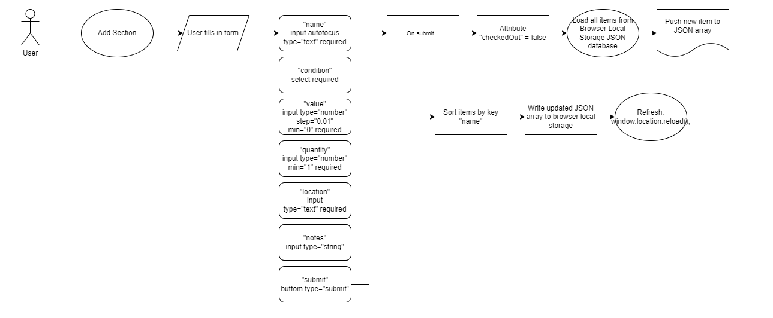

Slide 27
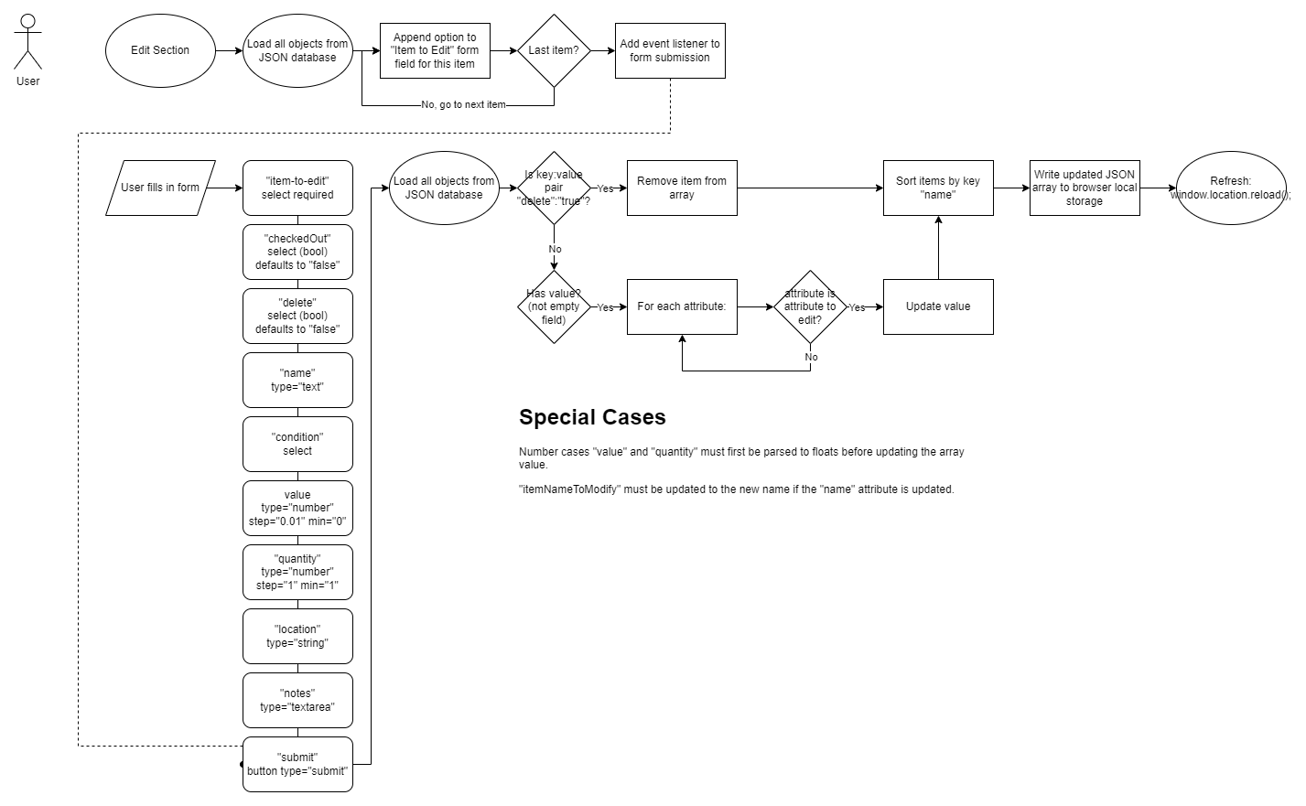

Slide 28
Sequence Diagrams
These diagrams show how the front end of the web application interacts with the client-side JavaScript processes and the browsers Local Storage database.

Slide 29
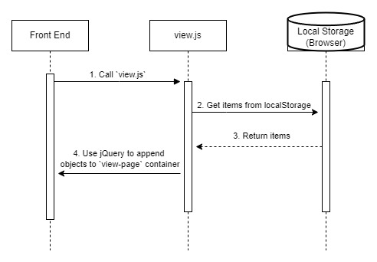
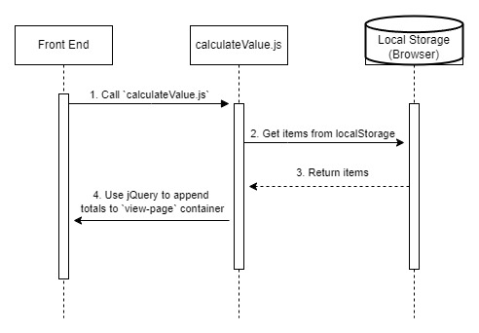

Slide 30
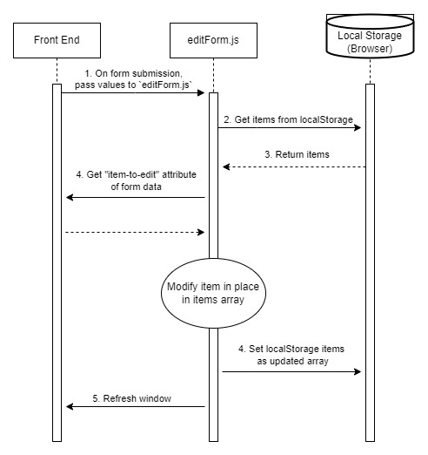
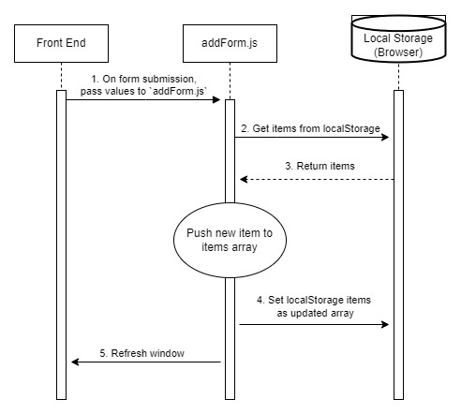

Slide 31
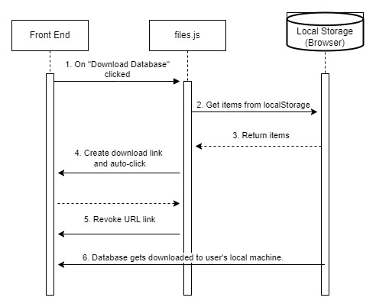
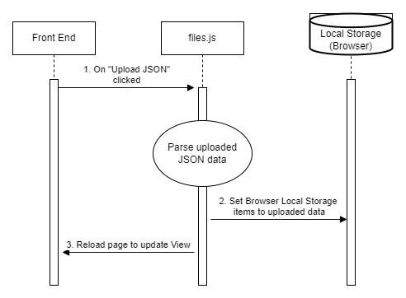

Slide 32
Challenges Faced

Slide 33
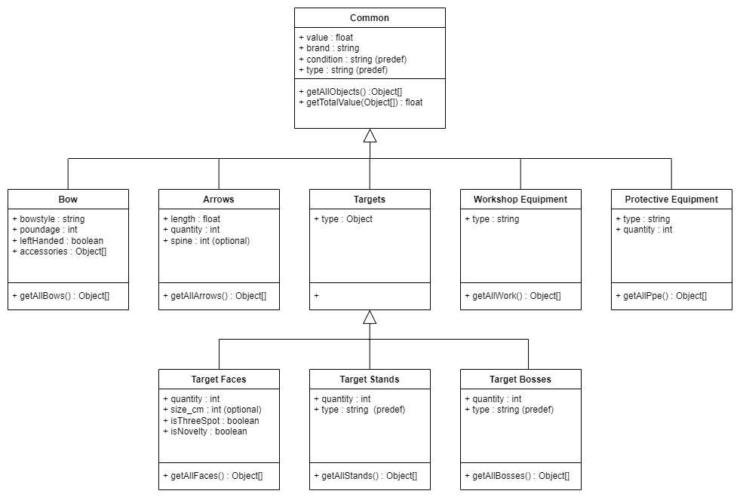
Original Plan:
Implement a relational database, where items would be linked together in parent-child relationships for items and the accessories connected to them.
This would also allow different ‘classes’ of item, representing bows, arrows, targets, etc - all of which would inherit from a base class.
It was determined that this overcomplicated the relationships for a flat-file database such as JSON, and would have required a backend handler, such as a SQL server, to manage. This would have fallen out of the scope of the coursework specifications.

Slide 34
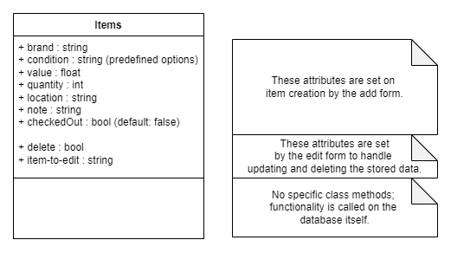
Original Plan:
Implement a relational database, where items would be linked together in parent-child relationships for items and the accessories connected to them.
This would also allow different ‘classes’ of item, representing bows, arrows, targets, etc - all of which would inherit from a base class.
It was determined that this overcomplicated the relationships for a flat-file database such as JSON, and would have required a backend handler, such as a SQL server, to manage. This would have fallen out of the scope of the coursework specifications.
As such, it was decided to instead implement a single class with attributes applicable to all items.

Slide 35
HTML Form Implementation
Most sprints and feature implementations were assigned a timespan of one or two weeks, depending on the expected ‘cost’ of that feature.
The longest and most costly feature took eight weeks to implement as described.
This feature was the HTML form which would be used to add new items to the database.
The issue arose as at the time the application was using a local JSON file to store item entries, which, using the Fetch API could not be written to by the browser for security reasons – only read.
This led to me needing to find a new solution to how the database was persisted between sessions.

Slide 36
HTML Form Implementation
To find this solution I turned to Dr Angela Yu’s ‘The Complete 2024 Web Development Bootcamp’ course with the expectation of using the course module on ‘Node.js’ and the ‘filesystem’ JavaScript module to manage the reading and writing of the database.
Upon reaching this module, I realised that it would not be suitable for this single-page application and would fall outside of the set coursework specifications, as it would require a server-side backend.
After this setback, I then found the solution implemented in the current iteration of the project: Browser Local Storage.
Data stored in local storage persists, even if the browser window is closed, unless explicitly cleared by the user or the application itself.

Slide 37
Project Poster

Slide 38
