Slide 1
ArrowTrack:
Archery Inventory Management Tool

Slide 2
Project Vision and Background

Slide 3
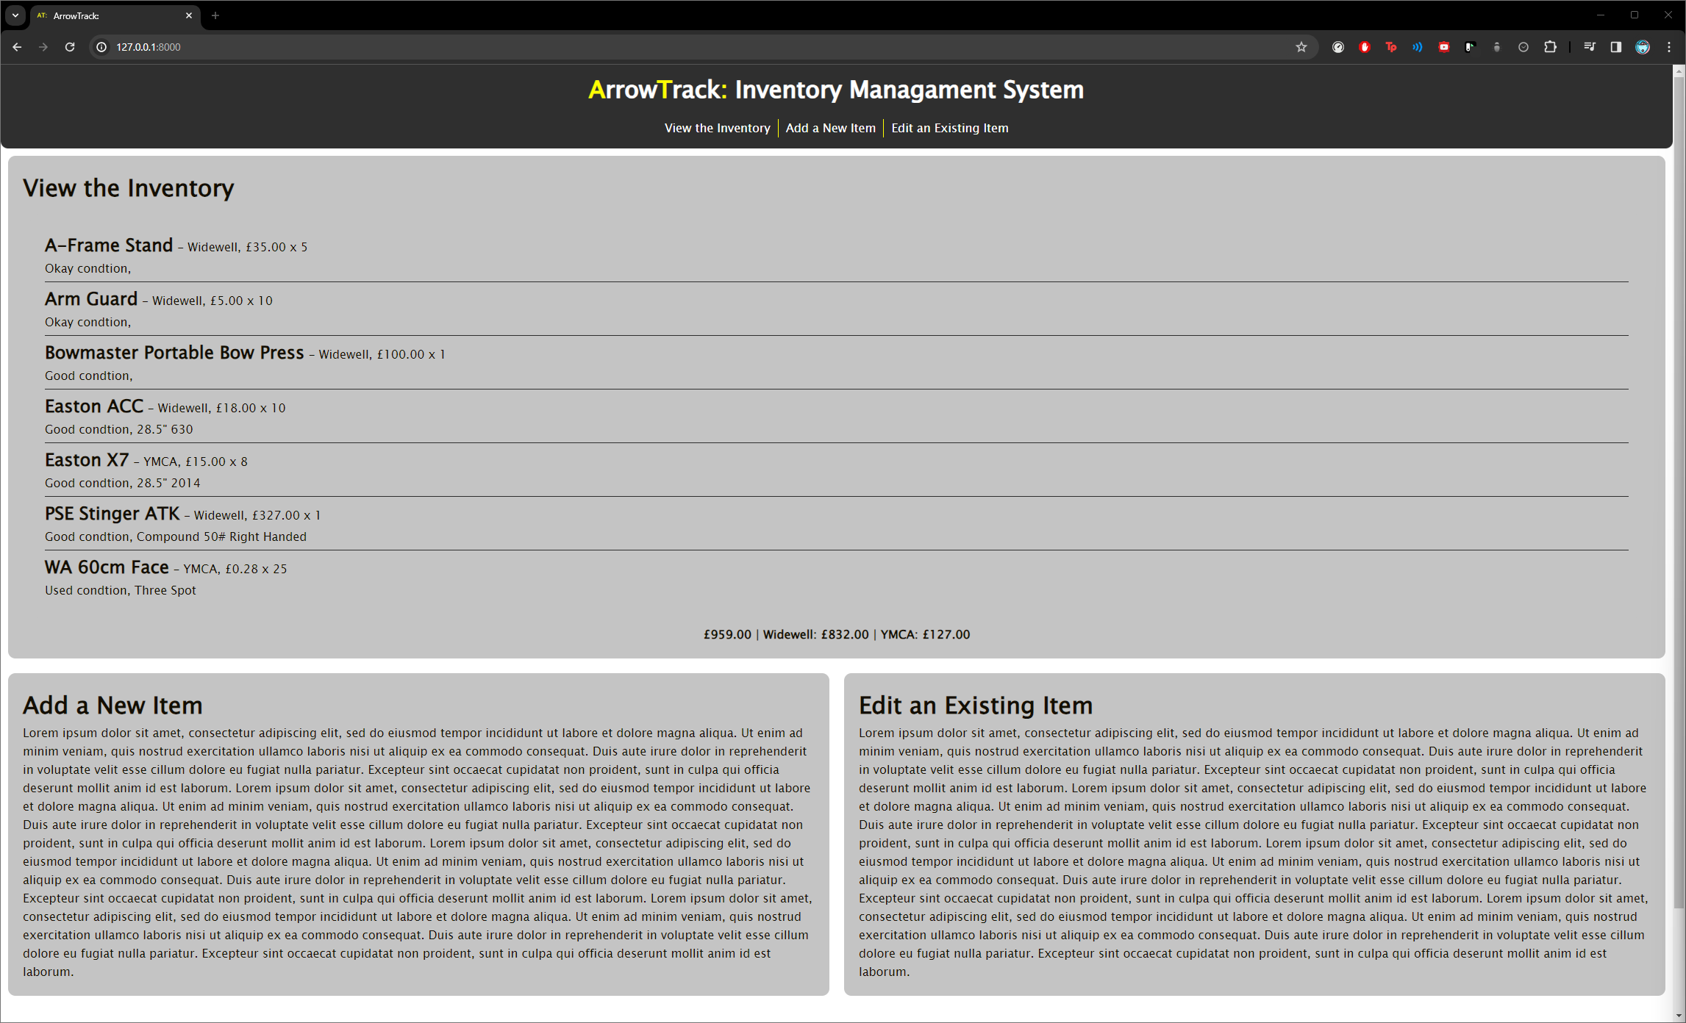

Slide 4
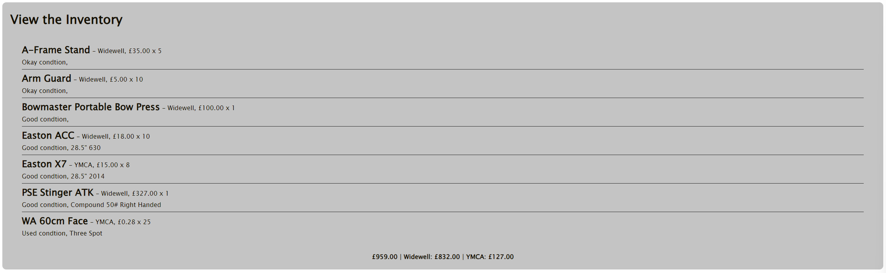

Slide 6
Project Planning and Sprints

Slide 7
Kanban Board Vid and Img

Slide 8
Roadmap Img

Slide 9
github.com/users/corey-richardson/projects/4

Slide 10
UML Diagrams

Slide 11
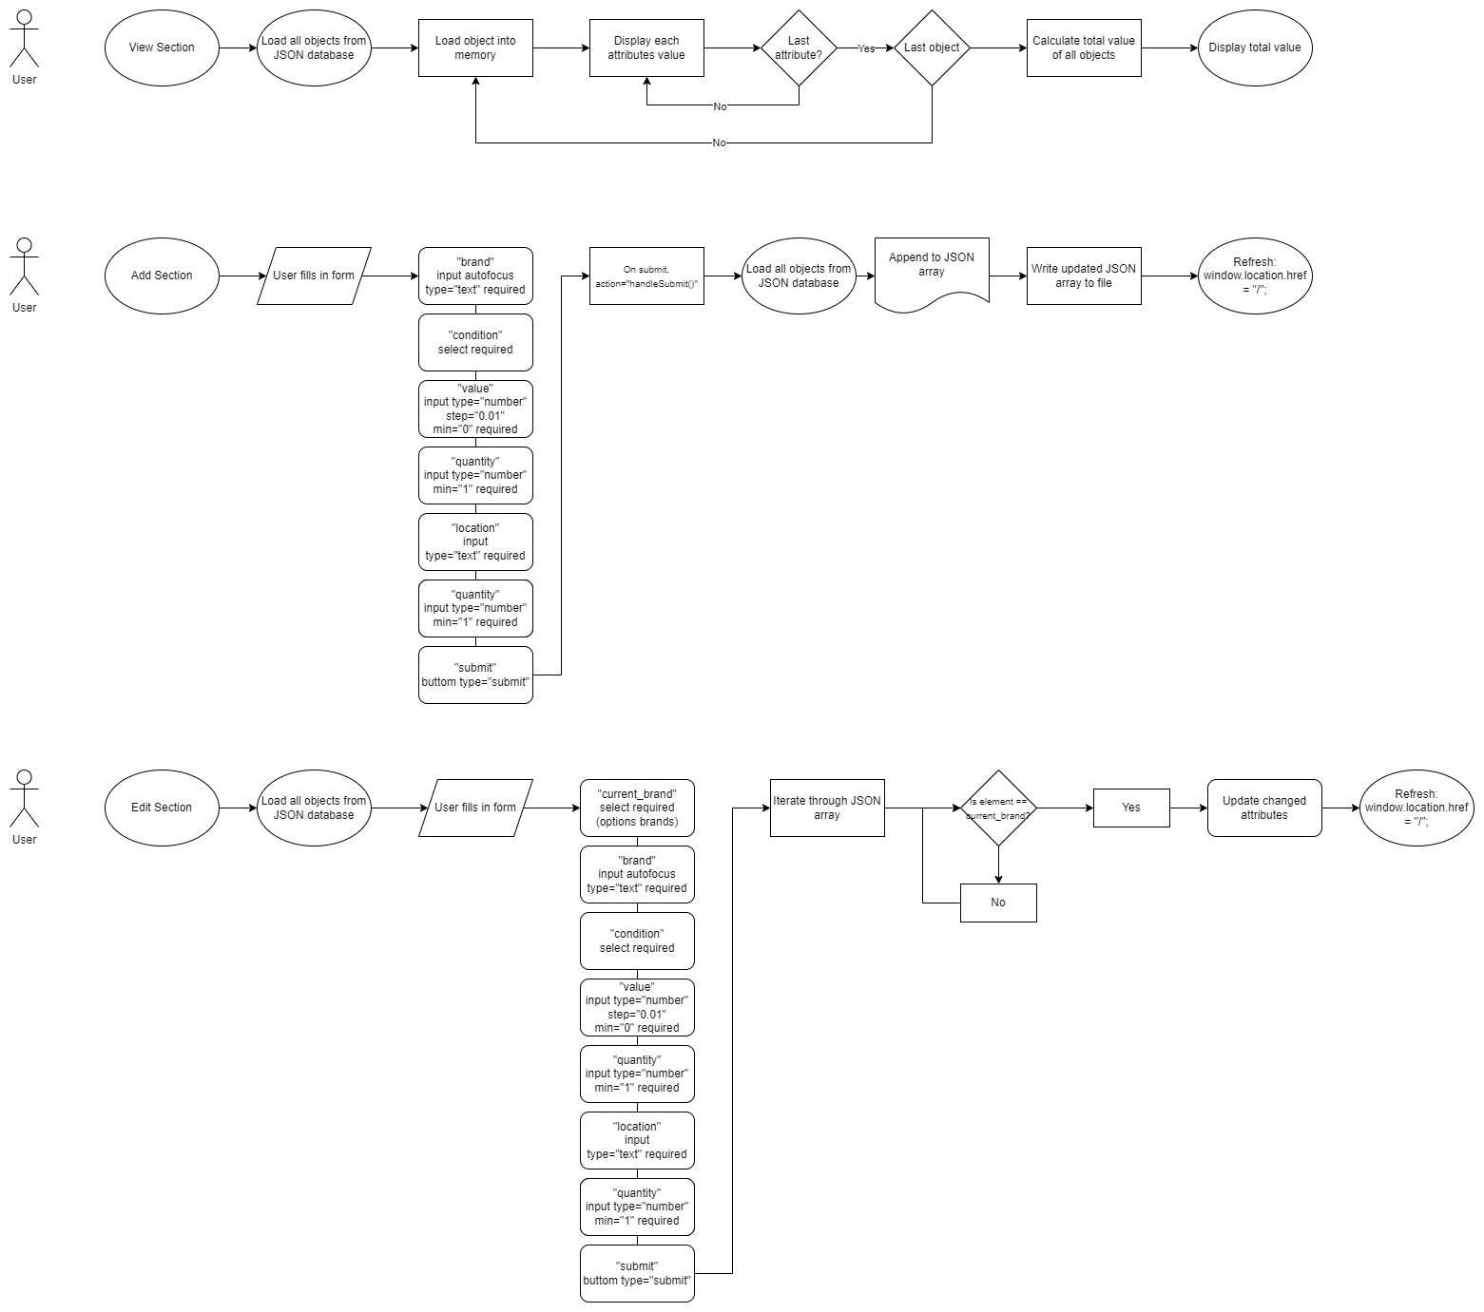

Slide 15
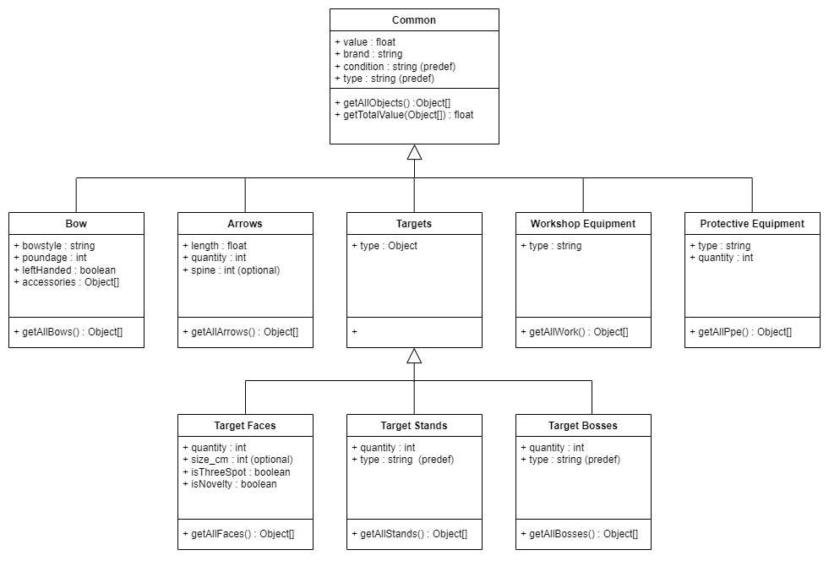

Slide 16
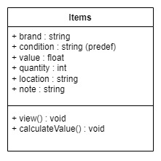

Slide 17
Initial Prototype

Slide 19
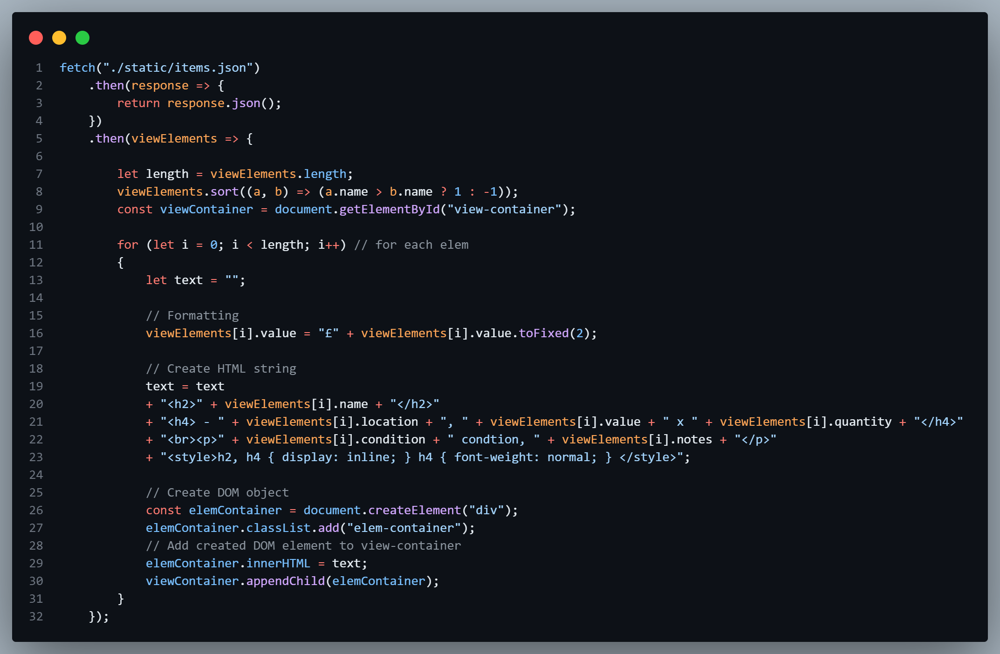

Slide 20
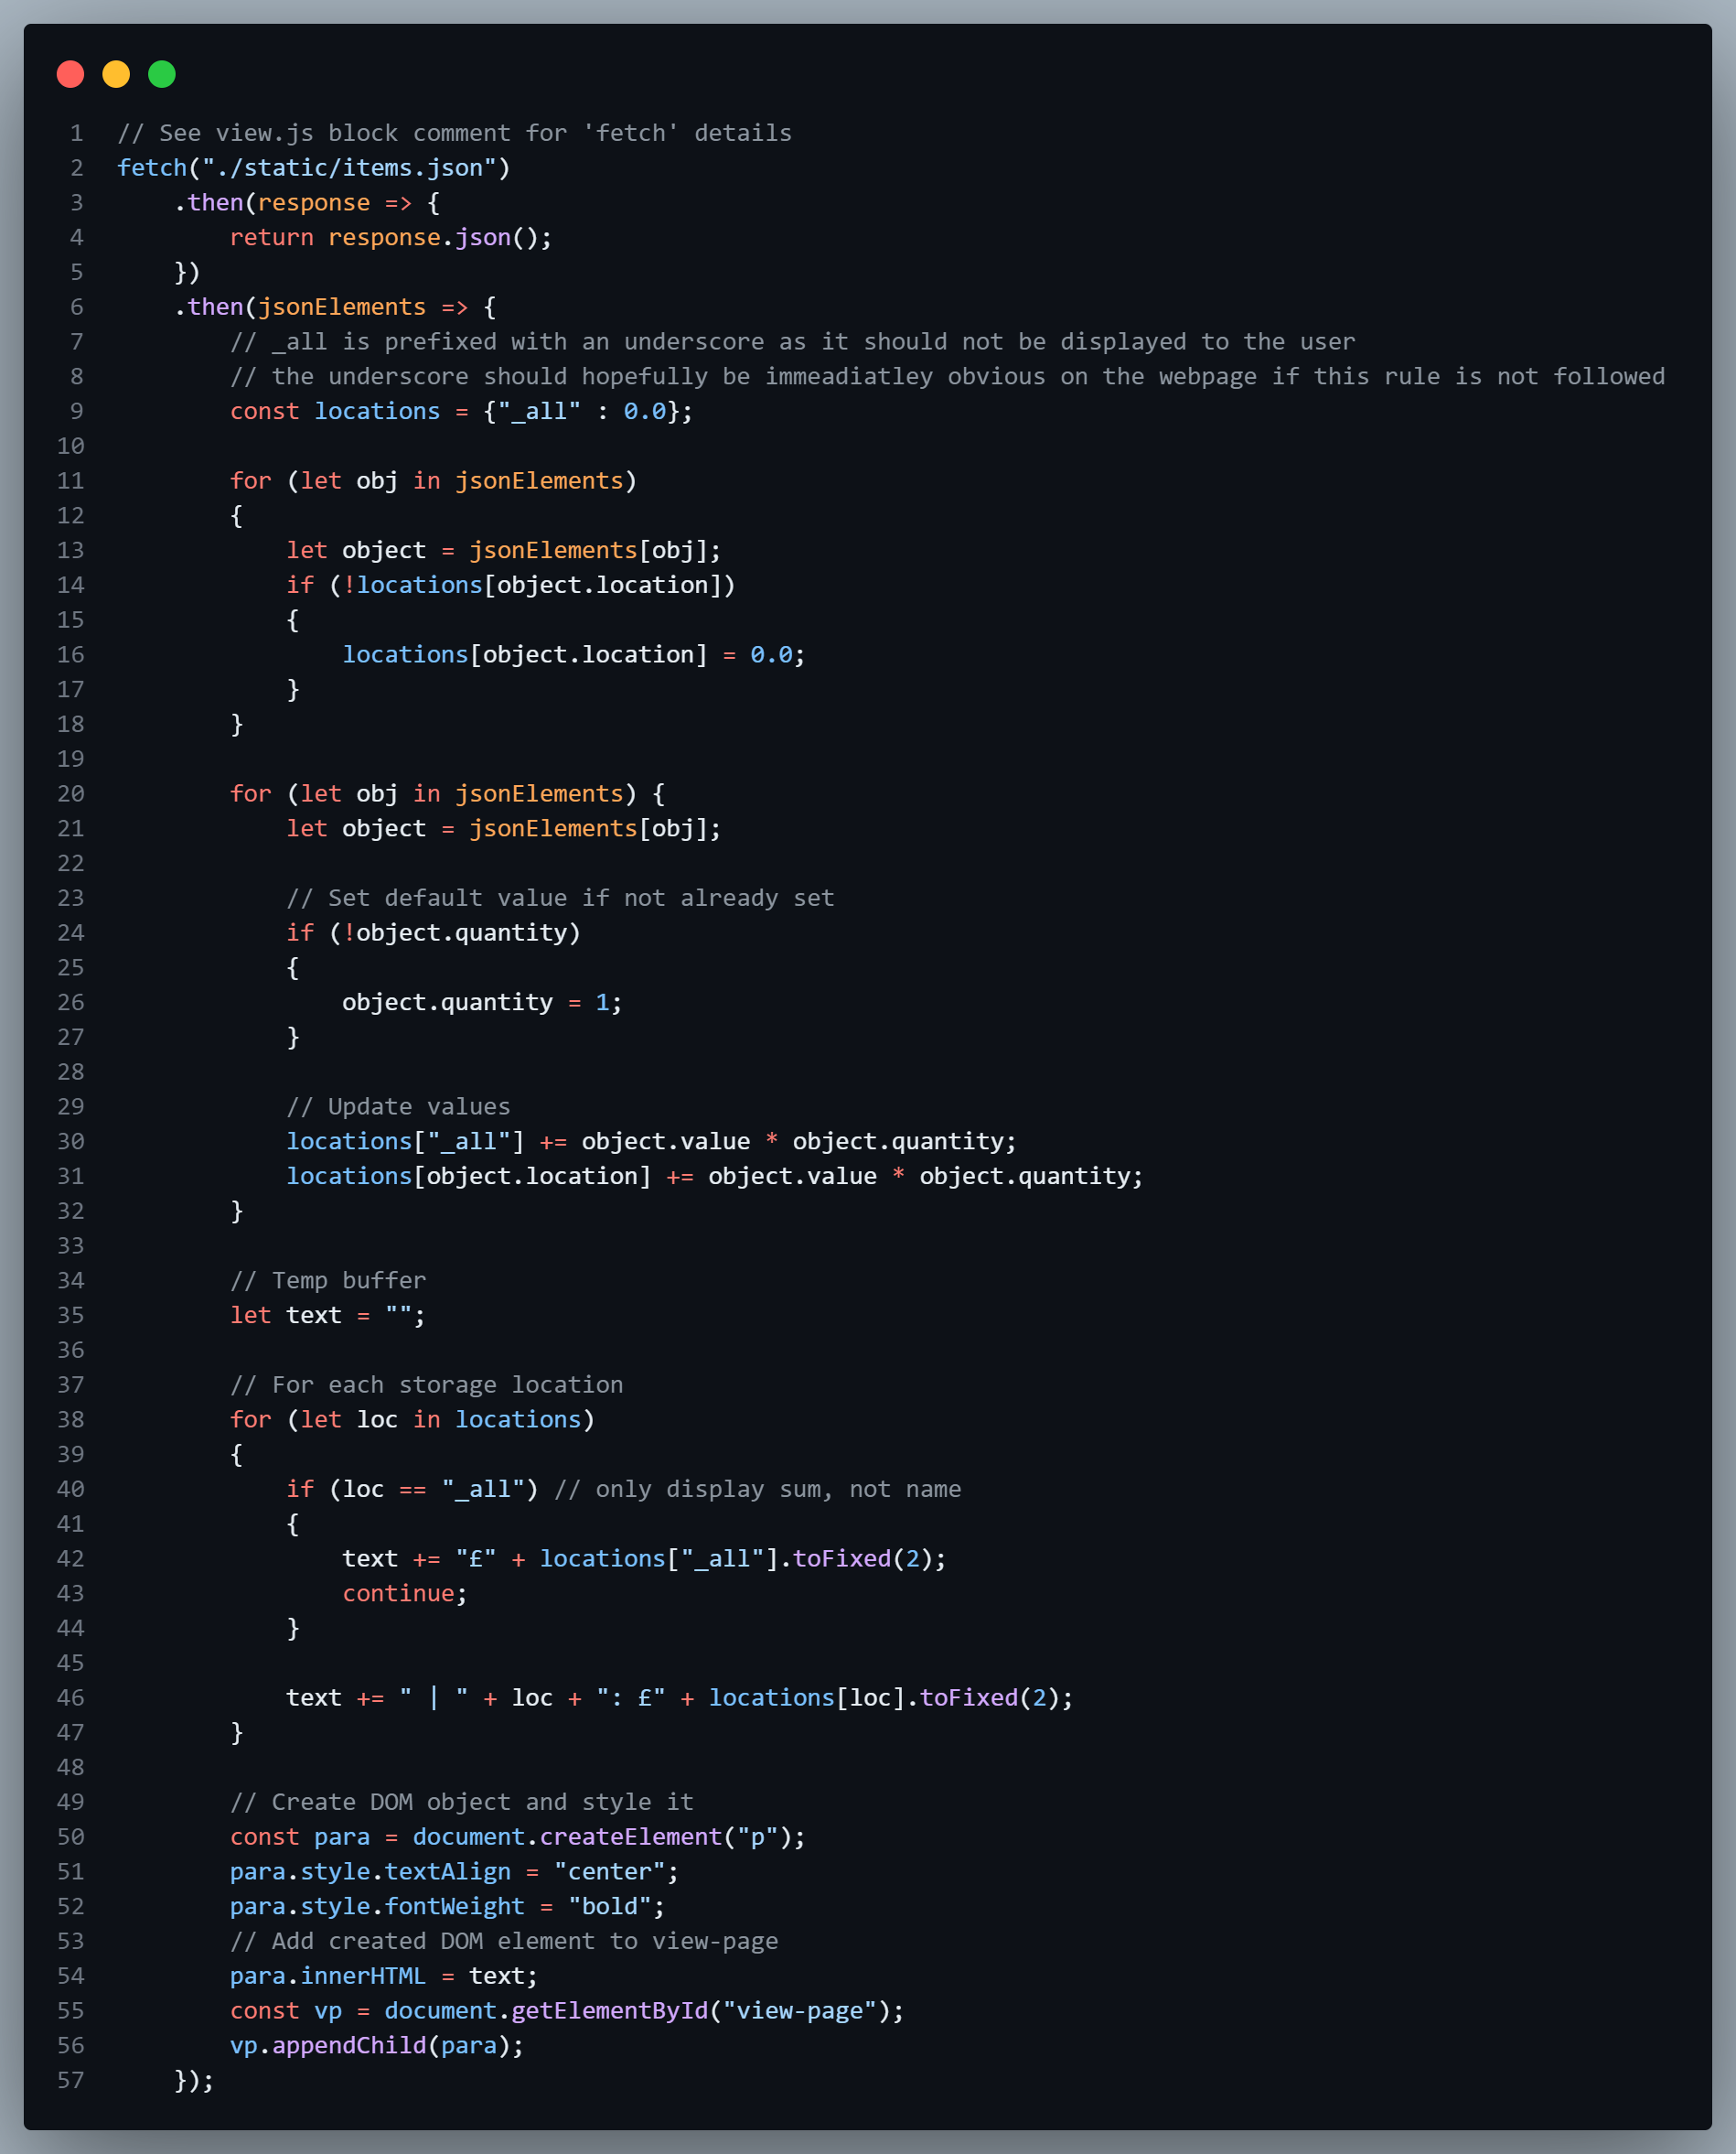

Slide 22
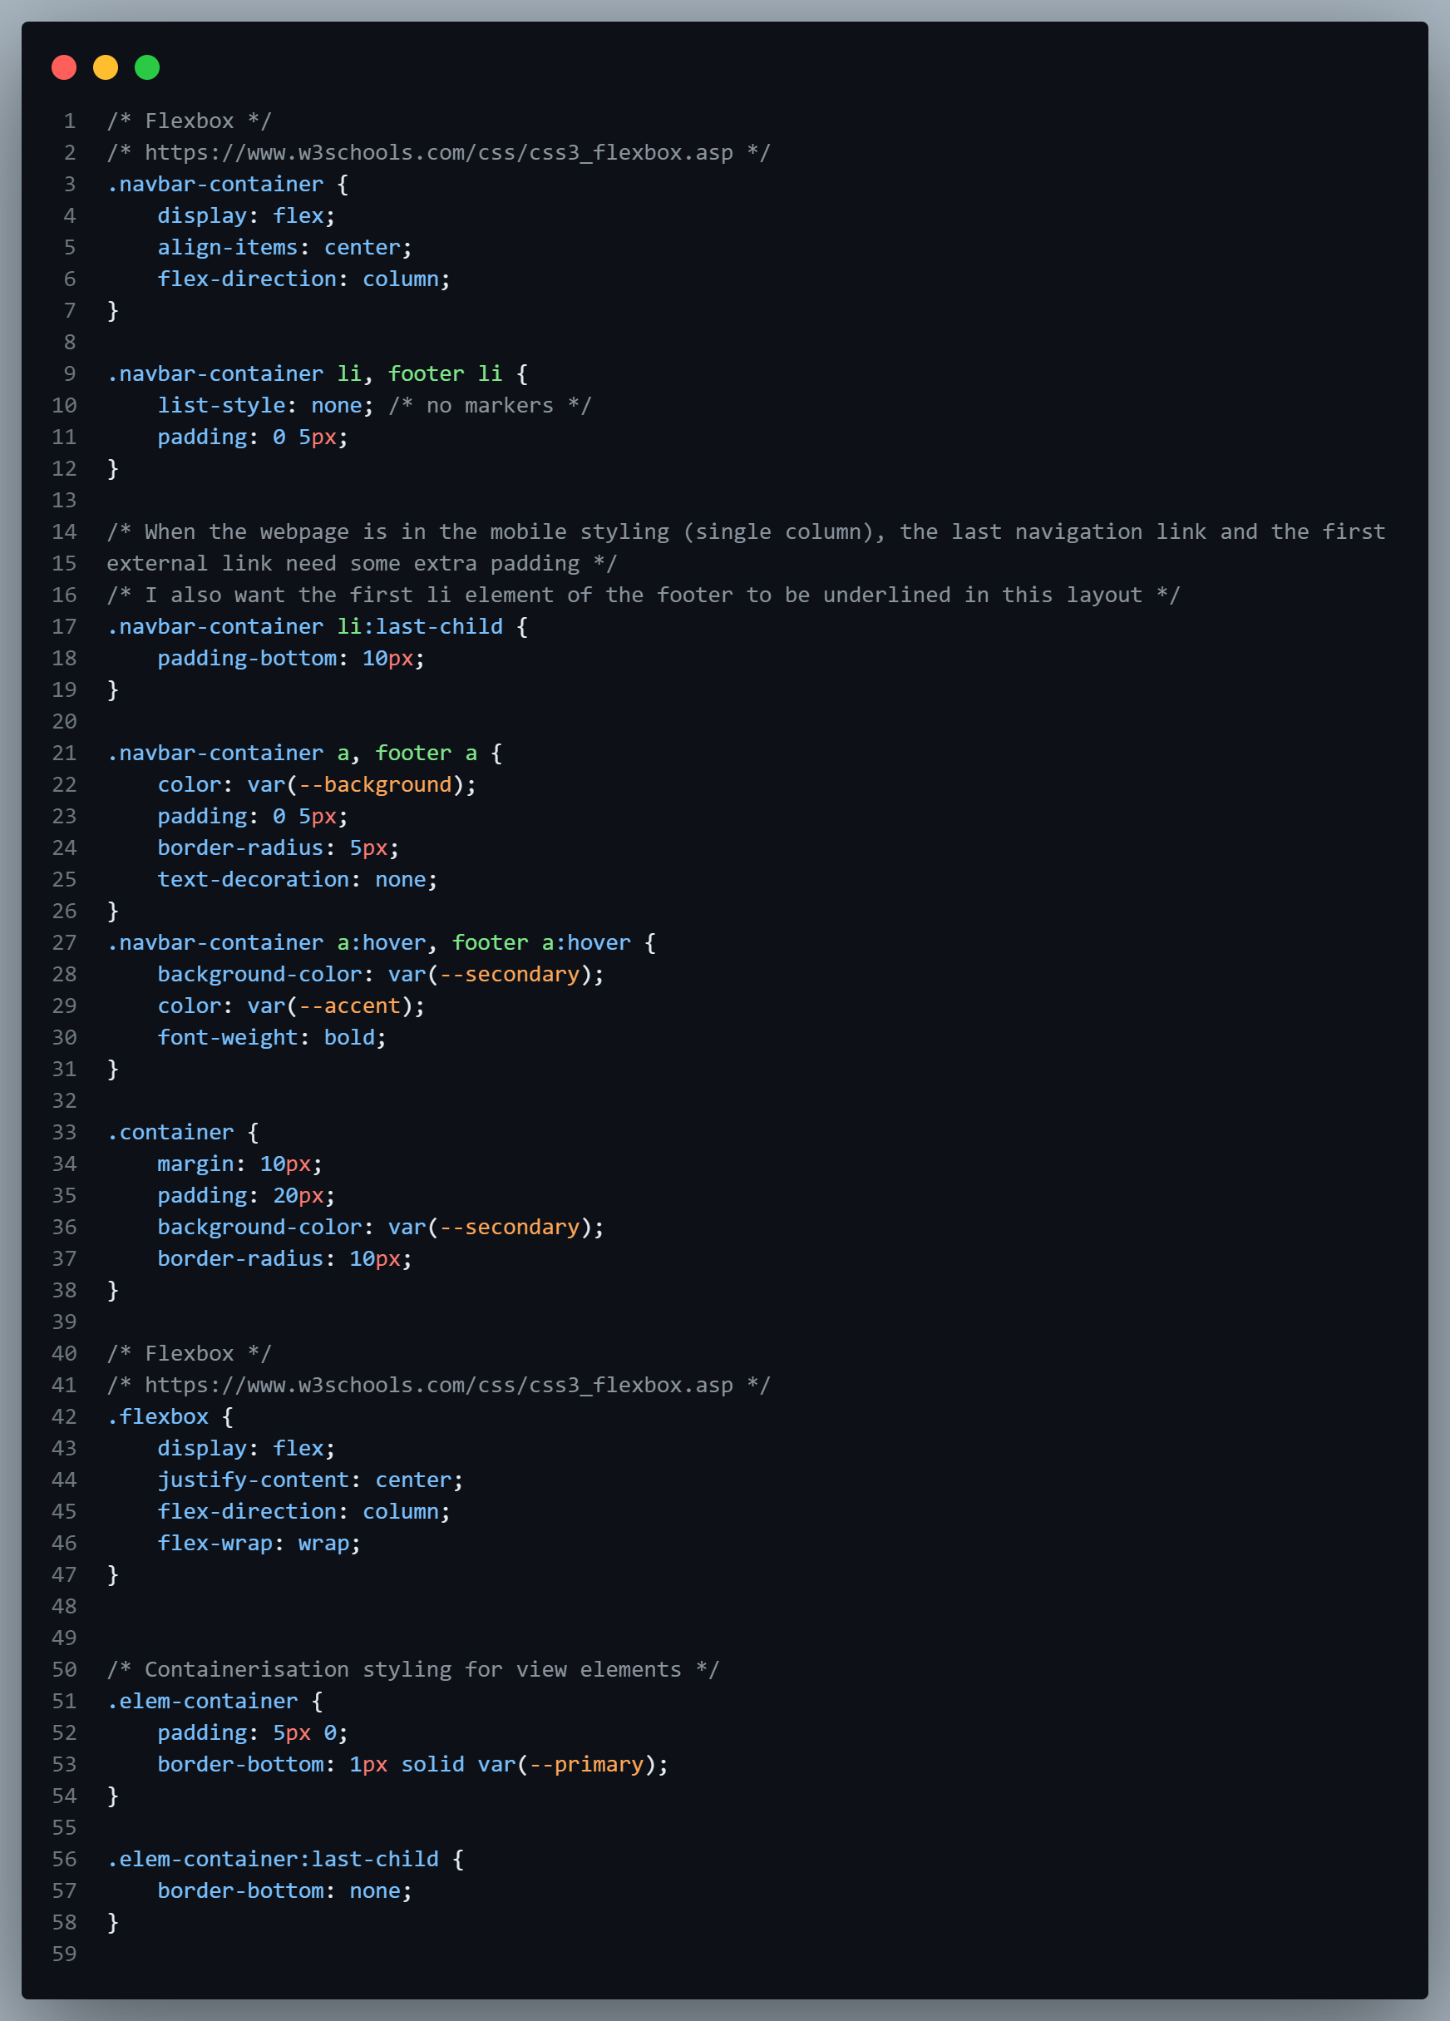
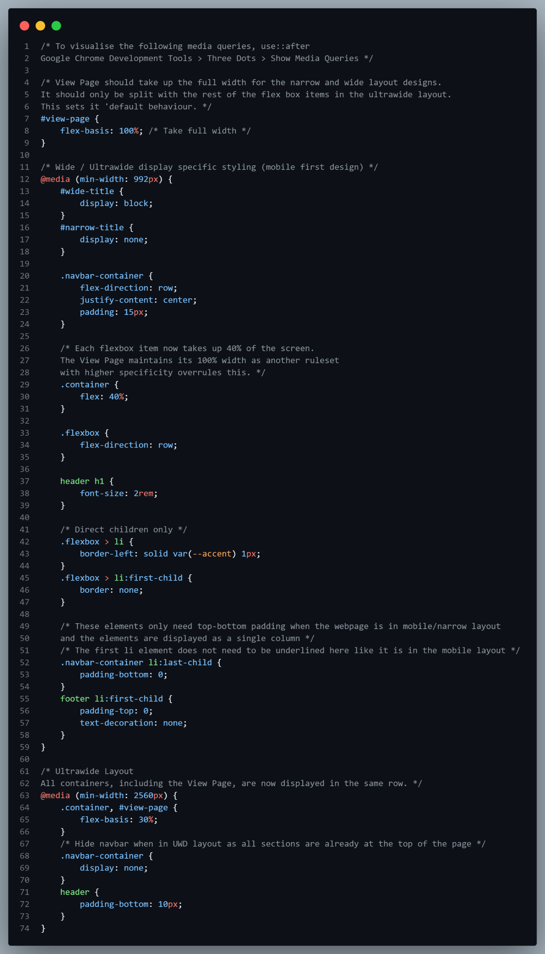

Slide 23
Mobile First means designing for mobile before designing for desktop or any other device; this will make the page display faster on smaller devices.
Instead of changing styles when the width gets smaller than 992px, we should change the design when the width gets larger than 992px.

Slide 24
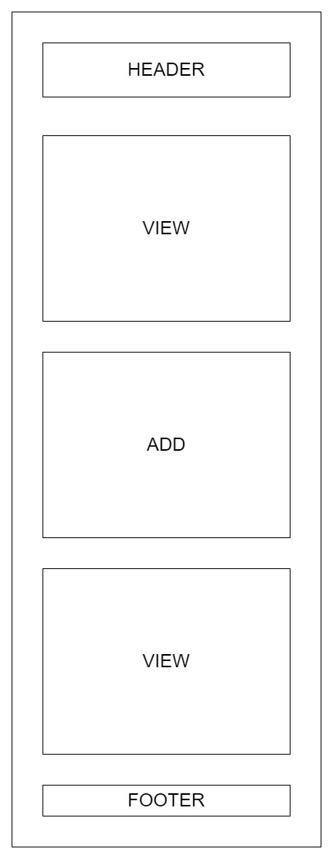
In this rendering, the view, add and edit sections of the page are displayed in one column, and the navbar and footer links are displayed stacked with no separators.
*EDIT

Slide 25
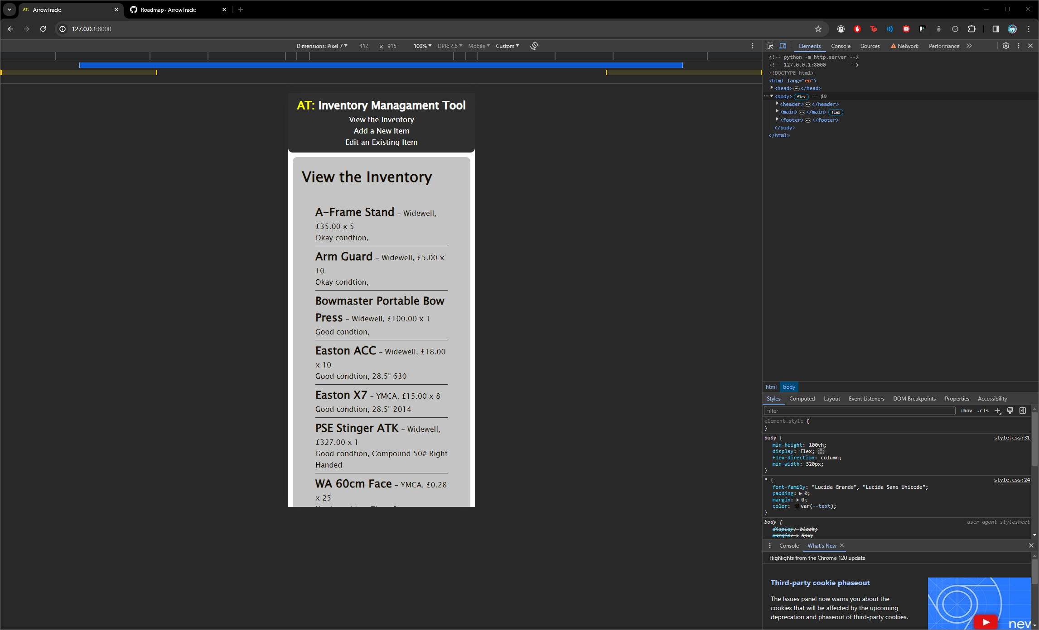

Slide 26
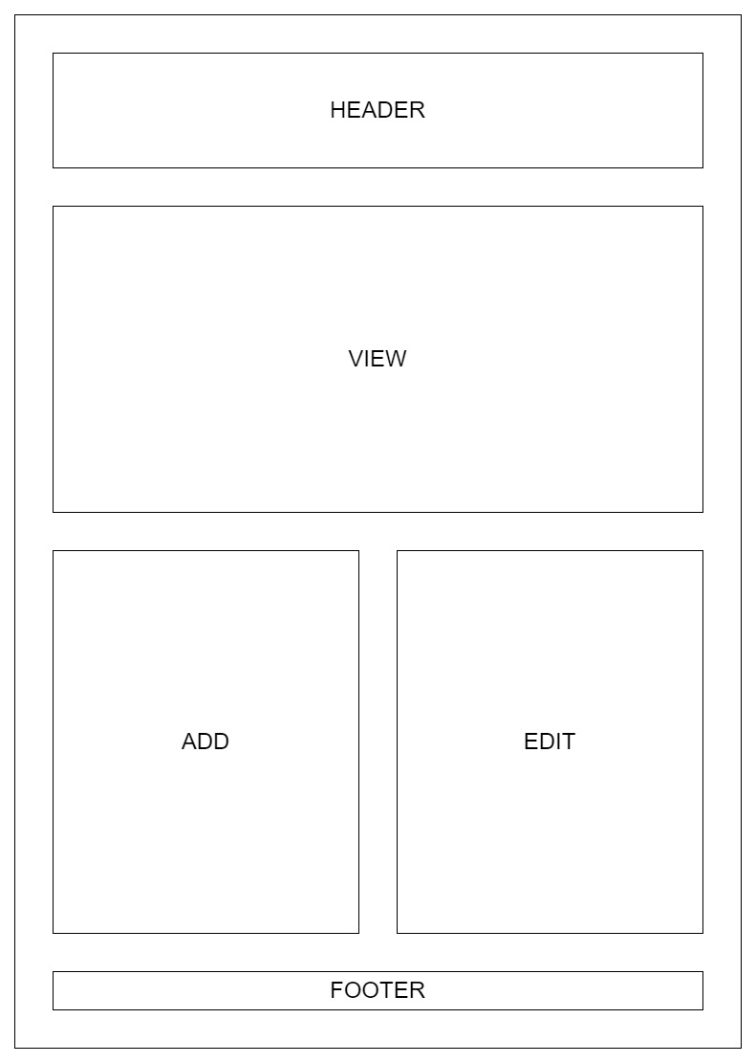
On midsized screens, the view, add and edit sections are displayed in two columns, where the view section has a column span of 2 columns. The navbar and footer links are now displayed in line with separators between them.

Slide 27
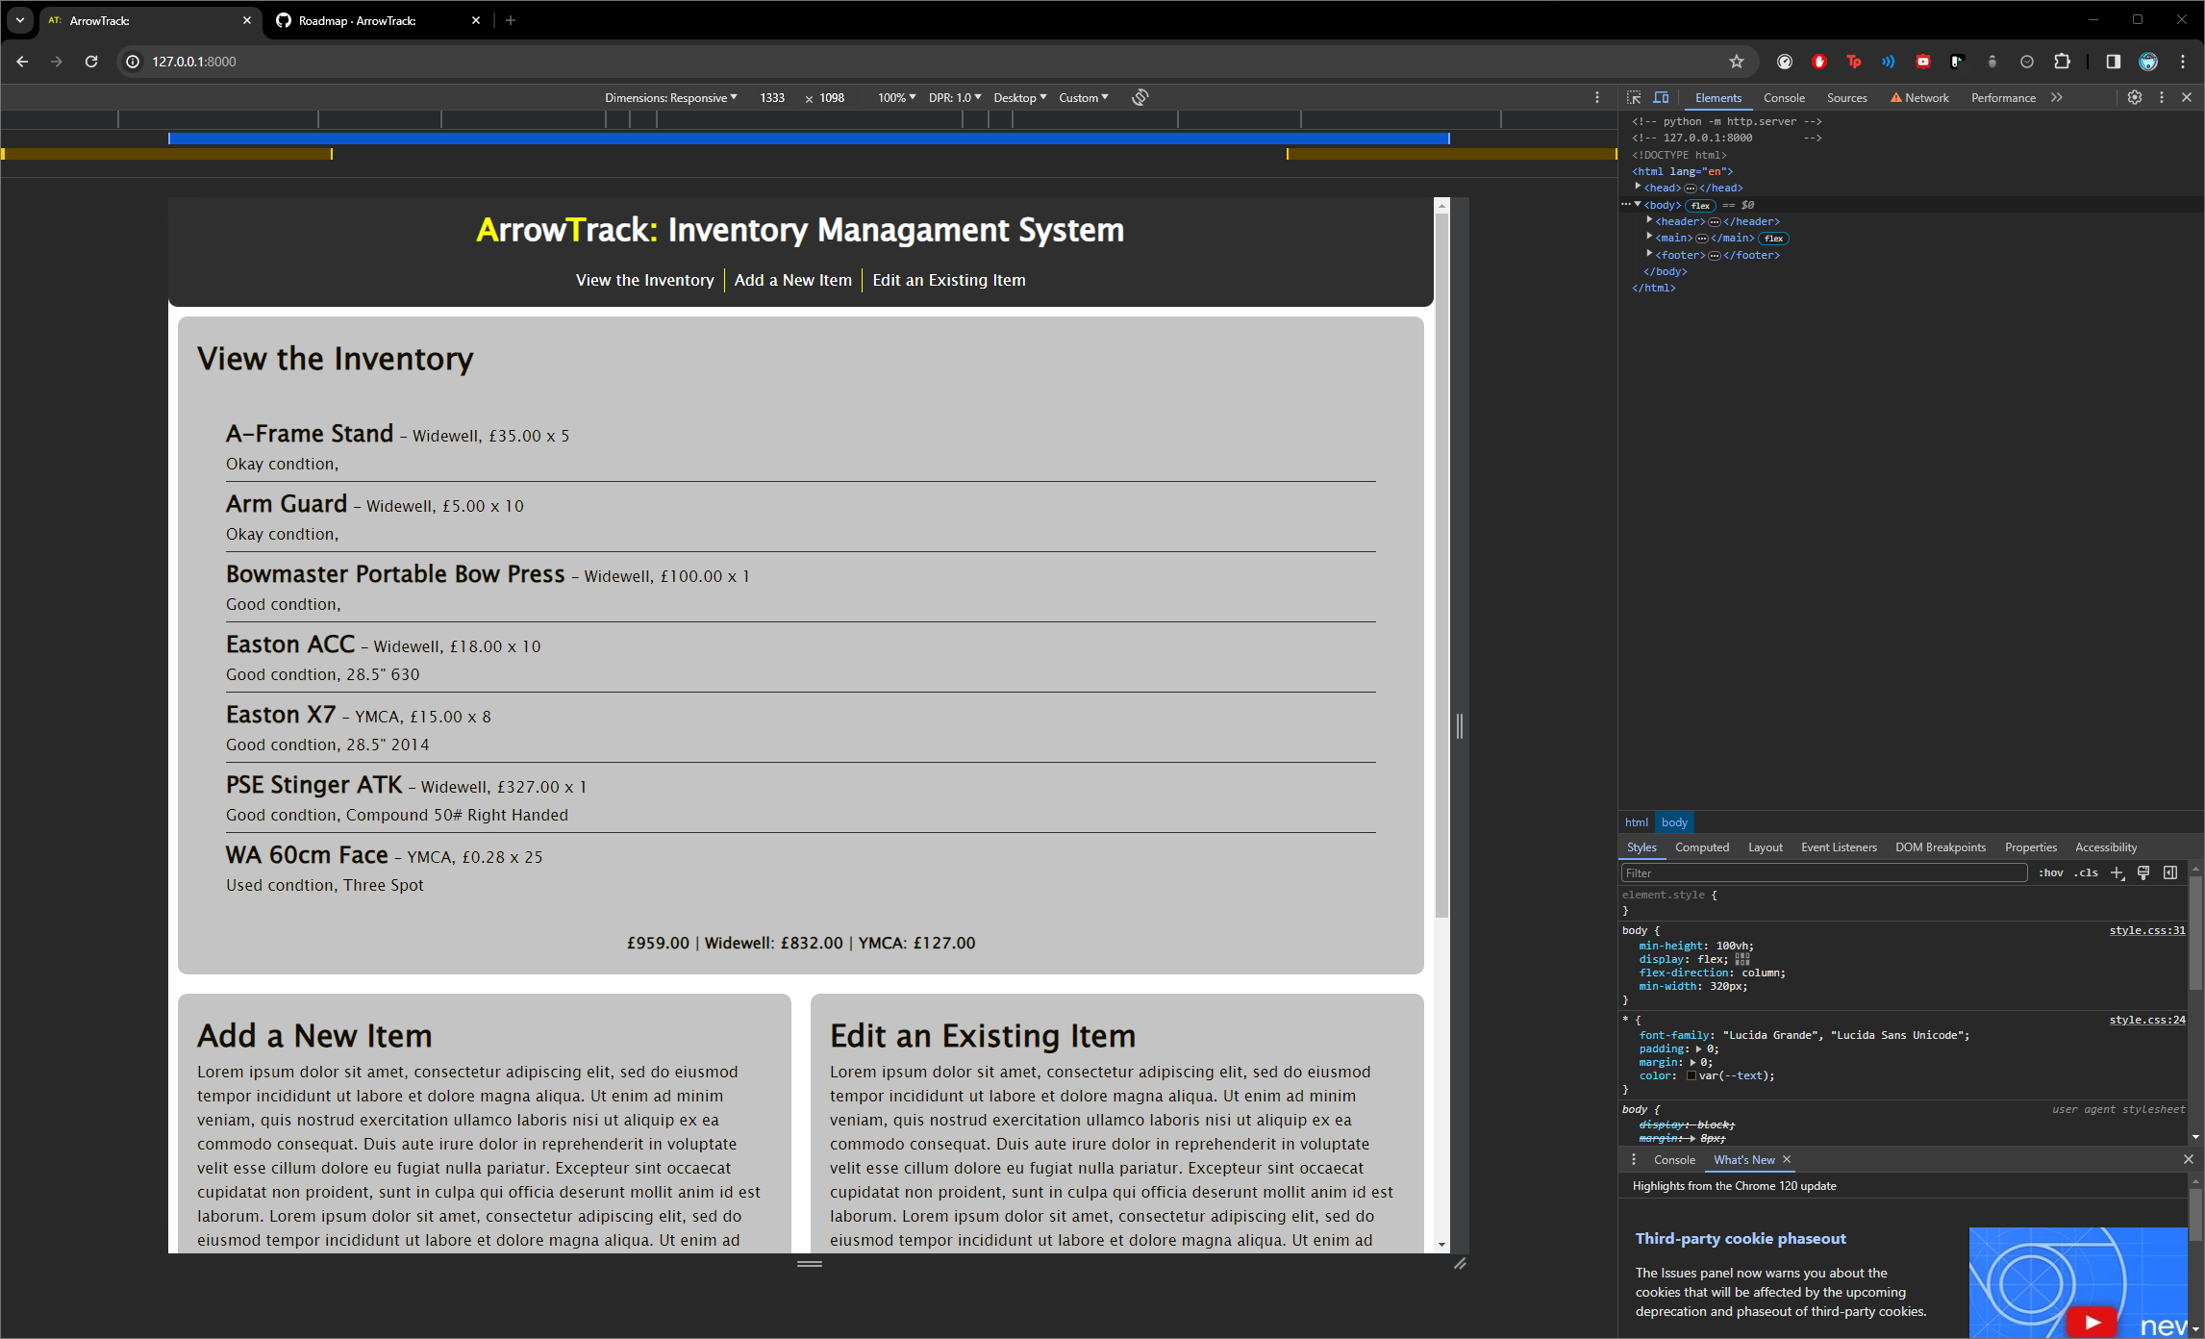

Slide 28
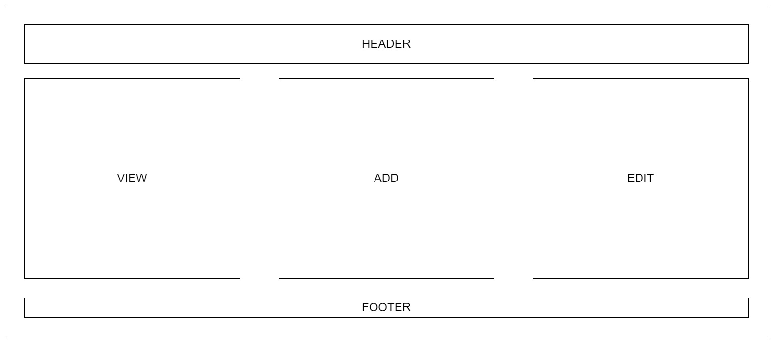
In this rendering, the view, add and edit sections of the page are displayed in one column, and the navbar and footer links are displayed stacked with no separators.

Slide 29
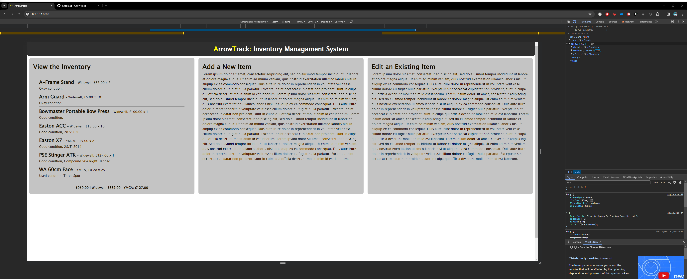

Slide 30
Challenges Faced

Slide 31
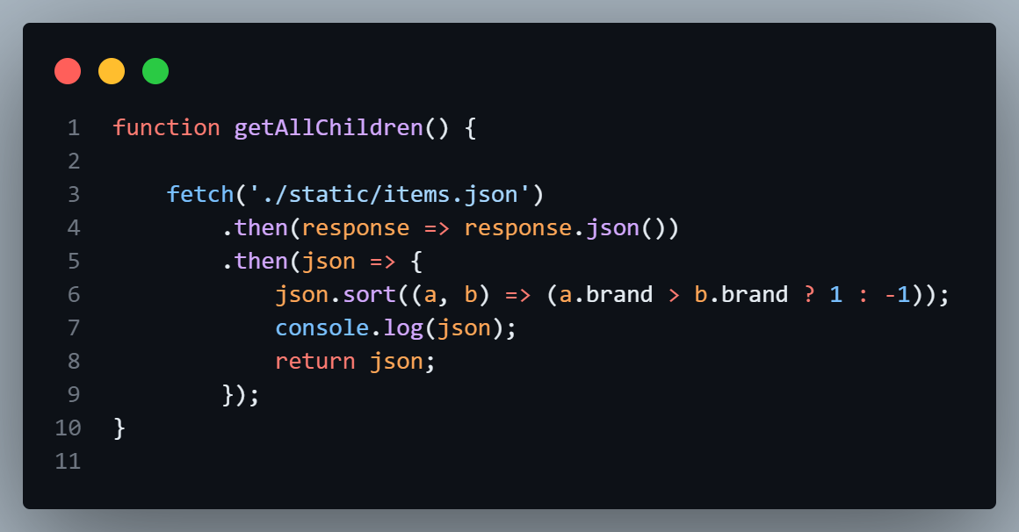

Slide 32
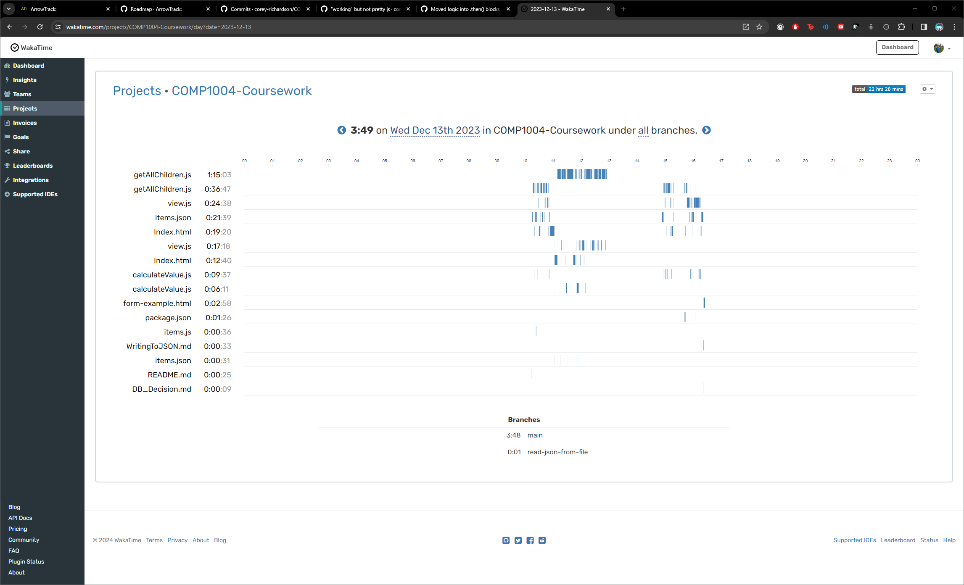

Slide 33
