Slide 1
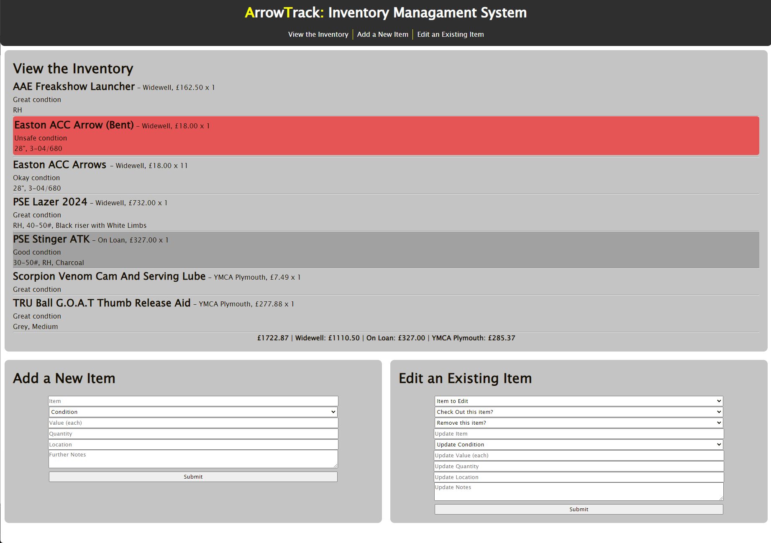
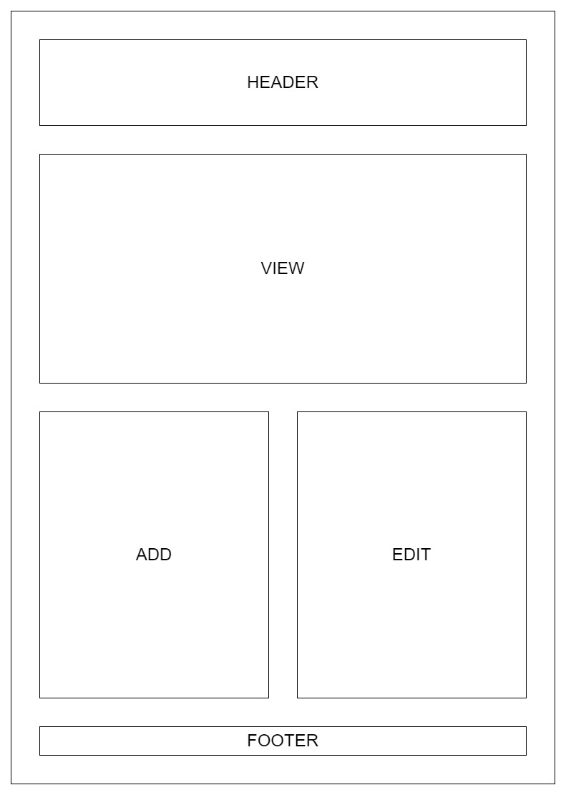
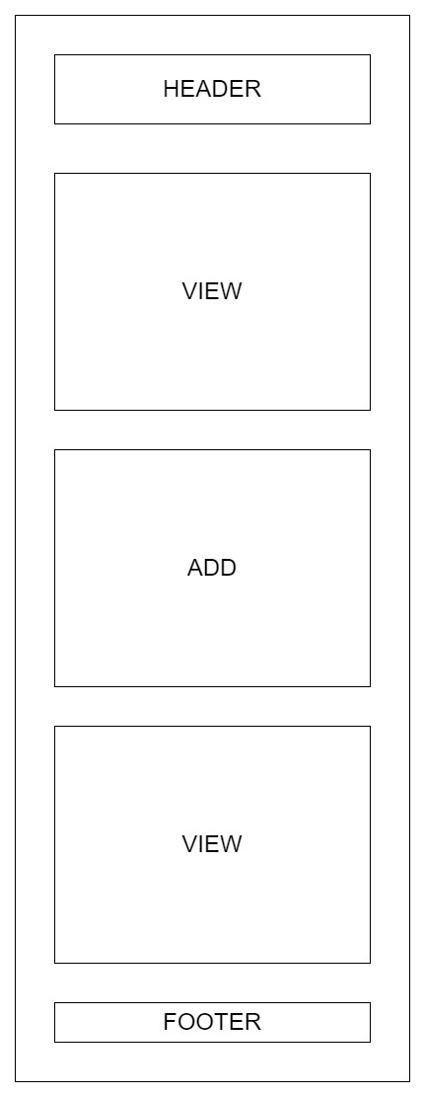
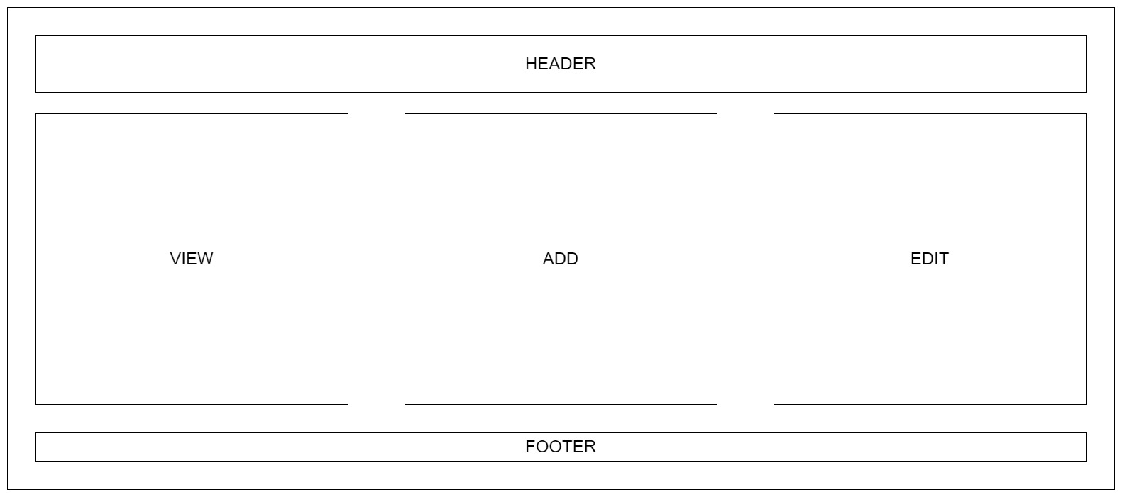

ArrowTrack:
Inventory Management System for Archers and Archery Clubs
OVERVIEW
As an archer and club committee member myself, I recognised the need for a tool that could be easily used to track owned items and their conditions for the purpose of maintenance and budget allocation for replacement equipment, for both individuals and clubs within the archery community, or even other sports communities. ArrowTrack was designed with the goal of addressing these needs.
CORE FEATURES
For individuals, the application provides a tool to monitor the condition of their equipment, ensuring longevity and performance, thus saving money in the long term on damages.
For clubs, where club-owned equipment can be spread across multiple indoor and outdoor ranges, or on loan out to club members trialling different bow setups, the ArrowTrack tool can be used to manage this in one centralised tool.
ArrowTrack’s total cost and by-location cost functionalities can be especially helpful to club treasurers and equipment officers, assisting in insurance estimations and budget planning.
TECHNOLOGY
ArrowTrack implements a single-page application (SPA)
architecture to provide a seamless and responsive user
experience, designed to act as a database front-end. The user’s
data is stored locally, client-side, ensuring data privacy and
confidentiality without the requirement of server-side databases.
This allows ArrowTrack to function anywhere, even in locations
without internet access such as remote archery ranges, ensuring
accessibility despite location.
HTML, CSS, JavaScript and jQuery were the core building blocks used
to create the structure, style and functionality
of this SPA, chosen for their compatibility with
modern web development, and their ability to
load content dynamically within the single
page application architecture.
“This project could be used by archers and archery clubs to track and help maintain the equipment they hold. This would also be useful to track the value of the inventory to assist in insurance calculations and track the items that may need replacing to help with budgeting.”
RES PONSIVE WEB DESIGN (RWD)
A Responsive Web Design and a Mobile-First approach
to development was employed to ensure that the web application remains usable and accessible across a variety of screen sizes to enhance the users experience when using the tool.
Corey Richardson
github.com/corey-richardson/ArrowTrack

