Slide 1

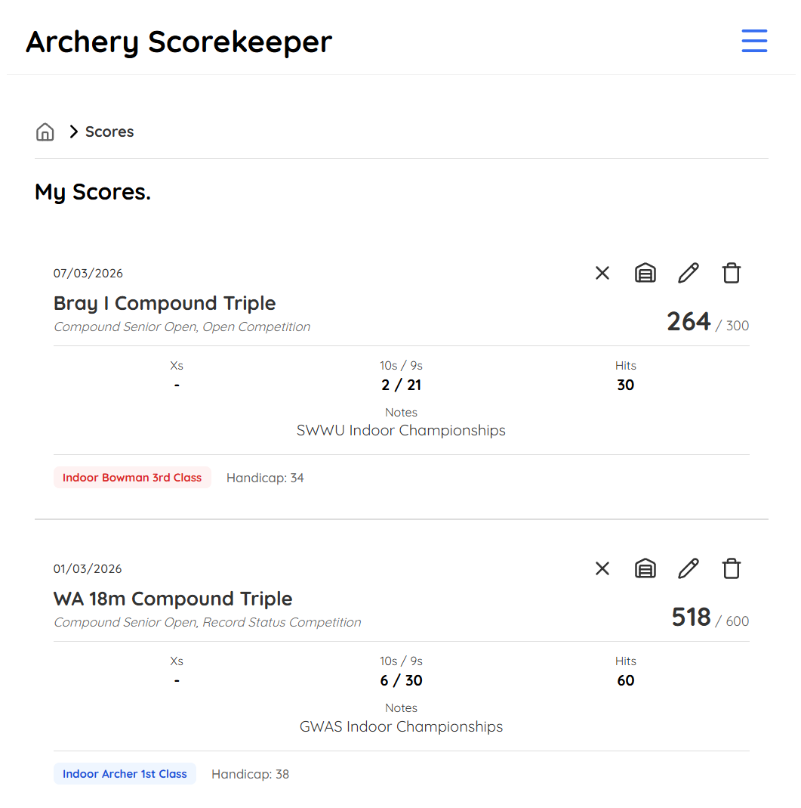
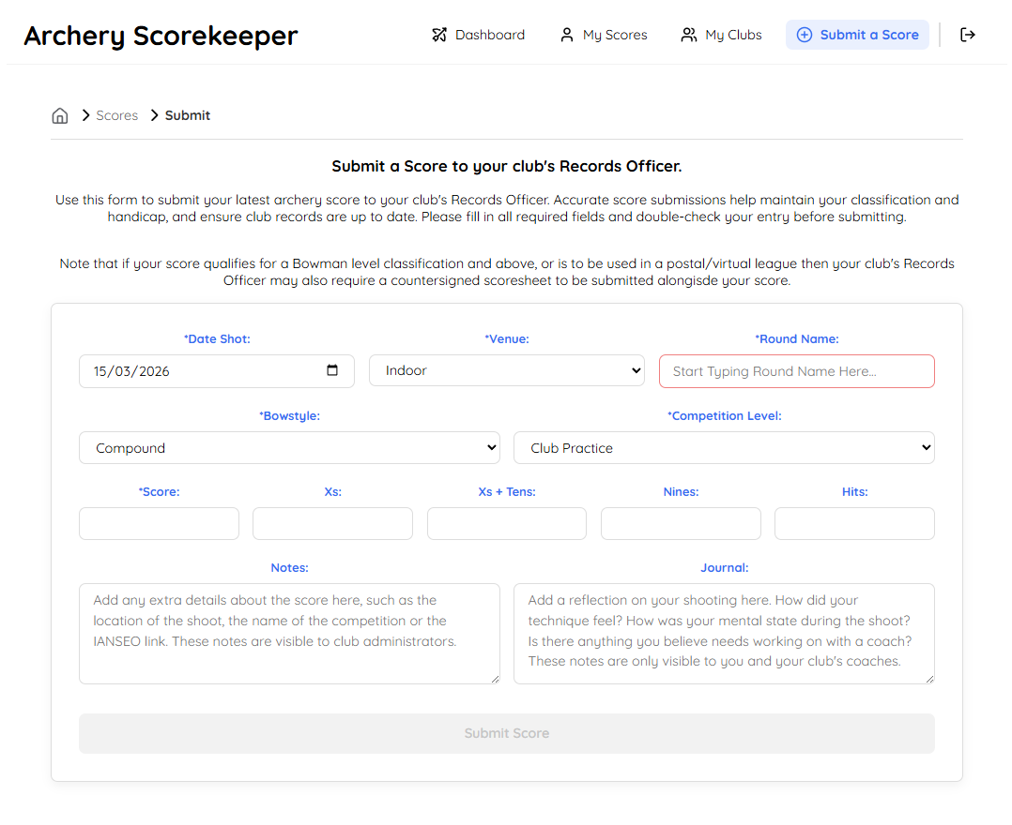








Archery Scorekeeper and Club Management Tool
Archery clubs are largely volunteer-led. The Archery Scorekeeper system acts as a digital secretary to assist these volunteers with the management of the club, handling archers’ score submissions and membership records.
With the traditional pen and paper or Excel spreadsheet method of managing scores, club Records Officers can spend hours staring at handicap tables and cross-referencing values against classification tables. This system automates this process by passing the user submitted scores directly to a Flask container to perform the domain-specific calculations and return the results instantly to the archer.
The system uses a multiple layer security methodology. Access to the website is governed by JWT Authentication, handled by a React Context Hook and persisted in local storage. The hook injects the authentication header into any API request, and the middleware blocks any request with a missing or invalid token. This is bolstered by an API-first Security architecture, with the Express backend stripping PII from the return values during the data serialisation phase, evaluated by the Role Based Access Control permission level of the requestor.
RBAC allows the members of a club to securely manage and own their own data profiles, whilst club officer roles giving volunteers access to specialised features which allow them to perform the duties of their role; Records Officers can manage scores, Admins can validate memberships, coaches can track journals that an archer keeps for performance metrics.
Data is further shielded by the Dockerised infrastructure, hosting the PostgreSQL database alongside the microservices on an isolated virtual bridge network, keeping sensitive data traffic internal on the server on a closed loop, off of the public internet during calculations.
The system utilises a full-stack PERN based architecture, using the Prisma ORM for type-safe data models. Docker is used to containerise and orchestrate communications between the frontend, backend, database and a Python Flask microservice container, running the archeryutils library to handle the automated classification assignments and handicapping.
Corey Richardson
corey.richardson@students.plymouth.ac.uk
BSc Computer Science (Software Engineering) 2026

