Slide 1

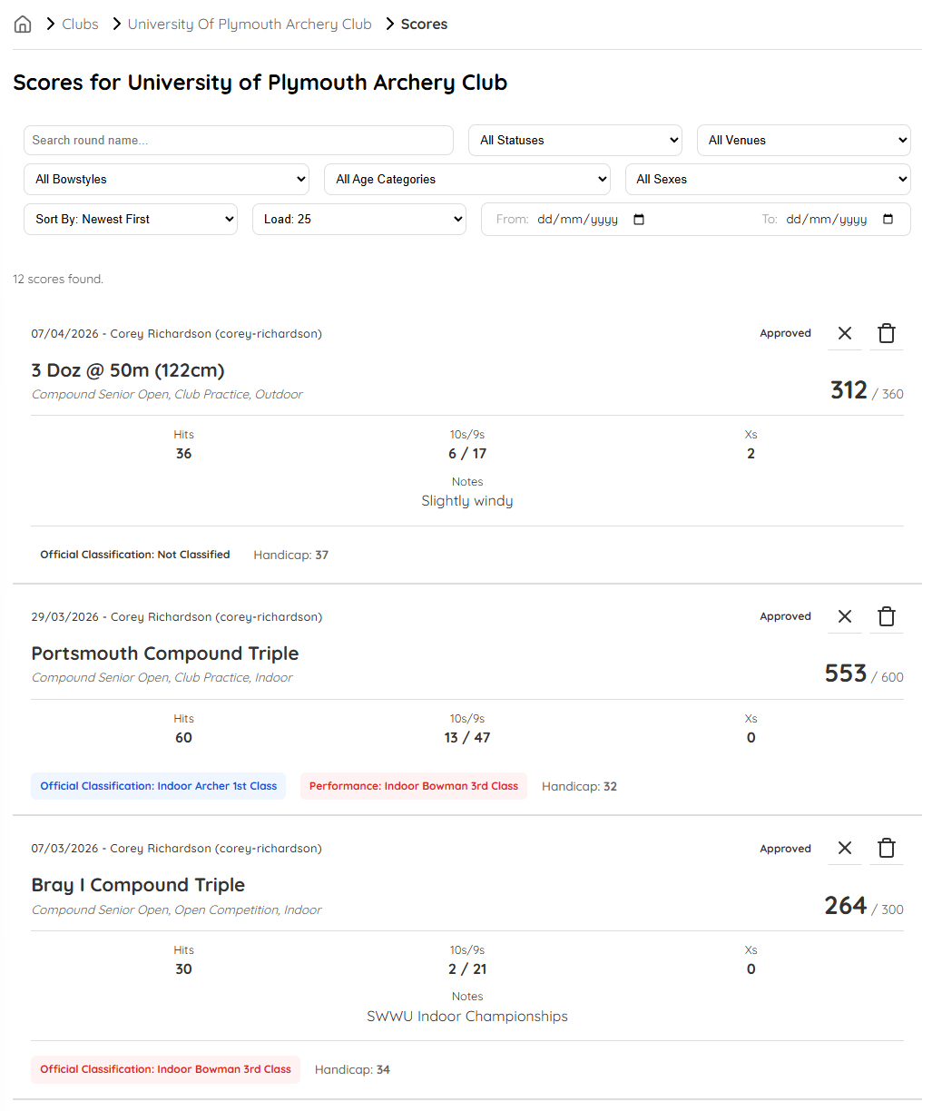









Archery Scorekeeper and Club Management Tool
Archery clubs are largely volunteer-led. The Archery Scorekeeper system acts as a digital secretary to assist these volunteers with the management of the club, handling archers’ score submissions and membership records.
With the traditional pen and paper or Excel spreadsheet method of managing scores, club Records Officers can spend hours staring at handicap tables and cross-referencing values against classification tables.
This system automates this process by passing the user submitted scores directly to a Python/Flask microservice to perform the domain-specific calculations and return the results instantly to the archer.
Club Secretaries and Tournament Officers can manage their members emergency contact information, keeping their archers safe at and away from the club.
Integrated journals allow Coaches to track archers progress via written notes and data metrics.
React Context managed JWT Authentication ensures API requests are validated by Express.js middleware before any data is processed or returned.
Role-Based Access Control offers granular permissions, restricting data visibility on the Principle of Least Privilege.
An AWS Virtual Private Cloud shields the database and Flask microservice from the public internet. Amazon CloudFront provides a single entry-point for external traffic, serving static S3 content and routing API traffic to an ECS Cluster, spanning across three Availability Zones.
The system was built on PostgreSQL, Express.js, React and Node.js to provide a modern full-stack foundation, leveraging Prisma ORM for type-safe data access.
Decoupled Express.js and Flask microservices communicate over a secure, private bridge network, via AWS Cloud.
https://www.archeryscorekeeper.co.uk
Corey Richardson
corey.richardson@students.plymouth.ac.uk
BSc Computer Science (Software Engineering) 2026

