Slide 1
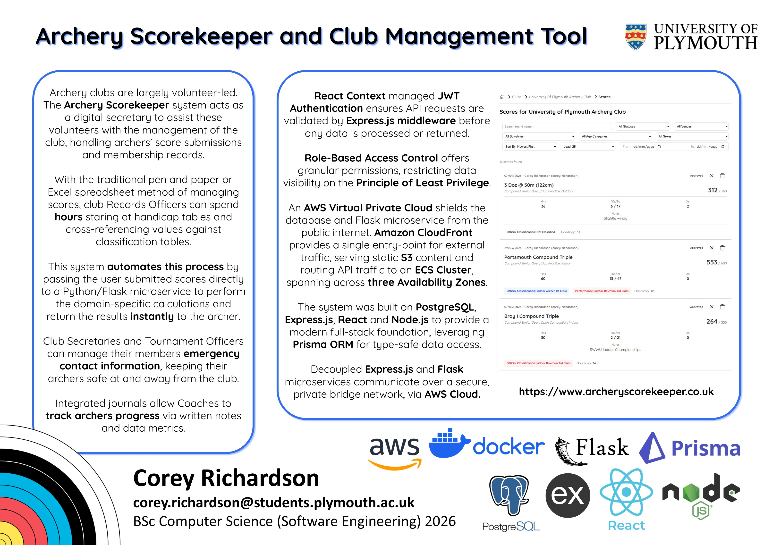

Slide 2
Archery Scorekeeper and Club Management Tool
Corey Richardson
10859643
BSc (Hons) Computer Science (Software Engineering)

Slide 3
Archery Scorekeeper and Club Management Tool
Archery clubs are volunteer-led.
The Archery Scorekeeper system acts as a full-stack digital secretary, assisting volunteers with club management, handling archers’ score submissions, automating the classification handicap workflow, and managing membership records.

Slide 4
Archery Scorekeeper and Club Management Tool
Before
Now
Clubs would use custom-made, bulky Excel Spreadsheets or commercial paid services, such as archr.net or GoldenRecords.
All in one, open-source, free to use.

Slide 5
Archery Scorekeeper and Club Management Tool
Before
Now
Club Records Officers would spend hours staring at handicap tables and cross-referencing values against classification tables.
This system automates the process by passing the user-submitted scores directly to a Python Flask microservice to perform domain-specific calculations and return the results instantly to the archer.

Slide 6
Archery Scorekeeper and Club Management Tool
Before
Now
Club Secretaries would have to manually track and store each members contact information, demographics, etc.
All information is stored in one location, providing the Club Secretary with an easy source of all relevant information related to their members.

Slide 7
Archery Scorekeeper and Club Management Tool
Before
Now
Club Captains and Tournament Officers would have to manually get each members Emergency Contact information.
Users can upload their Emergency Contact information to their profile, putting all safety information in one place.

Slide 8
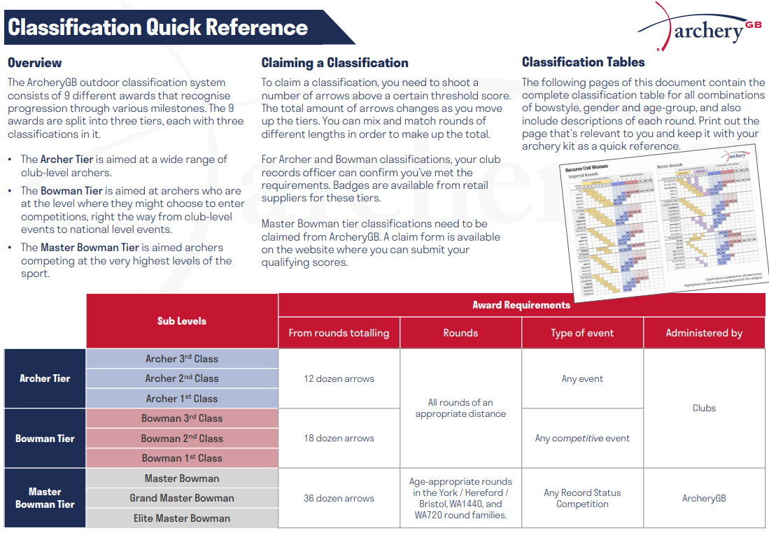

Slide 9
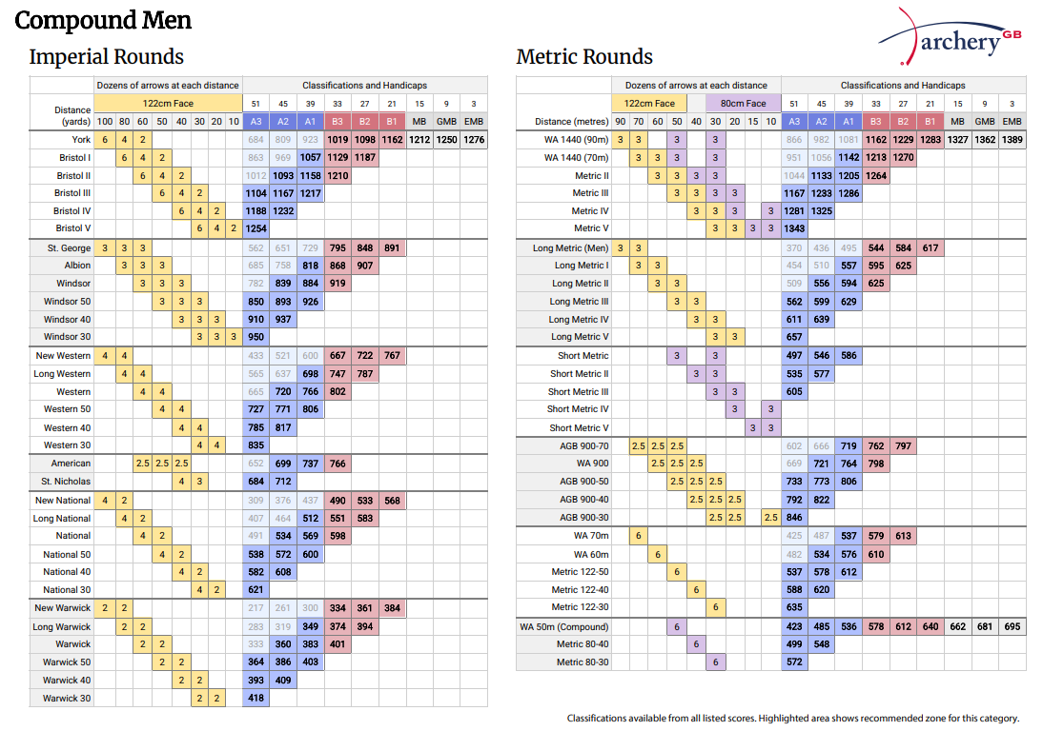

Slide 10
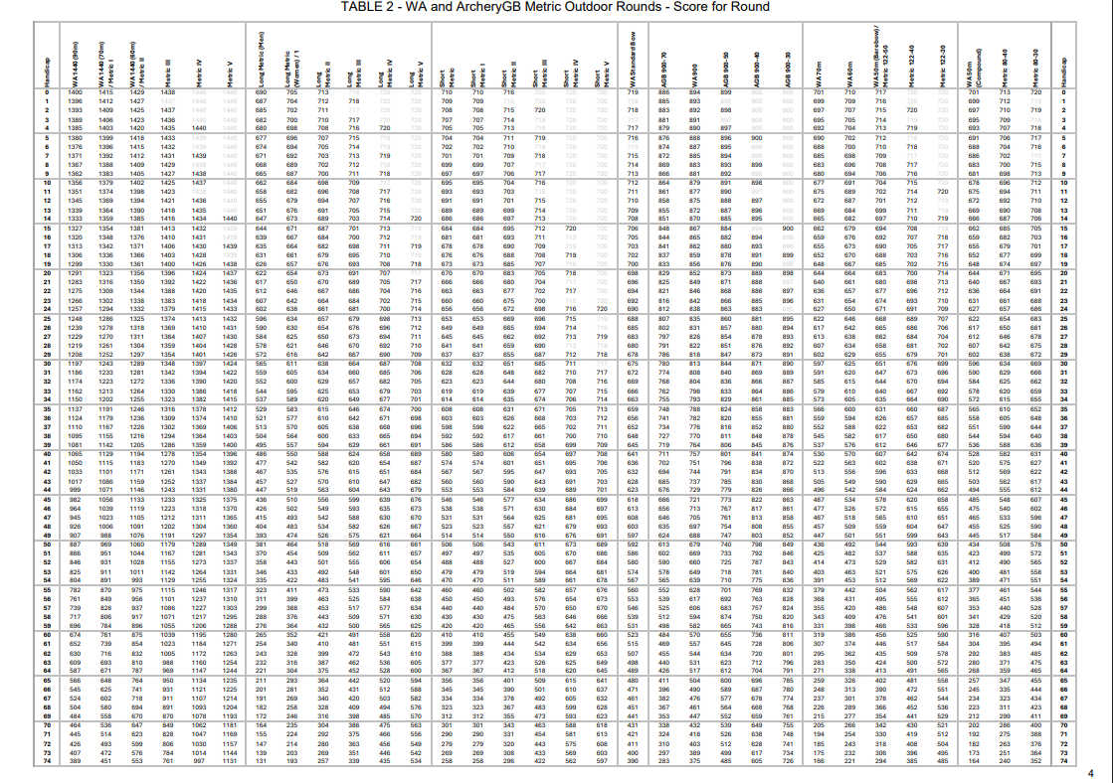

Slide 11
Live Demonstration
https://www.archeryscorekeeper.co.uk

Slide 12
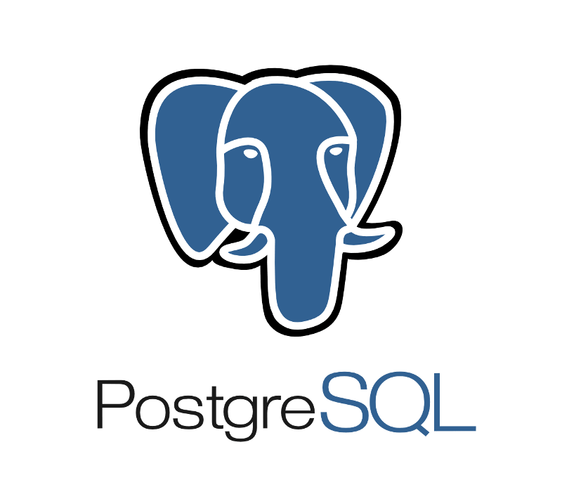


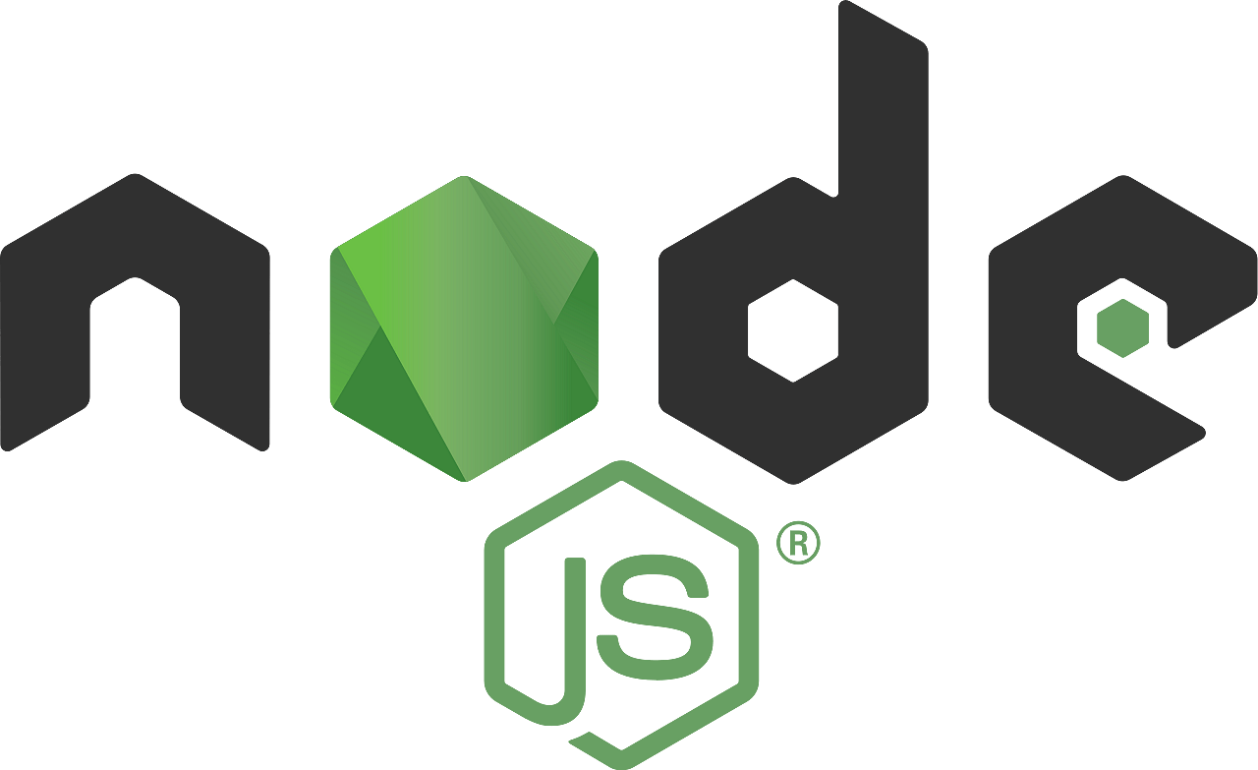



Slide 13
Hosted on AWS RDS, accessed via Prisma ORM for type-safety.
Prisma ORM generates a Prisma Client directly from the.
The Prisma engine parses the models defined in the schema and creates a TypeScript client which can be imported into the backend controllers.
Compile-time validation errors will be thrown immediately if there is an attempt to query a model or field that doesn’t exist, or if there is an attempt to save a value as the wrong data type, removing the possibility of a range of runtime errors

Slide 15
The Express.js backend acts as a hub for the entire system.
Developed using TypeScript to leverage the schema generated Prisma client to enforce compile-time type verification.
Handles React-Context managed JWT Authentication handshakes via the requireAuth middleware.
Microservice for performing domain specific archery classification (POST /calculate) and handicap calculations and lookups.
Uses the archeryutils Python library, which is maintained by the author of the official Archery GB scheme.
Exposes a GET /rounds path, returning a datalist of valid Archery GB and World Archery rounds.

Slide 16
The Express.js backend acts as a hub for the entire system.
Developed using TypeScript to leverage the schema generated Prisma client to enforce compile-time type verification.
Handles React-Context managed JWT Authentication handshakes via the requireAuth middleware.
Replaces the default single threaded Flask development server (which would handle requests sequentially) with a Gunicorn WSGI server using a pre-fork worker model to provide concurrency, meaning the server can handle multiple simultaneous requests in production.

Slide 18
JavaScript SPA using React Context API, custom hooks and real-time UI validation.

Slide 20
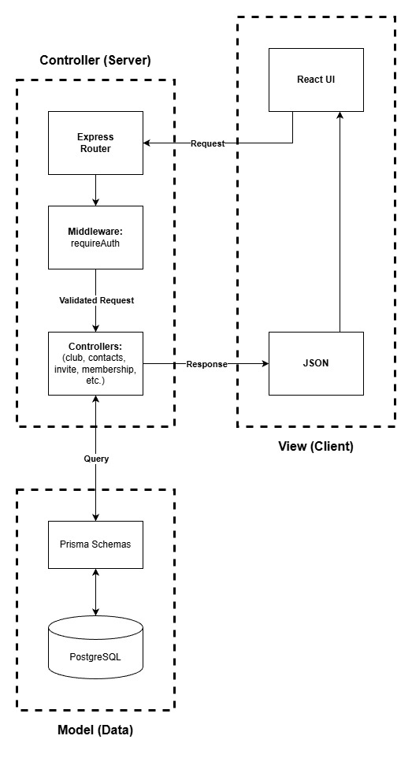
A modified Model-View-Controller pattern maintains separation of concerns.
The requireAuth middleware validates JWT tokens before a controller processes a request.
Controller methods handling domain-specific calculations and lookups are delegated to the Flask microservice over an internal bridge network.

Slide 21



Slide 22
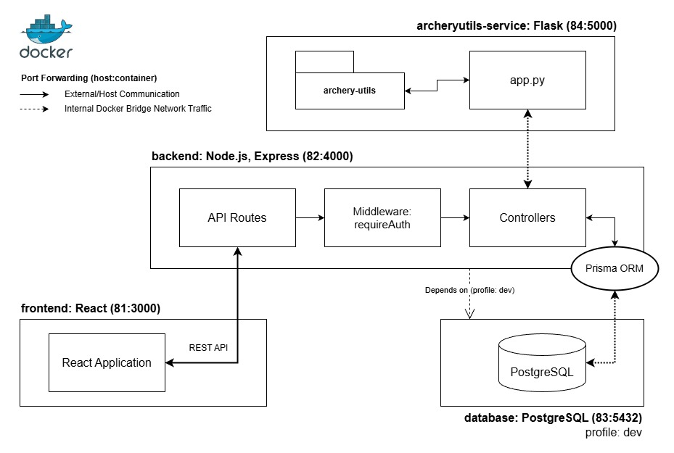

Slide 24
The system is deployed on an AWS Virtual Private Cloud, which shields the database and Flask microservice from the public internet.
CloudFront + Route 53: Single entry point serving static S3 frontend and routing /api/* requests to the ALB.
Application Load Balancer: Distributes traffic across three AZs.
ECS Fargate Cluster: Serverless containers for backend and utils services, connected to the RDS PostgreSQL instance.

Slide 25
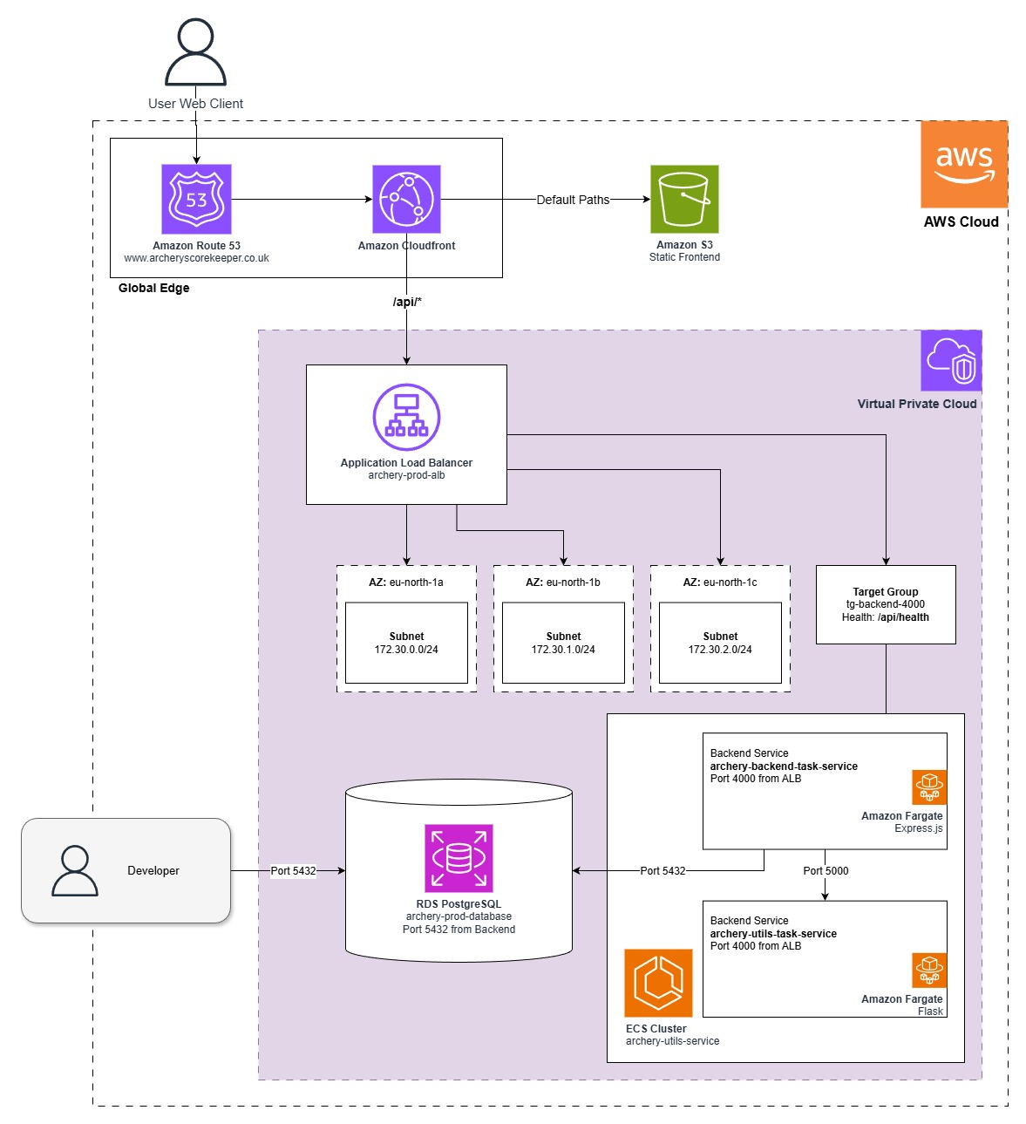

Slide 26
CI/CD Workflow
Shift-left approach; fail as early as possible.
A GitHub Actions pipeline enforces quality gates at each stage, blocking poor quality code from reaching the production environment.
Path filtering with dorny/paths-filter ensures that only the changed services are redeployed.
Cross-workflow communication between CI and CD workflow is used to pass commit metadata between workflows to handle this filtering.
ECS service stability checks prevent failing deployments from being marked as passing.

Slide 27
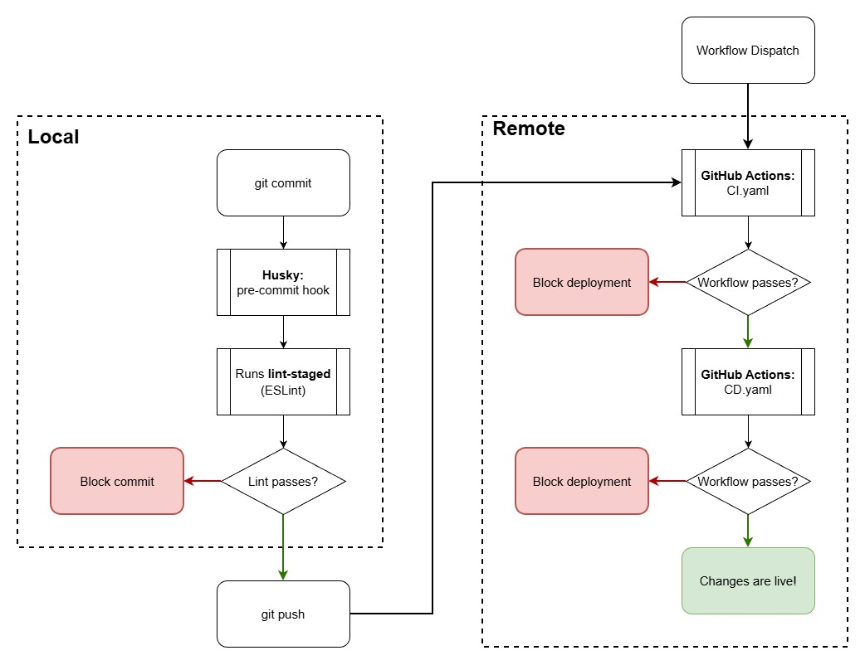

Slide 28
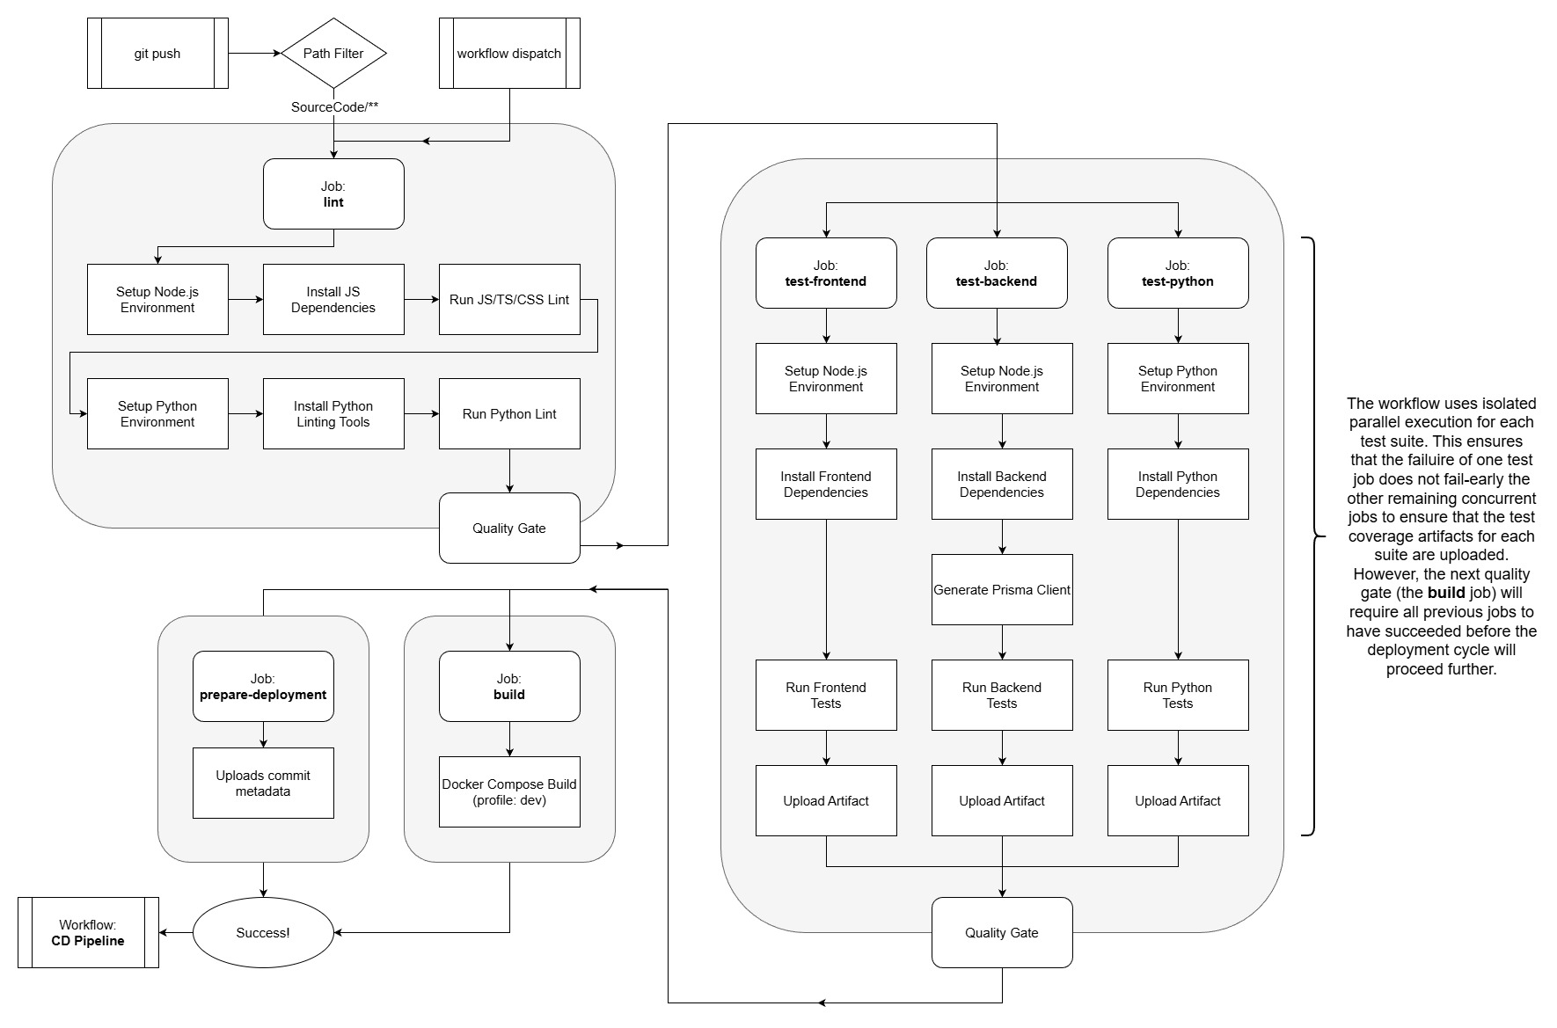

Slide 29
