Slide 1



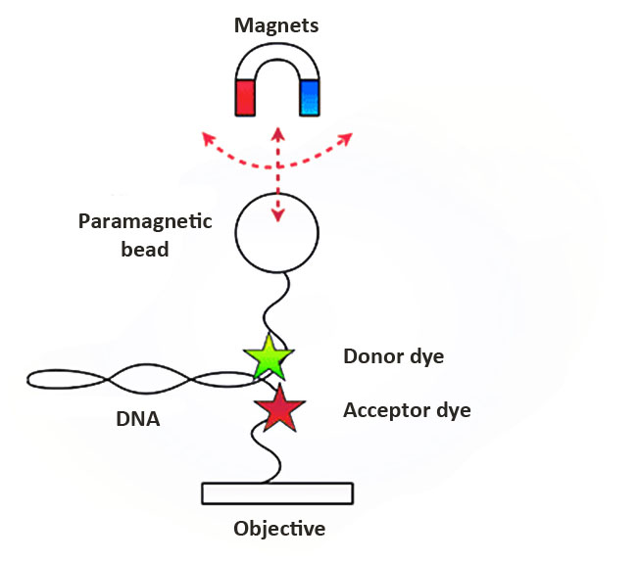
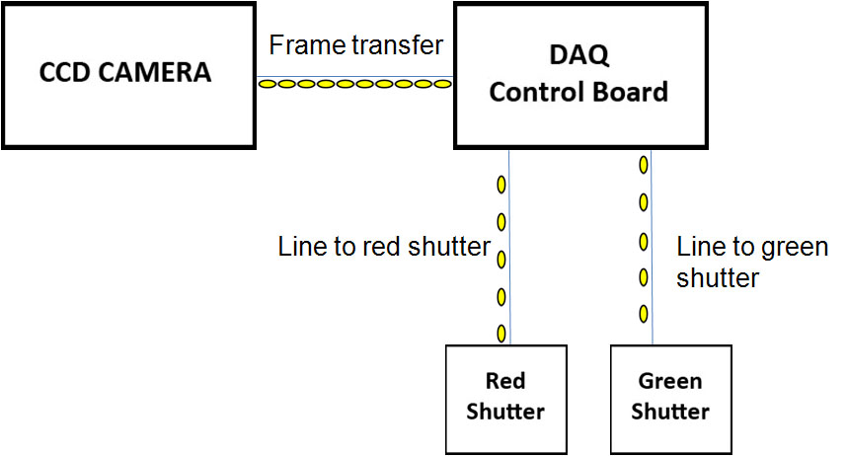
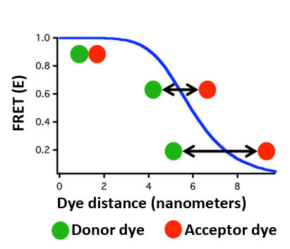
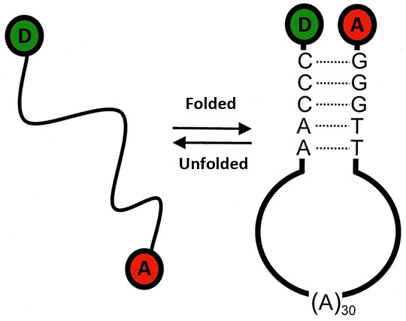
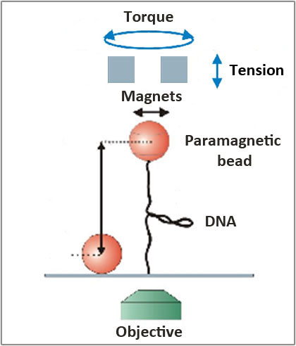
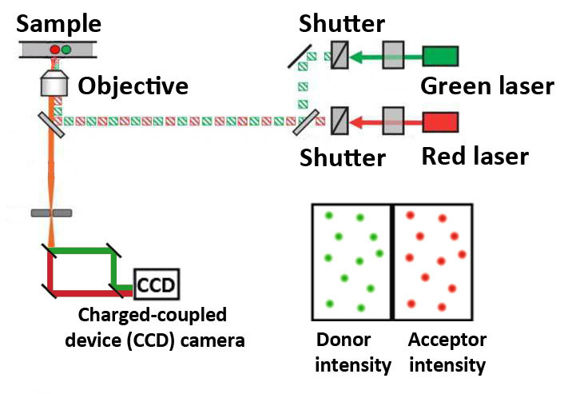
Alternating-laser Excitation (ALEX) Implemented on a Hybrid Magnetic Tweezers Single Molecule Förster Resonance Energy Transfer Instrument
Corey Short, Joe Parks, Salina Long and Michael Stone*
Department of Chemistry & Biochemistry, University of California, Santa Cruz, Santa Cruz, CA 95064
Abstract
Single-molecule spectroscopy has emerged as a technique to study the mechanisms of complex biological systems. Single-molecule measurements typically employ either a fluorescence-based approach such as single molecule Förster resonance energy transfer (smFRET) or a micromanipulation technique such as magnetic tweezers (MT); however, each technique has its own limitations. For our proof of principle experiment, we are using a model hairpin DNA to validate our instrumentation. MT-FRET is used on the hairpin to monitor the unfolded versus folded state of the DNA. Due to the limitations of FRET alone, we will implement alternating-laser excitation (ALEX) as a tool to determine the physical state of our DNA, or to determine if our dye has been photobleached.
Shutter Control Diagram
Recently, the integration of FRET and MT (MT-FRET, Figure 3) has become possible. This is novel because it permits researchers to mechanically manipulate molecules with MT while simultaneously measuring dynamic structural properties by smFRET. In our hairpin DNA experiment, the folded and unfolded state of the DNA is manipulated with the force of the magnets.
The CCD camera captures a signal and outputs the data to the digital I/O of the DAQ control board. The DAQ is wired to the shutters and it outputs a signal to open/close the shutters as shown (Figure 7). The program to sequence the shutter control is written in National Instruments LabVIEW 8.6.
Figure 3. MT and smFRET³
Figure 7. Shutter control
Ensemble Technique
Ensemble is a bulk measurement technique that determines the average behavior of molecules. Single-molecule spectroscopy is novel in comparison because it allows us to investigate the properties of individual molecules and not solely the mechanical and physical properties of large quantities of molecules.
Objective
One of the inherent problems with MT-FRET is during low-FRET and FRET efficiency (E) E = 0 (Figure 4). When the hairpin DNA unfolds (Figure 5), the DNA goes outside the measurable FRET range; therefore, we need to implement a third single molecule technique, alternating-laser excitation (ALEX), which gives us the ability to differentiate between the actual physical state of the DNA, or if low FRET is due to a photophysical effect.
Hairpin DNA Data
By implementing ALEX, we are able to determine the physical state of the hairpin during the low-FRET states when FRET approaches zero intensity (Figure 8). Thus, the direct acceptor excitation graph provided by ALEX confirms that the molecule has not been photobleached and is in fact in an unfolded physical state.
Single-Molecule Techniques
Single molecule Förster resonance energy transfer (smFRET, Figure 1) is a powerful method for monitoring nanometer scale motions within biological macromolecules, measured as the efficiency of energy transfer between a donor and acceptor dye. The donor dye is excited by a light source and the donor dye emits the light, or the energy is transferred to the acceptor dye. Basically, smFRET is a spectroscopic ruler for biological macromolecules.
Folded
Unfolded
Figure 8. Hairpin FRET and direct excitation
Future Direction
Alternating-laser excitation works. I have provided data to support this and the implementation of ALEX clearly provides us with a tool to differentiate if our dye has been photobleached during low and zero FRET states. A wide range of experiments in the Stone Lab will take advantage of this application.
Figure 4. High FRET vs. low FRET⁴
Figure 5. Hairpin DNA⁵
Figure 1. smFRET energy transfer¹
Alternating-laser Excitation
A green and red laser, donor and acceptor lights respectively, are emitted through shutters. The shutters open/close which alternates the light and the resulting alternating light spectrum enters the objective. The light spectrum enters a slit and is emitted through dichroic mirrors that split the red and green spectrum of light into the CCD camera (Figure 6). An image of the bead intensity is displayed on the computer screen. By this technique, the two dyes in the sample are excited directly and we are able to determine the physical state of the hairpin DNA by analyzing the image with software.
Acknowledgements
This research is funded by The National Institutes of Health NIGMS )GM51765-12). I want to thank the ACCESS Program: Prof. Phillip Crews, Pam D’Arcey, and Sarah Gerhardt; the Stone Research Lab; and Justin Daily at National Instruments.
Magnetic tweezers (MT) is a second single-molecule technique that permits the application of tension and torques to individual biomolecules. As shown in the diagram (Figure 2), one side of the DNA is tethered to the objective and the other to a paramagnetic bead. Magnets are used to exert torque and tension force to measure the elasticity and mechanical structural properties of biological macromolecules.
References
1. http://www.molecular-beacons.com/toto/images/FRET.jp1g
2. http://www.biotec.tudresden.de/cms/uploads/pics/magnetictweezers1.png
3. http://www.michaelschlierf.com/images/research_ma.png
4. http://www.dkfz.de/Macromol/research/smfret.html
5. http://www.pnas.org/content/98/10/5584/F1.large.jpg
6. http://ars.els-cdn.com/content/image/1-s2.0-S0006349505733464-gr1.jpg
Figure 2. Magnetic tweezers²
Figure 6. Alternating-laser excitation (ALEX)⁶

