Slide 1
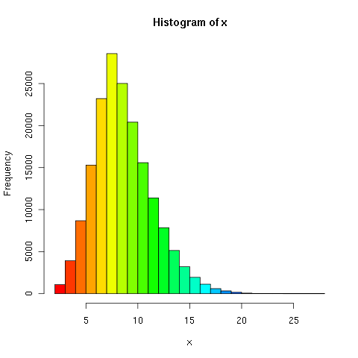
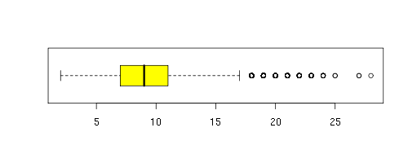
Word Length
Mode: 8
Tails off very rapidly around 17.
Minimum | 2
1st Quartile | 7
Median | 9
Mean | 9.085
3rd Quartile | 11
Maximum | 28

Slide 2
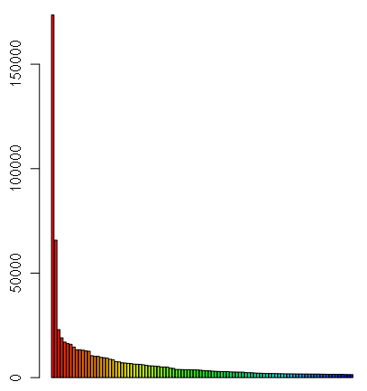
Successor Counts
Appears hyperbolic
Starts high, but trails off very fast with extremely long tail.
Hit nodes with high count means huge expansion in search.
Primary optimization point.

Slide 3
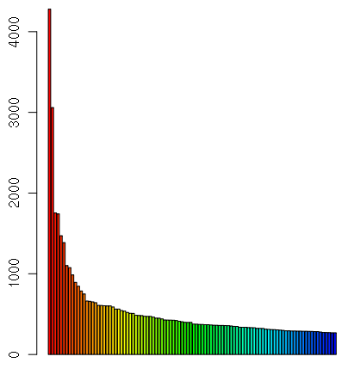
Predecessor Counts
Shows “ways to get to this node”
Lower than successors (4k vs 170k at the top)
Very long tail again.
Again appears hyperbolic.

Slide 4
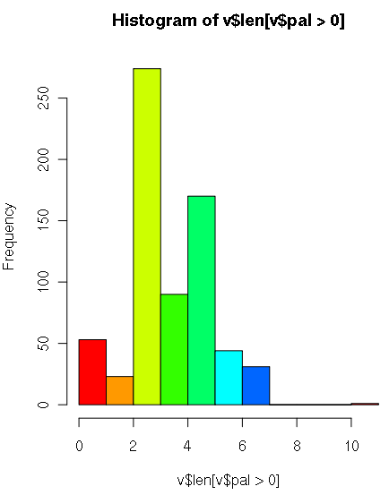

Length of Palindrome Nodes
Palindrome Node: Node whose remainder means palindrome.
Most are small.
686 Palindrome Nodes
Mode: 3
Minimum | 0
1st Quartile | 3
Median | 3
Mean | 3.822
3rd Quartile | 5
Maximum | 11

Slide 5
Branching Factor

