Slide 1
VidRoom
by
Corey Adkins

Slide 2

Why VidRoom?
To watch synchronize your video watching
with friends, family, and pets. No more
counting down!
To store video playlists in your unique
VidRoom for future use.
To celebrate, like Harold.

Slide 3
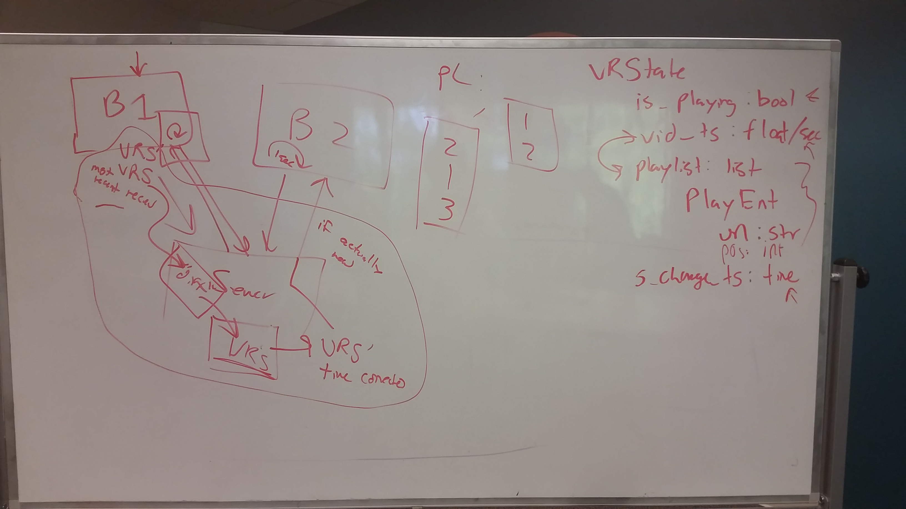
What did I learn?
Servers aren't usually built to interact with clients in this way.
When you start trying to get the server to do this, it gets complicated fast.
Pictured: Diagram David when we were discussing this:

Slide 4
Demo
Pull out your smartphones, and go to this link:
http://bit.ly/2es2FPY

Slide 5
Feel free to use it!
Online at vidroom.herokuapp.com

Slide 6
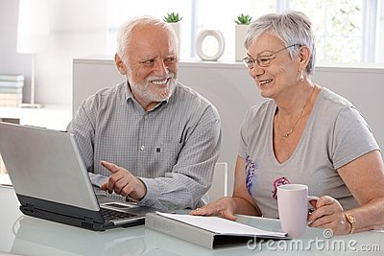
What's next?
  Bring the appearance of the website from 1997 to 2016
  Supporting of other formats, including potentially using the Dropbox API to play files from your Dropbox account.
  Exploring other models for web synchronization, like WebSockets.
  Serverless model using GitHub.
  Watching videos with friends.

