Slide 1
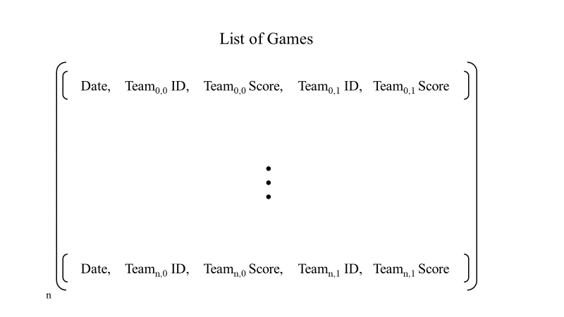

Slide 2
List of Games
Date, Team_{0,0} ID, Team_{0,0} Score, Team_{0,1} ID, Team_{0,1} Score
…
Date, Team_{n,0} ID, Team_{n,0} Score, Team_{n,1} ID, Team_{n,1} Score
n

Slide 3
Trained Model
1st Round Games
Predicted 2nd Round Games
Team_{0,0} ID, Team_{0,1} ID
Create feature vector
Predict
Select Winning ID
Create Match
Team_{0,?} ID, Team_{1,?} ID
Team_{1,0} ID, Team_{1,1} ID
Create feature vector
Predict
Select Winning ID
…
…
…
Team_{30,?} ID, Team_{31,?} ID
Team_{30,0} ID, Team_{30,1} ID
Create feature vector
Predict
Select Winning ID
Create Match
16
Team_{31,0} ID, Team_{31,1} ID
Create feature vector
Predict
Select Winning ID
32

Slide 4
Feature Vector
Label Vector
Team_{0,0} Kenpom Features
Team_{0,1} Kenpom Features
Team_{0,0} Score
–
Team_{0,1} Score
…
…
Team_{n,0} Score
–
Team_{n,1} Score
Team_{n,0} Kenpom Features
Team_{n,1} Kenpom Features
n

Slide 5
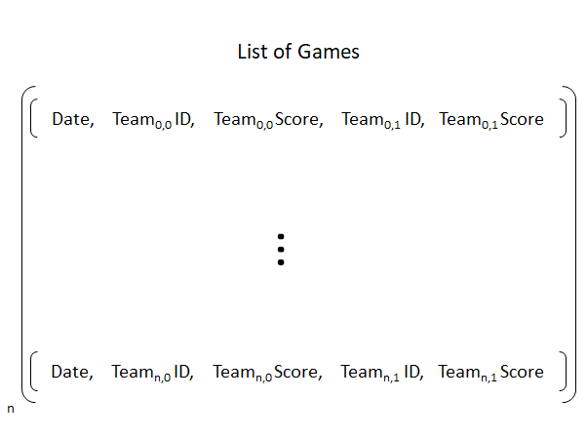
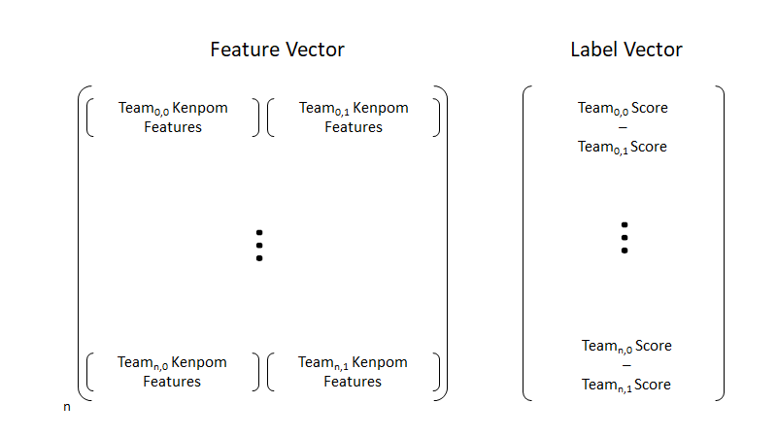
Raw Data
Formatted Data
Pre-process

Slide 6
Kenpom Statistics Dictionary
Team₀ ID
Kenpom Statistics for Team₀
Hash
…
…
Team_{m} ID
Kenpom Statistics for Team_{m}
m
m

