Slide 1
Breaking the Dependency Chain
Event-Driven Architecture for Independent Teams
How domain events, stream processing, and infrastructure abstraction eliminate coupling at every layer

Slide 2
The Problem: Independence in Name Only
Typical Microservice "Independence"
Shared Databases
Multiple teams read/write the same tables. Schema changes require cross-team coordination.
Frontend
API Dependency Chains
Service A calls B, which calls C, which calls D. A single slow or defective endpoint cascades everywhere.
API Gateway
Synchronized Deployments
Order Service
Coupled services must deploy together. One team's release blocks another.
Inventory Service
Cascading Failures
One service goes down and takes the rest of the chain with it.
Payment Service
One slow service slows everything above it

Slide 3
The Solution: Decouple at Every Layer
No Shared Database
Events, Not API Calls
Atomic Outbox Pattern
Each service owns its data store. Payroll API → MongoDB Listener API → MySQL Stream Processing → Kafka Schema changes stay within team boundaries.
Services communicate through domain events on Kafka. No service ever calls another service directly. A downstream consumer being slow or offline has zero impact on the producer. Teams deploy on their own schedule.
Entity state + event published in a single atomic transaction. No dual-write problem. No distributed transactions. No eventual consistency surprises. If the write succeeds, the event is guaranteed to publish.

Slide 4
The Balance Pipeline: From Event to Paycheck
Each stage is an independent process with its own data — no service calls another
Domain Events
Kafka
ksqlDB Stream Processing
Net Pay Processor (Kafka Streams)
Consumers
Employee, TimeEntry, Tax, Deduction changes
Durable event log (employee-events topic)
Real-time aggregation Gross pay per period
Taxes + deductions applied per period
GraphQL subscriptions Elasticsearch index
Why This Matters for Teams
Self-healing
If the Net Pay Processor restarts, it rebuilds from Kafka. No data loss, no manual recovery.
Edit-safe aggregation
Time entry corrections are automatically deduplicated — no double-counting, no reconciliation scripts.
Independently scalable
Each stage scales on its own. A spike in time entries doesn't slow down pay calculations.
Replay from any point
Kafka retains the event log. Rebuild any downstream view by replaying events.
Full pipeline details to follow in walkthrough

Slide 5
What Dapr Gives Us
Transactional Outbox (Built-in)
Reduced Onboarding Friction
Entity + event saved atomically in one call. Dapr handles the outbox relay to Kafka. Zero custom outbox infrastructure to build or maintain.
New team members learn one API surface (Dapr) instead of Kafka clients, MongoDB drivers, distributed transaction patterns, etc.
Infrastructure Abstraction
Observability for Free
Your code calls Dapr APIs, not Kafka/Mongo APIs directly. Swap Kafka for RabbitMQ, or MongoDB for Postgres, by changing a YAML file — no code changes.
Distributed tracing (Zipkin), metrics, and logging are built into the sidecar. No instrumentation code.
Sidecar Pattern
Resilience by Default
Dapr runs alongside your app, not inside it. Any language can use it — .NET, Java, Python, Go. Teams pick the stack that fits their service.
Retries, circuit breakers, and timeout policies configured in YAML. Consistent across all services without each team implementing their own.

Slide 6
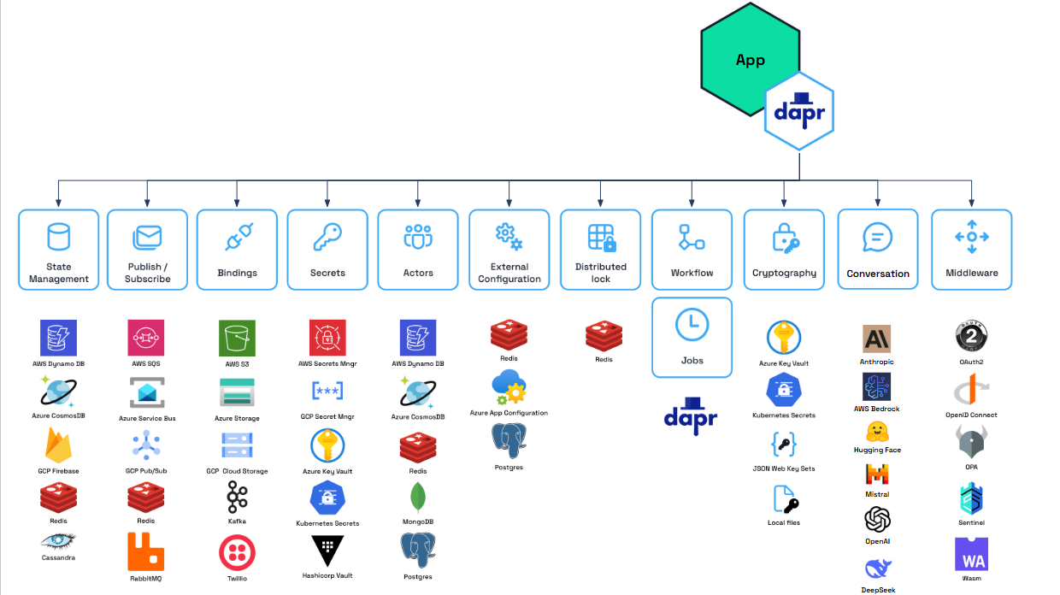

Slide 7
Testability: Confidence Without End-to-End Fragility
Unit Tests
Integration Tests
Pipeline Tests
Domain Logic in Isolation
Services in Isolation
Stream Processing in Isolation
Pure C# objects with no infrastructure. Employee, TimeEntry, Deduction entities raise domain events in memory. Test business rules with plain unit tests. No databases, no Kafka, no Dapr.
Each service has its own data store and communicates only through events. Test a service by feeding it events and asserting on its output events. No need to stand up the full stack.
ksqlDB queries are pure SQL transforms on Kafka topics. Test by publishing known events to a topic and querying the output table. Kafka Streams topology testable with TopologyTestDriver (in-memory).
Key insight: event-driven boundaries ARE test boundaries. The same interfaces that decouple teams also decouple tests.

Slide 8
This Isn't About Best Practices
It's About Organizational Velocity
Teams deploy independently — no coordination, no waiting.
A failure in one service is invisible to other services.
New services consume events without changing existing code.
Infrastructure decisions can change without rewriting applications.
Every component is testable in isolation at the boundary it already has.

Slide 9
Changes in payroll pro propagate to client listener
Changes to the parts that make up the balance recalculate the balance
Delete all data in the consumer. Restore employee, then child data.
Net pay uses a microservice for more complex aggregations
Elastic search populated via Kafka connectors to move data without writing code. Stream service uses a materialized view to put it in the best compatible format.
Dapr configuration file.
Ksqld sql file.

