Slide 1
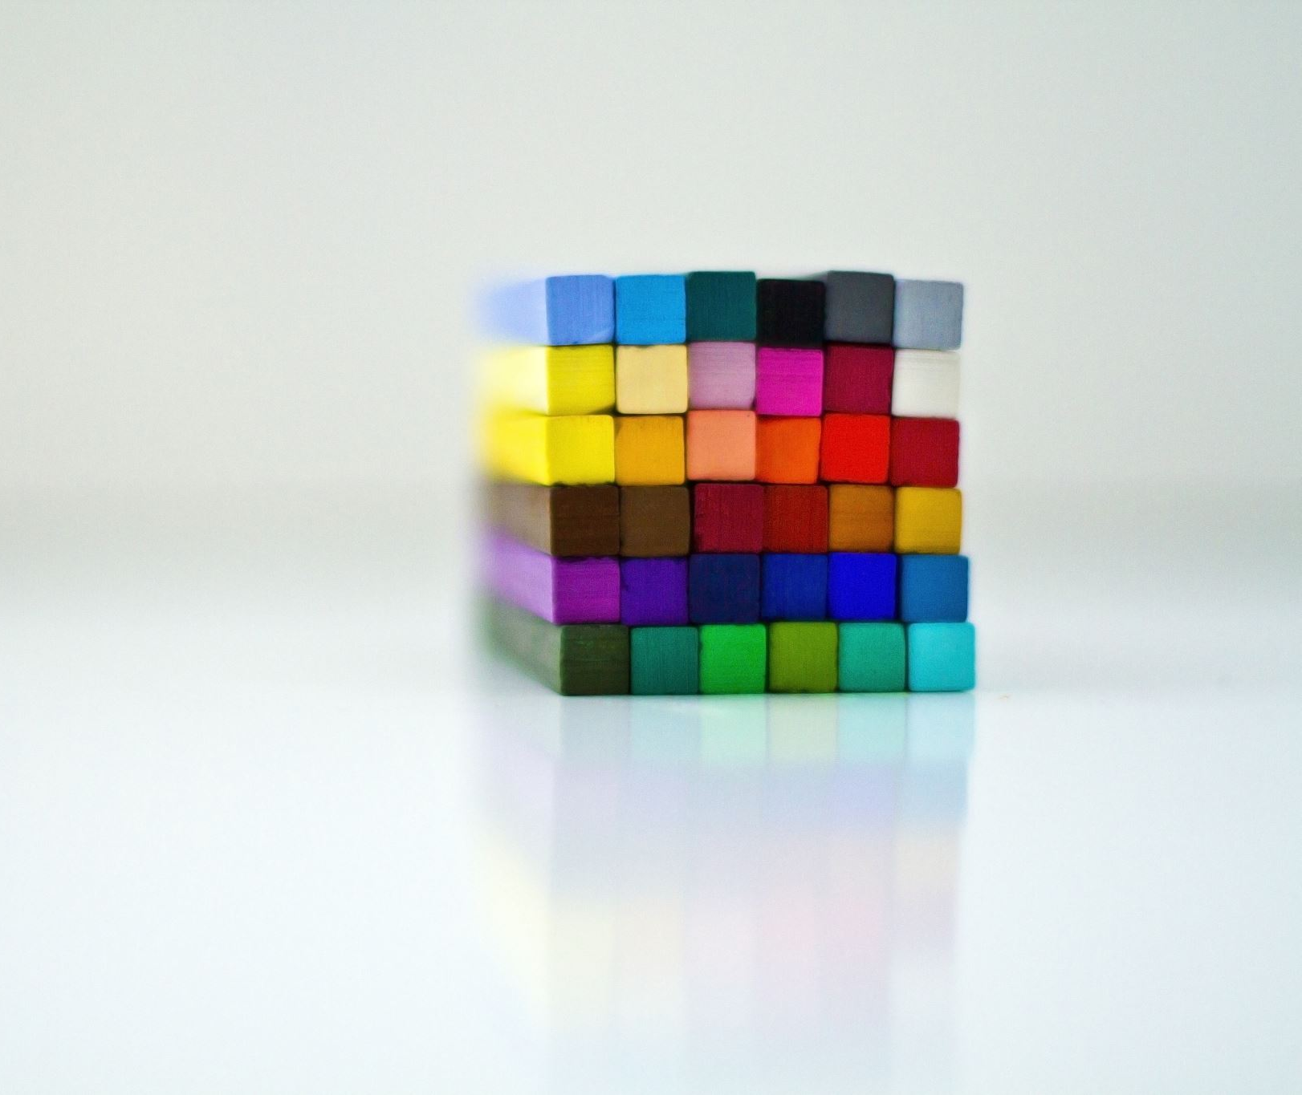
Magic Square
Corey Zhang

Slide 2

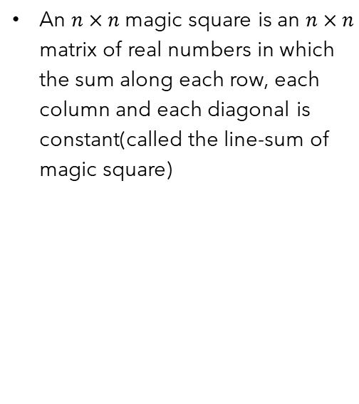
Definition of magic square
An $n×n$ magic square is an $n×n$ matrix of real numbers in which the sum along each row, each column and each diagonal is constant(called the line-sum of magic square)

Slide 3
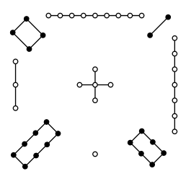
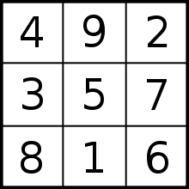
Lo-shu square

Slide 4
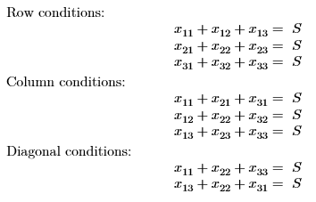
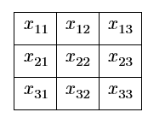
Magic square of order 3

Slide 5
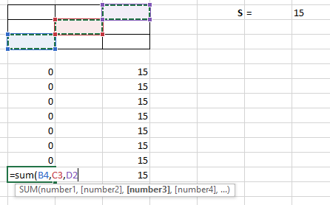
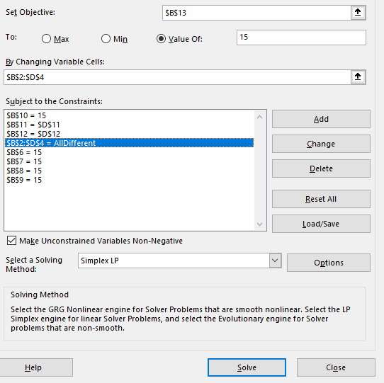
Magic square of order 3

Slide 6
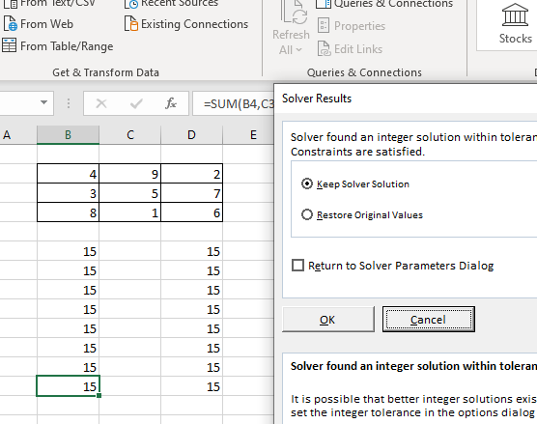
Magic square of order 3

Slide 7
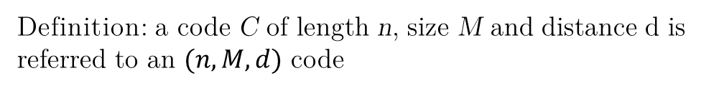
Application: Error Correcting Codes
Codes: {00, 01, 10, 11}
(2, 4, 1)
Codes: {00000, 01110, 10001, 11111}
(5, 4, 2)
Definition: a code C of length n, size M and distance d is referred to an $(n, M, d)$ code
Codes: {00000, 01110, 10001, 11111, 00111}
(5, 5, 2)
Codes: {01101, 00011, 10110, 11000}
(5, 4, 3)

Slide 8
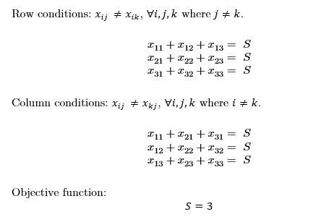
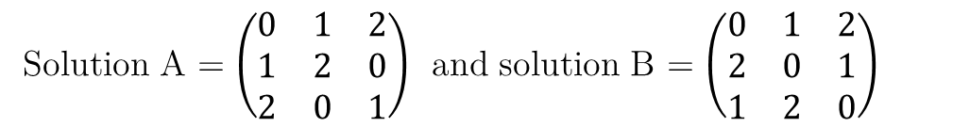
Application: Error Correcting Codes
Solution A = $\left(\begin{matrix}0 & 1 & 2 \\ 1 & 2 & 0 \\ 2 & 0 & 1\end{matrix}\right)$ and solution B = $\left(\begin{matrix}0 & 1 & 2 \\ 2 & 0 & 1 \\ 1 & 2 & 0\end{matrix}\right)$

Slide 9
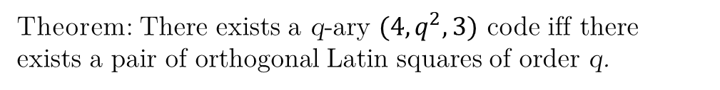
Application: Error Correcting Codes
A = $\left(\begin{matrix}0 & 1 & 2 \\ 1 & 2 & 0 \\ 2 & 0 & 1\end{matrix}\right)$ and B = $\left(\begin{matrix}0 & 1 & 2 \\ 2 & 0 & 1 \\ 1 & 2 & 0\end{matrix}\right)$
Theorem: There exists a q-ary $(4, q^{2},3)$ code iff there exists a pair of orthogonal Latin squares of order q.
{0000, 0111, 0222, 1012, 1120, 1201, 2021, 2102, 2210}

Slide 10

Properties of Vector
Addition: $\vec{v},\vec{w}$ are vectors $⟹$ $\vec{v}+\vec{w}$ is a vector
Commutativity: $\vec{v}+\vec{w}=\vec{w}+\vec{v}$
Zero vector: $\vec{0}$
Identity element: $\vec{0}+\vec{v}=\vec{v}+\vec{0}$ $=\vec{v}$
Inverses: $\vec{v}+\left(−\vec{v}\right)=\left(−\vec{v}\right)+\vec{v}=$ $\vec{0}$
Associativity: $\vec{v}+(\vec{w}$ $+ \vec{z})$ = $(\vec{v}+\vec{w})$ $+ \vec{z}$
Vector Spaces are Commutative Groups

Slide 11

Properties of Vector spaces
Scaling Vectors
$v=\left(v_{1},v_{2},…,v_{n}\right)$ and $c∈ℛ$
$c∙\vec{v}=$ $\left(c∙v_{1},c∙v_{2},…,{c∙v}_{n}\right)$
$c$ is called a scalar

Slide 12

Properties of Vector Scalars
Distributive Properties:
$$c∙\left(\vec{v}+\vec{w}\right)=c∙\vec{v}+c∙\vec{w}$$
$$\left(c+d\right)∙\vec{v}=c∙\vec{v}+d∙\vec{v}$$
Associative Property:
$$c∙\left(d∙\vec{v}\right)=(c×d)∙\vec{v}$$
Action of 1:
$$1∙\vec{v}=\vec{v}$$

Slide 13


Vector space definition
Commutative group $V$ under $"+“$
A field of scalars $F$
$v∈V$ a vector, $f∈F$ a scalar
$$⟹f∙v∈V$$
Distributive properties:
$f∙\left(\vec{v}+\vec{w}\right)=f∙\vec{v}+f∙\vec{w}$
$$\left(f+g\right)∙\vec{v}=f∙\vec{v}+g∙\vec{v}$$
Associative property:
$$f∙\left(g∙\vec{v}\right)=(f×g)∙\vec{v}$$
Scaling by 1:
$$1∙\vec{v}=\vec{v}$$

Slide 14
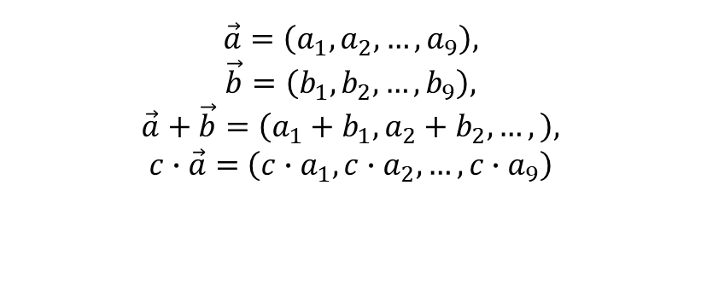
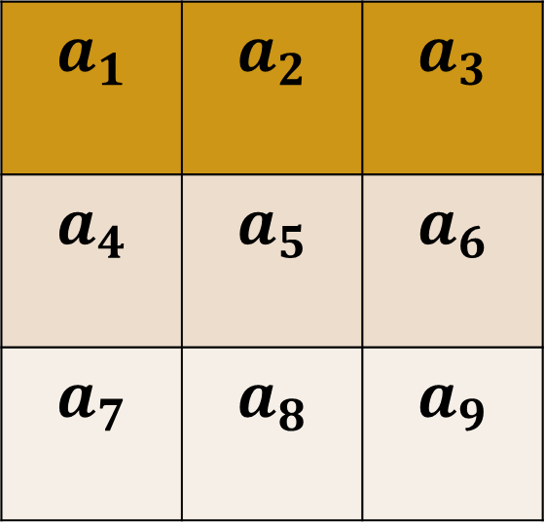
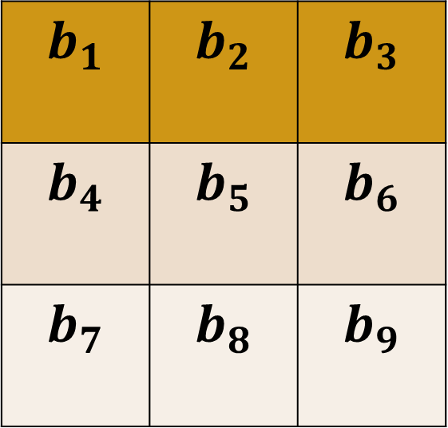
Vector space of magic square
Magic square of order 3
$$a_{1}$$ | $$a_{2}$$ | $$a_{3}$$
$$a_{4}$$ | $$a_{5}$$ | $$a_{6}$$
$$a_{7}$$ | $$a_{8}$$ | $$a_{9}$$
$$b_{1}$$ | $$b_{2}$$ | $$b_{3}$$
$$b_{4}$$ | $$b_{5}$$ | $$b_{6}$$
$$b_{7}$$ | $$b_{8}$$ | $$b_{9}$$
$$\vec{a}=\left(a_{1},a_{2},…,a_{9}\right),$$
$$\vec{b}=\left(b_{1},b_{2},…,b_{9}\right),$$
$$\vec{a}+\vec{b}=\left(a_{1}+b_{1},a_{2}+b_{2},…,\right),$$
$c∙\vec{a}=$ $\left(c∙a_{1},c∙a_{2},…,{c∙a}_{9}\right)$

Slide 15

Elementary magic square
Magic squares with row sum equal to 1
$$\left(\begin{aligned}&\begin{matrix}0 & 0 & 0\end{matrix} \begin{matrix}0 & 1\end{matrix} \\ &\begin{matrix}0 & 1 & 0\end{matrix} \begin{matrix}0 & 0\end{matrix} \\ &\begin{matrix}0 & 0 & 0\end{matrix} \begin{matrix}1 & 0\end{matrix} \\ &\begin{matrix}1 & 0 & 0\end{matrix} \begin{matrix}0 & 0\end{matrix} \\ &\begin{matrix}0 & 0 & 1\end{matrix} \begin{matrix}0 & 0\end{matrix}\end{aligned}\right)$$

Slide 16
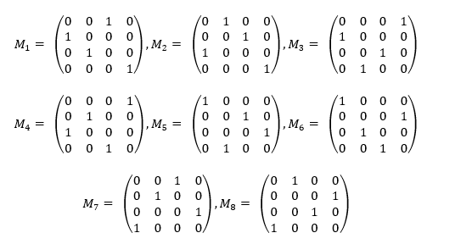

$4×4$ Magic Square

Slide 17
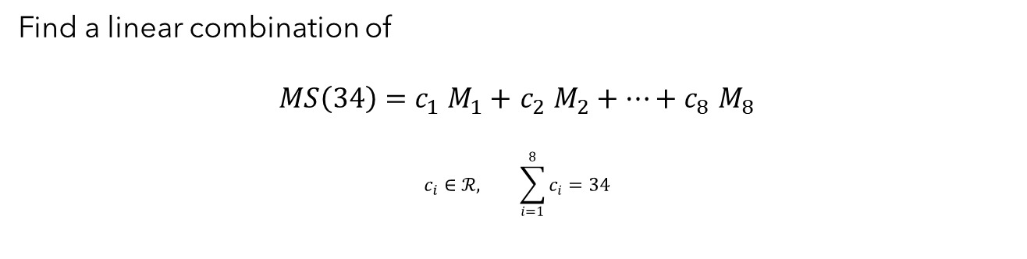
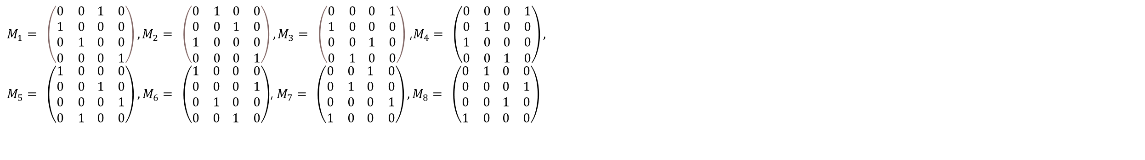
Building matrices
$M_{1}= \left(\begin{aligned}&\begin{matrix}0 & 0\end{matrix} \begin{matrix}1 & 0\end{matrix} \\ &\begin{matrix}1 & 0\end{matrix} \begin{matrix}0 & 0\end{matrix} \\ &\begin{matrix}0 & 1\end{matrix} \begin{matrix}0 & 0\end{matrix} \\ &\begin{matrix}0 & 0\end{matrix} \begin{matrix}0 & 1\end{matrix}\end{aligned}\right),M_{2}= \left(\begin{aligned}&\begin{matrix}0 & 1\end{matrix} \begin{matrix}0 & 0\end{matrix} \\ &\begin{matrix}0 & 0\end{matrix} \begin{matrix}1 & 0\end{matrix} \\ &\begin{matrix}1 & 0\end{matrix} \begin{matrix}0 & 0\end{matrix} \\ &\begin{matrix}0 & 0\end{matrix} \begin{matrix}0 & 1\end{matrix}\end{aligned}\right), M_{3}= \left(\begin{aligned}&\begin{matrix}0 & 0\end{matrix} \begin{matrix}0 & 1\end{matrix} \\ &\begin{matrix}1 & 0\end{matrix} \begin{matrix}0 & 0\end{matrix} \\ &\begin{matrix}0 & 0\end{matrix} \begin{matrix}1 & 0\end{matrix} \\ &\begin{matrix}0 & 1\end{matrix} \begin{matrix}0 & 0\end{matrix}\end{aligned}\right)$ ,$M_{4}= \left(\begin{aligned}\begin{matrix}0 & 0\end{matrix} \begin{matrix}0 & 1\end{matrix} \\ \begin{matrix}0 & 1\end{matrix} \begin{matrix}0 & 0\end{matrix} \\ \begin{matrix}1 & 0\end{matrix} \begin{matrix}0 & 0\end{matrix} \\ \begin{matrix}0 & 0\end{matrix} \begin{matrix}1 & 0\end{matrix}\end{aligned}\right),$
$M_{5}= \left(\begin{aligned}\begin{matrix}1 & 0\end{matrix} \begin{matrix}0 & 0\end{matrix} \\ \begin{matrix}0 & 0\end{matrix} \begin{matrix}1 & 0\end{matrix} \\ \begin{matrix}0 & 0\end{matrix} \begin{matrix}0 & 1\end{matrix} \\ \begin{matrix}0 & 1\end{matrix} \begin{matrix}0 & 0\end{matrix}\end{aligned}\right), M_{6}= \left(\begin{aligned}\begin{matrix}1 & 0\end{matrix} \begin{matrix}0 & 0\end{matrix} \\ \begin{matrix}0 & 0\end{matrix} \begin{matrix}0 & 1\end{matrix} \\ \begin{matrix}0 & 1\end{matrix} \begin{matrix}0 & 0\end{matrix} \\ \begin{matrix}0 & 0\end{matrix} \begin{matrix}1 & 0\end{matrix}\end{aligned}\right)$, $M_{7}= \left(\begin{aligned}\begin{matrix}0 & 0\end{matrix} \begin{matrix}1 & 0\end{matrix} \\ \begin{matrix}0 & 1\end{matrix} \begin{matrix}0 & 0\end{matrix} \\ \begin{matrix}0 & 0\end{matrix} \begin{matrix}0 & 1\end{matrix} \\ \begin{matrix}1 & 0\end{matrix} \begin{matrix}0 & 0\end{matrix}\end{aligned}\right),M_{8}= \left(\begin{aligned}\begin{matrix}0 & 1\end{matrix} \begin{matrix}0 & 0\end{matrix} \\ \begin{matrix}0 & 0\end{matrix} \begin{matrix}0 & 1\end{matrix} \\ \begin{matrix}0 & 0\end{matrix} \begin{matrix}1 & 0\end{matrix} \\ \begin{matrix}1 & 0\end{matrix} \begin{matrix}0 & 0\end{matrix}\end{aligned}\right)$
Find a linear combination of
$MS\left(34\right)=c_{1}$ $M_{1}+$ $c_{2}$ $M_{2}+…+c_{8} M_{8}$
$$c_{i}∈ℛ, \sum_{i=1}^{8}{c_{i}}=34$$

Slide 18
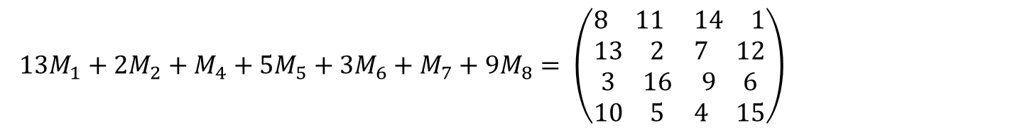

Build a matrix
$${34M}_{1}= \left(\begin{aligned}&\begin{matrix}0 & 0\end{matrix} \begin{matrix}34 & 0\end{matrix} \\ &\begin{matrix}34 & 0\end{matrix} \begin{matrix}0 & 0\end{matrix} \\ &\begin{matrix}0 & 34\end{matrix} \begin{matrix}0 & 0\end{matrix} \\ &\begin{matrix}0 & 0\end{matrix} \begin{matrix}0 & 34\end{matrix}\end{aligned}\right)$$
$13M_{1}+2M_{2}+M_{4}+5M_{5}+3M_{6}+M_{7}+9M_{8}= \left(\begin{aligned}\begin{matrix}8 & 11\end{matrix} \begin{matrix}14 & 1\end{matrix} \\ \begin{matrix}13 & 2\end{matrix} \begin{matrix}7 & 12\end{matrix} \\ \begin{matrix}3 & 16\end{matrix} \begin{matrix}9 & 6\end{matrix} \\ \begin{matrix}10 & 5\end{matrix} \begin{matrix}4 & 15\end{matrix}\end{aligned}\right)$

Slide 19

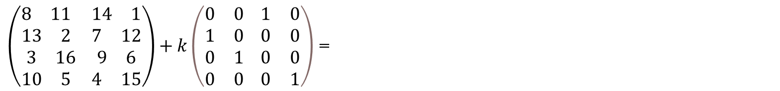
Finally
$$M_{1}= \left(\begin{aligned}&\begin{matrix}0 & 0\end{matrix} \begin{matrix}1 & 0\end{matrix} \\ &\begin{matrix}1 & 0\end{matrix} \begin{matrix}0 & 0\end{matrix} \\ &\begin{matrix}0 & 1\end{matrix} \begin{matrix}0 & 0\end{matrix} \\ &\begin{matrix}0 & 0\end{matrix} \begin{matrix}0 & 1\end{matrix}\end{aligned}\right)$$
8 | 11 | 14+k | 1
13+k | 2 | 7 | 12
3 | 16+k | 9 | 6
10 | 5 | 4 | 15+k
$\left(\begin{aligned}\begin{matrix}8 & 11\end{matrix} \begin{matrix}14 & 1\end{matrix} \\ \begin{matrix}13 & 2\end{matrix} \begin{matrix}7 & 12\end{matrix} \\ \begin{matrix}3 & 16\end{matrix} \begin{matrix}9 & 6\end{matrix} \\ \begin{matrix}10 & 5\end{matrix} \begin{matrix}4 & 15\end{matrix}\end{aligned}\right)+k\left(\begin{aligned}&\begin{matrix}0 & 0\end{matrix} \begin{matrix}1 & 0\end{matrix} \\ &\begin{matrix}1 & 0\end{matrix} \begin{matrix}0 & 0\end{matrix} \\ &\begin{matrix}0 & 1\end{matrix} \begin{matrix}0 & 0\end{matrix} \\ &\begin{matrix}0 & 0\end{matrix} \begin{matrix}0 & 1\end{matrix}\end{aligned}\right)$ =

Slide 20
References
[1] | G. L. Frederick Hillier, Introduction to Operations Research 11th Edition, McGraw-Hill Education, 2020.
[2] | F. Swetz, Legacy of the Luoshu: The 4,000 Year Search for the Meaning of the Magic Square of Order Three, A K Peters/CRC Press, 2008.
[3] | E. Emanouilidis, »Latin and magic squares,« International Journal of Mathematical Education in Science and Technology, årg. 36, nr. 5, pp. 546-549, 2005.
[4] | C. X. San Ling, Coding Theory: A First Course, Cambridge University Press, 2004.

