Slide 1
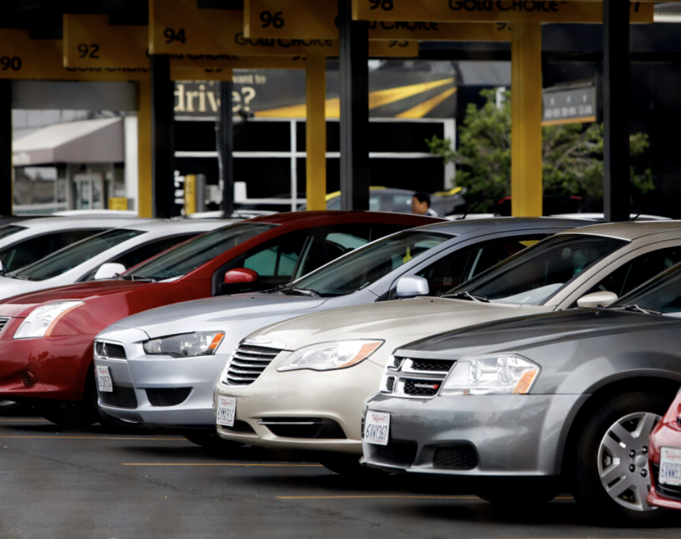
Lariat Rent-A-Car Analysis
Prepared specially for: Lariat Rent-A-Car
by Corey Hawkins
~ Includes observations and recommendations for profitability ~

Slide 2
Background
Lariat Rent-A-Car has partnered with the Thinkful DA Consultants, LLC team to perform analysis of their rental car fleet in 2018.
The company owns fifty branches across the United States, with the top 5 rental locations by volume as follows:
Pomona, CA
Longview, TX
Saint Louis, MI
Sacramento, CA
Baltimore, MD

Slide 3
Background Cont.
Over the company’s fifty locations, they rent 1840 car types, with the following producing the highest revenue:
2017 Ford - Ranger
2016 Ford - F-Series
2017 Toyota - RAV4
2016 Mercury - Sable
2016 Ford - Mustang
These are just a few of the care make/model/year combinations offered by Lariat Rent-A-Car, as can be seen in the dataset.

Slide 4
Goals
The company’s management team has a belief that certain types of cars are rented more often than others, but they aren't sure. They also want to know if, on average, some car types are more profitable than others.
Their primary goal is to acquire suggestions for increasing overall profitability across the company.

Slide 5

The Data
Lariat Rent-A-Car has provided the following dataset from their 2018 year of operations. The dataset includes four data files:
car_id_mapping (car id, car model year, car make, car model)
car_costs (car id, car cost monthly, car insurance monthly)
car_revenue (car id, branch id, driver age, driver gender, accident indicator, first rented date, rental length, rental price per day)
branch_location (branch id mapped to city and state, with airport location indication)

Slide 6

The Process
We have taken the dataset and combined it in such a way as to make it ready for analysis.
The analysis has been performed, and key findings were noted, along with recommendations to company management.
This information follows...

Slide 7
Key Findings
Two things in particular were found during the analysis of the data. The first observation is that:
The vast majority of car rentals are from the…
2017 Ford - Ranger

Slide 8
Key Findings
The second observation is that:
The 2017 Ford - Ranger produces the most profit per rental.
These observations suggest that there are TWO scenarios that you should be experimenting with, as follows:

Slide 9
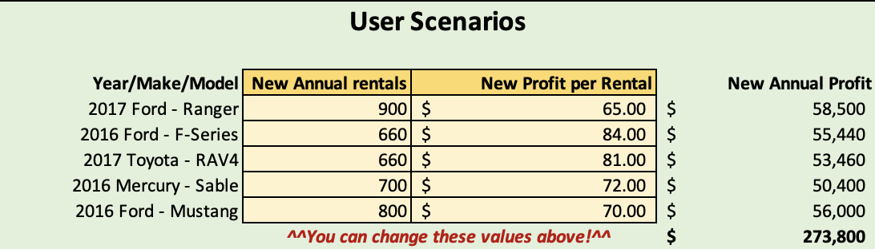
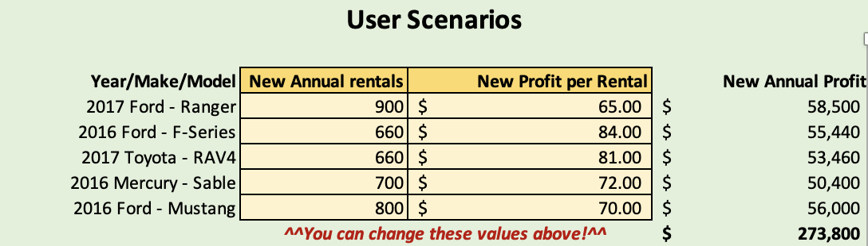
Your Two Scenarios
Scenario I: Experiment with changing the number of annual rentals for each of the top five car types:
Scenario II: Experiment with changing the expected profit per rental for each of the top 5 car types:
As you experiment with these scenarios, take note of the impact on annual profits:

Slide 10
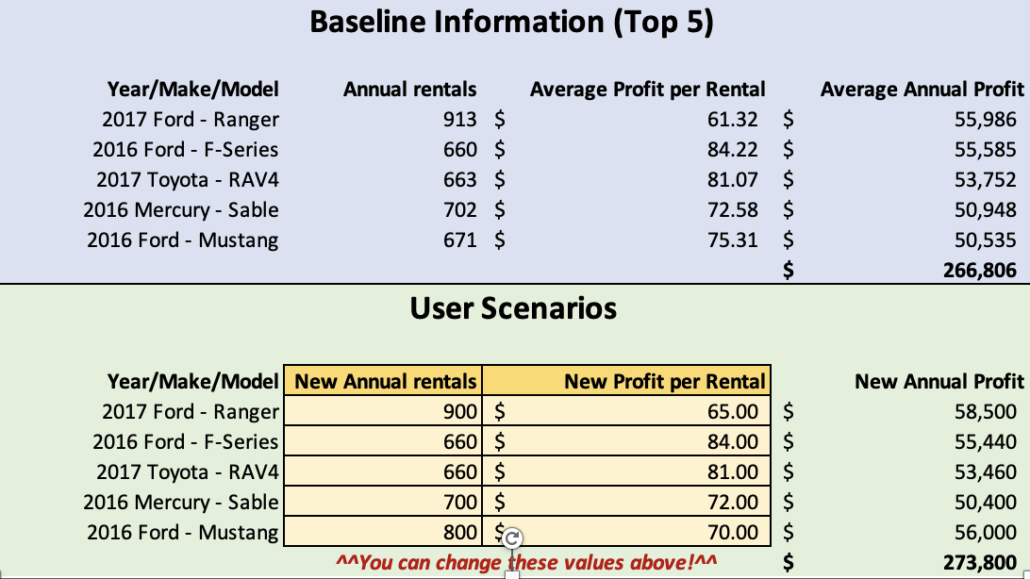
Recommendations
We suggest raising the profits of The 2017 Ford - Ranger and lowering the profits of the 2016 Ford - Mustang.
You should assume you'll have fewer 2017 Ford - Ranger rentals and more 2016 Ford - Mustang rentals. You’ve been provided a separate workbook with a model to experiment with what-if scenarios:
Change these values!

Slide 11

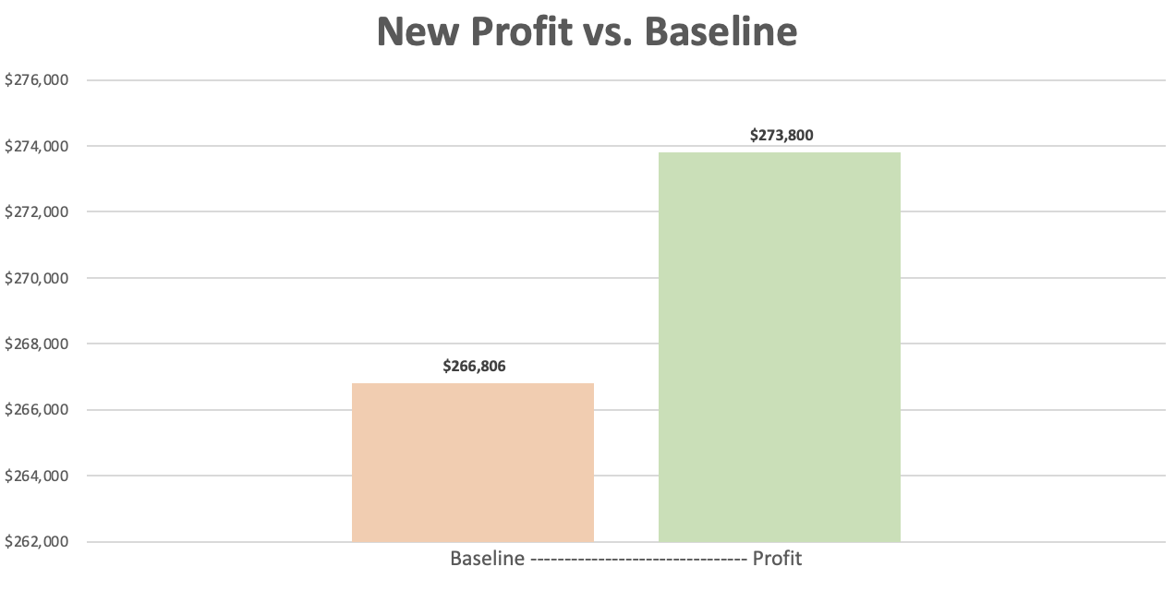
Call to Action
The chart below shows the effects on profits after reducing annual rentals and increasing profit per rental for the 2017 Ford – Ranger 2016 and Ford - Mustang, respectively.

Slide 12
Next Steps
There is other information that company management may find useful, such as comparing profitability of specific car makes or branch locations. That is out of the scope of this project, but it could be considered as a next step for analyzing profit models.
Please contact Thinkful DA Consultants, LLC for your future analytics needs!

Slide 13
Thank you!

