Slide 1

DS-40 Final Project
DS-SF-40 Final Project
Corey Kanon

Slide 2
Introduction
Background
The All-NBA Team is an annual National Basketball Association (NBA) honor bestowed on the best players in the league following every NBA season. The voting is conducted by a panel of sportswriters and broadcasters throughout the United States and Canada. The team has been selected in every season of the league's existence, dating back to its inaugural season in 1946. From 1946 to 1955, players were selected without regard to position; however, since 1956, each team has consisted of two guards, two forwards, and one center. Since 1988 it is composed of three five-man lineups—a first, second, and third team, typically comprising a total of 15 roster spots.
-Wikipedia

Slide 3
Introduction
Problem Statement
The members of the First All NBA Team for a given season can be successfully predicted based on modeling players' individual statistics.

Slide 4
The Dataset
Source
The dataset was downloaded from Open Source Sports. Their men's basketball database contains individual and team statistics from professional basketball leagues including the National Basketball Association through the 2011-12 NBA season.
Data Format
The dataset contains multiple csv files containing player information, player statistics, award designations, and other basketball sports data. The files contain a key based on the player name that allows for joining across data tables.

Slide 5
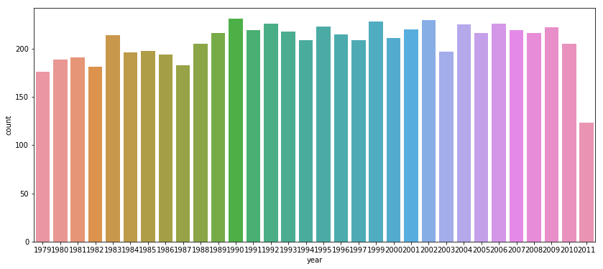
Data Pre-Processing
Data Wrangling
  Start data at the 1979 season (league was much different beforehand – e.g. no 3-pointer)
  Drop rows for players who did not play in more than 60 games that season (75%) perhaps due to injury or lack of talent
  Add target feature to indicate First All-Team classification
  Add feature for team wins (does team quality matter?)
  Adjust statistics to be per-game rather than season totals
  (e.g. total points/games played)
  Dataset: 6631 rows, 12 columns
  ~200 players per season
  over 32 years
Player counts by year

Slide 6
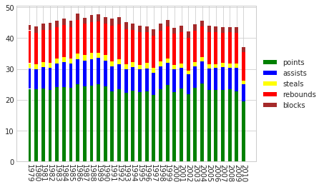
Exploratory Data Analysis
What does a top 20 player look like statistically?
  23.4 Points per game
  7.4 Assists per game
  1.6 Steals per game
  10.4 Rebs per game
  2.0 Blocks per game
Russell Westbrook's 2016-2017 MVP season:
  31.6 Points, 10.4 Assists, 1.6 Steals, 10.7 Rebs, .4 Blocks

Slide 7
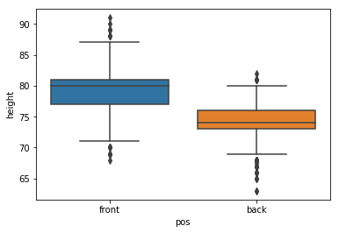
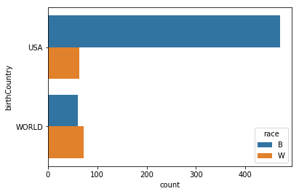
Exploratory Data Analysis
Other unrelated but interesting findings:
  Player heights:
  On average, front court players (forwards, centers) are a ½ foot taller than back court players (guards)
  Racial distribution of players: While recent American-born players are predominantly black, internationally-born players are mostly white

Slide 8
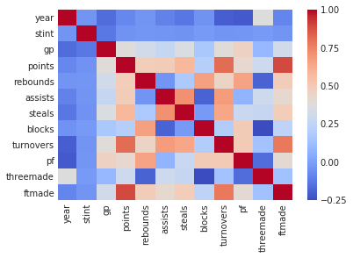
Feature Engineering
Initially the master table had over 40 features – important to pick only relevant/useful ones
  Reduce related features
    Rebounds, Offensive Rebounds, Defensive Rebounds
    Points, FG Attempted, FG Made
  Drop Postseason specific stats
  Drop features that are heavily
  correlated to others (ftmade
  is colinear to points?)

Slide 9
Preparations for Modeling
Null Accuracy (Imbalanced Dataset)
  0.0 (not on team) 97.6776 % (6477)
  1.0 (First Team All NBA) 2.3224 % (254)
Upsample to improve
  0.0 (not on team) 50 % (6477)
  1.0 (First Team All NBA) 50 % (6477)

Slide 10
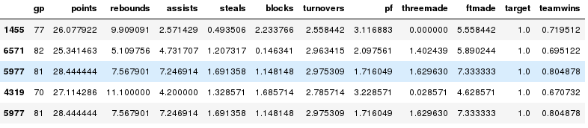
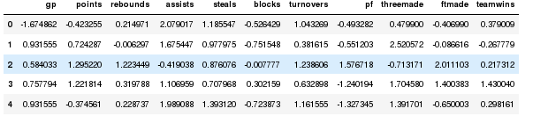
Preparations for Modeling
Data values
  Interpretable: reflect real statistics
  But features use different units (5 points is low, 5 steals high)
Normalize data to improve (MinMax)
  Values represent standard deviations (0 to 1)

Slide 11
Model: Decision Classifier
Good for classification based on features
Parameters
  No max depth, cross validation = 5
Model Performance
  Accuracy score is 99.3361 %
  Precision score is 98.7058 %
  Recall score is 100.0000 %
  Roc_auc score is 99.3284 %
Confusion Matrix
TN = 1595 | FP = 19
FN = 0 | TP = 1625

Slide 12
Model: K-Nearest Neighbors
Parameters
  N=3 (optimal), cross validation = 5, Xminmax
Model Performance
  Accuracy score is 98.7418 %
  Precision score is 97.5475 %
  Recall score is 100.0000 %
  Roc_auc score is 99.1200%
Confusion Matrix
TN = 1601 | FP = 13
FN = 0 | TP = 1625
Not as accurate as Decision Classifier

Slide 13
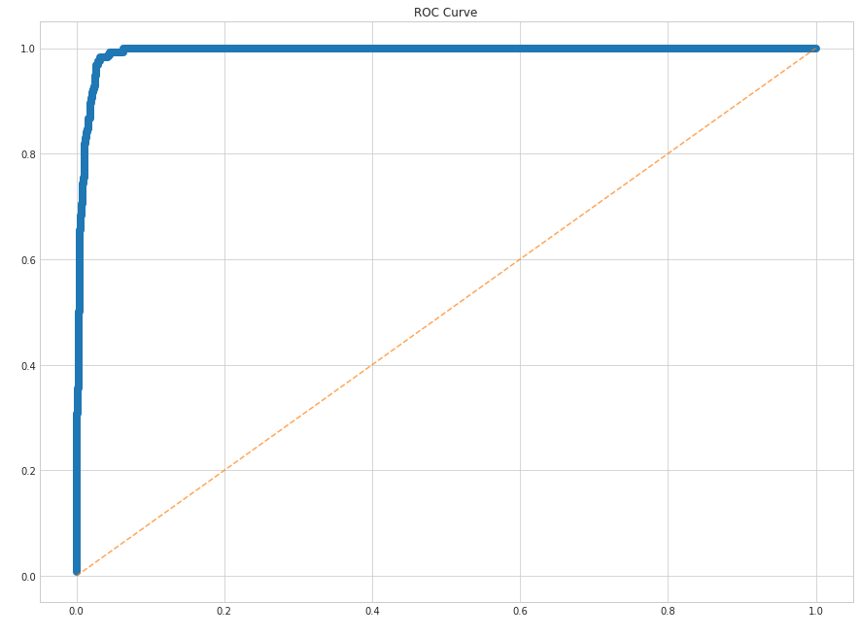
Model: Logistic Regression
Gives probabilities of a specific class being true
Parameters
  cross validation = 5, Z-score scaled (Xss)
Model Performance
  Accuracy score is 97.1284 %
  Precision score is 95.6983 %
  Recall score is 98.7030 %
  Roc_auc score is 99.2236 %
Confusion Matrix
DecisionTree still the best model so far
TN = 2457 | FP = 104
FN = 47 | TP = 2574

Slide 14
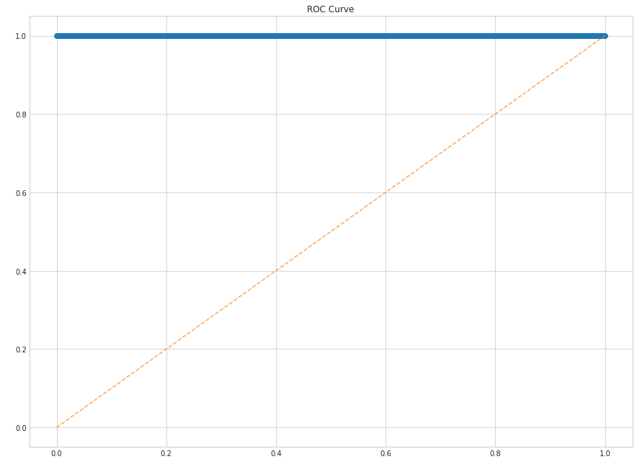
Model: Random Forest
Many Decision Trees (ensemble model)
Parameters
  cross validation = 5, n_estimators = 200
Model Performance
  Accuracy score is 99.5214 %
  Precision score is 98.9714 %
  Recall score is 100 %
  Roc_auc score is 99.9228 %
Confusion Matrix
Perfect ROC curve!
TN = 2579 | FP = 20
FN = 0 | TP = 2583

Slide 15
Insights
Points is clearly the main factor in predicting
  Points has .395593 importance rating
  Turnovers and FTMade are also useful
Personal Fouls, Threes Made, and Rebounds have low importance

Slide 16
Extensions to the Analysis
Enhancements to Data
  Include features representing advanced statistics such as PER, Win Shares, Plus/Minus, Defensive Rating
  This data can be obtained by scraping stat websites
  More granular level such as game level as opposed to season level – would provide more control over feature engineering and data wrangling
  Normalize data by season – pace of play has changed over time so inappropriate to compare cross-era players
Enhancements to Models
  Account for player position – currently all players are compared against each other

Slide 17
Extensions to the Analysis
Ask More Questions
  Predict Second and Third Team All NBA
  Predict All-Star Team members
  Predict Most Valuable Player award winners
  Predict Hall of Famer inductees

