Slide 1
Homelessness in Boston
Team - Jarrod Daniels, Jeenil Patel, Thomas Guaetta, Corey Kozlovski

Slide 2
Introduction
Homelessness is a complex issue that has continually been on the rise in recent years. When looking at data regarding homelessness, there are many factors one can look at. For the purpose of this project, our group wanted to take a more local focus at the homeless situation in the United States. Specifically we decided to look at data based off of Continuums of Care in the state of Massachusetts.
In order to tackle this we came up with a number of questions that we wished to solve. First, for 2018 we wanted to see if his proportion of homeless in Massachusetts is the same as the rest of the United States. Second, we wanted to see if the proportion of homelessness in Massachusetts CoC’s outside of Boston were the same as Boston. Building off the previous two questions, we then wanted to investigate whether or not Mass’s homeless proportion in 2018 was greater or less than the rest of the US and then conduct the same test for Boston against the rest of Mass Coc’s. Finally, we wanted to see if we could construct a linear model to predict the rate of homelessness in a city based on a given year.
Notes:
jarrod

Slide 3
Methods
We used Hypothesis Tests and Multiple Linear Regression throughout the project to analyze our data and find conclusions relevant to our research question
First off, we needed to normalize our data in order to better compare different data values. To do this we used a proportion of the number of homeless people in each state/CoC rather than the raw number
For all hypothesis tests, an alpha of 0.05 was used
The first test we did was to run a hypothesis test on the overall proportion of homelessness in MA against all other states
Then, we took a look at how Boston’s CoC compared to the rest of the MA’s CoC’s using another hypothesis test
To create a multi-linear regression model, we first had to prep the data. This meant factoring cities and subtracting the year by 2006 and taking the logarithm for the year to take into account that population tend to grow exponentially
The n constructed a linear model using homeless proportion as y, city as X1 and year as X2
After checking the assumptions we then judged the models predictive capabilities

Slide 4
Results
MA‘s proportion of overall Homelessness vs. non-MA States in US
Two Tailed
Null = All non-MA states have the same overall homelessness as MA
Alternate Hypothesis = All non-MA states have a different overall homelessness as MA
With a T-Statistic = 6.23183 and p-value = 9.535515e-08, we reject our null hypothesis of MA’s overall homeless is different than the rest of the country.
One Tailed
Null: All non-MA states have a greater than or equal to overall homelessness as MA
Alternate: All non-MA states have a lower overall homelessness than MA
With a T-Statistic = 6.170431 and p-value = 6.388e-08, we reject our null hypothesis of all non-MA states have a greater than or equal to overall homelessness as MA.
Boston CoC’s proportion of overall Homelessness vs. non-Boston CoC’s in MA
Two Tailed
Null: All non-Boston CoCs have the same overall homelessness as Boston’s CoC
Alternate Hypothesis: All non-Boston CoCs have a different overall homelessness than Boston’s CoC’s
With a t-value of 6.20904 & a p-value of 4.524516e-05, we reject the null-hypothesis that the average proportion of overall homelessness in MA equals the Boston CoCs
One Tailed
Null: All non-Boston CoC's in MA have a greater than or equal to overall homelessness as Boston
Alternate: All non-Boston CoC's in MA have a lower overall homelessness than Boston
With a T-Statistic = 6.20904 and p-value = 2.262258e-05, we reject our null hypothesis of non-Boston CoC’s in MA having a greater than or equal to overall homelessness as Boston

Slide 5
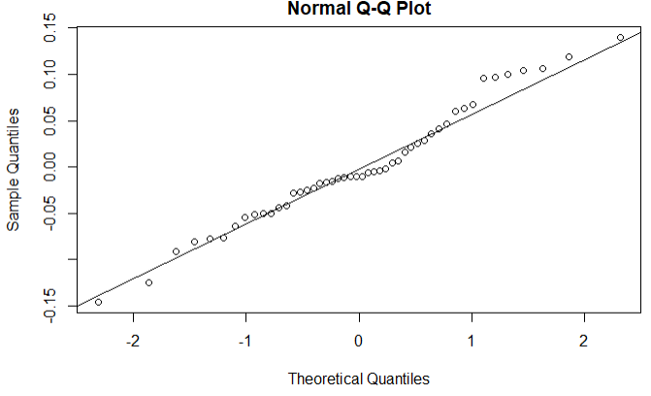
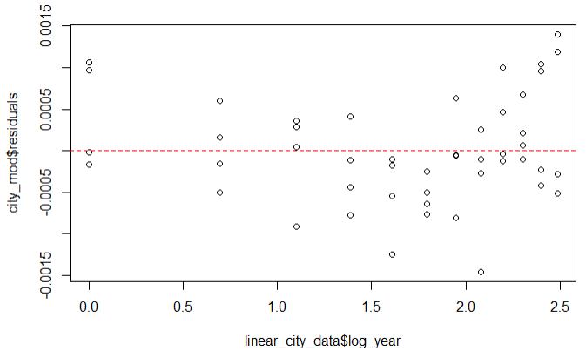
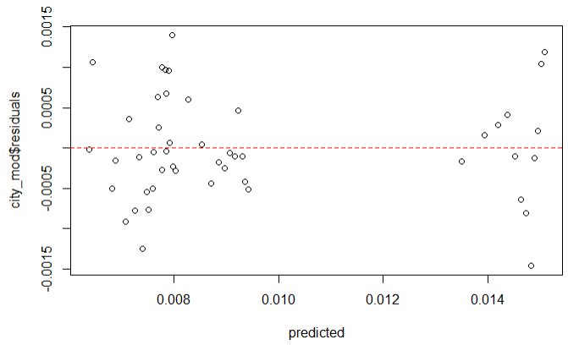
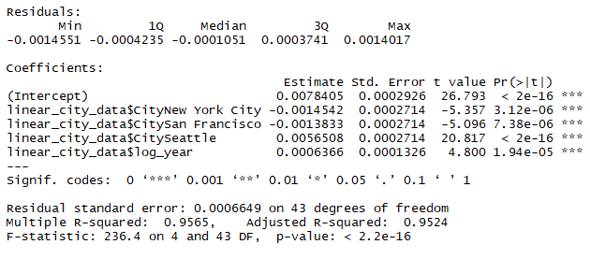
Results

Slide 6
Conclusion
Test 1 (MA vs. The rest of the states)
From our two-tailed test, our conclusion suggests that the overall Homelessness in MA is not in-order with the rest of the country. The p-value we calculated using the normalized data was 9.535515e-08 and because of this, we are able to reject the null hypothesis
From our one tailed test, we rejected our null hypothesis meaning that all non-MA states do not have a greater than or equal to overall homelessness as MA. We have statistically significant evidence to conclude that non-MA states have a lower overall homelessness than MA does.
Test 2 (Boston vs. Different CoCs)
In our two-tailed test, we concluded there is statistically significant evidence to suggest that the average homelessness for MA is different than Boston’s, and that the observed difference between the means is unlikely to be due to random chance.
In our one tailed test, we find that we have statistically significant evidence that the non-Boston CoC's have a lower average overall Homelessness proportion than Boston's CoC.
Test 3 (Multiple Linear Regression)
Taking into account that not every assumption passed, we normally would say that a linear model would not be the best way to assess the data
Given what was said before however, we can see that there is a significant relationship between year and predicting the proportion of homelessness and that overall the model would be considered significant.

Slide 7
Thank You

