Slide 1
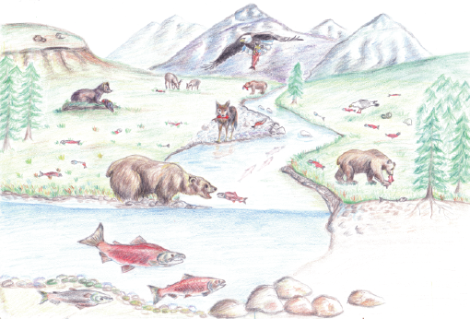

Slide 2
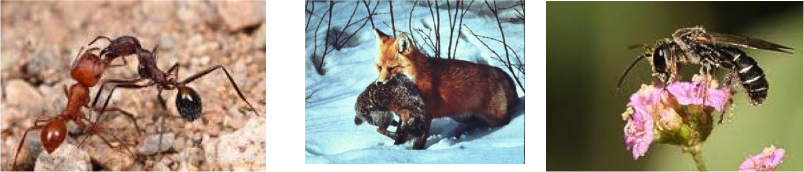
P
C
M

Slide 3
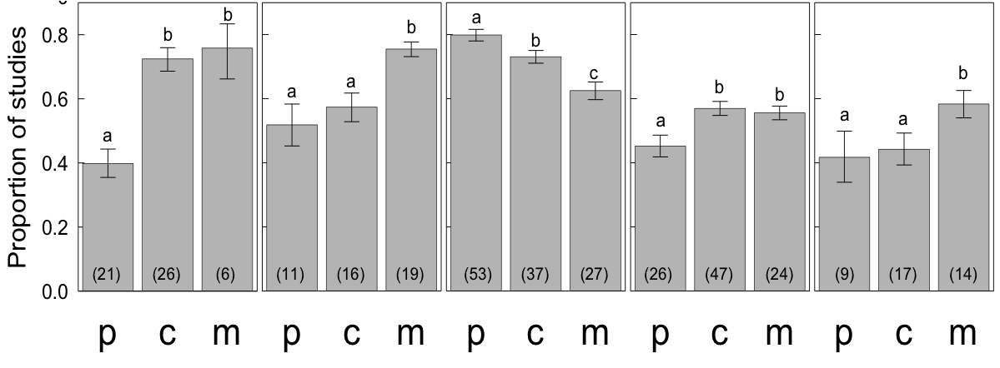
Abiotic
Spatial
Species Identity
Temporal
3rd party

Slide 4
Abiotic
Spatial
Species Identity
Temporal
3rd party

Slide 5
Abiotic
Spatial
Species Identity
Temporal
3rd party

