Slide 1
Contribution of traits, phenology, & phylogenetic history to plant-pollinator network
Scott Chamberlain
Simon Fraser University

Slide 2
Thanks to!
Elizabeth Elle
Jana Vamosi
Ralph Cartar
Sarah Semmler
Anne Worley
And many more…

Slide 3
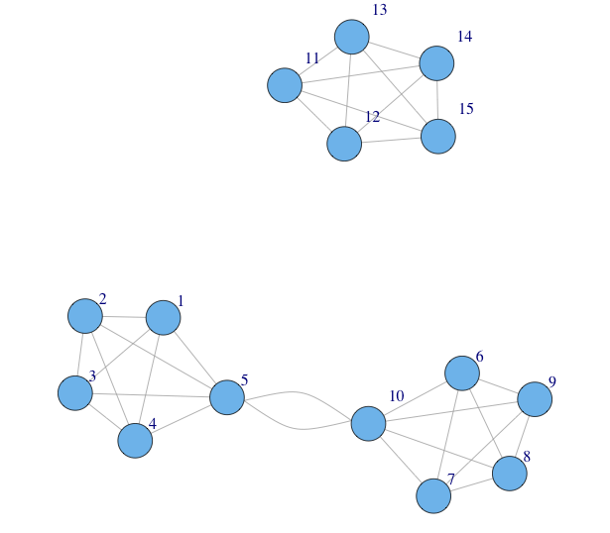
Species in communities form networks

Slide 4


Patterns often similar among networks
Pollinators
Plants

Slide 5
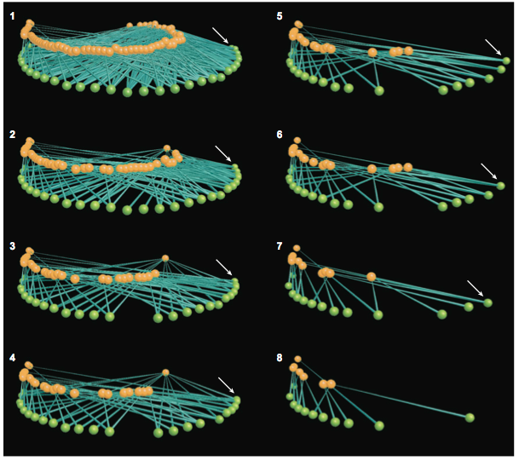
Structure matters
Bascompte&Jordano2007AREES

Slide 6
What drives network structure?
Traits
Phylogeny
Phenology

Slide 7
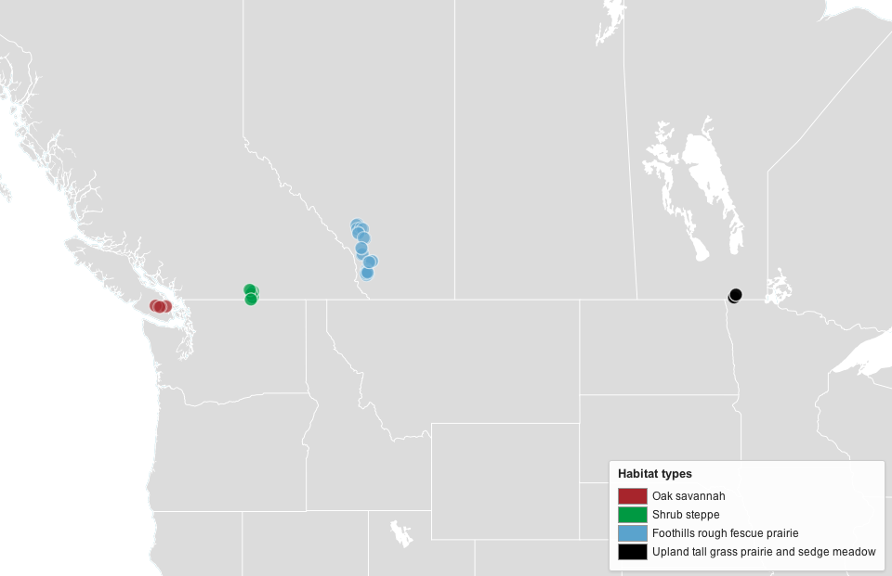
Study sites

Slide 8
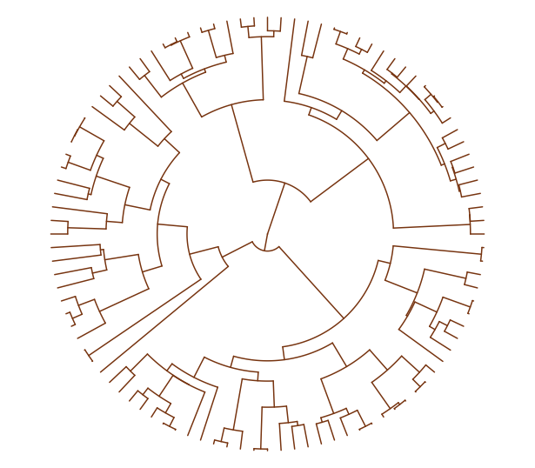
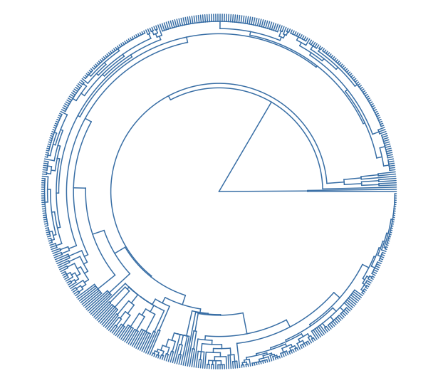
Phylogeny
Plants
Pollinators

Slide 9
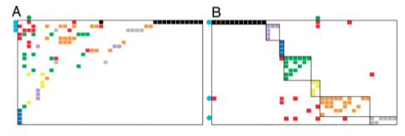
Species level metrics
Degree
Specialization
Within module degree
Among module connectivity

Slide 10
Traits - Pollinators
Nest location: above/below ground - NS
Nest type: excavator/renter - NS
Parasitic: yes/no - NS
Social: solitary/social –
Within module degree: social (module hubs), solitary (peripherals)
Among module connectivity: social (connectors), solitary (peripherals)
Degree: social (higher), solitary (lower)
Body size – larger spp. w/ larger degree

Slide 11
Traits - Plants
Breeding system
Gynomonoecious: less specialized, higher degree
Hermaphrodites: more specialized, lower degree
Growth form
Herbaceous: lower within module degree
Woody: higher within module degree
Flower symmetry:
Bilateral: lower within module degree, lower degree
Radial: higher within module degree, higher degree
Flower size: smaller flowers higher within module degree

Slide 12
Network level
network structure ~
FDisPO + FDisPL + MPDPO + MPDPL
Pollinator Functional Trait Dispersion

Slide 13
Conclusion
Network level
At network level, ⬆ pollinator functional diversity w/ ⬆ modularity & ⬇ connectance
Pollinator traits bigger drivers of network structure relative to plants
Species level
Sociality important in pollinators
Mating systems, flower symmetry & growth form important in plants
Phenology playing role - will explore more

Slide 14
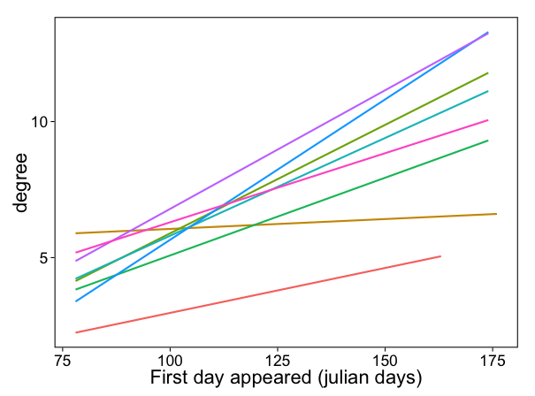
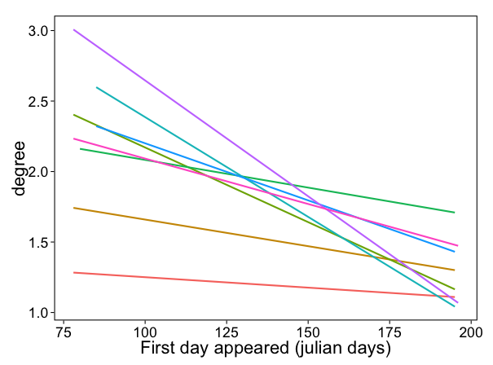
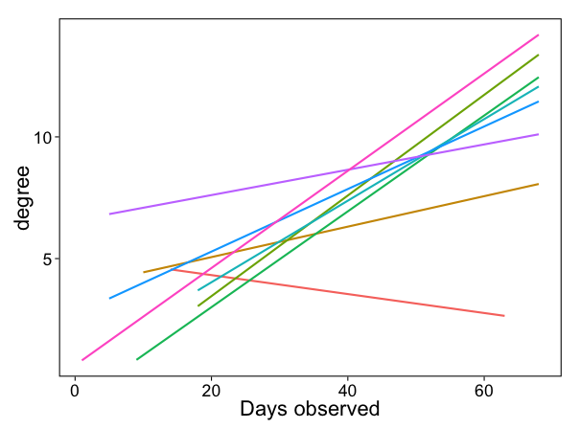
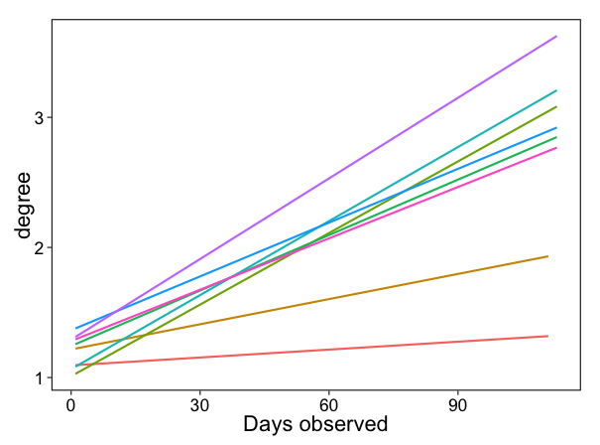
Phenology
Plants
Pollinators

Slide 15
Phenology

Slide 16
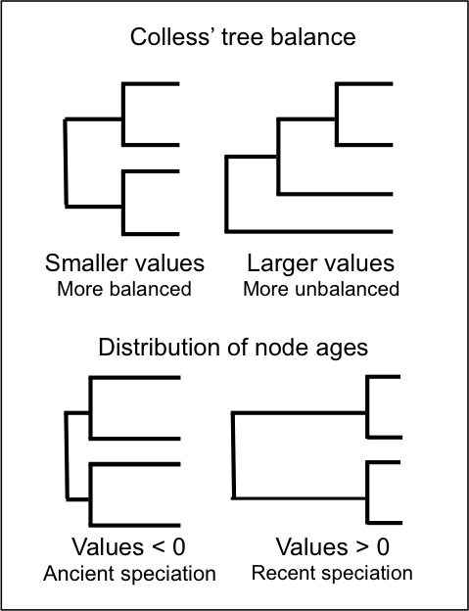
Phylogenetic tree shape

Slide 17
Phylogenetic tree shape

Slide 18

Thanks to
Coauthors
Elizabeth Elle
Jana Vamosi
Ralph Cartar
Sarah Semmler
Anne Worley
Funding: NSERC –
CANPOLIN

