Slide 1
Contribution of traits and phylogenetic history to plant-pollinator network
Scott Chamberlain (@recology_)
Simon Fraser University/rOpenSci
Co-authors: Elizabeth Elle, Jana Vamosi, Ralph Cartar, Sarah Semmler, Anne Worley

Slide 2
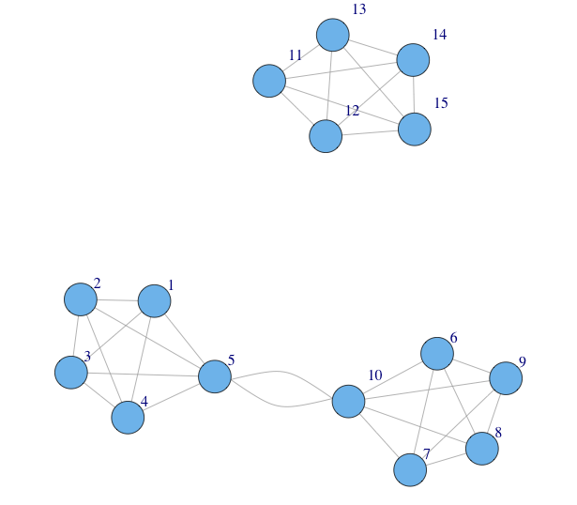
Species in communities form networks

Slide 3

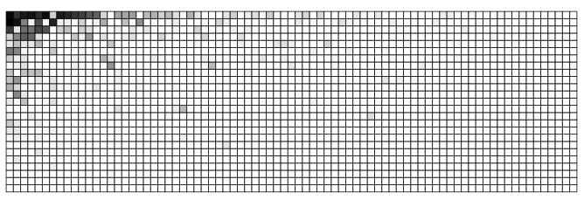
Patterns often similar among networks
Pollinators
Plants

Slide 4
What drives network structure?
Traits
Phylogeny
Phenology

Slide 5
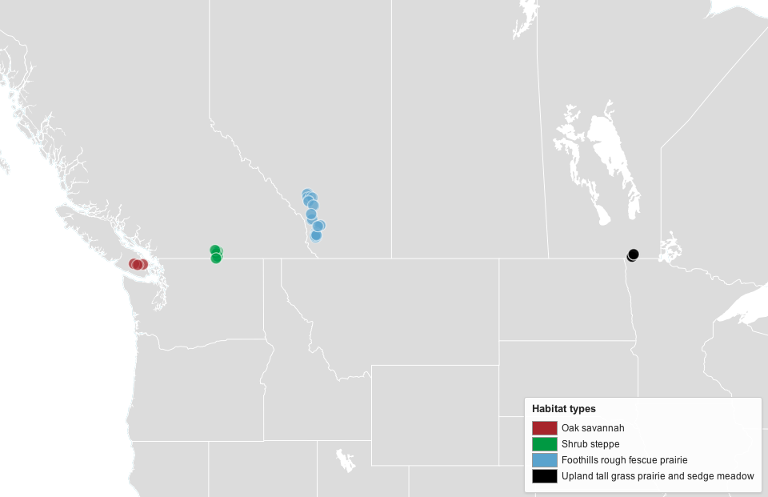
Study sites

Slide 6
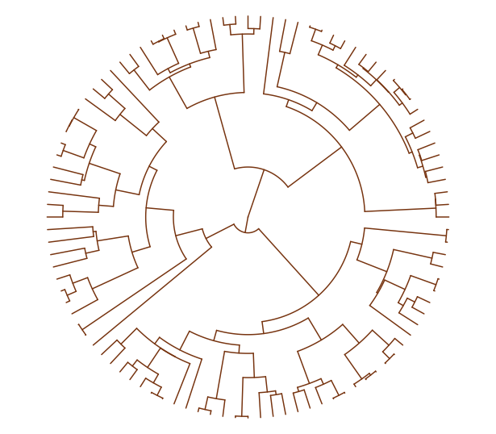
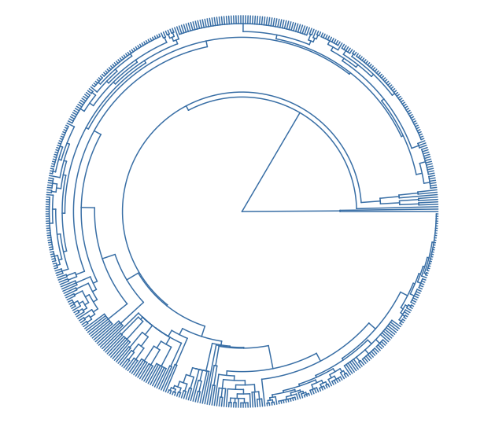
Phylogeny
Plants
Pollinators

Slide 7
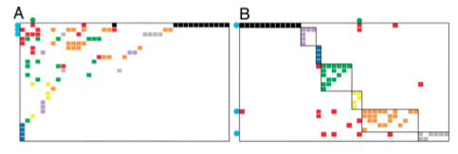
Species level metrics
Degree
Specialization
Within module degree
Among module connectivity

Slide 8
Traits - Pollinators
Nest location: above/below ground - NS
Nest type: excavator/renter - NS
Parasitic: yes/no - NS
Social: solitary/social –
Within module degree: social (module hubs), solitary (peripherals)
Among module connectivity: social (connectors), solitary (peripherals)
Degree: social (higher), solitary (lower)
Body size – larger spp. w/ larger degree

Slide 9
Traits - Plants
Breeding system
Gynomonoecious: less specialized, higher degree
Hermaphrodites: more specialized, lower degree
Growth form
Herbaceous: lower within module degree
Woody: higher within module degree
Flower symmetry:
Bilateral: lower within module degree, lower degree
Radial: higher within module degree, higher degree
Flower size: smaller flowers higher within module degree

Slide 10
Network level
network structure ~
FDisPO + FDisPL + MPDPO + MPDPL
Pollinator Functional Trait Dispersion

Slide 11
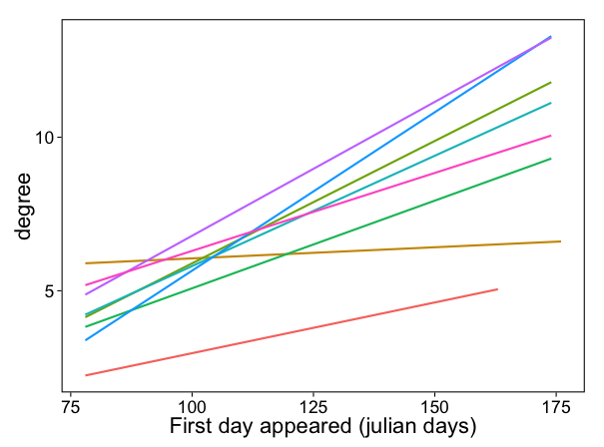
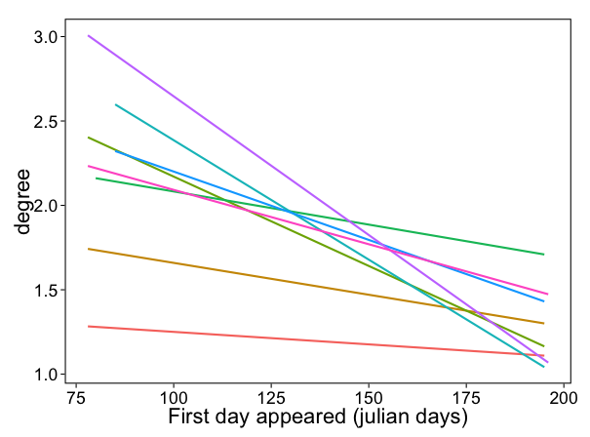
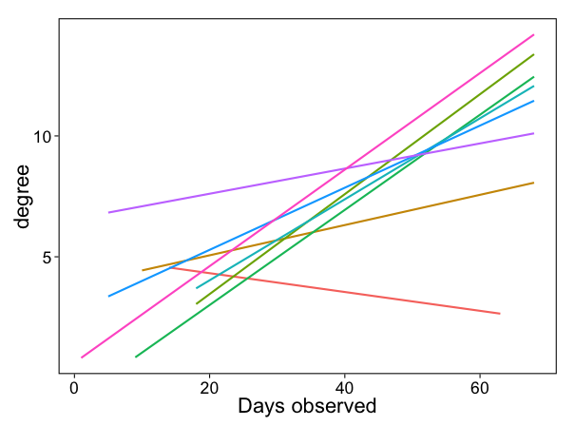
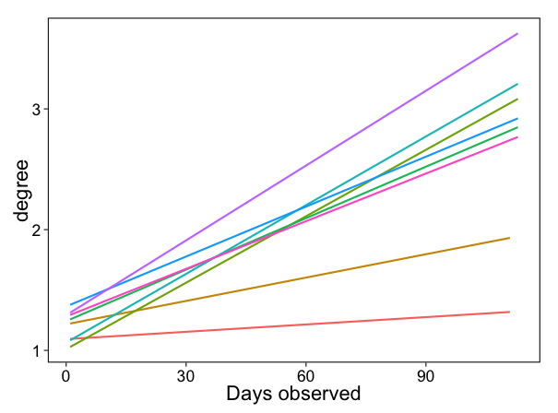
Phenology
Plants
Pollinators

Slide 12
Conclusion
Network level
At network level, ⬆ pollinator functional diversity w/ ⬆ modularity & ⬇ connectance
Pollinator traits bigger drivers of network structure relative to plants
Species level
Sociality important in pollinators
Mating systems, flower symmetry & growth form important in plants
Phenology playing role - will explore more

Slide 13
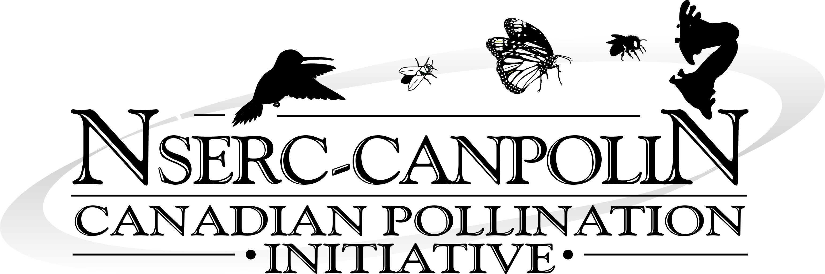
Thanks to
Coauthors
Elizabeth Elle
Jana Vamosi
Ralph Cartar
Sarah Semmler
Anne Worley
Funding: NSERC –
CANPOLIN

