Slide 1
Contribution of traits, phenology, & phylogenetic history to plant-pollinator network structure
Scott Chamberlain
Simon Fraser University

Slide 2
Thanks to!
Elizabeth Elle
Jana Vamosi
Ralph Cartar
Sarah Semmler
Anne Worley
And many more that provided data…

Slide 3
Species in communities form networks

Slide 4

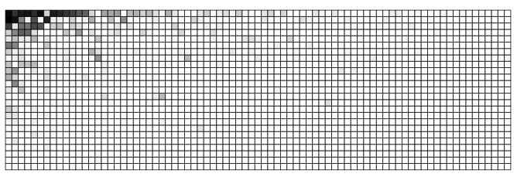
Patterns often similar among networks
Pollinators
Plants

Slide 5
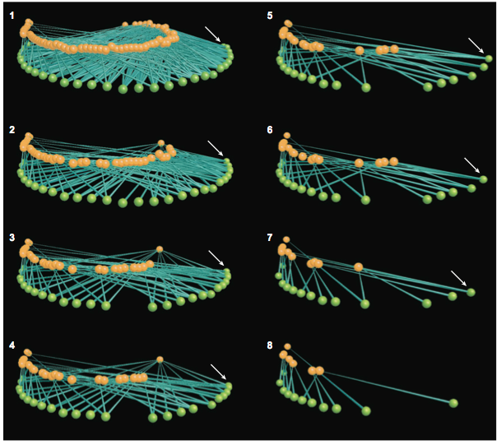
Structure matters
Bascompte&Jordano2007AREES

Slide 6
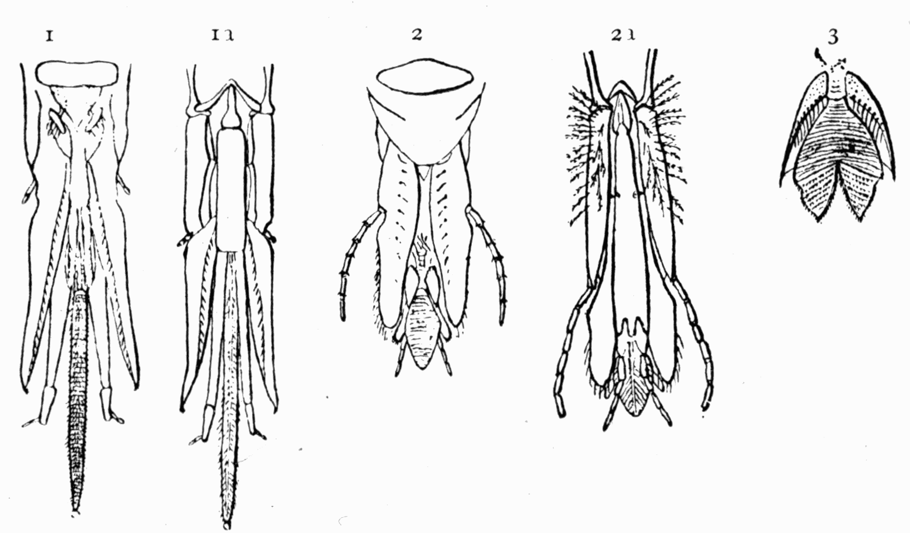

What drives network structure?
Traits
Phenology
Phylogeny
http://www.gutenberg.org/files/33874/33874-h/33874-h.htm
http://contently.com/strategist/2012/01/17/stay-on-track-with-your-editorial-calendar/

Slide 7
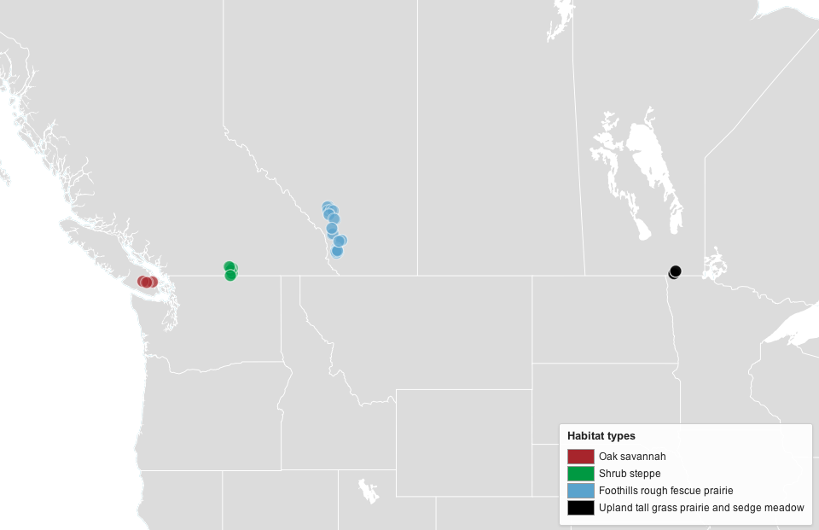
Study sites

Slide 8
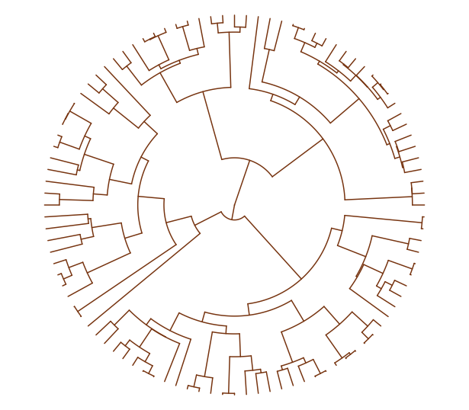
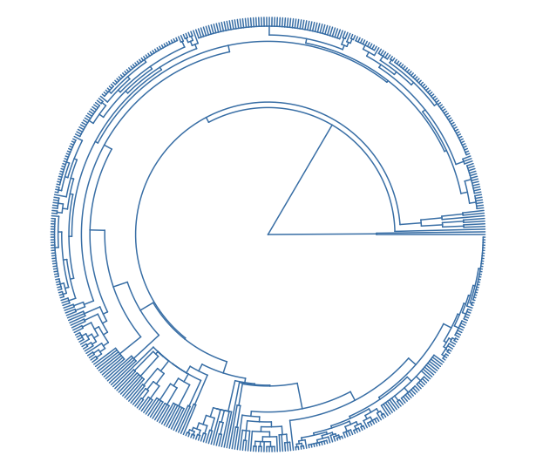
Phylogeny
Plants
Pollinators

Slide 9
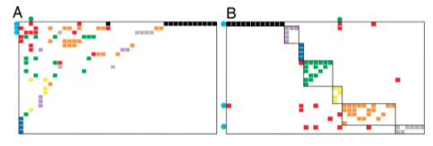
Species level metrics
Degree
Specialization (accounts for interaction intensity)
Within module degree
Among module connectivity

Slide 10
Traits - Pollinators
Nest location: above/below ground - NS
Nest type: excavator/renter - NS
Parasitic: yes/no - NS
Social: solitary/social –
Within module degree: social (module hubs), solitary (peripherals)
Among module connectivity: social (connectors), solitary (peripherals)
Degree: social (higher), solitary (lower)
Body size – larger spp. w/ larger degree

Slide 11
Traits - Plants
Breeding system
Gynomonoecious: less specialized, higher degree
Hermaphrodites: more specialized, lower degree
Growth form
Herbaceous: lower within module degree
Woody: higher within module degree
Flower symmetry:
Bilateral: lower within module degree, lower degree
Radial: higher within module degree, higher degree
Flower size: smaller flowers higher within module degree

Slide 12
Network level
network structure ~
FDisPO + FDisPL + MPDPO + MPDPL
Pollinator Functional Trait Dispersion

Slide 13
Conclusion
Species level
Sociality important in pollinators
Mating systems, flower symmetry & growth form important in plants
Phenology playing role - will explore more
Network level
At network level, ⬆ pollinator functional diversity w/ ⬆ modularity & ⬇ connectance
Pollinator traits bigger drivers of network structure relative to plants

Slide 14
Phenology
Species vary in when they start flowering (plants) and start flying (pollinators)
Variation among species can lead to changes in network structure

Slide 15
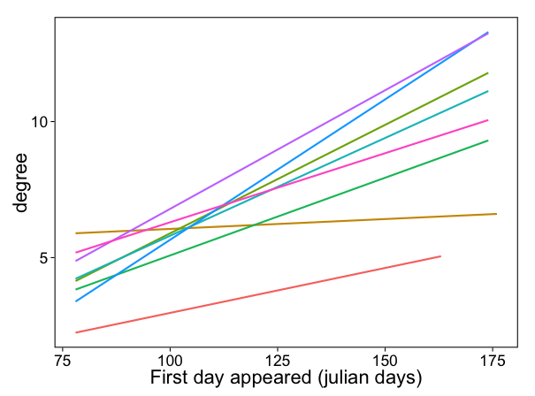
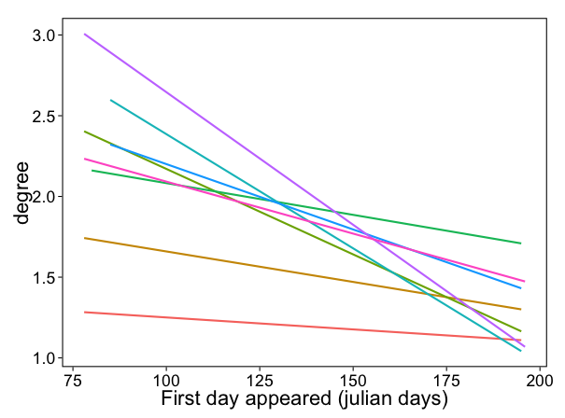
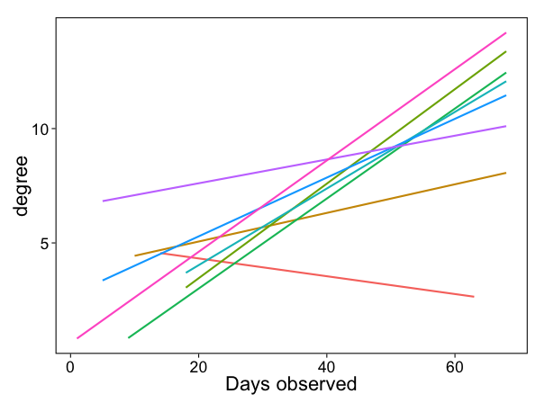
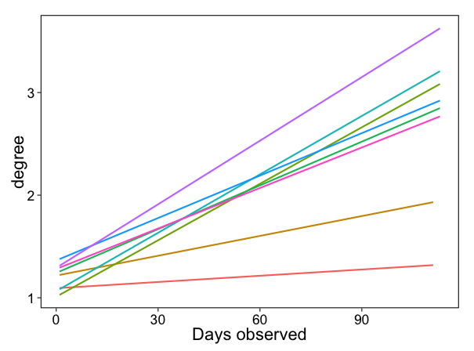
Phenology
Plants
Pollinators

Slide 16
Phylogenetic tree shape
Shape easily measured
Metrics represent whether
Branching events recent or old
Branching events even across tree, or some groups speciate more than others
This “shape” could influence who interacts with who

Slide 17
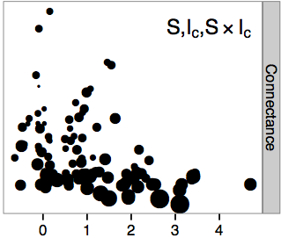
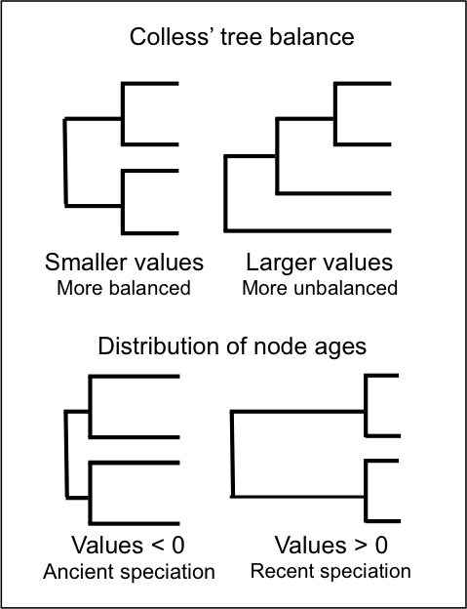

Phylogenetic tree shape
Modularity

Slide 18
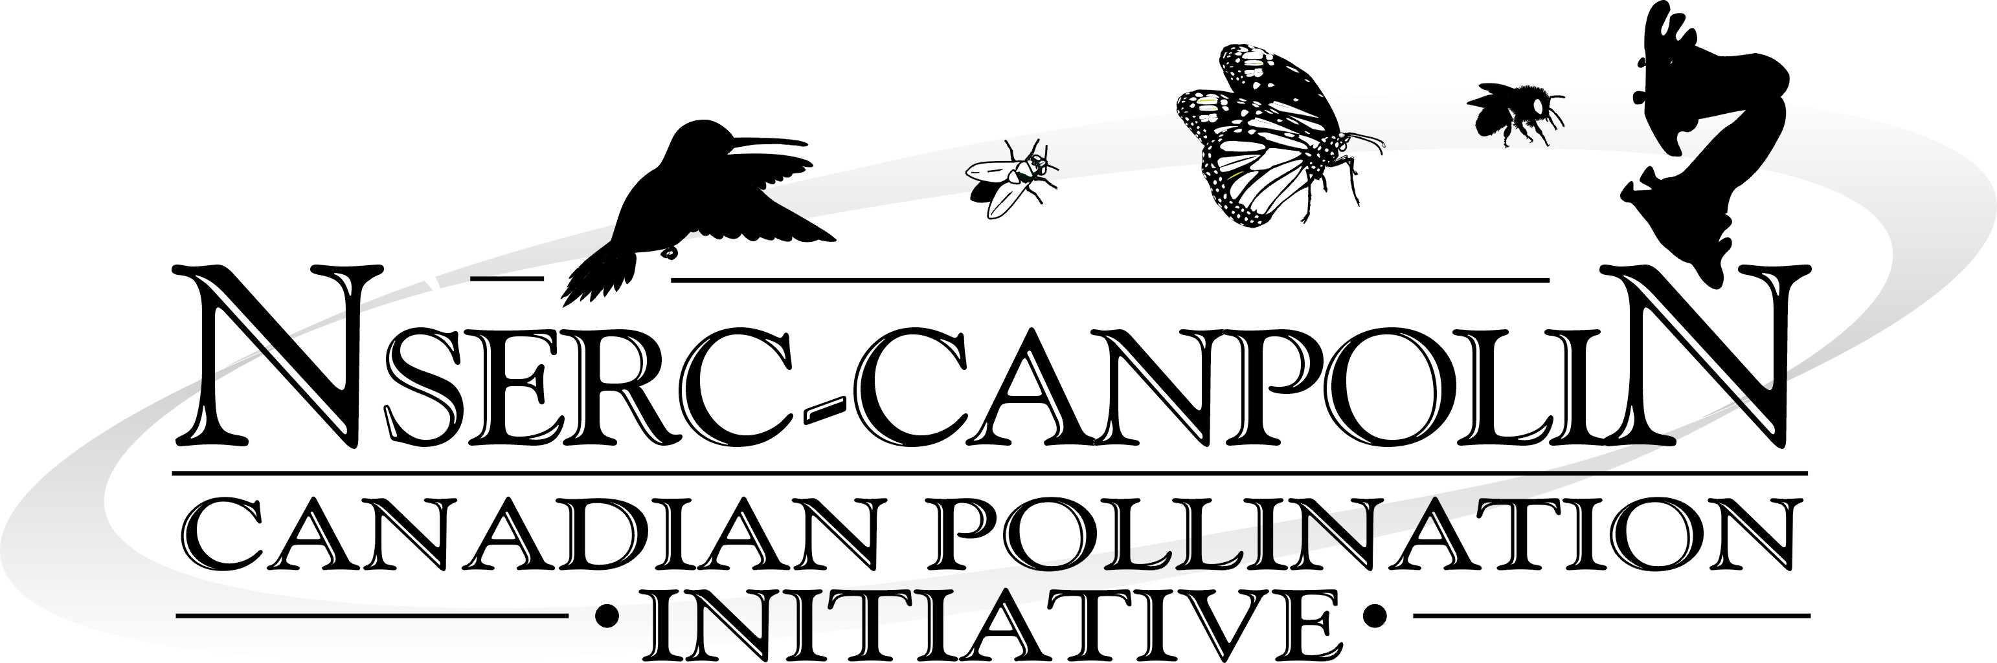
Thanks to
Coauthors
Elizabeth Elle
Jana Vamosi
Ralph Cartar
Sarah Semmler
Anne Worley
Funding:

