Slide 1


Patient Safety Incidents Related to Income
Corey Shields Colorado State University Global MIS581: Capstone – Business Intelligence and Data Analytics Dr. Steve Chung July 6, 2025

Slide 2
Overview
Objective
Our goals
Data Sources
Where are we getting our data
Methodology
How are we handling the data to provide actionable insight
Impact
What can be expected from the analysis
Notes:
Objective: Investigates whether communities with lower median household incomes experience higher rates of preventable patient safety incidents, using the PSI-90 composite score.
Data Sources: Combines CMS hospital safety data with U.S. Census income data, joined by ZIP code for geographic alignment.
Methodology: Uses Python for data preparation and integration; statistical analysis and regression modeling conducted in SAS Studio to explore income safety outcome correlations.
Impact: Aims to reveal income-related disparities in patient safety and support evidence-based healthcare policy improvements for underserved communities.

Slide 3
Research questions and hypotheses
Does lower income mean more patient safety incidents
H₀ (Null): No statistically significant relationship exists between median income by ZIP code and patient safety incident rates.
H₁ (Alternative): A statistically significant relationship exists between median income by ZIP code and patient safety incident rates.
Notes:
Health inequity persists in the U.S., disproportionately affecting low-income populations with reduced access to quality care and worse health outcomes.
Health equity: Defined as the absence of disparities in health across social, economic, and demographic groups (Ahmed et al., 2022).
Initial observations suggest a correlation between median household income by ZIP code and the frequency of patient safety incidents reported by CMS.
The study explores whether lower-income communities are at greater risk for adverse healthcare events.
Are lower-income areas more likely to have higher rates of patient safety incidents?

Slide 4
Literature Review
Socioeconomic Status and Health Outcomes
Hospital Quality and Resource Disparity
Measuring Deprivation Accurately
Geographic Income Disparities
Why PSI-90 Matters
Notes:
Lower income and education levels strongly predict poor outcomes: higher hospital readmissions, chronic illness, and mortality (Braveman et al., 2010).
Barriers to preventative and high-quality care in low-income communities lead to increased patient safety risks.
Long-term economic hardship contributes to systemic healthcare disadvantages.
Understaffed and under-resourced hospitals are more prone to safety incidents such as infections and surgical complications (Adler et al., 2016).
Medicare data shows higher 30-day mortality for patients from deprived neighborhoods treated at low-rated hospitals (Diaz et al., 2023).
Community SES and hospital quality combine to impact patient outcomes.
The Balanced Area Deprivation Index (bADI) improves on traditional socioeconomic indices by refining metrics to better predict adverse outcomes (Morid et al., 2025).
bADI shows stronger correlations with Medicare patient risks than previous tools.
The Area Deprivation Index (ADI) links ZIP code level SES to higher hospital readmissions and adverse events (Kind & Buckingham, 2018).
Mapping PSI-90 data with ADI/income data highlights areas of geographic health risk.
PSI-90 is a key national benchmark for hospital safety performance (PQM, 2024).
Publicly reported, linked to Medicare reimbursement, and includes location data.
Studies show income disparities persist in PSI-90 scores even after adjusting for hospital-level variables (James, 2013).

Slide 5
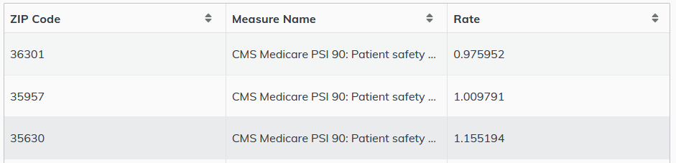
Dataset Variables
CMS Patient Safety Data (PSI-90)
Notes:
PSI-90 is a composite indicator of preventable adverse events in U.S. hospitals (e.g., pressure ulcers, post-op infections).
Derived from publicly available CMS Medicare data, it captures hospital level safety performance (CMS, 2019).

Slide 6
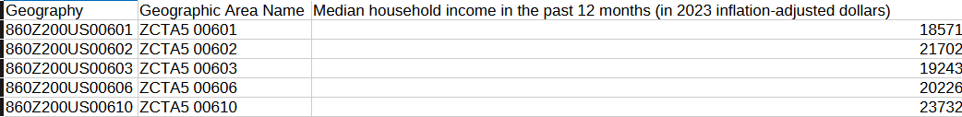
Dataset Variables (continued)
Census Bureau Income Data
Notes:
Provides median household income by ZIP code.
Offers essential context for assessing socioeconomic status at a local level.

Slide 7
Why use this data
Trusted & Publicly Available
Align directly with the research objective
Reflective of Hospital Outcomes
Reflective of Community Context
Notes:
Both are trusted, publicly available sources with consistent geographic identifiers.
Align directly with the research objective:
Explore the relationship between income level and patient safety incident rates.
CMS data reflects hospital outcomes, while Census data reflects community context enabling correlation analysis by location.
Combining PSI-90 with median income data allows for a location-based analysis of how socioeconomic disparities may impact patient safety outcomes.

Slide 8
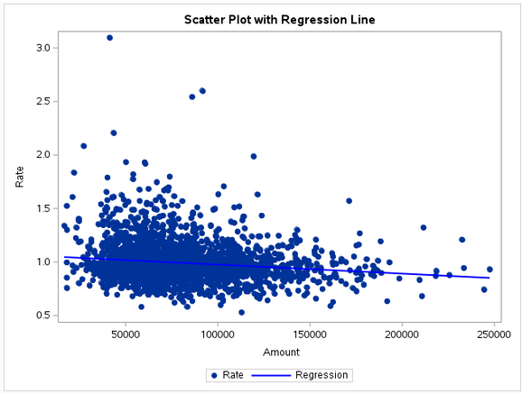
Findings
Analytical Approach
Model Validation
Visualizations
Notes:
Descriptive statistics to explore distributions of PSI-90 scores and median income.
Linear regression to model the relationship between:
Independent Variable: Median Household Income
Dependent Variable: PSI-90 Composite Score
Assumptions tested to ensure model reliability included Linearity, Normality of residuals, and Independence of residuals

Slide 9
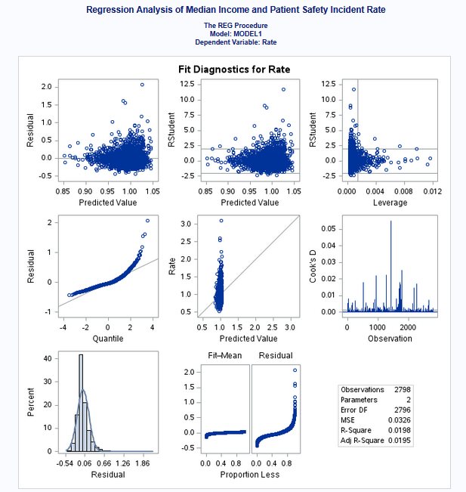
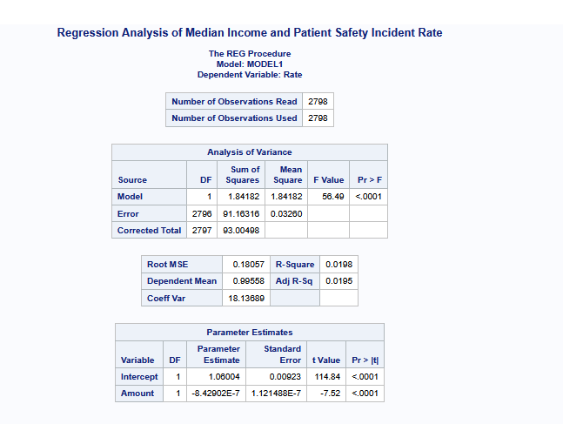
Regression
Notes:
Statistically significant negative relationship between:
Median income (ZIP code) and
Patient safety incident rates (PSI-90)
p-value < 0.0001 → Strong evidence of a relationship
R² = 0.0198 → Median income explains less than 2% of variation in PSI-90 scores → Low explanatory power limits practical use as a standalone predictor
Higher-income communities are less likely to experience adverse patient safety events.
Despite significance, income alone is not sufficient to explain differences in safety outcomes.

Slide 10
Conclusion
Key Takeaways
Study Limitations
Final Thoughts
Notes:
A statistically significant inverse relationship exists between median income and patient safety incidents (PSI-90).
Patients in lower-income ZIP codes are more likely to experience preventable hospital safety events.
Low R² value (0.0198) underscores that income alone is not a strong predictor, but an important contributing factor.
Highlights the structural inequalities embedded in the U.S. healthcare system.
Limited variables (e.g., hospital-level and demographic factors not included).
Truncated income data may reduce precision.
Reinforces the need for multifactorial models in health equity research.
Healthcare organizations should include socioeconomic data in quality improvement and risk adjustment.
Future research should incorporate variables like hospital staffing, demographics, and access to care.
Policy efforts should target resource allocation for hospitals in economically disadvantaged areas.
Public health IT should develop predictive tools using income and social risk data to flag high-risk communities.
Advancing health equity requires both data-driven insights and system-level interventions that account for the social determinants of safety and care quality.

Slide 11
References
See notes
Notes:
References
Adler, N. E., Cutler, D. M., Fielding, J. E., Galea, S., Glymour, M. M., Koh, H. K., & Satcher, D. (2016). Addressing social determinants of health and health disparities: A vital direction for health and health care. NAM Perspectives. Retrieved from https://nam.edu/wp-content/uploads/2016/09/Addressing-Social-Determinants-of-Health-and-Health-Disparities.pdf
Ahmed, S., Chase, L. E., Wagnild, J., Akhter, N., Sturridge, S., Clarke, A., Chowdhary, P., Mukami, D., Kasim, A., & Hampshire, K. (2022). Community Health Workers and health equity in low- and middle-income countries: Systematic review and Recommendations for policy and practice. International Journal for Equity in Health, 21(1). https://doi.org/10.1186/s12939-021-01615-y
Braveman, P., Egerter, S., & Williams, D. R. (2010). The social determinants of health: Coming of age. Annual Review of Public Health, 32, 381–398. https://doi.org/10.1146/annurev-publhealth-031210-101218
Centers for Medicare & Medicaid Services (CMS). (2019). CMS Patient Safety Indicators PSI 90 Fact Sheet. https://www.cms.gov/priorities/innovation/files/fact-sheet/bpciadvanced-fs-psi90.pdf
Centers for Medicare & Medicaid Services (CMS). (2025). CMS Medicare PSI-90 and component measures - six-digit estimate dataset. https://data.cms.gov/provider-data/dataset/muwa-iene
Diaz, A., Lindau, S. T., Obeng-Gyasi, S., Dimick, J. B., Scott, J. W., & Ibrahim, A. M. (2023). Association of Hospital Quality and neighborhood deprivation with mortality after inpatient surgery among Medicare beneficiaries. JAMA Network Open, 6(1). https://doi.org/10.1001/jamanetworkopen.2022.53620
James, J. T. (2013). A new, evidence-based estimate of patient harms associated with hospital care. Journal of Patient Safety, 9(3), 122–128. https://doi.org/10.1097/PTS.0b013e3182948a69
Kind, A. J. H., & Buckingham, W. R. (2018). Making neighborhood-disadvantage metrics accessible - The Neighborhood Atlas. New England Journal of Medicine, 378(26), 2456–2458. https://doi.org/10.1056/NEJMp1802313
Morid, M. A., Tillman, R. E., & Halperin, E. (2025). Balanced Area Deprivation Index (bADI): Enhancing social determinants of health indices to strengthen their association with healthcare clinical outcomes, utilization and costs. ArXiv. https://doi.org/10.48550/arXiv.2506.08131
PQM. (2024). Patient safety indicator (PSI) 90: Patient safety and adverse events composite. Patient Safety Indicator (PSI) 90: Patient Safety and Adverse Events Composite | Partnership for Quality Measurement. https://p4qm.org/measures/0531
Rundle, A. G., Bader, M. D., & Mooney, S. J. (2022). The disclosure of personally identifiable information in studies of neighborhood contexts and patient outcomes. Journal of Medical Internet Research, 24(3). https://doi.org/10.2196/30619
Serou, N., Sahota, L. M., Husband, A. K., Forrest, S. P., Slight, R. D., & Slight, S. P. (2021). Learning from safety incidents in high-reliability organizations: A systematic review of learning tools that could be adapted and used in healthcare. International Journal for Quality in Health Care, 33(1). https://doi.org/10.1093/intqhc/mzab046
Ruohoniemi, M., & Phillips, V. (2022). Choosing a Topic and Formulating Research Questions. Julie A. Hunt, Sarah Baillie, Megan Thompson, Mirja Ruohoniemi, Victoria Phillips, 3.
U.S Census Bureau (2023). Median Household Income in the Past 12 Months. https://data.census.gov/table/ACSDT5Y2023.B19013?q=B19013+ZIP+Code+Tabulation+Area
World Health Organization (WHO). (2025). World report on social determinants of health equity. https://www.who.int/teams/social-determinants-of-health/equity-and-health/world-report-on-social-determinants-of-health-equity

