Slide 1
Scannerbot
Prototype
Citlally Gomez, Kailyn King,
Andrew Le, Corey Talbert
April 19, 2023

Slide 2
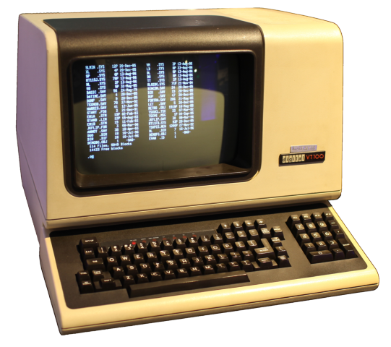
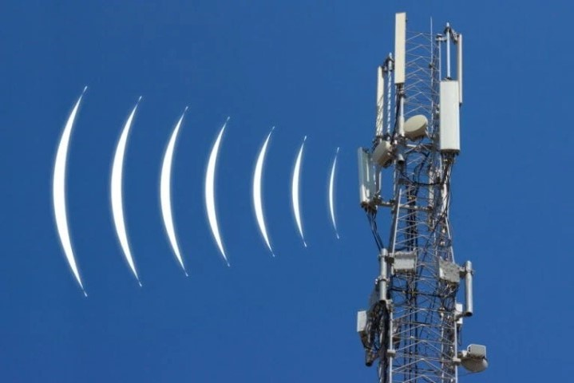



Radio receiver
Scanner Bot software host
Social media platform
Broadcaster
Users

Slide 3
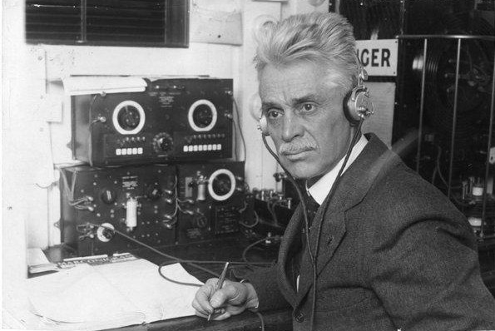
Functional Requirements
Receive and record transmissions
Transcribe transmission recordings
Analyze transcripts for contextual information
Thread related transcripts
Publish transcripts online
Log system activity
Have an interactive command line operator interface

Slide 4
Functional Requirements
Receive and record transmissions
Transcribe transmission recordings
Analyze transcripts for contextual information
Thread related transcripts
Publish transcripts online
Log system activity
Have an interactive command line operator interface

Slide 5
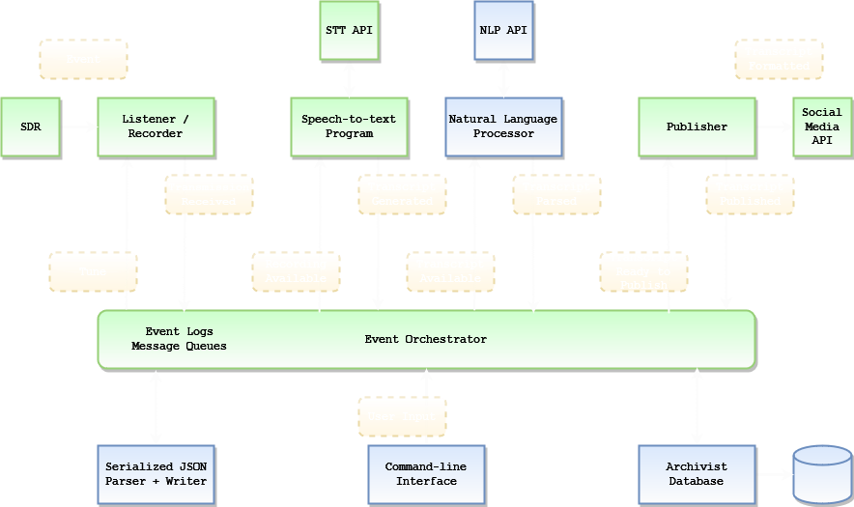
Architectural Components

Slide 6
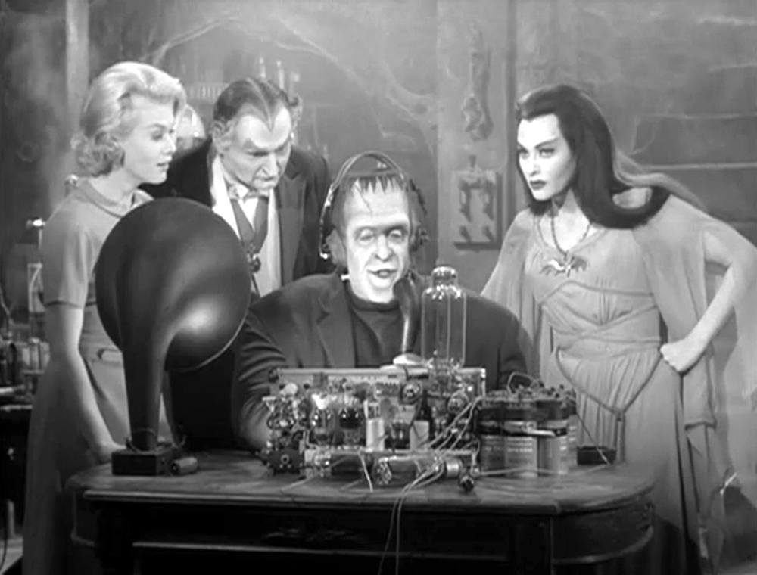
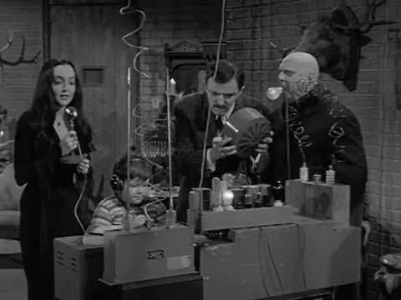
Architectural Components
Database
Provide a “memory” for the system
Natural Language Processor (Analyzer module)
Extract contextual information from transcripts

Slide 7
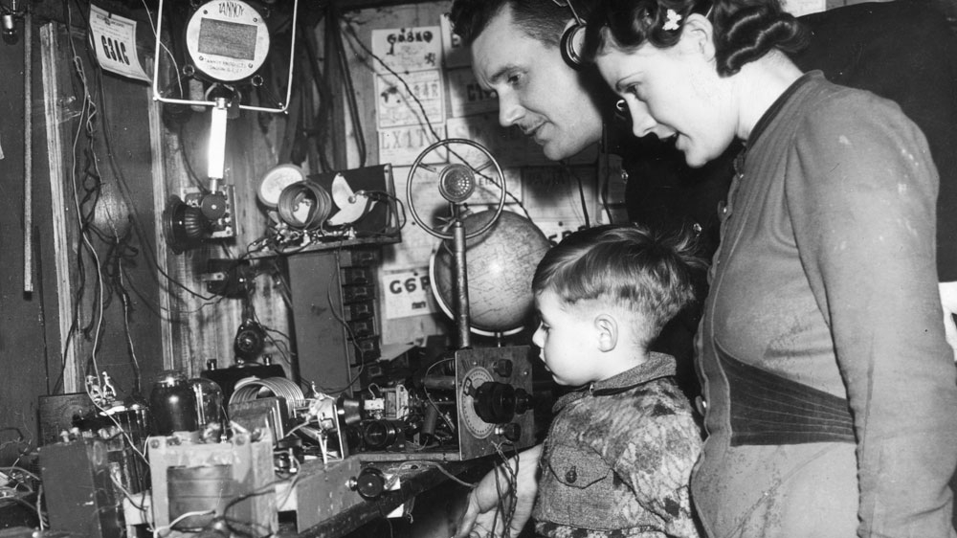
Quality of Service
Accuracy
Signal strength
Audio quality
Availability
Storage constraints
Processing constraints
Timing
Transcription bottleneck
Message passing

Slide 8
https://github.com/coreytalbert/scannerbot
https://twitter.com/testscannerbot
https://twitter.com/sdscannerbot
https://coreytalbert.com/scannerbotdemo.mp4

