Slide 1
























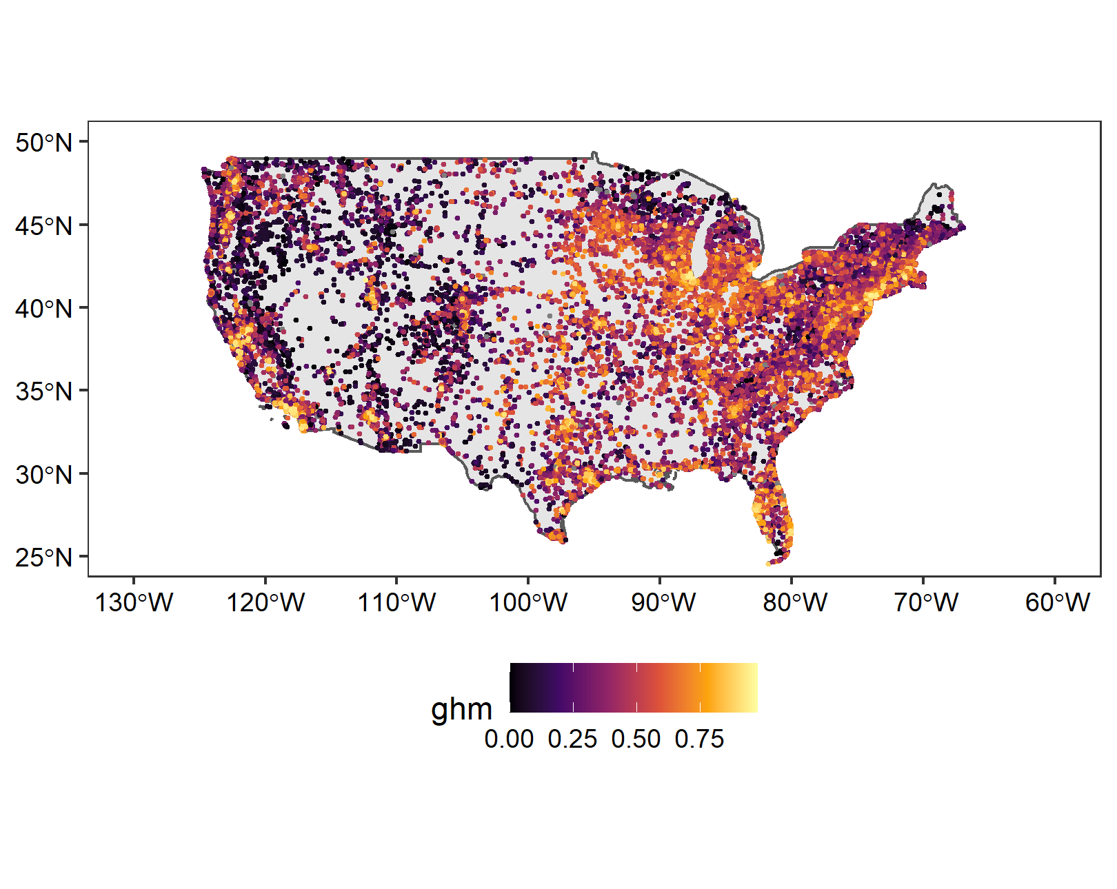
https://onlinelibrary.wiley.com/doi/full/10.1111/ele.13151

Slide 3




Slide 4
























(A)
(B)
SAD
only
Diversity
S
S_{n}
N
only
β_{Sn}
Modification gradient
(C)
agg
only

Slide 5
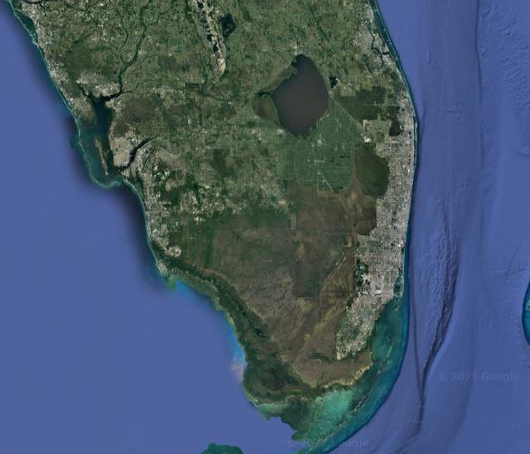
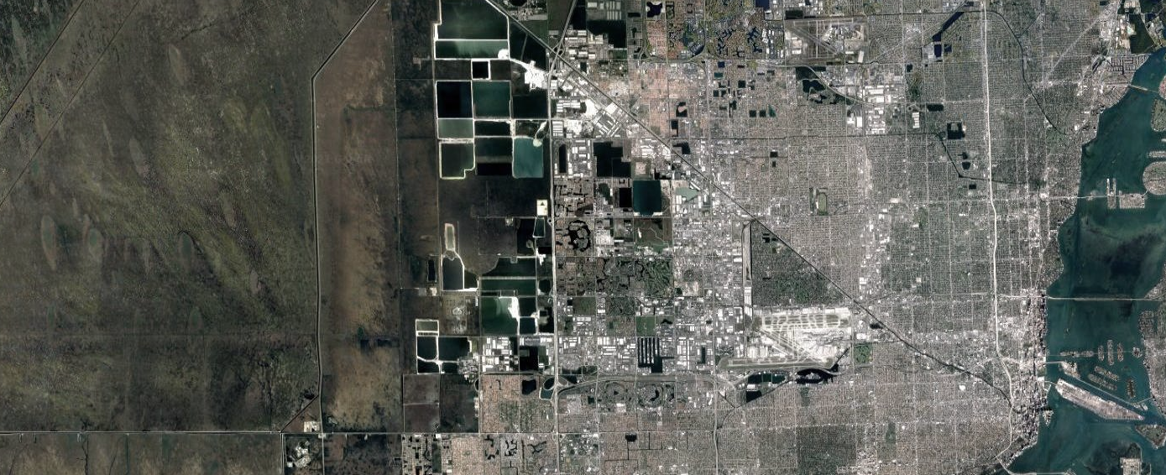




(A)
(B)
SAD
only
N
only
(C)
0.13
0.27
0.81
0.94
agg
only

Slide 6

(A)
(B)
SAD
only
N
only
(C)
0.13
0.27
0.81
0.94
agg
only

Slide 7
(A)
(B)
Number of individuals
Species abundance distribution
(C)
Spatial arrangement of conspecific individuals
0.13
0.27
0.81
0.94

Slide 8
SAD
only
N
only
agg
only
Gradient

Slide 9































S
S_{n}
β_{Sn}
Diversity

