Slide 1
























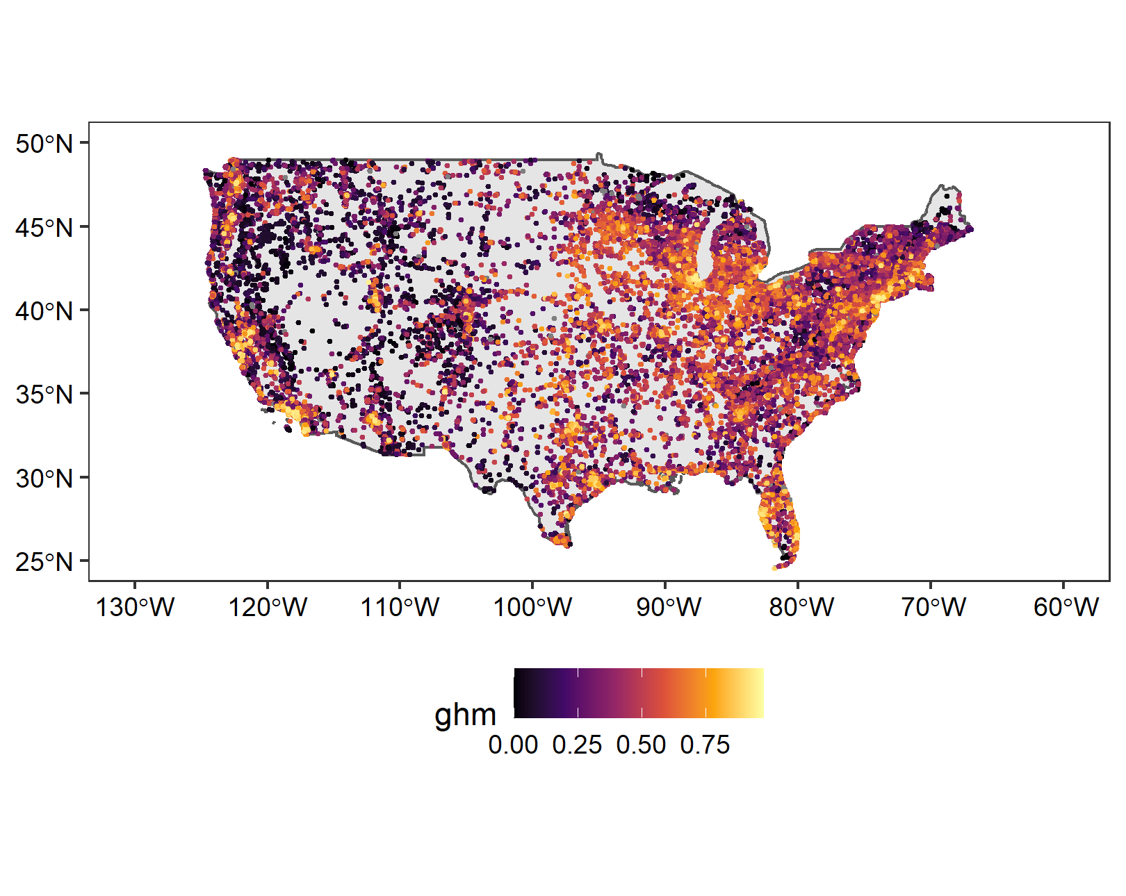
https://onlinelibrary.wiley.com/doi/full/10.1111/ele.13151

Slide 3




Slide 4
(A)
(B)
SAD
only
Diversity
N
only
Modification gradient
S
S_{n}
(C)
β_{Sn}
agg
only

Slide 5
SAD
only
N
only
agg
only
Gradient

Slide 6
S
S_{n}
β_{Sn}
Diversity

