Slide 1
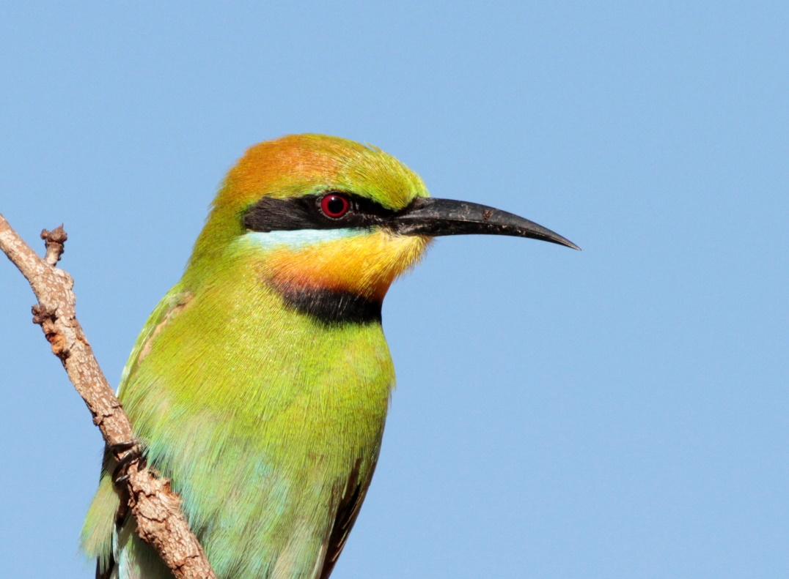

Random 500km landscape
Median species – median checklists = Urban Tolerance score
Urbanization
eBird checklist
species observation
Median species – median checklists = Urban Tolerance score
Urbanization

Slide 2
Random 500km landscape
Median species – median checklists = Urban Tolerance score
Urbanization
eBird checklist
species observation
Median species – median checklists = Urban Tolerance score
Urbanization

Slide 3
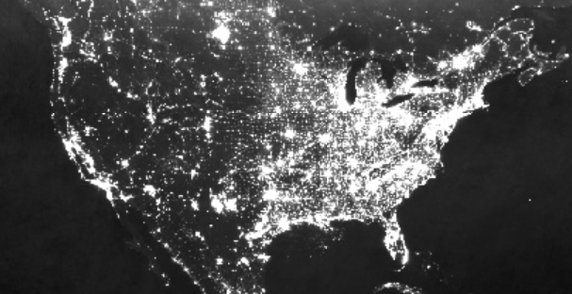
N=2000 randomly sampled buffers

Slide 4
Natural
Urban

Slide 5
(A)
(B)
Random 500km landscape
N=2000 randomly sampled 500 km landscapes
Median species – median checklists = Urban Tolerance score
Urbanization
eBird checklist
species observation
Median species – median checklists = Urban Tolerance score
Urbanization
(C)
Low species response variability
(D)
(E)
Many randomly calculated urban tolerance scores
H₁: Intra-specific variability
High environmental variability
UT
2.3
-0.4
1.5
-1.8
Species response variability
Species response variability
SD =
High species response variability
H₂: No intra-specific variability
Low species response variability
Buffer urbanness
0.7
4.4
1.5
6.7
Environmental variability
Environmental variability
Low environmental variability
SD =
High species response variability
Natural
Urban

Slide 6
(A)
N=2000 randomly sampled landscapes
(B)
Random 500km landscape
Median species – median checklists = Urban Tolerance score
Urbanization
eBird checklist
species observation
Median species – median checklists = Urban Tolerance score
Urbanization
(C)
Low species response variability
(D)
H₁: Intra-specific variability
High environmental variability
Species response variability
High species response variability
H₂: No intra-specific variability
Low species response variability
Environmental variability
Low environmental variability
High species response variability
Natural
Urban

Slide 7



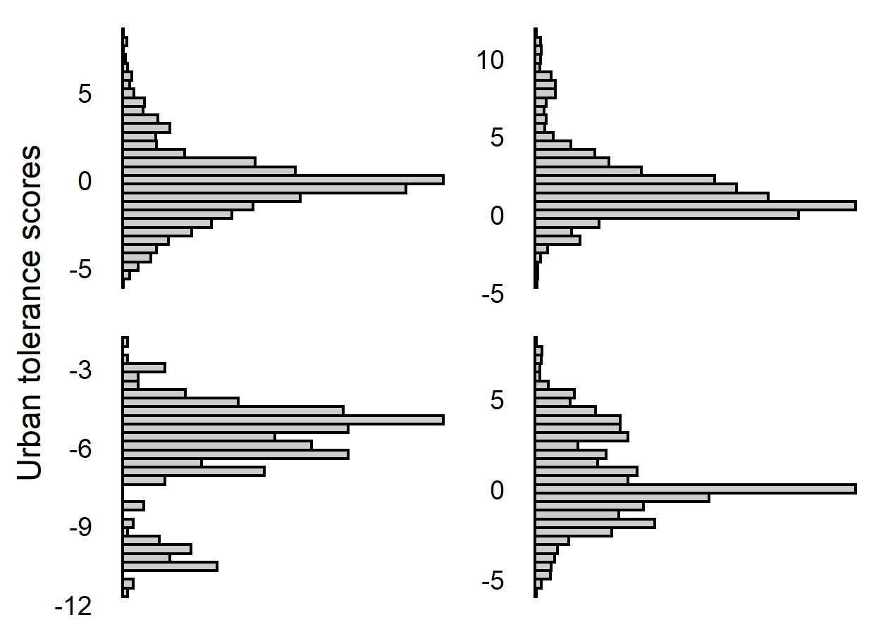

(A)
(B)
Random landscape
Urban avoider
N=2000 randomly sampled landscapes
Median species – median checklists = Urban Tolerance score
Urbanization
eBird checklist
absence
presence
Urban exploiter
Median species – median checklists = Urban Tolerance score
Urbanization
(C)
Low species response variability
(D)
For each species, collapse all buffer-specific urban tolerance scores into a single SD
(E)
High environmental variability
H₁: Intraspecific variability
SD
SD
Species response variability
High species response variability
H₂: No intraspecific variability
Low species response variability
SD
SD
Low environmental variability
Environmental variability
High species response variability
Natural
Urban

Slide 8
H₁: Intra-specific variability
Species response variability
High species response variability
H₂: No intra-specific variability
Low environmental variability
Environmental variability
Low species response variability
Low species response variability
Urbanization

Slide 9
H₁: Intra-specific variability
Species response variability
Low environmental variability
H₂: No intra-specific variability
Low species response variability

Slide 10
Low environmental variability
High species response variability
Low environmental variability
Low species response variability

Slide 11
Low environmental variability
High environmental variability
High species response variability
Low species response variability
Low environmental variability
Low species response variability

Slide 12
Low environmental variability
High environmental variability
High species response variability
Low species response variability
Low environmental variability
High environmental variability
Low species response variability
High species response variability

Slide 13
Low environmental variability
High environmental variability
H₁: Intra-specific variability
High species response variability
Species response variability
Low species response variability
Low environmental variability
H₂: No intra-specific variability
High environmental variability
Environmental variability
Low species response variability
High species response variability

Slide 14
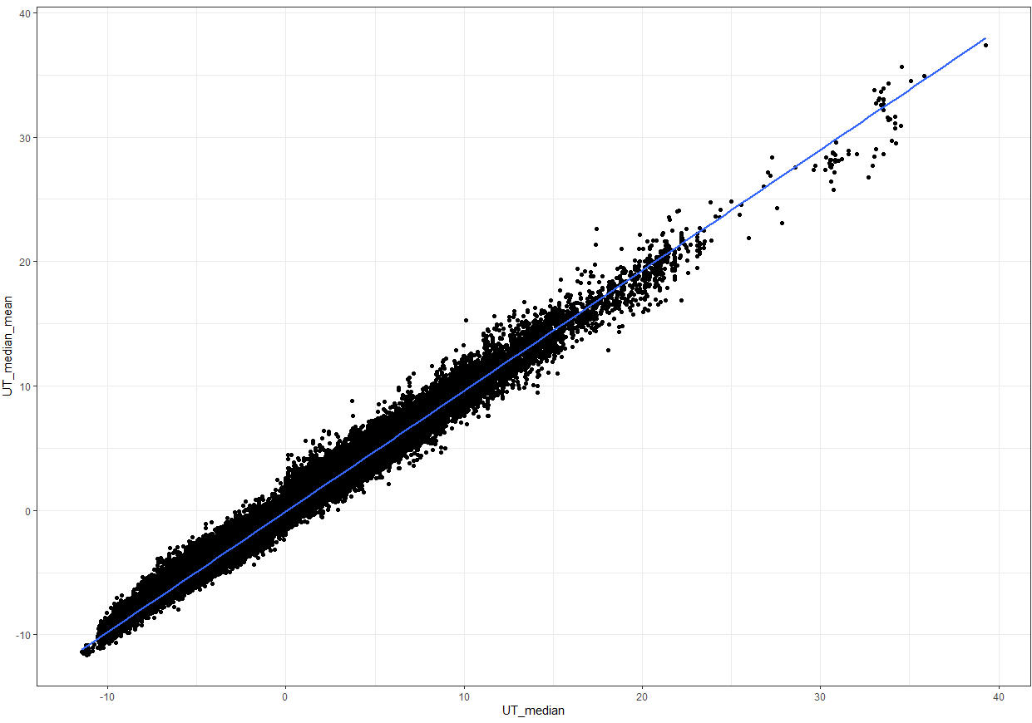

Slide 15
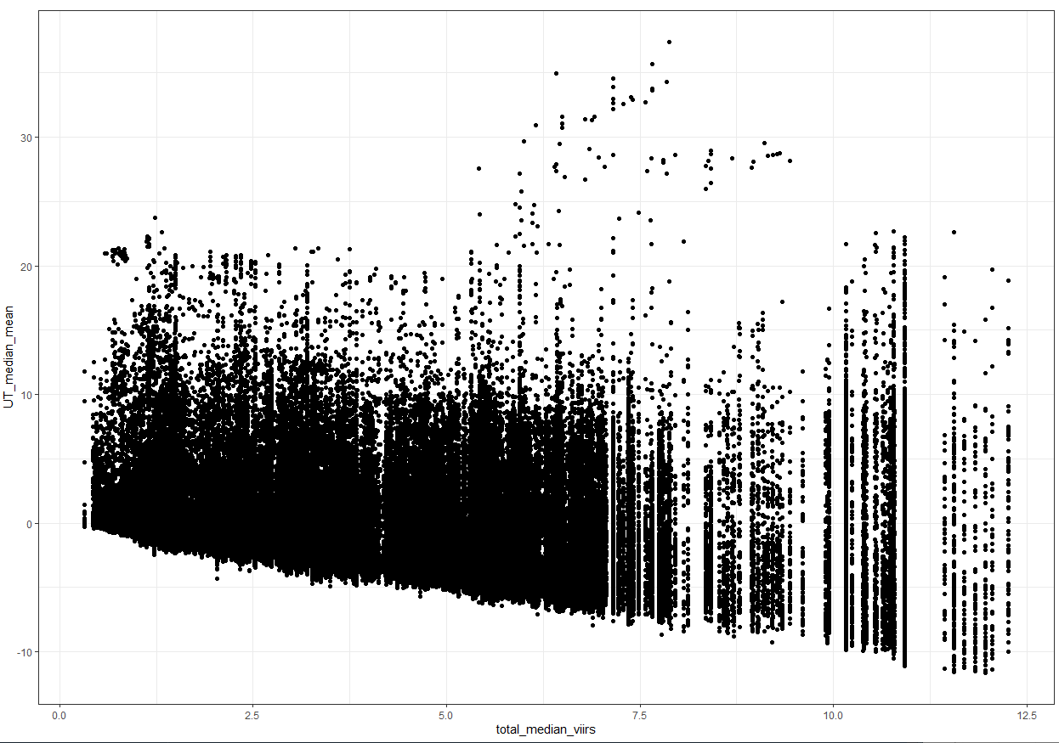

Slide 16
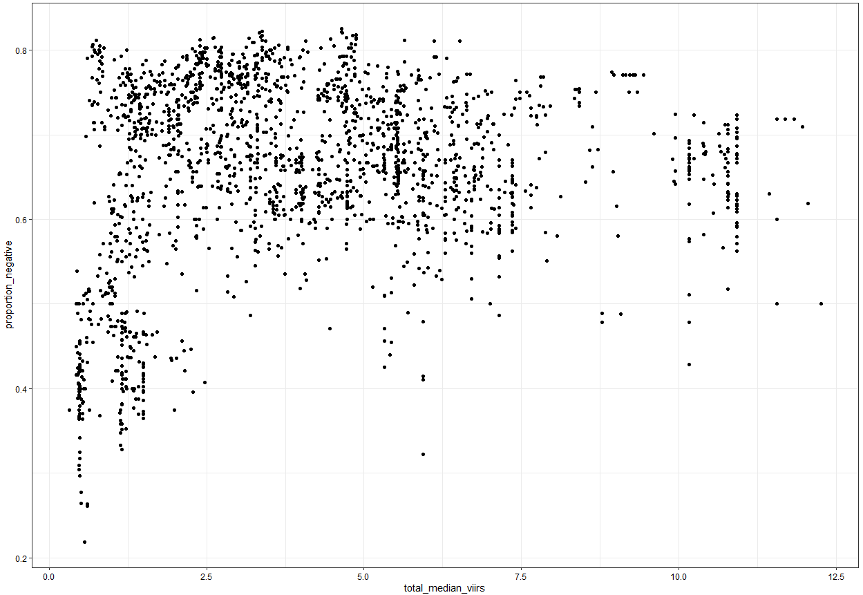

Slide 17
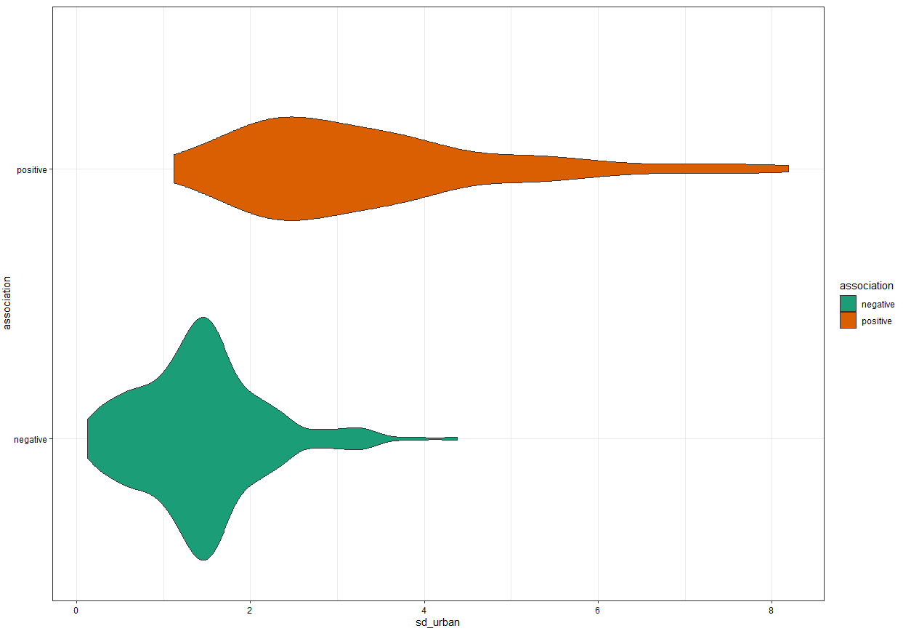

Slide 18
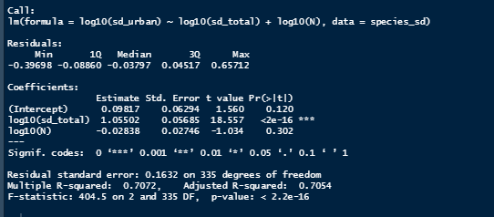
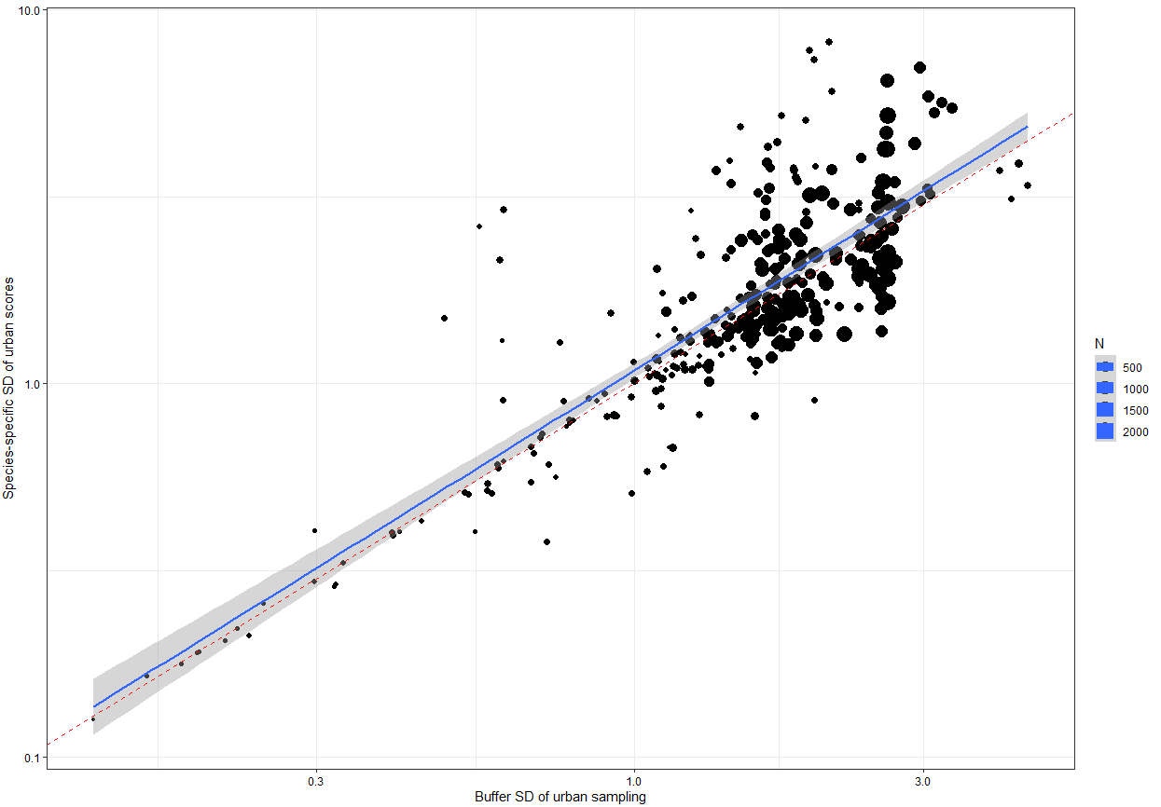

Slide 19
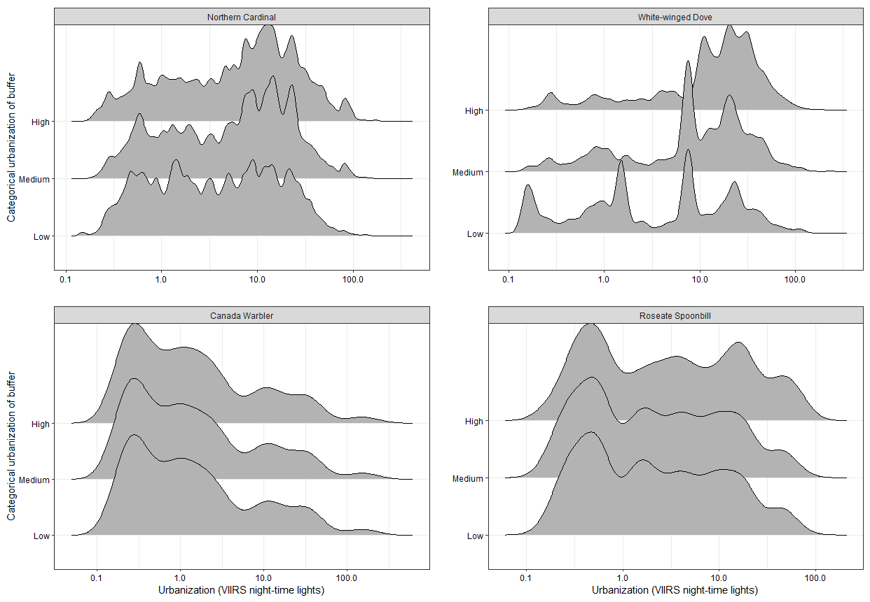

Slide 20
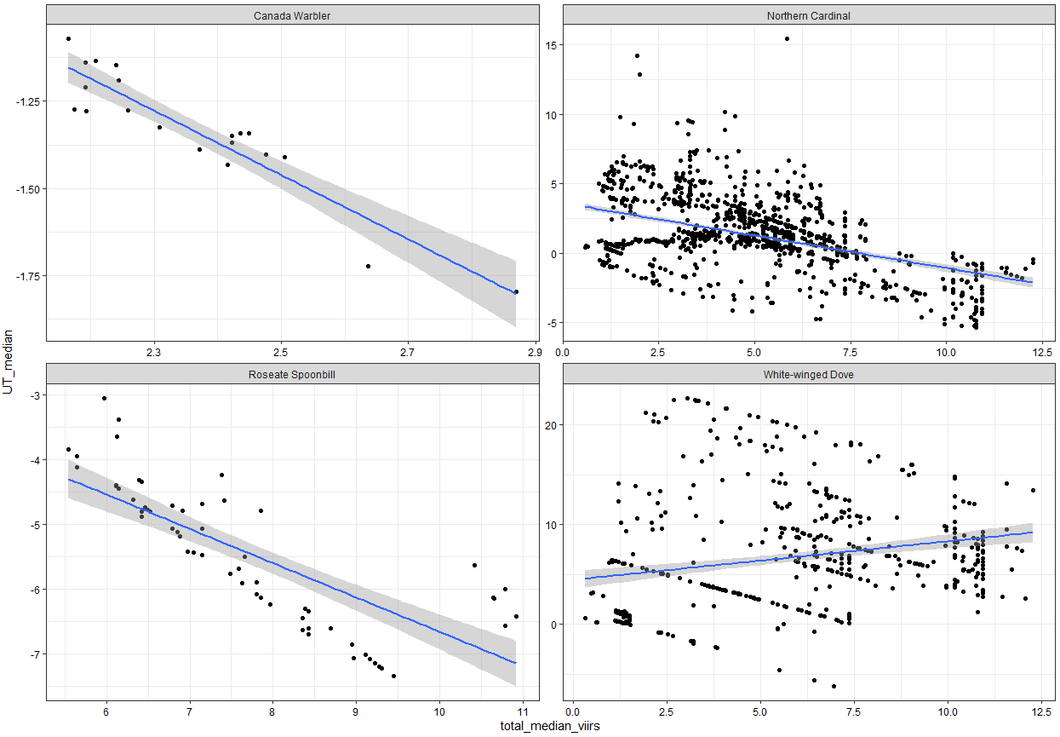

Slide 21
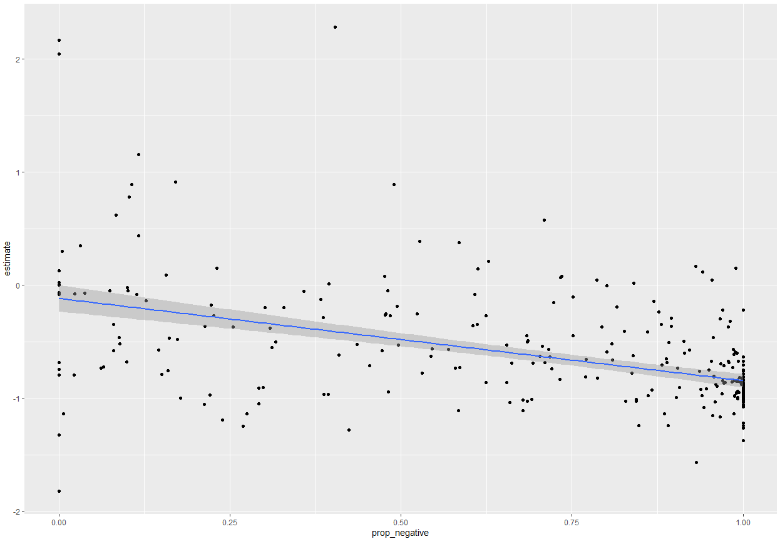

Slide 22
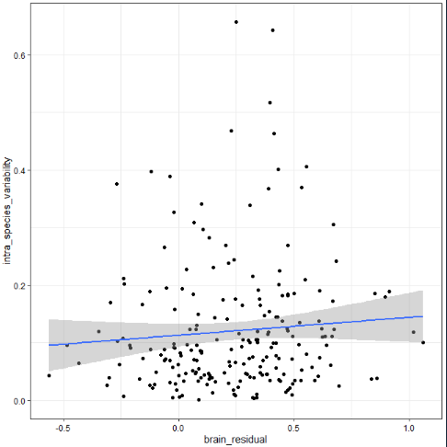
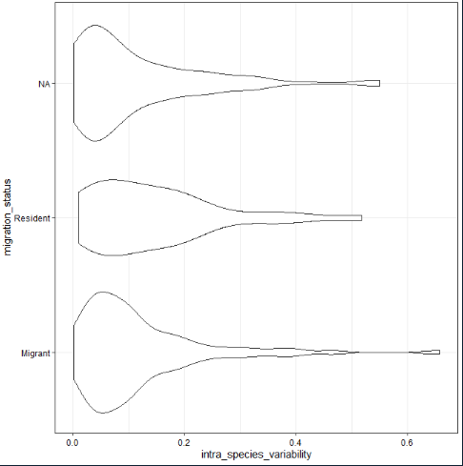
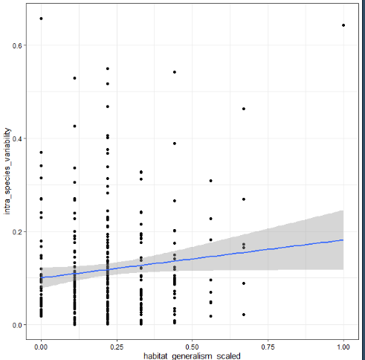
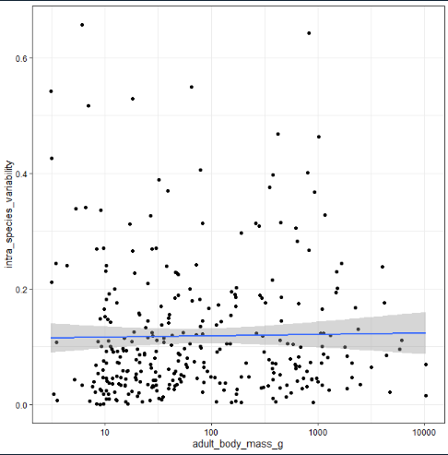

Slide 23
Low environmental variability
High environmental variability
H₁: Intra-specific variability
High species response variability
Species response variability
Low species response variability
Low environmental variability
H₂: No intra-specific variability
High environmental variability
Environmental variability
Low species response variability
High species response variability

