Slide 1
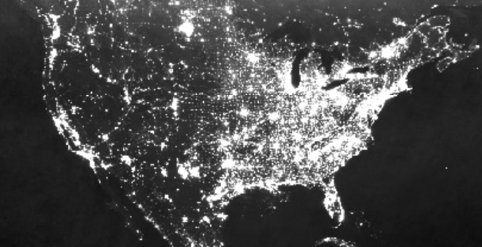



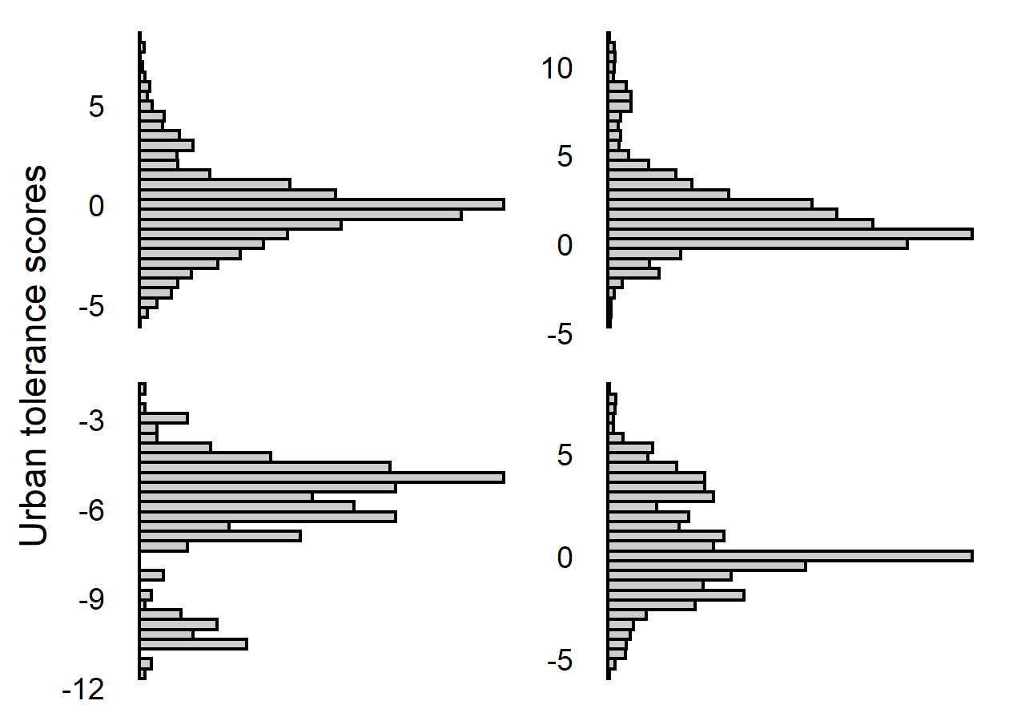

(A)
(B)
Random landscape
Urban avoider
N=2000 randomly sampled landscapes
Median species – median checklists = Urban Tolerance score
Urbanization
eBird checklist
absence
presence
Urban exploiter
Median species – median checklists = Urban Tolerance score
Urbanization
(C)
Low species response variability
(D)
For each species, collapse all buffer-specific urban tolerance scores into a single SD
(E)
High environmental variability
H₁: Intraspecific variability
SD
SD
Species response variability
High species response variability
H₂: No intraspecific variability
Low species response variability
SD
SD
Low environmental variability
Environmental variability
High species response variability
Natural
Urban

