Slide 1
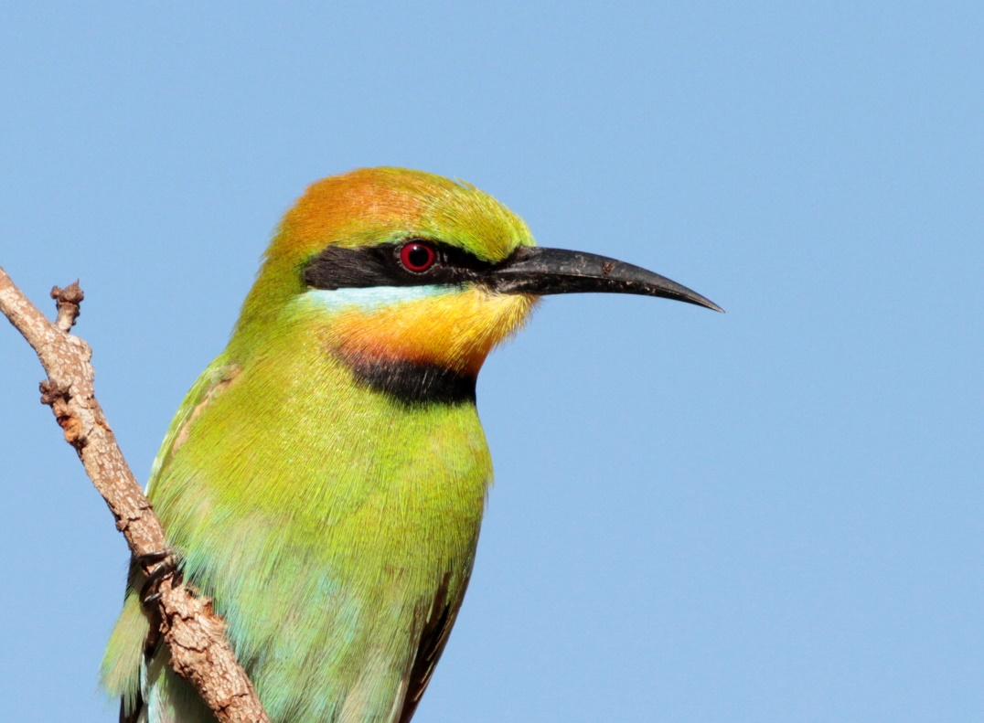
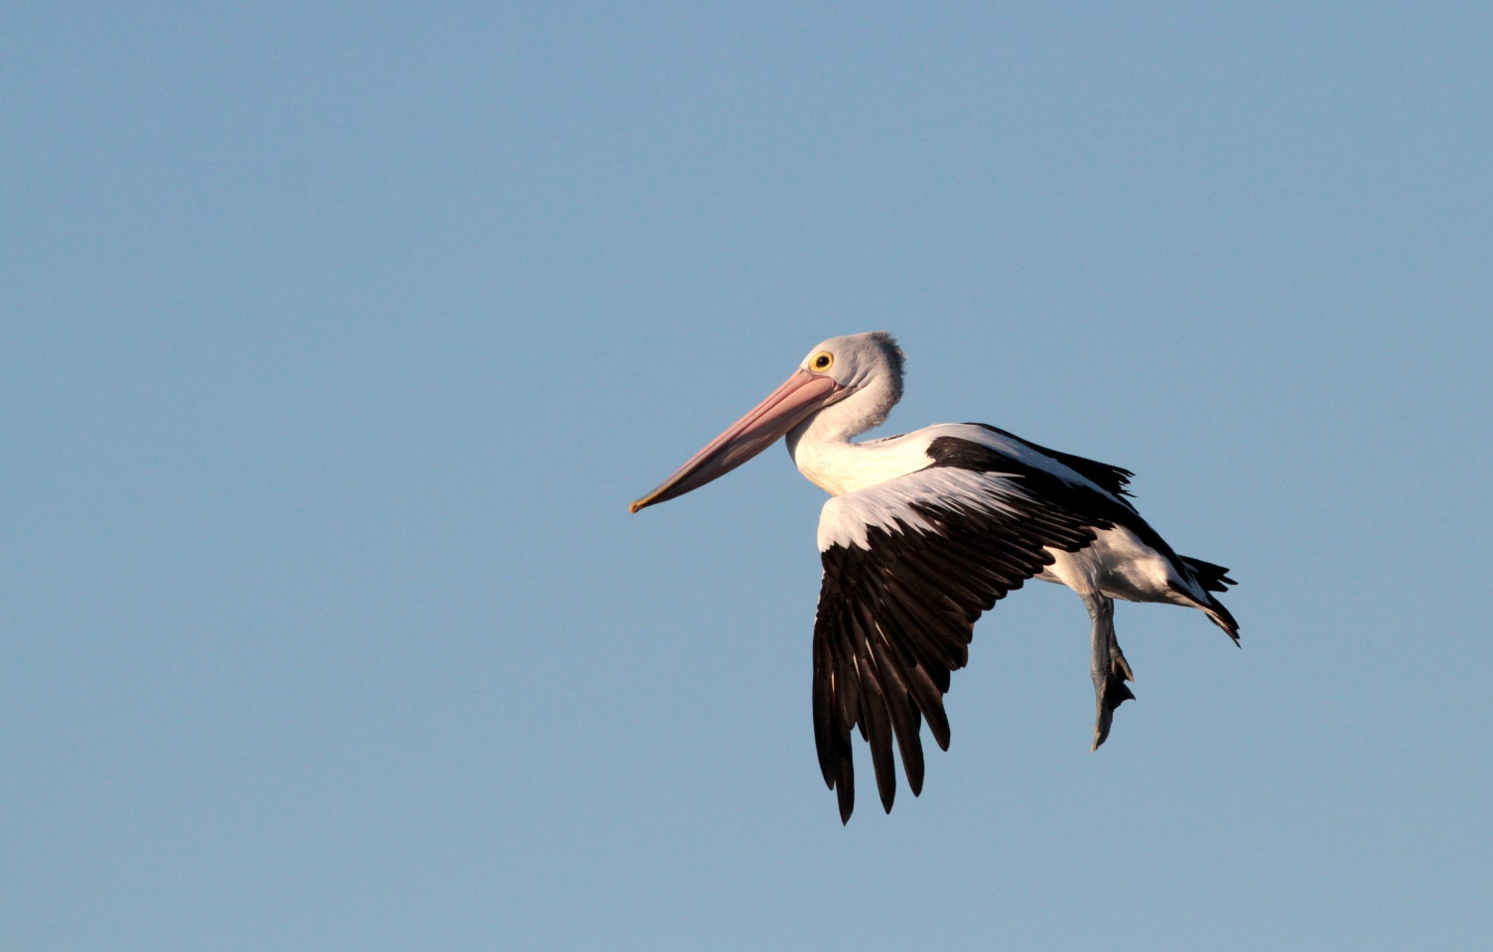
Random 500km landscape
Median species – median checklists = Urban Tolerance score
Urbanization
eBird checklist
species observation
Median species – median checklists = Urban Tolerance score
Urbanization

Slide 2
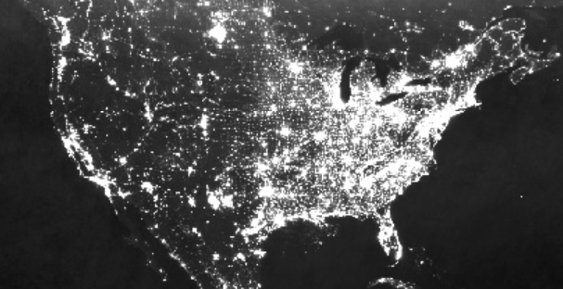

Slide 3
Natural
Urban

Slide 5
Low environmental variability
Low species response variability

Slide 6
Low environmental variability
High species response variability
Low environmental variability
Low species response variability

Slide 7
Low environmental variability
High environmental variability
High species response variability
Low species response variability
Low environmental variability
Low species response variability

Slide 8
Low environmental variability
High environmental variability
High species response variability
Low species response variability
Low environmental variability
High environmental variability
Low species response variability
High species response variability

Slide 9
Low environmental variability
High environmental variability
H₁: Intra-specific variability
High species response variability
Species response variability
Low species response variability
Low environmental variability
H₂: No intra-specific variability
High environmental variability
Environmental variability
Low species response variability
High species response variability

Slide 10
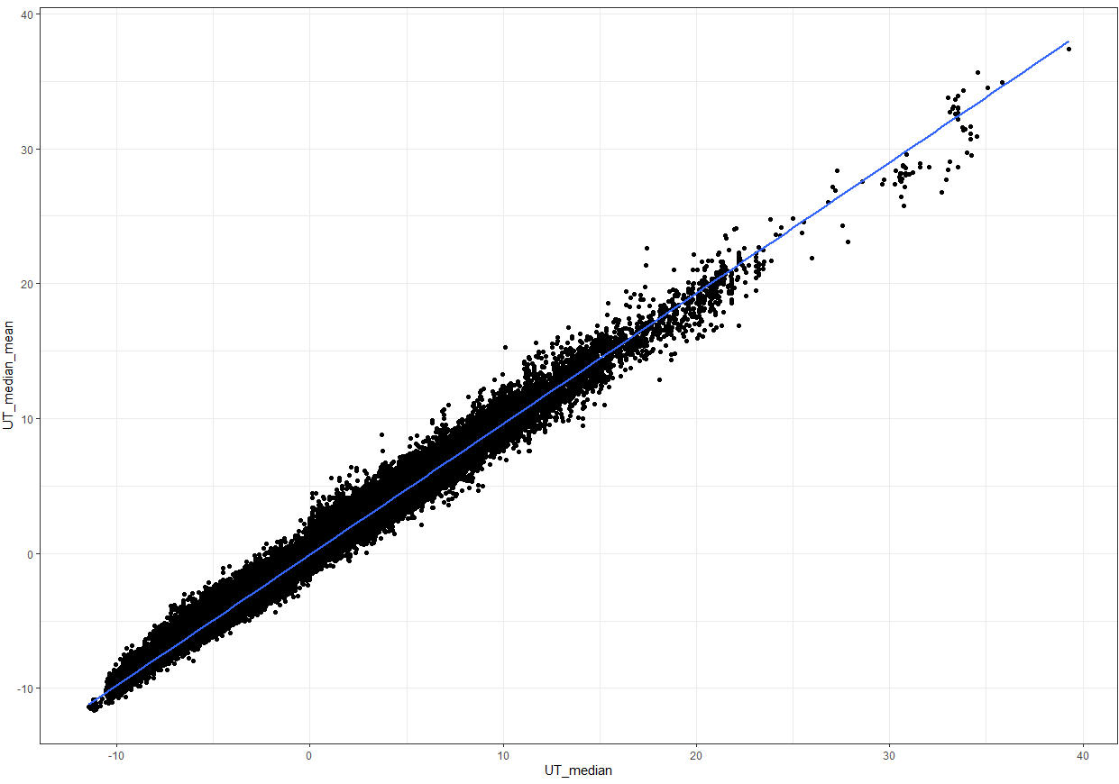

Slide 11
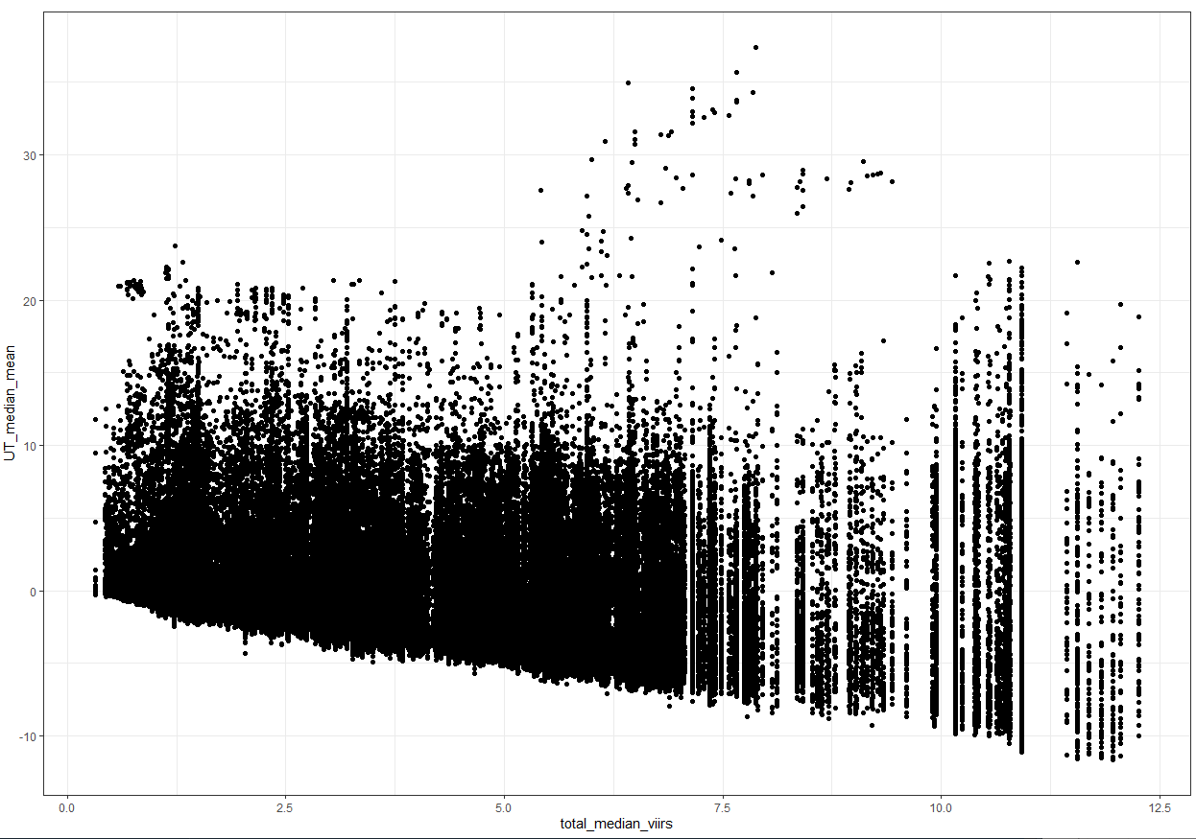

Slide 12
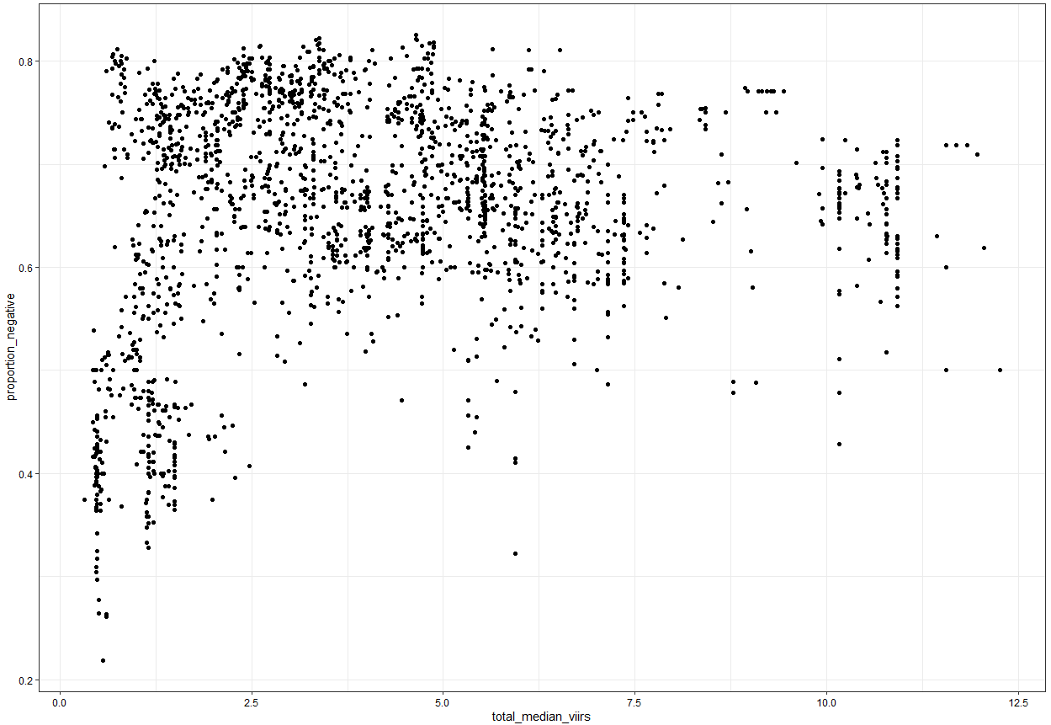

Slide 13
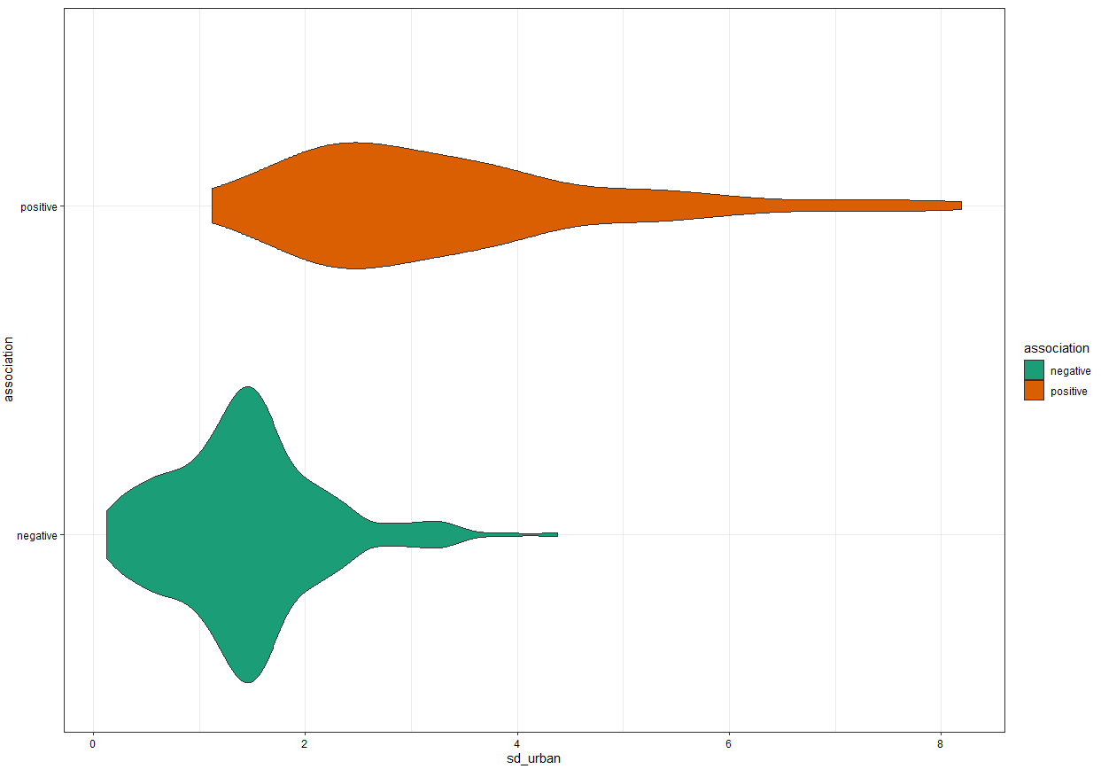

Slide 14
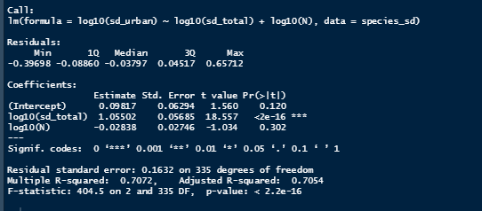
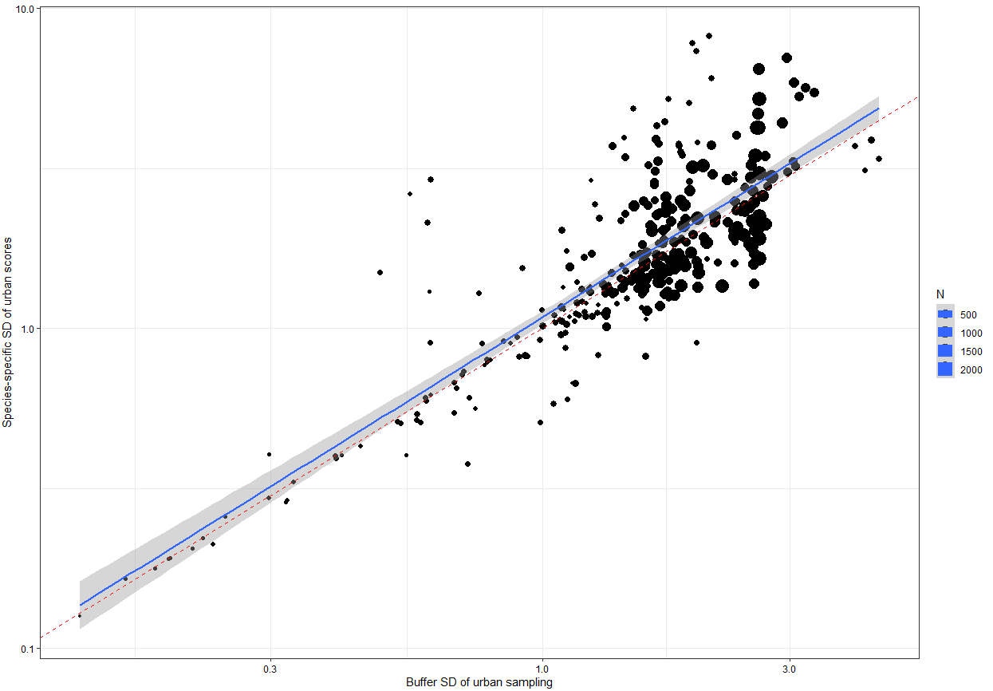

Slide 15
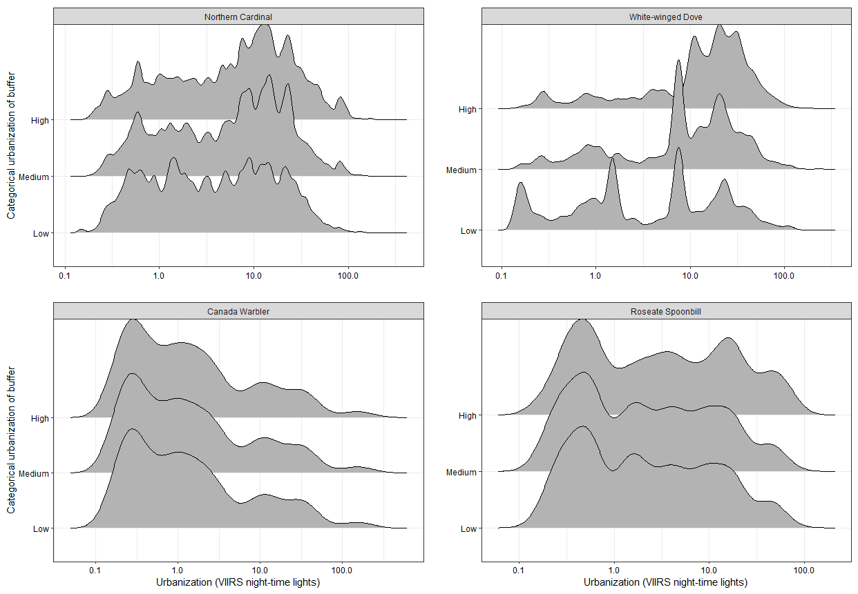

Slide 16
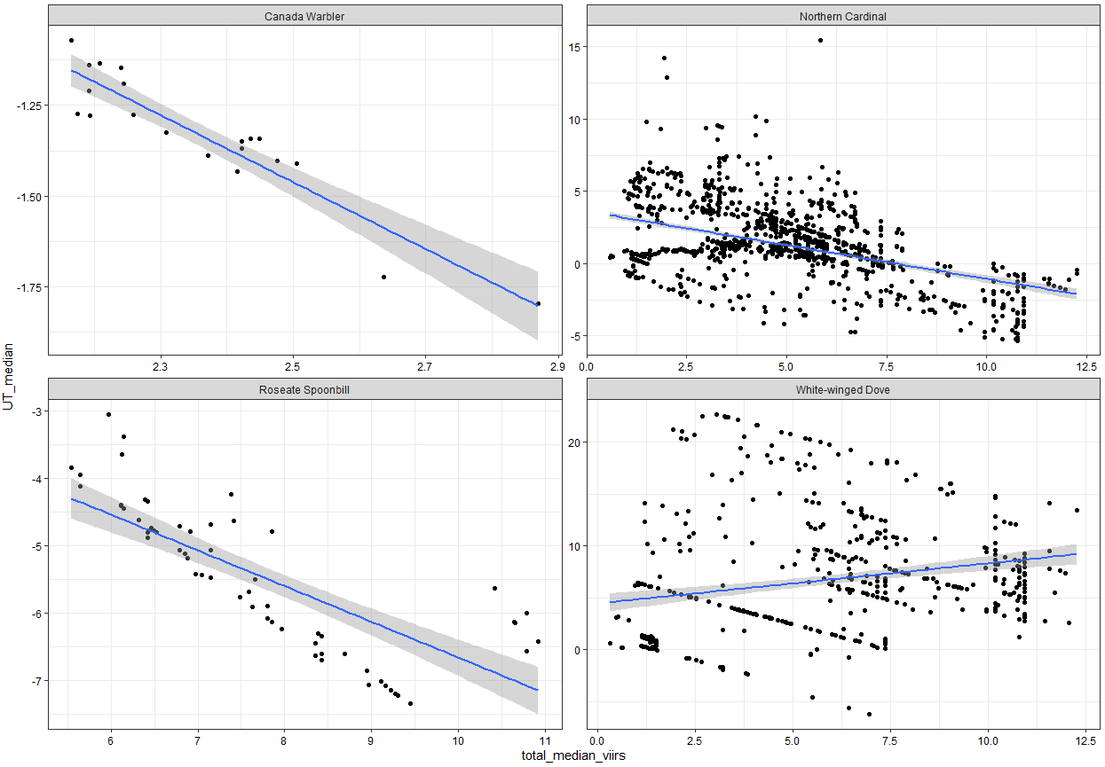

Slide 17
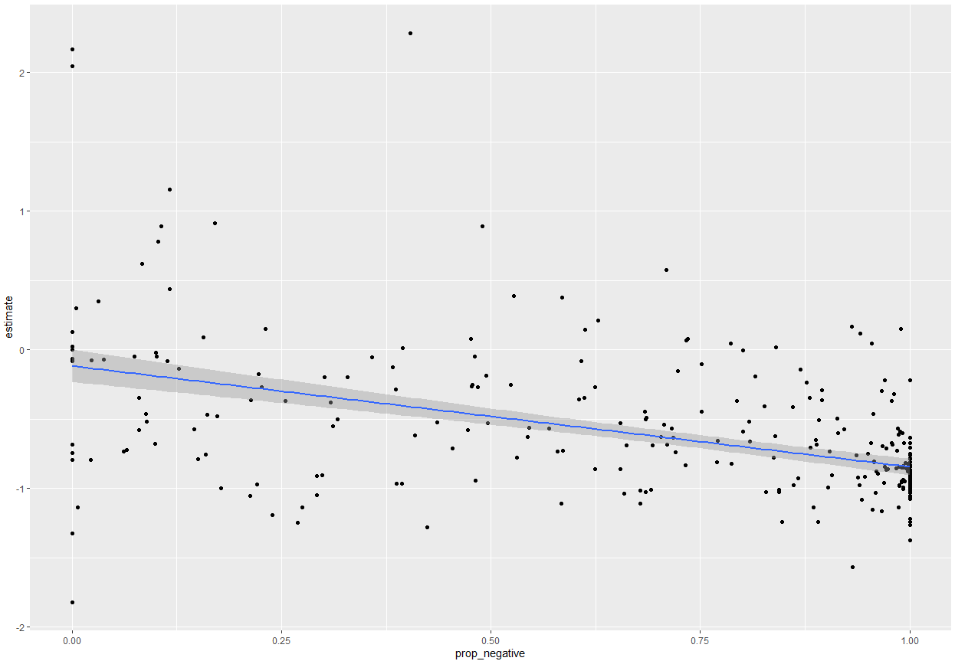

Slide 18
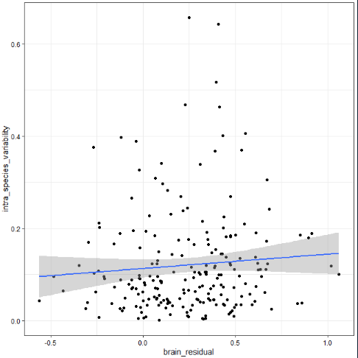
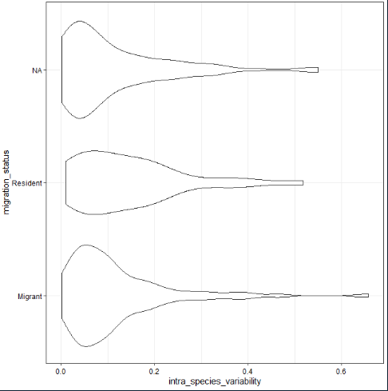
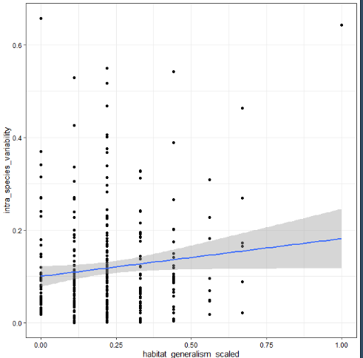
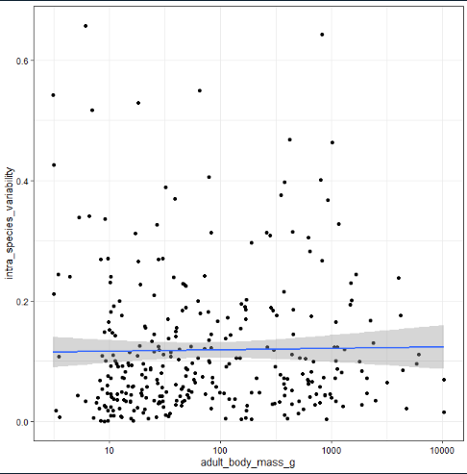

Slide 19
Low environmental variability
High environmental variability
H₁: Intra-specific variability
High species response variability
Species response variability
Low species response variability
Low environmental variability
H₂: No intra-specific variability
High environmental variability
Environmental variability
Low species response variability
High species response variability

