Slide 1
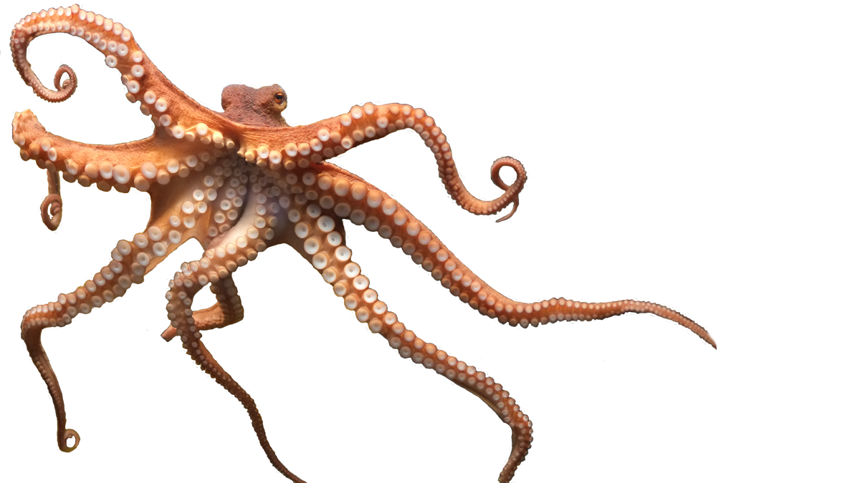


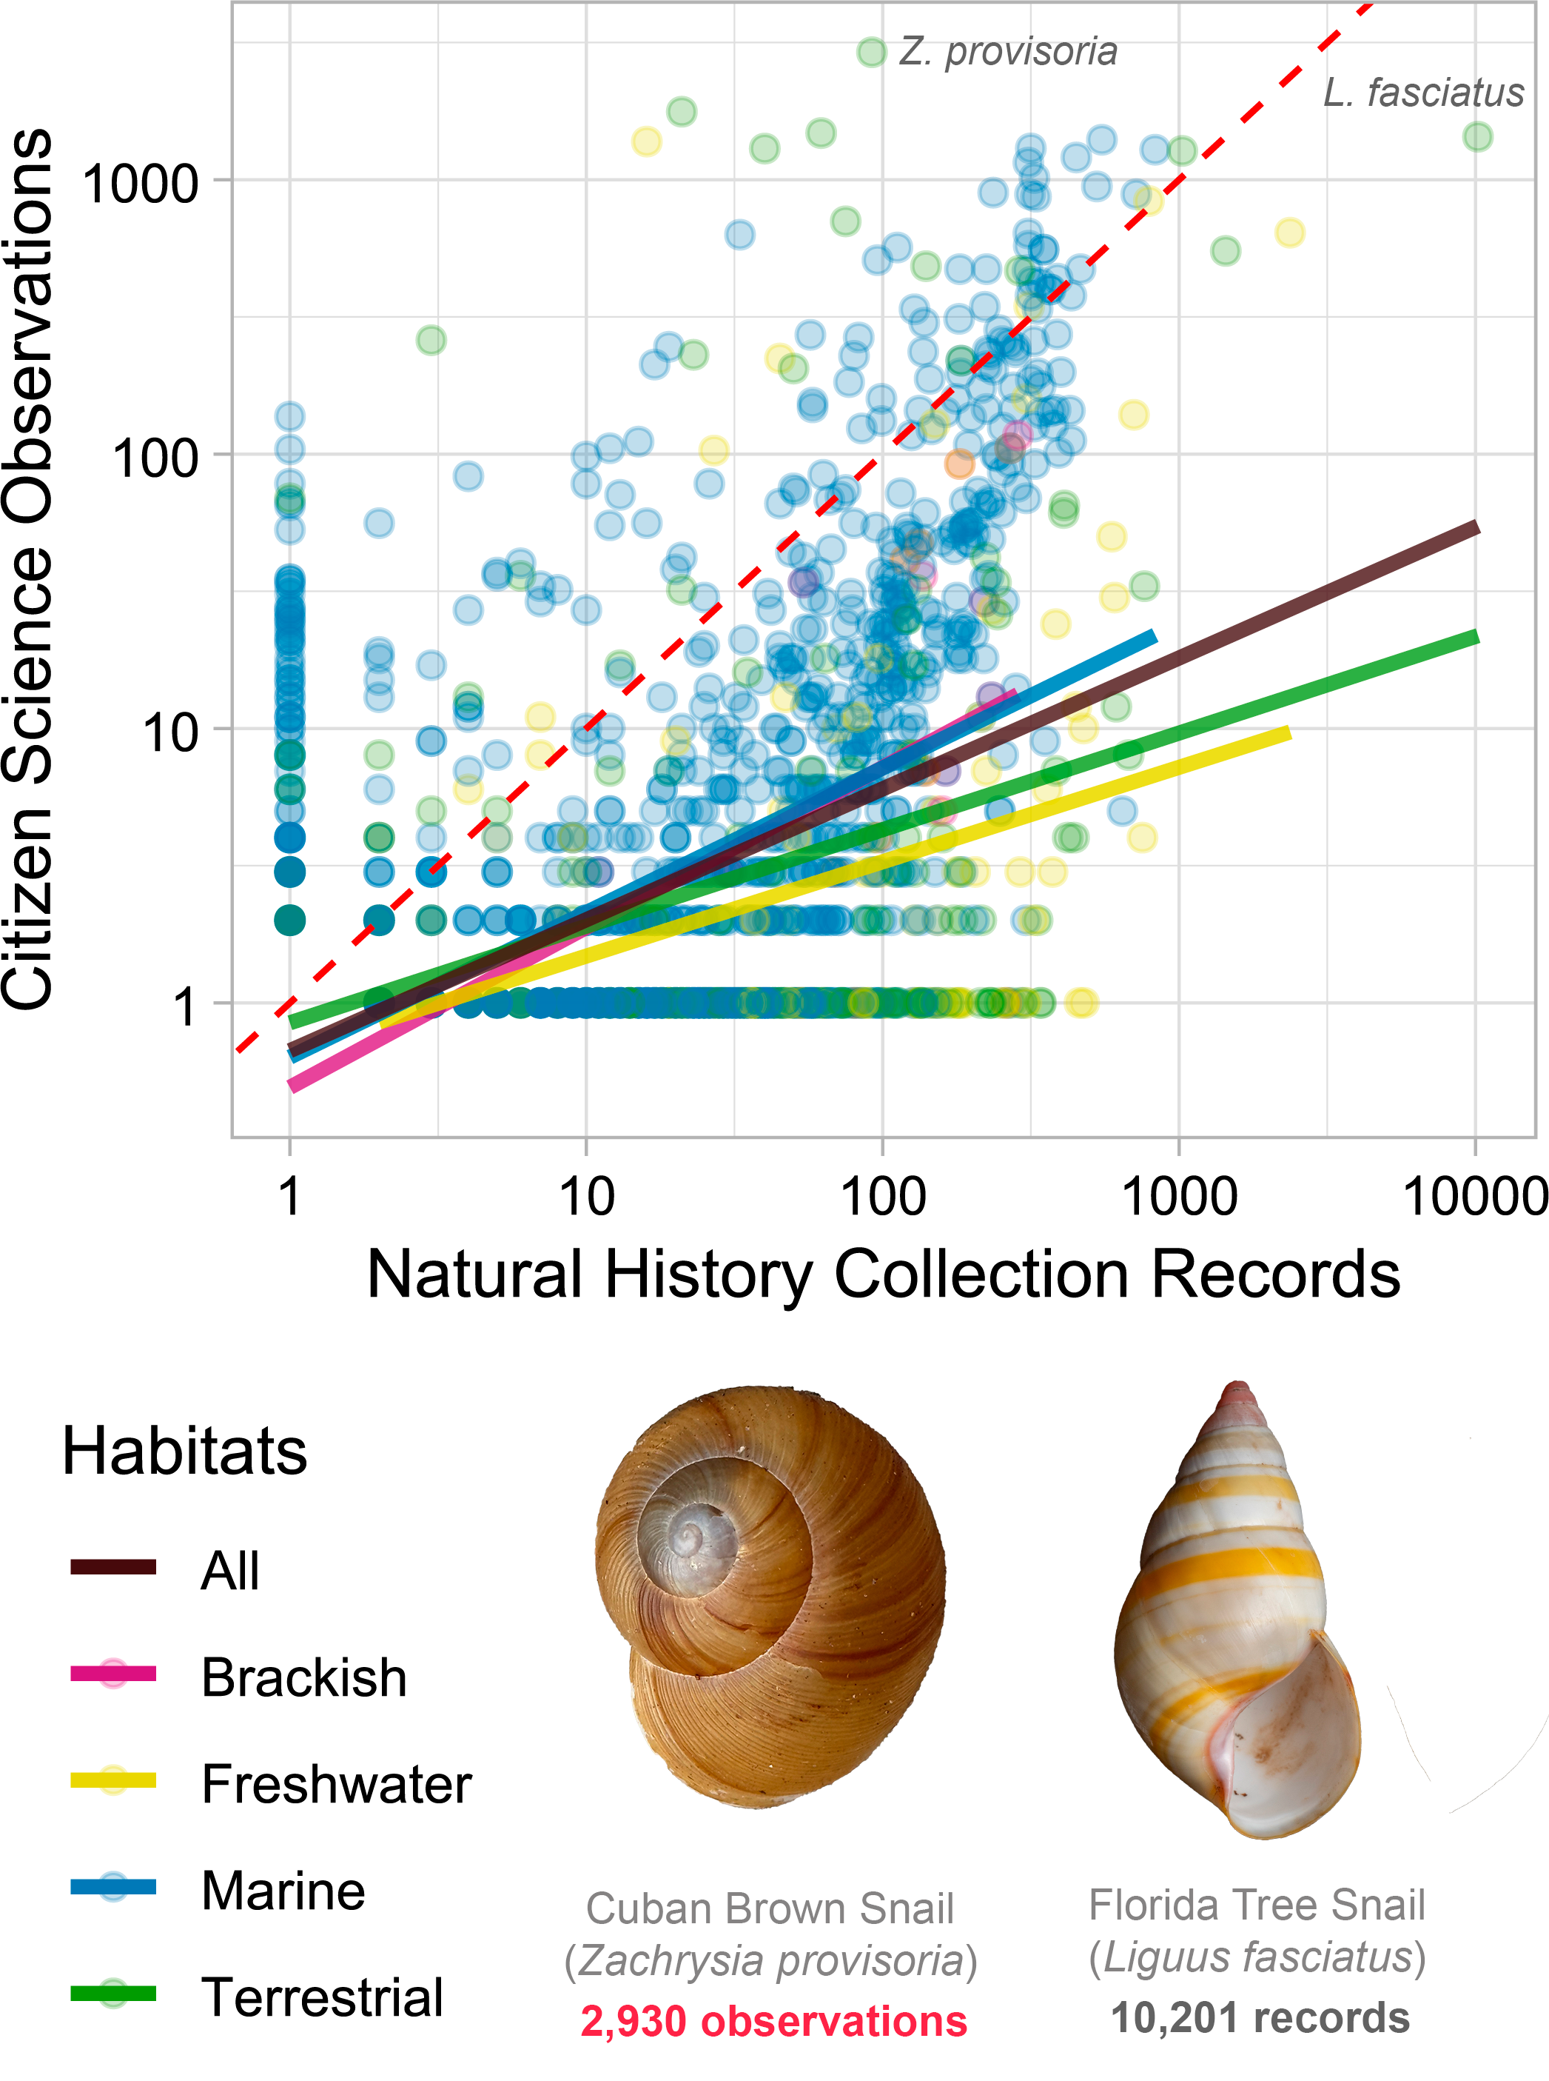
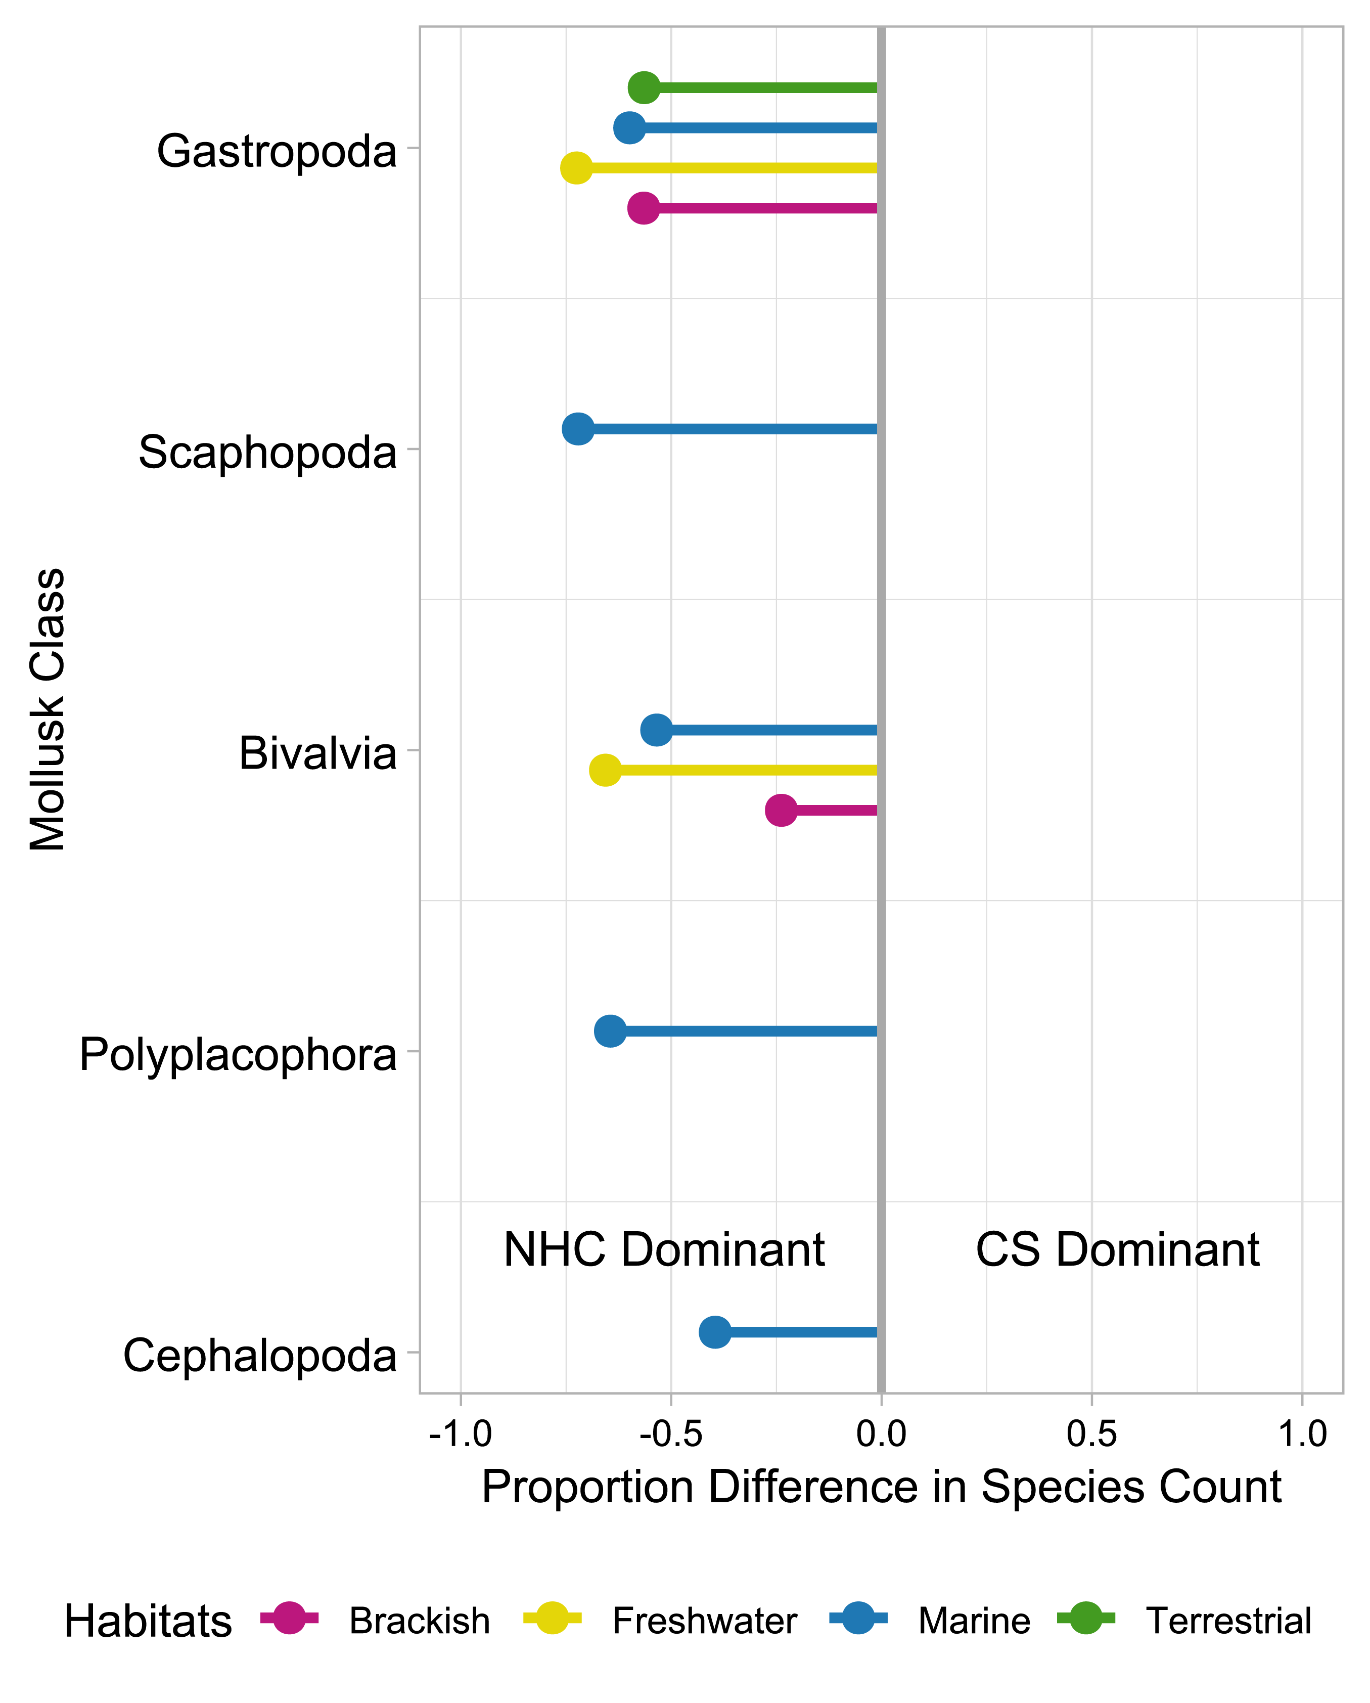
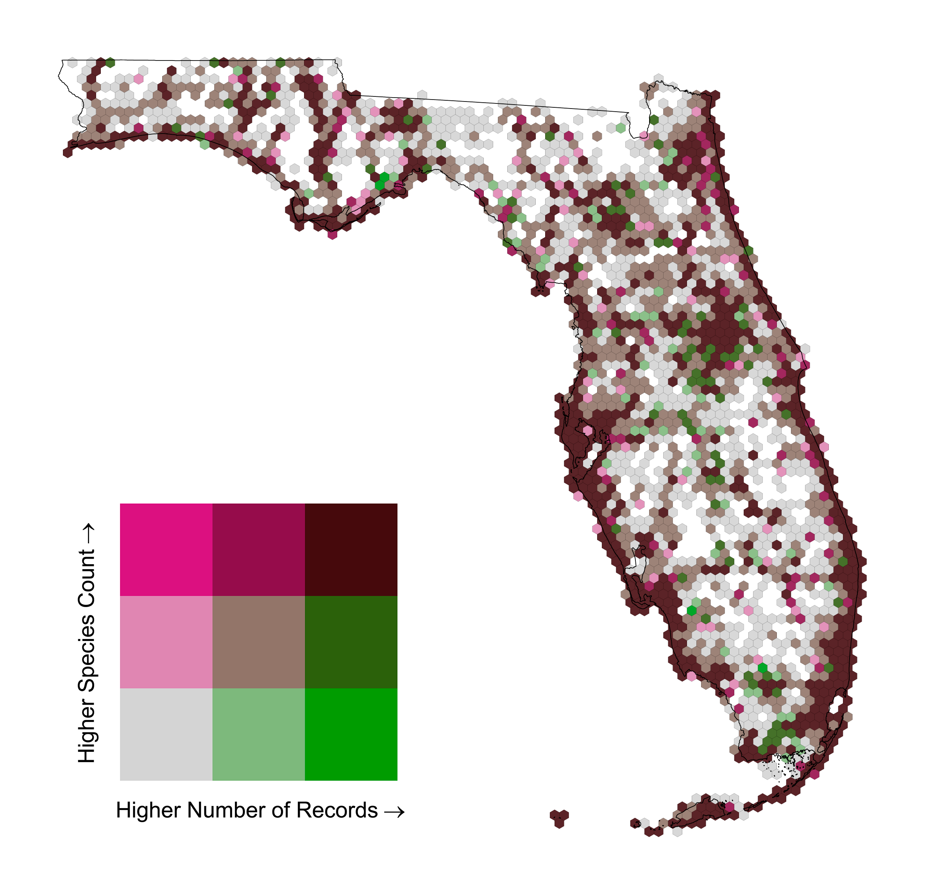


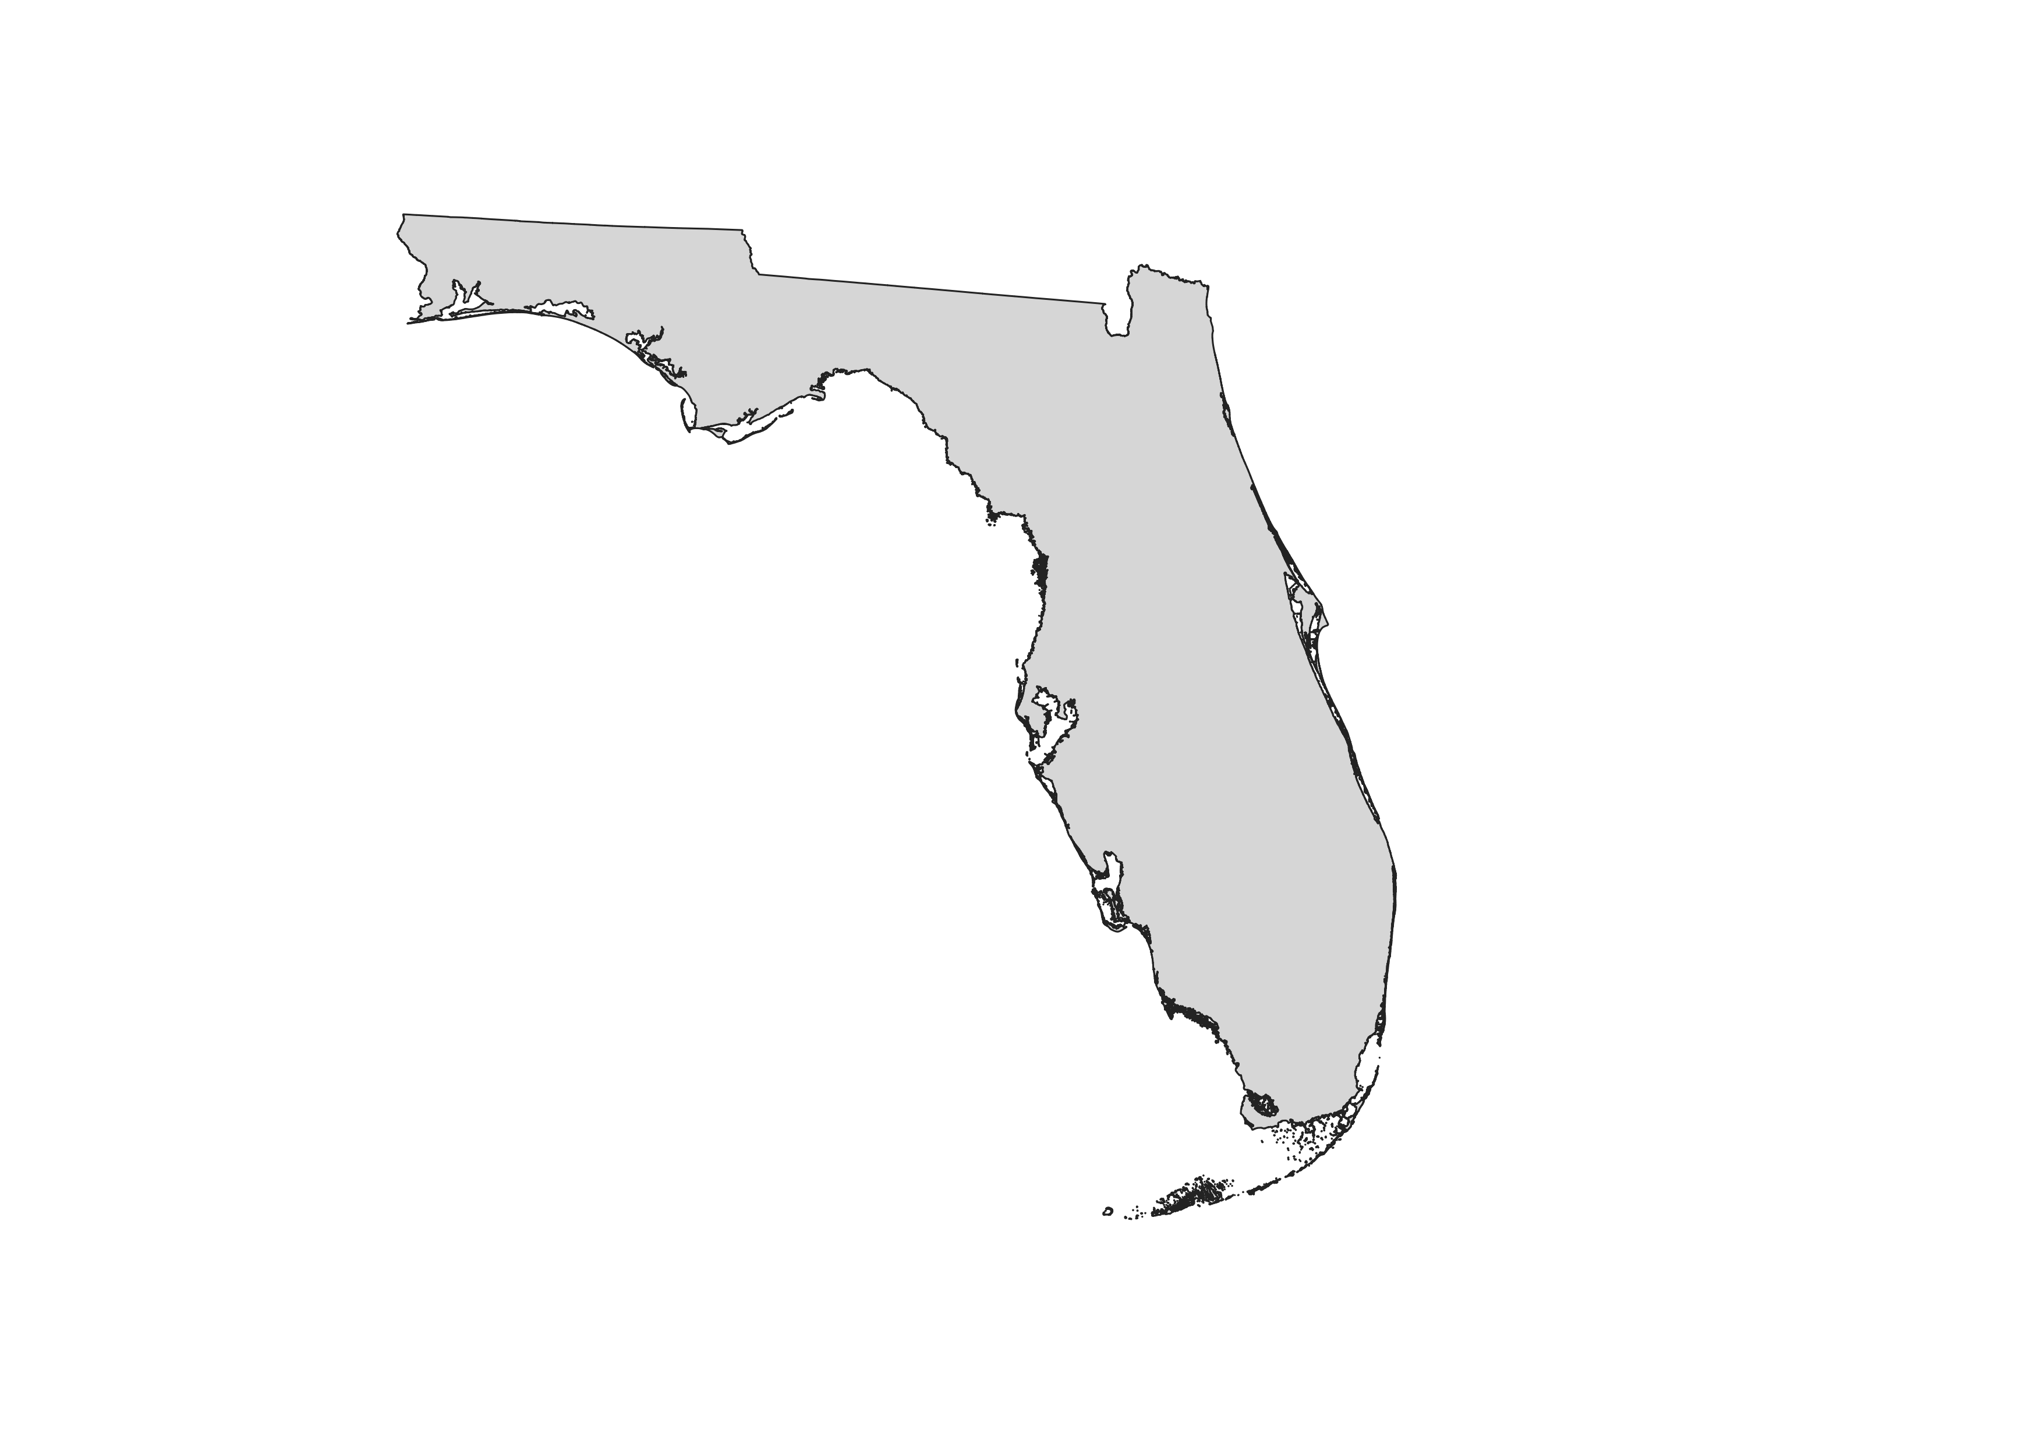


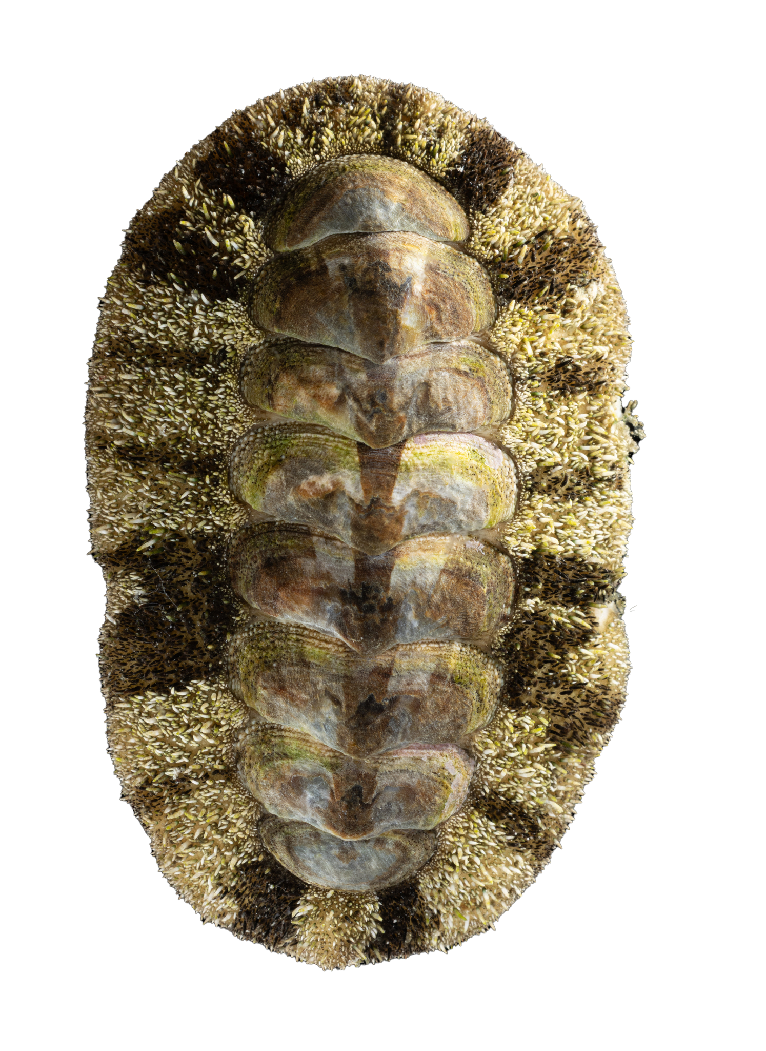
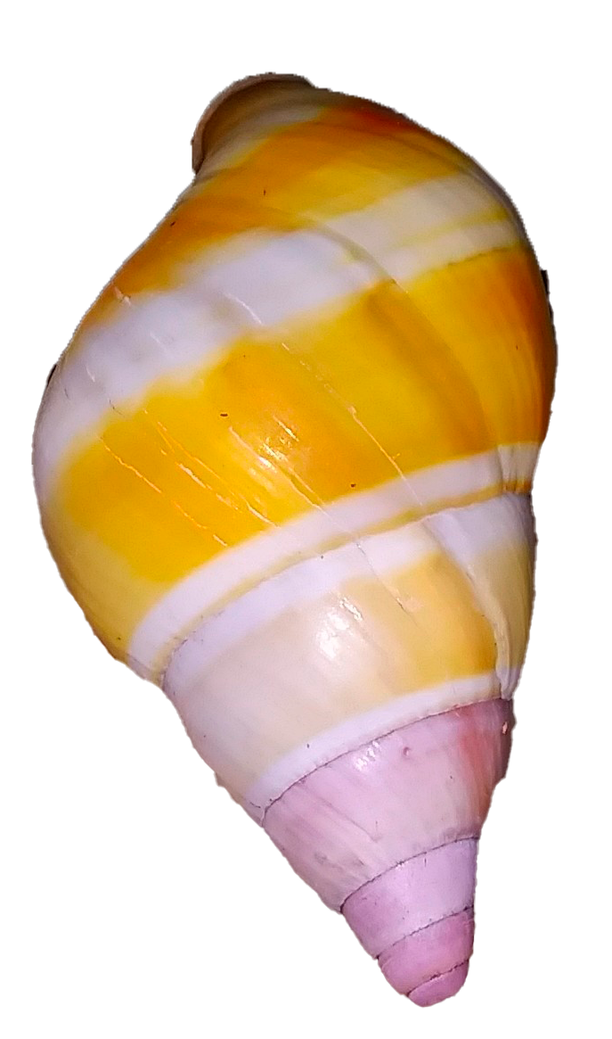
Understanding how big data and bias shape mollusk recording in Florida
Oniel Alvarez¹, Brittany M. Mason¹ and Corey T. Callaghan¹
¹Fort Lauderdale Research and Education Center, Department of Wildlife Ecology and Conservation, University of Florida
Introduction
Preliminary Results
Biodiversity data availability has increased exponentially in the last two decades.
Mollusks are a megadiverse group with relevant functional and ecological importance but poor conservation allocations.
Biodiversity big data can help us understand how biases shape where and what mollusk taxa are being recorded.
This can help us inform on conservation strategies at different geographic scales, integrating communities with initiatives like citizen science projects.
123,430 NHC records & 3,060 species (2384 unique)
58,794 CS observations & 786 species (110 unique)
Contributions from the analyzed mollusk recording sources are disproportionate.
There’s a relevant bias towards marine gastropod recording.
Higher sampling effort in coastal and urban areas.
1
2
3
Objectives
Analyze how Natural History Collections (NHC) & Citizen Science (CS) contribute locally to mollusk recording.
Understand how habitat accessibility and taxonomic biases shape mollusk recording in Florida.
Figs. 1) Relationship between the number of observations / records per species coming from citizen science and natural history collections, across habitats. Expressed as log10 (x+1). 2) Proportion difference in NHC and CS mollusk species counts for each habitat category. Proportion expressed as CS species – NHC species / Total species.3) Bivariate map representing the mollusk recording effort and bias across Florida.
Mollusk photos: Tom Kelley & Turner Brockman
Methods
Discussion
Data filtering and selection
182,224 records + 3,170 species
CS can inform on relevant aspects like invasive mollusks in Florida. These results are similar to Rosa et al. (2022).*
Access to habitats, and possibly beachcombing culture, plays an important role in local CS mollusk recording. While NHC professional contribution shape its recording.
The disproportional biases towards marine mollusk could impact future conservation analysis on mollusks from Florida.
Data acquisition
Habitat classification
Taxonomic assessment
196,166 records
+
3,606 species
Source, recording, taxonomic and distribution bias analysis
Mollusk photos: ©ggiribet / © daniel_e
*Rosa, R. M., Cavallari, D. C., & Salvador, R. B. (2022). iNaturalist as a tool in the study of tropical molluscs. PLOS ONE, 17(5), e0268048. https://doi.org/10.1371/journal.pone.0268048

